Slide 1


Backtesting and error metrics for modern time series forecasting

Slide 2
Backtesting and error metrics for modern time series forecasting

Slide 3



Contents
Modern time series forecasting
Backtesting
Error metrics

Slide 4

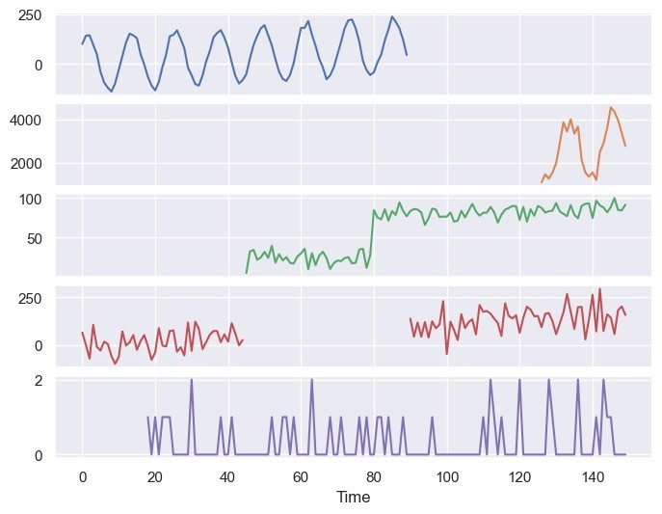




Modern time series forecasting
Large number of related time series
Number of products sold
Multiple characteristics
Trend
Seasonality
Outliers
Intermittency
Missing data
Hierarchical

Slide 5









Modern time series forecasting
Large number of related time series
Product
Category
Tops
Total
Multiple characteristics
Trend
Seasonality
Outliers
Intermittency
Missing data
Hierarchical
Hats
Jackets

Slide 6

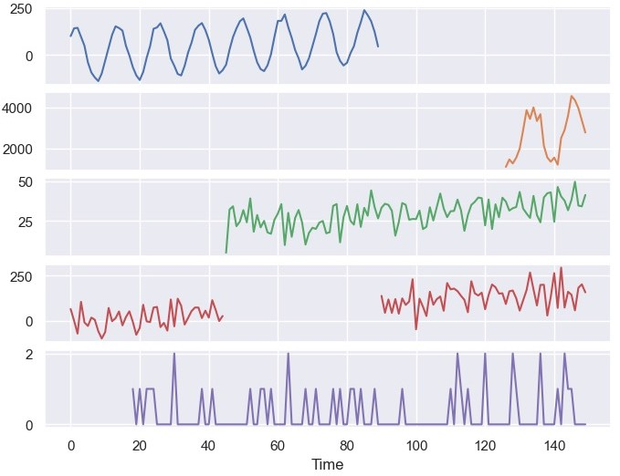






Modern time series forecasting
Number of products sold
Time | Product ID | Sales
… | ... | …
1 | 1 | 10
2 | 1 | 12
3 | 1 | 343
4 | 1 | 54
… | … | …
140 | 2 | 545
141 | 2 | 53
142 | 2 | 32
… | … | …

Slide 7
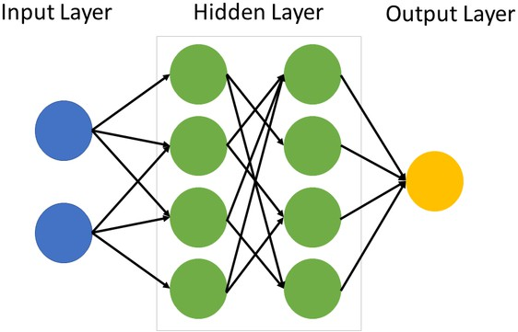
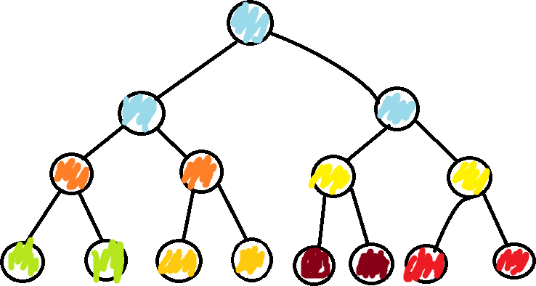
Modern time series forecasting
Traditional ML models
Deep learning

Slide 8
Backtesting
Backtesting is where we measure the performance
of a forecasting model on historic data.
Actuals
We want to estimate the performance of the model on future data.
Time

Slide 9

Backtesting
Train
Test
Backtesting is where we measure the performance
of a forecasting model on historic data.
Actuals
We want to estimate the performance of the model on future data.
Forecast
Forecast horizon
Time

Slide 10
Backtesting
Backtesting is where we measure the performance
of a forecasting model on historic data.
Train Test
We want to estimate the performance of the model on future data.
It is common to randomly shuffle data into train and test sets.
x1 | x2 | y
… | … | 0
… | … | 1
… | … | 0
… | … | 0
… | … | 0
… | … | 1
… | … | 0

Slide 11

Backtesting
Backtesting is where we measure the performance
of a forecasting model on historic data.
Train Test
We want to estimate the performance of the model on future data.
It is common to randomly shuffle data into train and test sets.
We can’t randomly shuffle the data into train and test sets when working with time series.
time | x1 | x2 | y
1 | … | … | 0
2 | … | … | 1
3 | … | … | 0
4 | … | … | 0
5 | … | … | 0
6 | … | … | 1
7 | … | … | 0

Slide 12



Backtesting
Time
Full dataset
Split 1
Error metric
Train
Test
Error metric
Average error metric
Split 2
Train
Test
Split 3
Train
Test
Error metric
…
Forecast horizon

Slide 13





Backtesting
Time
Full dataset
Split 1 Train Test ^{Error} metric
Train Test ^{Error Average}
Split 2 _{metric} error
metric
Split 3 Train Test ^{Error} metric
… Forecast
horizon
Large dataset with multiple time series
Time consuming
Memory consuming
Error prone

Slide 14
Backtesting parameters
Training window type
Refitting frequency
Step size

Slide 15
Choosing backtesting parameters is a trade-off
A reliable estimate of model performance.
Time and memory consumption of backtesting.

Slide 16
Backtesting parameters: Window type
Expanding window
Train
Test
Split 1
Split 2
Split 3

Slide 17
Backtesting parameters: Window type
Rolling window (window size is fixed)
Train
Test
Split 1
Split 2
Split 3

Slide 18
Backtesting parameters: Window type
Expanding window
Rolling window
Pros
Uses all the training data.
Cons
More memory used.
Longer to train model.
Very old data may not be that useful.
Pros
Less memory used.
Faster to train model.
Focuses more on recent data.
Cons
Less training data.

Slide 19
Backtesting parameters: Step size
Train Test
Split 1
1 step
Split 2
1 step
Split 3

Slide 20
Backtesting parameters: Step size
Train Test
Split 1
2 steps
Split 2
2 steps
Split 3

Slide 21
Backtesting parameters: Step size
Small step size
Large step size
1 step
5 steps
Pros
Larger # of splits gives better error estimate.
Cons
More time and memory used.
Pros
Less time and memory used.
Cons
Fewer # of splits gives worse error estimate.

Slide 22
Backtesting parameters: Refit frequency
Train
Test
Fit model & predict
Split 1
Fit model & predict
Split 2
Fit model & predict
Split 3

Slide 23
Backtesting parameters: Refit frequency
Train
Test
Fit model & predict
Split 1
No fit, but still predict
Split 2
Fit model & predict
Split 3

Slide 24
Backtesting parameters: Refit frequency
Refit every step
Refit periodically
Pros
Better estimate of model performance.
Cons
More time.
Pros
Less time.
Cons
Worse estimate of model performance.

Slide 25




Choosing backtesting parameters is a trade-off
We trade-off reliability against time & memory.
The trade-off varies for model selection, hyperparameter tuning, and error measurement.
More reliable error estimate
Less reliable error estimate
Measure forecasting error accurately.
Model selection
Longer time series
Many time series
Hyperparameter tuning
29

Slide 26
Backtesting: Try to reflect process in production
Example: There is a gap between when the forecast is created relative to when it is used. This gap should be reflected in backtesting.
Train
Gap
forecast horizon
Time

Slide 27
Backtesting: Try to reflect process in production
Example: There is a gap between when the forecast is created relative to when it is used. This gap should be reflected in backtesting.
Train Gap Test
Split 1
Split 2
Split 3

Slide 28


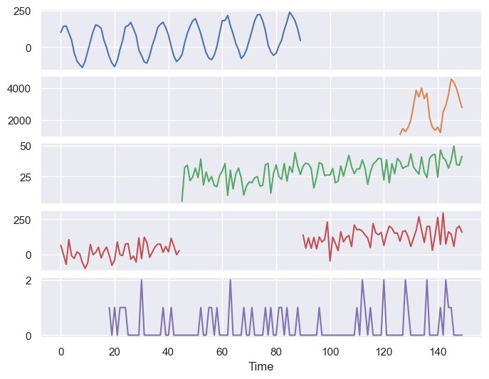




Backtesting: Edge cases for multiple series
Window of data needed to create features
Product doesn’t exist at train time but does exist at in forecast horizon.
Product does exist at train time but not in the the forecast horizon.

Slide 29
Backtesting: Edge cases for multiple series
Window of data needed to create features
Not enough historic data to create features.

Slide 30
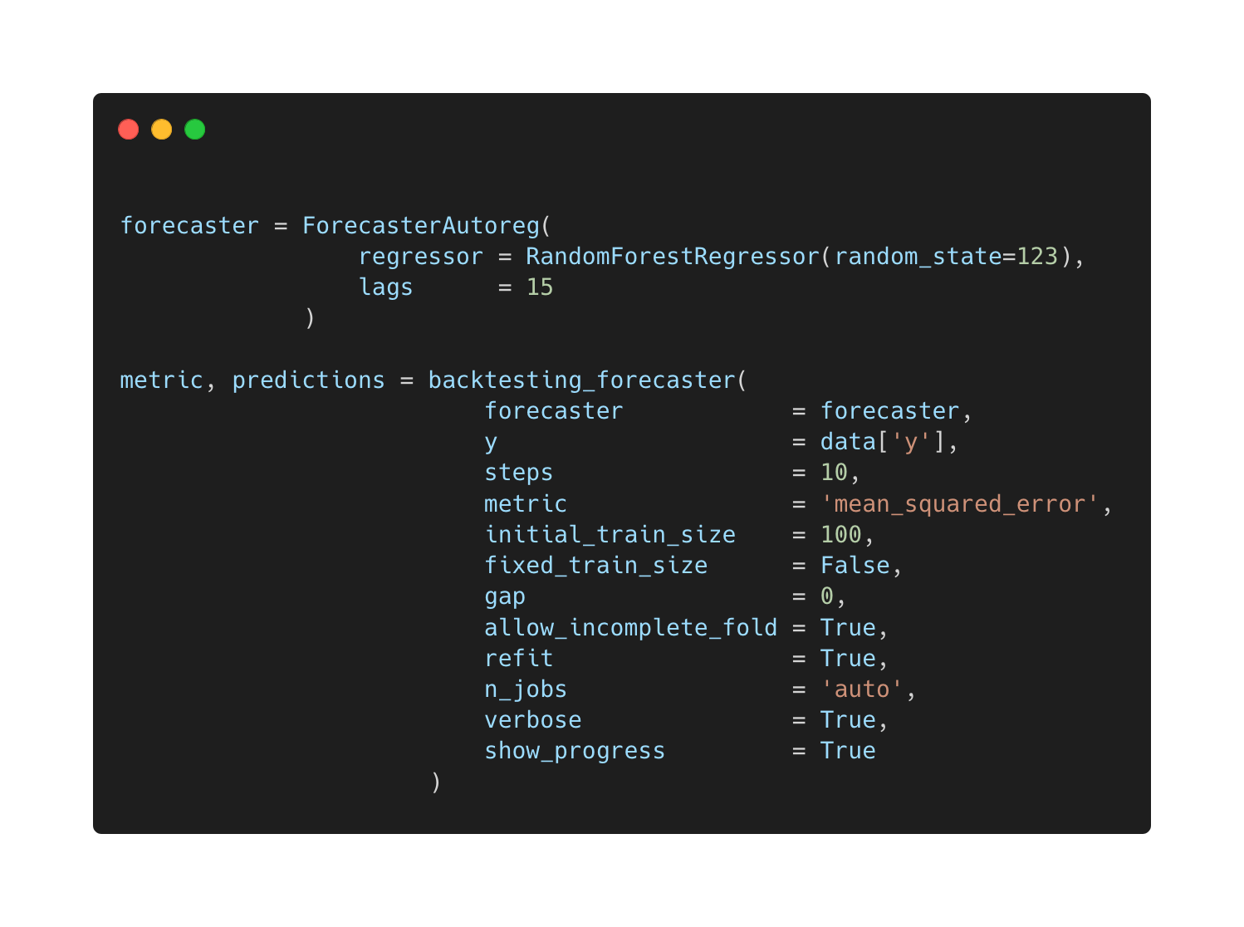

Open source libraries make this easier

Slide 31
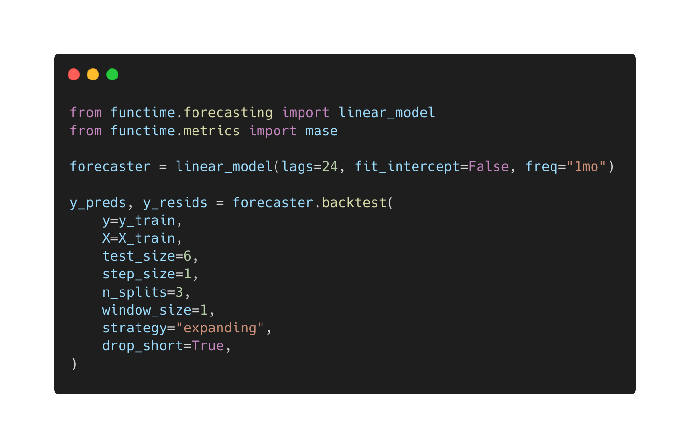

Open source libraries make this easier

Slide 32



Forecasting with machine learning in Python

Slide 33
Contents
Modern time series forecasting
Backtesting
Error metrics

Slide 34
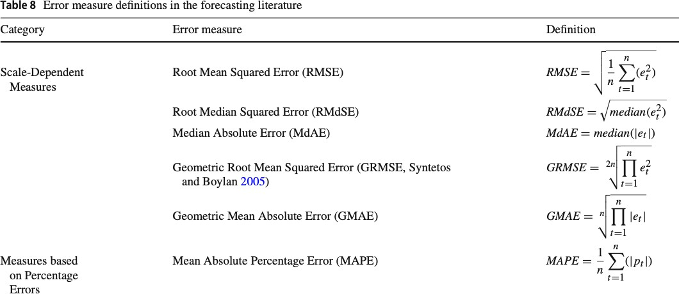

There are a lot of forecasting error metrics
This review paper documents over 40 metrics.
Why are there so many error metrics?
How do we pick the right error metric(s)?
Hewamalage, Hansika, Klaus Ackermann, and Christoph Bergmeir. "Forecast evaluation for data scientists: common pitfalls and best practices." Data Mining and Knowledge Discovery 37.2 (2023): 788-832.

Slide 35
Structure of most error metrics
The properties of an error metric depends on three main components that make a metric.
Mean absolute error
𝑀𝐴𝐸 = 𝑚𝑒𝑎𝑛 𝑒_{𝑡}

Slide 36

Structure of most error metrics
The properties of an error metric depends on three main components that make a metric.
Mean absolute error
𝑀𝐴𝐸 = 𝑚𝑒𝑎𝑛 𝒆_{𝒕}
Scale-dependent base error:
𝑒_{𝑡} = 𝑦_{𝑡} − 𝑦-_{𝑡}
Each forecast, 𝑦0_{𝑡} , is associated with a base error.

Slide 37

Structure of most error metrics
The properties of an error metric depends on three main components that make a metric.
Mean absolute error
𝑀𝐴𝐸 = 𝑚𝑒𝑎𝑛 |𝑒_{𝑡}|
Scale-dependent base error:
𝑒_{𝑡} = 𝑦_{𝑡} − 𝑦-_{𝑡}
Positive transform:
Absolute value: |x|
Each forecast, 𝑦0_{𝑡} , is associated with a base error.
The base error is transformed to be positive.

Slide 38

Structure of most error metrics
The properties of an error metric depends on three main components that make a metric.
Mean absolute error
𝑀𝐴𝐸 = 𝒎𝒆𝒂𝒏 |𝑒_{𝑡}|
Scale-dependent base error:
𝑒_{𝑡} = 𝑦_{𝑡} − 𝑦-_{𝑡}
Positive transform:
Absolute value: |x|
Each forecast, 𝑦0_{𝑡} , is associated with a base error.
The base error is transformed to be positive.
The base errors are aggregated with a
summary operator.
Summary operator:
mean

Slide 39
Structure of most error metrics
The properties of an error metric depends on three main components that make a metric.
Mean absolute percentage error
𝑀𝐴𝑃𝐸 = 𝑚𝑒𝑎𝑛 |𝑝_{𝑡}|
Each forecast, 𝑦0_{𝑡} , is associated with a base error.
Percentage error:
𝑒
The base error is transformed to be positive.
𝑦_{𝑡} − 𝑦-_{𝑡}
𝑝 = 100
𝑡
𝑦_{𝑡} 𝑦_{𝑡}
𝑡
= 100
The base errors are aggregated with a
summary operator.
Positive transform:
Absolute value: |x|
Summary operator:
mean

Slide 40
Structure of most error metrics
The properties of an error metric depends on three main components that make a metric.
Mean absolute percentage error
𝑀𝐴𝑃𝐸 = 𝑚𝑒𝑎𝑛 |𝑝_{𝑡}|
Each forecast, 𝑦0_{𝑡} , is associated with a base error.
Percentage error:
The base error is transformed to be positive.
𝑦_{𝑡} − 𝑦-_{𝑡}
𝑝 = 100
𝑡
𝑦_{𝑡}
The base errors are aggregated with a
summary operator.
Positive transform:
Absolute value: |x|
Not all error metrics follow this pattern.
Summary operator:
mean

Slide 41

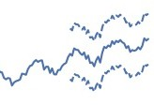


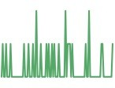
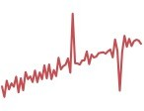

How to pick error metrics for forecasting?
Use case & properties of the time series
Properties of error metrics
𝐸 𝑦_{𝑡}, 𝑦$_{𝑡}
Modelling
Reporting
Over vs under forecasting
Does scale matter?
Hierarchy
Level shifts
Intermittency
Outliers

Slide 42






How to pick error metrics for forecasting?
Properties of error metrics
y
MAE = 10
Actuals
𝐸 𝑦_{𝑡}, 𝑦$_{𝑡}
Scale dependence.
100
Forecast
Time
y
MAE = 100
Actuals
1000
Forecast
Time

Slide 43


How to pick error metrics for forecasting?
Properties of error metrics
𝐸 𝑦_{𝑡}, 𝑦$_{𝑡}
Scale dependence.
y
MAE = 10
Actuals
Sensitive to outliers.
100
Forecast
Time

Slide 44





How to pick error metrics for forecasting?
Properties of error metrics
𝑦$ = 𝑦 + 𝛿
𝑦
𝑦$ = 𝑦 − 𝛿
𝛿
Over forecast
𝐸 𝑦_{𝑡}, 𝑦$_{𝑡}
Scale dependence.
𝛿
Actual
Under forecast
Sensitive to outliers.
Symmetric to over and under forecasting.
Over forecast
Under forecast
Swap
𝑦, 𝑦$
𝑦
𝑦$
𝑦$
𝑦
𝛿
𝛿

Slide 45
How to pick error metrics for forecasting?
Properties of error metrics
Intermittent time series
Train Test
𝐸 𝑦_{𝑡}, 𝑦$_{𝑡}
Scale dependence.
Sensitive to outliers.
Symmetric to over and under forecasting.
Actuals
Can it handle zeros?
Time

Slide 46
How to pick error metrics for forecasting?
Properties of error metrics
𝐸 𝑦_{𝑡}, 𝑦$_{𝑡}
Scale dependence.
The RMSE: The MAE:
1
¹ ) |𝑦 − 𝑦0 |
_{𝑁} )(𝑦_{𝑡} − 𝑦0_{𝑡})²
𝑁
𝑡 𝑡
𝑡
𝑡
Sensitive to outliers.
is minimized by the mean:
is minimized by the median:
Symmetric to over and under forecasting.
𝑦0_{𝑡} = 𝑚𝑒𝑎𝑛(𝑦_{𝑡})
𝑦0_{𝑡} = 𝑚𝑒𝑑𝑖𝑎𝑛(𝑦_{𝑡})
Can it handle zeros?
Optimise for mean, median, etc.

Slide 47
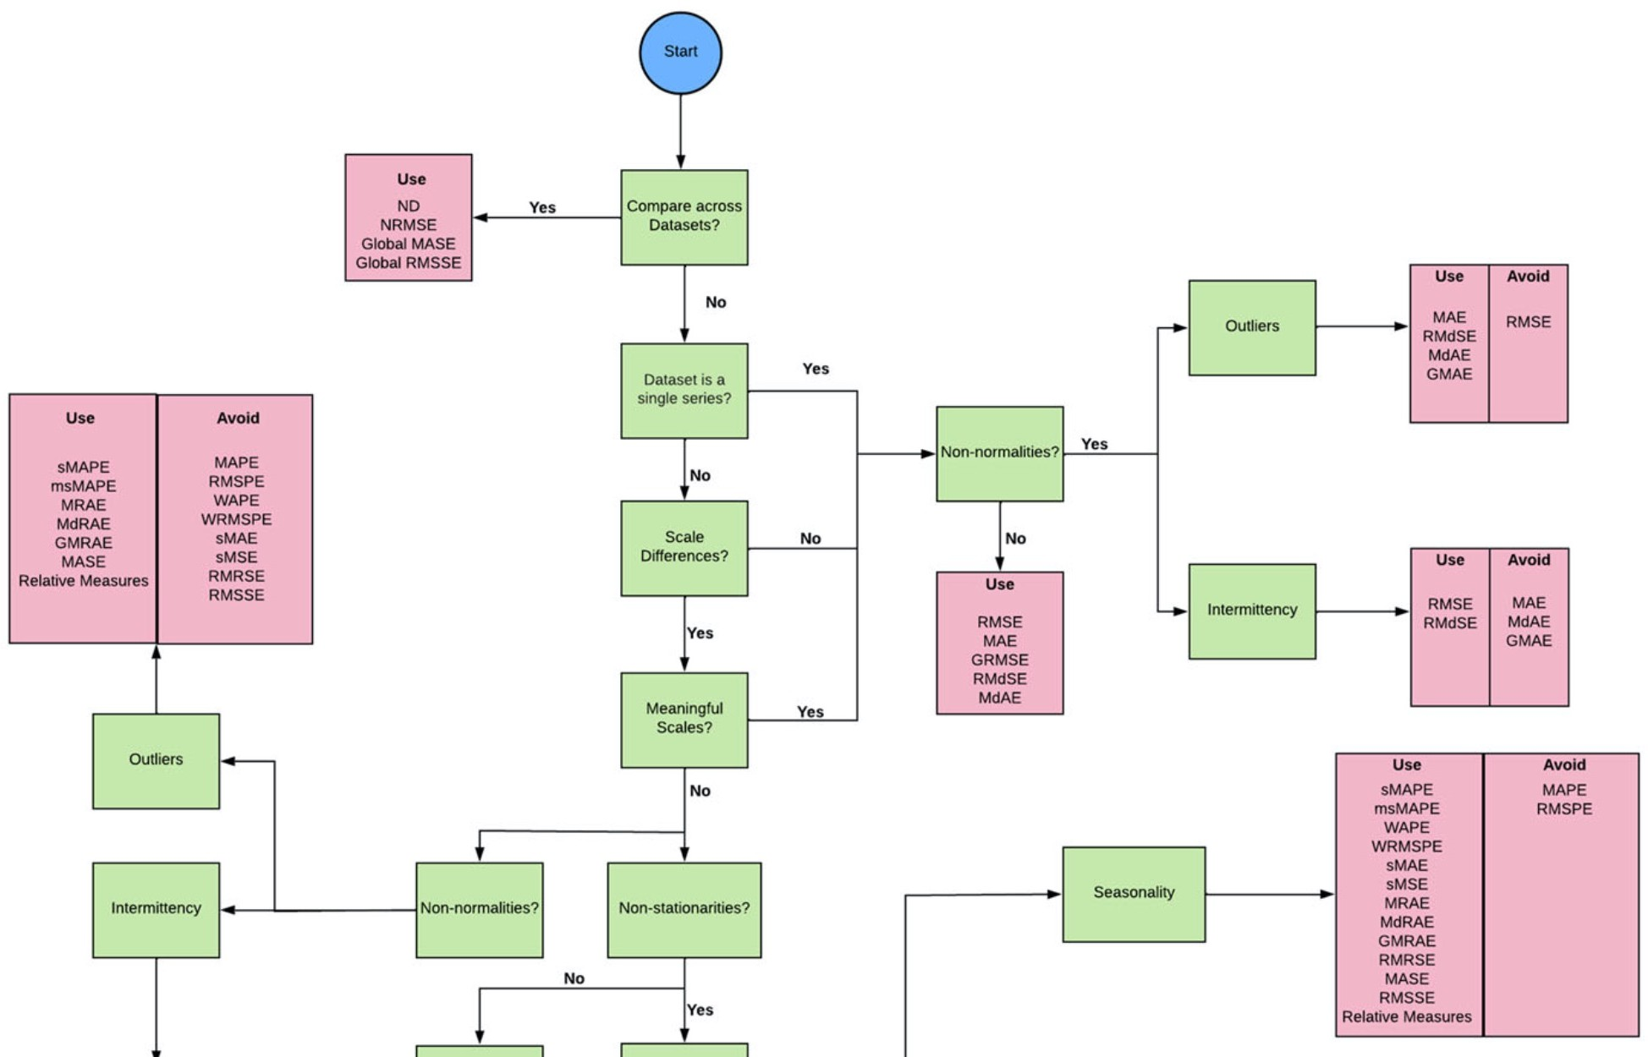
Guidelines
Hewamalage, Hansika, Klaus Ackermann, and Christoph Bergmeir. "Forecast evaluation for data scientists: common pitfalls and best practices." Data Mining and Knowledge Discovery 37.2 (2023): 788-832.

Slide 48





Multiple time series where the scale matters
Number of products sold
We want:
Larger time series to contribute more to the error (i.e., scale dependence).
Symmetry to over/under forecasting.
Tolerate zeros.
To be able to compare errors for different subsets of timeseries at different scales.
RMSE and MAE cover almost all these requirements.

Slide 49










Multiple time series errors
Forecast Horizon
𝐻 = 3
_{𝑒}(1)
Actuals
2
Averaging
_{𝑒}(1)
Time series 1
𝑅𝑀𝑆𝐸⁽¹⁾
_{𝑒}(1)
3
Forecast
𝑀
1
𝑚𝑒𝑎𝑛 𝑅𝑀𝑆𝐸 = ¹ 9 𝑅𝑀𝑆𝐸^{(𝑖)}
𝑀
𝑖=1
𝑀 = 2
_{𝑒}(2)
2
Actuals
Pooling
_{𝑒}(2)
Time series 2
𝑅𝑀𝑆𝐸⁽²⁾
_{𝑒}(2)
3
Forecast
1
1
𝑀 𝐻
2
𝑅𝑀𝑆𝐸 =
9 9 𝑒 ^{𝑖}
𝑀𝐻
𝑡
Time
𝑖=1 𝑡=1

Slide 50






Multiple time series errors
Forecast Horizon
𝐻 = 3
_{𝑒}(1)
2
Averaging
_{𝑒}(1)
Time series 1
𝑅𝑀𝑆𝐸⁽¹⁾
_{𝑒}(1)
3
Forecast
𝑚𝑒𝑎𝑛 𝑅𝑀𝑆𝐸 = ¹ (𝑅𝑀𝑆𝐸⁽¹⁾+ 𝑅𝑀𝑆𝐸⁽²⁾)
1
2
𝑀 = 2
_{𝑒}(2)
2
Actuals
Pooling
_{𝑒}(2)
Time series 2
𝑅𝑀𝑆𝐸⁽²⁾
_{𝑒}(2)
3
Forecast
1
1
Time
𝑅𝑀𝑆𝐸 =
(𝑒 ¹ ² + 𝑒 ¹ ²+ 𝑒 ¹ ² + 𝑒 ² ² + 𝑒 ² ² + 𝑒 ² ²)
1 2 3 1 2 3
2 ∗ 3

Slide 51


Multiple time series errors
Pool scale-dependent errors over multiple time series and scale by mean of all the time series.
Normalised Deviation (aka normalized MAE)
Normalised RMSE
1 _{∑𝑀}
∑𝐻
1 _{∑𝑀}
∑𝐻
(𝑒 ^{𝑖} )²
₌ 𝑅𝑀𝑆𝐸
|𝑒 ^{𝑖} |
𝑀𝐴𝐸
𝑀𝐻
𝑖=1
𝑡=1
𝑡
𝑖=1
𝑡=1
𝑡
𝑁𝑅𝑀𝑆𝐸 =
𝑁𝐷 = ^{𝑀𝐻}
=
1 _{∑𝑀}
∑𝐻
_{|𝑦}(𝑖) |
|𝑦|
1 _{∑𝑀}
∑𝐻
_{|𝑦}(𝑖) |
|𝑦|
𝑀𝐻
𝑖=1
𝑡=1
𝑡
𝑀𝐻
𝑖=1 𝑡=1
𝑡

Slide 52
Multiple time series errors
Larger time series contribute more to the error than smaller ones.
Normalised Deviation (aka normalized MAE)
Normalised RMSE
1 _{∑𝑀}
∑𝐻
1 _{∑𝑀}
∑𝐻
(𝑒 ^{𝑖} )²
₌ 𝑅𝑀𝑆𝐸
|𝑒 ^{𝑖} |
𝑀𝐴𝐸
𝑀𝐻
𝑖=1
𝑡=1
𝑡
𝑖=1
𝑡=1
𝑡
𝑁𝑅𝑀𝑆𝐸 =
𝑁𝐷 = ^{𝑀𝐻}
=
1 _{∑𝑀}
∑𝐻
_{|𝑦}(𝑖) |
|𝑦|
1 _{∑𝑀}
∑𝐻
_{|𝑦}(𝑖) |
|𝑦|
𝑀𝐻
𝑖=1
𝑡=1
𝑡
𝑀𝐻
𝑖=1 𝑡=1
𝑡

Slide 53
Multiple time series errors
Symmetric to over/under forecasting and can tolerate zeros.
Normalised Deviation (aka normalized MAE)
Normalised RMSE
1 _{∑𝑀}
∑𝐻
1 _{∑𝑀}
∑𝐻
(𝑒 ^{𝑖} )²
₌ 𝑅𝑀𝑆𝐸
|𝑒 ^{𝑖} |
𝑀𝐴𝐸
𝑀𝐻
𝑖=1
𝑡=1
𝑡
𝑖=1
𝑡=1
𝑡
𝑁𝑅𝑀𝑆𝐸 =
𝑁𝐷 = ^{𝑀𝐻}
=
1 _{∑𝑀}
∑𝐻
_{|𝑦}(𝑖) |
|𝑦|
1 _{∑𝑀}
∑𝐻
_{|𝑦}(𝑖) |
|𝑦|
𝑀𝐻
𝑖=1
𝑡=1
𝑡
𝑀𝐻
𝑖=1 𝑡=1
𝑡

Slide 54
Multiple time series errors
These metrics can be used to compare errors between different subsets/datasets of time series.
Normalised Deviation (aka normalized MAE)
Normalised RMSE
1 _{∑𝑀}
∑𝐻
1 _{∑𝑀}
∑𝐻
(𝑒 ^{𝑖} )²
₌ 𝑅𝑀𝑆𝐸
|𝑒 ^{𝑖} |
𝑀𝐴𝐸
𝑀𝐻
𝑖=1
𝑡=1
𝑡
𝑖=1
𝑡=1
𝑡
𝑁𝑅𝑀𝑆𝐸 =
𝑁𝐷 = ^{𝑀𝐻}
=
1 _{∑𝑀}
∑𝐻
_{|𝑦}(𝑖) |
|𝑦|
1 _{∑𝑀}
∑𝐻
_{|𝑦}(𝑖) |
|𝑦|
𝑀𝐻
𝑖=1
𝑡=1
𝑡
𝑀𝐻
𝑖=1 𝑡=1
𝑡

Slide 55





Multiple time series where the scale is arbitrary
Temperature readings
We want:
Each time series to contribute equally to the error regardless of scale.
Symmetry to over/under forecasting.
Tolerate zeros.
To be able to compare errors for different subsets of timeseries.
We need to use scale-independent error metrics.

Slide 56




Scale-independent error metrics
Percentage error
Weighted mean absolute percentage error
Scale independent when comparing series. Interpretable.
Symmetric to over/under forecasting
1
∑_{𝑡} 𝑤_{𝑡}
𝐻
𝑊𝐴𝑃𝐸 =
) 𝑤 |𝑝 |
𝑡 𝑡
Well defined when 𝑦0_{𝑡} = 0 or some 𝑦_{𝑡} = 0 . Not well defined when all 𝑦_{𝑡} = 0 in horizon.
𝑡)1
𝖶_{𝑡})|𝑦_{𝑡}| ₌ 1
𝐻
) |𝑒 |
𝑒_{𝑡} 𝑦_{𝑡} − 𝑦-_{𝑡}
𝑦
∑_{𝑡} |𝑦_{𝑡}|
𝑡
𝑝 =
=
𝑡)1
𝑡
𝑦
𝑡
𝑡
𝑀𝐴𝐸
=
𝑚𝑒𝑎𝑛( 𝑦_{𝑡} )

Slide 57
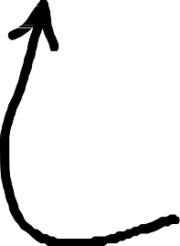
Scale-independent error metrics
Scaled error
Train Test
Mean absolute scaled error
𝑀𝐴𝑆𝐸 = 𝑚𝑒𝑎𝑛 |𝑞_{𝑡}|
Scale independent.
Symmetric to over/under forecasting
𝒚
Well defined when 𝑦0_{𝑡} = 0 or 𝑦_{𝑡} = 0 .
Not well defined when all 𝑦_{𝑡} = 0 in train set.
𝒚J
_{𝑆 = 𝑀𝐴𝐸}(𝑡𝑟𝑎𝑖𝑛)
_{𝑀𝑆𝐸}(𝑡𝑟𝑎𝑖𝑛)
𝑛𝑎𝑖𝑣𝑒
𝑛𝑎𝑖𝑣𝑒
Root mean squared scaled error
𝑒_{𝑡}
𝑦_{𝑡} − 𝑦-_{𝑡}
𝑞_{𝑡} = _{𝑆} =
𝑆
𝑅𝑀𝑆𝑆𝐸 = 𝑚𝑒𝑎𝑛 𝑞²
𝑡
_{𝑆 = 𝑀𝑆𝐸}(𝑡𝑟𝑎𝑖𝑛)
𝑛𝑎𝑖𝑣𝑒

Slide 58



Multiple time series errors
Forecast Horizon
𝐻 = 3
Average the scale-independent error metrics
_{𝑒}(1)
Time series 1
𝑊𝐴𝑃𝐸⁽¹⁾
_{𝑒}(1)
3
Forecast
1
∑
𝑀
𝑖=1
𝑊𝐴𝑃𝐸
𝑀
𝑖
𝑚𝑒𝑎𝑛 𝑊𝐴𝑃𝐸 =
𝑀 = 2
_{𝑒}(2)
2
Actuals
= ¹ (𝑊𝐴𝑃𝐸⁽¹⁾+ 𝑊𝐴𝑃𝐸⁽²⁾)
_{𝑒}(2)
2
Time series 2
𝑊𝐴𝑃𝐸⁽²⁾
_{𝑒}(2)
3
Forecast
1
Time

Slide 59



Hierarchical forecasts
Coherent forecast
We want the most accurate forecasts at all levels.
_{𝑧𝑡 = 𝑦}(1) _{+ 𝑦}(2)
𝑡 𝑡
𝑧̂ = 𝑦0⁽¹⁾+ 𝑦0⁽²⁾
We pick an error metric 𝐸.
t
𝑡 𝑡
We create a forecast to minimise 𝐸(𝑦_{𝑡} ¹ , 𝑦0⁽¹⁾) and
𝑡
𝐸(𝑦_{𝑡} ² , 𝑦0⁽²⁾).
𝑡
Does this also minimize 𝐸(𝑧_{𝑡}, 𝑧̂_{t})?
No! Only if the error metric is a function of 𝒆^{𝟐}.
_{𝑦}(1)
_{𝑦0}(1)
_{𝑦}(2)
_{𝑦0}(2)
𝒕
𝑡
𝑡
𝑡
𝑡
Examples: RMSE, RMSSE
Kolassa, S., 2023. Do we want coherent hierarchical forecasts, or minimal MAPEs or MAEs?(We won’t get both!). International Journal of Forecasting, 39(4), pp.1512-1517.

Slide 60
Intermittent time series
Train
Test
Train
Test
Actuals
Actuals
Forecast
Time
Forecast
Time
MAE is minimised by the median.
RMSE is minimised by the mean.
“Best” forecast is zero. MAE is bad metric for intermittent data.
“Best” forecast is a non-zero constant: “avg. units sold over time”.

Slide 61





Conclusions
Number of products sold
1. Modern time series forecasting involves many related time series.

Slide 62
Conclusions
Rolling window
Modern time series forecasting involves many related time series.
Selecting backtesting parameters is a trade-off between reliability and speed.
Step size
5 steps

Slide 63
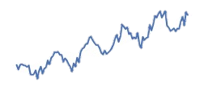
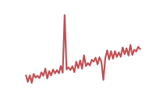
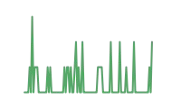



Conclusions
Modern time series forecasting involves many related time series.
Selecting backtesting parameters is a trade-off between reliability and speed.
𝑀𝐴𝐸 = ¹ 2 |𝑒 |
𝑁
𝑖
3. Selecting error metrics requires pairing properties of our data and error metrics.
𝑖
Over forecast
Under forecast
Swap
𝑦, 𝑦$
𝑦
𝑦$
𝑦$
𝑦
𝛿
𝛿

Slide 64
Conclusions
Modern time series forecasting involves many related time series.
Selecting backtesting parameters is a trade-off between reliability and speed.
Selecting error metrics requires pairing properties of our data and error metrics.
Many python libraries are available to support with forecasting.

Slide 65
Thank you!

