Slide 1

Team members
TARUN R - 1MS17IS123
SUMUKH M LOHIT - 1MS17IS120
PRANAV R HEGDE - 1MS18IS412

Slide 2
tRADEMARKS

Slide 3
Brief background
The Trade Marks Registry was established in India in 1940 and presently it administers the Trade Marks Act, 1999. It acts as a resource and information centre and is a facilitator in matters relating to trade marks in the country.
The objective of the Trade Marks Act, 1999 is to register trade marks applied for in the country and to provide for better protection of trade mark for goods and services and also to prevent fraudulent use of the mark.
The main function of the Registry is to register trade marks which qualifies for registration under the Act and Rules.

Slide 4
WHAT IS TRADEMARK ?
A trademark is a type of intellectual property consisting of a recognizable sign, design, or expression which identifies products or services of a particular source.
Trademarks used to identify services are usually called service marks.

Slide 5

Trademark vs service mark

Slide 6
Let’s say you’re planning a family dinner and want to get a nice bottle of wine. The small wine shop you visit may have their name and logo registered as a service mark, as they’re providing the service of selling you wine.
While there, the wine you purchase likely has its name and logo registered as a trademark, as it’s a physical product you can purchase.

Slide 7
Examples of trademarks and service marks
McDonald’s is a registered service mark for restaurant services. Similarly, Walmart is a registered service mark for retail store services.
In contrast, if you sell a line of electronic products or clothing products, then you would want to get a trademark for your product. For example Nikon for cameras and levis if you take a clothing brand.

Slide 8
The line between a trademark and a service mark is often so thin that many companies simply end up having both. For example, Google lists its brand as both a trademark and a service mark.
Main concern should not be whether your company has a service mark or a trademark, but whether your mark is registered. That’s the best way to ensure that others don’t infringe on your mark.

Slide 9

Types of trademarks
Brand names like Apple, McDonald's.
Product names like iPod and Mac
Company logos like the golden arches at McDonald's and NBC's peacock logo
Slogans like Capital One's "What's in your wallet?" and McDonald's "I'm lovin' it"

Slide 10

Words in a stylized font like "Coca-Cola" and "Ebay"
Product shapes like the Coca-Cola bottle and Apple iPod
Symbols (also known as devices) like the Nike swoosh symbol and Mercedes emblem
Combination (also known as composite) marks include more than one feature like the Starbucks coffee emblem (a name and a symbol).

Slide 11
Symbols of trademarks
A trademark may be designated by the following symbols:
™ (the "trademark symbol", which is the letters "TM" in superscript, for an unregistered trademark, a mark used to promote or brand goods)
℠ (which is the letters "SM" in superscript, for an unregistered service mark, a mark used to promote or brand services)
® (the letter "R" surrounded by a circle, for a registered trademark)

Slide 12

Use of the "TM" & “SM” symbol does not, however, ensure that it is protected under trademark law.
Legal protection is guaranteed with the registered mark, "®". This requires registration and it is highly recommended to have a trademark attorney assist you with the process.

Slide 13
Registrable marks
Registrable marks according to the TRIPS agreement states that “any sign, or any combination of signs, capable of distinguishing the goods or services of one undertaking from those of other undertakings, shall be capable of constituting a trademark”.
Examples
Combination of multiple colors or a particular color can be combined with a word.
Those marks forming a 3-dimensional sign.

Slide 14
Non registrable marks
The marks that are not distinctive enough from other marks and which cannot be registered as a trademark are called Non-Registrable marks.
Examples
Marks consist of subject matter that hurt the religious senses of any class or sections of the Indian citizens.
Marks of the goods whose shapes are directly obtained from the nature of the goods.

Slide 15
Trademark classes
Trademark law 2002, suggests that trademark can be registered in India under the following classes:
Class 1. Chemical used in industry, science, photography, agriculture, horticulture and forestry; unprocessed artificial resins, unprocessed plastics; manures; fire extinguishing compositions; tempering and soldering preparations.
Class 2 . Paints, varnishes.
Class 3 . Bleaching preparations and other substances for laundry use.
Class 4 . Industrial oils and greases; lubricants.

Slide 16
Class 5 . Pharmaceutical, veterinary and sanitary preparations; food for babies; plasters, disinfectants, fungicides, herbicides
Class 6. Common metals and their alloys.
Class 7 . Machines and machine tools; motors and engines.
Class 8 . Hand tools and implements (hand-operated)
Class 9 . Scientific surveying, electric, cinematographic, weighing, measuring, life saving and teaching apparatus and instruments; apparatus for recording, transmission or reproduction of sound or images, mechanisms for coin-operated apparatus; cash registers, data processing equipment and computers; fire extinguishing apparatus.

Slide 17
Class 10 . Surgical, medical, dental and veterinary apparatus and instruments, artificial limbs, eyes and teeth; suture materials
Class 11 . Apparatus for lighting, heating, steam generating, cooking, refrigerating.
Class 12 . Vehicles; apparatus for locomotion by land, air or water
Class 13 . Firearms; ammunition and projectiles; explosives; fire works
Class 14 . Precious metals and their alloys .
Class 15. Musical instruments
Class 16 . Paper, cardboard and goods made from these materials, not included in other classes.
Class 17 . Rubber, gum, asbestos, mica and goods made from these materials.
Class 18 . Leather and imitations of leather.
Class 19 . Building materials, (non-metallic).
Class 20 . Furniture, mirrors, picture frames.

Slide 18
Class 21 . Household or kitchen utensils ,containers,brushes.
Class 22 . Ropes, string, nets, tents.
Class 23 . Yarns and threads, for textile use
Class 24 . Textiles and textile goods.
Class 25 . Clothing, footwear, headgear
Class 26 . Lace and embroidery, ribbons ,buttons and hooks.
Class 27 . Carpets, rugs, mats.
Class 28 . Games and playthings.
Class 29 . Meat, fish, poultry.
Class 30 . Coffee, tea, cocoa, sugar, rice.
Class 31. Agricultural, horticultural and forestry products.
Class 32 . Beers, mineral and aerated waters.
Class 33 .Alcoholic beverages(except beers)
Class 34 . Tobacco, smokers’ articles, matches

Slide 19
SERVICES CLASSES
Class 35 .Advertising, business management.
Class 36 .Insurance, financial affairs.
Class 37 . Building construction.
Class 38. Telecommunications.
Class 39. Transport; packaging and storage of goods.
Class 40. Treatment of materials.
Class 41. Education; providing of training; entertainment; sporting and cultural activities.
Class 42. Scientific and technological services and research.
Class 43. Services for providing food and drink.
Class 44. Medical services, veterinary services, hygienic and beauty care for human beings.
Class 45. Legal services; security services for the protection of property and individuals.

Slide 20
Trademark rules
With effect from 6 March 2017, the new trademark rules came into existence. The intention is to simplify the whole trademark registration process and make it hassle-free and quick.
Some of the features of the new rules are sound marks are made registrable; 3D marks are made registrable; e-filing is promoted, separate fees structure for an individual/startup/small enterprise, hearing via video conferencing.
The number of forms has been cut down to 8 from the existing around 75 forms.

Slide 21
Trademarks registration procedure
1)Trademark Search
2)Trademark Filing
A trademark registration application must contain the following information:
Logo or the Trademark
Name and address of the trademark owner
Classification or Trademark Class
Trademark used since date
Description of the goods or services

Slide 22
3)Trademark Application Allotment
4)Vienna Codification
The Vienna Classification or Vienna Codification, established by the Vienna Agreement (1973). Once the trademark registration application is filed, the Trademark Registrar will apply the Vienna Classification to the trademark based on the figurative elements of marks. While this work is in progress, the trademark application status usually reflects as “Sent for Vienna Codification”.
5)Trademark Examination
6)Trademark Journal Publication
7)Trademark Registration

Slide 23
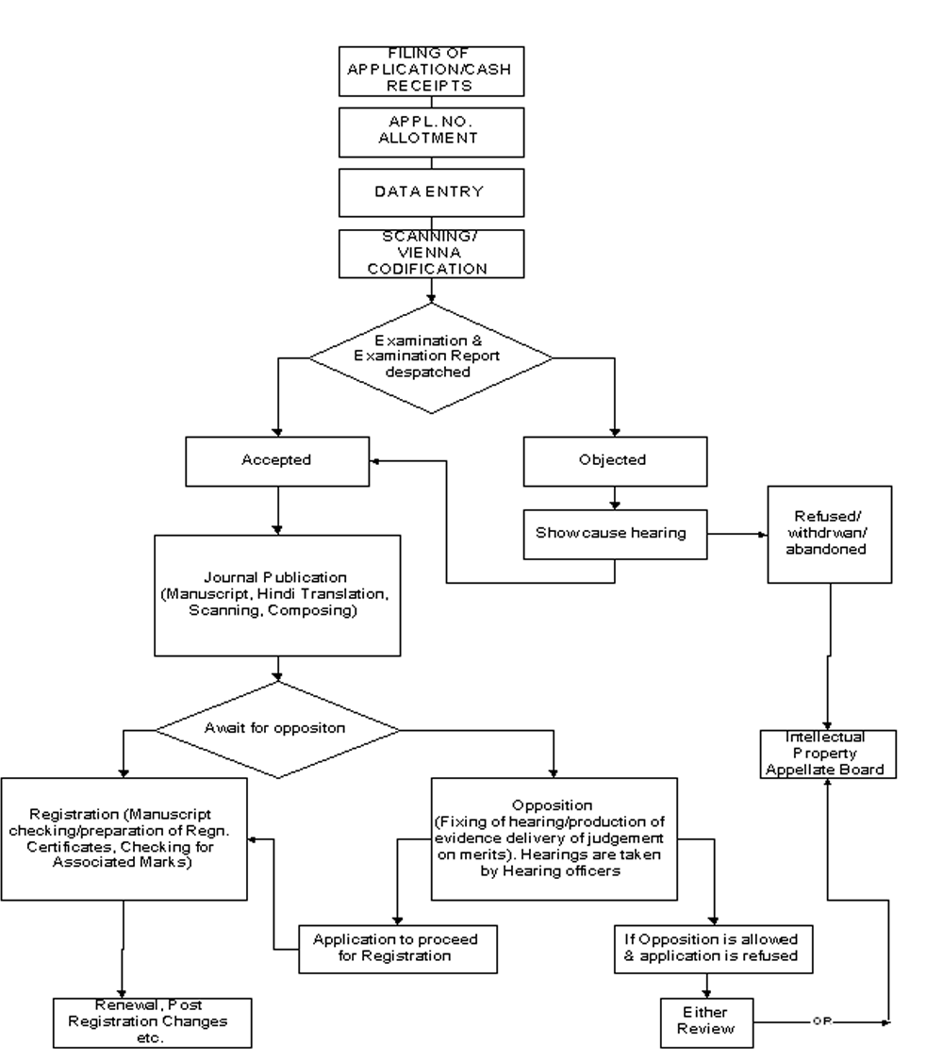

Slide 24
Trademark opposition
“Any person” may oppose a trademark.
Opposition period-Within four (4) months from the date of publication of the mark in the Trademark Journal. The period is not extendable under any circumstance.

Slide 25
Trademark opposition procedure
Trademarks Opposition Procedure
Stage 1 – Filing a Notice of Opposition/Filing a Counter-Statement
Stage 2 – Filing of Evidence in support of Opposition
Stage 3 – Filing of Evidence in support of Counter- Statement
Stage 4 – Filing of Evidence in Reply
Stage 5 – Hearing

Slide 26
Trademark licensing
The licensing of a mark is to allow others to use the mark without assigning the ownership
A trade mark license is basically an agreement in which trade mark owner permits someone else to use the licensor’s trademark in connection with specific products and Services.
Ex: Coca-Cola allowing independent bottlers of their soft drinks to label the finished product with the Coca-cola Trademark.

Slide 27
Assignment of trademark
A mark may be assigned or transferred to another entity in any of the following manners:
1)Complete Assignment to another entity
2)Assignment to another entity but with respect to only some of the goods/ services
3)Assignment with goodwill
4)Assignment without goodwill
Trademarks can be Assigned by way of a properly executed Trademark Assignment Agreement

Slide 28
Restrictions on assignment of trademark
Restrictions on the assignment of a registered trade mark under Trademarks Act,1999:-
Restriction in the creation of exclusive rights for more than one persons with respect to the same goods or services.
Restriction on assignment that results in different people using the trademark in different parts of the country simultaneously.

Slide 29
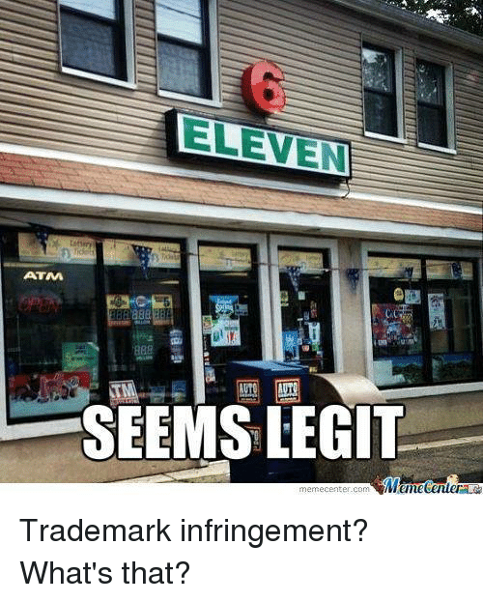

Slide 30
Trademark infringement
Section 29 of the Act says that a registered trademark is infringed when an unregistered proprietor or licensee uses the said trademark for trade and business purposes.
Identity with registered mark
Similarity with registered mark and identity of goods/services
Identity with registered mark and goods and services-presumption of confusion
Identity with a registered mark having reputation
Similarity of trade name with registered trademark
Application of registered mark on labelling, packaging knowing that it is sans authorization
7. Use of registered trademarks in advertisements

Slide 31
The section says there is no infringement of trademark:
Use of mark to indicate the kind, quality, quantity, etc
Use of mark outside the scope of registration
Implied consent of use
Use of registered trademark in relation to accessories and parts
Use of the two registered trademarks that are similar to each other.

Slide 32
THANK YOU

