Slide 1
14.GUI Programming in Java:
Objectives:
Understanding Event Handling
Studying more Components

Slide 2
Event-Driven Programming
Procedural programming is executed in procedural order.
In event-driven programming, code is executed upon activation of events.

Slide 3
Events and Listeners
An event can be defined as a type of signal to the program that something has happened.
The event is generated by external user actions such as mouse movements, mouse button clicks, and keystrokes, or by the operating system, such as a timer.
Events are responded to by event listeners

Slide 4
The Delegation Model
Event-generating Objects send Events to Listener Objects
Each event-generating object (usually a component) maintains a set of listeners for each event that it generates.
To be on the list, a listener object must register itself with the event-generating object.
Listeners have event-handling methods that respond to the event.

Slide 5
Event Classes
We will focus on ActionEvent and ListSelectionEvent

Slide 6
Selected User Actions
Source Event Type User Action Object Generated
Click a button JButton ActionEvent
Click a check box JCheckBox ItemEvent, ActionEvent
Click a radio button JRadioButton ItemEvent, ActionEvent
Press return on a text field JTextField ActionEvent
Select a new item JComboBox ItemEvent, ActionEvent
Select an item from a List JList ListSelectionEvent
Window opened, closed, etc. Window WindowEvent
Mouse pressed, released, etc. Any Component MouseEvent
Key released, pressed, etc. Any Component KeyEvent

Slide 7
Java AWT Event Listener Interfaces
ActionListener
AdjustmentListener
ComponentListener
ContainerListener
FocusListener
ItemListener
KeyListener
MouseListener
MouseMotionListener
TextListener
WindowListener
ListSelectionListener
All are in the java.awt.event or javax.swing.event package
All are derived from EventListener in the java.util package
NOTE: any object that will respond to an event must implement a listener interface.

Slide 8
How to Implement a Listener Interface
Use the implements keyword in the class declaration
Register the object as a listener for a component’s event, using the component’s addXListener method. (where X is the type of event). (Typically done in constructor)
Declare and fully define all methods for the interface that you are implementing
Requires:
Complete method signature
Method body

Slide 9
Selected Event Handlers
Event Class Listener Interface Listener Methods (Handlers) ActionEvent ActionListener actionPerformed(ActionEvent)
ItemEvent ItemListener itemStateChanged(ItemEvent)
ListSelection ListSelection valueChanged
Event Listener (ListSelectionEvent)

Slide 10
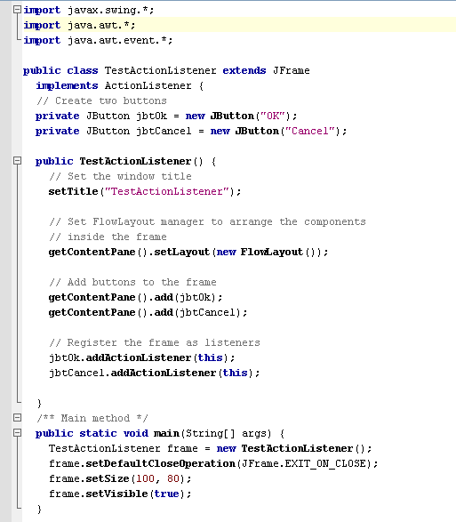
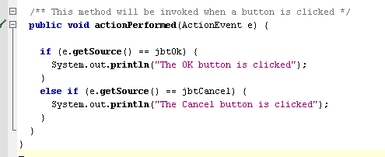
Handling Simple Action Events
The method for responding to an Action event.
Implementing the listener interface
Registering the frame to be a listener for action events generated by the two buttons

Slide 11
Handling Simple Action Events –
a closer look at the event-handling method
actionPerformed is a method
required for all ActionListeners
An Event object’s getSource() method returns a reference to the Component object that generated the event.

Slide 12
Alternative Approaches to Listening
Implement the listener with the main application class, and have the one listener assigned to all components generating the events
This is the approach I generally use with my examples
Advantage: simplicity for beginner programmers
Disadvantage: event-handler method may require if-statement or switch with several branches when multiple components generate the event
Use inner classes to implement the listeners and create a different instance as each component’s listener.
Named inner class or anonymous inner class (This is the approach used in the textbook most of the time)
Advantage: no need to test within the listeners for determining which component sent the event. Each component has its own dedicated listener
Disadvantage: harder to understand for novice programmers

Slide 13
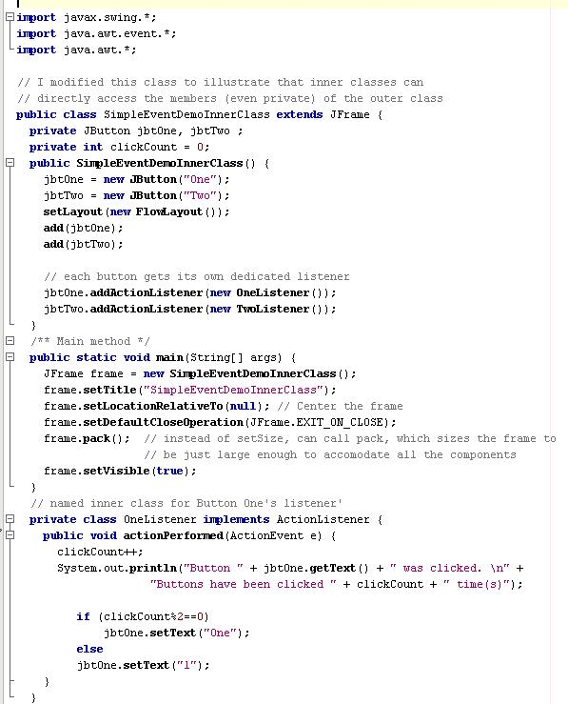
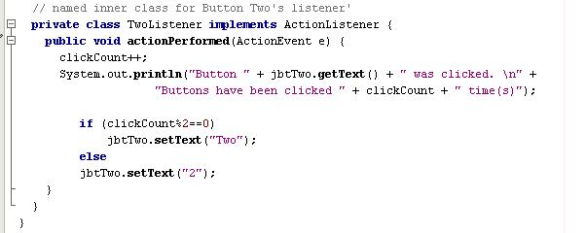
Example with named inner classes, one for listening to each button
Inner class has direct access to all members (even private) of the outer class

Slide 14
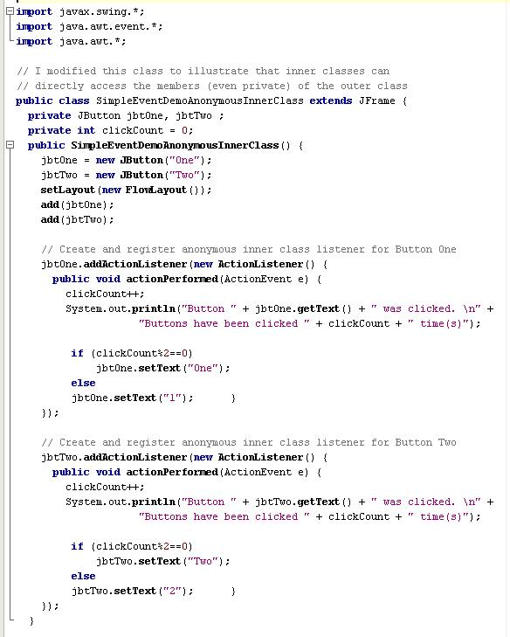
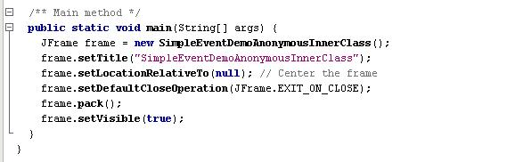
Example with anonymous inner classes, one for listening to each button

Slide 15
Working with JLabel, JTextField, JTextArea, JList, JComboBox, and JRadiobutton

Slide 16
JLabel
Swing class for a non-editable text display
Typical constructor:
JLabel(stringValue)
Other Useful Methods:
getText() – returns a string containing the text in the label component
setText(String) – sets the label component to contain the string value

Slide 17
JTextField
Swing class for an editable text display
Many constructors possible – here’s one:
JTextField(columnWidth)
Will instantiate a text field component of the specified width (width is approximate number of characters visible).
Some useful methods:
getText() – returns the text value in the text field
getSelectedText() – returns the text value that has been highlighted in the text field
setText(stringValue) – sets the text value to the indicated argument
append(stringvalue) – appends the text value of the string to the already existing text in the component

Slide 18
JTextArea
Swing class for an editable text display
Many constructors possible – here’s one:
JTextArea(rowHeight , columnWidth)
Will instantiate a text area component of the specified width and height (width is approximate number of characters visible, height is approximate number of text lines visible)
Some useful methods:
getText() – returns the text value in the text field
getSelectedText() – returns the text value that has been highlighted in the text field
setText(stringValue) – sets the text value to the indicated argument
append(stringvalue) – appends the text value of the string to the already existing text in the component

Slide 19
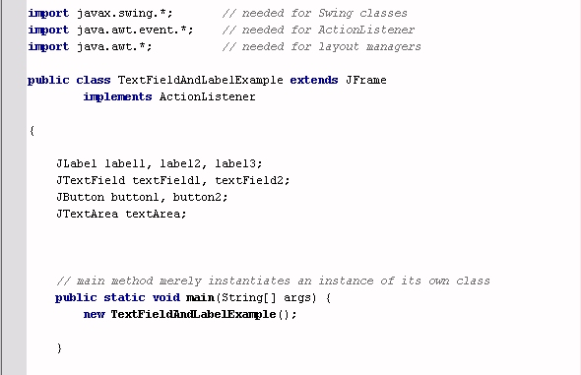

Slide 20
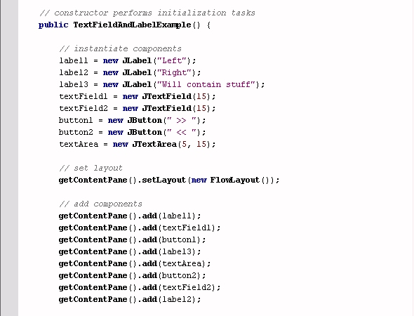
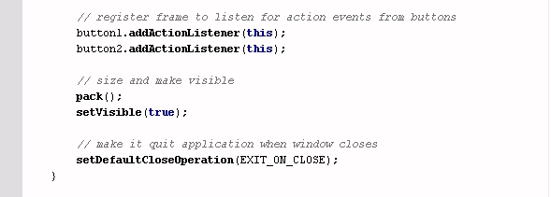

Slide 21
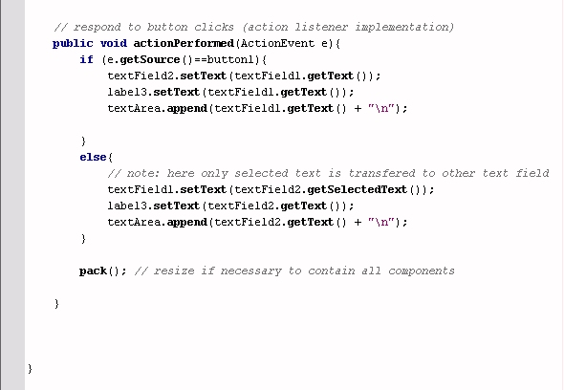
Note use of getText, setText, getSelectedText and append methods.

Slide 22
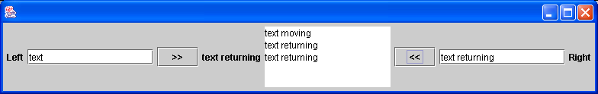

Slide 23
JList
Swing GUI component that presents a list of items
Many constructors…here’s one:
JList(sourceArray);
Produces a ListSelectionEvent
Handling this event by implementing a ListSelectionListener
Need to import javax.swing.event package for this
Some useful methods:
addListSelectionListener – specify which objects will respond to list selection event
setListData – indicate the source of data for this list (e.g. an array)
getSelectedIndex – identify the current selection from the list (0-based) -- -1 indicates nothing is selected from list.
setFixedCellHeight and setFixedCellWidth – indicate pixel size of each item of the list.

Slide 24
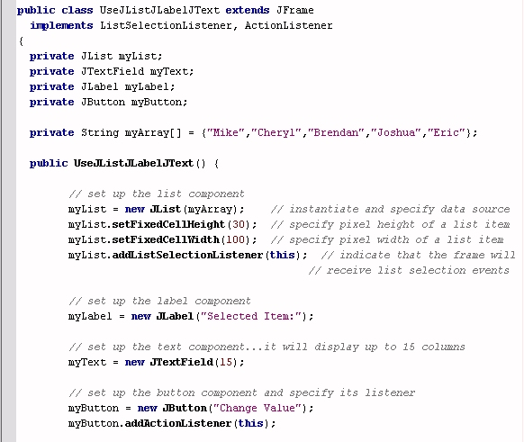
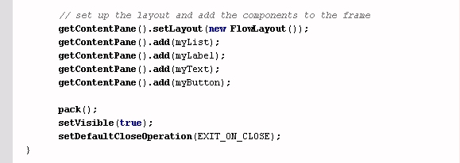
JList Example 1: using lists, text fields, labels, and buttons
Implementing listeners
components
List’s data source

Slide 25
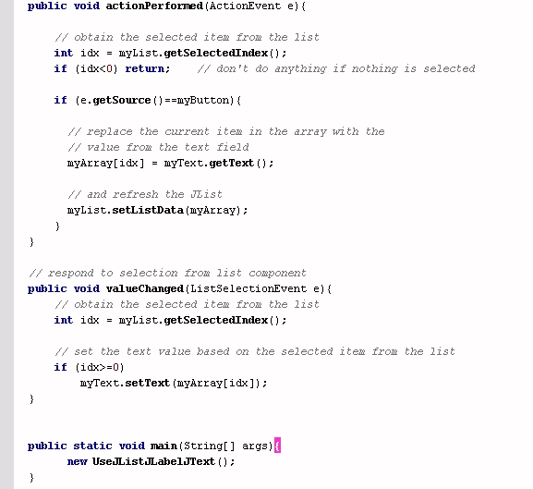
JList Example 1: using lists, text fields, labels, and buttons (con’t.)
When array changes, refresh the list
valueChanged is the ListSelectionListener event handler method
Use list index tp get associated array element

Slide 26
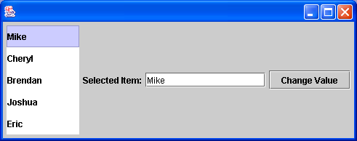
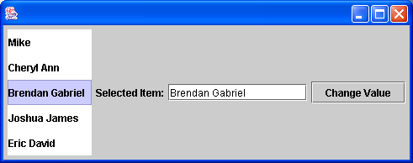

Slide 27
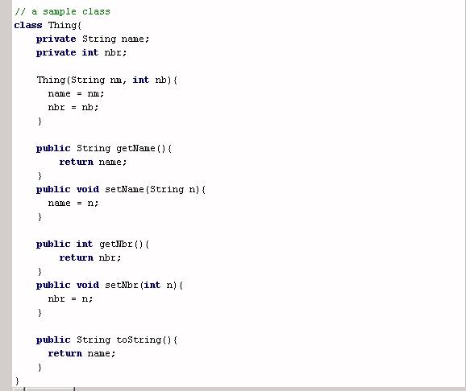
JList Example 2: slightly more complicated…data source is an array of objects
This is the class being used
for the array associated with the JList.
toString is a method that overrides the Object class’s method of the same name. This determines what will be displayed in the JList.

Slide 28
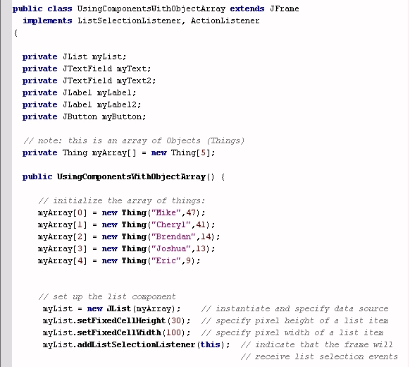
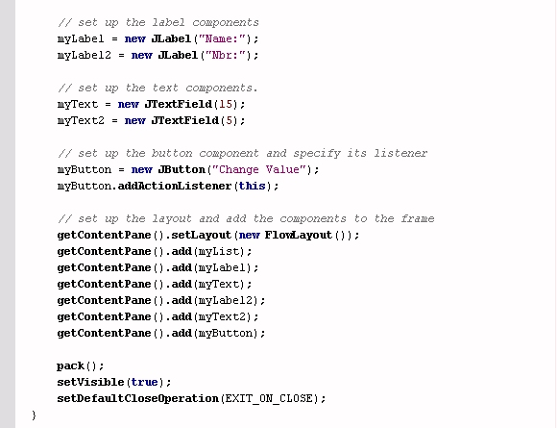
JList Example 2: slightly more complicated…data source is an array of objects

Slide 29
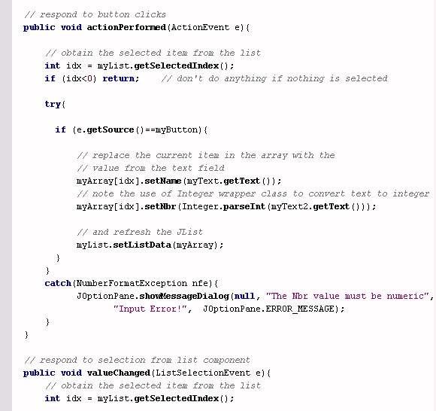
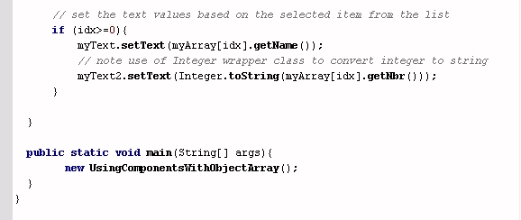
JList Example 2: slightly more complicated…data source is an array of objects

Slide 30
Exception Handling
This example makes use of Exception handling
try/catch format
NOTE: if the text entered into the numeric field cannot be parsed into a number, an Exception is thrown (specifically a NumberFormatExeption).

Slide 31
Exception Handling Using try and catch
try{
……..
}
catch (ExceptionType e){
……..
}
If code within the try block causes an error, the program will automatically branch to the catch block

Slide 32
JList Example 2: slightly more complicated…data source is an array of objects
Code in the try block
This may throw an exception
Here we handle the exception

Slide 33
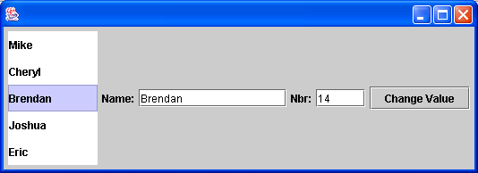
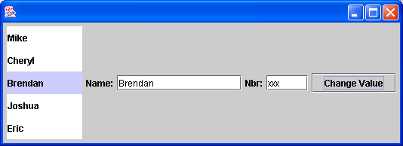
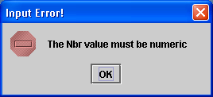

Slide 34
JComboBox
Swing GUI component that presents a dropdown list of items
Many constructors…here’s one:
JComboBox(sourceArray);
Produces an ActionEvent and an ItemEvent
You can handle these event by implementing an ActionListener or an ItemListener
If you want to handle these events, you need to import java.awt.event package
Some useful methods:
getSelectedIndex – identify the current selection from the list (0-based) -- -1 indicates nothing is selected from list.
getSelectedItem – returns the currently selected object from the list. Since it returns an Object reference, if you want to treat it as string, you should call toString() for the returned object
setSelectedIndex – Changes the current selection to whatever the integer is that is passed as an argument.
setSelectedItem – sets the currently selected item to whatever the Object is that is passed as an argument

Slide 35
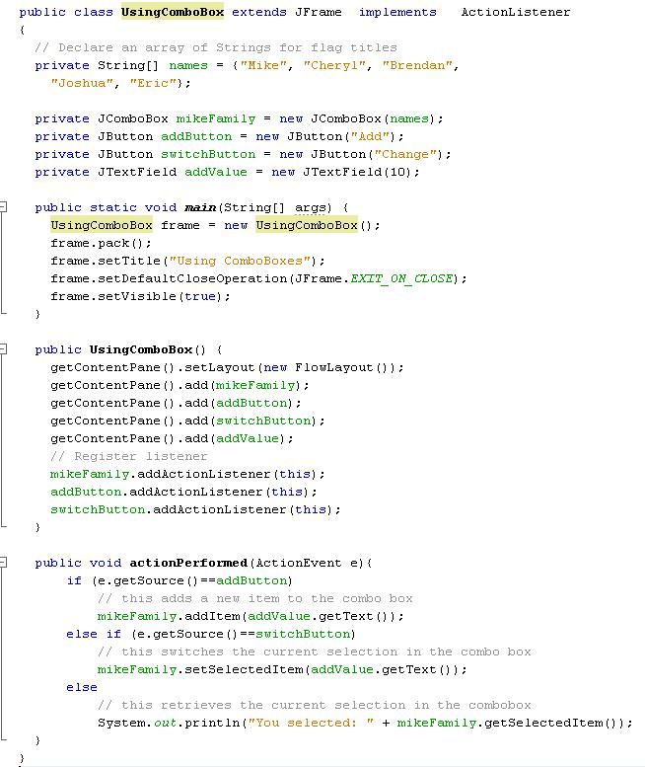
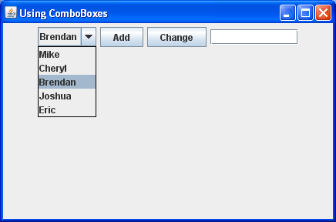

Slide 36
JRadioButton
Swing GUI component that presents a radio buttons of options. You group the options into a ButtonGroup.
Many constructors…here’s one:
JRadioButton(Label)
Since a RadioButton is a button, it produces an ActionEvent. It also generates a ChangeEvent
You can handle these event by implementing an ActionListener or an ChangeListener
If you want to handle these events, you need to import java.awt.event package
Lots of useful methods…here’s three:
setMnemonic – Specifies a alt-Key alternative for selecting the RadioButton.
isSelected – returns a boolean value to specify if the button has been selected
setSelected(boolean) – allows you to programmatically change the selection status of a RadioButton
Put related RadioButtons into a ButtonGroup, so only one will be selected at a time
Instantiate the ButtonGroup
Call the ButtonGroup’s add method to assign RadioButtons

Slide 37
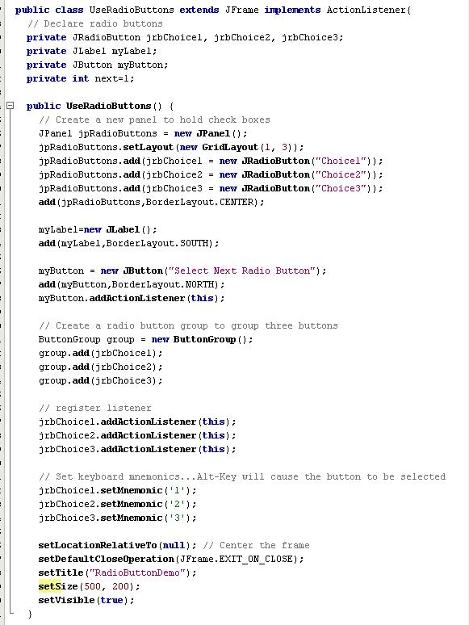
By putting all buttons into a panel, you can place them all together in the same region of the frame’s BorderLayout
By putting all buttons into a ButtonGroup, you ensure that only one will be selected at a time
This code causes the RadioButtons to generate ActionEvents that the frame will listen to
Via setMnemonic, you allow Alt-1, Alt-2 and Alt-3 to select the appropriate RadioButtons

Slide 38
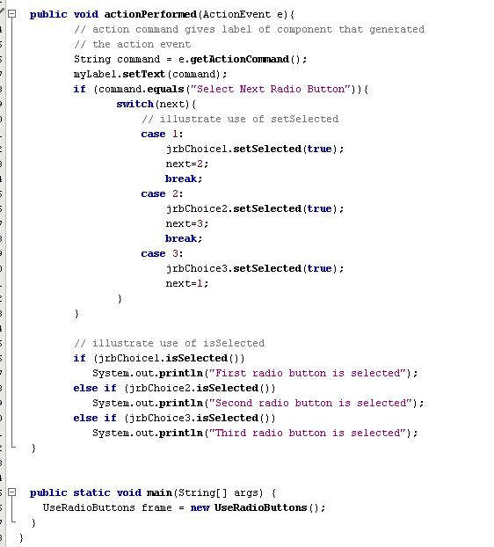
A component’s action command is usually its label, although you can change this
The setSelected method can be used to programmatically change the current RadioButton selection
The isSelected method can be used to determine if a RadioButton is selected

Slide 39
