Slide 1

242-210. Programming
Fundamental II
by Dr.Andrew Davison
12. Exceptions
Objectives
  examine Java's exception handling

Slide 2
Contents
1. Motivation
2. Exception Handling (in outline)
3. Many Catch Blocks
4. The Exception Class Hierarchy
5. Throwing an Exception
continued

Slide 3
6. Not Handling an Exception
7. Defining New Exceptions
8. Nested Catching
9. What if Several Handlers can match?
10. The finally Clause
11. The assert Statement

Slide 4
1. Motivation
Lots of error checking in code makes the code harder to understand
  more complex
  more likely that the code will have errors!
Add error checking to the following C code:
  int a[SIZE];
  y = ...
  x = (1.0/a[y]) + (2.0/a[y+1]) + (3.0/a[y+2]);

Slide 5
Some Error Checking (in C)!
:
if (y >= SIZE)
printf(“Array index %d too big\n”, y);
else if (a[y] == 0)
printf(“First denominator is 0\n”);
if (y+1 >= SIZE)
printf(“Array index %d too big\n”, y+1);
else if (a[y+1] == 0)
printf(“Second denominator is 0\n”);
if (y+2 >= SIZE)
printf(“Array index %d too big\n”, y+2);
else if (a[y+2] == 0)
printf(“Third denominator is 0\n”);
:

Slide 6
A Solution
Separate the error checking code from the main program code
  the standard approach since the 1980’s
Java uses exception handling
  a mechanism that it “borrowed” from C++ and Ada

Slide 7
2. Exception Handling (in outline)
Format of code:
  statements;
  try {
  code...;
  }
  catch (Exception-type e) {
  code for dealing with e exception
  }
  more-statements;
a try block
a catch block

Slide 8
Basic Approach
The programmer wraps the error-prone code inside a try block.
If an exception occurs anywhere in the code inside the try block, the catch block is executed immediately
  the block can use information stored in the e object
continued

Slide 9
After the catch block (the catch handler) has finished, execution continues after the catch block (in more-statements).
  execution does not return to the try block
continued

Slide 10
If the try block finishes successfully without causing an exception, then execution skips to the code after the catch block
  i.e. to more-statements

Slide 11
Catching Math Errors
int x = 0;
int y;
:
try {
y = 1/x;
:
}
catch (ArithmeticException e)
{ System.out.println(e);
...;
y = 0;
}
System.out.println(“y is “ + y);
any Java code
is allowed here

Slide 12
Attempting Recovery
// Try to save an address book
boolean successful = false;
int attempts = 0;
do {
try {
addressbook.saveToFile(filename);
successful = true;
}
catch(IOException e) {
System.out.println( e.getMessage() );
System.out.println("Unable to save to " + filename);
attempts++;
if(attempts < MAX_ATTEMPTS)
filename = an alternative file name;
}
} while(!successful && attempts < MAX_ATTEMPTS);
if(!successful)
Report the problem and give up;

Slide 13
3. Many Catch Blocks
There can be many catch blocks associated with a try block
  the choice of which to use is based on matching the exception object (e) with the argument type of each catch block
  after a catch handler has finished, execution continues after all the handlers

Slide 14
Code Format
  statements;
  try {
  code...;
  }
  catch (NullPointerException e) {
  code for dealing with a NULL pointer exception
  }
  catch (IOException e) {
  code for dealing with an IO exception
  }
  catch (MyOwnException e) {
  code for dealing with a user-defined exception
  }
  more-statements;

Slide 15
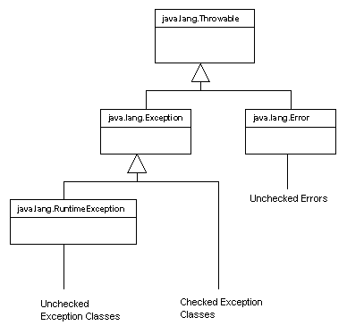
4. The Exception Class Hierarchy
for errors that
occur inside
the JVM, not
in your code

Slide 16
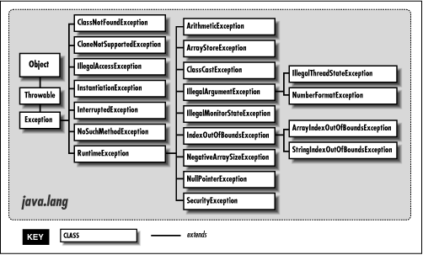
In More Detail (but not all!)

Slide 17
4.1. Two Exception Categories
1. Checked exceptions
  subclasses of Exception
  recovery should be possible for these types of errors
  your code must include try-catch blocks for these or the compiler will reject your program
    e.g. IOException
continued

Slide 18
2. Unchecked exceptions
  subclasses of RuntimeException
  exceptions of this type usually mean that your program should terminate
  the compiler does not force you to include try-catch blocks for these kinds of exceptions
    e.g. ArithmeticException

Slide 19
4.2. Text IO
Uses checked
exceptions
1
IO can generate lots of exceptions, but usually the program can recover
  e.g. file not found, so look somewhere else
Most IO methods can produce java.io.IOException
  a checked exception which your code must handle with try-catch blocks

Slide 20
Text Output to a File
Use the FileWriter class
  open a file
  write to the file
  close the file
Failure at any point results in an IOException

Slide 21
Text Output to File
try {
FileWriter writer = new FileWriter("name of file");
while(there is more text to write) {
...
writer.write(next piece of text);
...
}
writer.close();
}
catch(IOException e) {
// something went wrong with accessing the file
}
the try-catch block
must be included

Slide 22
Text Input From File
Use the FileReader class.
Use BufferedReader for line-based input:
  open a file
  read from the file
  close the file
Failure at any point results in an IOException.

Slide 23
Text Input From File
try {
BufferedReader reader =
new BufferedReader(new FileReader("filename"));
String line = reader.readLine();
while(line != null) {
do something with line
line = reader.readLine();
}
reader.close();
}
catch(FileNotFoundException e) {
// the specified file could not be found
}
catch(IOException e) {
// something went wrong with reading or closing
}
the try-catch block
must be included

Slide 24
4.3. Checking Maths
Uses an unchecked
exception
2
int x = 0;
int y;
:
try {
y = 1/x;
:
}
catch (ArithmeticException e)
{ ...;
y = 0;
}
System.out.println(“y is “ + y);

Slide 25
Or:
int x = 0;
int y;
:
y = 1/x;
:
System.out.println(“y is “ + y);
a try-catch block does
not need to be included

Slide 26
5. Throwing an Exception
Exceptions are caused (thrown or raised) by the JVM.
Also, the programmer can throw an exception by using:
  throw e

Slide 27
Example
private double safeSqrt(double x)
{
try {
if (x < 0.0)
throw new ArithmeticException();
. . .;
}
catch (ArithmeticException e)
{ x = 0.0; }
. . . ;
return sqrt(x);
}

Slide 28
5.1. Handling Exceptions
Exceptions thrown by a method can be either:
  caught by the method’s catch handler(s)
    we’ve seen examples already
  or be listed in the method's throws declaration

Slide 29
Throws Declaration
Format:
  int g(int h) throws a, b, c
  {
  // method body which may throw
  // exceptions a, b, c
  }
The idea is that the exceptions are to be passed up to the method that called g().
continued

Slide 30
Example
double safeSqrt(double x) throws
ArithmeticException
{
if (x < 0.0)
throw new ArithmeticException();
. . .;
return sqrt(x);
}

Slide 31
foo()
throws
(or returns)
calls
void foo(double x)
{
double result;
try {
result = safeSqrt(x);
}
catch(ArithmeticException e)
{ System.out.println(e);
result = -1;
}
System.out.println("result: " + result);
}
safeSqrt()

Slide 32
6. Not Handling an Exception
If a method raises an exception and it does not have a catch block or throws declaration then…
  if the exception is a runtime exception (an unchecked exception), then the program will terminate at runtime
  if the exception is a checked exception, then the compiler will reject your code at compile time

Slide 33
7. Defining New Exceptions
You can subclass RuntimeException to create new kinds of unchecked exceptions.
Or subclass Exception for new kinds of checked exceptions.
Why? To improve error reporting in your program.

Slide 34
7.1 DivisionByZero Example
A new unchecked maths exception:
  DivideByZeroException
  to handle division-by-zero exceptions
The example program takes two strings as input, converts them to integers, and divides them
  number format exceptions are possible, and division-by-zero

Slide 35
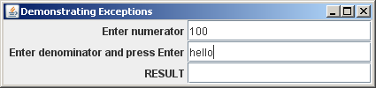
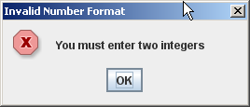
Usage
There are two possible
kinds of exceptions.
1. Number
Format
Exception
continued

Slide 36
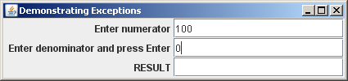
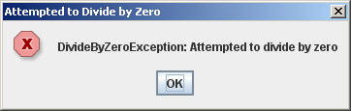
2. Divide By Zero
Exception
continued

Slide 37
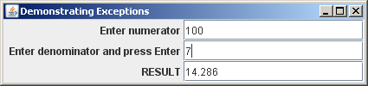
Correct at last!!

Slide 38
DivideByZeroException Class
public class DivideByZeroException
extends ArithmeticException
{
public DivideByZeroException()
{ super( "Attempted to divide by zero" ); }
}

Slide 39
DivideByZeroTest.java
// divide two input strings
import java.text.DecimalFormat;
import javax.swing.*;
import java.awt.*;
import java.awt.event.*;
public class DivideByZeroTest extends JFrame
implements ActionListener
{
private JTextField input1, input2, output;
private int number1, number2;
private double result;
:

Slide 40
public DivideByZeroTest()
{
super( "Demonstrating Exceptions" );
Container c = getContentPane();
c.setLayout( new GridLayout(3,2) );
c.add( new JLabel( "Enter numerator ",
SwingConstants.RIGHT ) );
input1 = new JTextField(10);
c.add( input1);
:

Slide 41
c.add( new JLabel( "Enter denominator
and press Enter ", SwingConstants.RIGHT ) );
input2 = new JTextField(10);
c.add( input2 );
input2.addActionListener(this);
c.add( new JLabel( "RESULT ",
SwingConstants.RIGHT ) );
output = new JTextField();
c.add( output );
setDefaultCloseOperation(
JFrame.EXIT_ON_CLOSE);
setSize(425,100);
setVisible(true);
} // end of DivideByZeroTest()

Slide 42
public void actionPerformed( ActionEvent e )
{
DecimalFormat precision3 =
new DecimalFormat( "0.000");
output.setText( "" ); // empty JTextField
try {
number1 = Integer.parseInt(input1.getText());
number2 = Integer.parseInt(input2.getText());
result = quotient( number1, number2);
output.setText( precision3.format(result) );
}
:

Slide 43
catch ( NumberFormatException nfe ) {
JOptionPane.showMessageDialog( this,
"You must enter two integers",
"Invalid Number Format",
JOptionPane.ERROR_MESSAGE );
}
catch ( DivideByZeroException dbze ) {
JOptionPane.showMessageDialog( this,
dbze.toString(),
"Attempted to Divide by Zero",
JOptionPane.ERROR_MESSAGE );
}
} // end of actionPerformed()
continued

Slide 44
// Throw an exception when divide-by-zero
public double quotient( int numerator,
int denominator )
throws DivideByZeroException
{
if ( denominator == 0 )
throw new DivideByZeroException();
// not caught here, so listed in throws
return ( double ) numerator/denominator;
} // end of quotient()

Slide 45
public static void main( String args[] )
{ new DivideByZeroTest(); }
} // end of DivideByZeroTest class

Slide 46
Catching Pattern
actionPerformed()
:
try{
// parsing
// call to quotient()
}
catch NumberFormat
catch DivideByZero
:
quotient() throws ...
if (denom == 0)
throw DivideByZero
:
sometimes called
nested catching

Slide 47
8. Nested Catching
When an exception is thrown, its type is matched against the arguments of the catch handlers in its block.
If no handler matches in that block, then the exception is passed out to the enclosing block:
  e.g. quotient() → actionPerformed()
continued

Slide 48
The exception keeps being passed out to the next enclosing block until:
  a suitable handler is found; or
  there are no blocks left to try
    and the program terminates with a stack trace

Slide 49
Stack Trace Example
If no handler is called, then the system prints a stack trace as the program terminates
  it is a list of the called methods that are waiting to return when the exception occurred
  very useful for debugging/testing
The stack trace can be printed by calling printStackTrace()

Slide 50
Using a Stack Trace
// The getMessage and printStackTrace methods
public class UsingStackTrace
{
public static void main( String args[] )
{
try {
method1();
}
catch ( Exception e) {
System.err.println(e.getMessage() + "\n");
e.printStackTrace();
}
} // end of main()

Slide 51
public static void method1() throws Exception
{ method2(); }
public static void method2() throws Exception
{ method3(); }
public static void method3() throws Exception
{
throw new Exception(
"Exception thrown in method3" );
}
} // end of UsingStackTrace class

Slide 52
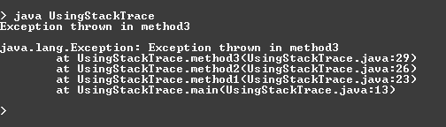
Usage
main()
method1()
method2()
method3()
e.getMessage() output
Exception!!
e.printStackTrace()
output

Slide 53
Notes
method1() and method2() require throws declarations since they call a method that may throw a Exception.
The compiler will reject the program at compile time if the throws are not included
  Exception is a non-runtime (checked) exception

Slide 54
9. What if Several Handlers can
Match?
If several handlers can match an exception, then the first one found by the JVM is used.

Slide 55
What is a Match?
Matching is based on the Exception class hierarchy.
If the class of the exception is the same as the argument type of the handler, then there is a match.
continued

Slide 56
A match is also possible if the handler argument is a superclass for the exception type.
  e.g. the handler:
  catch(ArithmeticException e) {
  // code
  }
  can catch an exception of class DivisionByZeroException
continued

Slide 57
The most general handler:
  catch (Exception e) {
  // code
  }
  can catch any exception because Exception is the superclass of all exception types

Slide 58
10. The finally Clause
try {
// Protect one or more statements here.
}
catch(Exception e) {
// Report and recover from the exception here.
}
finally {
// Perform actions here whether
// or not an exception is thrown.
}

Slide 59
A finally clause is executed even if a return statement is executed in the try or catch clauses.
An uncaught or nested exception still exits via the finally clause.
Typical usage is to free system resources before returning, even after throwing an exception
  e.g. close files, network links

Slide 60
11. The assert Statement
Used for internal consistency checks
  e.g. check an object's state after it was meant to have been changed
Use asserts during development, and remove them in the finished version of the program.

Slide 61
Format
Two forms:
  assert boolean-expression
  assert boolean-expression : msg-expr
boolean-expression should be true at this point in the execution.
An AssertionError is thrown if the boolean-expression is false, and msg-expr is output.

Slide 62
Assert Statement
public void removeDetails(String key)
{
if(key == null)
throw new IllegalArgumentException("...");
if(keyInUse(key)) {
ContactDetails details = book.get(key);
book.remove(details.getName());
book.remove(details.getPhone());
numberOfEntries--;
}
assert !keyInUse(key);
assert consistentSize() :
"Inconsistent book size in removeDetails";
}

Slide 63
Guidelines for Asserts
Use them for checking your code only.
Remove them from your finished code.
Don’t change things in asserts:
// BAD:
assert book.remove(name);
This is bad because asserts
should only check things.

