Slide 1
Threads
objective:
understanding: thread, thread state, and synchronization

Slide 2
Coverage
Thread class
run, start methods
yield, join
sleep
Synchronization
synchronized methods & objects
wait/notify/notifyAll
conditions

Slide 3
java.lang.Thread
Two techniques to create threads in java
1) implementing the Runnable interface
The Runnable interface should be implemented by any class whose instances are intended to be executed by a thread. The class must define a method, called run, with no arguments.
invoke Thread constructor with an instance of this Runnable class
2) extending Thread
Define a subclass of java.lang.Thread
Define a run method
In another thread (e.g., the main), create an instance of the Thread subclass
Then, call start method of that instance
Notes:
Don’t call run method directly.
Two methods to

Slide 4
Example 1
Create 2 threads from the Main, then start them
Threads will be instances of different thread sub-classes

Slide 5
class MyThreadA extends Thread {
public void run() { // entry point for thread
for (;;) {
System.out.println("hello world1");
}
}
}
class MyThreadB extends Thread {
public void run() { // entry point for thread
for (;;) {
System.out.println("hello world2");
}
}
}
public class Main1 {
public static void main(String [] args) {
MyThreadA t1 = new MyThreadA();
MyThreadB t2 = new MyThreadB();
t1.start();
t2.start();
// main terminates, but in Java the other threads keep running
// and hence Java program continues running
}
}

Slide 6
hello world2
hello world2
hello world1
hello world2
hello world1
hello world2
hello world2
hello world1
hello world1
hello world1
hello world1
hello world2
hello world1
hello world1
hello world2
hello world2
hello world1
hello world1
hello world2
hello world2
hello world1
hello world1
hello world2
Notes:
Run on Mac OS X, 3/14/08
Sometimes in multithreaded programs, you see parts of the output more interspersed than this.

Slide 7
Example 2
Create 2 threads from the Main, then start them
Threads will be instances of the same thread sub-class
Use argument of constructor of new thread class to pass text name of thread, e.g., “thread1” and “thread2”
Data member provides different data per thread (i.e., then name)
A data member can also be used to share data
Notes:
Have the students work this example.

Slide 8
class MyThread extends Thread {
private String name;
public MyThread(String name) {
this.name = name;
}
public void run() {
for (;;) {
System.out.println(name + ": hello world");
}
}
}
public class Main2 {
public static void main(String [] args) {
MyThread t1 = new MyThread("thread1");
MyThread t2 = new MyThread("thread2");
t1.start(); t2.start();
}
}

Slide 9
thread2: hello world
thread2: hello world
thread2: hello world
thread2: hello world
thread2: hello world
thread2: hello world
thread2: hello world
thread2: hello world
thread2: hello world
thread2: hello world
thread2: hello world
thread2: hello world
thread2: hello world
thread2: hello world
thread2: hello world
thread1: hello world
thread2: hello world
thread1: hello world
thread2: hello world
thread2: hello world
thread1: hello world
thread2: hello world
thread2: hello world
Notes:
See the variation in output.

Slide 10
java.lang.Thread
public static void yield();
Method of java.lang.Thread
Thread gives up CPU for other threads ready to run
Notes:
int i=0;
if(i%10000==0)
yield();

Slide 11
class MyThread extends Thread {
private String name;
public MyThread(String name) {
this.name = name;
}
public void run() {
for (;;) {
System.out.println(name + ": hello world");
yield();
}
}
}
public class Main3 {
public static void main(String [] args) {
MyThread t1 = new MyThread("thread1");
MyThread t2 = new MyThread("thread2");
t1.start(); t2.start();
}
}

Slide 12
Some Output
thread1: hello world
thread2: hello world
thread1: hello world
thread2: hello world
thread1: hello world
thread2: hello world
thread1: hello world
thread2: hello world
thread1: hello world
thread2: hello world
thread1: hello world
thread2: hello world
thread1: hello world
thread2: hello world
thread1: hello world
thread2: hello world
thread1: hello world
thread2: hello world
thread1: hello world
thread2: hello world
thread1: hello world
thread2: hello world
thread1: hello world
Notice the alternation of output

Slide 13
More Thread Members: join
public final void join();
MyThread t1 = new MyThread("thread1");
t1.start();
t1.join();
Wait until the thread is “not alive”
Threads that have completed are “not alive” as are threads that have not yet been started
public static void sleep (long millis) throws InterruptedException;
Makes the currently running thread sleep (block) for a period of time
InterruptedException - if another thread has interrupted the current thread.

Slide 14
Join Example
Notes:
หลัง System.out ->System.exit();

Slide 15
Some output
…
hello world1
hello world1
hello world1
hello world1
hello world1
hello world1
hello world1
hello world1
hello world1
hello world1
hello world1
hello world1
hello world1
hello world1
hello world1
hello world1
hello world1
hello world1
hello world1
hello world1
hello world1
Thread is done!

Slide 16
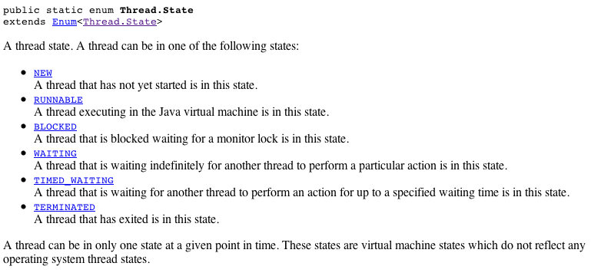
Thread State
public Thread.State getState()
Returns the state of this thread. This method is designed for use in monitoring of the system state, not for synchronization control
http://java.sun.com/javase/6/docs/api/java/lang/Thread.State.html

Slide 17
Thread Scheduling in Java
public final void setPriority(int newPriority);
public final int getPriority();
public static final int MAX_PRIORITY
// 10
public static final int MIN_PRIORITY
// 1
Scheduling
Priority inherited from parent, but can be changed
Higher priority threads generally run before lower priority threads
For equal priority threads, best to call yield() intermittently to handle JVM’s with user-level threading (i.e., no time-slicing)

Slide 18
Sharing Data Across Java Threads
Consider the situation where a parent thread wants to pass data to a child thread
e.g., so that child can change data and parent can have access to the changed data
How can this be done?
Can pass an object instance to the child thread constructor, and retain that object instance in a data member
Notes:
ง่าย แต่มีปัญหา คือ bad style + RMI

Slide 19
class SharedData {
public int a = 0;
public String s = null;
public SharedData() {
a = 10;
s = "Test";
}
}
class MyThread extends Thread {
private SharedData m_data = null;
public MyThread(SharedData data) {
m_data = data;
}
public void run() {
for (;;) {
m_data.a++;
}
}
}
Notes:
RMI fail

Slide 20
public class Main5 {
public static void main(String [] args) {
SharedData data = new SharedData();
MyThread t1 = new MyThread(data);
t1.start();
for (;;) {
data.a--;
}
}
}
If we have multiple threads accessing this shared data, how do we synchronize access to ensure it remains in a consistent state?
Notes:
Of course, part of this depends on how we define “consistent state”.

Slide 21
Basic Tools for Synchronization in Java
Synchronized methods
Synchronized objects
Methods
wait
notify
notifyAll
Also should talk about condition variables in Java
Notes:
Synchronized method objects
wait/nofify
condition

Slide 22
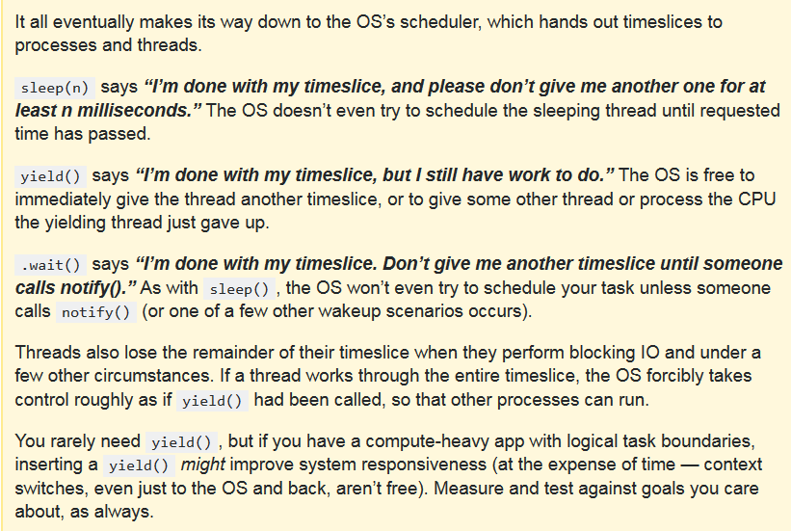
Thread Methods

Slide 23
Synchronized Methods: Monitors
synchronized keyword used with a method
E.g.,
public synchronized void SetValue() {
// Update instance data structure.
// When the thread executes here, it exclusively has the monitor lock
}
Provides instance-based mutual exclusion
A lock is implicitly provided-- allows at most one thread to be executing the method at one time
Used on a per method basis; not all methods in a class have to have this
But, you’ll need to design it right!!
Notes:
static method to synchronized

Slide 24
Difference: Synchronized vs. Non-synchronized
Class with synchronized methods
How many threads can access the methods of an object?
Class with no synchronized methods
How many threads can access the methods of an object?
Notes:
First: 1
Second: N – as many as want to

Slide 25
Example
Construct a queue (FIFO) data structure that can be used by two threads to access the queue data in a synchronized manner
Producer thread: Adds data into queue
Consumer thread: Removes data from queue
For one instance of the queue, only one thread should be able to modify the queue, i.e., we should have mutual exclusion on methods of one instance of the queue

Slide 26
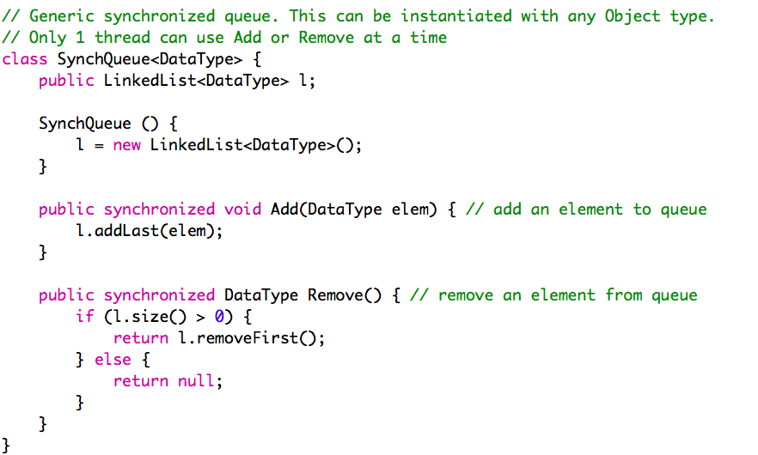
http://www.cprince.com/courses/cs5631/lectures/JavaThreads/SynchMainGeneric.java

Slide 27
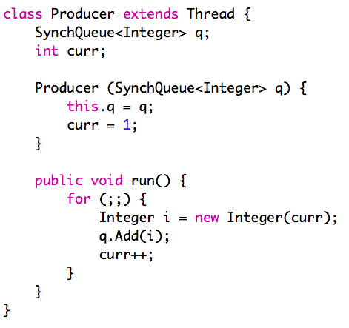
http://www.cprince.com/courses/cs5631/lectures/JavaThreads/SynchMainGeneric.java

Slide 28
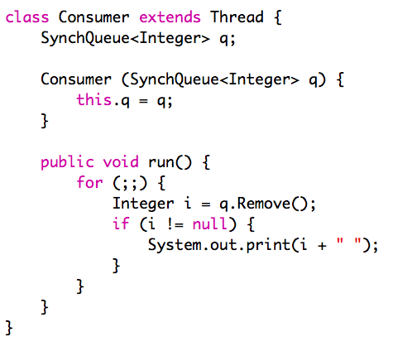
http://www.cprince.com/courses/cs5631/lectures/JavaThreads/SynchMainGeneric.java
Notes:
Point out that this is a polling solution– should really make the consumer block to wait for the queue to be non-empty

Slide 29
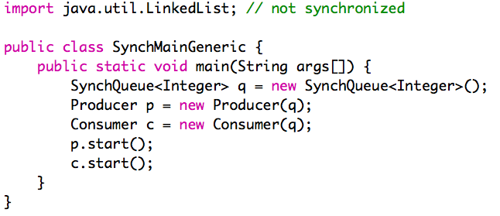
http://www.cprince.com/courses/cs5631/lectures/JavaThreads/SynchMainGeneric.java

Slide 30
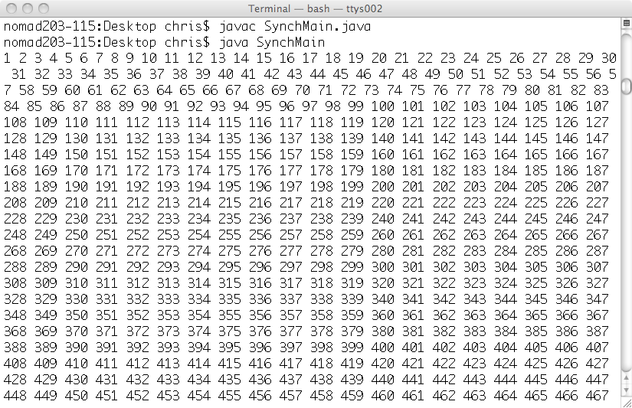
Let’s run this and see what happens

Slide 31


Slide 32
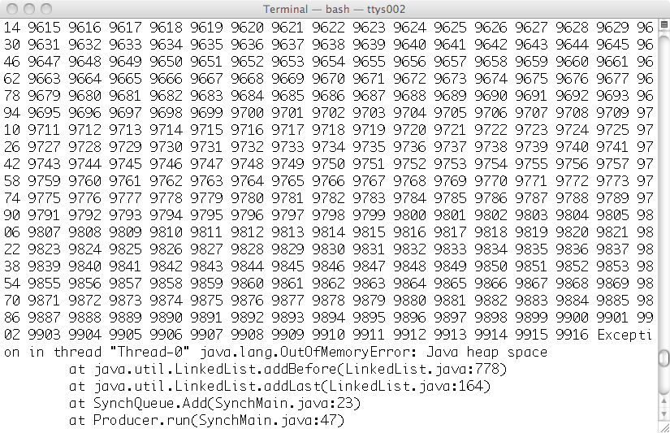
Ooops! What happened?

Slide 33
This implementation has a problem! The Consumer prints, which slows it down a LOT, and thus the producer is faster, and thus the producer fills up the queue, and causes heap space to run out!!
Would like to alter this program to limit the maximum number of items that are stored in the queue.
Goal: have the producer block (wait) when the queue reaches some fixed size limit

Slide 34
Also
Better to have the Remove block (wait) when the queue is empty
I.e., presently we are doing a “busy wait” (also called polling)
We are repeatedly checking the queue to see if it has data, and using up too much CPU time doing this
Notes:
See also:
http://java.sun.com/docs/books/tutorial/collections/implementations/queue.html
java.util.concurrent.LinkedBlockingQueue<E>
http://java.sun.com/j2se/1.5.0/docs/api/java/util/concurrent/BlockingQueue.html

Slide 35
wait method (see also java.lang.Object)
Does a blocking (not busy) wait
Relative to an Object
E.g., Used within a synchronized method
Releases lock on Object and waits until a condition is true
Blocks calling process until notify() or notifyAll() is called on same object instance (or exception occurs)
Typically used within a loop to re-check a condition
wait(long millis); // bounded wait

Slide 36
notify and notifyAll methods (see also java.lang.Object)
Stop a process from waiting– wakes it up
Relative to an Object
E.g., Used within a synchronized method
Wakes up a blocked thread (notify) or all blocked threads (notifyAll)
One woken thread reacquires lock; The awakened thread will not be able to proceed until the current thread relinquishes the lock on this object.
For notify, if more than one thread available to be woken, then one is picked

Slide 37
Typical use of wait within a synchronized method
while (condition not true) {
try {
wait(); // this.wait();
} catch( ) {
System.out.println(“Interrupted!”);
}
}
// After loop, condition now true & thread
// has monitor lock for this object instance
Notes:
System.exit()

Slide 38
Example
Extend the example from before:
a queue (FIFO) data structure that can be used by two threads to access the queue data in a synchronized manner
This time, use wait & notify to block the Producer thread if the queue is full, and block Consumer thread if the queue is empty

Slide 39
Re-checking Monitor Conditions
wait/notify
After receiving a notify, a process waiting on a condition may not be next to gain access to monitor (to the data)
E.g., occurs if notifyAll used
Process may need to re-check the conditions upon which it was waiting
An “awakened thread will compete in the usual manner with any other threads that might be actively competing to synchronize on this object; for example, the awakened thread enjoys no reliable privilege or disadvantage in being the next thread to lock this object.” (http://java.sun.com/j2se/1.5.0/docs/api/)

Slide 40
InterruptedException
Wait can be woken by the exception, I.e., for reasons other than notify
Sometimes this can be handled as part of the process of re-checking conditions
There is another way to handle it too
Notes:
See http://java.sun.com/j2se/1.5.0/docs/api/java/lang/Object.html#wait()
for reasons why wait can be woken
“if another thread interrupted the current thread before or while the current thread was waiting for a notification. The interrupted status of the current thread is cleared when this exception is thrown.”
See also: http://java.sun.com/j2se/1.5.0/docs/api/java/lang/Thread.html#interrupt()
Threads can receive interrupted exception if they don’t have the monitor lock!!

Slide 41
Exception in Wait
// In a synchronized method
// check your condition, e.g., with a semaphore
// operation, test “value” member variable
if /* or while */ (/* condition */) {
boolean interrupted;
do {
interrupted = false;
try {
wait();
} catch (InterruptedException e) {
interrupted = true;
}
} while (interrupted);
}
Only allows release from wait caused by notify or notifyAll

Slide 42
Synchronized Blocks
Synchronized methods
Implicitly lock is on this object
Synchronized blocks
lock on an arbitrary, specified object
similar to condition variables in monitors
but need to have a synchronized block around an object before wait/notify used
use wait/notify on the object itself

Slide 43
Syntax
synchronized (object) {
// object.wait()
// object.notify()
// object.notifyAll()
}
For example, this allows you to synchronize just a few lines of code, or to synchronize on the basis of an arbitrary object

Slide 44
Another Example
Suppose in a Global File Table, suppose that per open file you keep an
Object Lock;
you can then use a synchronized block to make sure that some operations only get done in a mutually exclusive manner on the file
synchronized (file[i].Lock) {
// if we get to here we’re the only one
// accessing file i
}

Slide 45
Conditions
Java interface:
http://download.oracle.com/javase/6/docs/api/java/util/concurrent/locks/Condition.html
Let’s you have multiple independent wait events for a monitor
So, have one monitor lock, but can wait within the monitor for more than one reason
Use await/signal (not wait/notify)
Also: Must have explicit lock (don’t use synchronized keyword)
Lock monitor as very first thing you do
Unlock monitor as very last thing you do

Slide 46
END!

Slide 47
References & Resource
Java Threads by Scott Oaks & Henry Wong (O’Reilly)
API docs
http://download.oracle.com/javase/6/docs/api/
java.lang.Thread, java.lang.Runnable
java.lang.Object, java.util.concurrent
Tutorials
http://download.oracle.com/javase/tutorial/essential/concurrency/index.html
http://download.oracle.com/javase/tutorial/essential/concurrency/procthread.html
Introduction to Java Threads
http://www.javaworld.com/javaworld/jw-04-1996/jw-04-threads.html
Thread safety
http://en.wikipedia.org/wiki/Thread-safety
http://www.javaworld.com/jw-08-1998/jw-08-techniques.html

Slide 48
Example
Implement Semaphore class with Java synchronization
Provide constructor, and P (wait) and V (signal) methods
Use synchronized methods
and Java wait/notify
Note
Java implements Semaphores—
http://java.sun.com/j2se/1.5.0/docs/api/java/util/concurrent/Semaphore.html
Notes:
Another implementation of this without the complex code for dealing with the InterruptedException would be to have the V operation increment a variable, and have the P operation test that variable to see if it is > 0. See Semaphore-v3.java

Slide 49
java.lang.Runnable Interface
The Runnable interface should be implemented by any class whose instances are intended to be executed by a thread. The class must define a method of no arguments called run.
Known Implementing Classes:
AsyncBoxView.ChildState, FutureTask, RenderableImageProducer, Thread, TimerTask
From http://java.sun.com/j2se/1.5.0/docs/api/
Runnable can be used to create threads
See p.136-137 of text

Slide 50
Example
Two producer threads (A & B), and one consumer thread
Consumer needs one type of item from thread A and one type of item from thread B before it can proceed
Use a loop and a wait and recheck conditions in the consumer
Notes:
Another example of checking/rechecking conditions: Let them work this one in class

Slide 54
Blocking Remove
// only 1 thread can use Add or Remove at a time
class SynchQueue {
public LinkedList<Integer> l;
SynchQueue () {
l = new LinkedList<Integer>();
}
public synchronized void Add(Integer elem) {
l.addLast(elem);
notify();
}
public synchronized Integer Remove() {
while (l.size() == 0) {
try {
wait();
} catch (InterruptedException e) {
System.out.println(“ERROR: Thread interrupted!”);
}
}
return l.removeFirst();
}
}
Notes:
I’ve marked the changes to the previous version in red.

Slide 55
