Slide 1
242-210 PF II
4. Object Interaction
Objectives
introduce modularization and abstraction
explain how an object uses other objects
compare object and primitive types
Original Slides by Dr. Andrew Davison

Slide 2
Topics
1. Modularization and Abstraction
2. A Digital Clock
3. Using ClockDisplay
4. A More Graphical Clock

Slide 3
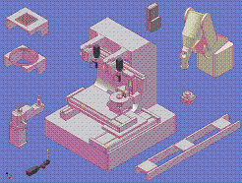

1. Modularization and Abstraction
Modularization divides a problem into simpler sub-parts, which can be built separately, and which interact in simple ways.
Abstraction is the ability to ignore low level details of a problem to focus on the higher levels.

Slide 4
Use in Programming
Use modularization to split a programming problem into sub-parts (modules).
implement the modules
The implementation of the complete program will be easier, since abstraction can be used to write software in terms of the modules.

Slide 5
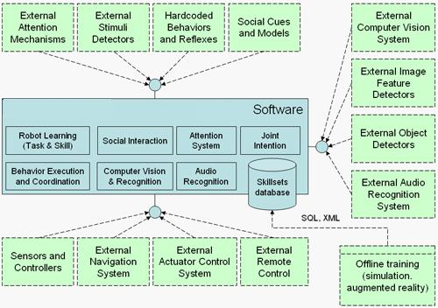
e.g. Robot Software
Modules
("black
boxes")
Abstraction
"links" the
modules
together
using their
visible
interfaces.

Slide 6
Use in OOP
Use modularization to split a programming problem into objects.
Implement the classes for the objects.
The implementation of the class for the complete program will be easier, since abstraction can be used to write the class in terms of other classes (yours and predefined ones).

Slide 7
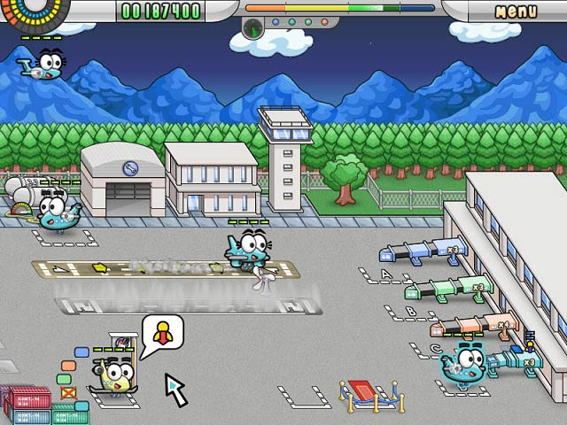
e.g. Airport Control System
Classes for:
Plane, Gate, Luggage,
Passenger, etc.
Use them to create objects
such as plane1, plane2, gate2, myLuggage
Abstraction simplifies the
communication between
the objects; only use their
visible interface.

Slide 8
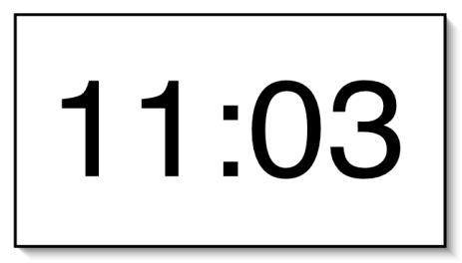
2. A Digital Clock
Implement a digital clock display, which shows the hours (0-23) and minutes (0-59).

Slide 9


Modularizing the Clock Display
Divide the clock display problem into two parts
how to display the hours
how to display the minutes
We need two number display objects
We need a NumberDisplay class
two NumberDisplay
objects

Slide 10
Objects Diagram
ClockDisplay object
NumberDisplay object
(for hours)
NumberDisplay object
(for minutes)

Slide 11
NumberDisplay Interface
What kind of interface is needed for a NumberDisplay class?
get and set the number
return the number as a string
useful for printing
increment the number
the number will 'loop'
e.g. 0, 1, 2, ..., 59, 0, 1, ... for the minutes display

Slide 12
The NumberDisplay Class
public class NumberDisplay
{
private int currValue;
private int maxValue; // number at which currValue goes back to 0
public NumberDisplay(int max)
{ maxValue = max;
currValue = 0;
}
continued

Slide 13
public void setValue(int newValue)
/* Set currValue to the new value. If the new value is less than zero or over maxValue, don't set it.
*/
{ if ((newValue >= 0) && (newValue < maxValue))
currValue = newValue;
}
public int getValue()
{ return currValue; }
continued

Slide 14
public String getDisplayValue()
// return currValue as a string
{
if (currValue < 10)
return "0" + currValue; //pad string with leading 0
else
return "" + currValue;
}
public void increment()
/* Increment currValue, rolling over to zero if the
maxValue is reached. */
{ currValue = (currValue + 1) % maxValue; }
} // end of NumberDisplay class

Slide 15
ClockDisplay Interface
What kind of interface is needed for a ClockDisplay class?
initialize the clock and set the time
return the current time as a string
useful for printing
increment the time by one minute
The time will be represented using two NumberDisplay fields.

Slide 16
The ClockDisplay Class
public class ClockDisplay
{
private NumberDisplay hours;
private NumberDisplay minutes;
private String currTimeString; // the current time as a string
public ClockDisplay()
// intialize the clock to 00:00
{
hours = new NumberDisplay(24);
minutes = new NumberDisplay(60);
setTimeString();
}
two private
NumberDisplay
fields
create two
NumberDisplay
objects
continued

Slide 17
a private method is
one that only other
methods in the class can call
private void setTimeString()
/* store the current time as a string of the form "hours:minutes" */
{ currTimeString = hours.getDisplayValue() + ":" + minutes.getDisplayValue(); }
method calling
in NumberDisplay
objects
continued

Slide 18
public void setTime(int hour, int minute)
// set time to the specified hour and minute
{
hours.setValue(hour);
minutes.setValue(minute);
setTimeString();
} // end of setTime()
public String getTime()
// return the current time as a string
{ return currTimeString; }
method calling
in NumberDisplay
objects
continued

Slide 19
public void minIncrement()
// increment the clock by one minute;
// hour increments when minutes roll over to 0
{
minutes.increment();
if (minutes.getValue() == 0) // mins rolled
hours.increment();
setTimeString();
} // end of minIncrement()
} // end of ClockDisplay class

Slide 20
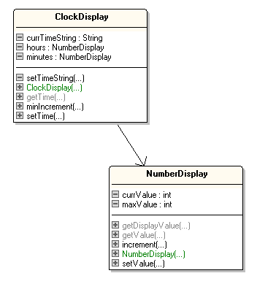
Classes Diagram
uses

Slide 21
3. Using ClockDisplay
public class ClockDemo
{
public static void main(String[] args)
{
ClockDisplay clock = new ClockDisplay();
clock.setTime(14, 10); // set time to 14:10
while(true) {
clock.minIncrement();
System.out.println(" tick...");
System.out.println("Current time: "+clock.getTime());
wait(100); // slow down the looping
}
} // end of main()

Slide 22
wait() is a static method
so it can be called by main()
without main() having to create an object first.
private static void wait(int milliseconds)
/* stop execution for milliseconds amount of time */
{
try {
Thread.sleep(milliseconds);
}
catch (Exception e) { }
} // end of wait()
} // end of ClockDemo class
sleep() is a method
in Java's Thread class

Slide 23
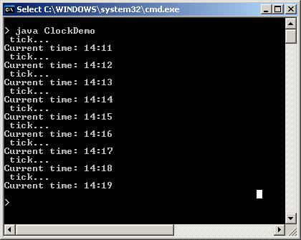
Compilation and Execution
Compile NumberDisplay.java, ClockDisplay.java, and ClockDemo.java
$ javac *.java
I typed ctrl-c to
stop the looping.

Slide 24
Objects Diagram for ClocksDemo
NumberDisplay object
ClockDisplay object
clock
currValue
hours
14
maxValue
24
minutes
currTimeString
NumberDisplay object
currValue
19
14:19
maxValue
60
String object

Slide 25
4. A More Graphical Clock
Michael Kölling and Bruce Quig have developed a simple Canvas class for displaying text and basic shapes in a window.
We can use Canvas to display the changing clock display instead of using stdout.

Slide 26
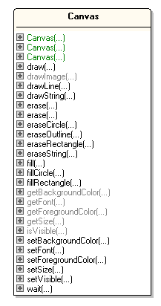
Canvas Class Diagram
Only showing the
public methods
(the interface).
To use Canvas, we only
need to understand its
interface.
I don't care how it is
implemented.

Slide 27
ClockCanvasDemo
Using Canvas
(compare to
slide 21)
public class ClockCanvasDemo
{
public static void main(String[] args)
{
Canvas canvas = new Canvas("Clock Demo",300,150, Color.white);
canvas.setVisible(true);
canvas.setFont( new Font("Dialog", Font.PLAIN, 96));
ClockDisplay clock = new ClockDisplay();
clock.setTime(14, 10); // set time to 14:10
while(true) {
clock.minIncrement();
canvas.erase(); // clear the canvas
canvas.drawString( clock.getTime(), 30, 100);
canvas.wait(100); // slow down the looping
}
} // end of main()
} // end of ClockCanvasDemo class

Slide 28
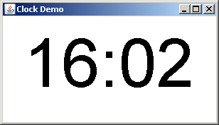
Compilation and Execution
Compilation includes ClockCanvasDemo.java and Canvas.java
$ javac *.java
$ java ClockCanvasDemo

