Slide 1
242-210 PF II
5. Grouping Objects
Objectives
discuss call-by-value and call-by-reference, arrays, collections, and iterators
Original Slides by Dr. Andrew Davison

Slide 2
Topics
1. Parameter Passing
2. Arrays: Similar but Different
3. Call-by-Reference with Classes
4. Grouping Objects
5. A Notebook Example
6. Iteration (looping)
7. An Auction Example
8. Fixed-size Collections
9. More Information

Slide 3
1. Parameter Passing
In C all arguments are copied into functions:
called call-by-value
Java uses call-by-value and call-by-reference.

Slide 4
What is Call-by-Reference?
An example for an imaginary language:
function foo() { integer x := 2; bar(x); print(“x is” + x); }
function bar(ref integer w) { w := 5; }
“x is 5” is printed
continued

Slide 5
Call-by-reference creates a link from the variable in the called function (e.g. w in bar()) to the original variable (e.g. x in foo())
when w changes, x is also changed

Slide 6
Java’s Parameter Passing
Variables of primitive types (e.g. int, double, char) are passed call-by-value (copied)
this means that methods must 'return' results
e.g. see next example
Object-type variables are passed call-by-reference
this means that changes to objects are 'remembered' when a method finishes without the need for a 'return'

Slide 7
Call-by-Value Example
public class SimpleCalls
{
public static void main(String[] args)
{
int x = 3;
System.out.println("1. x = " + x);
squareBad(x);
// x = squareGood(x);
System.out.println("2. x = " + x);
} // end of main()
continued

Slide 8
static is used so that main() can call
these methods without creating an object first;
it has nothing to do with parameter passing
private static void squareBad(int x)
{
System.out.println("sqBad 1. x = " + x);
x = x*x;
System.out.println("sqBad 2. x = " + x);
}
private static int squareGood(int x)
{
System.out.println("sqGood 1. x = " + x);
x = x*x;
System.out.println("sqGood 2. x = " + x);
return x;
}
} // end of SimpleCalls class

Slide 9
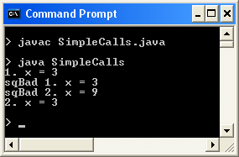

Execution
When calling squareBad()
→ no change to x in main()
When calling squareGood()
→ x is changed in main()

Slide 10
2. Arrays: Similar but Different
Java arrays look like C arrays, but...
Java arrays do not support pointer manipulation.
Arrays are objects, and so are passed to methods using call-by-reference.

Slide 11
Declaring and Allocating Arrays
declare the type (e.g. int)
allocate memory with new
Some coding styles:
int c[] = new int[12]; // creates a 12 element int array c[0] = 2;
or
int c[]; // declares an array; no memory yet c[0] = 2; // ERROR! c = new int[12]; // allocates memory c[0] = 2; // OK
continued

Slide 12
a bit confusing, since no 'new' is required
or:
int n[] = {1, 3, 4, 6, 78} // creates a 5 element integer array
A common error:
int foo[12]; // a syntax error in Java

Slide 13
A Different Syntax
Instead of:
int c[] = new int[12];
Can write:
int[] c = new int[12];

Slide 14
UseArray.java
import javax.swing.JOptionPane;
public class UseArray
{
public static void main(String[] args)
{
int n[]; // declare array name
n = new int[10]; // allocate memory to array
// no values stored in n[], so will contain 0's
String output = "Cell Value\n";
for(int i = 0; i < n.length; i++)
output += "n[" + i + "] == " + n[i] + "\n";
JOptionPane.showMessageDialog( null, output,
"Using an Array", JOptionPane.INFORMATION_MESSAGE );
} // end of main()
} // end of UseArray class
two
steps

Slide 15
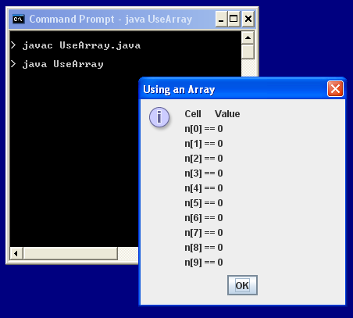
Execution

Slide 16
Notes
...
n
0
1
9
object
n is declared: its type is specified
int n[]
n is allocated memory with new
n = new int[10];
n.length
length always holds the length of the array object (i.e. 10 in this case)

Slide 17
Using an Array
Square brackets are used to access an array element:
n[i]
Array elements are used like ordinary variables
on the left of an assignment:
n[0] = 3;
in an expression:
x = n[1] – 3;
n[i]++;

Slide 18
For-loop pseudo-code
General form of a for loop
for(initialization; condition; post-body action) {
statements to be repeated
}
Equivalent in while-loop form
initialization;
while(condition) {
statements to be repeated
post-body action
}

Slide 19
Example
i only exists inside
the loop
for loop version
for(int i = 0; i < n.length; i++) {
System.out.println(i + ": " + n[i]);
}
while loop version
int i = 0;
while(i < n.length) {
System.out.println(i + ": " + n[i]);
i++;
}

Slide 20
Passing Arrays to Methods
Arrays are Java objects
they are passed to methods using call-by-reference
i.e. changes to an array inside a method affects the original
no return or pointers are required

Slide 21
PassArray.java
public class PassArray
{
public static void main(String[] args)
{
int a[] = { 1, 2, 3, 4, 5 };
System.out.println("Values in the original array:");
for(int i = 0; i < a.length; i++)
System.out.print( a[i] + " ");
System.out.println(); :

Slide 22
modifyArray(a); // pass array call-by-reference
System.out.println("Values in the modified array:");
for(int i = 0; i < a.length; i++)
System.out.print( a[i] + " ");
System.out.println();
System.out.println("Before: a[3] = " + a[3]);
modifyElement(a[3]); // pass call-by-value
System.out.println("After: a[3] = " + a[3]);
} // end of main()
continued

Slide 23
static is used so that main() can call
these methods without creating an object first;
it has nothing to do with parameter passing
b is an array
object, so passed
call-by-reference
private static void modifyArray(int b[])
// multiply each element by 2
{ for (int j = 0; j < b.length; j++)
b[j] *= 2;
}
private static void modifyElement(int elem)
// multiply elem by 2
{ elem *= 2; }
} // end of PassArray class
no return required
elem is a
primitive type,
so passed
call-by-value

Slide 24
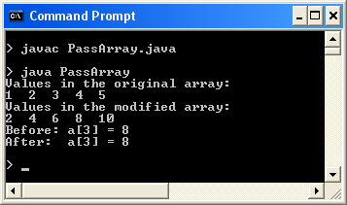
Execution
changed
unchanged

Slide 25
Notes
This application uses call-by-reference to change an entire array object, a
it remains changed back in main()
It also tries to changes an array element, a[3], by using call-by-value (copying)
it does not stay changed back in main()

Slide 26
Call-by-Reference Diagram
main()
modifyArray(int b[])
1
2
3
4
5
object
reference
back to
object
b variable
a
: b[i] *= 2; :
:
modifyArray(a); :

Slide 27
Call-by-Value Diagram
main()
a
modifyElement(int elem)
2
4
6
8
10
8
elem
object
a
: elem *= 2; :
:
modifyElement( a[3]); :
value is
copied
over

Slide 28
3. Call-by-Ref with Classes
public class Counter {
private int val;
public Counter(int x) { val = x; }
public void incr()
{ val++; }
public int getVal()
{ return val; }
}

Slide 29
Using Counter (1)
Counter c = new Counter(5);
Counter d = c;
Counter e = d;
e.incr();
System.out.println( c.getVal() );
What is printed?

Slide 30
Using Counter (2)
public static void main(String[] args) {
Counter c = new Counter(5);
foo(c);
System.out.println( c.getVal() );
}
private static void foo(Counter w)
{ w.incr(); }
What is
printed?

Slide 31
Using Counter (3)
public static void main(String[] args) {
Counter c = bar();
System.out.println( c.getVal() );
}
private static Counter bar()
{
Counter w = new Counter(5);
return w;
}
What is
printed?

Slide 32
4. Grouping Objects
Many applications involve collections of objects:
personal organizers
library catalogs
student-record system
The number of stored items varies over time as new items are added and old ones removed.
Arrays have a basic problem: their size is fixed
e.g. what should the size be for a student-record array?

Slide 33
Collection Classes
Grouping objects is a common need
the java.util package contains useful classes
I'll be using the ArrayList collection class
a list data structure with no fixed size
it grows and shrinks depending on how many obejcts are stored inside it

Slide 34
ArrayList Example
ArrayList<String> msgs;
msgs = new ArrayList<String>(); // no fixed size
msgs.add(“hello”);
msgs.add(“see you”);
String s1 = msgs.get(0);
System.out.println(“size: “ + msgs.size());
msgs
. . .
“hello”
“see you”

Slide 35
remove() Complicates Things
msgs.remove(0);
System.out.println( msgs.size() ); // ??
String s2 = msgs.get(0); // ??
msgs
. . .
“see you”

Slide 36

5. A Notebook Example
show a note
store a note
list all notes
remove a note
get the number
of notes
This interface helps the implementor decide on the class's operation/methods.

Slide 37
The Notebook Class
import java.util.ArrayList;
public class Notebook
{
private ArrayList<String> notes;
public Notebook()
{ notes = new ArrayList<String>(); }
The list will store
String objects, and
is called notes
continued

Slide 38
ArrayList.add(),
ArrayList.remove()
ArrayList.size()
public void storeNote(String note)
// add a note (a string) to the notebook
{ notes.add(note); }
public void removeNote(int noteIdx)
// Remove a note from the notebook if it exists.
{
if ((noteIdx >= 0) && (noteIdx < notes.size())) // a valid note number
notes.remove(noteIdx);
}

Slide 39
ArrayList.add() adds to the end of the list, and each entry has an index position
the indicies start at 0
ArrayList.remove() removes the object at the specified index position, which changes the indicies of the objects after it in the list.
ArrayList.size() returns the current size of the list.

Slide 40
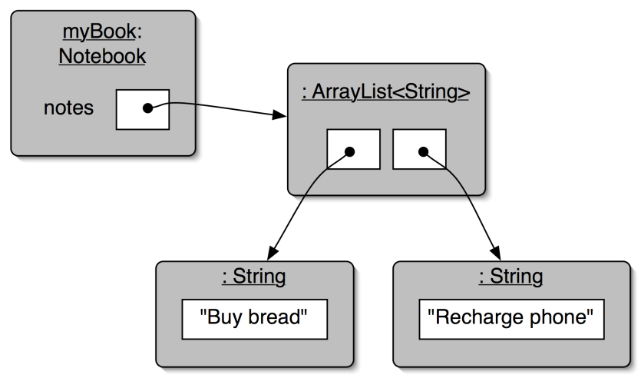
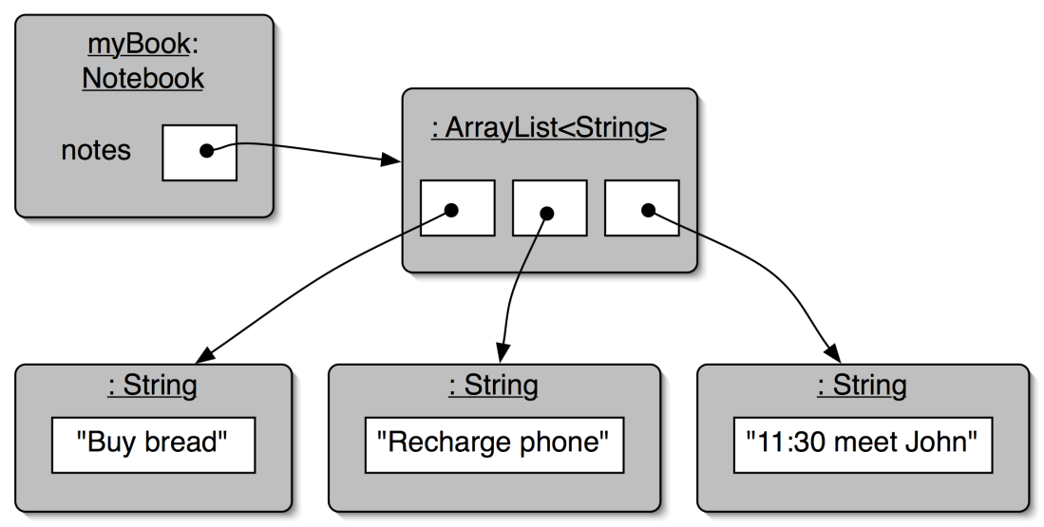
Using add()
0
1
notes.add("11:30 meet John");
0
1
2
notes.size() now
returns 3

Slide 41
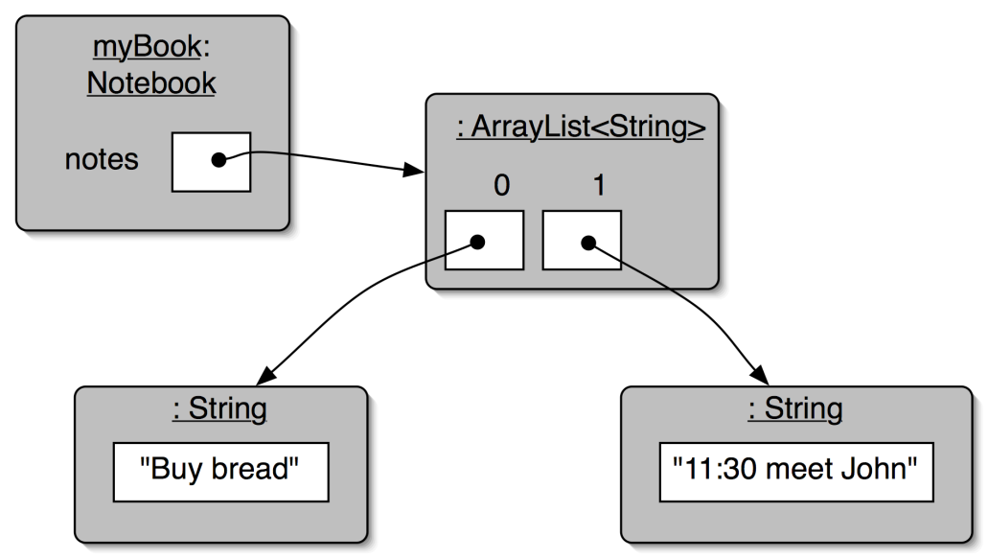
Using remove()
0
1
2
notes.remove(1);
The index position of
the "meet" note
changes when the second
object is removed.
notes.size() is now 2
0
1

Slide 42
The Notebook Class (continued)
public void showNote(int noteIdx)
{
if ((noteIdx >= 0) && (noteIdx < notes.size())) // if a valid note number
System.out.println( notes.get(noteIdx) );
}
public int numNotes()
{ return notes.size(); }
ArrayList.get()
returns a link to the
object at index
noteIdx
continued

Slide 43
The Java for-each loop
public void listNotes() // for each note in notes, print it
{ for (String note : notes)
System.out.println(note);
}
} // end of Notebook class

Slide 44
The For-each Loop
for keyword
loop header
for(ElementType element : collection) {
loop body;
}
Statement(s) to be repeated
For each element in collection,
do the statements in the loop body.

Slide 45
Generic Classes
Collections are known as parameterized or generic classes.
The type parameter says what we want in the list:
ArrayList<String>
ArrayList<TicketMachine>
etc.
ArrayList implements list functionality, and there are other classes in java.util that implement queues, sets, maps, etc.

Slide 46
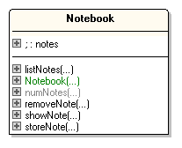
The Notebook Class Diagram
My class diagram generation tool, essmodel, doesn't handle generic collections correctly

Slide 47
Using Notebook
public class NotebookDemo
{
public static void main(String[] args)
{
Notebook book = new Notebook();
System.out.println("Store note: \"Teaching maths\"");
book.storeNote("Teaching maths");
System.out.println("Store note: \"Teaching Java\"");
book.storeNote("Teaching Java");
System.out.println("No. of notes: " + book.numNotes()); :

Slide 48
System.out.println("Note 1: ");
book.showNote(1);
System.out.println("Note 2: ");
book.showNote(2);
System.out.println("All notes: ");
book.listNotes();
System.out.println("Remove Note 0");
book.removeNote(0);
System.out.println("No. of notes: " + book.numNotes());
System.out.println("All notes: ");
book.listNotes();
} // end of main()
} // end of NotebookDemo class

Slide 49
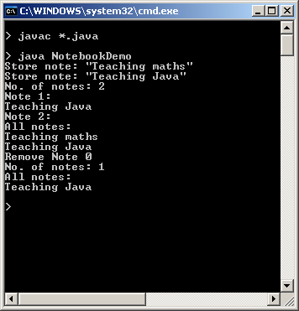
Execution

Slide 50
6. Iteration (looping)
We often want to perform some actions an arbitrary number of times.
e.g., print all the notes in the notebook
Java has several sorts of loop statement
familiar ones: for, while, do-while
new one: for-each

Slide 51
listNotes() using 'while'
compare with the
for-each version
on slide 37
public void listNotes()
{
int index = 0;
while(index < notes.size()) {
System.out.println(notes.get(index));
index++;
}
}
while the value of index is less than the size of the collection, print the next note, and then increment index

Slide 52
for-each versus while
for-each:
easier to write
safer: it's guaranteed to finish
while:
processing order can be varied
'while' can be used with data structures other than collections
take care: a 'while' loop can go into an infinite loop (never stops)

Slide 53
'While' Without a Collection
// print all even integers from 0 to 30
int index = 0;
while(index <= 30) {
System.out.println(index);
index = index + 2; // steps of 2
}

Slide 54
Searching a Collection
public int findNote(String searchString) {
int index = 0;
while(index < notes.size()) {
String note = notes.get(index);
if(note.contains(searchString))
return index;
index++;
}
return -1; // used to indicate failure
}
contains() is from the String class

Slide 55
Iterators
The 'while' loop requires that the data structure have an index, so that different elements can be accessed
e.g. array[index], notes.get(index)
Many data structures don't have indicies
e.g. trees, graphs
so it's not easy to search them with 'while'
iterators are the solution

Slide 56
Using an Iterator Object
java.util.Iterator
returns an Iterator object
Iterator<ElementType> it = myCollection.iterator();
while(it.hasNext()) {
call it.next() to get the next object
do something with that object
}
compare with the
for-each and while versions
on slides 37 and 45
public void listNotes()
{
Iterator<String> it = notes.iterator();
while(it.hasNext())
System.out.println(it.next());
}
continued

Slide 57
All collection classes (e.g. ArrayList) provide special Iterator objects that provide sequential access to the whole collection.
Test for a 'next' element with hasNext()
Get 'next' element with next()

Slide 58
Comparing for-each, 'while' and Iterator
Ways to iterate over a collection:
for-each loop
use if we want to process every element from start to finish
while loop
use if we want to vary the processing order
use for repetition that doesn't involve a collection
Iterator object
often used with collections where indexed access is not very efficient, or impossible

Slide 59
7. An Auction Example
An auction consists of a list of lots (things to sell). A lot may include a bid.
auction
ArrayList of Lot objects
. . . .
idNum
Bid object
Lot
object
description
highest Bid
bidderName
or null
value

Slide 60
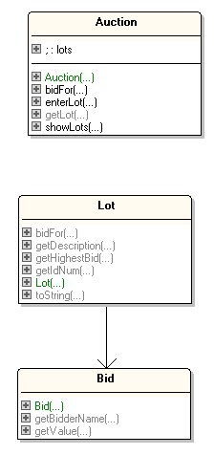
The Auction Class Diagrams
uses
uses

Slide 61
Using Auction
public class AuctionDemo
{
public static void main(String[] args)
{
Auction auc = new Auction();
System.out.println("Add lot 5: \"Amazing Fantasy 15\"");
auc.enterLot(5, "Amazing Fantasy 15");
System.out.println("Add lot 6: \"FF 1\"");
auc.enterLot(6, "FF 1");
System.out.println("Add lot 2: \"Xmen 5\"");
auc.enterLot(2, "Xmen 5"); :

Slide 62
System.out.println("Current lots");
auc.showLots();
System.out.println("ad bids 100 for lot 5");
auc.bidFor(5, "ad", 100);
System.out.println("klc bids 25 for lot 6");
auc.bidFor(6, "klc", 25);
System.out.println("ad bids 10 for lot 6");
auc.bidFor(6, "ad", 10);
System.out.println("klc bids 101 for lot 5");
auc.bidFor(5, "klc", 101);
System.out.println("Lot 5 info: " + auc.getLot(5));
System.out.println("Current lots");
auc.showLots();
} // end of main()
} // end of AuctionDemo class

Slide 63
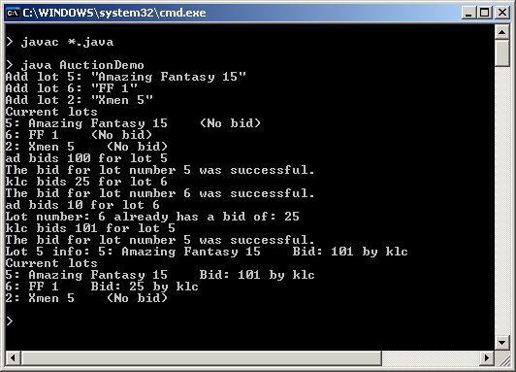
Execution

Slide 64
The Auction Class
(partial)
an anonymous
object (one with no variable name)
public class Auction
{
private ArrayList<Lot> lots; // list of lots in the auction
public Auction()
{ lots = new ArrayList<Lot>(); }
public void enterLot(int lotNum, String description)
{ lots.add( new Lot(lotNum, description) ); } // should check uniqueness of lotNum
public void showLots()
{ for (Lot lot : lots)
System.out.println(lot.toString());
}
continued

Slide 65
public Lot getLot(int lotNum)
/* Return the lot with the given number. Return null
if a lot with this number does not exist. */
{
for (Lot lot : lots)
if (lot.getIdNum() == lotNum)
return lot;
// lot with that number not found
System.out.println("Lot number: " + lotNum + " does not exist.");
return null;
} // end of getLot()
: // more methods
} // end of Auction class
null means 'no object'

Slide 66
8. Fixed-size Collections
If the size of the collection is known when the program is being written then the collection can be stored in an array.
Java arrays can store objects or primitive-type values (e.g. ints, chars, floats).

Slide 67
The LogAnalyzer Example
The LogAnalyzer reads in a log file and reports the information grouped into hours.
The log file (weblog.txt) consists of lines of the form:
year month day hour minute

Slide 68
weblog.txt Contents
2007 5 01 00 10
2007 5 01 00 10
2007 5 01 00 19
2007 5 01 01 27
2007 5 01 02 17
2007 5 01 02 28
2007 5 01 02 28
2007 5 01 02 28
2007 5 01 02 28
2007 5 01 02 28
2007 5 01 02 28
2007 5 01 02 51
2007 5 01 05 12
2007 5 01 05 30 : :
year month day hour minute

Slide 69
Using LogAnalyzer
public class LADemo
{
public static void main(String[] args)
{
LogAnalyzer la = new LogAnalyzer();
la.printData();
la.printHourlyCounts(); // hourly output
} // end of main()
} // end of LADemo class

Slide 70
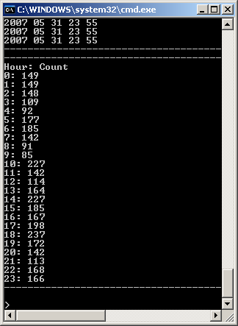
Hourly Output
The output is always grouped into 24 hours, and so can be stored in an array.

Slide 71
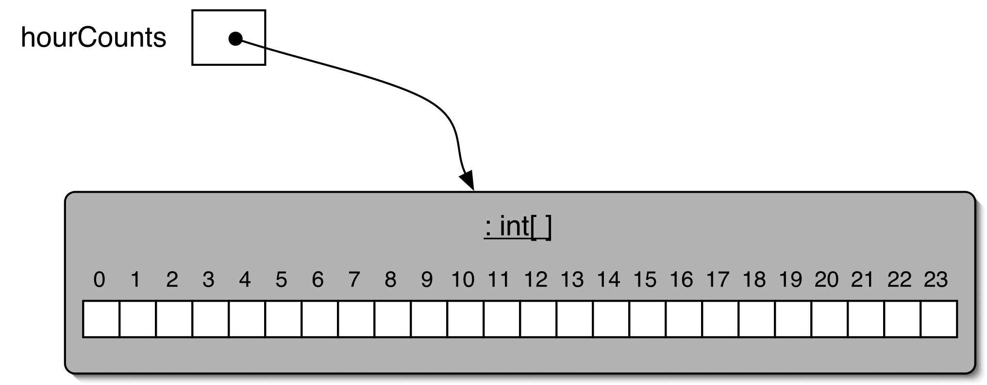
The hourCounts[] Array

Slide 72
The LogAnalyzer Class
public class LogAnalyzer
{
private static final String LOG_FNM = "weblog.txt";
private int[] hourCounts;
private LogfileReader reader;
public LogAnalyzer()
{
hourCounts = new int[24];
reader = new LogfileReader(LOG_FNM);
analyzeHourlyData();
} // end of LogAnalyzer()
Array variable declaration
Array object creation
continued

Slide 73
private void analyzeHourlyData()
{
while (reader.hasMoreEntries()) {
LogEntry entry = reader.nextEntry();
int hour = entry.getHour();
hourCounts[hour]++;
}
} // end of analyzeHourlyData()
continued

Slide 74
public void printHourlyCounts()
{
System.out.println("--------------------------------");
System.out.println("Hour: Count");
for (int hour = 0; hour < hourCounts.length; hour++)
System.out.println(hour + ": " + hourCounts[hour]);
System.out.println("--------------------------------");
} // end of printHourlyCounts()

Slide 75
9. More Information
Java has many tutorials on different topics, and extensive documentation
I asked you to download the Java tutorials and docs along with the SDK at the start of this course

Slide 76
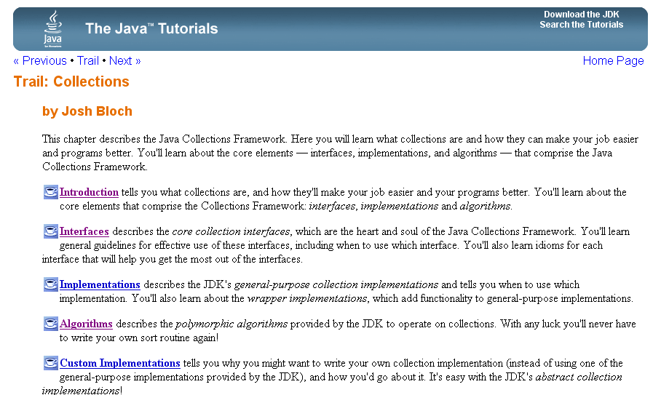
Collections Tutorial

Slide 77
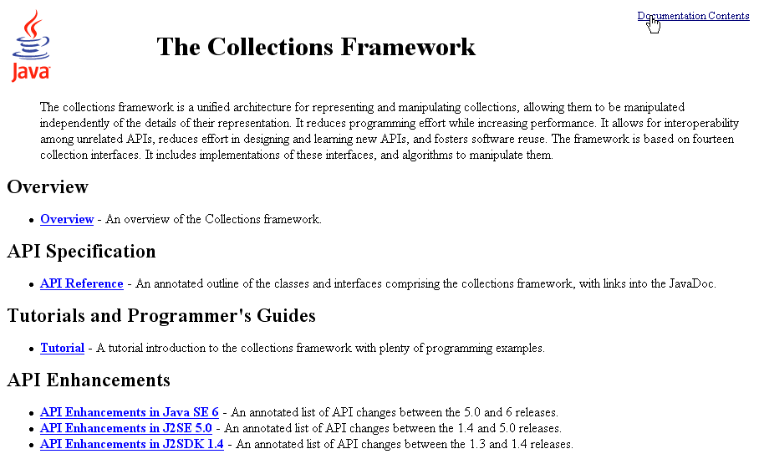
Collections Documentation

Slide 78
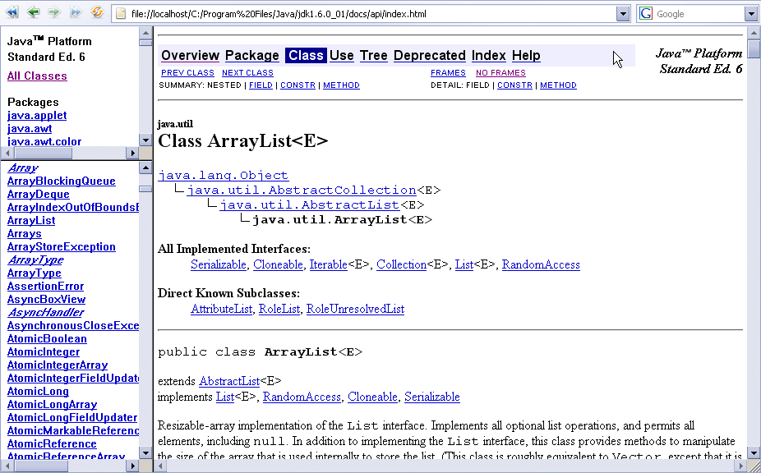
ArrayList Documentation

