Slide 1
242-210 PF II
6. Using Libraries
Objectives
utilize some useful Java libraries
e.g. String, Scanner, HashMap, and Random
Original Slides by Dr. Andrew Davison

Slide 2
Topics
1. The String Class
2. The InputReader Class
3. Reading Input with Scanner
4. Maps

Slide 3
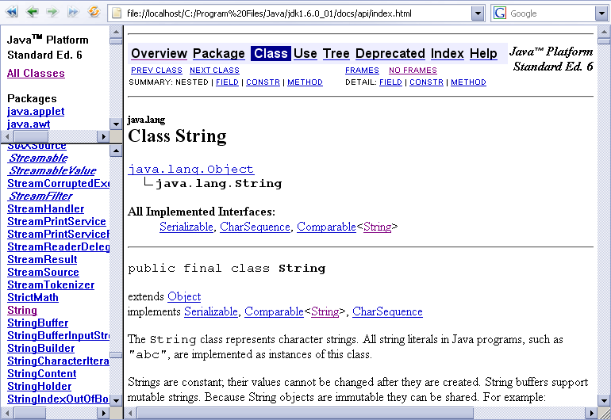
1. The String Class
In the java.lang package

Slide 4
Creating a String Object
Four different ways
(there are more).
1
String color = "blue"; String s1 = new String("hello "); char chs[] = {‘a’, ‘n’, ‘d’, ‘y’}; String s2 = new String(chs); String s3 = s1 + s2 + " davison"; // + is string concatenation
s1
2
"hello "
3
4

Slide 5
Testing Strings for Equality
s1.equals(s2)
lexicographical (dictionary) comparison
returns true if s1 and s2 contain the same text
s1 == s2
returns true if s1 and s2 refer to the same object
Strings should always be compared with equals().
continued

Slide 6
t1
"foo"
t2
String t1 = "foo"; String t2 = "foo";
t1 == t2 returns false since t1 and t2 are different objects
t1.equals(t2) returns true since t1 and t2 contain the same text
"foo"

Slide 7
Comparing Strings
s1.compareTo(s2)
returns 0 if s1 and s2 are equal
returns < 0 if s1 < s2; > 0 if s1 > s2
s1.startsWith("text")
returns true if s1 starts with “text”
s1.endsWith("text")
returns true if s1 ends with “text”

Slide 8
Locating Things in Strings
for text analysis
s1.indexOf('c')
returns index position of first ‘c’ in s1, otherwise -1
s1.lastIndexOf('c')
returns index position of last ‘c’ in s1, otherwise -1
Both of these can also take string arguments:
s1.indexOf("text")

Slide 9
Extracting Substrings
s1.substring(5)
returns the substring starting at index position 5
s1.substring(1, 4)
returns substring between positions 1 and 3
note: second argument is end position + 1

Slide 10
Changing Strings
s1.replace('a', 'd')
return new String object; replace every ‘a’ by ‘d’
s1.toLowerCase()
return new String object where every char has been converted to lowercase
s1.trim()
return new String object where any white space before or after the s1 text has been removed

Slide 11
How do you Change a String?
Any change to a String object creates a new object, but this can be assigned back to the existing String variable.
String w = "foo"; String newW = w + "bar"; w = newW;
or
String w = "foo"; w = w + "bar";
w
"foo"

Slide 12
Other String Methods
There are many more String methods!
e.g. s.length()
Look at the Java documentation for the String class.

Slide 13
Strings and Arrays
String[] msgs = new String[2];
msgs[0] = "hello";
msgs[1] = new String("hi");
String t = msgs[1];
t.toLowerCase();
msgs[1].toLowerCase();
t = msgs[1].toLowerCase();
What is built?
What is changed?

Slide 14
StringBuilder
A StringBuilder object is like a String, but can be modified
its contents are changed in-place through calls such as append(), without the overhead of creating a new object (as happens with String)
The StringBuffer class is similar to StringBuilder but is slower since it can deal with Java threads.
StringBuilder sb = new StringBuilder("Andrew");
sb.append(" Davison");

Slide 15
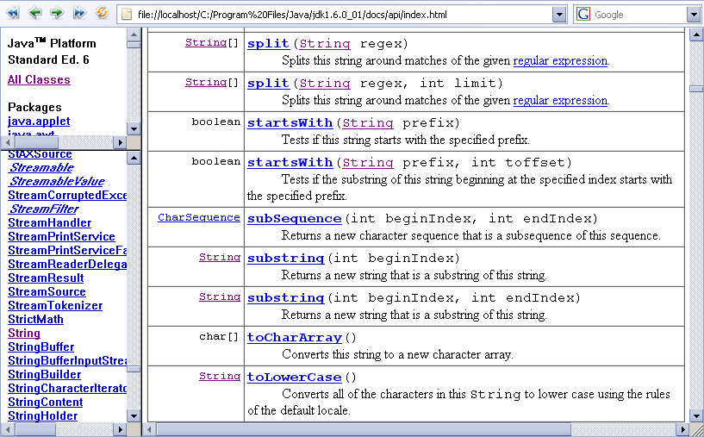
The Java API Docs

Slide 16
2. The InputReader Class
import java.util.*;
public class InputReader
{
private Scanner reader;
public InputReader()
{ reader = new Scanner( System.in ); }
Java's name for
stdin / cin
continued

Slide 17
public String getInput()
// Read a line of text from standard input
{
System.out.print(">> "); // print prompt
String inputLine = reader.nextLine();
return inputLine.trim().toLowerCase(); // trim spaces, and make lowercase
} // end of getInput()
} // end of InputReader class

Slide 18
Combining String Ops
String s1 = " ANDREW "; s1 = s1.trim(); // "ANDREW" s1 = s1.toLowerCase(); // "andrew"
or
String s1 = " ANDREW "; s1 = s1.trim().toLowerCase(); // "andrew"

Slide 19
4. Reading Input with Scanner
The Scanner class reads tokens (words) from an input stream.
The input is broken into tokens based on spaces or regular expressions
the token separator can be changed
The tokens can be Strings, primitive types (e.g. int, float, char, double, boolean), BigIntegers, or BigDecimals.

Slide 20
Read an Integer from the Keyboard
Scanner sc = new Scanner(System.in); int i = sc.nextInt(); sc.close();
You specify the input token type by calling methods like nextInt(), nextDouble(), etc.
continued

Slide 21
The nextXXX() method throws an exception (error) when the input doesn't match the expected token type.
nextXXX() ignores spaces before/after the input.

Slide 22
ConsoleAdd.java
import java.util.Scanner; public class ConsoleAdd { public static void main(String[] args) { Scanner s = new Scanner( System.in ); System.out.print("Enter first integer: ") int x = s.nextInt(); System.out.print("Enter second integer: ") int y = s.nextInt(); s.close(); System.out.println("Adding gives: " + (x+y) ); } } // end of ConsoleAdd class

Slide 23
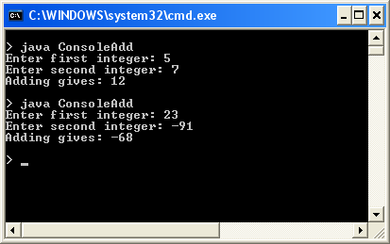
Usage

Slide 24
Read floats from a File
Scanner sc = new Scanner(new File("floats.txt")); while ( sc.hasNextFloat() ) float f = sc.nextFloat(); sc.close();
Scanner supports many nextXXX() and hasNextXXX() methods
e.g. nextBoolean() and hasNextBoolean()
hasNextXXX() returns true if nextXXX() would succeed.

Slide 25
FloatsAdd.java
import java.io.*; import java.util.Scanner; public class FloatsAdd { public static void main(String[] args) { float num; float total = 0.0f; System.out.println("Openning " + args[0]); :

Slide 26
try { Scanner sc = new Scanner( new File(args[0]) ); while ( sc.hasNextFloat() ) { num = sc.nextFloat(); System.out.println(num); total += num; } sc.close(); } catch(FileNotFoundException e) { System.out.println("Error: " + args[0] + " not found"); } System.out.println("Floats total = " + total ); } } // end of FloatsAdd class

Slide 27

floats.txt Input File

Slide 28
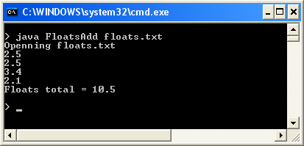
Usage

Slide 29
Extract day and year from a String
String sampleDate = "25 Dec 2007";
Scanner sDate = Scanner.create(sampleDate);
int dom = sDate.nextInt(); // gets 25
String mon = sDate.next(); // gets "Dec"
int year = sDate.nextInt(); // gets 2007
sDate.close();

Slide 30
4. Maps
Maps are collections that contain pairs of objects.
a pair consists of a key and a value
A real-world Map example:
a telephone book
The programmer passes a key to the Map.get() method, and it returns the matching value (or null).
name → phone no.

Slide 31
Using a Map
A HashMap with Strings as keys and values
HashMap
"Charles Nguyen"
"(531) 9392 4587"
"Lisa Jones"
"(402) 4536 4674"
"William H. Smith"
"(998) 5488 0123"
A telephone book

Slide 32
Coding a Map
HashMap <String, String> phoneBook = new HashMap<String, String>();
phoneBook.put("Charles Nguyen", "(531) 9392 4587");
phoneBook.put("Lisa Jones", "(402) 4536 4674");
phoneBook.put("William H. Smith", "(998) 5488 0123");
String phoneNumber = phoneBook.get("Lisa Jones");
System.out.println( phoneNumber );
prints: (402) 4536 4674

