Slide 1
242-210 PF II
7. Inheritance
Objectives
to introduce inheritance, superclasses, subclasses, polymorphic data structures, and wrapper classes
Original Slides by Dr. Andrew Davison

Slide 2
Topics
1. The DoME Example
2. Inheritance Hierarchies
3. DoME using Inheritance
4. Polymorphism
5. The Revised Database Class
6. Classes and Types
7. A Vehicle Example
8. The Object Class
9. Collections and Primitive Types

Slide 3
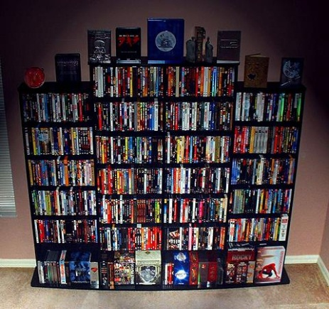
1. The DoME Example
DoME = "Database of Multimedia Entertainment"
The database stores details about CDs and DVDs in ArrayLists
CD: title, artist, no. of tracks, playing time, a got-it, flag, a comment
DVD: title, director, playing time, got-it, comment
The details can be printed.
Notes:
database to store details of all CDs and videos I know

Slide 4
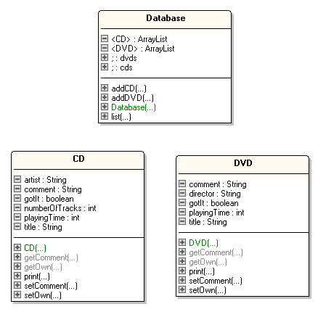
DoME Classes
essModel
cannot display
the ArrayLists
properly
"uses"
Notes:
add the obvious methods (getters and setters); not complete here - just examples
add a print method to print out the details

Slide 5
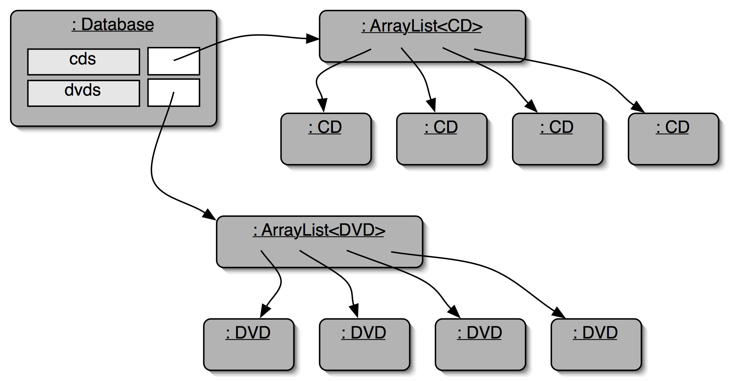
DoME Objects
Notes:
database object will hold two collections: one for CDs, one for videos

Slide 6

The CD Class
public class CD
{
private String title, artist, comment;
private int numberOfTracks, playingTime;
private boolean gotIt;
public CD(String theTitle, String theArtist, int tracks, int time)
{ title = theTitle;
artist = theArtist;
numberOfTracks = tracks;
playingTime = time;
gotIt = false;
comment = null;
} // end of CD()
continued

Slide 7
public void setComment(String com)
{ comment = com; }
public String getComment()
{ return comment; }
public void setOwn(boolean ownIt)
// set the flag indicating whether we own this CD.
{ gotIt = ownIt; }
public boolean getOwn()
// return true if we own a copy of this CD.
{ return gotIt; }
continued

Slide 8
public void print()
// print details about this CD
{
System.out.print("CD: " + title + " (" + playingTime + " mins)");
if (gotIt)
System.out.println("*");
else
System.out.println();
System.out.println(" " + artist);
System.out.println(" tracks: " + numberOfTracks);
if (comment != null)
System.out.println(" " + comment);
} // end of print()
} // end of CD class

Slide 9

The DVD Class
public class DVD
{
private String title, director, comment;
private int playingTime; // playing time of the movie
private boolean gotIt;
public DVD(String theTitle, String theDirector, int time)
{
title = theTitle;
director = theDirector;
playingTime = time;
gotIt = false;
comment = null;
} // end of DVD()
Notice the many
similarities with
the CD class.
continued

Slide 10
public void setComment(String com)
{ comment = com; }
public String getComment()
{ return comment; }
public void setOwn(boolean ownIt)
// set the flag indicating whether we own this DVD.
{ gotIt = ownIt; }
public boolean getOwn()
// return true if we own a copy of this DVD.
{ return gotIt; }
continued

Slide 11
public void print()
// print details about this DVD
{
System.out.print("DVD: " + title + " (" + playingTime + " mins)");
if (gotIt)
System.out.println("*");
else
System.out.println();
System.out.println(" " + director);
if (comment != null)
System.out.println(" " + comment);
} // end of print()
} // end of DVD class

Slide 12

The Database Class
Notice the code
duplication due
to the use of
two ArrayLists.
public class Database
{
private ArrayList<CD> cds;
private ArrayList<DVD> dvds;
public Database()
{ cds = new ArrayList<CD>();
dvds = new ArrayList<DVD>();
}
public void addCD(CD theCD)
{ cds.add(theCD); }
public void addDVD(DVD theDVD)
{ dvds.add(theDVD); }
continued

Slide 13
public void list()
// print a list of all currently stored CDs and DVDs
{
for (CD cd : cds)
cd.print();
for (DVD dvd : dvds)
dvd.print();
} // end of list()
} // end of Database class

Slide 14
Using the DoME Database
public class UseDome1
{
public static void main(String[] args)
{
Database db = new Database();
CD beatles = new CD("the white album", "the beatles",13, 122);
db.addCD( beatles);
beatles.setComment("the best of the later period");
db.addCD( new CD("morrison hotel", "the doors", 11, 109));
db.addCD( new CD("dark side of the moon","pink floyd",9,100));
:
continued

Slide 15
db.addDVD( new DVD("citizen kane", "welles", 97));
DVD drs = new DVD("dr. strangelove", "kubrick", 143);
drs.setComment("what was written on the bomb?");
db.addDVD(drs);
db.addDVD( new DVD("star wars: a new hope", "lucas", 100));
db.list();
} // end of UseDome1()
} // end of UseDome1 class

Slide 16
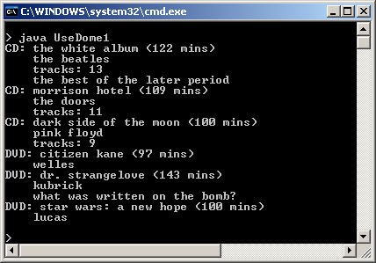
Execution

Slide 17
Problems with DoME's Design
Code duplication: the CD and DVD classes are very similar
it makes maintenance harder
it introduces the danger of bugs
The Database class also suffers from code duplication.
Notes:
we note a lot of code duplication.
this is one problem with this solution (there are others)

Slide 18
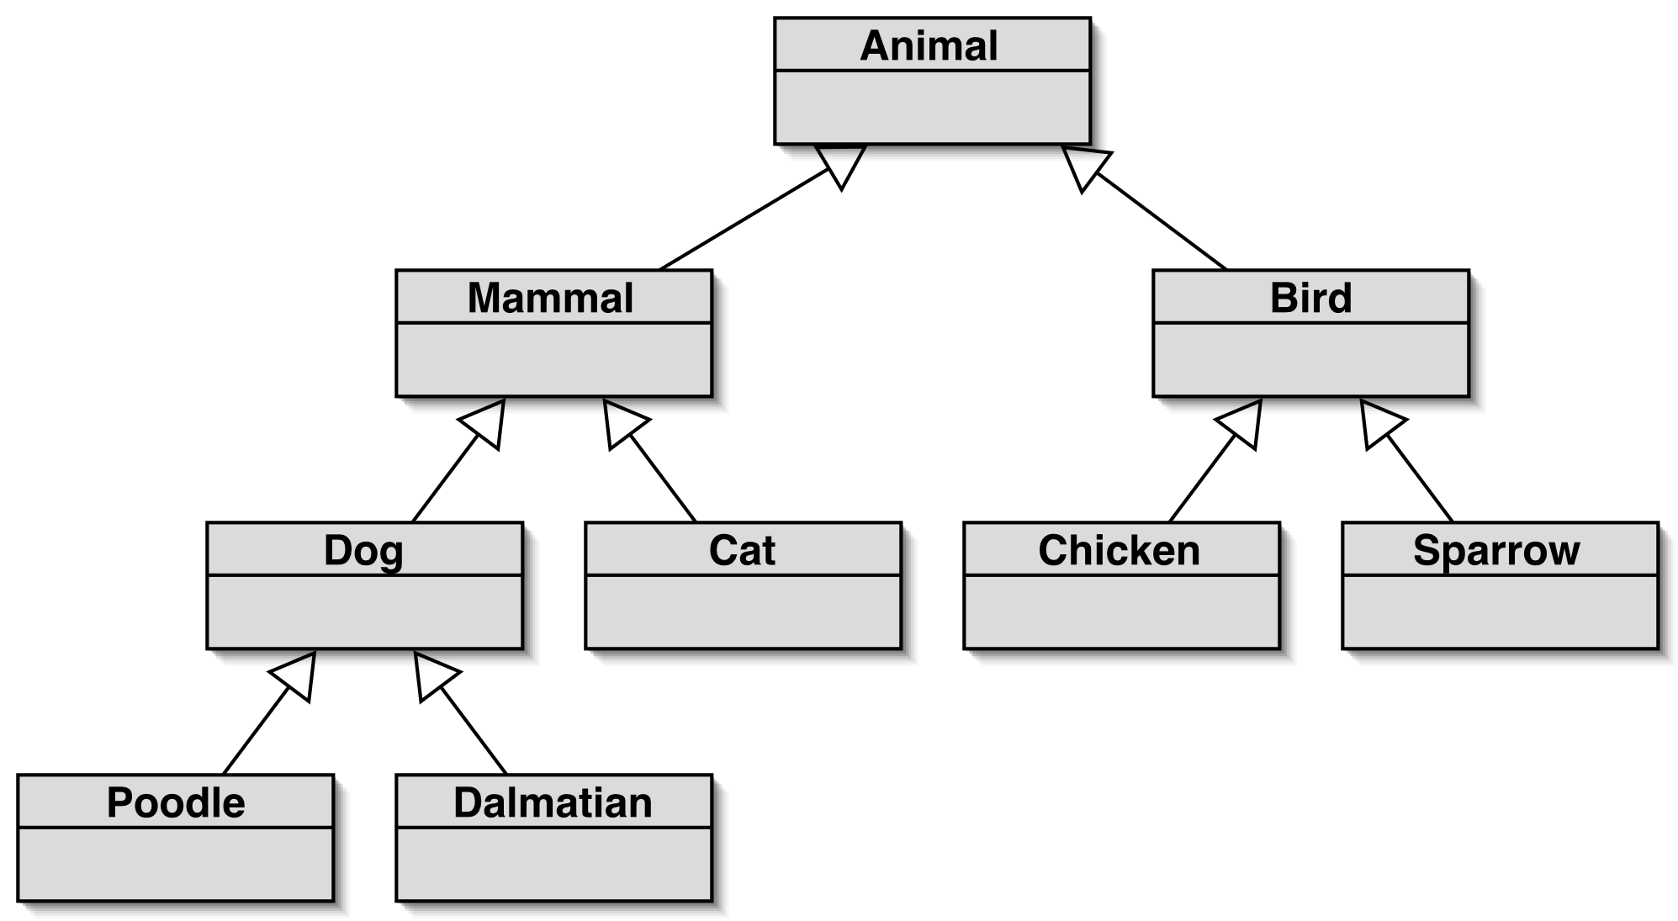
2. Inheritance Hierarchies
"is a"
Notes:
inheritance hierarchies are nothing unusual. we see them all the time.
(a masters student is a students is a person...)

Slide 19
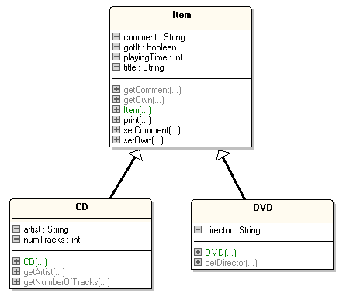


3. DoME using Inheritance
Compare the
fields and
methods with
those for CD
and DVD in
slide 4.
"is a"
Notes:
solution: inheritance. make superclass with common attributes, make subclasses

Slide 20
Inheritance Terminlogy
The Item class is a superclass.
The new versons of the CD and DVD classes are subclasses
the superclass defines fields (attributes) and methods which are inherited by the subclasses
the subclasses add extra fields and methods

Slide 21
The Item Class
public class Item
{
private String title, comment;
private int playingTime;
private boolean gotIt;
public Item(String theTitle, int time)
{
title = theTitle;
playingTime = time;
gotIt = false;
comment = null;
}
Fields and methods
that were common
to the old CD and
DVD classes are
now in the Item
superclass.
continued

Slide 22
public void setComment(String com)
{ comment = com; }
public String getComment()
{ return comment; }
public void setOwn(boolean ownIt)
// set the flag indicating whether we own this item.
{ gotIt = ownIt; }
public boolean getOwn()
// return true if we own a copy of this item.
{ return gotIt; }
continued

Slide 23
public void print()
// print details about this item
{
System.out.print("title: " + title + " (" + playingTime + " mins)");
if (gotIt)
System.out.println("*");
else
System.out.println();
if (comment != null)
System.out.println(" " + comment);
} // end of print()
} // end of Item class

Slide 24
The Revised CD Class
public class CD extends Item
{ private String artist;
private int numTracks;
public CD(String theTitle, String theArtist, int tracks, int time)
{ super(theTitle, time);
artist = theArtist;
numTracks = tracks;
}
public String getArtist()
{ return artist; }
public int getNumberOfTracks()
{ return numTracks; }
} // end of CD class
Much shorter
than the old
CD class.

Slide 25
How is this Line Now Executed?
CD beatles = new CD("the white album", "the beatles",13, 122);

Slide 26
The Revised DVD Class
public class DVD extends Item
{
private String director;
public DVD(String theTitle, String theDirector, int time)
{
super(theTitle, time);
director = theDirector;
}
public String getDirector()
{ return director; }
} // end of DVD class
Much shorter
than the old
DVD class.

Slide 27
How is this Line Executed?
DVD d1 = new DVD("citizen kane", "welles", 97)

Slide 28
Superclass Constructor Call
The subclass constructors should always contain a super() call as the first statement.
CD has 6 fields (4 inherited) and 9 methods (6 inherited)
DVD has 5 fields (4 inherited) and 8 methods (6 inherited),

Slide 29
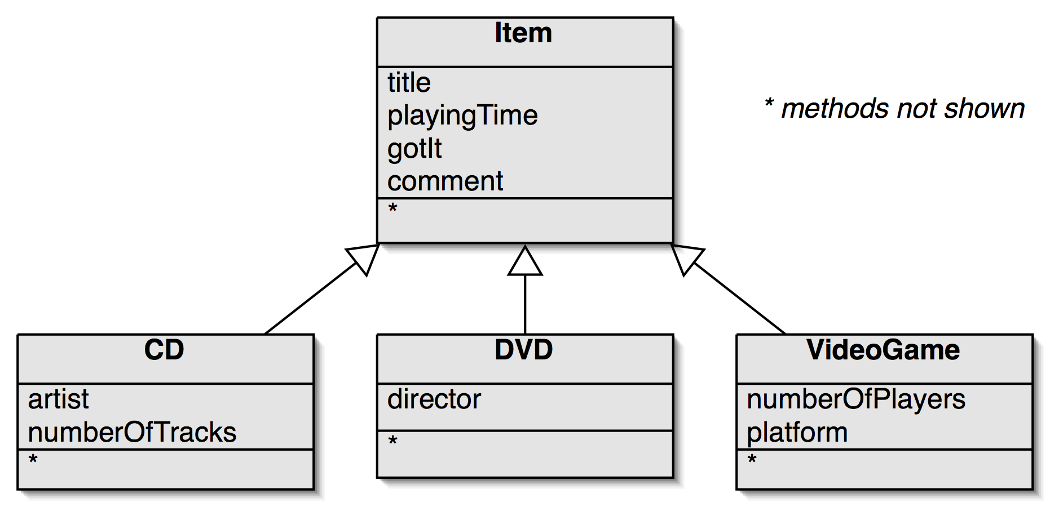

Adding More Item Subclasses
"is a"
continued
Notes:
it is now much easier to add new types.
common attributes do not need to be rewritten.

Slide 30
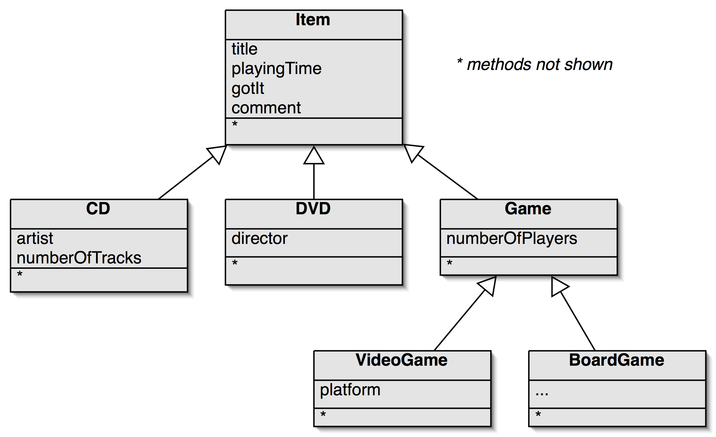


"is a"
Notes:
when adding new types, the hierarchy may be extended

Slide 31
The Benefits of Inheritance
A comparison between the old and new versions of CD and DVD show:
no code duplication
code reuse (of Item)
Inheritance simplifies:
maintenance, extendibility

Slide 32
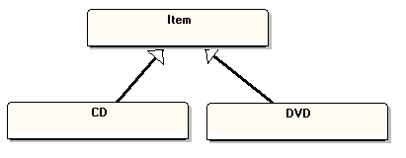
4. Polymorphism
A superclass variable can be assigned any subclass object:
Item a1 = new CD(...);
Item a2 = new DVD(...);
"is a"
continued

Slide 33
This polymorphic feature becomes very useful when a collection (e.g. ArrayList, array, HashMap) is defined using a superclass
the collection can store subclass objects

Slide 34

Polymorphic Data Structures
Normal data structures (e.g. int a[]) can only hold one type of thing (e.g integers).
A polymorphic data structure can hold different types of objects
the trick is to define the data structure using a superclass (e.g. Item)
it can then hold subclass objects (e.g. CD, DVD)

Slide 35
Items ArrayList
: ArrayList<Item> items = new ArrayList<Item>; items.add( new CD(...) ); items.add( new DVD(...) ); items.add( new CD(...) ); items.add( new DVD(...) ); :
any subclass
objects of Item
. . . .
items

Slide 36
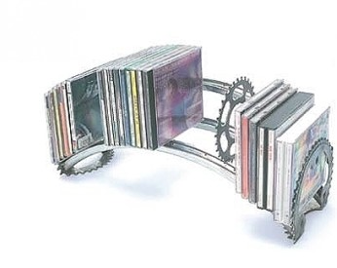
5. The Revised Database Class
import java.util.ArrayList;
public class Database
{
private ArrayList<Item> items;
public Database()
{ items = new ArrayList<Item>(); }
public void addItem(Item theItem)
{ items.add(theItem); }
Only one ArrayList,
and only Item
objects are being
manipulated.
continued

Slide 37
public void list()
// print a list of all currently stored items
{
for (Item item : items)
item.print();
} // end of list()
} // end of Database class
No code duplication
unlike in the old
version of Database.

Slide 38
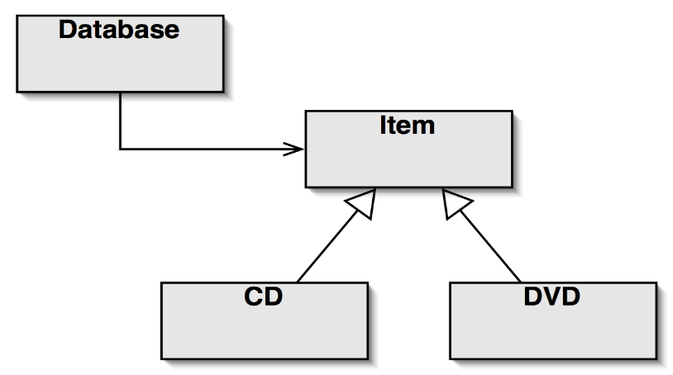
Class Diagram
Why does Database now use Item instead of CD and DVD?
Because Item is a superclass of CD and DVD, which allows Database to manipulate objects of both subclasses.
"uses"
"is a"
Notes:
class diagram is simple (ArrayList not shown in BlueJ)

Slide 39
Changes from the Old Database
Now there is only one ArrayList, which stores Item objects
called a polymorphic data structure
The use of a single ArrayList simplifies the Database methods
no more code duplication due to the use of two ArrayLists for CDs and DVDs

Slide 40
A Polymorphic Interface
The items polymorphic data structure in Database is accessed using methods that take a superclass parameter (i.e. Item)
This means that the methods can accept arguments which are subclass objects (i.e. CD and DVD objects)

Slide 41
Superclass Parameters
In the first Database class:
public void addCD(CD theCD);
public void addVideo(DVD theDVD);
Now, Database has:
public void addItem(Item theItem)
This method is called with:
DVD myDVD = new DVD(...);
database.addItem(myDVD); CD myCD = new CD(...); database.addItem(myCD);
A subclass object can be passed to the Item superclass parameter of addItem().

Slide 42
Using DoME (v.2)
public class UseDome2
{
public static void main(String[] args)
{
Database db = new Database();
CD beatles = new CD("the white album", "the beatles",13,122);
db.addItem(beatles);
beatles.setComment("the best of the later period");
db.addItem(new CD("morrison hotel", "the doors", 11, 109));
db.addItem(new CD("dark side of the moon","pink floyd",9,100)); :
continued

Slide 43
db.addItem(new DVD("citizen kane", "welles", 97));
DVD drs = new DVD("dr. strangelove", "kubrick", 143);
drs.setComment("what was written on the bomb?");
db.addItem(drs);
db.addItem(new DVD("star wars: a new hope", "lucas", 100));
db.list();
} // end of UseDome2()
} // end of UseDome2 class

Slide 44
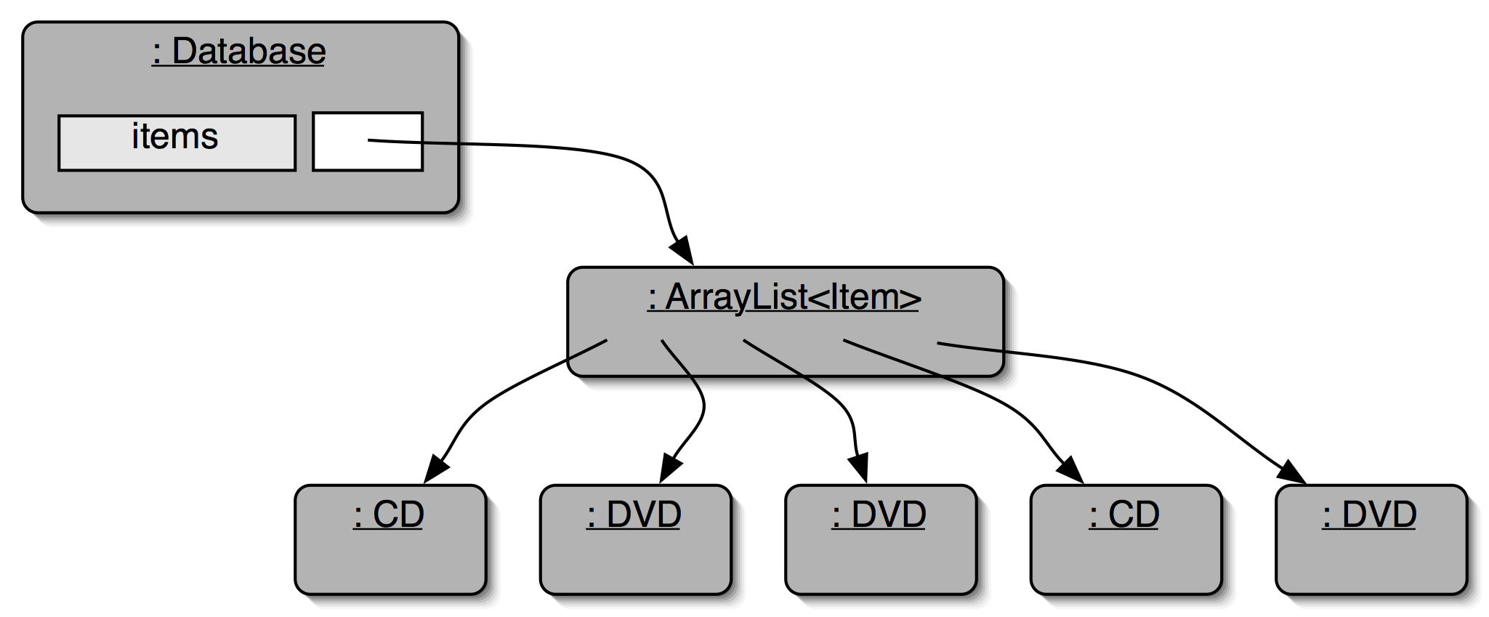
Object Diagram
Compare with the
old version of Database
shown in slide 5.
Notes:
database object will hold two collections: one for CDs, one for videos

Slide 45
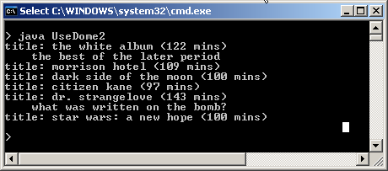
Execution
Compare with
slide 16
There's a 'problem' with this output, which I'll discuss (and fix) in Part 9.

Slide 46
6. Classes and Types
Sometimes classes can be thought of as new types:
superclasses are supertypes
subclasses are subtypes
Subclass (subtype) objects can be assigned to superclass (supertype) variables.

Slide 47
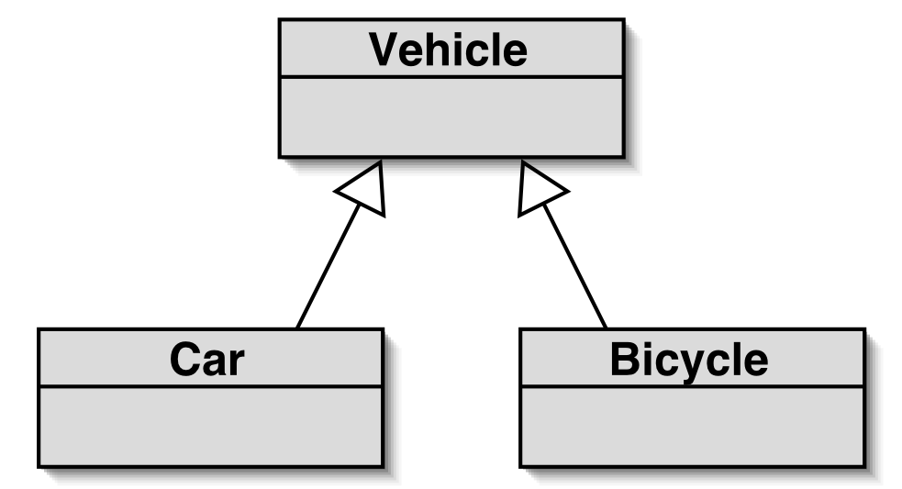
7. A Vehicle Example
Vehicle is a superclass, with subclasses for different types of vehicles.
wheels, seats
"is a"
an engine
a bell

Slide 48
A Vehicle Array
This time the
polymorphic data
structure is an array.
: Vehicle vs[] = new Vehicle[100]; vs[0] = new Bicycle(...); vs[1] = new Car(...); vs[2] = new Bicycle(...); vs[3] = new Car(...); :
any subclass object
of Vehicle
. . . .
vs

Slide 49
One-way Casting
We can assign subclass objects to superclass variables:
Vehicle v = new Bicycle(...); // ok
Ok since a bicycle has all the features of a vehicle, and some extra ones (e.g. a bell) which do not matter.
continued

Slide 50
In general, we cannot assign superclass objects to subclass variables:
Bicycle b = new Vehicle(...); // compile-time error
An error since a vehicle does not have all the features of a bicycle (e.g. no bell).

Slide 51
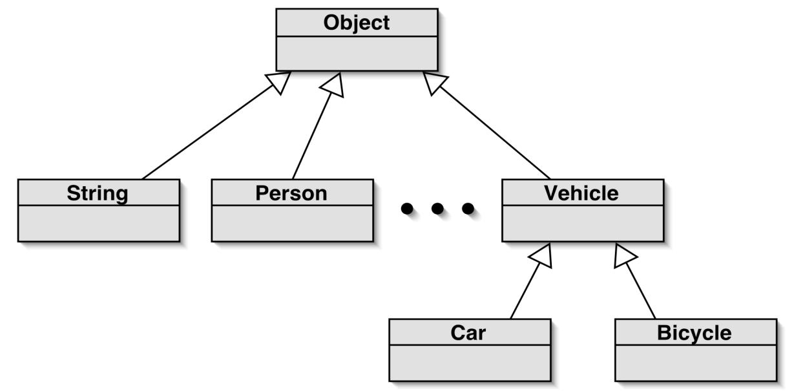
8. The Object Class
All classes are subclasses of the Object class
Object is a sort of "super-grandfather" of every class
"is a"
All classes inherit from Object.
continued

Slide 52
This means that a collection (ArrayList, array, etc) of type Object can store any kind of object:
ArrayList<Object> list = new ArrayList<Object>();
list.add( "andrew" );
list.add( new CD(...) );
list.add( new Bike(...) );

Slide 53
9. Collections and Primitive Types
Objects can be added to a collection.
But what about variables of primitive types, (which are not objects)?
e.g. int x; float f; char ch;

Slide 54

Wrapper Classes
Primitive types (int, char, etc) are not classes.
a primitive variable must be wrapped up as an object
Wrapper classes exist for all primitive types:
Primitive type Wrapper class
int Integer
float Float
char Character
... ...

Slide 55
Using Wrapper Classes
ArrayList<Integer> markList = new ArrayList<Integer>();
int mk = 72;
Integer iwrap = new Integer(mk);
markList.add(iwrap);
. . .
Integer iObj = markList.get(0);
int value = iObj.intValue();
wrap var
(int --> Integer)
unwrap it
(Integer --> int)
In practice, autoboxing and unboxing mean we don't often have to do this.

Slide 56
Autoboxing and Unboxing
ArrayList<Integer> markList = new ArrayList<Integer>();
int mk = 72;
markList.add(mk);
autoboxing: int --> Integer
. . .
int value = markList.get(0);
unboxing: Integer --> int

