Slide 1
242-210 F II
Semester 2, 2012-2013
8. More on Inheritance
Objectives
the use of super, overriding, method polymorphism (dynamic binding), protected access, toString()
Original Slides by Dr. Andrew Davison

Slide 2
Topics
1. Students Example
2. Method Polymorphism
3. Extends and Private
4. DoME v.2 Output Problem
5. The Object Class's Methods

Slide 3
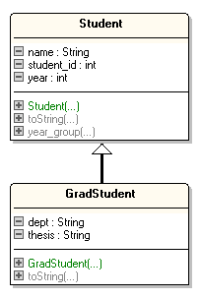


1. Students Example
Develop a class called Student
Use it to define a subclass called GradStudent

Slide 4
Student.java
continued
public class Student { private int student_id; private int year; private String name;
public Student(String nm, int id, int y) { name = new String(nm); student_id = id; year = y; }

Slide 5
public String toString() { return "Student: " + name + ", " + student_id + ", " + year; } public int year_group() { return year; } } // end of Student class

Slide 6
GradStudent.java
public class GradStudent extends Student { private String dept; private String thesis; // constructor public GradStudent(String nm, int id, int y, String d, String th) { super(nm, id, y); // call superclass constructor dept = new String(d); thesis = new String(th); }
continued

Slide 7
public String toString() { return "Grad " + super.toString() + ", " + dept + ", " + thesis; } } // end of GradStudent class

Slide 8
TestStuds.java
public class TestStuds { public static void main(String args[]) { Student s1 = new Student("Jane Doe", 100, 1); GradStudent gs1; gs1 = new GradStudent("John Smith", 200, 4, "Pharmacy", "Retail Thesis"); :
continued

Slide 9
System.out.println("Student s1"); System.out.println(s1.toString()); System.out.println("Year " + s1.year_group() + "\n"); System.out.println("GradStudent gs1"); System.out.println(gs1.toString()); System.out.println("Year " + gs1.year_group() + "\n"); : // see later } } // end of TestStuds class

Slide 10
Compilation and Execution
$ javac Student.java $ javac GradStudent.java $ javac TestStuds.java $ java TestStuds

Slide 11
TestStuds Output
$ java TestStuds Student s1 Student: Jane Doe, 100, 1 Year 1 Grad student gs1 GradStudent: John Smith, 200, 4, Pharmacy, Retail Thesis Year 4 : // see later

Slide 12

Objects Diagrams
Student s1
GradStudent gs1
student_id
100
student_id
200
year
1
year
4
name
“Jane Doe”
name
“John Smith”
Student object
dept
“Pharmacy”
thesis
“Retail Thesis”
GradStudent object

Slide 13
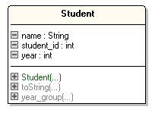
Method Lookup for s1.toString()
Student s1
Student
object
instance of

Slide 14
Method Lookup for gs1.toString()
GradStudent gs1
GradStudent
object
instance of
Overriding: use the first version of toString() found in the inheritance hierarchy.

Slide 15
Super Calls in Methods
Overridden methods are hidden ...
... but we still want to be able to call them.
An overridden method can be called from the method that overrides it with:
super.method(...)
compare with the use of super in constructors

Slide 16
Method Lookup for gs1.year_group()
GradStudent gs1
GradStudent
object
instance of
Move up the inheritance
hierarchy until a suitable
method is found.

Slide 17
TestStuds.java Continued
: Student stud; stud = gs1; // refer to subclass System.out.println("Student stud"); System.out.println( stud.toString() ); System.out.println("Year " + stud.year_group()); } } // end of TestStuds class

Slide 18
Objects Diagram
student_id
200
GradStudent gs1
year
4
Student stud
name
“John Smith”
dept
“Pharmacy”
gs1 and stud refer
to the same object
thesis
“Retail Thesis”
GradStudent object

Slide 19
Output
Student stud Grad Student: John Smith, 200, 4, Pharmacy, Retail Thesis Year 4
Even though stud is of type Student, it can refer to a GradStudent object
because GradStudent is a subclass of Student

Slide 20
Method Lookup of stud.toString()
Student stud
GradStudent
object
instance of
Overriding again: use the first version found.

Slide 21
2. Method Polymorphism
A superclass variable can store subclass objects.
Method calls are polymorphic:
the chosen method depends on the object
often called dynamic binding since the choice of method is made at run-time

Slide 22
Method Polymorphism Example
Student stud; GradStudent g; PostGradStudent p; : stud = new Student(); stud.toString(); // which toString()? val = // some input number if (val == 1) stud = g; else stud = p; stud.toString(); // which toString()?

Slide 23
The toString() method used by stud will vary over time
initially it will be the one in Student
later, depending on the value of val, it will be the method in GradStudent or PostGradStudent
the JVM can only choose the right class when the code is executed (i.e. at run-time)

Slide 24
3. Extends and Private
continued
Student has three private variables (student_id, name, year) which are inherited by GradStudent
what does this mean?
Private variables in a superclass cannot be directly seen or changed by a subclass.

Slide 25
This means that methods in the GradStudent class cannot directly see or change student_id, name, or year
how can they be seen/changed?
A better object diagram:
student_id
200
year
4
GradStudent gs1
name
“John Smith”
dept
“Pharmacy”
thesis
“Retail Thesis”
continued

Slide 26
The creator of a class with private variables can also include public get/set methods for them:
public class Student { private String name: : public String getName() { return name; } public void setName(String n) { name = n; } : }
A bad design
choice.
continued

Slide 27
Usage in GradStudent.java:
public String changeName(...) { String name = getName(); // change name in some way setName( name ): }
In the user’s code:
GradStudent gs = new GradStudent(…); gs.setName(“andy”);
probably a bad idea
to allow this
continued

Slide 28
Public get/set methods allow subclasses to see/change private variables, but they also can be used by users
this solution destroys the interface
that's why it's a bad design choice
The better solution is to use protected.

Slide 29
Protected Variables
Better, but still
not the best design
choice.
The protected variables of a superclass can be accessed by methods in subclasses
(and by other classes in the package)
but they are private to users of the class
this level of visibility is between public and private

Slide 30
Example
public class Student { private int student_id; private int year; protected String name; : }
Now GradStudent can use name directly, but cannot see/change student_id or year:
name = "andrew"; // in GradStudent
Users of Student cannot see/change any of the variables.

Slide 31
Protected Methods
The best design
choice.
The best approach is to use protected get/set methods for a private variable:
public class Student { private String name; // stays private : protected String getName() { return name; } protected void setName(String n) { name = n; } : }

Slide 32
Protected methods hide the implementation of name from GradStudent
the interface is maintained
Protected methods cannot be called by the users of Student or GradStudent.

Slide 33
Summary of the Approaches
How do we make inherited private data accessible to subclass methods?
Three approaches:
public methods
exposes inherited class to user; bad
protected variables
variables only visible to subclass, but subclass sees implementation; not good
protected methods
best

Slide 34
4. DoME v.2 Output Problem
CD: A Swingin' Affair (64 mins)*
Frank Sinatra
tracks: 16
my favourite Sinatra album
DVD: O Brother, Where Art Thou? (106 mins)
Joel & Ethan Coen
The Coen brothers’ best movie!
What we get
in DoME v.1
title: A Swingin' Affair (64 mins)*
my favourite Sinatra album
title: O Brother, Where Art Thou? (106 mins)
The Coen brothers’ best movie!
What we get in DoME v.2
Some information isn't printed

Slide 35
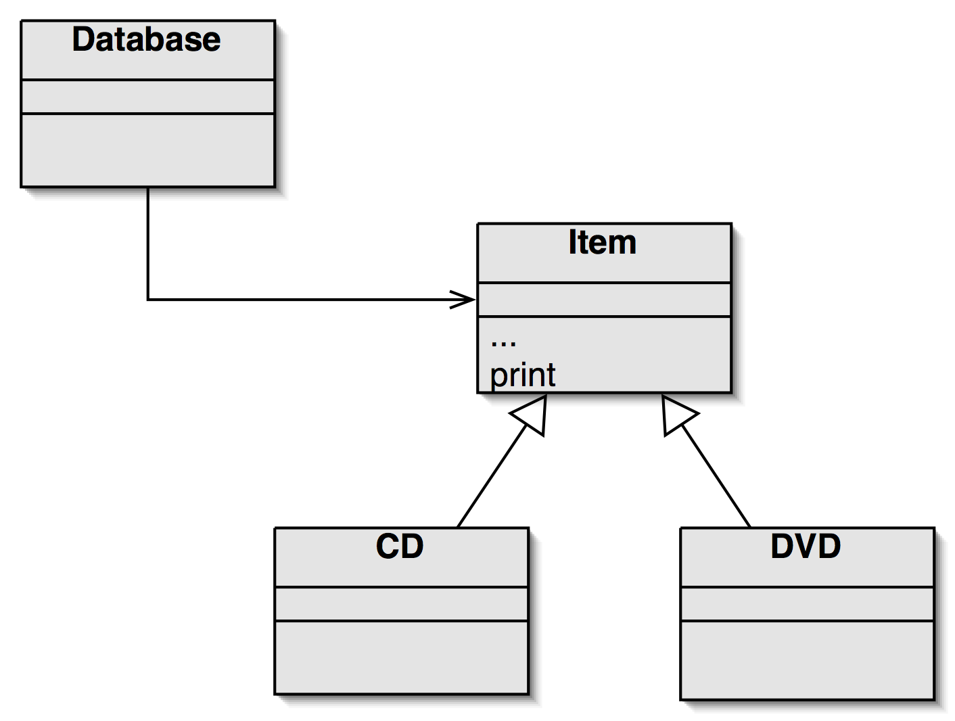
The Inheritance Hierarchy
uses
At runtime, a call to
print() will use
Item.print().
is a

Slide 36
The Reason for the Problem
The print() method in Item only prints the fields defined in Item.
Inheritance only works 'upwards':
a subclass inherits its superclass fields and methods
The superclass method (e.g. print()) knows nothing about its subclass’s fields or methods.

Slide 37
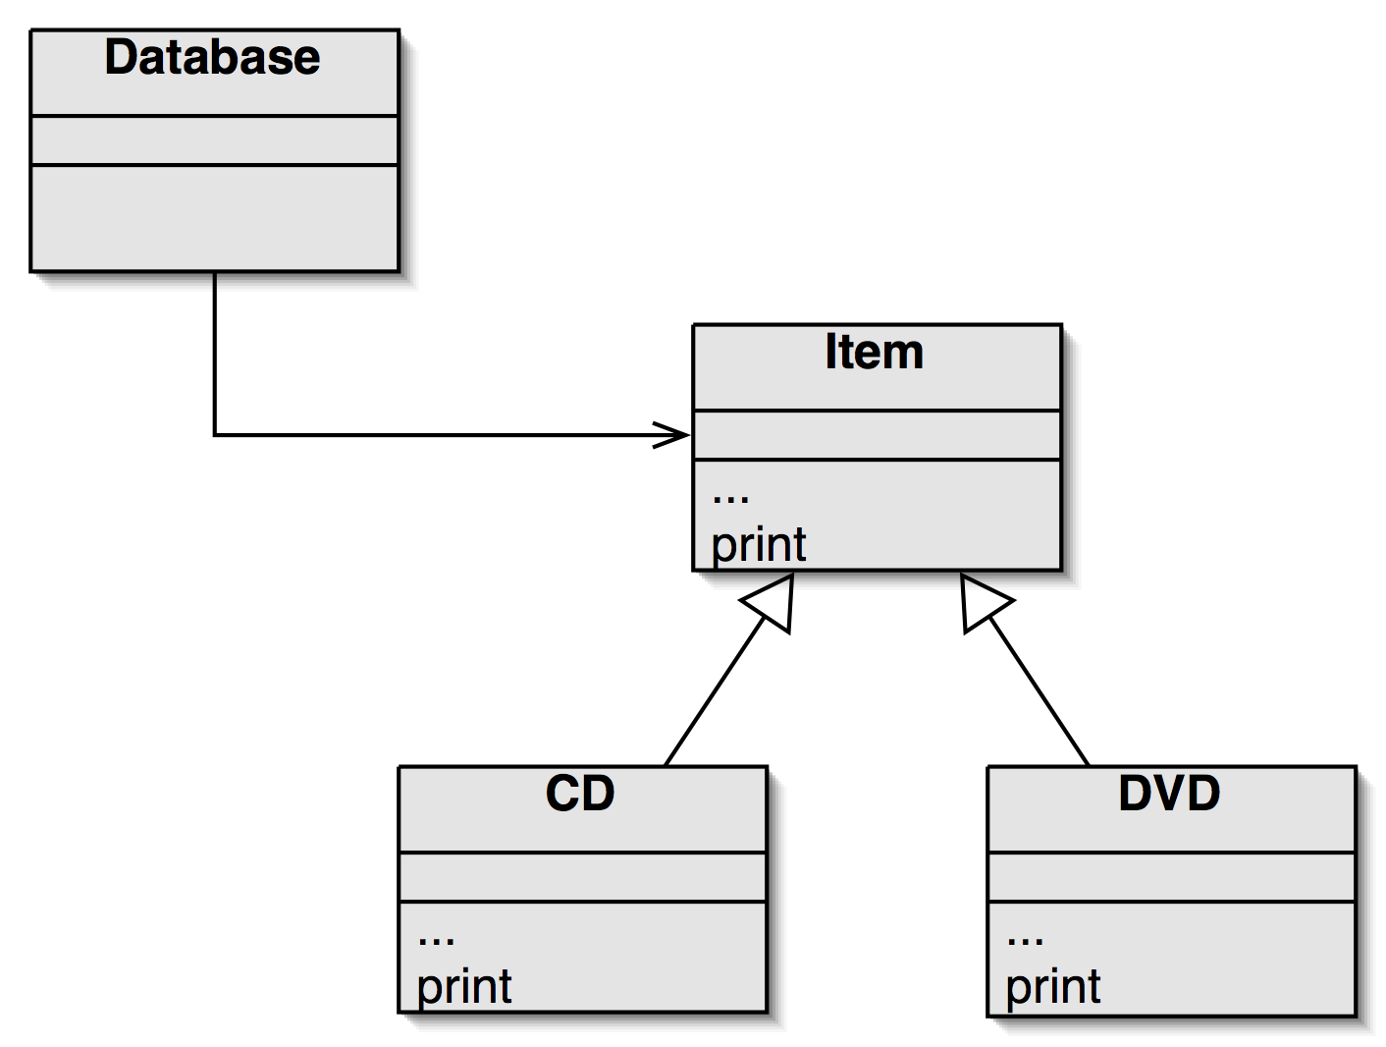
The Solution: Overriding
print() in super- and subclasses.
uses
CD and DVD print() will use super.print() to print the Item info
is a
At runtime, a call to
print() will use either
CD.print() or DVD.print() .

Slide 38
CD's print()
// in the CD class
public void print()
{
System.out.println("CD: " + artist);
System.out.println("tracks: " + numTracks); super.print(); // print info stored in Item
}

Slide 39
5. The Object Class’s Methods
Methods in Object are inherited by all classes.
any of these may be overridden
The toString() method is often overridden
public String toString()
returns a string representation of the object

Slide 40
Overriding toString()
public class Item
{
:
public String toString()
{
String info = title + " (" + playingTime + " mins)");
if(gotIt)
return info + "*\n" + " " + comment + "\n");
else
return info + "\n" + " " + comment + "\n");
} // end of toString()
} // end of Item class

Slide 41
Using toString()
Instead of a print() method use toString():
System.out.println( item.toString() );
println() will call an object's toString() method automatically, so the above call can be simplified to:
System.out.println( item );

