Slide 1
242-210 F II
Semester 2, 2012-2013
9. More Abstraction Techniques
Objectives
use a foxes-and-rabbits simulation to introduce abstract classes, interfaces, and multiple inheritance

Slide 2
Topics
1. Benefits of Simulation
2. Foxes and Rabbits Simulation
3. Improving the Code
4. Further Abstractions
5. From Abstract to Interface
6. Why Have Interface Types?

Slide 3



1. Benefits of Simulation
Use to make predictions:
the weather, the stock market, traffic systems, nuclear processes
Allows experimentation
safer, cheaper, quicker
Example:
‘How will the wildlife be affected if we build a road through a park?’

Slide 4
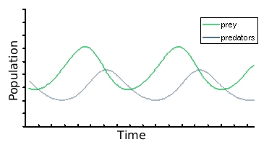

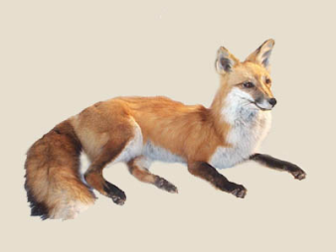
Predator-prey Simulations
There is often a natural balance between wild animals which varies over time.
e.g. rabbits
e.g. foxes

Slide 5
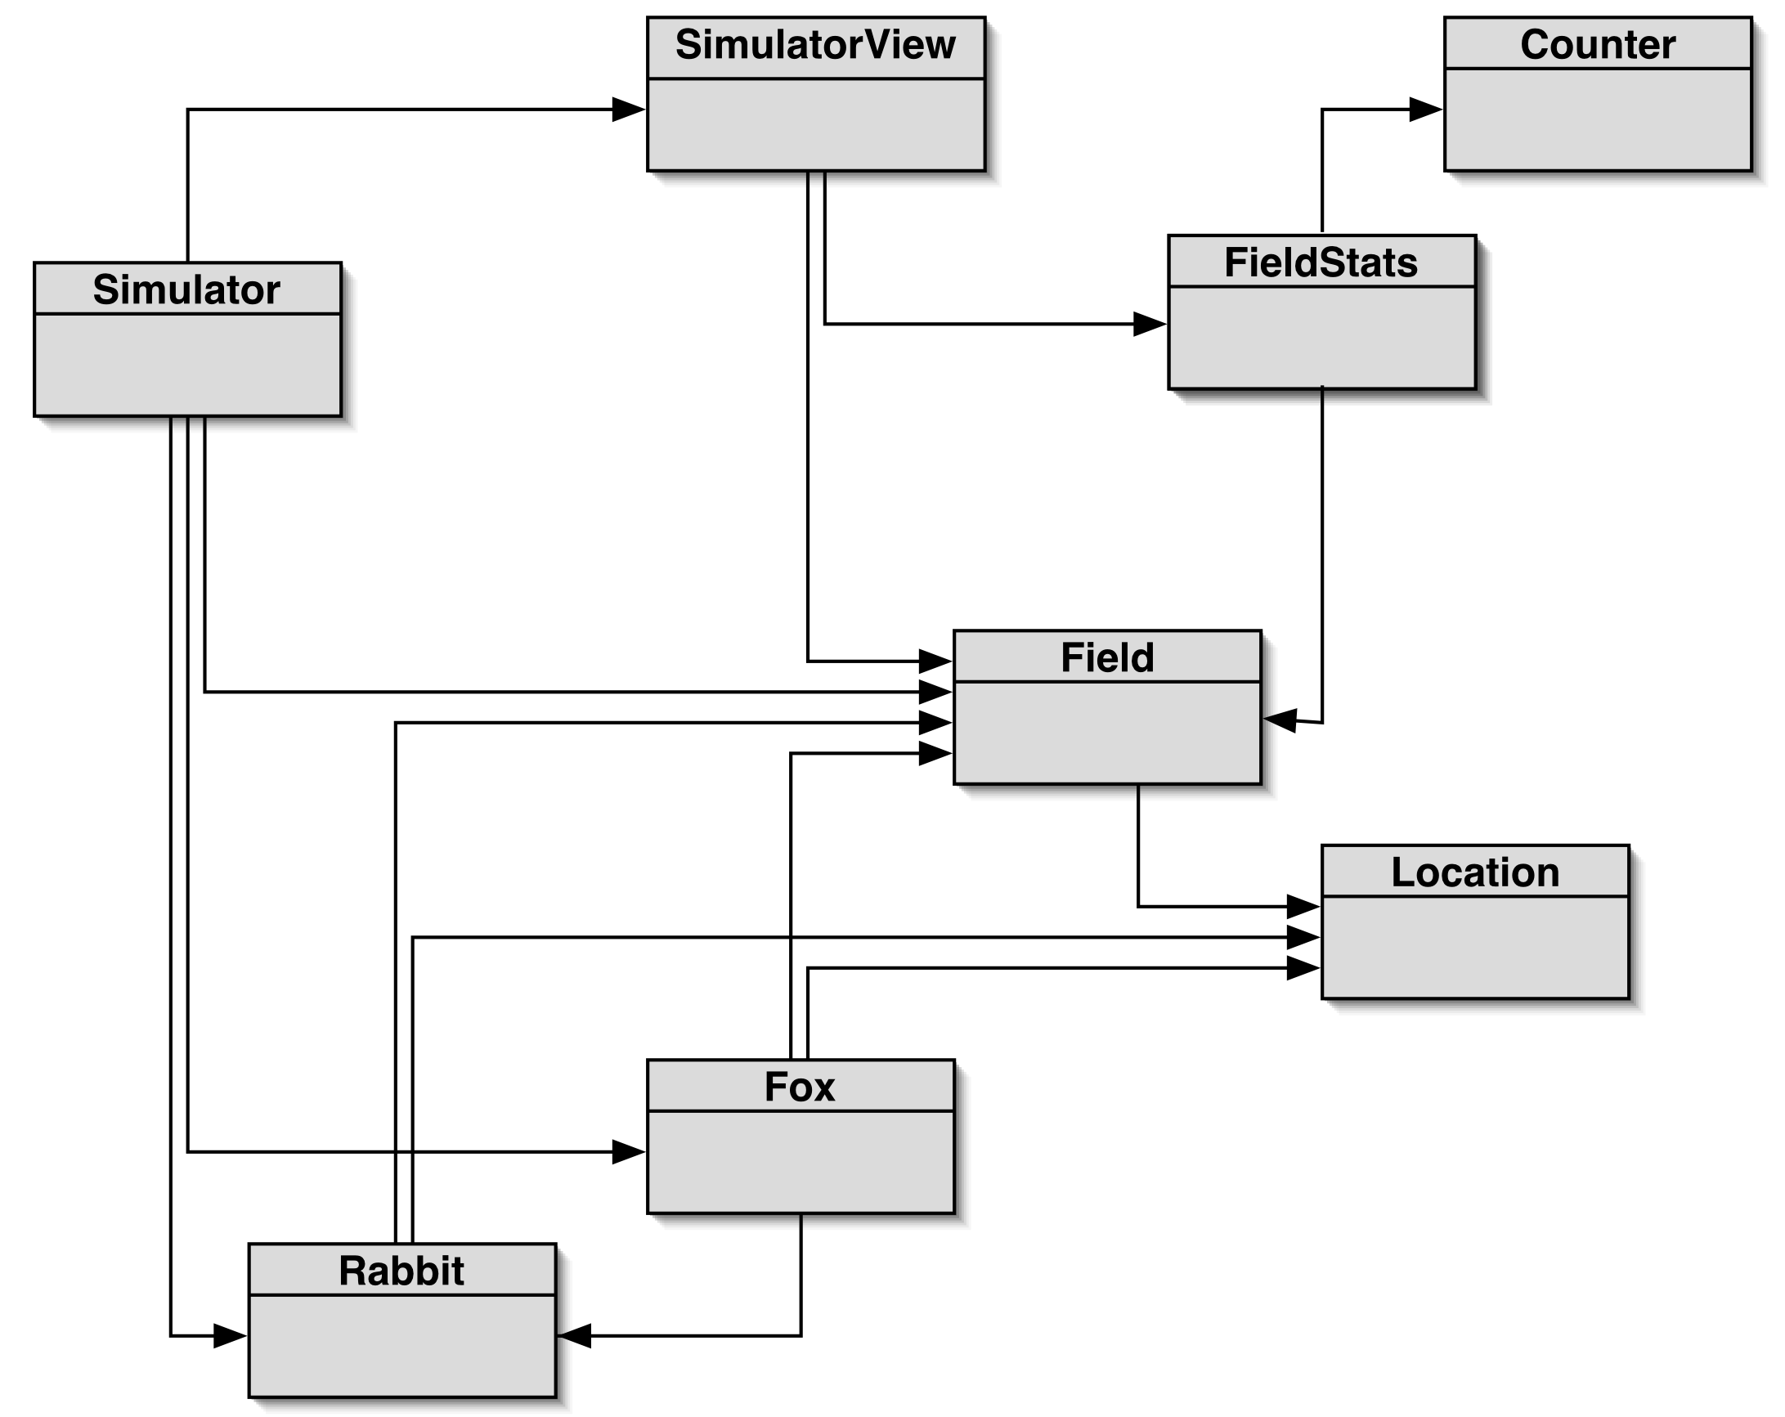
2. Foxes and Rabbits Simulation
Version 1
application
details are not
important

Slide 6
The Important Classes
Fox
for simulating foxes (the predators)
Rabbit
for simulating rabbits (the prey)
Simulator
manages the overall simulation
holds collections of foxes and rabbits

Slide 7
The Remaining Classes
Field
the field where the foxes and rabbits live, breed, get eaten, die
Location
a 2D position in the field
SimulatorView
a graphical view of the field
FieldStats, Counter
calculates statistics shown in the GUI

Slide 8
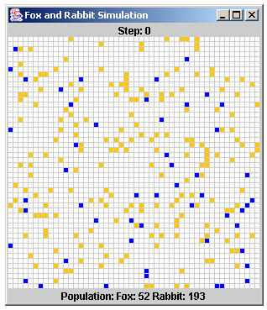
SimulatorView Visualization
Rabbits =
orange/yellow
Foxes = blue

Slide 9
2.1. Simulating Rabbits and Foxes
The Simulator object sets up the field, and creates an initial mix of rabbits and foxes.
Simulator then enters a loop, which advances the simulation one step at a time
in each step, all the rabbits and foxes are updated by calling their 'behaviour' methods

Slide 10

A Rabbit’s State
public class Rabbit
{
// constants . . .
private int age;
private boolean alive; // alive or not?
private Location location; // position in field
// methods . . .
}

Slide 11

A Rabbit’s Behaviour
Implemented in Rabbit.act():
a rabbit gets older when act() is called
it may die of old age
a rabbit may create new rabbits
a rabbit tries to move to an empty adjacent square in the field
overcrowding will kill a rabbit

Slide 12
Rabbit.act()
The details are not
important.
public void act(Field updatedField, List<Rabbit> newRabbits)
/* A rabbit breeds, moves about, or dies of old age or overcrowding. */
{
incrementAge(); // may die
if (isAlive) {
int numBirths = breed(); // have rabbit breed
for (int b = 0; b < numBirths; b++) {
Rabbit newRabbit = new Rabbit(false); //create new rabbit
newRabbits.add(newRabbit);
Location loc = updatedField.randomAdjLoc(location);
newRabbit.setLocation(loc);
updatedField.place(newRabbit, loc); // put rabbit in field
} :
continued

Slide 13
// try to move this rabbit
Location newLoc = updatedField.freeAdjLoc(location); // find a new location
if (newLoc != null) { // if new location is free
setLocation(newLoc);
updatedField.place(this, newLoc);
}
else // can't move - so die due to overcrowding
isAlive = false;
}
} // end of act()

Slide 14

A Fox’s State
public class Fox
{
// constants . . .
private int age;
private boolean alive; // alive or not?
private Location location; // position in field
private int foodLevel; // increased by eating rabbits
// methods . . .
}

Slide 15

A Fox’s Behavior
Implemented in Fox.act():
a fox gets older and hungrier when act() is called
it may die of old age or hunger
a fox may create new foxes
a fox tries to move to a food (rabbit) location or an empty adjacent square in the field
overcrowding will kill a fox

Slide 16
Fox.act()
The details are not
important.
public void act(Field currentField, Field updatedField, List<Fox> newFoxes)
/* A fox breeds, moves about looking for food,
or dies of old age, hunger, or overcrowding. */
{
incrementAge(); // may die
incrementHunger(); // may die
if (isAlive) {
int numBirths = breed(); // have fox breed
for (int b = 0; b < numBirths; b++) {
Fox newFox = new Fox(false); // create new fox
newFoxes.add(newFox);
Location loc = updatedField.randomAdjLoc(location);
newFox.setLocation(loc); // place new fox in field
updatedField.place(newFox, loc);
} :
continued

Slide 17
// try to move this fox
Location newLoc = findFood(currentField, location);
if (newLoc == null) // if no food found then move randomly
newLoc = updatedField.freeAdjLoc(location);
if (newLoc != null) { // if new location is free
setLocation(newLoc);
updatedField.place(this, newLoc);
}
else // can't move - so die due to overcrowding
isAlive = false;
}
} // end of act()

Slide 18
The Simulator Class
Three main parts:
a constructor that sets up lists of rabbits and foxes, two field objects (current, updated), the GUI
a populate() method
each animal is given a random starting age and location on the field
a simulateOneStep() method
iterates over the lists of foxes and rabbits

Slide 19
Part of simulateOneStep()
for(Iterator<Rabbit> it = rabbits.iterator(); it.hasNext(); ){
Rabbit rabbit = it.next();
rabbit.act(updatedField, newRabbits);
if(! rabbit.isAlive())
it.remove();
}
...
for(Iterator<Fox> it = foxes.iterator(); it.hasNext(); ) {
Fox fox = it.next();
fox.act(field, updatedField, newFoxes);
if(! fox.isAlive())
it.remove();
}

Slide 20
3. Improving the Code
Fox and Rabbit are very similar but do not have a common superclass.
simulateOneStep() uses similar-looking code for manipulating both animal lists.
Simulator is tightly coupled to specific classes
it ‘knows’ a lot about the behaviour of foxes and rabbits

Slide 21
The Animal Superclass
Place common animal fields in Animal:
age, alive, location
Simulator can now be significantly decoupled.

Slide 22
Decoupled Iteration in simulateOneStep()
for(Iterator<Animal> it = animals.iterator(); it.hasNext(); ){
Animal animal = iter.next();
animal.act(field, updatedField, newAnimals);
if(! animal.isAlive())
it.remove();
}
This code uses a single list of Animals, which stores both Rabbit and Fox objects.
All objects are updated by calling act().

Slide 23
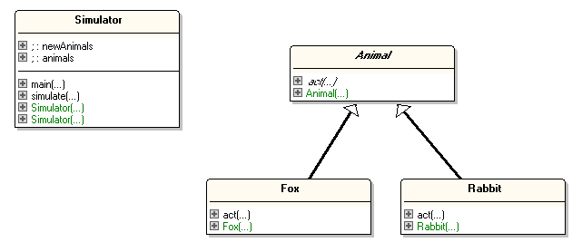
Simulation Class Diagrams
uses
is a

Slide 24
Animal.act()
There must be an act() method in Animal.
But it's not clear what should go in act(), since the behaviours of Rabbit and Fox are so different
compare the code in the old Rabbit.act() and Fox.act()
continued

Slide 25
Instead of writing an Animal.act() method which does nothing useful, define it as abstract: abstract public void act(Field currentField, Field updatedField, List<Animal> newAnimals); // no body code for act()
This makes the Animal class become abstract.

Slide 26
The Animal Abstract Class
public abstract class Animal
{
// fields . . .
abstract public void act(Field currentField,
Field updatedField, List<Animal> newAnimals); // no body code for act()
// other (ordinary) methods . . .
}

Slide 27
Abstract Classes and Methods
An abstract method has no body code
i.e. the method has no implementation
Abstract classes cannot be used to create objects
e.g. you cannot write: Animal a = new Animal();
continued

Slide 28
Subclasses of an abstract class should implement the abstract methods
e.g. Rabbit and Fox must implement act()
Rabbit and Fox are called concrete classes
If a subclass does not implement act() then it becomes abstract (just like Animal), and so cannot create objects.

Slide 29
4. Further Abstractions
A better simulation would include more animals, and other types of things (e.g. people, trees, the weather).
This means that the superclass used by Simulator should be more general than Animal.

Slide 30
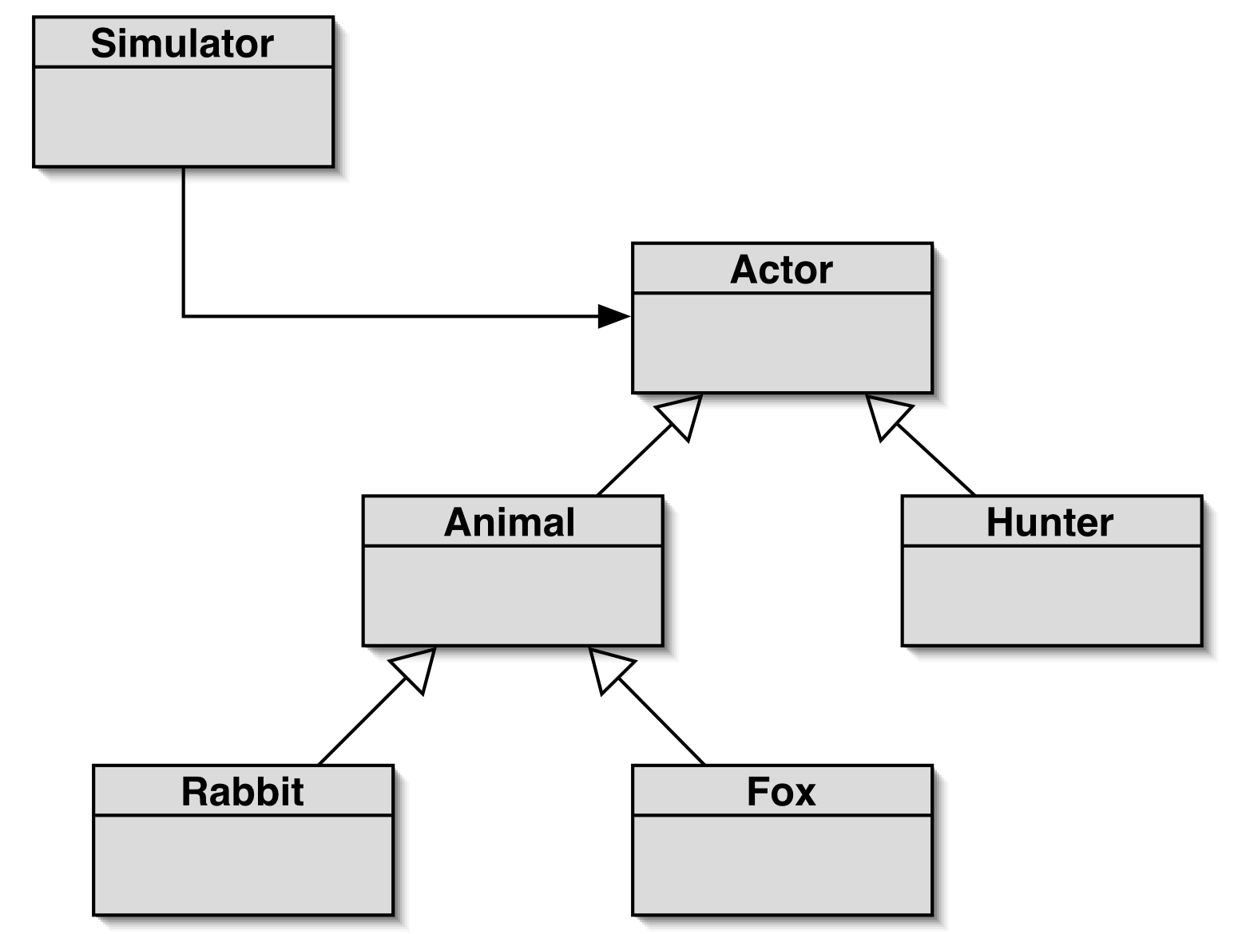

Simulator using Actor
uses
is a
abstract
classes
concrete classes

Slide 31
The Actor Abstract Class
The Actor class contains the common parts of all actors, including an abstract act() method.
public abstract class Actor
{
// fields . . .
abstract public void act(Field currentField,
Field updatedField, List<Actor> newActors); // no body code for act()
// other (ordinary) methods . . .
}

Slide 32
Animal would extend Actor, but still be abstract:
public abstract class Animal extends Actor
{
// fields . . .
abstract public void act(Field currentField,
Field updatedField, List<Actor> newActors); // no body code for act()
// other (ordinary) methods . . .
}

Slide 33

Hunter would extend Actor, and supply code for act():
public class Hunter extends Actor
{
// fields . . .
public void act(Field currentField,
Field updatedField, List<Actor> newActors); { code for Hunter behaviour ... }
// other methods . . .
}

Slide 34
5. From Abstract to Interface
If an abstract class is so general that it cannot contain any useful data fields for objects, only abstract methods, then it can be changed into an interface
sometimes called an interface type

Slide 35
An Actor Interface
public interface Actor
{
void act(Field currentField, Field updatedField,
List<Actor> newActors);
}
All the methods in an interface are public and abstract by default
so no need to include public and abstract keywords
continued

Slide 36
An interface cannot have a constructor.
An interface can have fields, but they must be for defining class constants
i.e. defined as public, static, and final

Slide 37



Classes and Interface Summary
A (ordinary) Class.
All methods have
implementations. Can create objects.
An Abstract Class.
Some methods have
implementations; the ones with no implementations
are abstract.
An Interface
No methods have
implementations.
Cannot create
objects.

Slide 38
Using an Interface
An interface is reused with the keyword implements (not extends).
The subclass must implement all of the methods in the interface.
continued

Slide 39
Hunter would implement the Actor interface by supplying code for act():
public class Hunter implements Actor
{
// fields . . .
public void act(Field currentField,
Field updatedField, List<Actor> newActors); { code for Hunter behaviour ... }
// other methods . . .
}

Slide 40
6. Why have Interface Types?
There are three main reasons for using interfaces:
to support polymorphism between different objects
to implement a form of multiple inheritance
to allow classes to offer different implementations for the same thing

Slide 41
6.1. Why have Interface Types? (1)
Implementing an interface forces a class to offer the interface methods and become the interface's subclass
this allows objects to be grouped together and manipulated more easily
e.g. into polymorphic data structures

Slide 42
Example: Using Polymorphism
public interface Insurable
// methods required to make an class insurable
{
void setRisk(String risk);
String getRisk();
}

Slide 43
An Insurable Car
public class InsurableCar implements Insurable
{
private String type;
private int yearMade;
private Color colour;
// other fields related to cars...
private String riskKind;
public InsurableCar(String t, int y, Color c)
{ type = t;
yearMade = y;
colour = c;
riskKind = "Third Party, fire and theft";
} // end of InsurableCar()
public String toString()
{ return "CAR: " + colour + ", " + type + ", " + yearMade; }
// other methods related to cars...
continued

Slide 44
These methods MUST
be here since
InsurableCar
implements Insurable.
public void setRisk(String risk)
{ riskKind = risk; }
public String getRisk()
{ return riskKind; }
} // end of InsurableCar class

Slide 45
An Insurable House
public class InsurableHouse implements Insurable
{
private int yearBuilt;
private int numRooms;
// other fields related to houses...
private String riskKind;
public InsurableHouse(int y, int nr)
{ yearBuilt = y;
numRooms = nr;
riskKind = null;
} // end of InsurableHouse()
public String toString()
{ return "HOUSE: " + numRooms + ", " + yearBuilt; }
// other methods related to houses...
continued

Slide 46
public void setRisk(String risk)
{
if (riskKind == null)
riskKind = risk;
else
riskKind = riskKind + " / " + risk;
} // end of setRisk()
public String getRisk()
{ return riskKind; }
} // end of InsurableHouse class
These methods MUST
be here since
InsurableHouse
implements Insurable.

Slide 47
Using Insurables
Collect the insurable
objects together in a
polymorphic array.
public class UseInsurables
{
public static void main(String[] args)
{
Insurable[] ins = new Insurable[3];
ins[0] = new InsurableCar("toyota corolla", 1999, Color.WHITE);
ins[1] = new InsurableHouse(1995, 7);
ins[1].setRisk("Subsidence");
ins[1].setRisk("Flood");
ins[2] = new InsurableCar("porsche", 2007, Color.RED);
ins[2].setRisk("Comprehensive");
ins[2].setRisk("Any Named Driver");
for (Insurable in : ins)
System.out.println(in + " (" + in.getRisk() + ")");
} // end of main()
} // end of UseInsurables class
This method must be
available to every object.

Slide 48
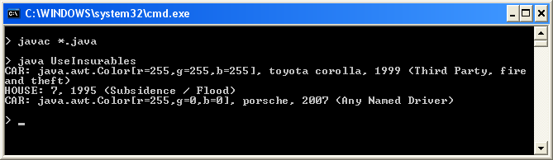
Execution

Slide 49

6.2. Why have Interface Types? (2)
Interface types allow Java subclasses to use a form of multiple inheritance.
e.g. an iPhone is a phone, and a camera, and a web browser
less powerful then multiple inheritance in C++ but simpler to understand, and much easier to implement efficiently in the JVM

Slide 50
Multiple Inheritance Example
All of the simulation objects representing real things (e.g. Rabbit, Fox, Hunter) need to drawn after each update.
This suggests a separate collection of drawable things which simulateOneStep() iterates over after its update stage.
continued

Slide 51
// update all actors
for(Iterator<Actor> it = actors.iterator(); it.hasNext(); ){
Actor actor = iter.next();
actor.act(field, updatedField, newActors);
if(!actor.isAlive())
it.remove();
}
// draw things
for(Drawable d : drawables)
d.draw(...);
continued

Slide 52
This approach requires another superclass called Drawable, which declares an abstract draw() method.
Drawable simulation things must then inherit both Drawable and Actor
i.e. use multiple inhertitance

Slide 53
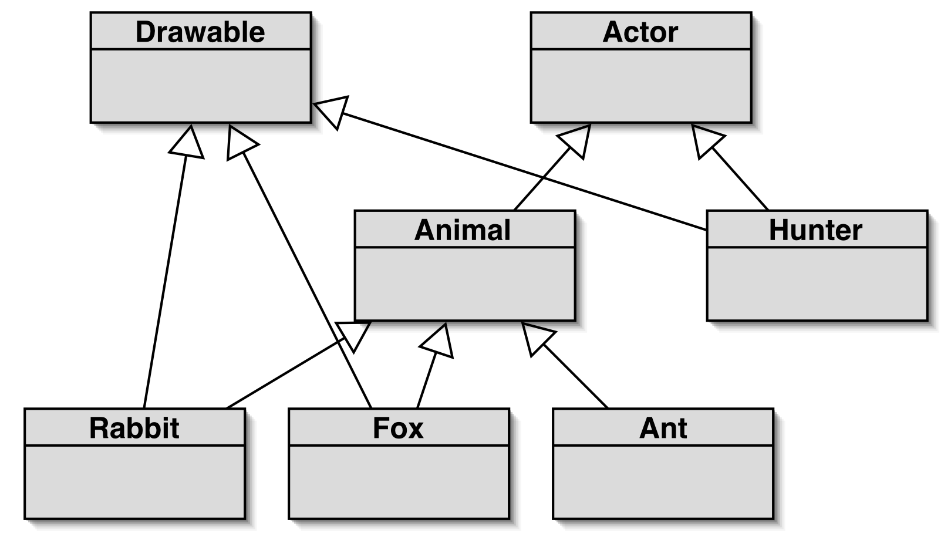
Class Diagram
<<interface>>
<<interface>>
implements
implements
implements
abstract
multiple
inheritance
concrete classes

Slide 54
Multiple Inheritance
Multiple inheritance allows a class to inherit functionality from multiple ancestors.
Java only allows it for interfaces
since interfaces have no implementations, and so can be 'combined' easily

Slide 55
Classes with Multiple Inheritance
public class Hunter implements Actor, Drawable
{
...
}
public class Fox extends Animal implements Drawable
{
...
}
okay, since only one
class

Slide 56
6.3. Why have Interfaces Types ? (3)
Classes that implement the same interface must have the same methods, but can implement those methods in any way they want.
This gives the user more choice over which classes to use, and allows the choice to be changed easily.

Slide 57
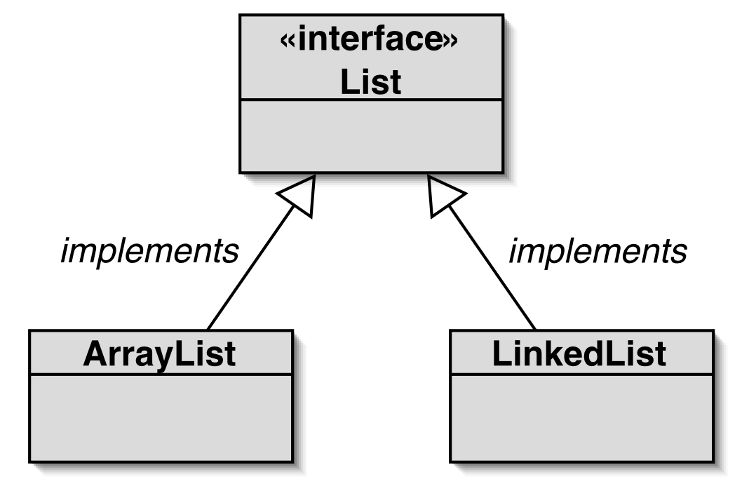
Alternative Implementations
Part of
Java's
library.
both classes offer the same List methods (but implemented differently)
continued

Slide 58
The users of the ArrayList and LinkedList classes know that they have the same interface since they both implement List.
The choice is about which implementation is faster for the operations needed
e.g. compare ArrayList.add()'s speed with that for LinkedList.add()

Slide 59
Code Fragment
Using ArrayList:
ArrayList<String> notes = new ArrayList<String>(); notes.add("hello"); notes.add(0, "hi"); System.out.println( notes.get(1) );
To use a LinkedList instead, change only the first line to:
LinkedList<String> notes = new LinkedList<String>();

