Slide 1
Computer Engineering Lab 1
242-301, Semester 1, 2017-2018
3SA03. Introduction to JDBC
Objective
to give some background on JDBC to help with the lab exercises

Slide 2
Overview
1. What is JDBC?
2. The JDBC-ODBC Bridge
3. Four Types of JDBC Drivers
4. JDBC Pseudocode
5. SimpleJDBC.java
Continued

Slide 3
6. Meta Data
7. Using MS Access
8. More Information

Slide 4
1. What is JDBC?
JDBC is a Java library which allows Java programs to execute SQL inside databases.

Slide 5
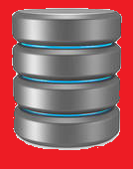
JDBC in Use
Oracle DB
driver
for Oracle
Sybase DB
Java
program
JDBC
driver
for Sybase
connectivity
data processing
: // many more
utilities
non-MS driver
for Access
Access DB
Green means
"Java code"
jdbc-odbc
bridge
odbc
driver

Slide 6
2. The JDBC-ODBC Bridge
ODBC (Open Database Connectivity) is a Microsoft API that allows C/C++ programs to execute SQL inside databases
ODBC is supported by many database companies.
Continued

Slide 7
The JDBC-ODBC bridge allowed Java code to use the C/C++ interface of ODBC
The JDBC-ODBC bridge used to come free with Java:
discontinued in Java 8
Instead I will use the free "UCanAccess" non-Microsoft driver for Access databases.
this is a type 4 driver for JDBC

Slide 8
3. Four Types of JDBC Driver
1. JDBC-ODBC Bridge (type 1)
translate Java to the ODBC API
used by many Windows-based databases, e.g. MS-Access
2. Database Protocol Driver (type 4)
Independent from the OS/hardware because the driver is in Java.
Continued

Slide 9
3. Native API Connection Driver (type 2)
connected by a OS native module, dependent on the OS or hardware (e.g. DLLs on Windows)
4. Net Connection Driver (type 3)
use Java to access the database via networking middleware (usually TCP/IP)
required for networked applications

Slide 10
Using UCanAccess
Download UCanAccess-4.0.2-bin.zip from:
http://sourceforge.net/projects/ucanaccess/
unzip in directory with my code and batch files
Documentation at:
http://ucanaccess.sourceforge.net/site.html

Slide 11
Some UCanAccess Features
Supports many old Access formats
SELECT, INSERT, UPDATE, DELETE
DDL: CREATE table with primary key, DROP
Transactions and savepoints
Concurrent access from multiple users
ANSI 92 SQL, core SQL-2008, MS Access SQL
LIKE operator, wildcard character

Slide 12
Other JDBC Drivers
Lists of drivers (freeware, shareware, and commercial) can be found at:
http://en.wikipedia.org/wiki/JDBC_driver
http://www.oracle.com/technetwork/java/ index-136695.html

Slide 13
4. JDBC as a Diagram
DriveManager
creates
Connection
creates
Statement
creates
ResultSet
SQL
data
make link to driver
Driver
Green means
"Java code"
SQL
data

Slide 14
DriveManager
It is responsible for establishing the connection to the database through the driver.
e.g.
Class.forName( "net.ucanaccess.jdbc.UcanaccessDriver");
Connection conn = DriveManager.getConnection(url);
name of the database

Slide 15
Name the Database
The name and location of the database is given as a URL
the details of the URL vary depending on the type of database that is being used

Slide 16
UCanAccess Database URL
jdbc:ucanaccess:// host.domain.com: 2048 c:/file
The comms
protocol
The machine
holding the
database.
The port
used for the
connection.
The path to
the database
on the machine
(accdb or mdb)
e.g. jdbc:ucanaccess://Books.accdb

Slide 17
Statement Object
The Statement object provides a ‘workspace’ where SQL queries can be created, executed, and results collected.
e.g.
Statement st = conn.createStatement(): ResultSet rs = st.executeQuery( “select * from Authors”); : st.close();

Slide 18
ResultSet Object
Stores the results of a SQL query.
A ResultSet object is similar to a ‘table’ of answers, which can be examined by moving a ‘pointer’ (cursor).
Continued

Slide 19
cursor
23
John
5
Mark
17
Paul
98
Peter
Cursor operations:
first(), last(), next(), previous(), etc.
Typical code:
while( rs.next() ) { // process the row; }

Slide 20
5. SimpleJDBC.java
// SimpleJDBC.java // Displays the firstnames and lastnames // of the Authors table in the Books db. import java.sql.*; public class SimpleJDBC { public static void main(String[] args) { // The URL for the Books database. String url = UcanaccessDriver.URL_PREFIX + "Books.accdb"; :

Slide 21
try { // load the UCanAccess driver Class.forName( "net.ucanaccess.jdbc.UcanaccessDriver"); // connect to db using DriverManager Connection conn = DriverManager.getConnection(url); // Create a statement object Statement statement = conn.createStatement(); // Execute the SQL query ResultSet rs = statement.executeQuery( "SELECT lastName, firstName FROM Authors" ); :

Slide 22
// Print the result set while( rs.next() ) System.out.println( rs.getString("lastName") + ", " + rs.getString("firstName") ); // Close down statement.close(); conn.close(); } :

Slide 23
catch (ClassNotFoundException e) { System.out.println( "Could not load UCanAccess library: "+e); } catch (SQLException e) { System.out.println("SQL Exception: "+e); } } // end of main() } // end of SimpleJDBC class

Slide 24
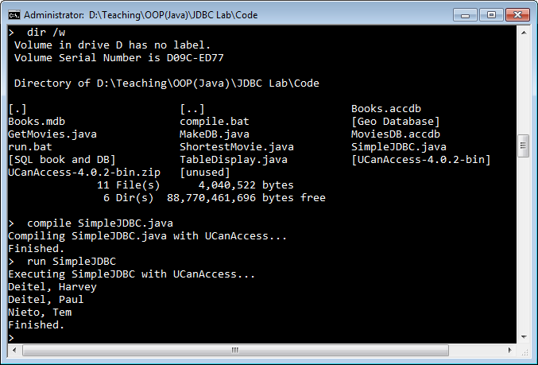
Correct Execution

Slide 25
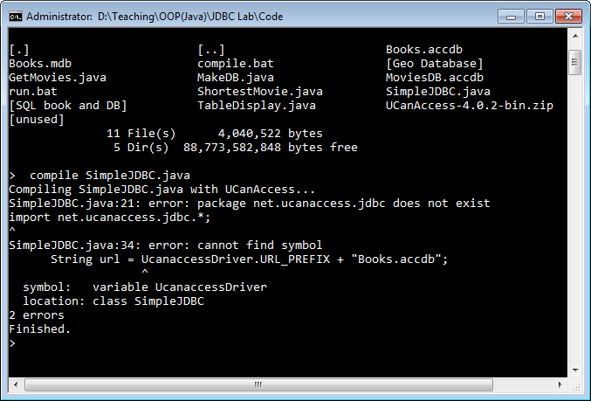
No UCanAccess Folder

Slide 26
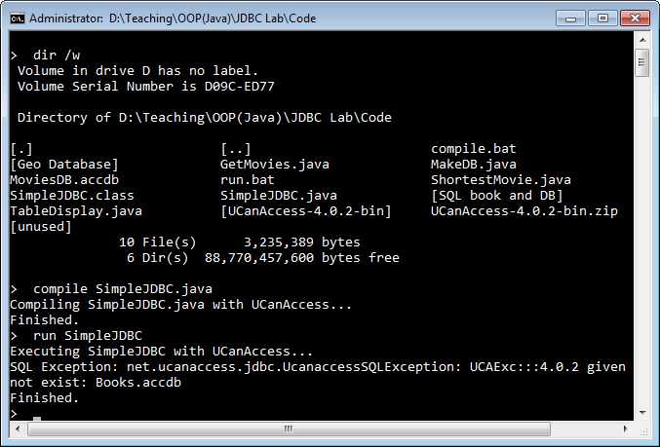
No Books.accdb in Folder

Slide 27
5.1. Accessing a ResultSet
The ResultSet class contains many methods for accessing the value of a column of the current row
can use the column name or position
e.g. get the value in the lastName column:
rs.getString("lastName")
Continued

Slide 28
There are many methods for accessing the data, e.g.
getString(), getDate(), getInt(), getFloat(), getObject()
JDBC documentation starts at:
http://docs.oracle.com/javase/7/docs/api/ java/sql/package-summary.html
look in "ResultSet"

Slide 29
6. Meta Data
Meta data is the information about the database:
e.g. the number of columns, the types of the columns
meta data is the schema information
meta data
ID
Name
Course
Mark
007
James Bond
Shooting
99
008
Aj. Andrew
Kung Fu
1

Slide 30
One important use for metadata is for formatting result set data
e.g. instead of displaying the results as text, display them in a Java table with headers, rows, columns
see TableDisplay.java in the Exercises

Slide 31
6.1. Accessing Meta Data
The getMetaData() method can be used on a ResultSet object to create its meta data object.
e.g.
ResultSetMetaData md = rs.getMetaData();

Slide 32
6.2. Using Meta Data
int numCols = md.getColumnCount(); for (int i = 1; i <= numCols; i++) { if (md.getColumnType(i) == Types.CHAR) System.out.println( md.getColumnName(i) ) }

Slide 33
6.3. More Meta Data Methods
getTableName()
getPrecision()
number of decimal digits in the column
isSigned()
returns true if column has signed numbers
isCurrency()
etc.

Slide 34
ResultSetMetaData Docs
JDBC documentation starts at:
http://docs.oracle.com/javase/7/docs/api/ java/sql/package-summary.html
look in "ResultSetMetaData"

Slide 35
7. Using MS Access
MS Access changed its file formats when Access 2007 was released:
for Access 2003 (and earlier) you should use Books.mdb
for Access 2007 and later, you should use Books.accdb
both versions are in the lab's website.

Slide 36
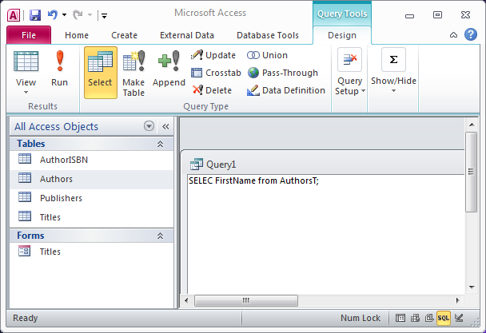
Access and SQL
How to use SQL in Access is described at:
http://www.jaffainc.com/SQLStatementsInAccess.htm
And on the website, in sqlAccess2007.txt and sql_intr.pdf

Slide 37
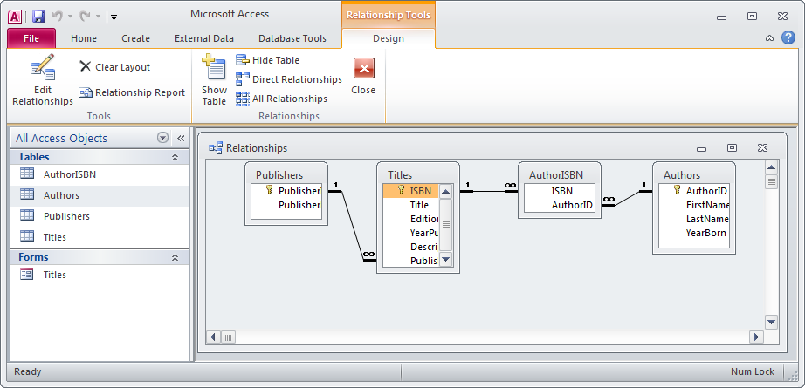
TableRelationships in Books.accdb
(and Books.mdb)
Under Database Tools > Relationships

Slide 38
8. More Information
Java: How to Program, 10th edition Paul Deitel and Harvey Deitel Pearson, 2015, Chapter 24
I've placed an extract of that chapter on the website
It will only be there for 1-2 weeks
The JDBC tutorial is very good
http://docs.oracle.com/javase/tutorial/jdbc

