Slide 1


IBM employee data analytic
Presented by
Panuvat Danvorapong
Notes:
Good morning everyone, my name is Mohammad Bakir, and I am here to talk about my Employee Attrition predicting model. Lets start with why is employee attrition important.

Slide 2







Objective
To find interesting or insight from IMB employee data set
Visualize the result from insight
Create machine learning to predict the attrition trend
Journey
Finding insights
Visualization
Prediction
Tool
Analyze the feature and target
Create ML algorithms and evaluating the result
Create database sever
Query the insights
Demonstrate the insight from SQL
Show interesting points by graphs
Detail

Slide 3




Finding insights
Process
Create database on Postgres
Query database
Analyze the insight
Summarize the insight
Question
Imagine you are acting as logical Human resource staff
1. If the workers resign from company, does the working year affect to the attrition?
2. What’s the environment of working place and workload?
3. Which level of education is the most effect to the attrition?
4. What is the relationship between salary and performance on each department?
** All query’s code included in attachment!

Slide 4
1. If the workers resign from company, does the working year affect to the attrition?
Analysis :
As you can see on the scatter graph, the number of attrition points mostly located in range 8-25 years, whereas a few points located in range 0-5 years
Summary :
This could be a reason people who take very long time in order to be promoted tends to resign rather than a short time to be promoted

Slide 5
2. What’s the environment of working place and workload?
Analysis :
As you can see on the bar graph, while the most worker who resigned thinks workplace is better, the least is best in terms of work life balance.
Summary :
This could explain that even thought the work is not loaded on workers, the people who resign might think there will be a better place to work integrated living than IBM.

Slide 6
3. Which level of education is the most effect to the attrition?
Analysis :
As you can see on the bar graph, the graph illustrates that the education level on bachelor degree is the most group who resigned as red tab shown
Summary :
This could explain that the bachelor degree group might in exploring period of their-life or even predict that in order to be promoted on IBM required more than bachelor’s degree level. Thus, they might want to study master or doctor.

Slide 7
4. What is the relationship between salary and performance on each department?
Analysis :
As you can see on the bar graph, the graph illustrates that sales department get the highest monthly income compared to others but the performance is lower than others. Summary :
This could explain that sale department might have top sale who make lots of profit to company and get a huge commission even though there are many low performance salesman among the department.
Slightly low performance
General performance
Good performance

Slide 8
Process Pipeline
Data Pre-Processing
/Cleansing
Model selection/training
Deployment
Notes:
In order to attack this problem and to develop my product, my approach was to first collect employee attrition data. This data was obtained from Kaggle

Slide 9

Data Pre-processing
Import dataset : to get ready for do ML algorithms
Import library : to get ready for do ML algorithms
Data exploring : to explore the dependent/independent features
Encoding : to change categorical column to numerical column
Feature selection : to select unnecessary independent column out
Split dataset into training : testing : train 80% test 20%
Feature scaling : to rescale the data down and balancing dataset
Notes:
I chose a data set developed by IBM data scientist, the data contained over 35 employee feature categories to which I reduced down to 20 comprehensive categories.

Slide 10
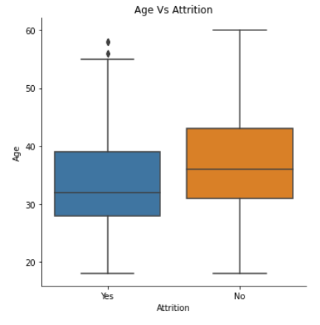
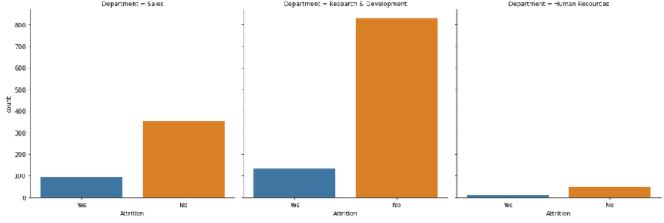
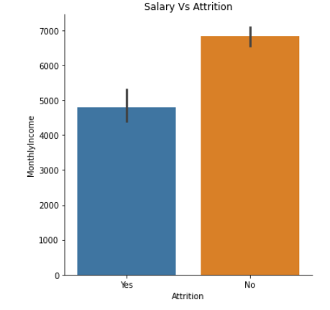
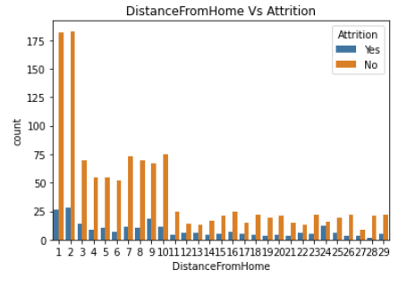
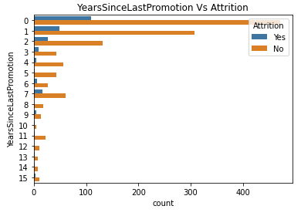
Visualize the relationship between indecent and dependent variable
Notes:
I transformed a few features to follow a uniform normal distribution, one hot encoded categorical value representations and standardized data using feature scaling.

Slide 11
Feature Selection
From 35 independent variable
1 target variable (Attrition)
To 20 independent variable
1 target variable (Attrition)
After create dummy convert cat to int
38 columns (int)
Notes:
I transformed a few features to follow a uniform normal distribution, one hot encoded categorical value representations and standardized data using feature scaling.

Slide 12

A
Model selection / training
Due to this is a binary problem which target variable can be only “Yes”/ ”No”
Result
Accuracy : 81.63%
Precision : 59.09%
Recall : 22.41 %
F1-value : 32.94 %
Apply to Supervised learning “Classification”
Algorithms : Logistic regression because there are many catagorical dependent variable
Spit Train 80% and Test 20%
Model Evaluation
Notes:
I transformed a few features to follow a uniform normal distribution, one hot encoded categorical value representations and standardized data using feature scaling.

Slide 13

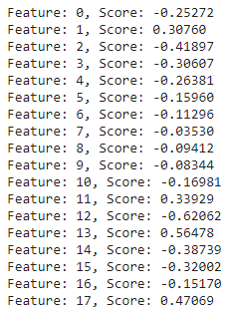
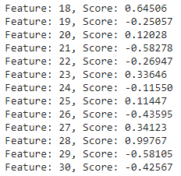
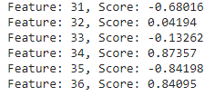
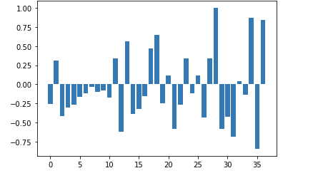
Deployment - Feature Importance
Feature | Ranking | correlation coefficient
Job role sale representative | 1 | 0.99
Overtime | 2 | 0.84
Years since last promotion | 3 | 0.68
Year in current role | 4 | 0.64
Department sale | 5 | 0.62
Notes:
This slide shows a graph of my top 10 features as predicted by model, with Monthly Income, Age, Years At Company, Distance from Home, and Total Working Years being the top 5.

Slide 14
Job role sale rep
Overtime
Year in current role
Year since last promotion
Department
Important Features
Summary
List of what HR should do next?:
HR might focus on role sale-rep what’s wrong with this role. They might not get enough commission or sale leakage to other organizations.
HR should emphasize on overtime payment. Did employee get the payment or they don’t have authorize by their management level.
HR must try to increase vacancy of promotion because all employees expected to grow up in their job.
Similarly to previous concerned point, did employee promoted to be managerial or they bored of doing the same job everyday. HR must rotate employee to do something new to reflect their challenge
HR must look for insight of each department whether the manpower is enough or not because lack of manpower caused workload.
Notes:
An example of how this affects the bottom line. On average it takes 20% of entry level salary to replace a salaried employee, 50% of salary for mid-level position, and %125 for senior level positions.
If we take all low salary employees who left, 200 of them and calculate the total cost of replacing them, that is between $475,000 on the low end upwards to 3 and a half million dollars on the high end.
It’s important that your organization identifies employees who are leaving in order to potential reduce the financial impact on your companies bottom line. Let’s talk about how my product can help you reduced employee attrition.

Slide 15
Thanks you
See more detail on
https://github.com/Panuvat-Dan/Machine_learning_study

