Slide 1

Stabuck data analysis

Slide 2





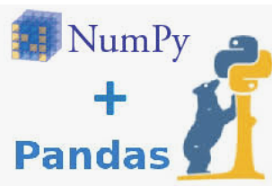
Objective
To find interesting or insight from Stabuck data set
Visualize the result from insight
Create machine learning to predict the customer loyalty to Starbuck (loyal or un-loyal)
Journey
Data-gathering
Visualization
Prediction
Tool
Gather data from Kaggle, etc.
Convert semi-structural
database to CSV file
No need to create database
Demonstrate the insight from SQL
Show interesting points by graphs
Analyze the feature and target
Create ML algorithms model classification
evaluating the result and accuracy
Detail

Slide 3




Data gathering
Visualization
Process pipeline
Gather the data
Convert data-type
Analyze the insight
Create Dashboard
Data is semi structural and non-relation to each table. Therefore, I am going to use non-programing language which is Tableau instead of
programming language which is SQL language
Data Pre-Processing
/Cleansing
Machine learning selection/ train and test model
Deployment to marketing team
Prediction
Process pipeline

Slide 4
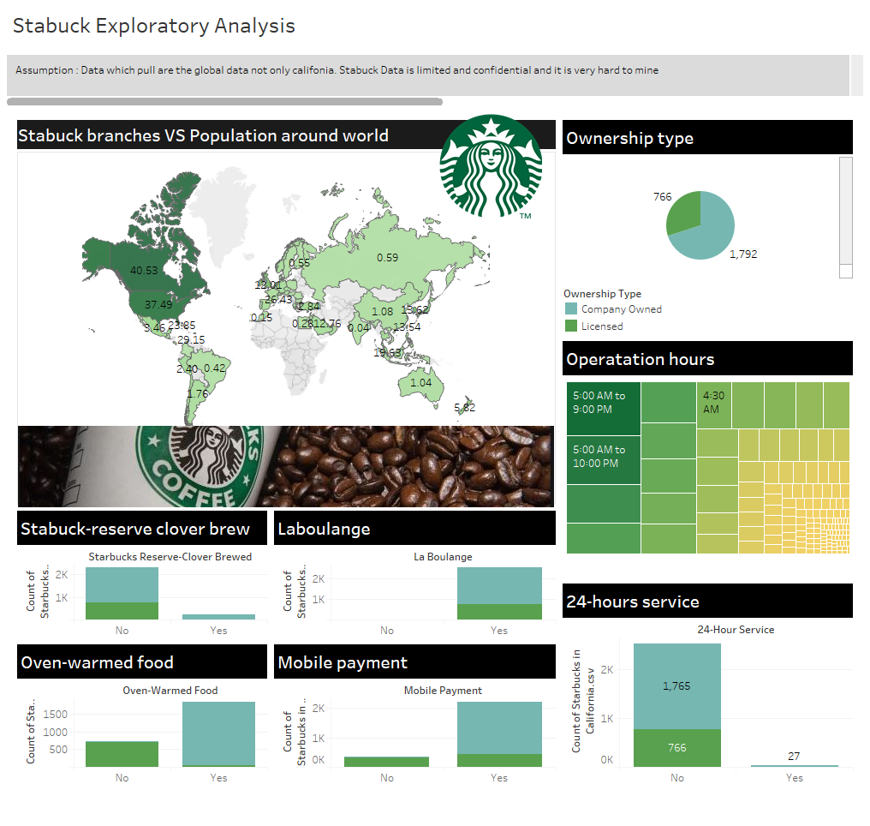
Publish on: https://public.tableau.com/profile/panuvat.danvorapong#!/vizhome/Stabuckanalysis/Overviewstory

Slide 5
From the limited dataset which I’ve found on website, 4 insights found as right hands side!
Although USA has highest branch, Canada has more space and sufficient reserve for their people due to most branch per inhabitants.
More than 70 of Starbucks is owned by the company. That mean the rest is licensed located around restrict area that company can’t settle like airport. However, if there is law to obey, they might not issue license to those entrepreneurs.
As you see on graph, there is no licensed Starbuck allows to open 24 hrs. service and laboulange. In contrast, Startbuck owned by company have all necessary equipment.
Operating hour that mostly open around the world is 5 AM. - 9 PM. It predict that in the early morning and the late afternoon people want to have caffeine.
❖
◆

⬥
⬥

Slide 6

Data Pre-processing
Import dataset : to get ready for do ML algorithms
Import library : to get ready for do ML algorithms
Data exploring : to explore the dependent/independent features
Encoding : to change categorical column to numerical column
Feature selection : to select unnecessary independent column out
Split dataset into training : testing : train 80% test 20%
Feature scaling : to rescale the data down and balancing dataset
Notes:
I chose a data set developed by IBM data scientist, the data contained over 35 employee feature categories to which I reduced down to 20 comprehensive categories.

Slide 7
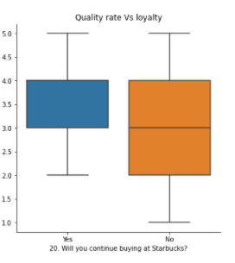
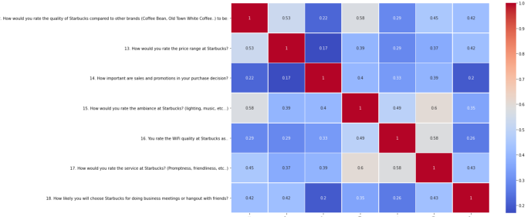
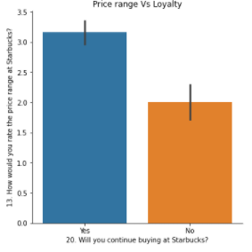
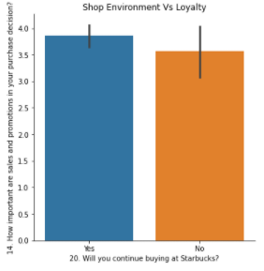
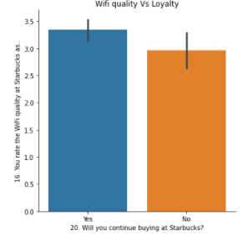
Visualize the relationship between independent and dependent variable
Notes:
I transformed a few features to follow a uniform normal distribution, one hot encoded categorical value representations and standardized data using feature scaling.

Slide 8
Feature Selection
From 21 independent variable
1 target variable (loyalty)
To 17 independent variable
Remove timestamp,wifi,staff service,environment
1 target variable (loyalty)
After create dummy convert cat to int
33 columns (numeric)
Notes:
I transformed a few features to follow a uniform normal distribution, one hot encoded categorical value representations and standardized data using feature scaling.

Slide 9

A
Model selection / training
Due to this is a binary problem which target variable can be only “Yes”/ ”No”
Model Result
Accuracy : 91.3%
Precision : 66.7%
Recall : 66.7 %
F1-value : 67 %
Apply to Supervised learning “Classification”
Algorithms : Logistic regression because there are many categorical dependent variable
Spit Train 80% and Test 20%
Model Evaluation
Notes:
I transformed a few features to follow a uniform normal distribution, one hot encoded categorical value representations and standardized data using feature scaling.

Slide 10

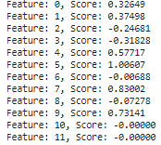
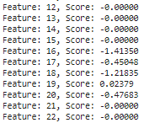

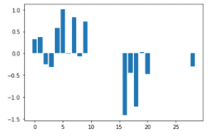
Deployment - Feature Importance
Feature | Ranking | correlation coefficient
1. Visit time on Starbuck shop | 1 | 1.006 (perfect correlation)
2. Price rate per 1 visit Starbuck shop | 2 | 1.2 (high correlation)
3. Time you spend on Starbuck shop per 1 round | 3 | 0.83 (high correlation)
4. Membership card | 4 | 0.73 (high correlation)
5. Income per head | 5 | 0.57 (normal correlation)
Notes:
This slide shows a graph of my top 10 features as predicted by model, with Monthly Income, Age, Years At Company, Distance from Home, and Total Working Years being the top 5.

Slide 11
Important Features
Visit time on Starbuck shop
Price rate per 1 visit Starbuck shop
Membership card
Income per head
Time you spend on Starbuck shop per 1 round
Summary
List of what Stabuck should do next?:
Marketing staffs should create campaign to focus targets who spend time and dine-in at shop. For example, buy one get one there will be a lot of customers to increase sale volume.
Marketing should cluster customers into group by money spending and analyze their income per head because it effects to customer loyalty.
Time spending on shop and customer who already have membership card tends to be loyal and continue a membership.
Although this classification model is more than 90% accurate, there will be features that actually important to predict if the data is large enough because this model created by only 123 sample spaces
Notes:
An example of how this affects the bottom line. On average it takes 20% of entry level salary to replace a salaried employee, 50% of salary for mid-level position, and %125 for senior level positions.
If we take all low salary employees who left, 200 of them and calculate the total cost of replacing them, that is between $475,000 on the low end upwards to 3 and a half million dollars on the high end.
It’s important that your organization identifies employees who are leaving in order to potential reduce the financial impact on your companies bottom line. Let’s talk about how my product can help you reduced employee attrition.

Slide 12
For more detail and code
Readme : https://github.com/Panuvat-Dan/Stabuck_analysis_loyalprediction
GoogleColab(please reload if it doesn’t show code) : https://github.com/Panuvat-Dan/Stabuck_analysis_loyalprediction/blob/main/Stabuck_loyal_customer_ML_prediction.ipynb
References & Credit
Dataset : https://www.kaggle.com/ozlerhakan/analysis-of-starbucks-dataset
https://towardsdatascience.com/accuracy-precision-recall-or-f1-331fb37c5cb9

