Slide 1
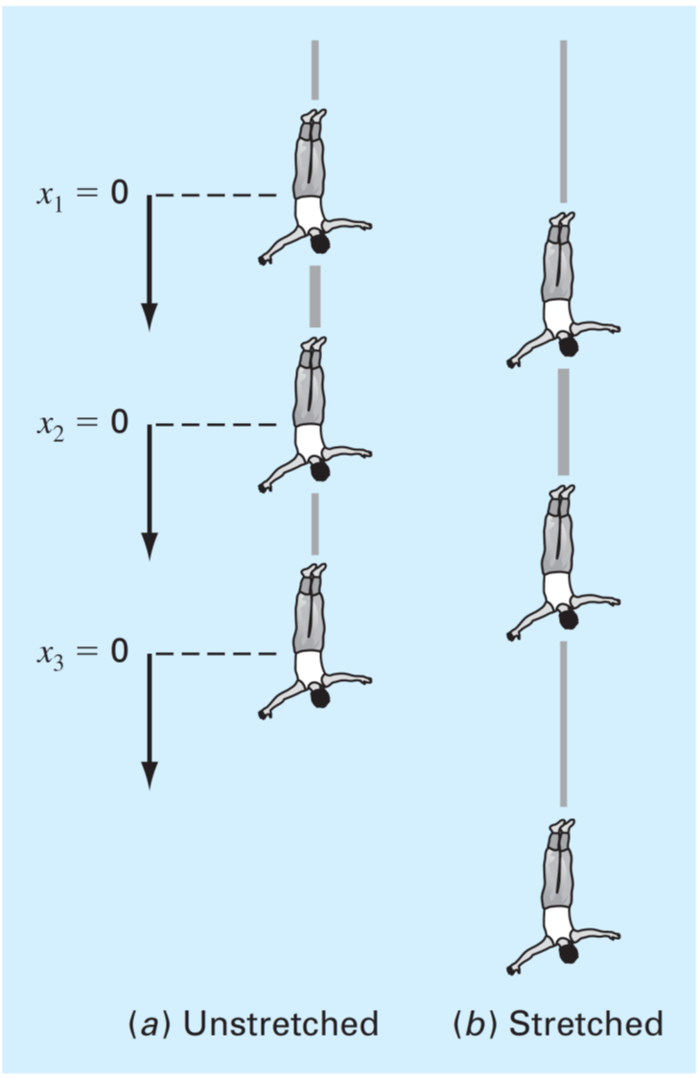

Slide 2
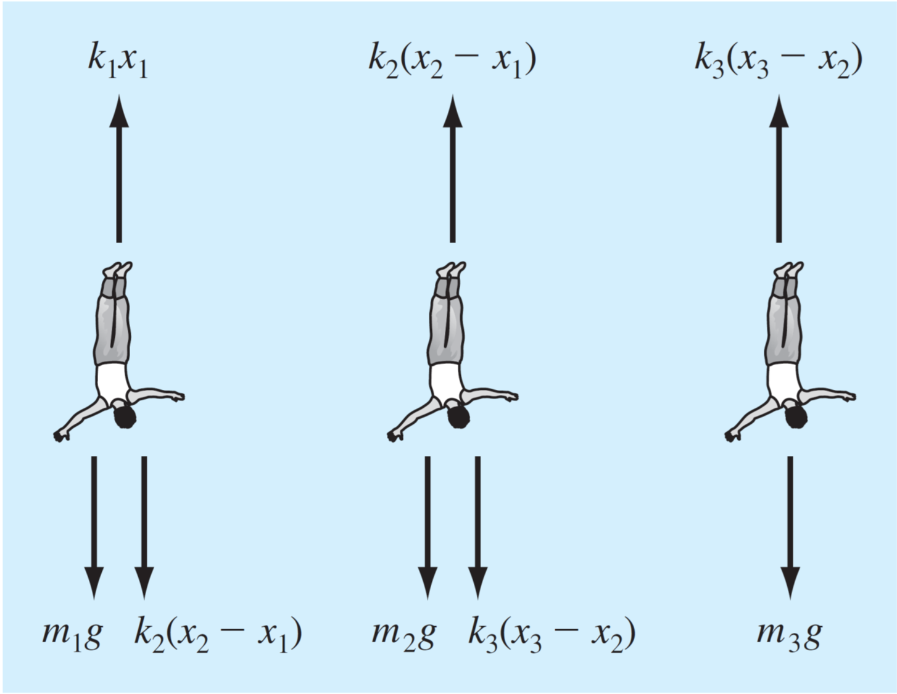

Slide 3
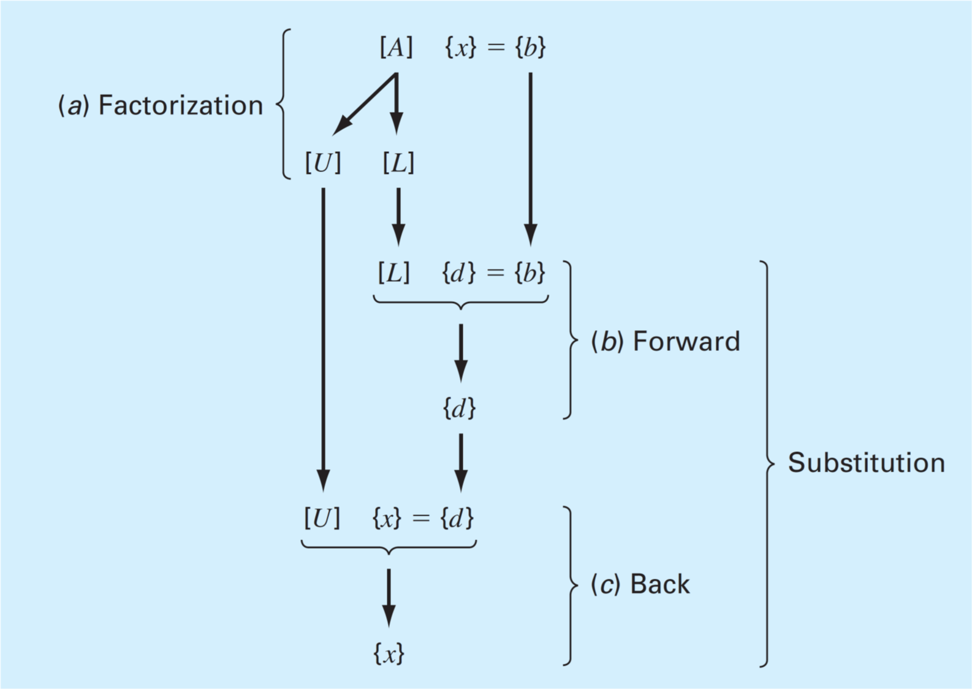


$\{x\text{\}}\text{ = }\{y$}
$\{y$}

Slide 4
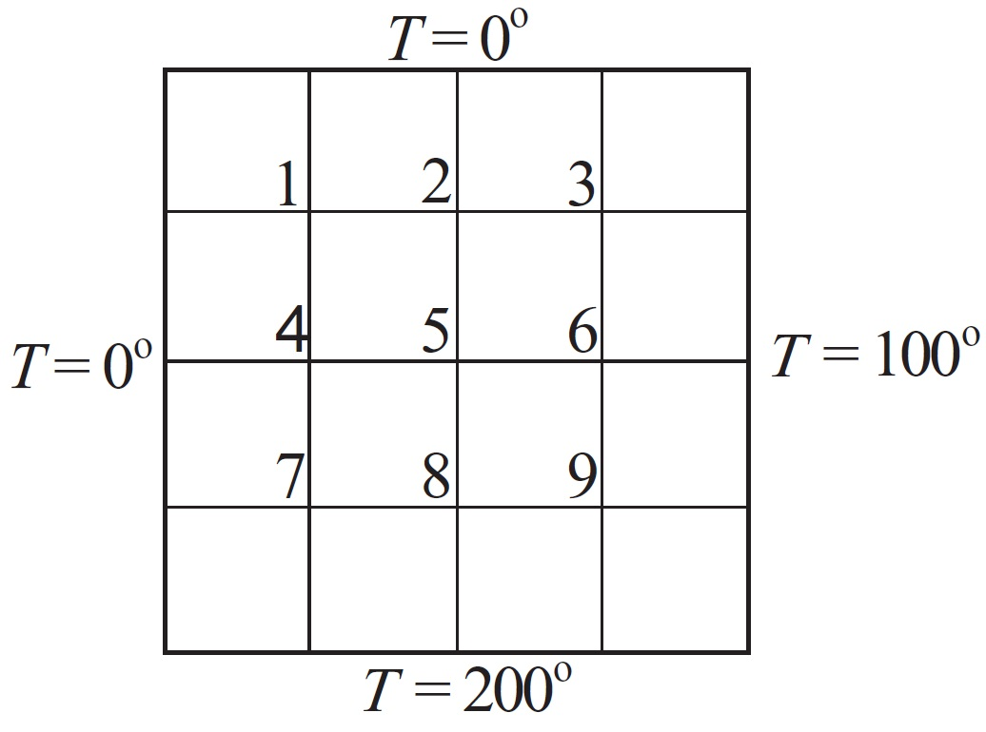











$$x$$
$$1,1$$
$$1,2$$
$$1,3$$
$$y$$
$$2,1$$
$$2,2$$
$$2,3$$
$$3,1$$
$$3,2$$
$$3,3$$

Slide 5
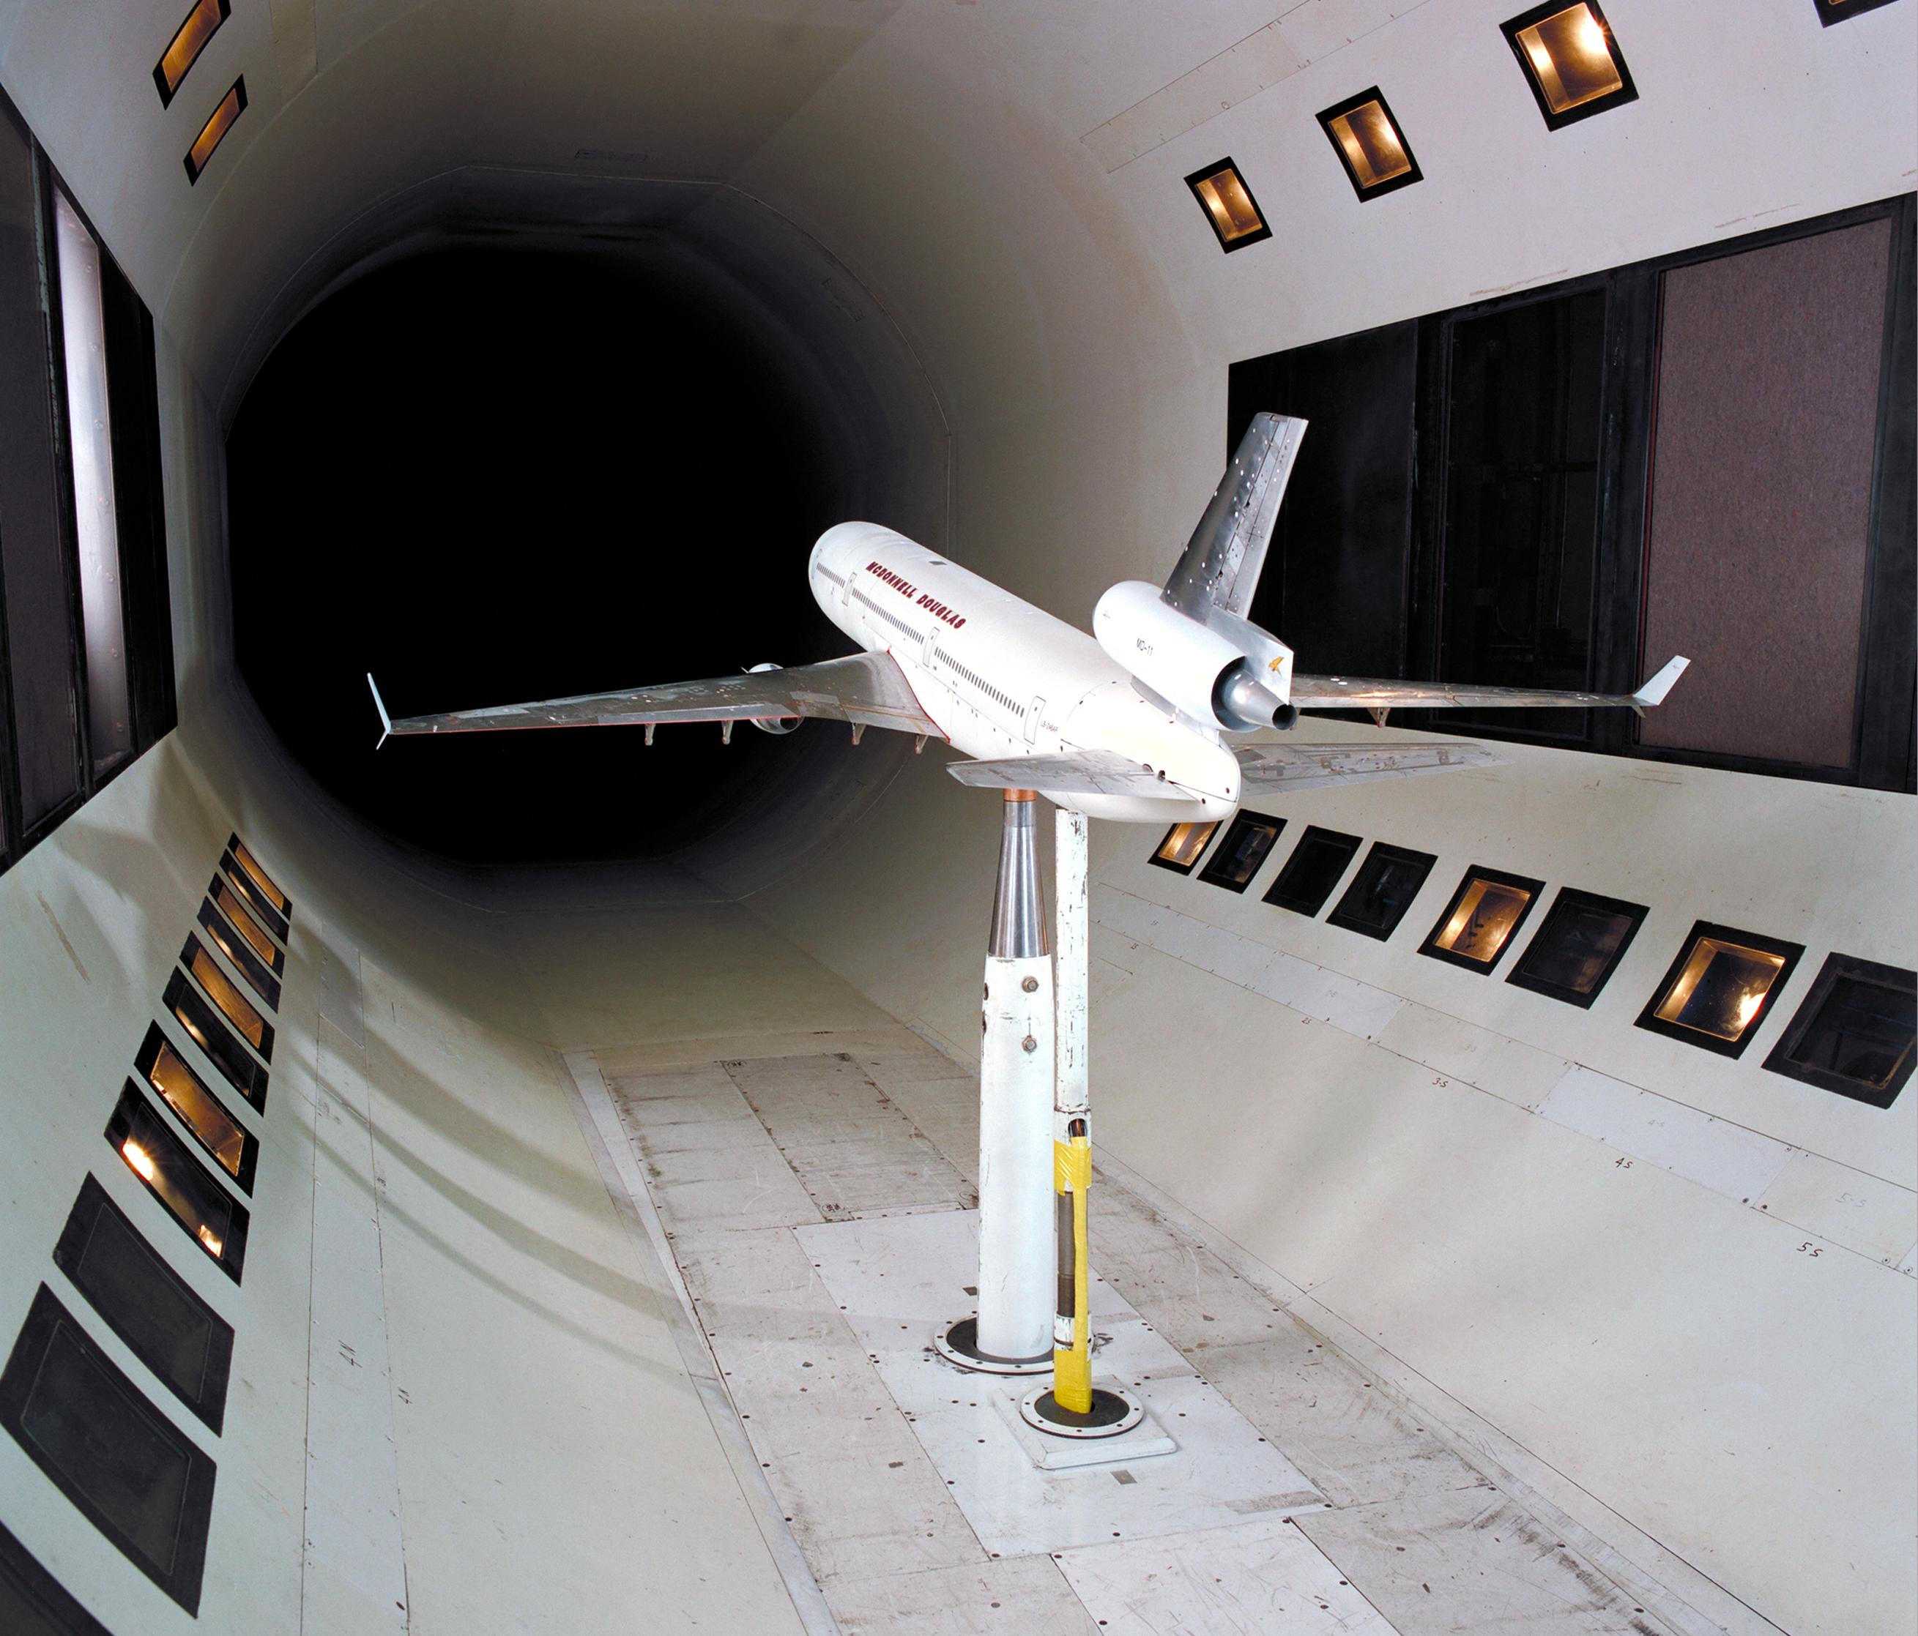
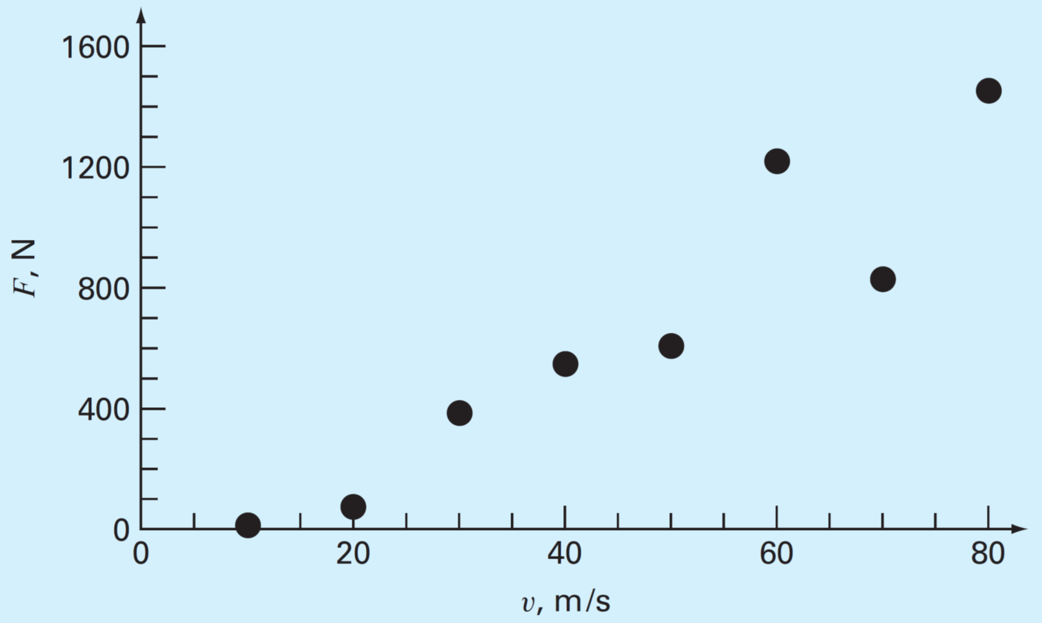

Slide 6
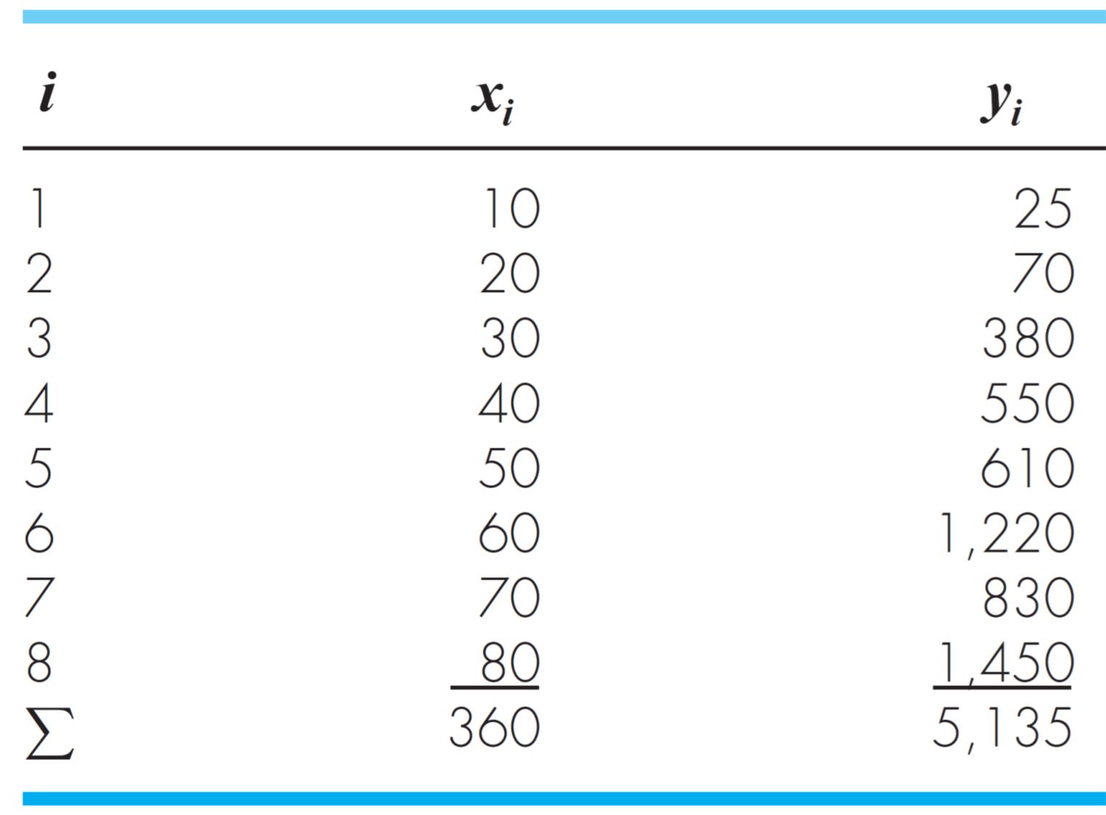

Slide 7
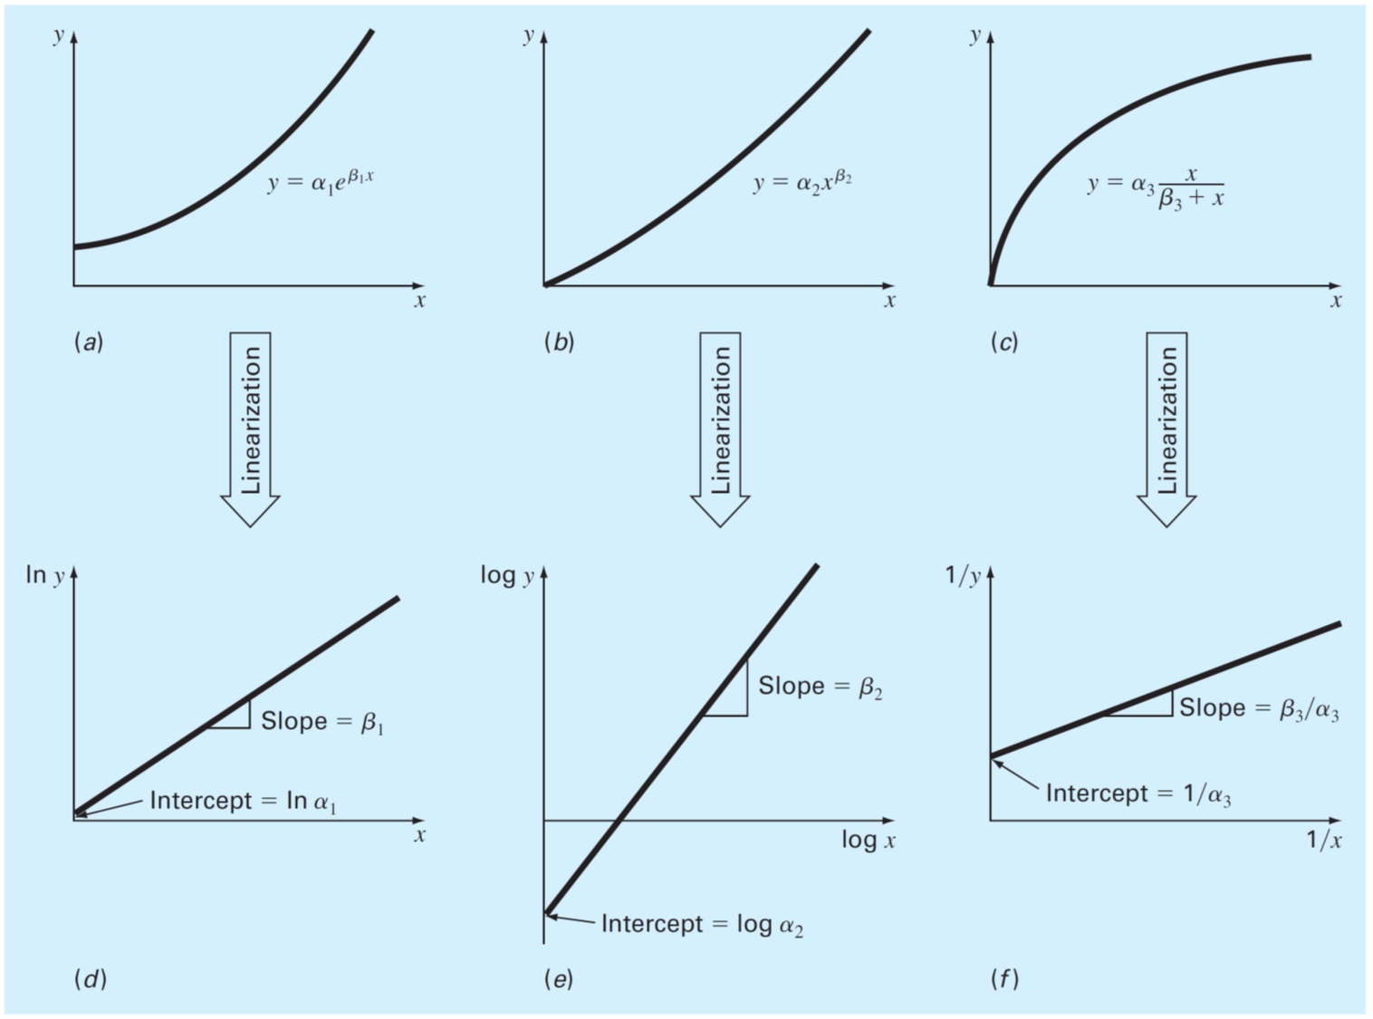

Slide 8
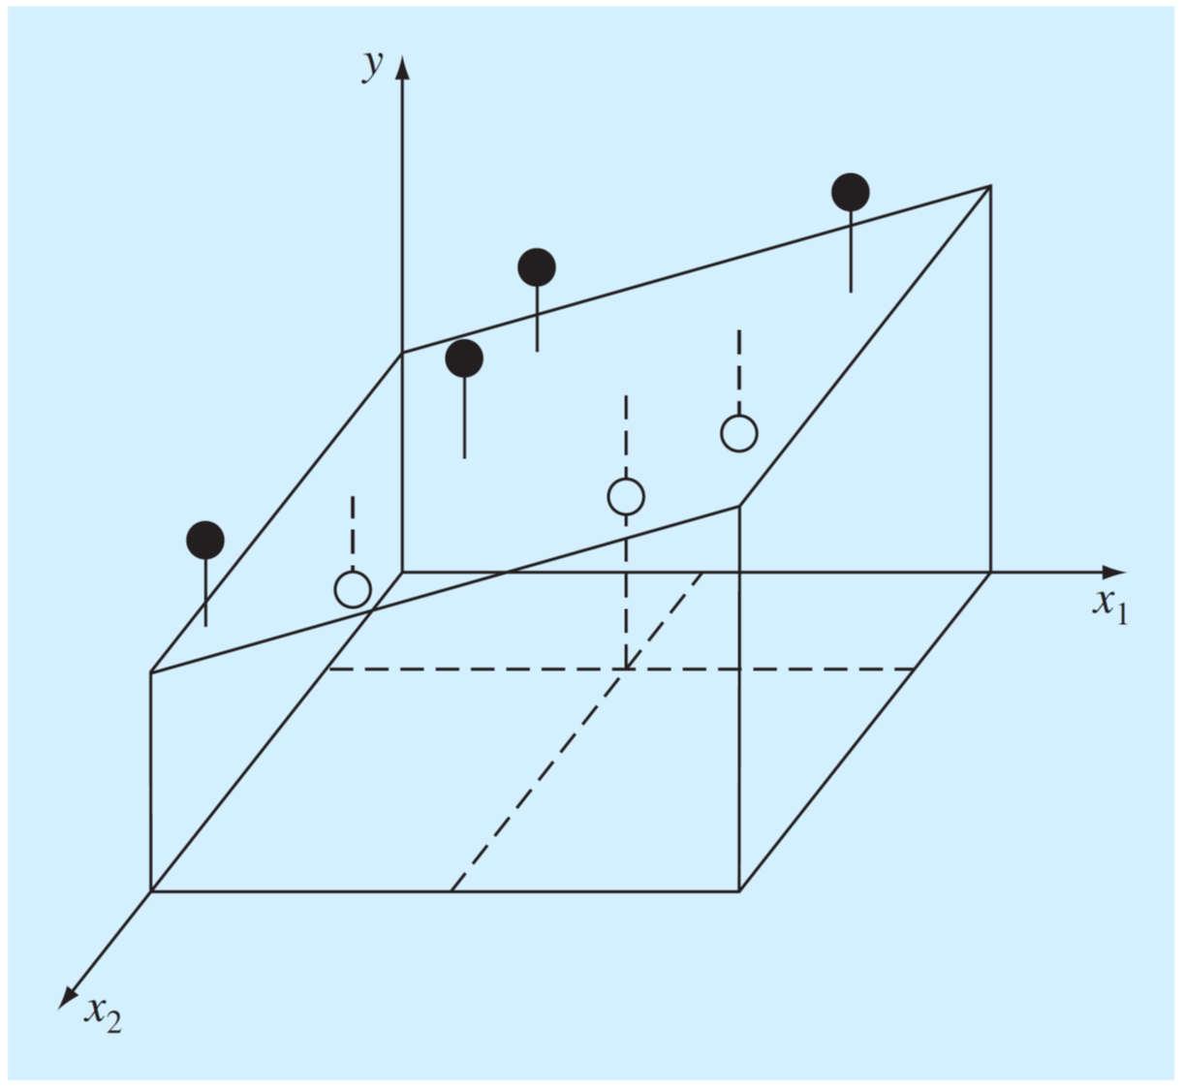

Slide 9
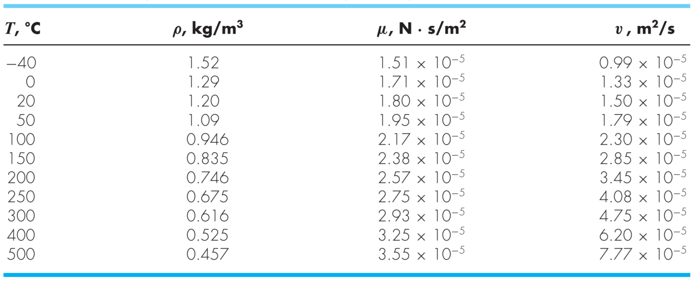

Slide 10
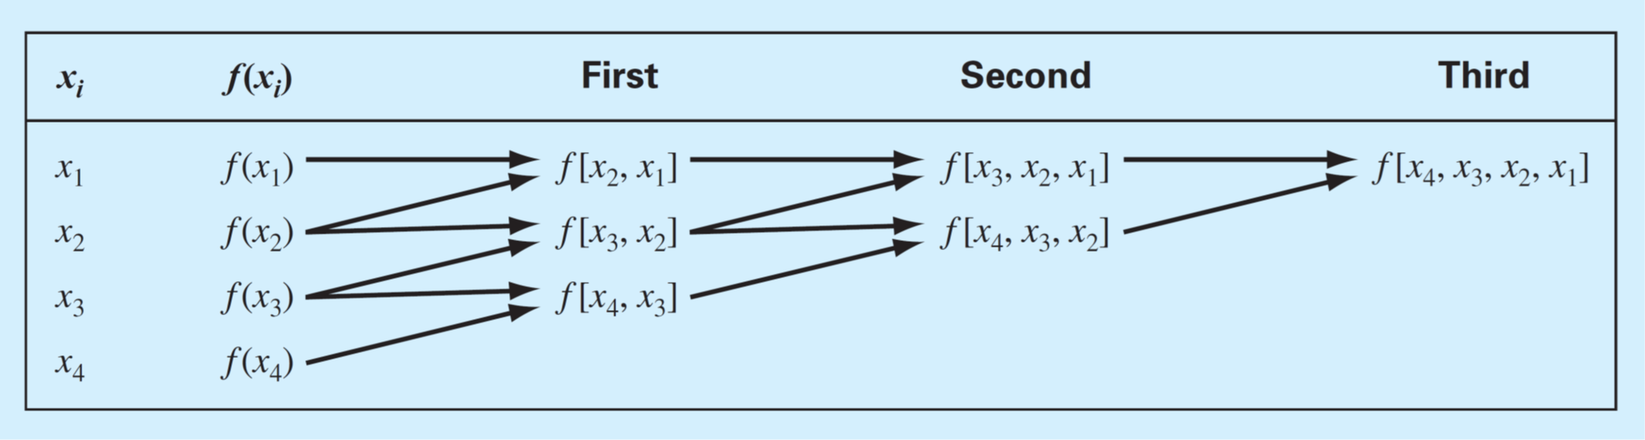

Slide 11
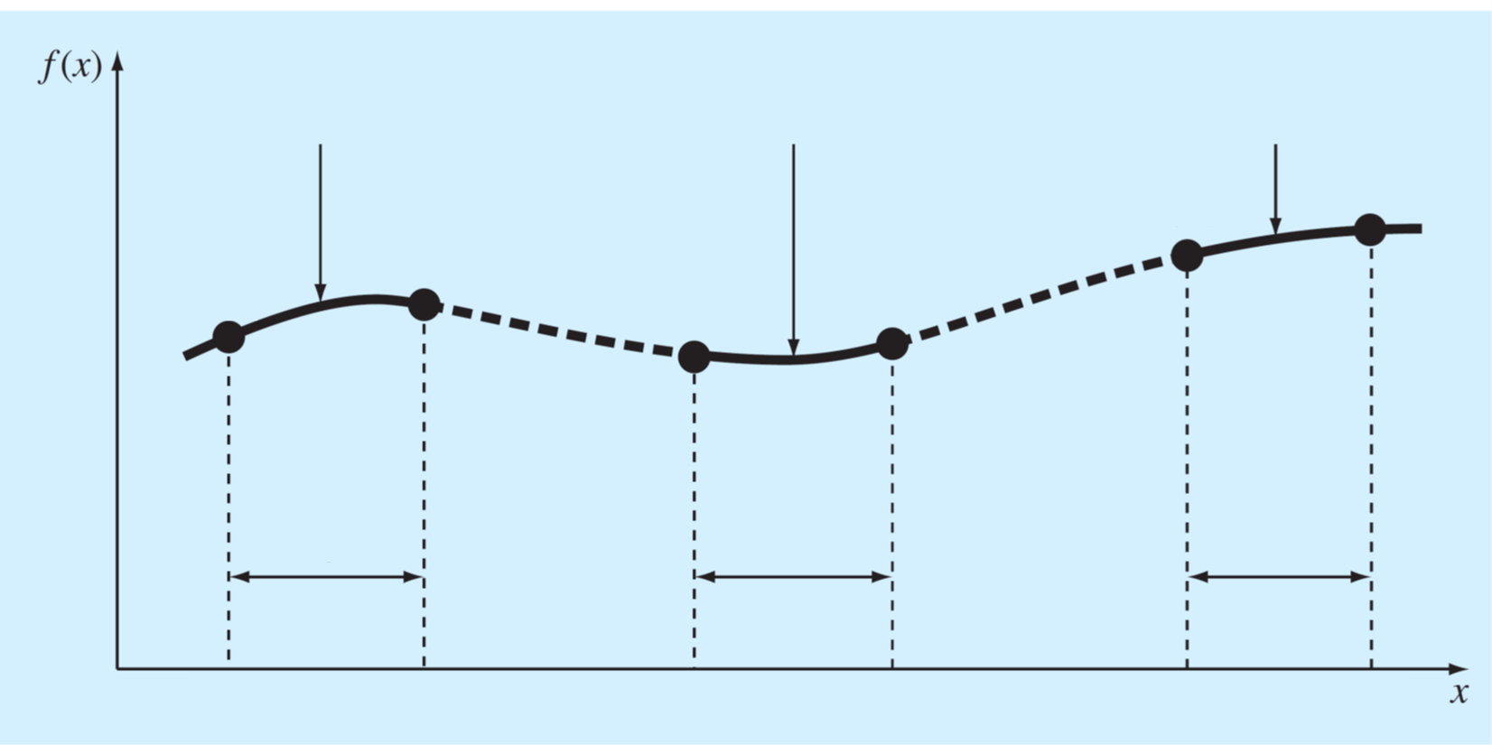


















$$S_{1}(x)$$
$$S_{i}(x)$$
$$S_{n}(x)$$
$$f_{n−1}$$
$$f_{n}$$
$$f_{1}$$
$$f_{0}$$
$$f_{i}$$
$$f_{i+1}$$
Intervalo $1$
Intervalo $i$
Intervalo $n$
$$x_{0}$$
$$x_{1}$$
$$x_{i}$$
$$x_{i+1}$$
$$x_{n−1}$$
$$x_{n}$$

Slide 12
