Slide 1
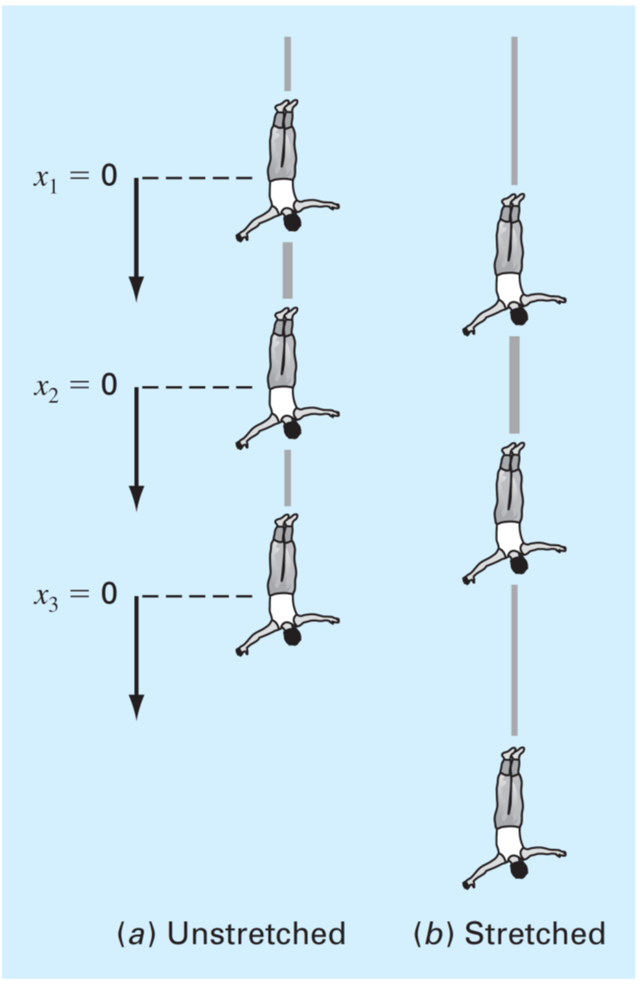

Slide 2
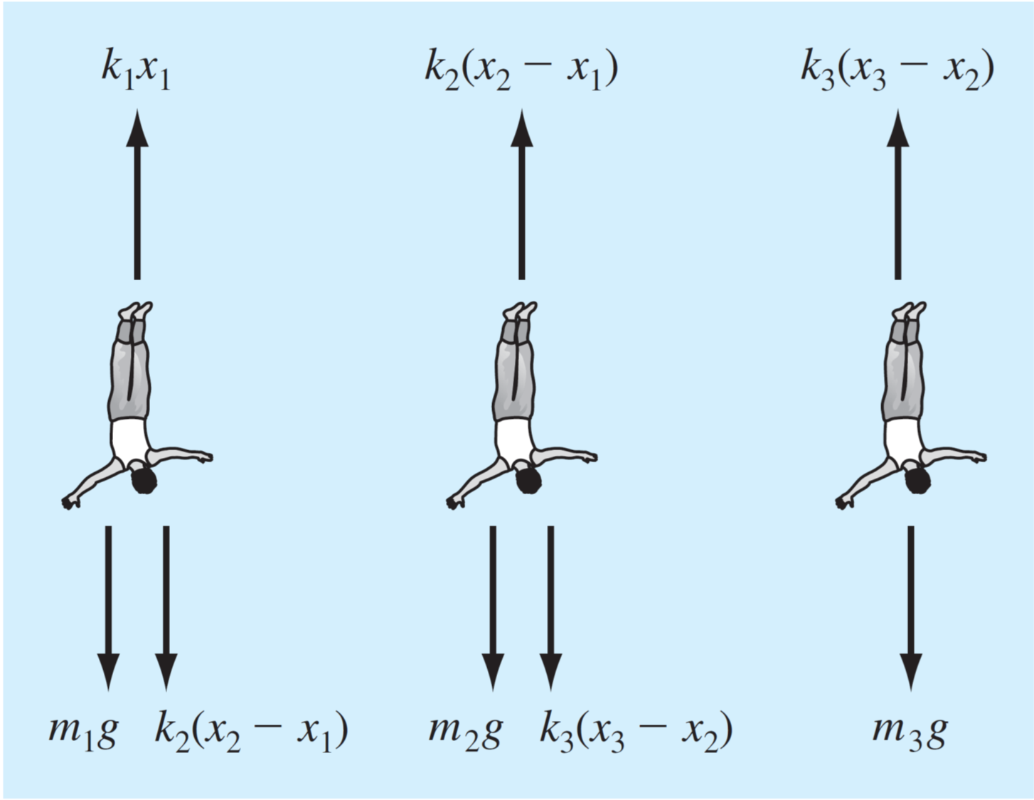

Slide 3
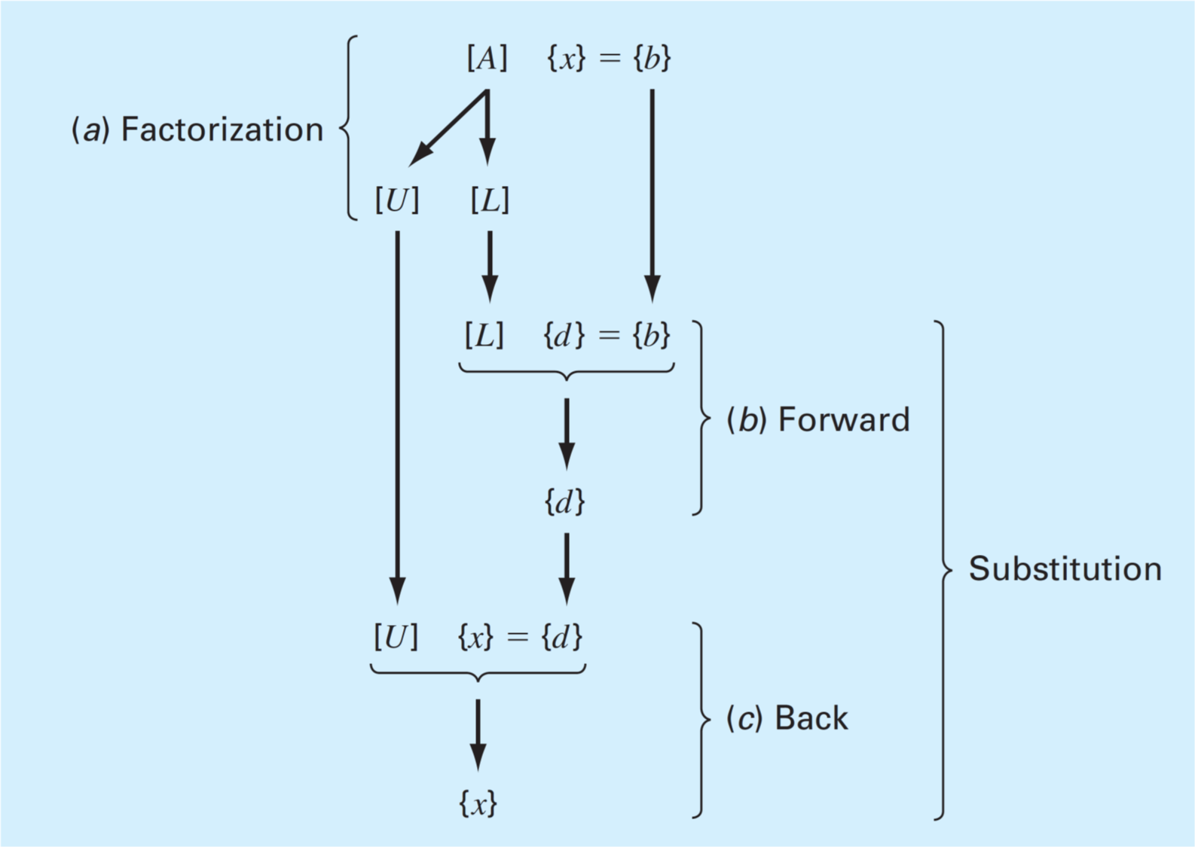


$\{x\text{\}}\text{ = }\{y$}
$\{y$}

Slide 4
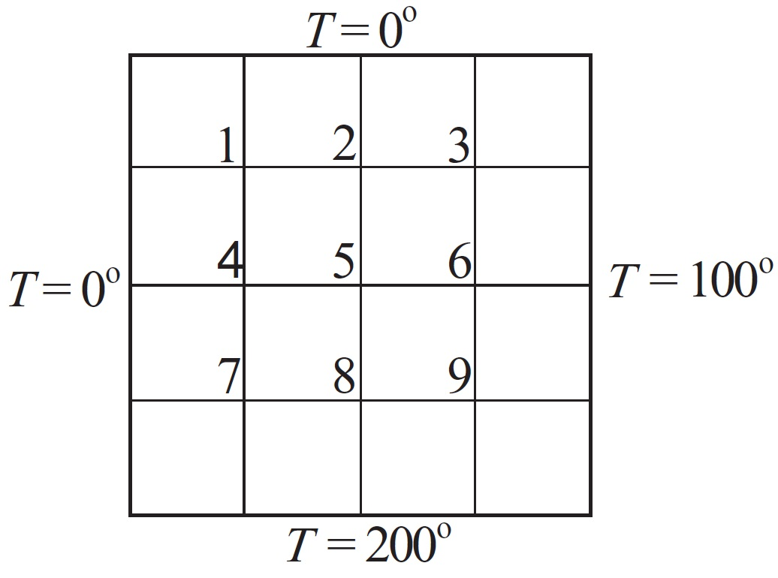











$$x$$
$$1,1$$
$$1,2$$
$$1,3$$
$$y$$
$$2,1$$
$$2,2$$
$$2,3$$
$$3,1$$
$$3,2$$
$$3,3$$

Slide 5
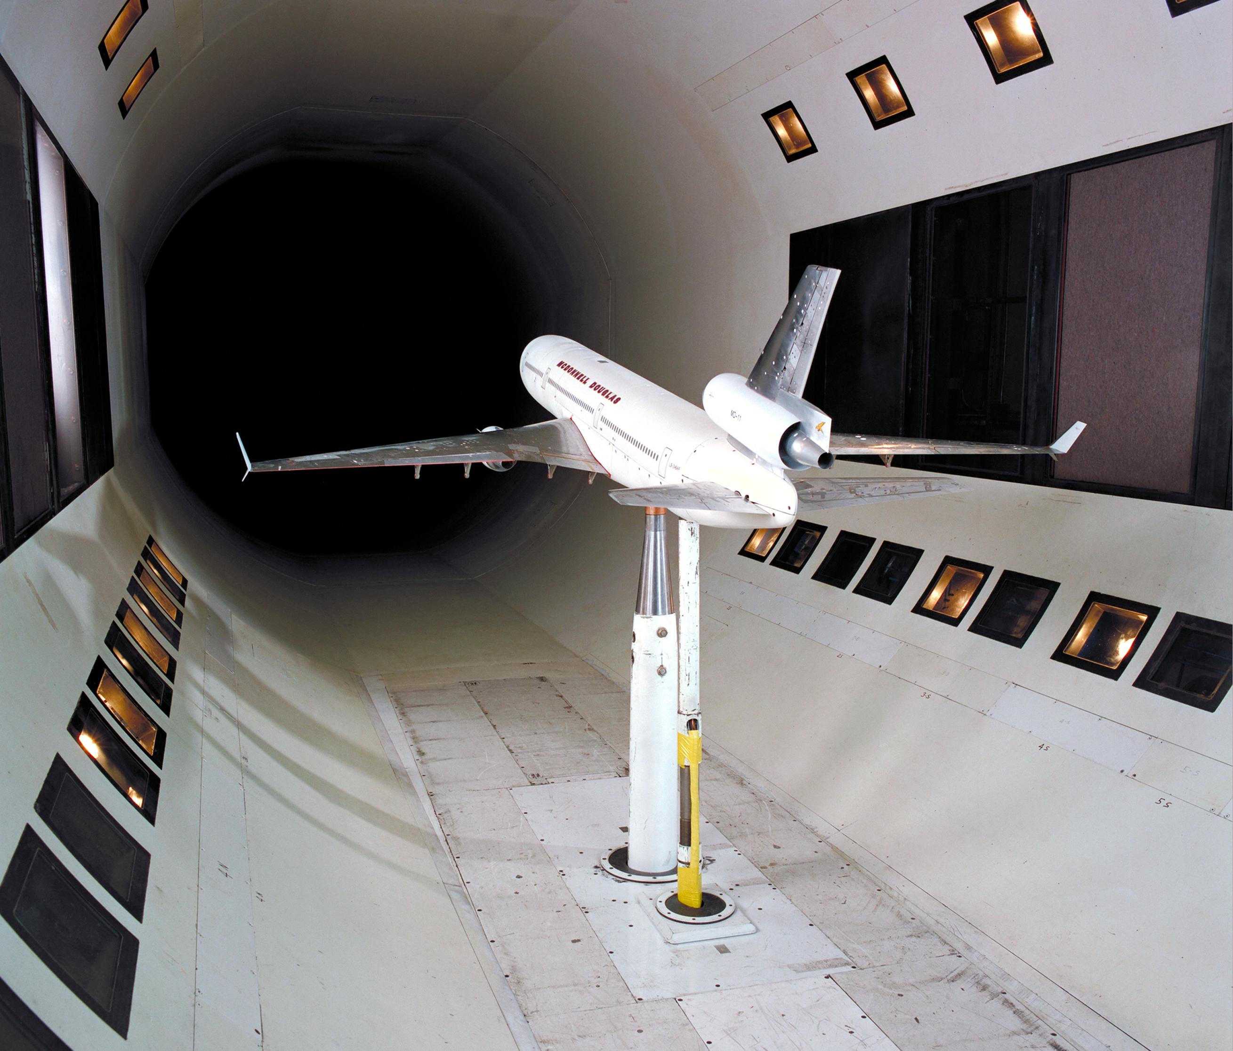
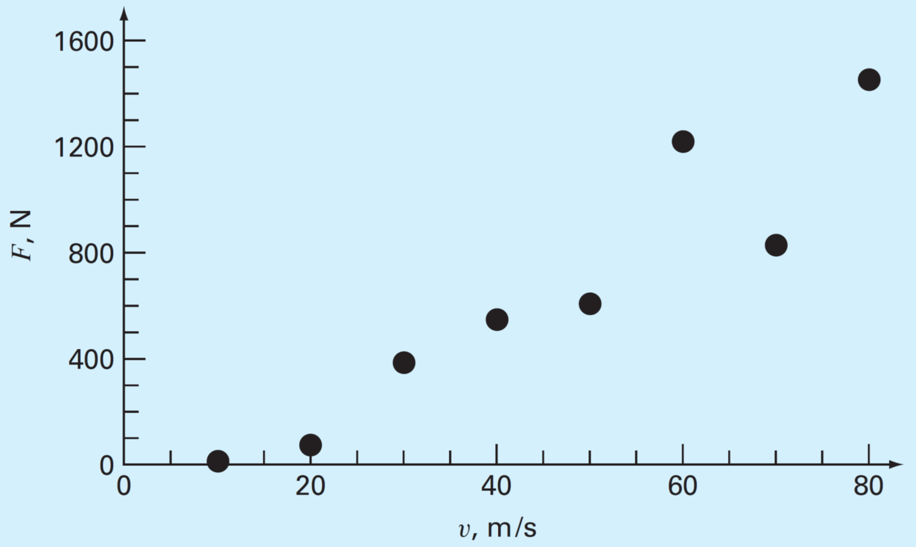

Slide 6
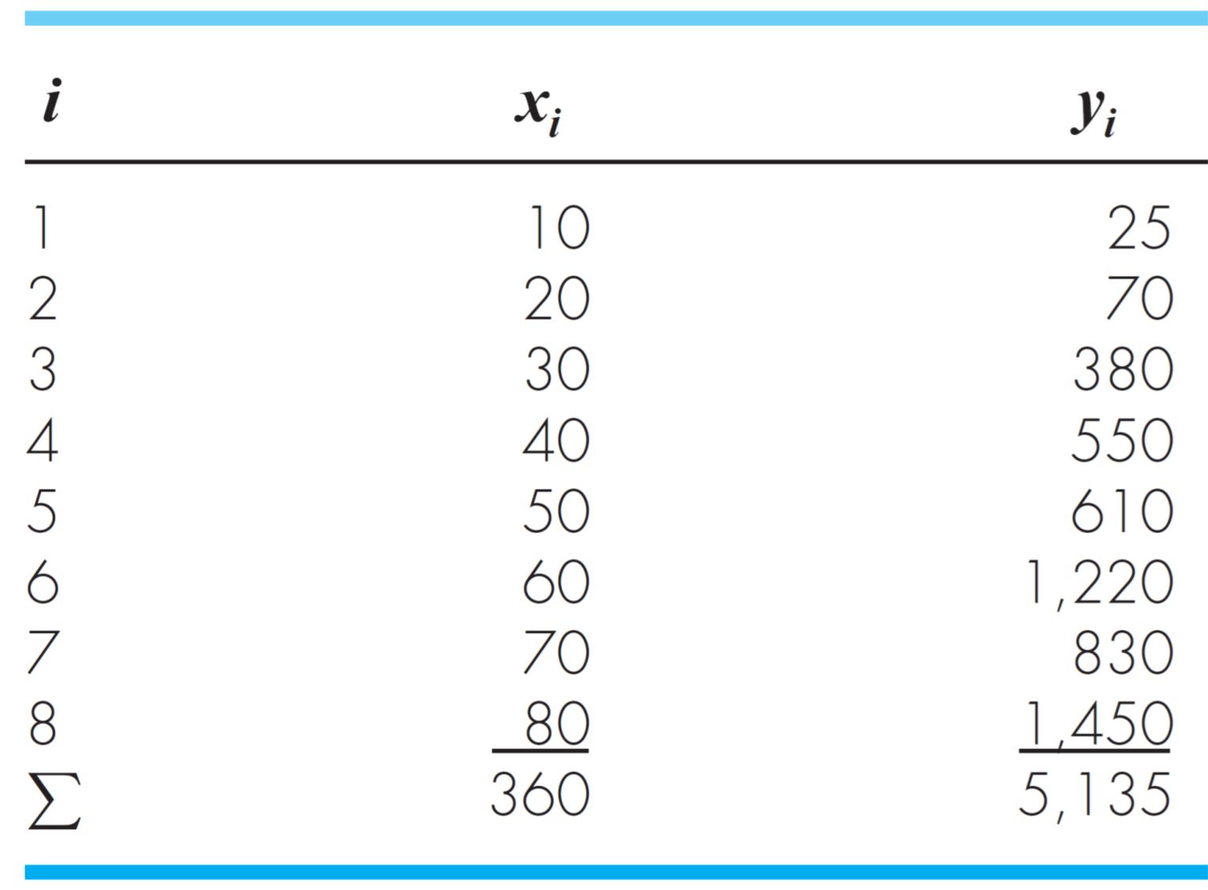

Slide 7
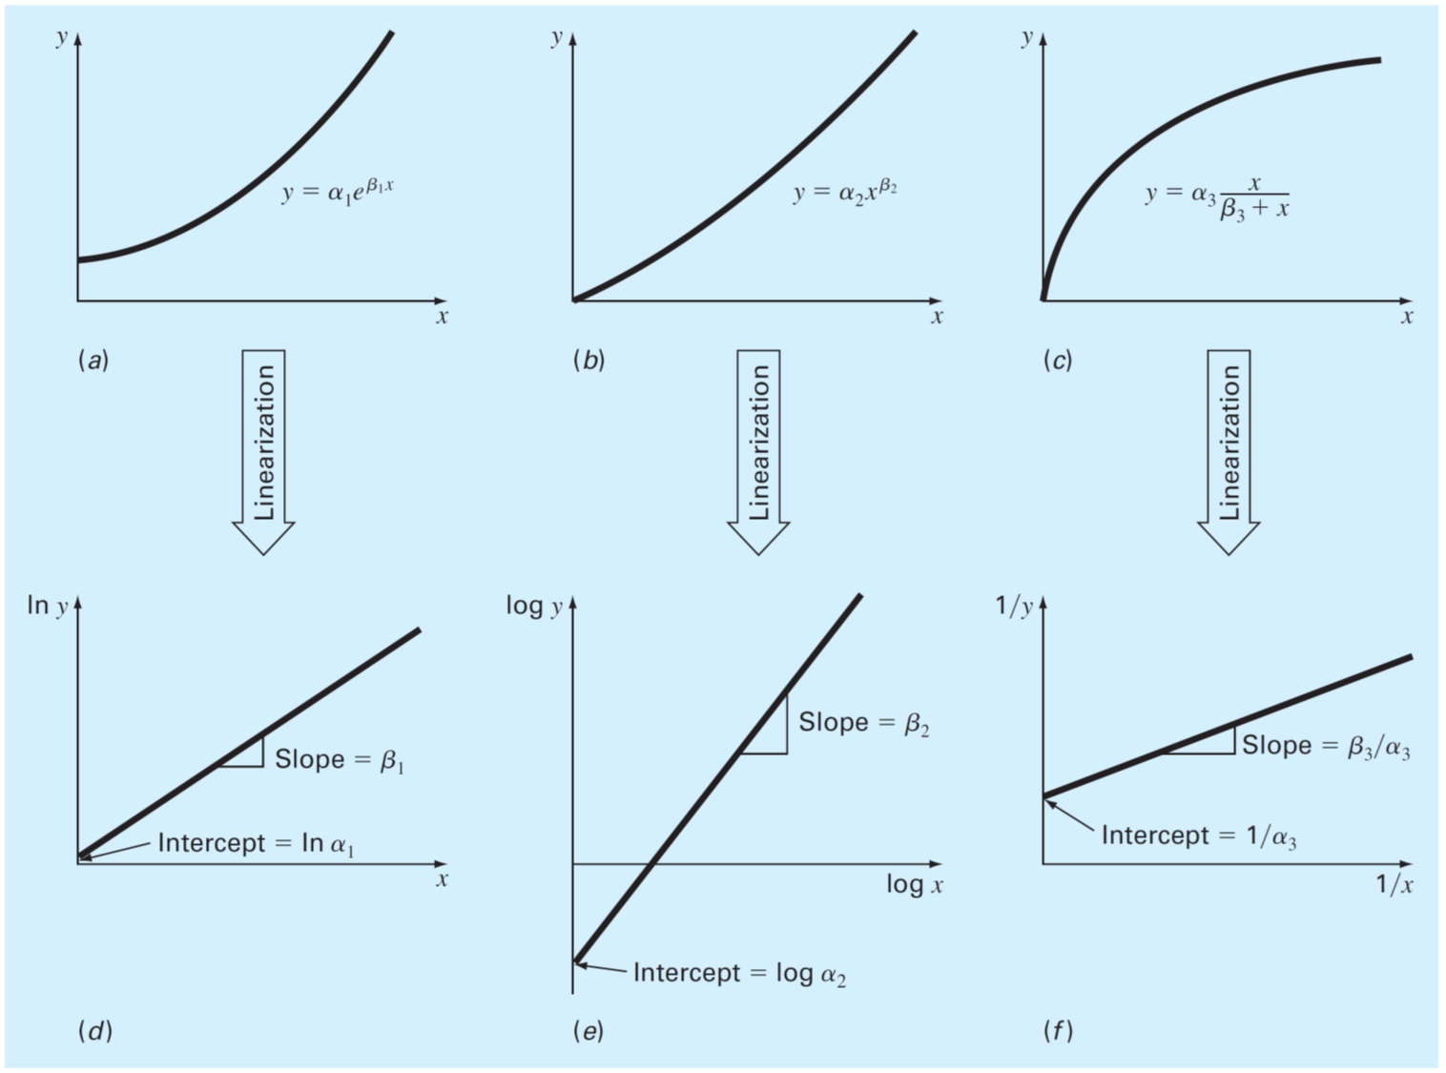

Slide 8
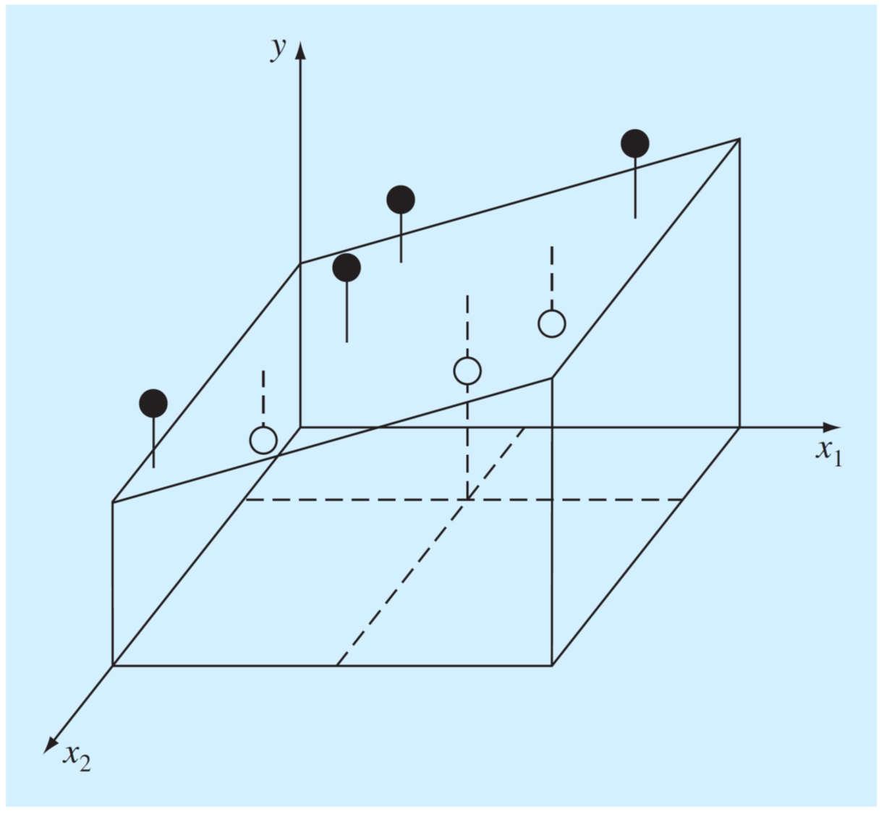

Slide 9
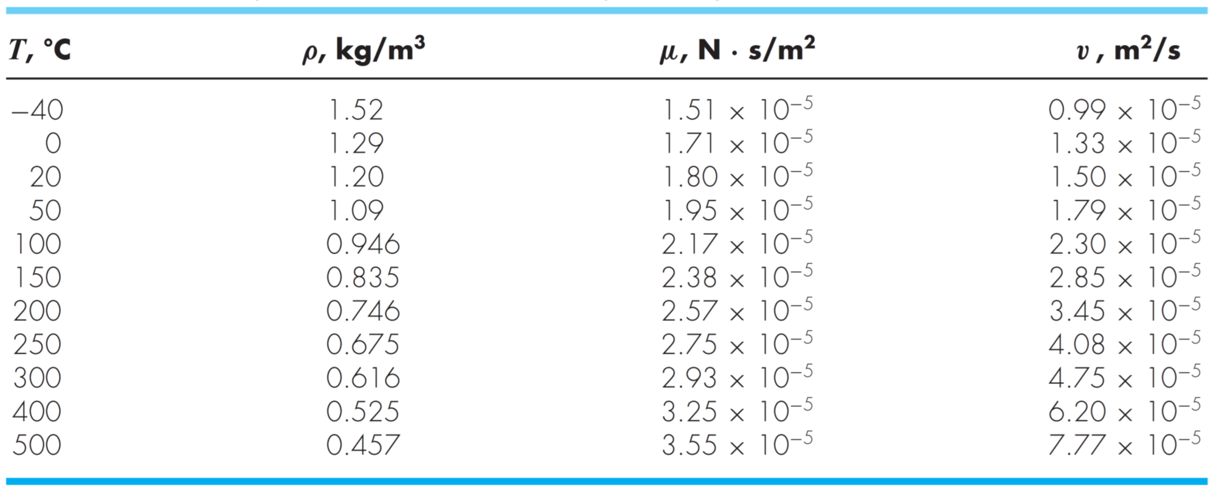

Slide 10
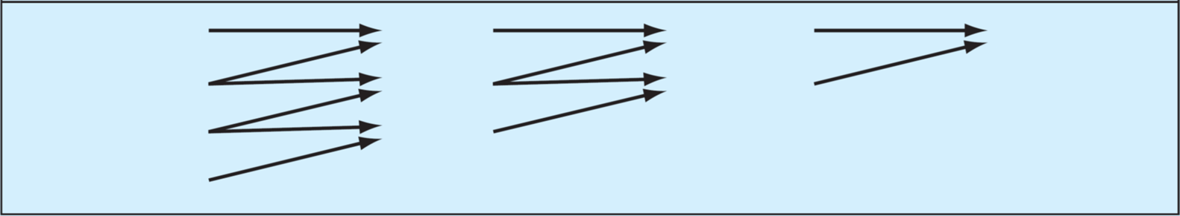














$$x_{0}$$
$$y_{0}$$
$$f_{ }\left[x_{1},x_{0}\right]$$
$$f_{ }\left[x_{2},x_{1},x_{0}\right]$$
$$f_{ }\left[x_{4},x_{3},x_{2},x_{1}\right]$$
$$x_{1}$$
$$y_{1}$$
$$f_{ }\left[x_{2},x_{1}\right]$$
$$f_{ }\left[x_{3},x_{2},x_{1}\right]$$
$$x_{2}$$
$$y_{2}$$
$$f_{ }\left[x_{3},x_{2}\right]$$
$$x_{3}$$
$$y_{3}$$

Slide 11
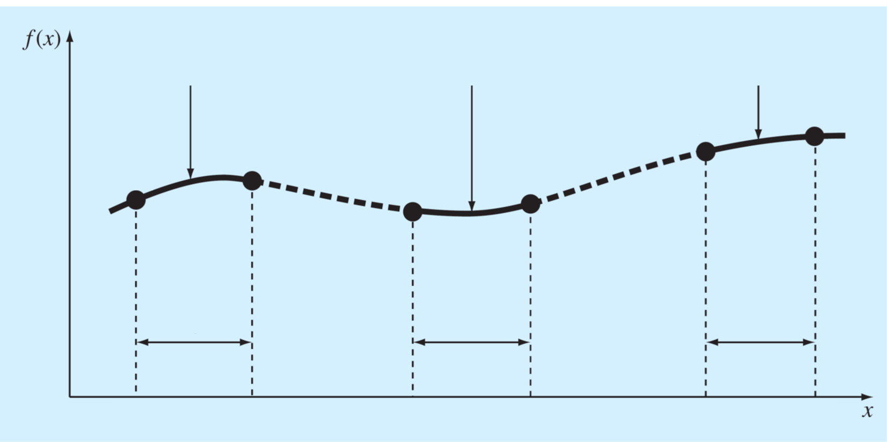


















$$S_{1}(x)$$
$$S_{i}(x)$$
$$S_{n}(x)$$
$$f_{n−1}$$
$$f_{n}$$
$$f_{1}$$
$$f_{0}$$
$$f_{i}$$
$$f_{i+1}$$
Intervalo $1$
Intervalo $i$
Intervalo $n$
$$x_{0}$$
$$x_{1}$$
$$x_{i}$$
$$x_{i+1}$$
$$x_{n−1}$$
$$x_{n}$$

Slide 12
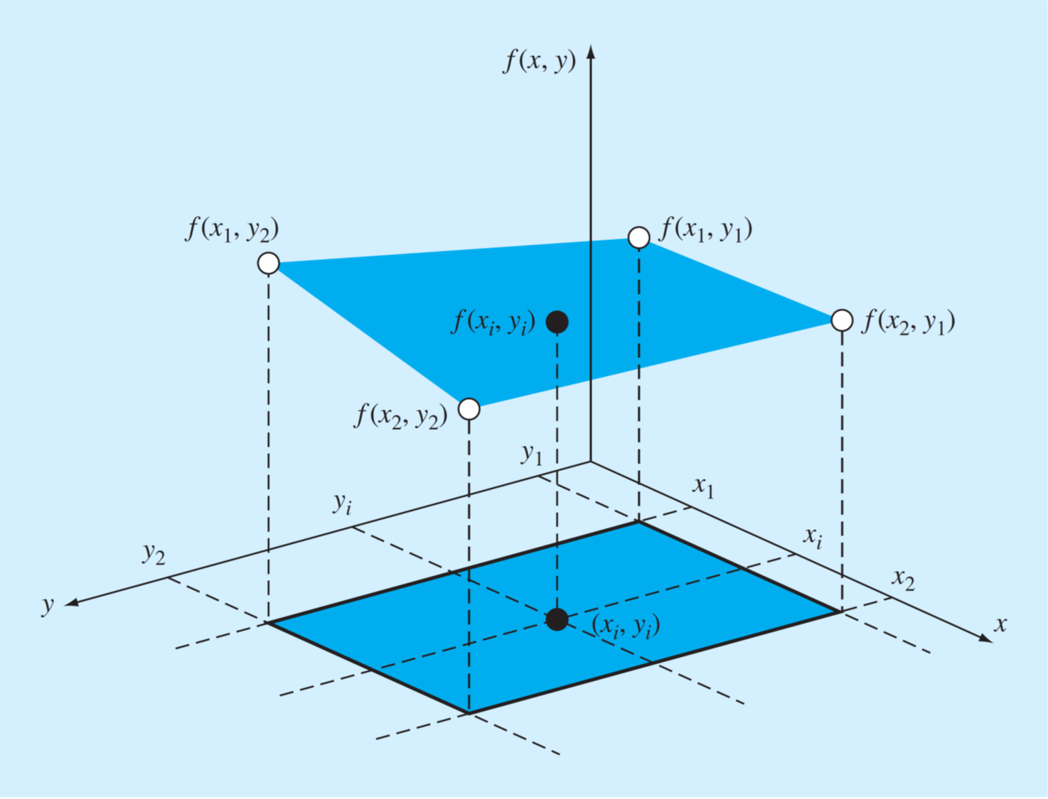

Slide 13
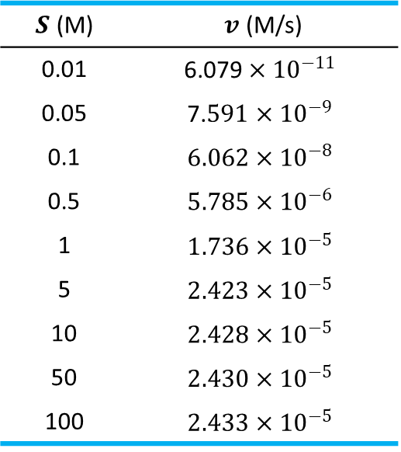
$S$ (M) | $v$ (M/s)
0.01 | $$\text{6.079}×{10}^{−11}$$
0.05 | $$\text{7.}591×{10}^{−9}$$
0.1 | $$6.062×{10}^{−8}$$
0.5 | $$5.785×{10}^{−6}$$
1 | $$1.736×{10}^{−5}$$
5 | $$2.423×{10}^{−5}$$
10 | $$2.428×{10}^{−5}$$
50 | $$2.430×{10}^{−5}$$
100 | $$2.433×{10}^{−5}$$
$$x$$ | −0.04 | 0.93 | 1.95 | 2.90 | 3.83 | 5.00 | 5.98 | 7.05 | 8.21 | 9.08 | 10.09
$$y$$ | 3.28 | 10.52 | 34.21 | 76.58 | 122.38 | 207.02 | 303.77 | 412.30 | 566.72 | 695.33 | 889.31

Slide 14





$$P_{1}$$
$$P_{2}$$
$$ΔP=P_{2}−P_{1}<0$$
$$V$$
$$D$$
$$L$$

Slide 15
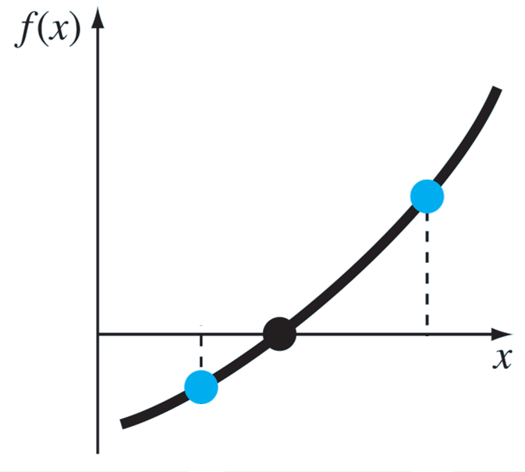





$$f(b)$$
$$c$$
$$a$$
$$b$$
$$f(a)$$

Slide 16
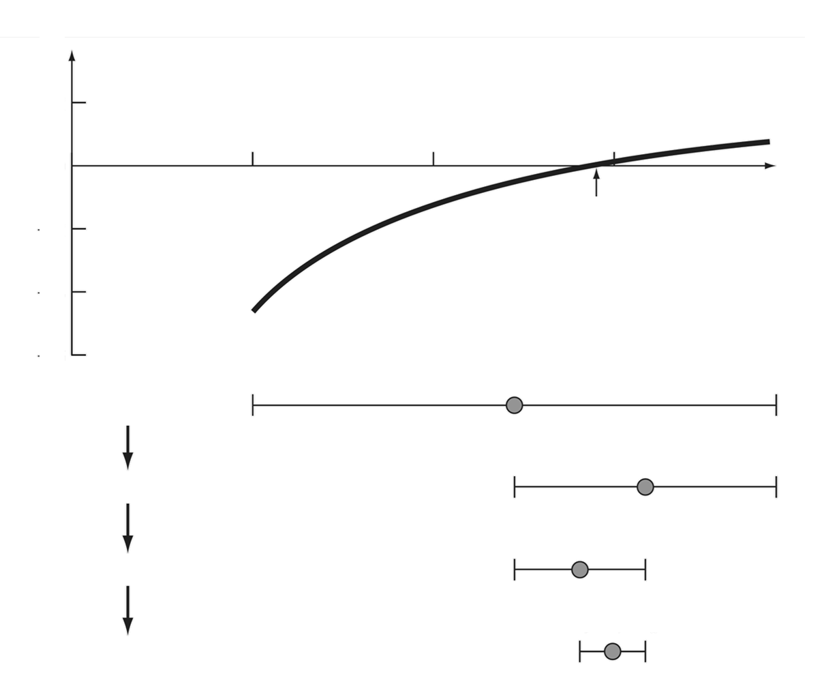














$$f(x)$$
$$x$$
$$x_{0}$$
$$a$$
$$m_{1}$$
$$b$$
1era iteración
$$m_{1}$$
$$m_{2}$$
$$b$$
2da iteración
$$m_{1}$$
$$m_{3}$$
$$m_{2}$$
3ra iteración
$$m_{3}$$
$$m_{2}$$
4ta iteración

Slide 17
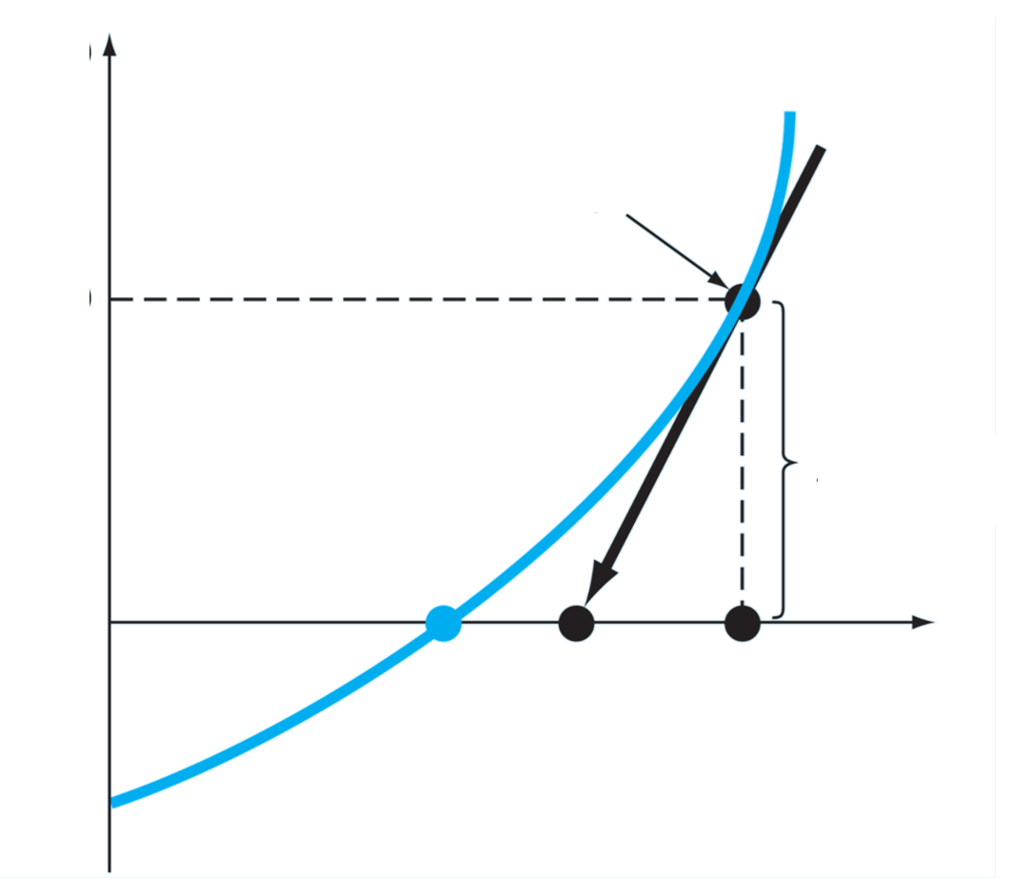






$$f(x)$$
$$f′(x_{k})$$
$$f(x_{k})$$
$$x_{k+1}$$
$$x_{k}$$
$$x$$

