Slide 1
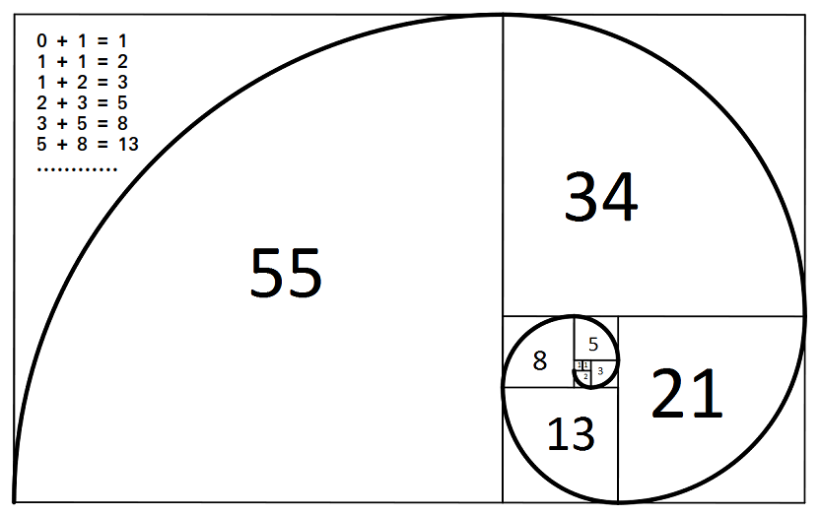

Slide 2
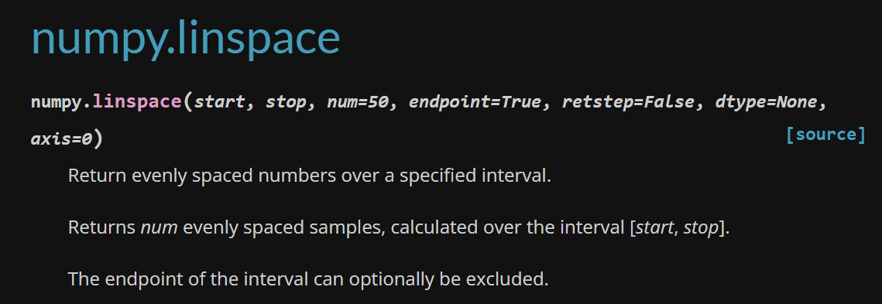

Slide 3
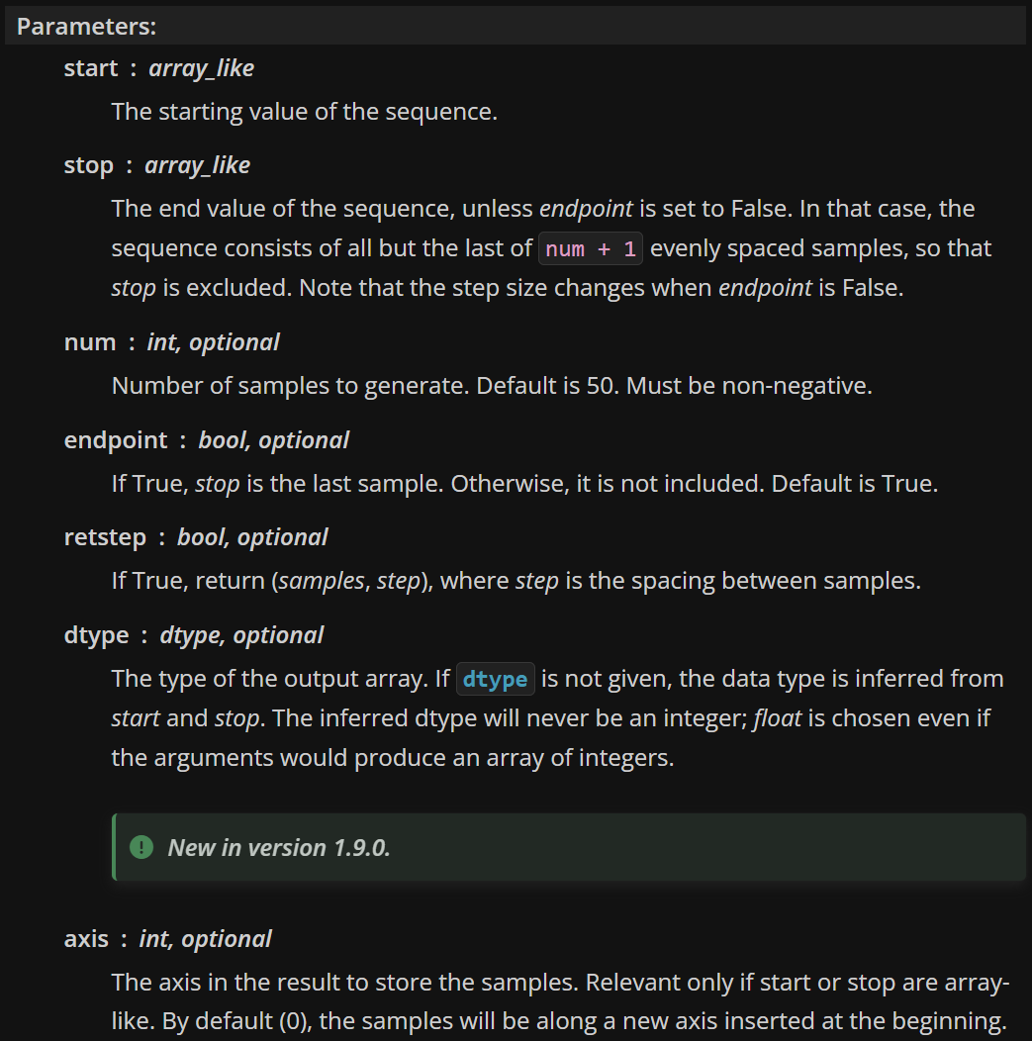

Slide 4
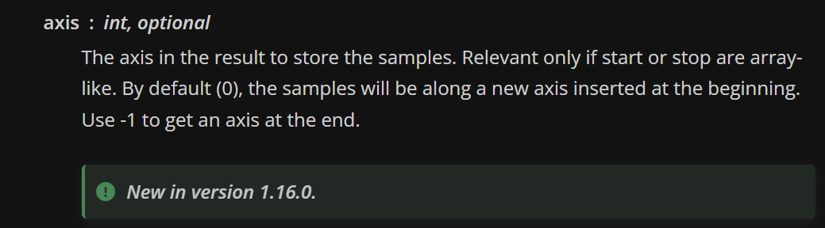

Slide 5
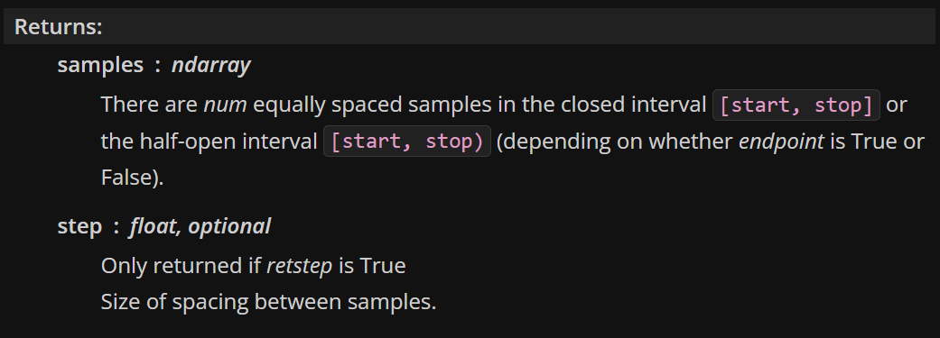

Slide 6
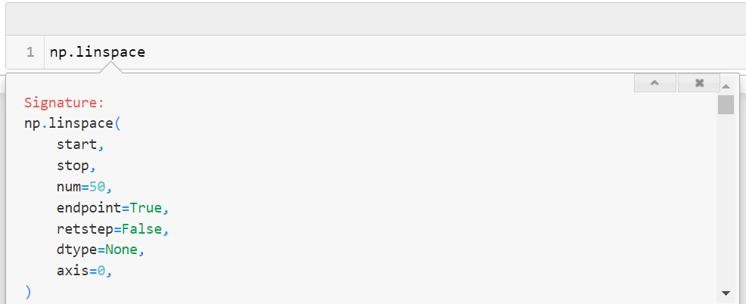

Slide 7
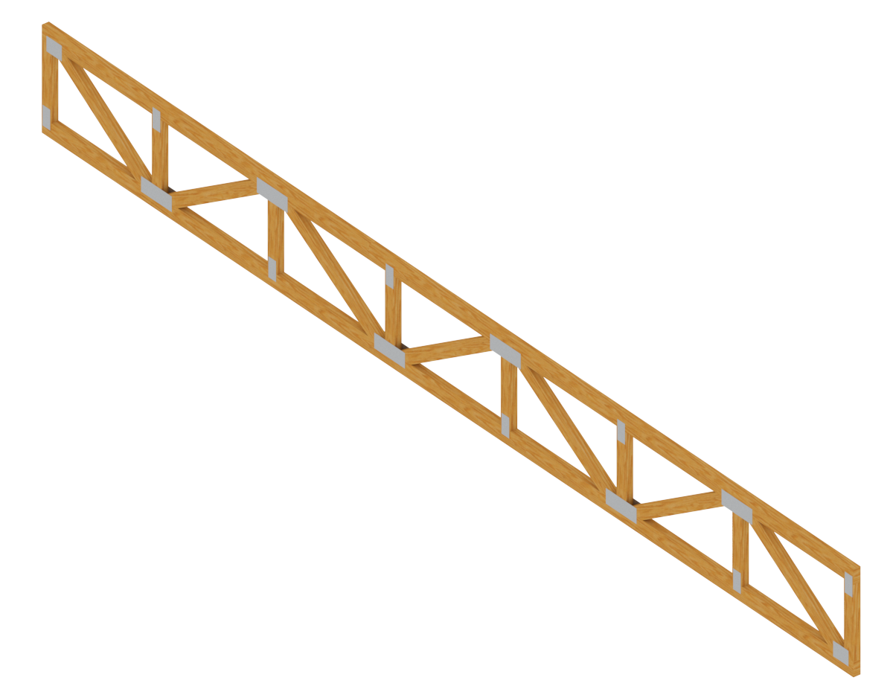
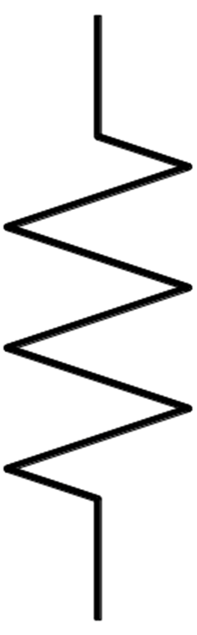
Reticulado
Sistema equivalente

Slide 8
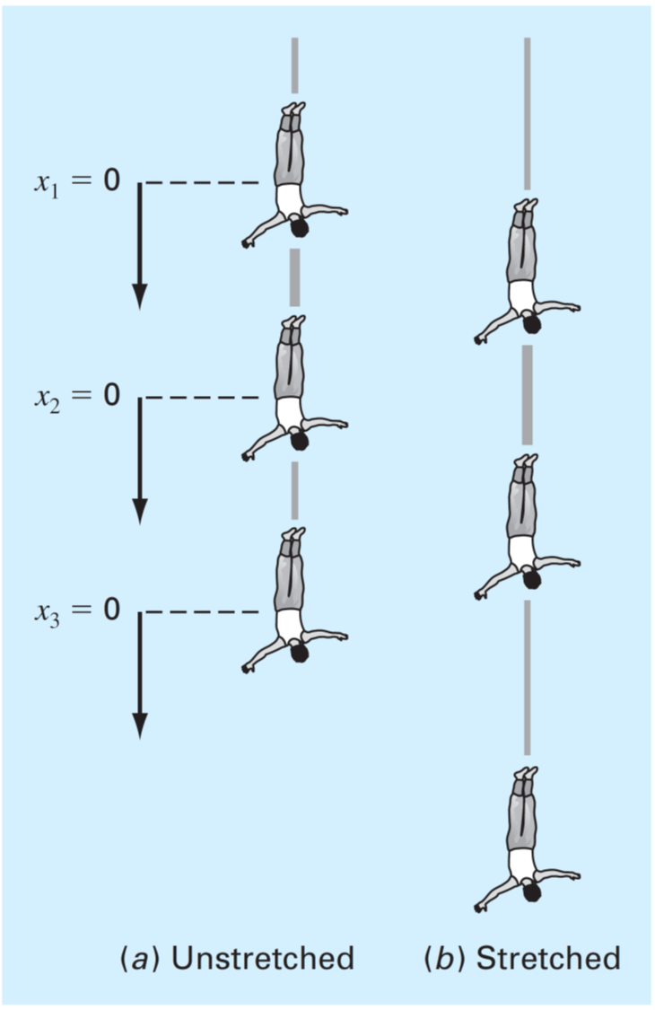
Inicial
Estirado

Slide 9
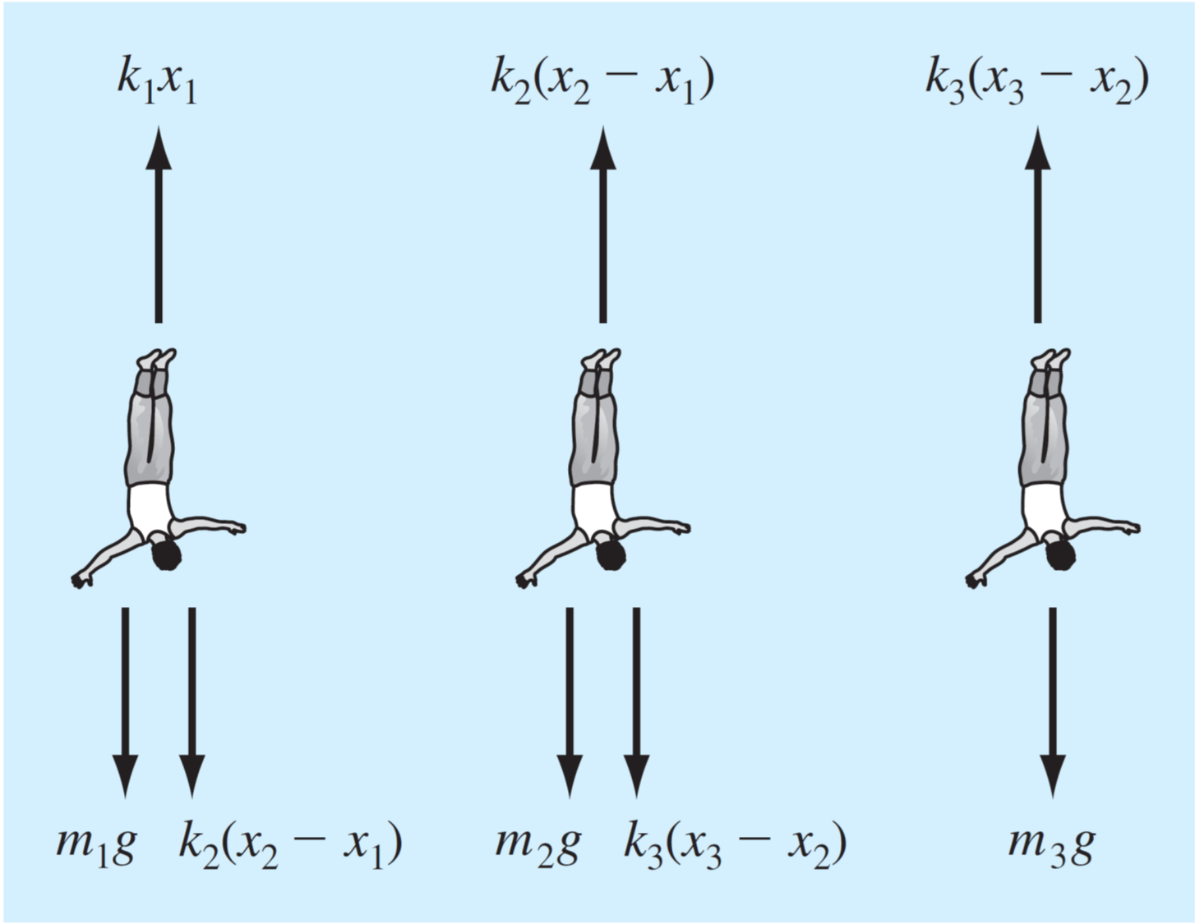

Slide 10
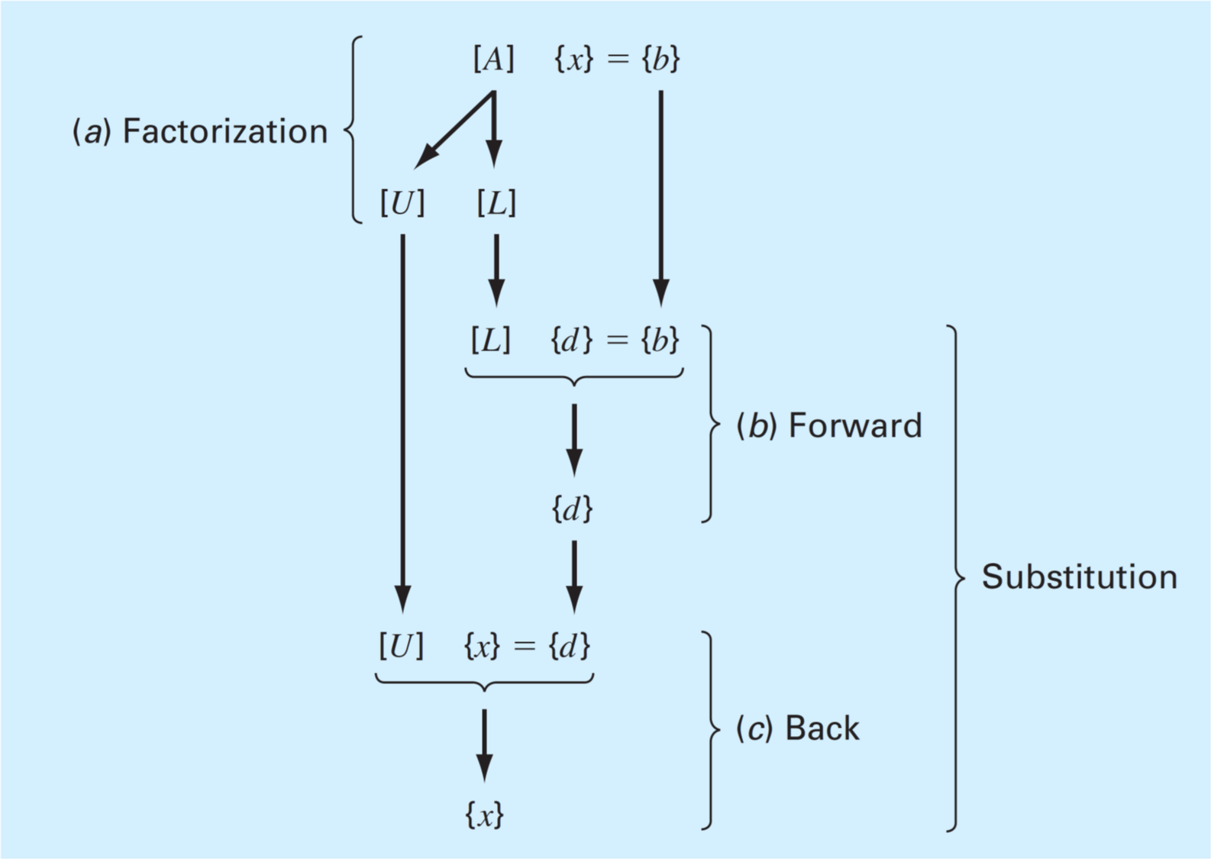


$\{x\text{\}}\text{ = }\{y$}
$\{y$}

Slide 11
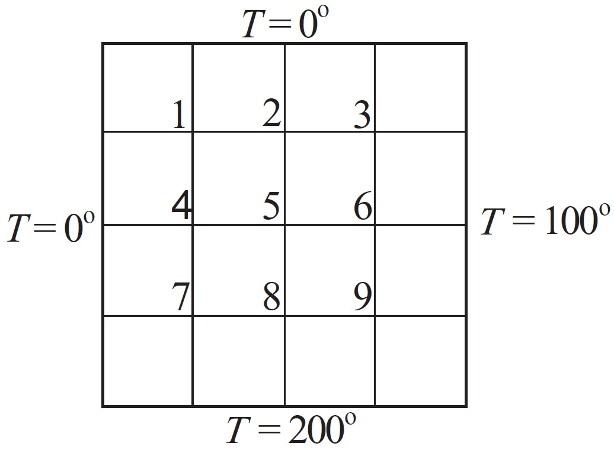











$$x$$
$$1,1$$
$$1,2$$
$$1,3$$
$$y$$
$$2,1$$
$$2,2$$
$$2,3$$
$$3,1$$
$$3,2$$
$$3,3$$

Slide 12
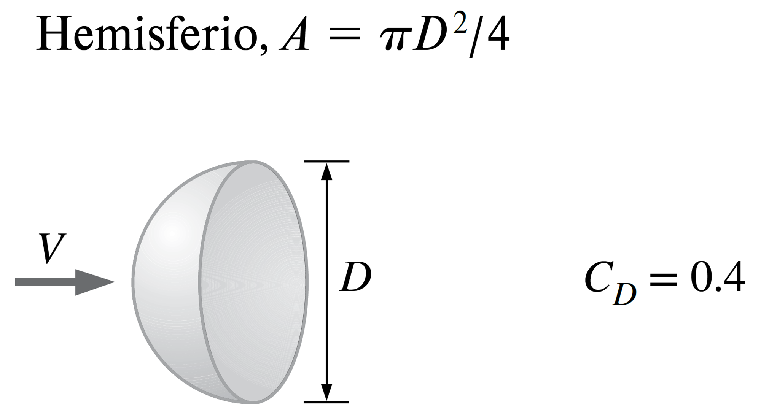

$$F=\frac{1}{2}ρAC_{D}V^{2}$$

Slide 13
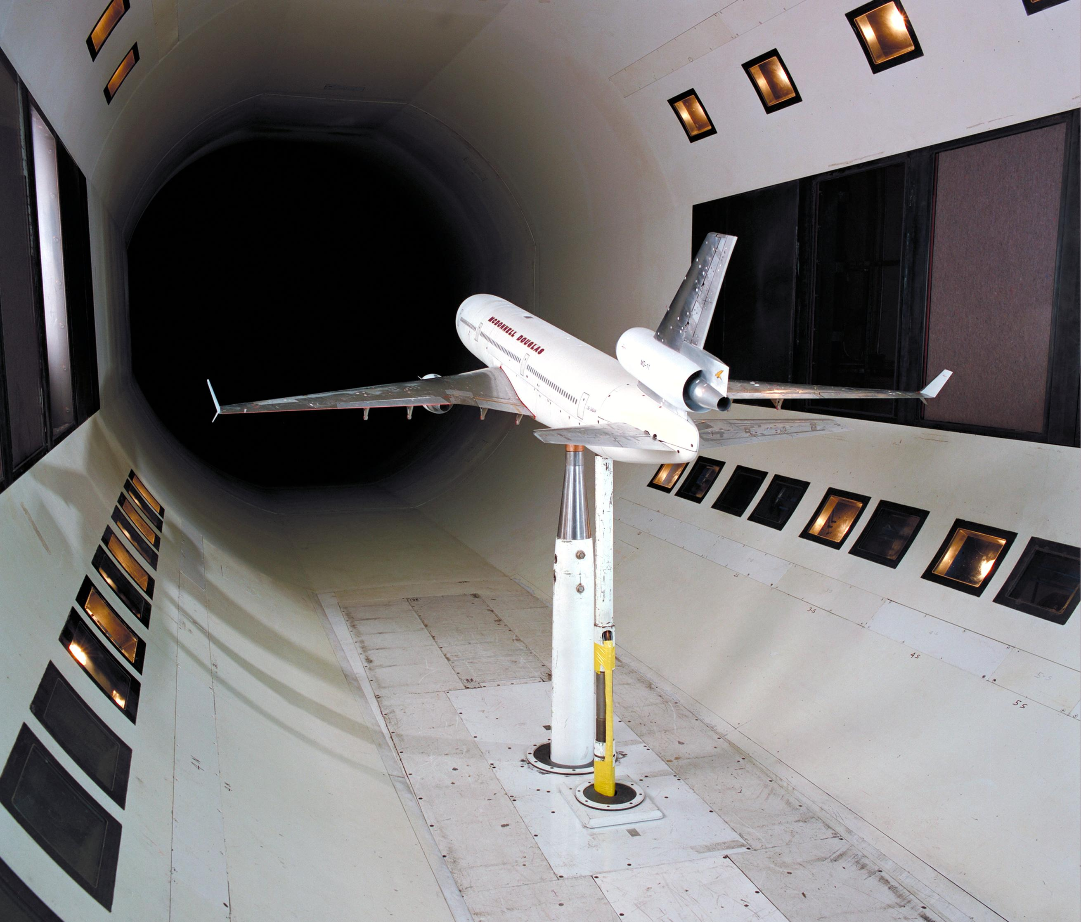
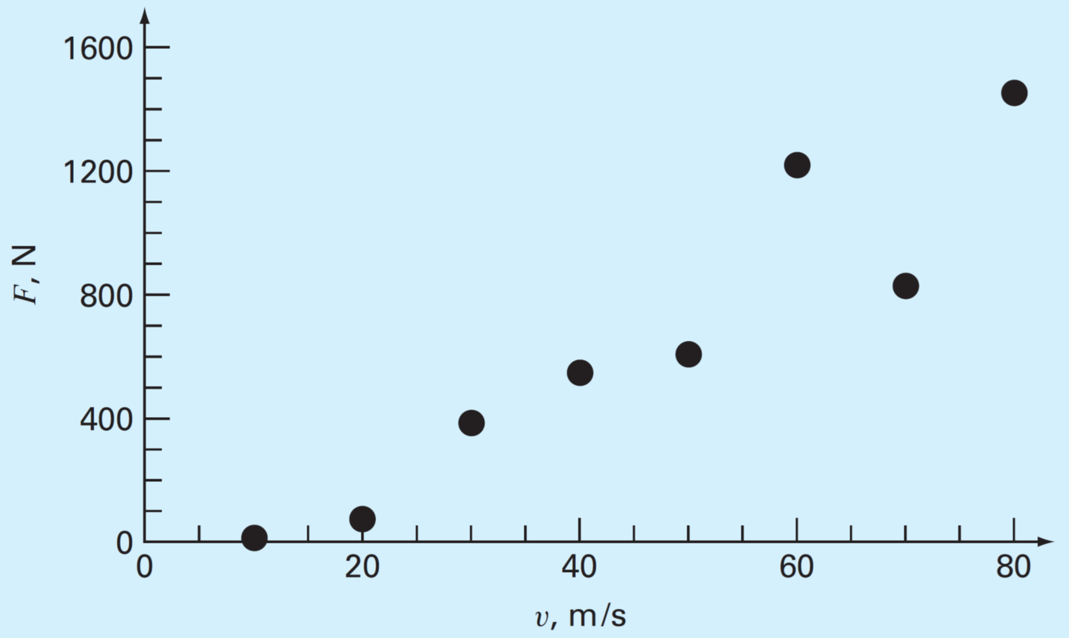

Slide 14
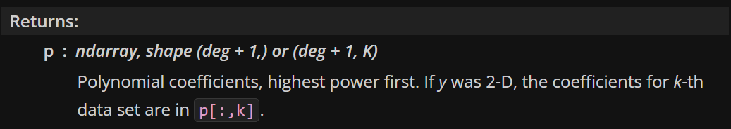

Slide 15
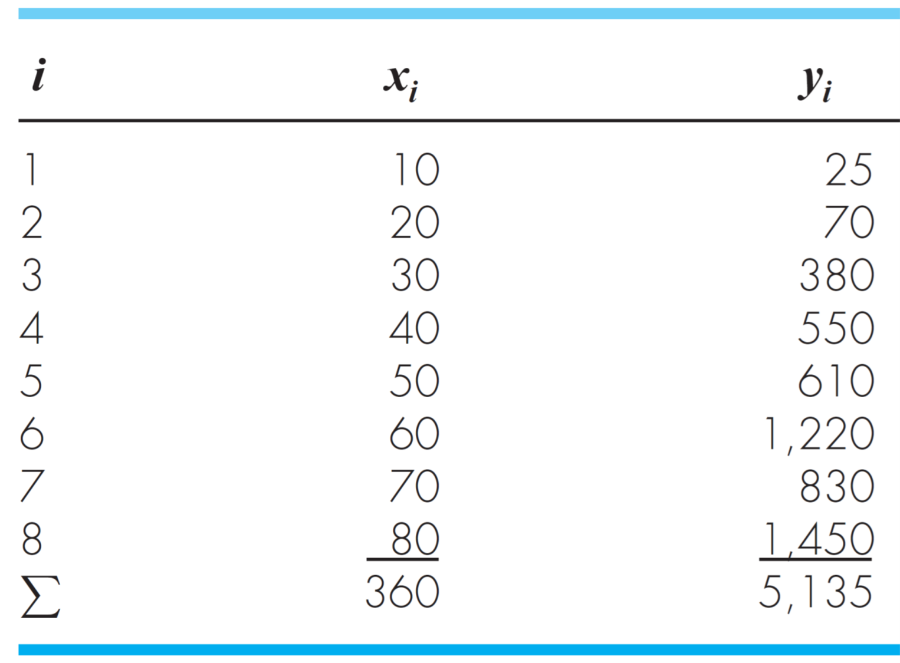

Slide 16
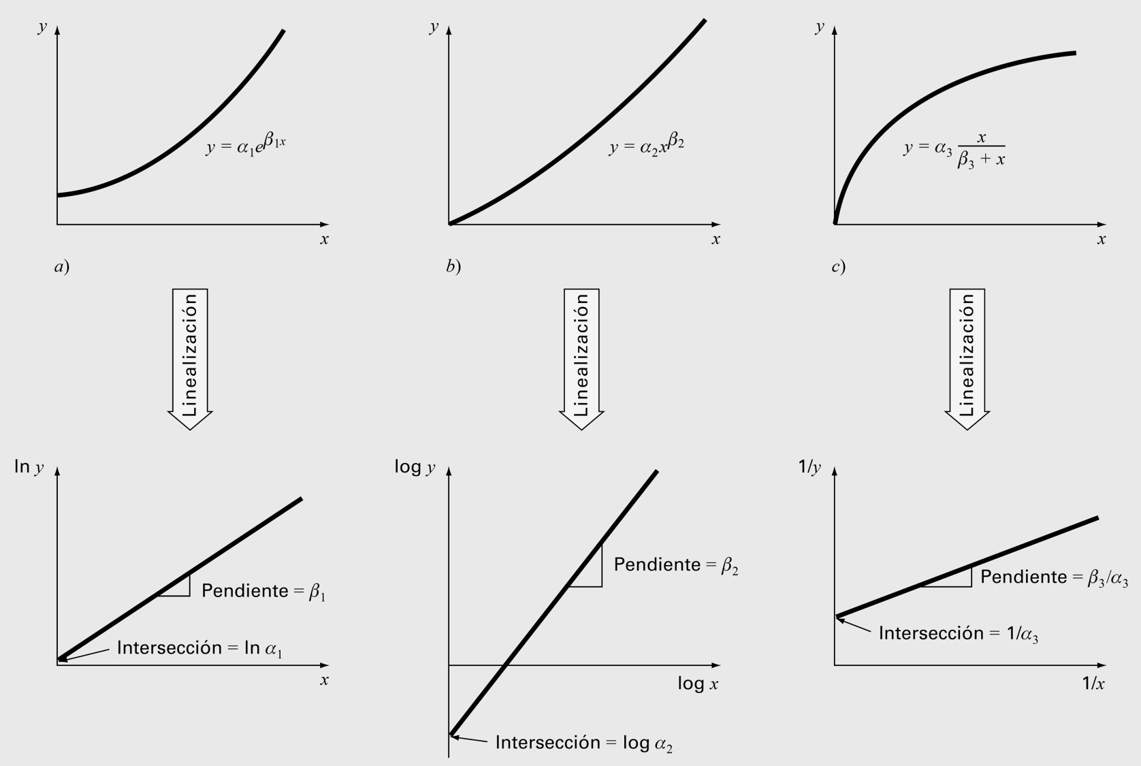

Slide 17
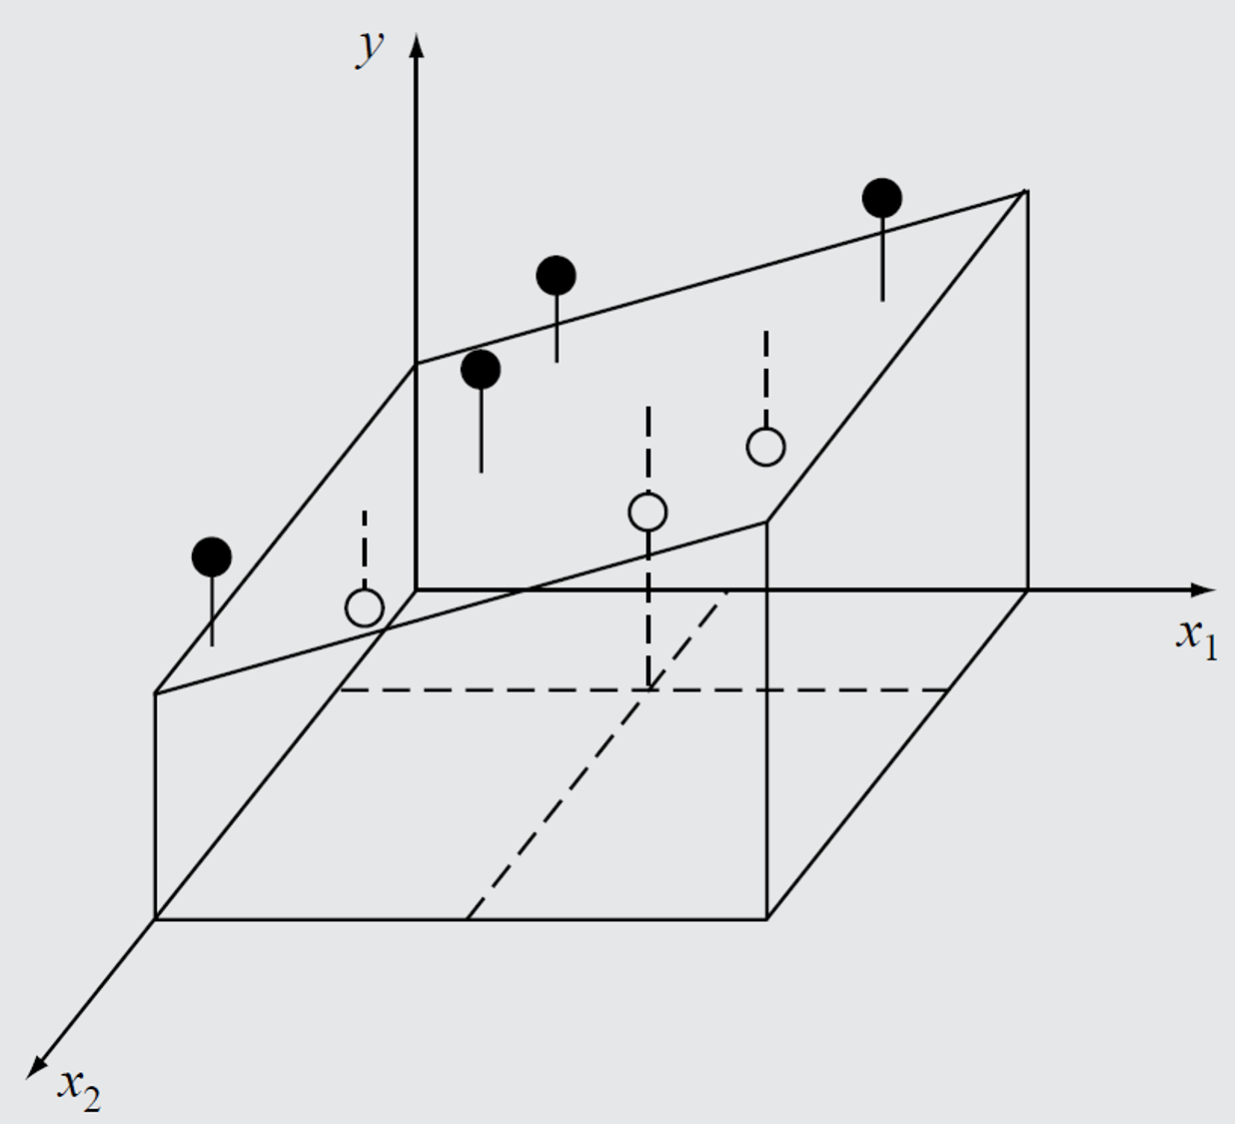

Slide 18
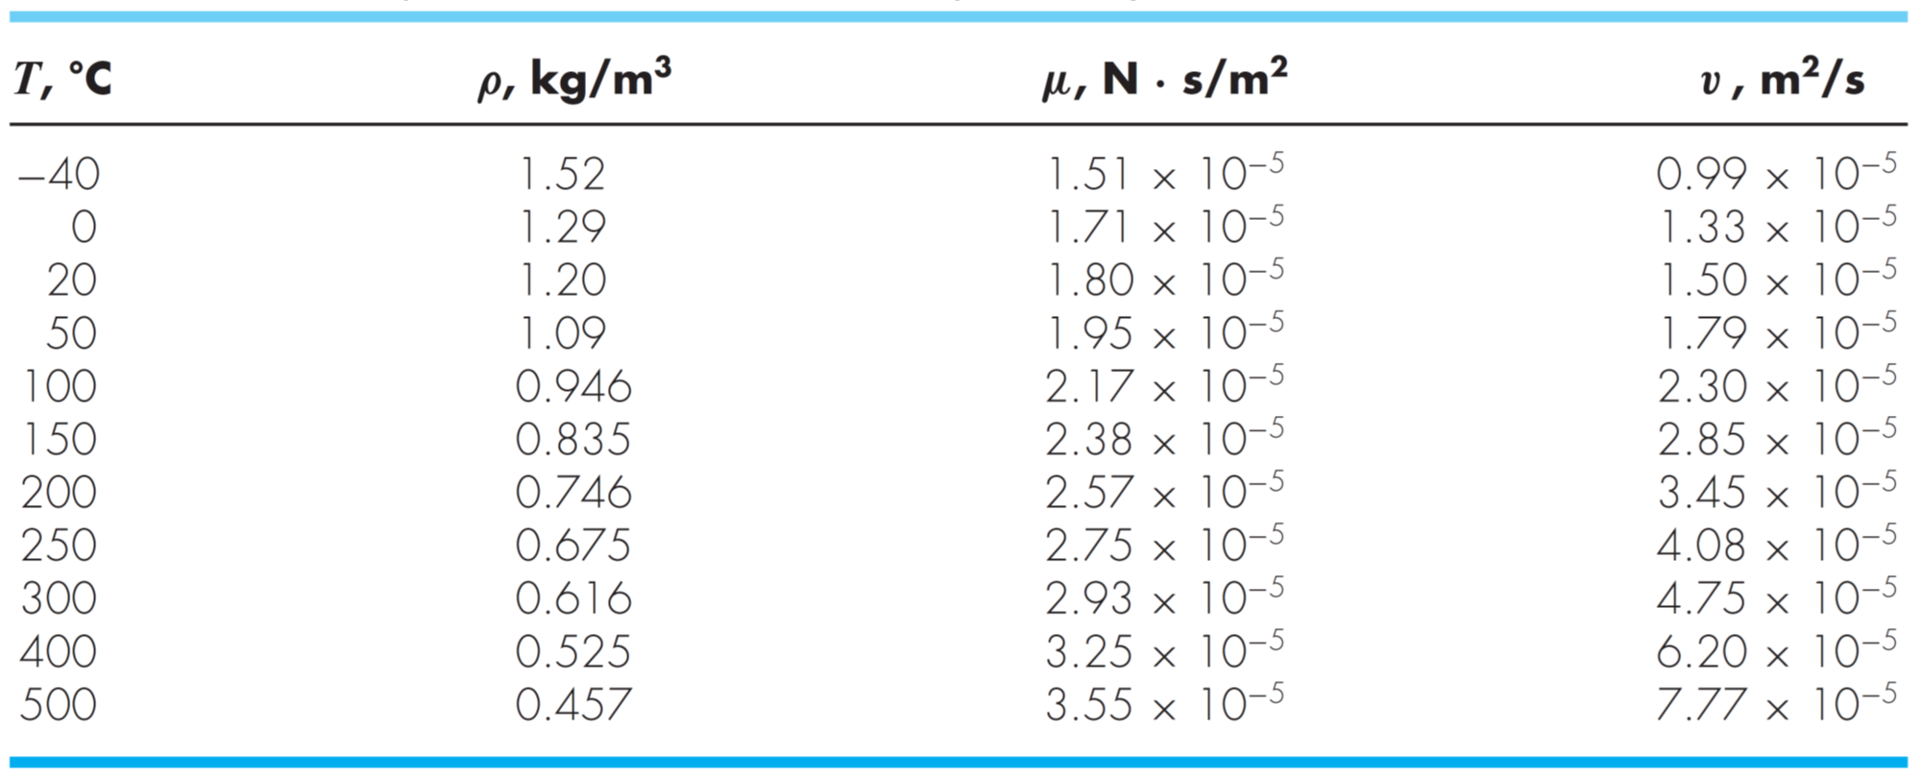

Slide 19
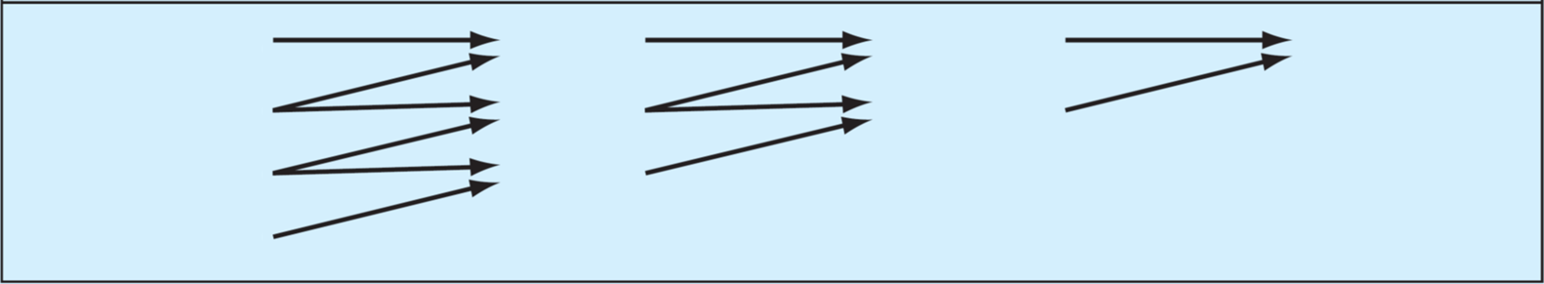














$$x_{0}$$
$$y_{0}$$
$$f_{ }\left[x_{1},x_{0}\right]$$
$$f_{ }\left[x_{2},x_{1},x_{0}\right]$$
$$f_{ }\left[x_{4},x_{3},x_{2},x_{1}\right]$$
$$x_{1}$$
$$y_{1}$$
$$f_{ }\left[x_{2},x_{1}\right]$$
$$f_{ }\left[x_{3},x_{2},x_{1}\right]$$
$$x_{2}$$
$$y_{2}$$
$$f_{ }\left[x_{3},x_{2}\right]$$
$$x_{3}$$
$$y_{3}$$

Slide 20
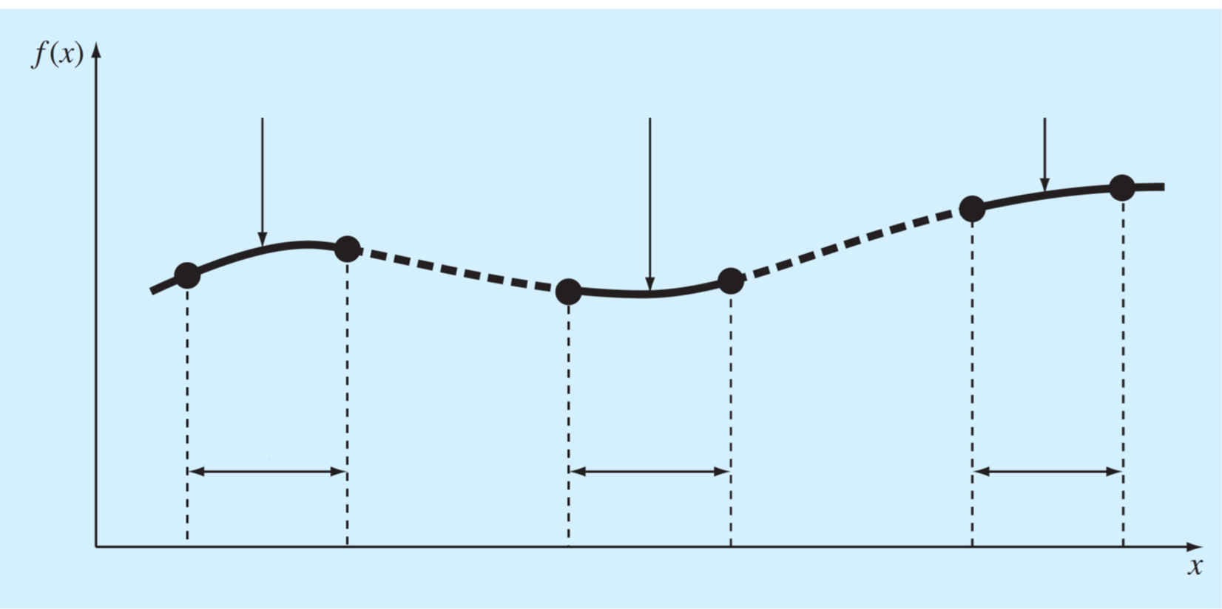


















$$S_{1}(x)$$
$$S_{i}(x)$$
$$S_{n}(x)$$
$$f_{n−1}$$
$$f_{n}$$
$$f_{1}$$
$$f_{0}$$
$$f_{i}$$
$$f_{i+1}$$
Intervalo $1$
Intervalo $i$
Intervalo $n$
$$x_{0}$$
$$x_{1}$$
$$x_{i}$$
$$x_{i+1}$$
$$x_{n−1}$$
$$x_{n}$$

Slide 21
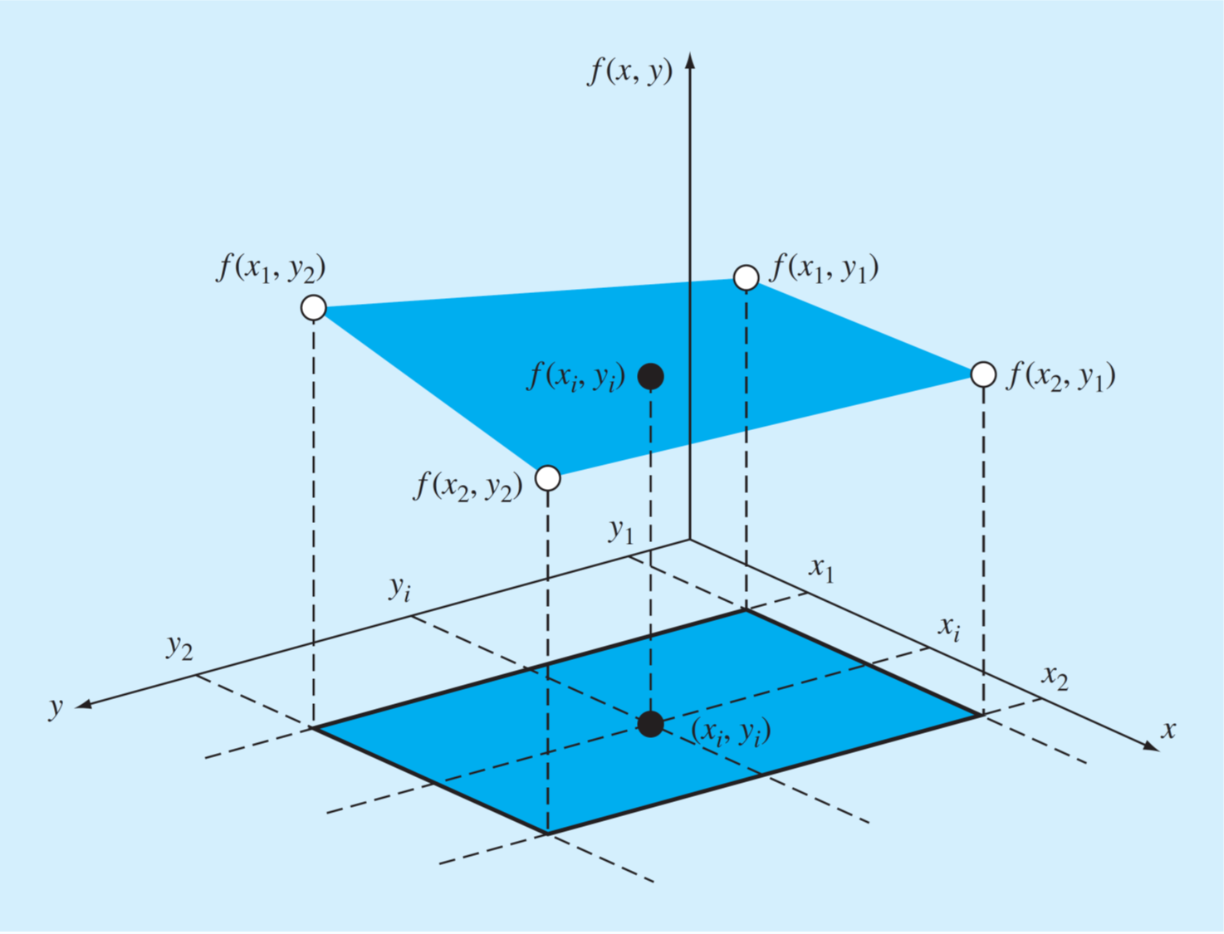

Slide 22
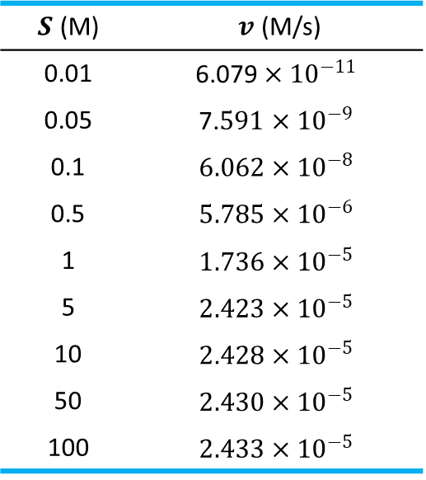
$S$ (M) | $v$ (M/s)
0.01 | $$\text{6.079}×{10}^{−11}$$
0.05 | $$\text{7.}591×{10}^{−9}$$
0.1 | $$6.062×{10}^{−8}$$
0.5 | $$5.785×{10}^{−6}$$
1 | $$1.736×{10}^{−5}$$
5 | $$2.423×{10}^{−5}$$
10 | $$2.428×{10}^{−5}$$
50 | $$2.430×{10}^{−5}$$
100 | $$2.433×{10}^{−5}$$
$$x$$ | −0.04 | 0.93 | 1.95 | 2.90 | 3.83 | 5.00 | 5.98 | 7.05 | 8.21 | 9.08 | 10.09
$$y$$ | 3.28 | 10.52 | 34.21 | 76.58 | 122.38 | 207.02 | 303.77 | 412.30 | 566.72 | 695.33 | 889.31

Slide 23





$$P_{1}$$
$$P_{2}$$
$$ΔP=P_{2}−P_{1}<0$$
$$V$$
$$D$$
$$L$$

Slide 24







$$f(x)$$
$$f(b)$$
$$c$$
$$a$$
$$b$$
$$x$$
$$f(a)$$

Slide 25
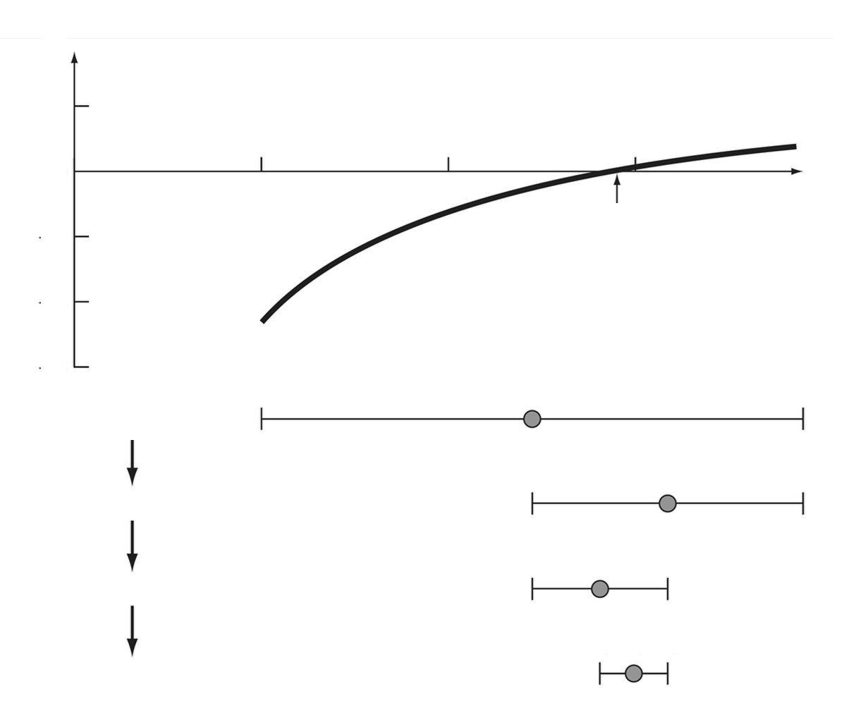














$$f(x)$$
$$x$$
$$x_{0}$$
$$a$$
$$m_{1}$$
$$b$$
1era iteración
$$m_{1}$$
$$m_{2}$$
$$b$$
2da iteración
$$m_{1}$$
$$m_{3}$$
$$m_{2}$$
3ra iteración
$$m_{3}$$
$$m_{2}$$
4ta iteración

Slide 26
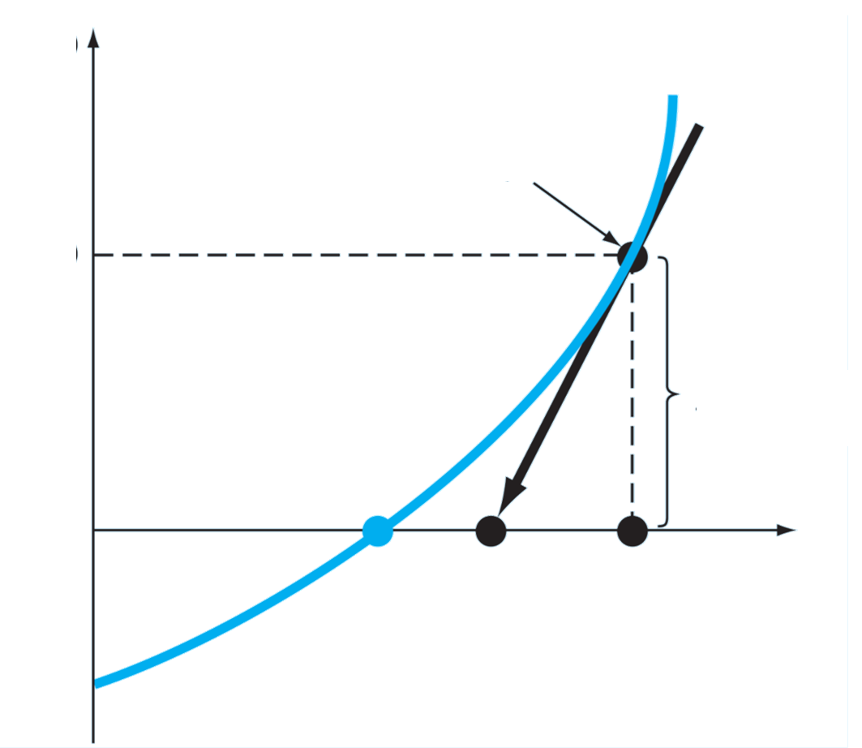






$$f(x)$$
$$f′(x_{k})$$
$$f(x_{k})$$
$$x_{k+1}$$
$$x_{k}$$
$$x$$

Slide 27
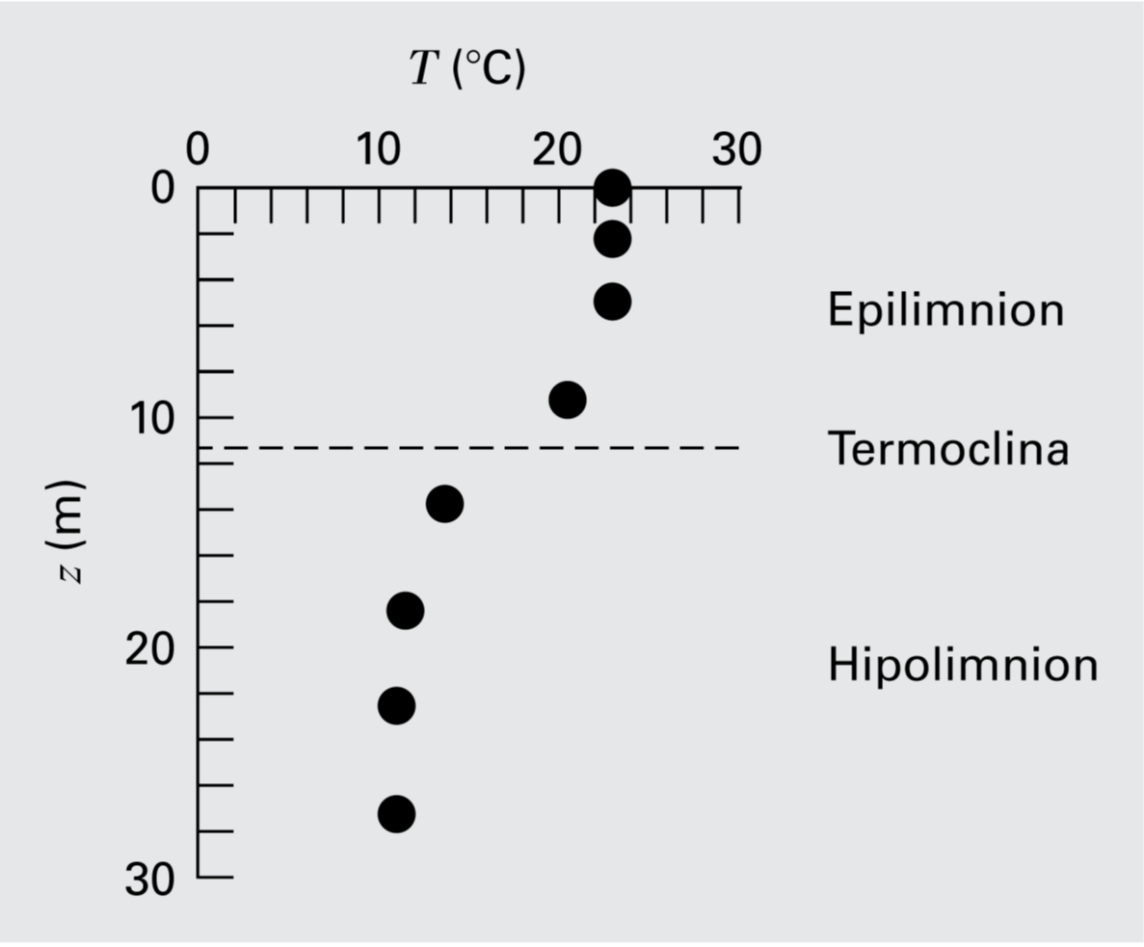
Z (m) | 0 | 2.3 | 4.9 | 9.1 | 13.7 | 18.3 | 22.9 | 27.2 | 30.0
T (°C) | 22.8 | 22.8 | 22.8 | 20.6 | 13.9 | 11.7 | 11.1 | 11.1 | 11.1
U (m/s) | 0.5 | 2 | 10 | 0.5 | 2 | 10 | 0.5 | 2 | 10
H (m) | 0.15 | 0.15 | 0.15 | 0.3 | 0.3 | 0.3 | 0.5 | 0.5 | 0.5
KL (m/d) | 0.48 | 3.9 | 57 | 0.85 | 5 | 77 | 0.8 | 9 | 92

Slide 28
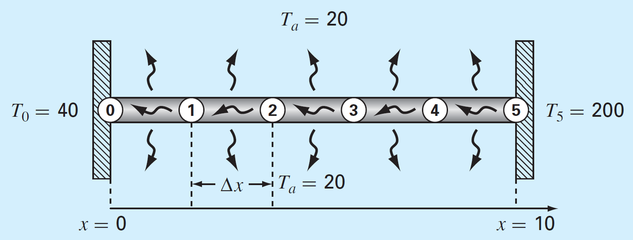

Slide 29
Kl_predict(2, 0.15)
Kli=3.9

Slide 30
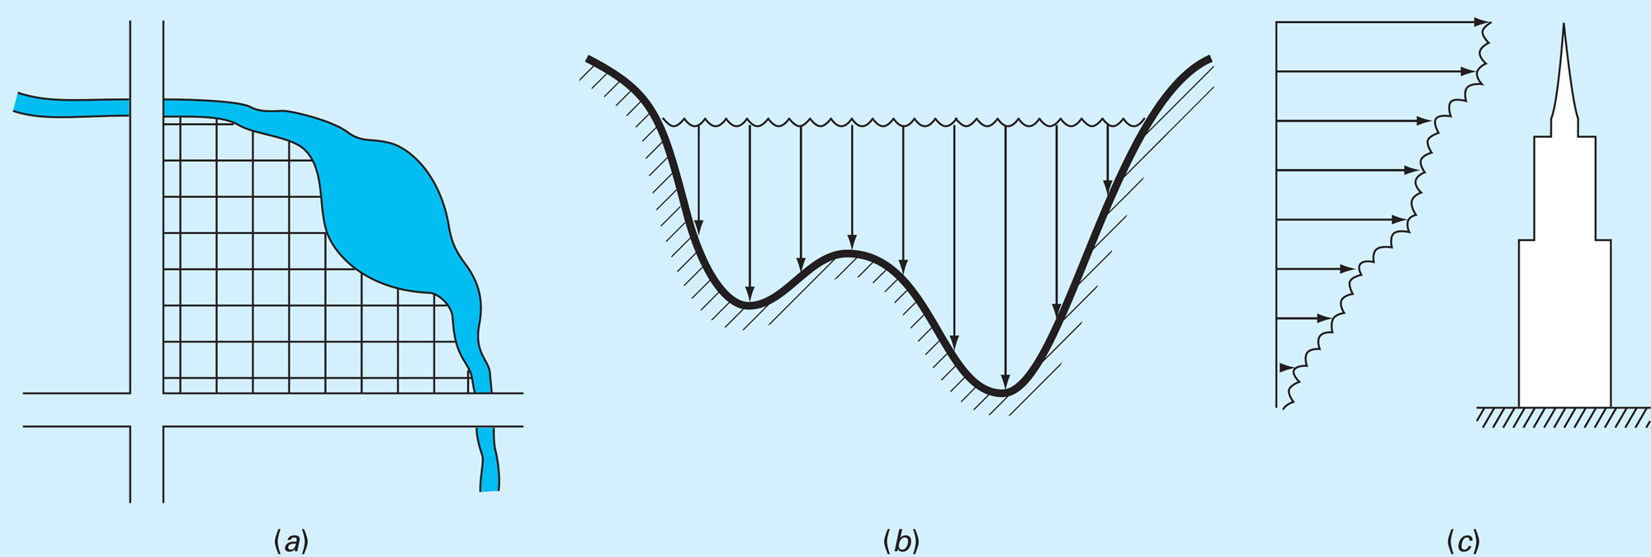

Slide 31
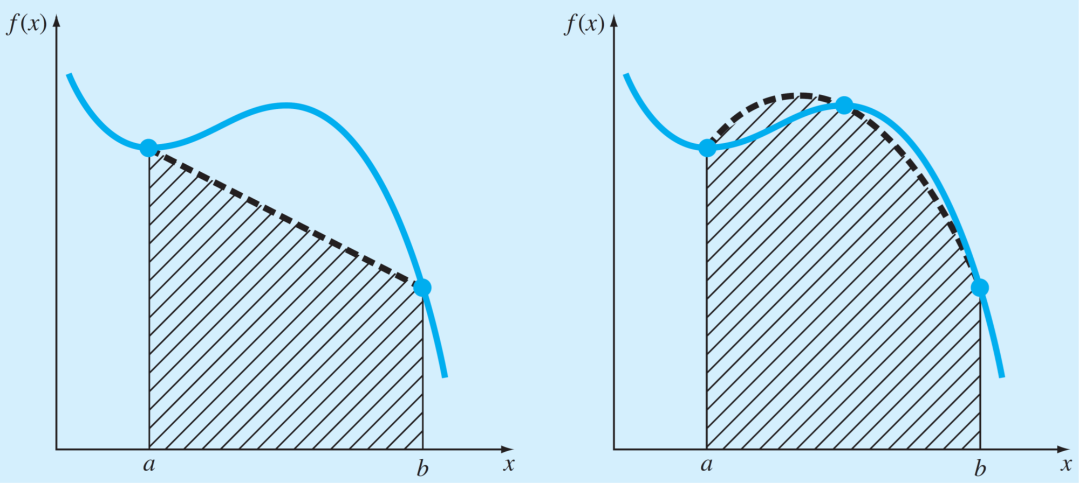
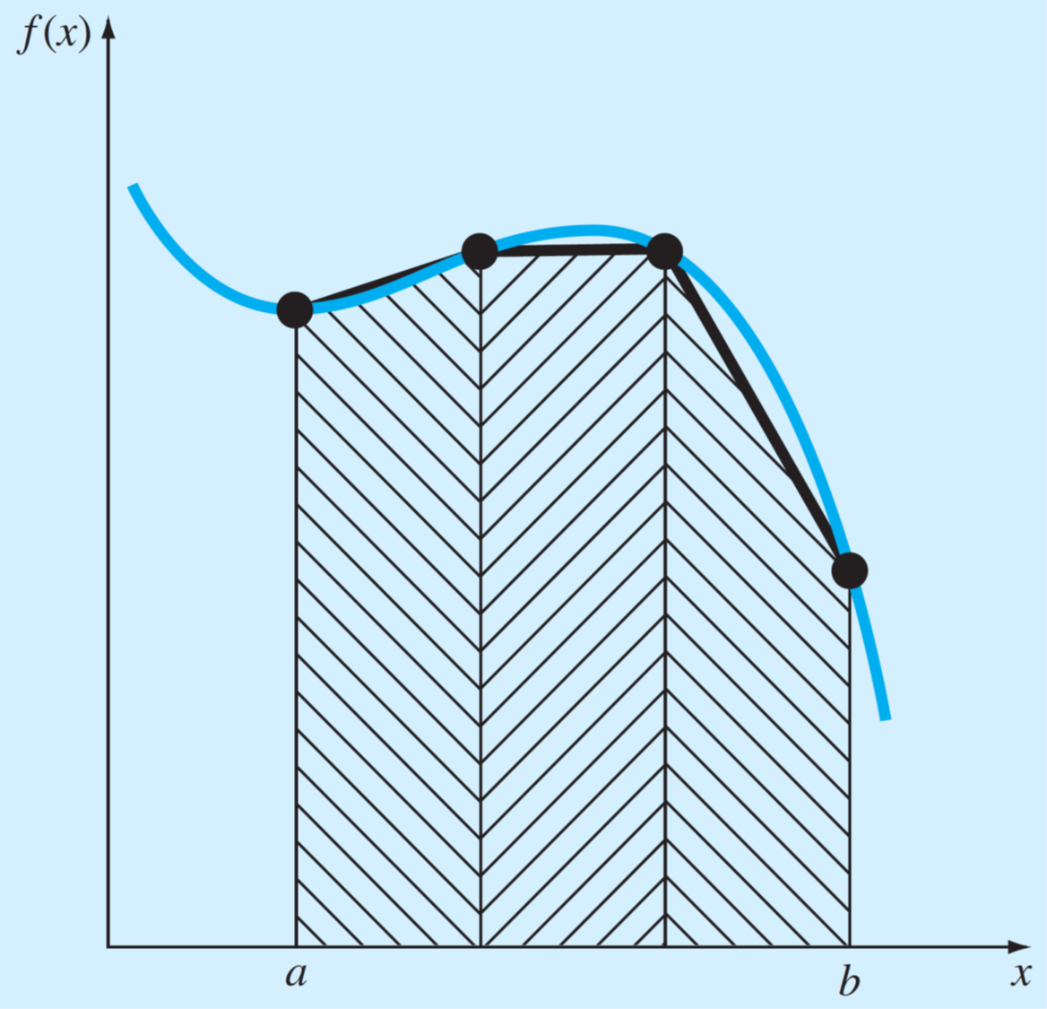












$$f\left(x\right)$$
$$f\left(x\right)$$
$$f\left(x\right)$$
$$a$$
$$b$$
$$x$$
$$a$$
$$b$$
$$x$$
$$a$$
$$b$$
$$x$$

Slide 32





$$h_{i}$$
$${f(x}_{i})$$
$$x_{i}$$
$$x_{i+1}$$
$$x$$

Slide 33



$$f\left(x\right)$$
$$h_{i}$$
$$x_{i}$$
$$x_{i+1}$$
$$x$$

Slide 34





$$h_{i}$$
$$f\left(x\right)$$
$$x_{0}$$
$$x_{1}$$
$$x_{2}$$
$$x_{3}$$
$$x_{4}$$
$$x$$

Slide 35




$$f\left(x\right)$$
Cambio abrupto
$$h_{i}$$
Región suave
$$x_{i}$$
$$x_{i+1}$$
$$x$$

Slide 36
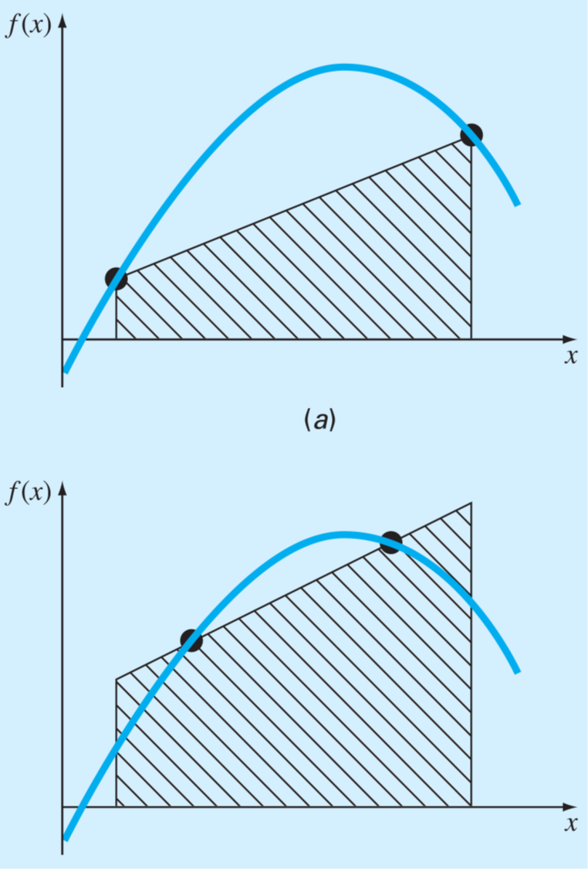




$$f\left(x\right)$$
$$f\left(x\right)$$
$$x$$
$$x$$

Slide 37
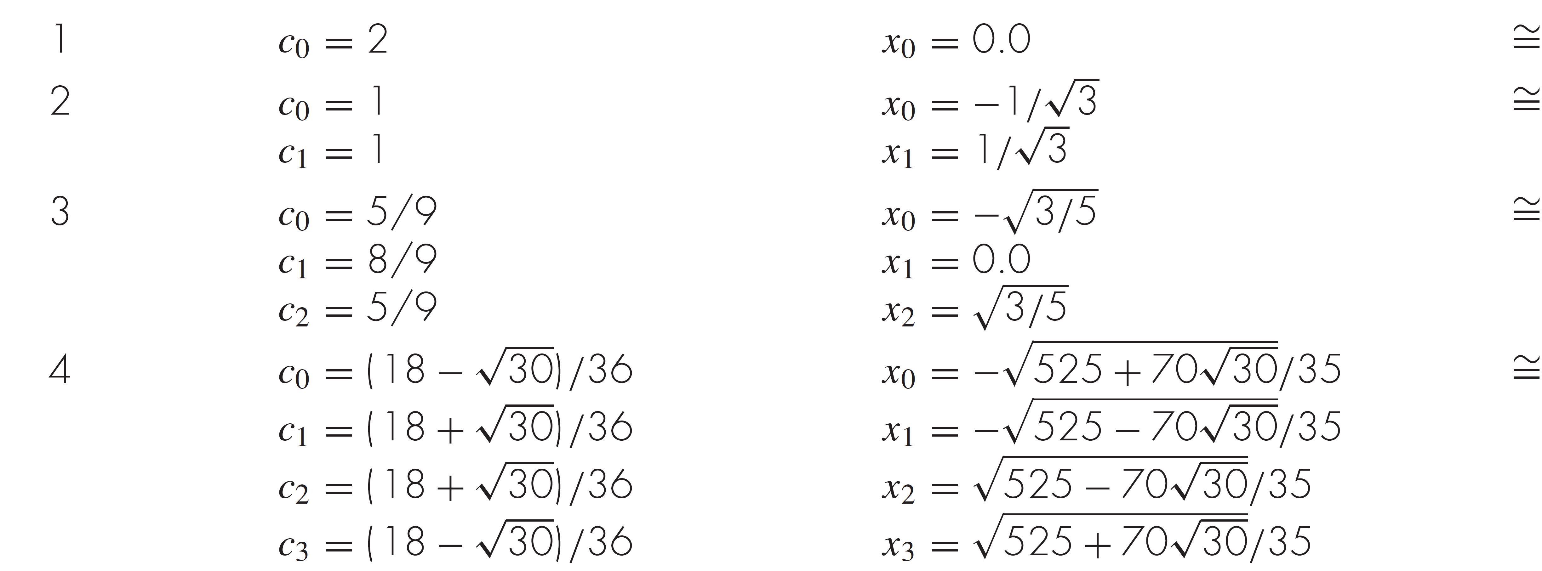




Orden
Pesos
Puntos de evaluación
Error
$$O\left(h^{3}\right)$$
$$O\left(h^{5}\right)$$
$$O\left(h^{7}\right)$$
$$O\left(h^{9}\right)$$

Slide 38


Bomba
$$H_{0} =65 m$$
$$D=120 mm$$

Slide 39






$$H$$
Curva de rendimiento de la bomba
$$H_{bba}\left(Q\right)$$
$$H_{sys}\left(Q\right)$$
Punto de operación
$$H_{op}$$
Curva de demanda del sistema
$$Q_{op}$$
$$Q$$

Slide 40
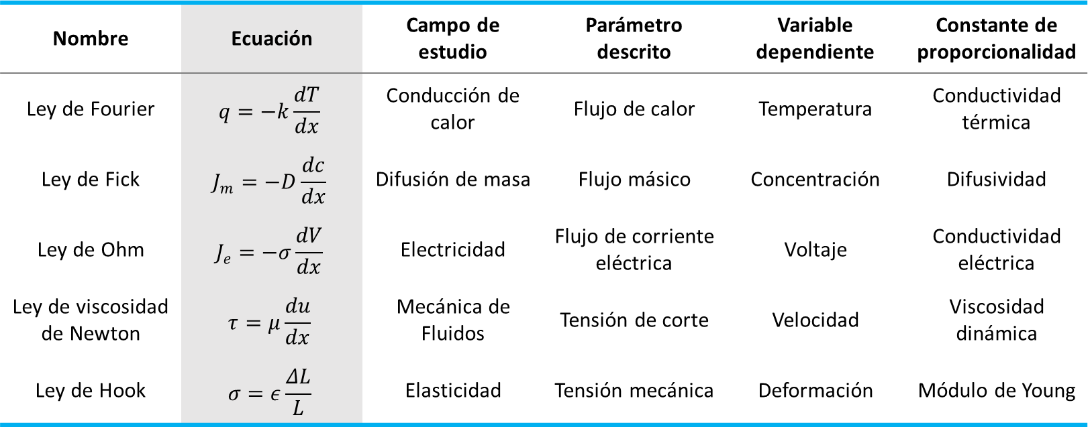
Nombre | Ecuación | Campo de estudio | Parámetro descrito | Variable dependiente | Constante de proporcionalidad
Ley de Fourier | $$q=−k\frac{dT}{dx}$$ | Conducción de calor | Flujo de calor | Temperatura | Conductividad térmica
Ley de Fick | $$J_{m}=−D\frac{dc}{dx}$$ | Difusión de masa | Flujo másico | Concentración | Difusividad
Ley de Ohm | $$J_{e}=−σ\frac{dV}{dx}$$ | Electricidad | Flujo de corriente eléctrica | Voltaje | Conductividad eléctrica
Ley de viscosidad de Newton | $$τ=μ\frac{du}{dx}$$ | Mecánica de Fluidos | Tensión de corte | Velocidad | Viscosidad dinámica
Ley de Hook | $$σ=ε\frac{ΔL}{L}$$ | Elasticidad | Tensión mecánica | Deformación | Módulo de Young

Slide 41
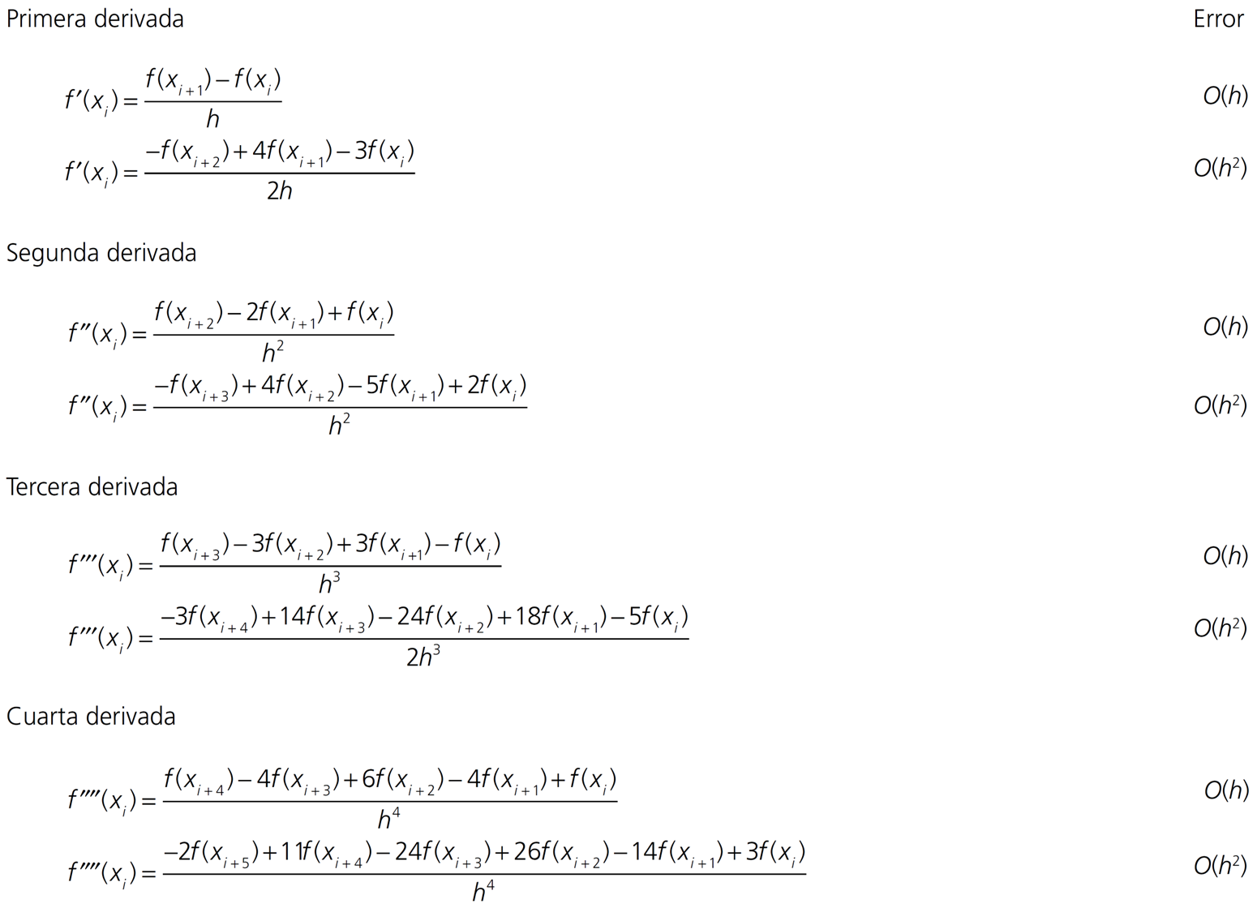

Slide 42
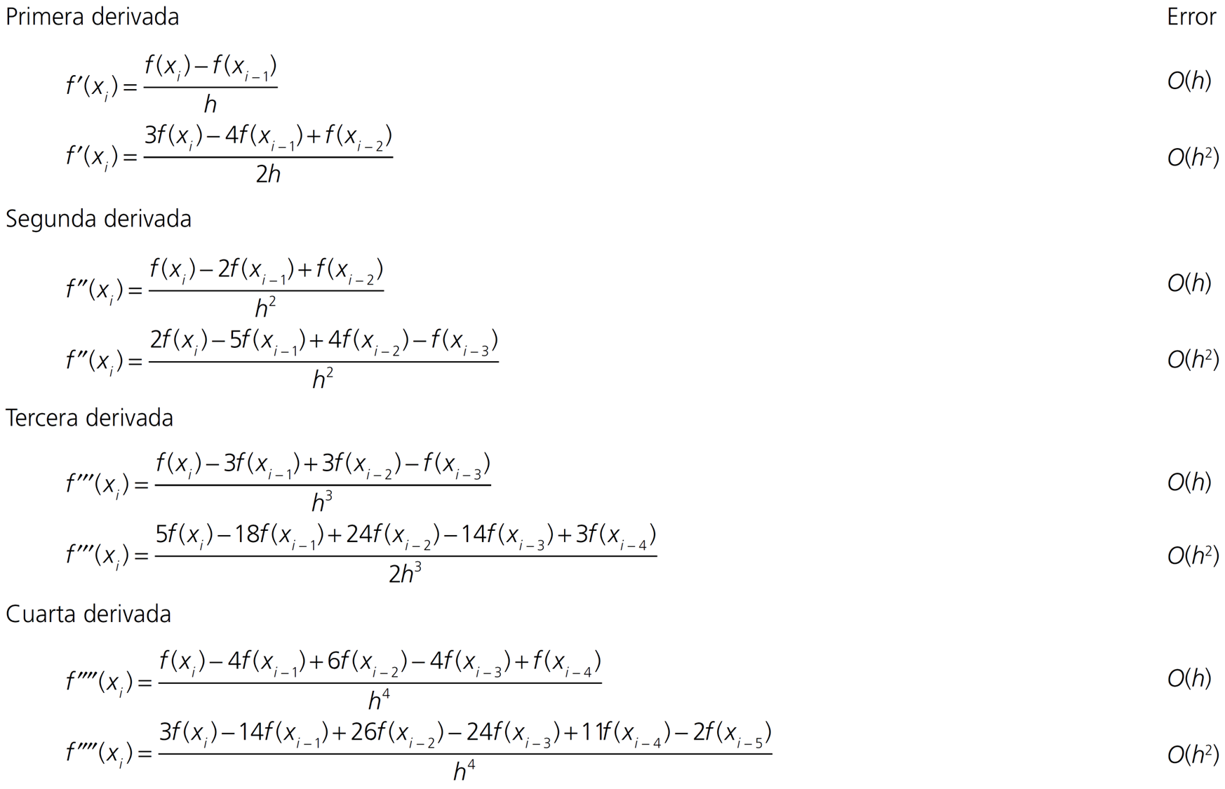

Slide 43
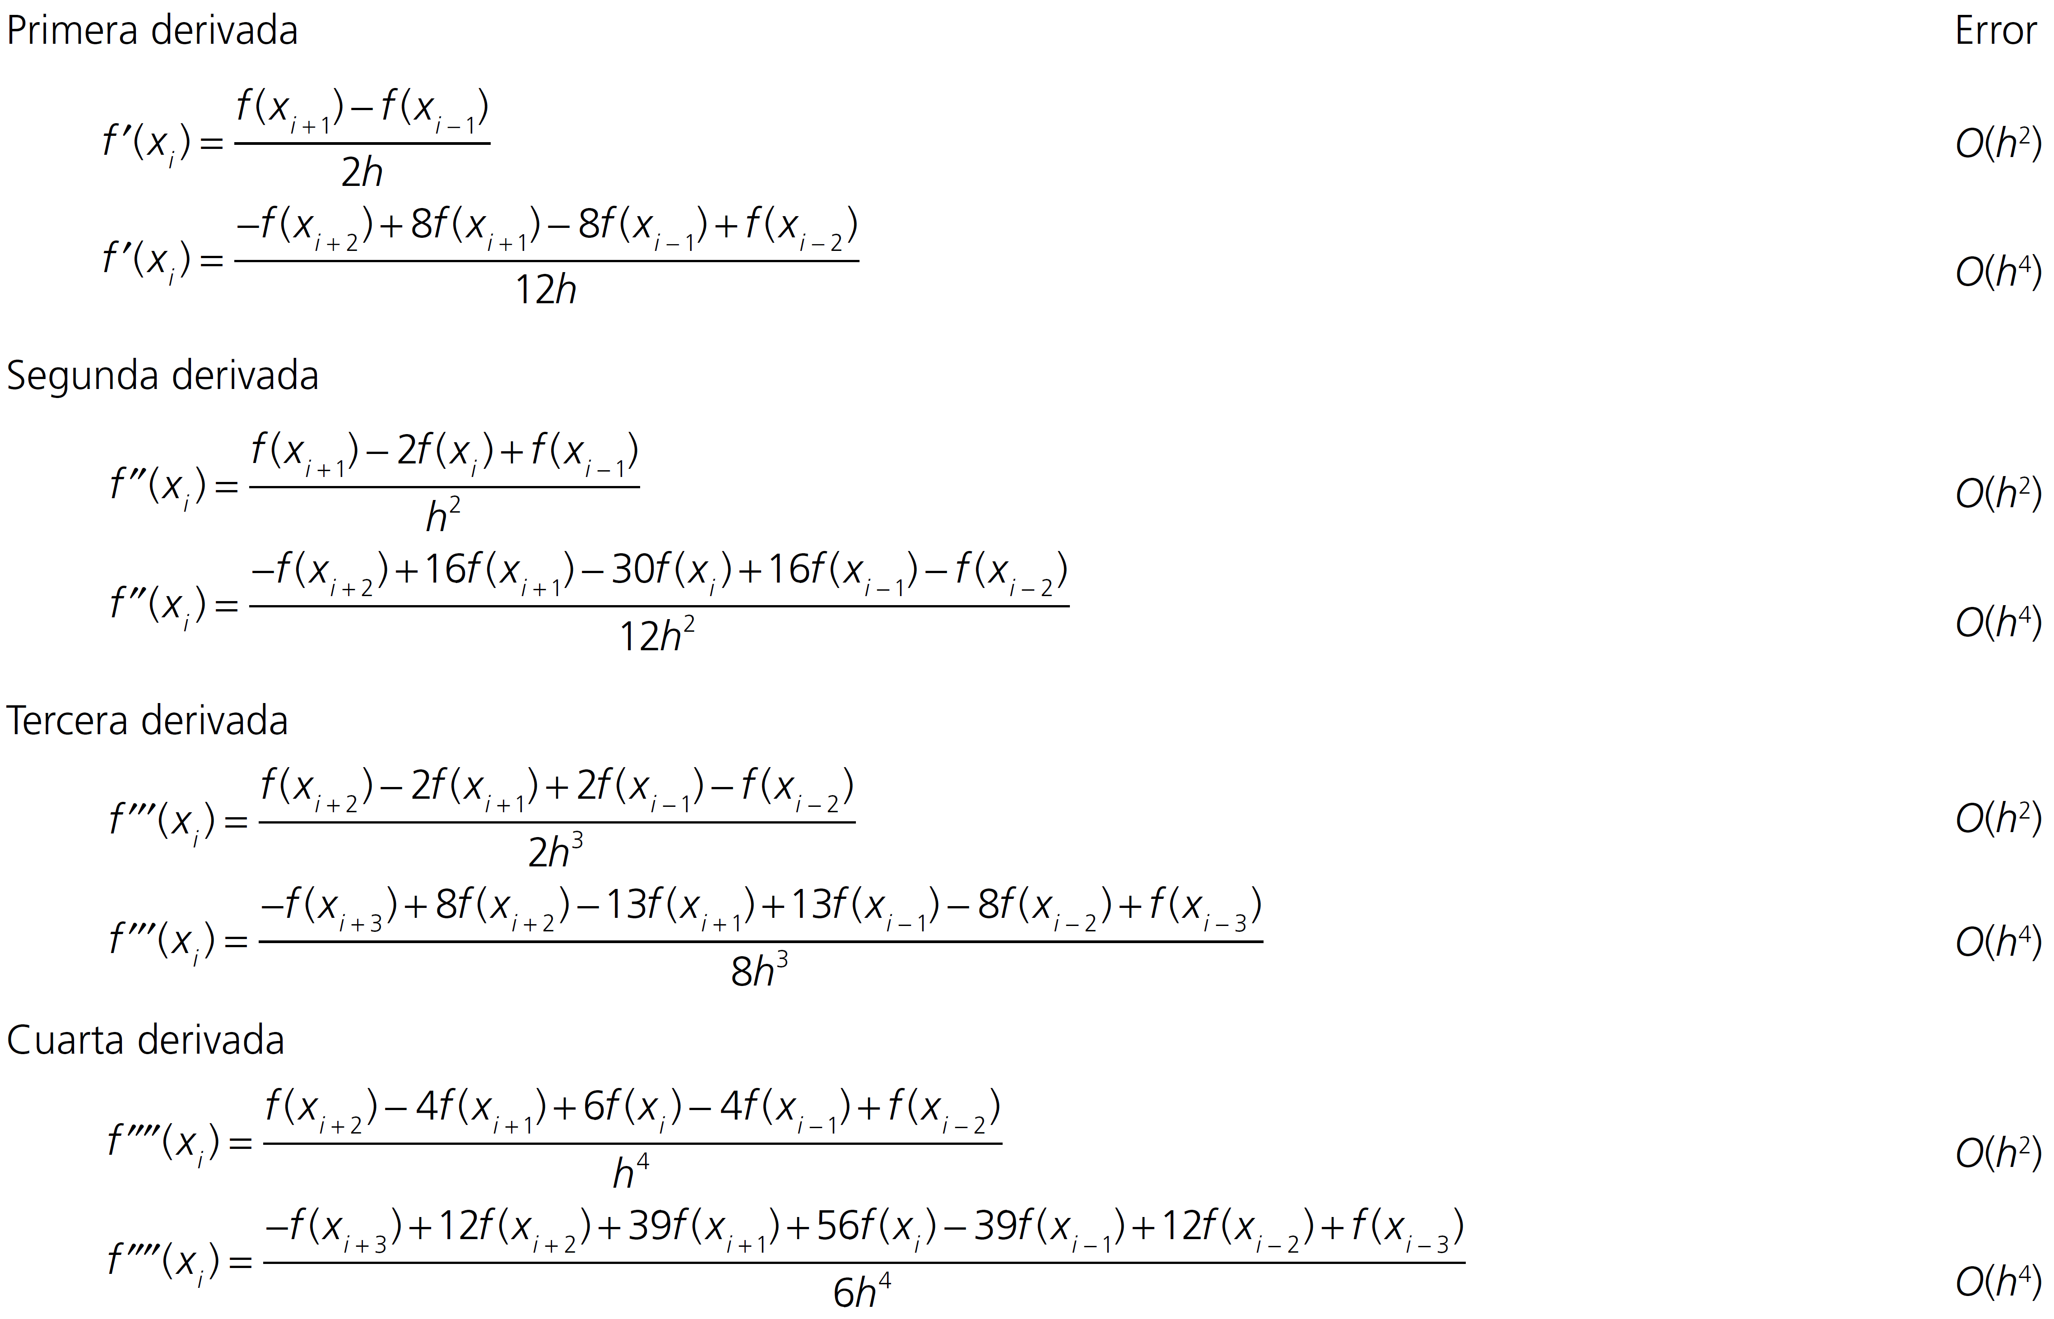


Slide 44


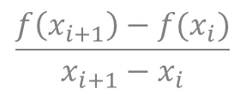




















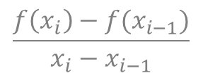


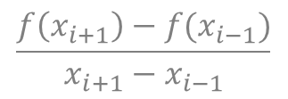
$$\frac{f\left(x_{i}\right)−f(x_{i−1})}{x_{i}−x_{i−1}}$$
$$f\left(x\right)$$
$$f\left(x\right)$$
$$f\left(x\right)$$
$$f′\left(x_{i}\right)$$
$$f′\left(x_{i}\right)$$
$$\frac{f\left(x_{i+1}\right)−f(x_{i−1})}{x_{i+1}−x_{i−1}}$$
$$f′\left(x_{i}\right)$$
$$\frac{f\left(x_{i+1}\right)−f(x_{i})}{x_{i+1}−x_{i}}$$
$$h$$
$$h$$
$$h$$
$$h$$
$$h$$
$$h$$
$$x$$
$$x$$
$$x$$
$$x_{i−1}$$
$$x_{i}$$
$$x_{i+1}$$
$$x_{i−1}$$
$$x_{i}$$
$$x_{i+1}$$
$$x_{i−1}$$
$$x_{i}$$
$$x_{i+1}$$

Slide 45




Componente
especular
Luz incidente
Gases atmosféricos
$$t_{atm}$$
$$θ_{sun}$$
$$θ_{sun}$$
Componente difusa

Slide 46
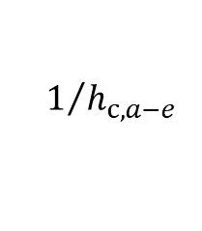

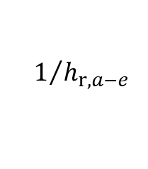

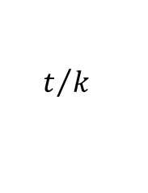


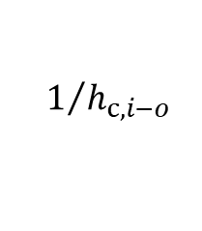
$$T_{i}$$
$$T_{e}$$
$$1/{h_{c,a−e}}$$
$$T_{o}$$
$$t/k$$
$$T_{a}$$
$$1/{h_{c,i−o}}$$
$$1/{h_{r,a−e}}$$

Slide 47
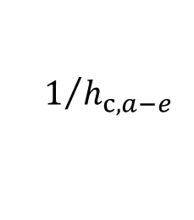



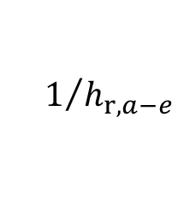




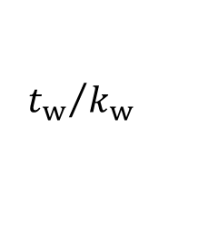
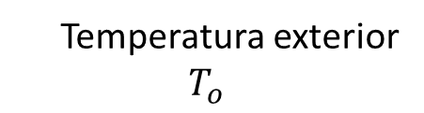





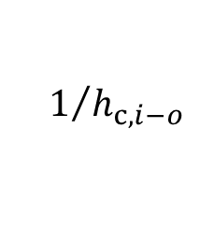

Vista superior de la casa
Pérdida de calor por los muros
(red de resistencias térmicas)
$$q_{s}^{′′}$$
Temperatura exterior
$$T_{o}$$
$$T_{wo}$$
$$T_{wi}$$
$$1/{h_{c,a−e}}$$
$$q_{s}^{′′}$$
$$q_{s}^{′′}$$
$$T_{i}$$
$${{t_{e}}/k}_{e}$$
$${t_{w}}/{k_{w}}$$
Temperatura interior
$$T_{i}$$
$$W$$
$$T_{o}$$
$$1/{h_{c,i−o}}$$
$$q_{s}^{′′}$$
$$1/{h_{r,a−e}}$$
$$q_{s}^{′′}$$
aislante
ladrillo
$$L$$

Slide 48




$$Q$$
$$Q_{1}$$
$$Q$$
$$Q_{2}$$

Slide 49



$$l$$
$$Θ$$
$$m$$

Slide 50












Pendiente
$$k_{2}=F\left(t_{i+1},y_{i}+k_{1}h\right)$$
Pendiente
$$\frac{F\left(t_{i},y_{i}\right)+F\left(t_{i+1},y_{i}+k_{1}h\right)}{2}$$
Pendiente
$k_{1}=F\left(t_{i},y_{i}\right)$
$$y_{i}+k_{1}h$$
$$y_{i}+\frac{1}{2} \left(k_{1}+k_{2}\right)h$$
$$t_{i}$$
$$t_{i+1}$$
$$t$$
$$t_{i}$$
$$t_{i+1}$$
$$t$$
Predictor
Corrector

Slide 51










Pendiente
$k_{2}=F\left(t_{i+1/2},y_{i}+k_{1}h/2\right)$
Pendiente
$k_{2}=F\left(t_{i+1/2},y_{i}+k_{1}h/2\right)$
$$y_{i}+k_{2}h$$
Pendiente
$k_{1}=F\left(t_{i},y_{i}\right)$
$$t_{i}$$
$$t_{i+1/2}$$
$$t$$
$$t_{i}$$
$$t_{i+1}$$
$$t$$
Predictor
Corrector

Slide 52






$$y$$
$$h$$
$$t_{i}$$
$$t_{i+1}$$
$$t$$

Slide 53

Predictor
Corrector

Slide 54


Slide 55




$t$, (min) | 0 | 5 | 10 | 15 | 20 | 25
$T$ (°C) | 80 | 44.5 | 30.0 | 24.1 | 21.7 | 20.7

Slide 56








radiación
$$T_{a}$$
$${σ′(T}_{∞}^{4}−T^{4})$$
$$T_{b}$$
$$dx$$
convección
$$h^{′}\left(T_{∞}−T\right)$$
$$x$$
$$0$$
$$L$$

Slide 57


Slide 58

radiación
$${\left.\frac{dT}{dx}\right|}_{x=L}=h\left[T_{∞}−T\left(L\right)\right]$$
$$T_{a}$$
$${σ′(T}_{∞}^{4}−T^{4})$$
$$dx$$
convección
$$h^{′}\left(T_{∞}−T\right)$$
$$x$$
$$0$$
$$L$$

Slide 59








$$T_{a}$$
$$T_{b}$$
$$dx$$
convección
$$h^{′}\left(T_{∞}−T\right)$$
$$x$$
$$0$$
$$L$$
$$T_{h}$$
$$T_{h}$$
$$dx$$
$T_{∞}$ (temperature aire)
$$x$$
$$0$$
$$L$$

Slide 60

$${\left.\frac{dT}{dx}\right|}_{x=L}=h\left[T_{∞}−T\left(L\right)\right]$$
$$T_{a}$$
$$dx$$
convección
$$h^{′}\left(T_{∞}−T\right)$$
$$x$$
$$0$$
$$L$$

Slide 61


Slide 62


Slide 63




$$m,n$$
$$0,n$$
$$m,0$$

Slide 64






$${\left.\frac{dT}{dy}\right|}_{y=H}=h\left[T_{∞}−T\left(x,H\right)\right]$$
$$L$$
$$T\left(0, y\right)=T_{a}$$
$$T\left(L, y\right)=T_{b}$$
$$H$$
$${\left.−\frac{dT}{dy}\right|}_{y=0}=q_{0}$$

Slide 65













$${\left.\frac{dT}{dy}\right|}_{y=H}=h\left[T_{∞}−T\left(x,H\right)\right]$$
$$0,2$$
$$1,2$$
$$2,2$$
$$0,1$$
$$1,1$$
$$2,1$$
$$T\left(0, y\right)=T_{a}$$
$$T\left(L, y\right)=T_{b}$$
$$0,0$$
$$1,0$$
$$2,0$$
$$−{\left.\frac{dT}{dy}\right|}_{y=0}=q_{0}$$

Slide 66

$$T_{0,0}^{k}=T_{a}$$

Slide 67


$$1,1$$
$$T_{1,0}^{k}=T_{1,1}^{k−1}+Δyq_{0}$$

Slide 68


$$2,1$$
$$T_{2,0}^{∗}=T_{2,1}^{k−1}+Δyq_{0}$$

Slide 69

$$T_{m,0}^{k}=T_{b}$$

Slide 70

$$T_{1,0}^{k}=T_{a}$$

Slide 71





$$1,2$$
$$0,1$$
$$2,1$$
$$1,0$$
$$T_{1,1}^{k}=\frac{1}{2Δx^{2}+2Δy^{2}}\left[2Δy^{2}\left(T_{2,1}^{k−1}+T_{0,1}^{k}\right)+2Δx^{2}\left(T_{1,2}^{k−1}+T_{1,0}^{k}\right)\right]$$

Slide 72





$$2,2$$
$$1,1$$
$$3,1$$
$$2,0$$
$$T_{2,1}^{k}=\frac{1}{2Δx^{2}+2Δy^{2}}\left[2Δy^{2}\left(T_{3,1}^{k−1}+T_{1,1}^{k}\right)+2Δx^{2}\left(T_{2,2}^{k−1}+T_{2,0}^{k}\right)\right]$$

Slide 73

$$T_{m,1}^{k}=T_{b}$$

Slide 74

$$T_{0,n}^{k}=T_{a}$$

Slide 75


$$T_{1,n}^{k}=\frac{1}{1+hΔy}\left(T_{1,n−1}^{k}+ΔyhT_{∞}\right)$$
$$1,n−1$$

Slide 76


$$T_{2,n}^{k}=\frac{1}{1+hΔy}\left(T_{2,n−1}^{k}+ΔyhT_{∞}\right)$$
$$2,n−1$$

Slide 77

$$T_{m,n}^{k}=T_{b}$$

Slide 78







$$L$$
$$q$$
$$x$$
$$L$$
$$l$$
$$y$$
$$z$$

Slide 79













Vista frontal de la barra
Vista lateral de la barra
Evolución de la temperatura radial de la barra
$$r$$
Aire a temperatura $T_{∞}$
convección
$$0$$
$$1$$
$$⋯$$
$$i$$
$$⋯$$
$$n$$
$$h^{′}\left(T\left(R\right)−T_{∞}\right)$$
$$2R$$
$$R$$

Slide 80





convección
$$h\left(T_{r=R} −T_{∞}\right)$$
$$r$$
$$0$$
$$1$$
$$⋯$$
$$i$$
$$⋯$$
$$n$$
$$R$$

Slide 81










Ecuación gobernante, $r∈\left[R,∞\right)$
$$−{k_{w}\left.​\frac{∂T_{w}}{∂r}\right|}_{r=R}=q_{R}$$
$$\frac{∂^{2}T_{w}}{∂r^{2}}+\frac{2}{r}\frac{∂T_{w}}{∂r}=0$$
Partícula de oro
$$q_{R}$$
$$r$$
Condiciones de borde
$$−{k_{w}\left.​\frac{∂T_{w}}{∂r}\right|}_{r=R}=q_{R}; T_{w}\left(r=R\right)=100° C$$
$$−{k_{w}\left.​\frac{∂T_{w}}{∂r}\right|}_{r=R_{∞}}≈0$$
$$R$$
$$R_{∞}$$
$$T_{w}\left(r=R\right)=100° C$$
Agua

Slide 82
$${\left.\frac{dT}{dx}\right|}_{x=L}=h\left[T_{∞}−T\left(L\right)\right]$$
$$T_{a}$$
$$dx$$
convección
$$h^{′}\left(T_{∞}−T\right)$$
$$x$$
$$0$$
$$L$$

Slide 83


Slide 84





$$q^{′′}$$
$$0$$
radiación
$$L$$
$$x$$
convección
convección

Slide 85





$$−{k_{c}\left.​\frac{∂T}{∂r}\right|}_{r=R}=h\left[T\left(R\right)−T_{∞}\right]$$
$$r$$
$$R$$
Aire
Cebolla

Slide 86








$$D_{0}$$
$$h_{0}$$
$$h$$
$$d$$
$$v_{c}$$
$$V_{c}$$
$$θ$$
$$D_{1}$$
caso 2

Slide 87









Corte A-A’
$$h\left(x\right)$$
$$b$$
$$f\left(x\right)$$
$$A$$
$$h_{2}$$
$$x$$
$$h_{1}$$
$$A′$$
$$L$$

Slide 88





$$D_{0}$$
$$h_{0}$$
$$h$$
$$d$$
$$v_{c}$$
$$θ$$
$$V_{c}$$
$$θ$$
$$v\left(t\right)$$
caso 2
$$D_{1}$$

Slide 89



Slide 90














(a)
(b)
(c)
Vista en corte A-A’
Balance de energía para la condición de borde
en $x=\left(W−D\right)/2$
cold
$$y$$
$$Dq_{loss}^{′′}$$
$$DS$$
$$−k_{p}δ_{p}{\left.\frac{dT_{p}}{dx}\right|}_{x=\left(W−D\right)/2}$$
$$−k_{p}δ_{p}{\left.\frac{dT_{p}}{dx}\right|}_{x=\left(W−D\right)/2}$$
A
A’
$$T_{p}$$
$${\left.\frac{dT_{p}}{dx}\right|}_{x=0}=0$$
$$q_{f}^{′}$$
$${\left.\frac{dT_{p}}{dx}\right|}_{x=\left(W−D\right)/2}$$
$$x$$
hot
$$x=0$$
$$x=\left(W−D\right)/2$$

Slide 91


