Slide 1
Virtual Memory Simulator
MAT3501 - Principles of Operating System, MIM - HUS

Slide 2
Program architecture
Page Table
Instruction
VA
Lookup
Frame | Valid | Dirty | Ref
PA | 0/1 | 0/1 | 0/1
ASM program
LOAD R1, 0x20A
STORE R0, 0x14E
CPU
MMU
data
Page
Fault
R/W
Repl. algos
OS Page Supervisor
Update entry
R/W
Backing store
Page Repl.
RAM
CPU executes instructions to access virtual memory
MMU translates VA to PA using Page Table and gets data from RAM using PA
In case of Page Fault, control is passed to OS Page Supervisor module to do page replacement and update Page Table
After Page Fault is resolved, control is returned to MMU to redo step 2
CPU execute the instruction with data returned by MMU

Slide 3
Program Modules
File (.c/.h) | Description
config.h | Common configuration declaration
cpu | Simulate CPU. Read instructions from a asm program and execute
mmu | Simulate MMU, Translate VA to PA using page table (no TLB)
page_supervisor | Simulate OS Page Supervisor. Call replacement algo and update Page Table
replacement | Replacement algos
Makefile | Make file
*.asm | Asm programs

Slide 4
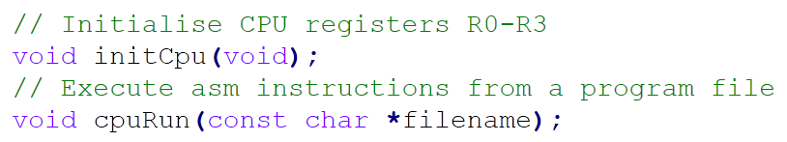
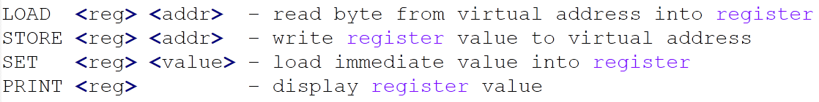
CPU module
ASM program
LOAD R1, 0x20A
STORE R0, 0x14E
CPU
Instruction set

Slide 5
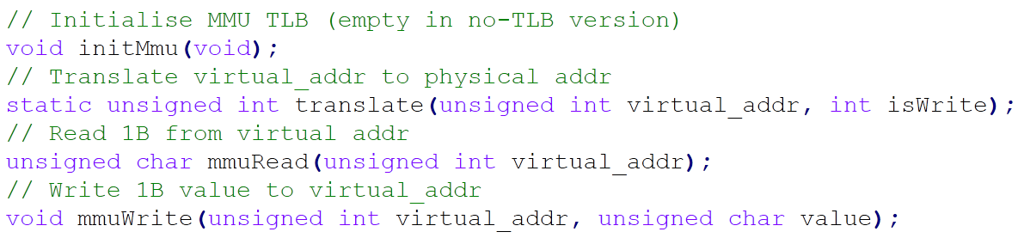
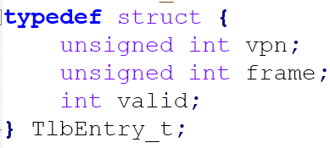
MMU module
data
CPU
MMU
mmu_read(va)
mmu_write(va)

Slide 6
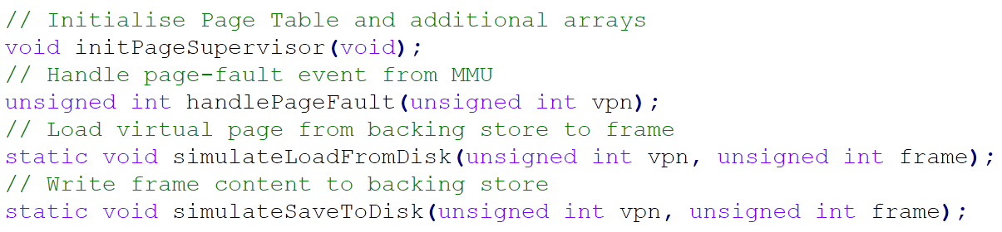
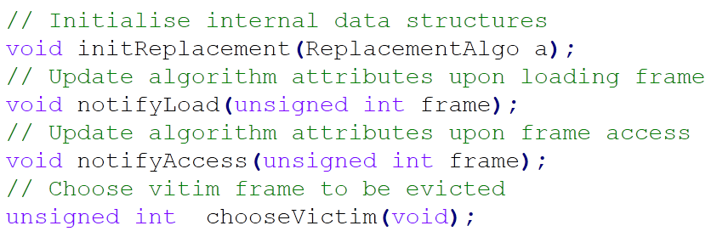
Page Supervisor module
MMU
Page
Fault
OS Page Supervisor
Replacement algos

Slide 7
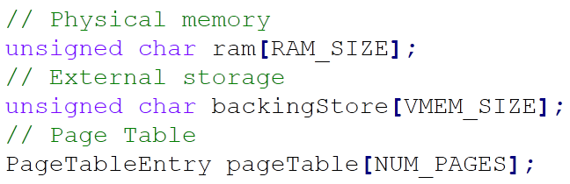
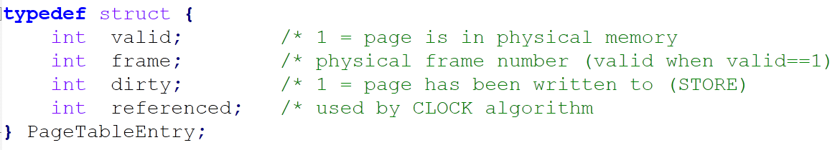
Memory & Page Table

