Slide 1
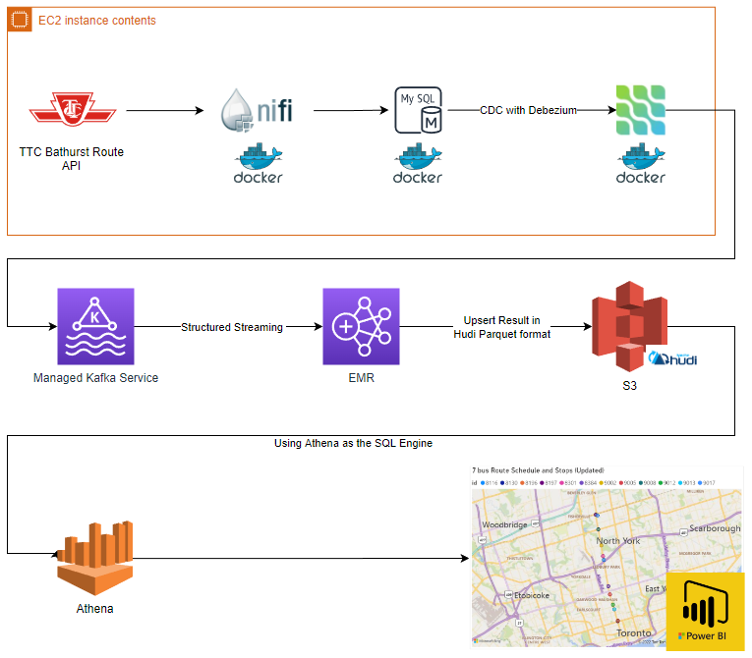
Streaming Project
Andi An
August 10, 2022
Notes:
Hey everyone, the purpose of this project is to demo and explain my LinkedIn Batch ETL Project

Slide 2
Agenda
Key Topics | Duration
Introduction | 2 mins
Architecture | 5 mins
Demo | 5 mins
Future Improvements | 3 mins
Objectives are to:
Introduce the project architecture
Demonstrate functionalities
Review the potential future improvement
Desired outcomes are to:
Showcase the project

Slide 3
Introduction
Objective
The goal of this project is to build a streaming data pipeline to report on live TTC bus/streetcar information. The final output of this project is an interactive PowerBI dashboard, which provides an overview of the route 7 Bathurst Street.
Motivation
The motivation of the project was based on an interest in learning different aspect of streaming data pipeline.
Project Consideration
This project also provides an excellent opportunity to develop skills and experience in a range of tools. As such, the project is more complex than required, utilizing nifi, mysql, debezium, docker, and a series of AWS technology (S3, MSK,EMR,Athena).

Slide 4
Pipeline Architecture
Components
Data Source
The architecture of this project is designed to be run continuously streaming API data of TTC bus and streetcar into S3.
Currently, the data source is public API that report on the lat, long of TTC buses on the Bathurst route.
Ingestion and CDC
Ingestion is completed using NIFI via docker container. Data is ingested into MYSQL database as an append only table.
Debezium is used to perform change data capture on the MYSQL table, data is streaming into a topic on a managed kafka service cluster on aws
Data Processing and Storage
Spark structured streaming is used to consume the kafka topic and transform the data as it arrives.
Data is then upserted into a hudi table on S3
Compute resources
EC2 is used to host nifi ,MySQL and Debezium connect via docker
MSK is used to support the debezium CDC process, the topic is then consumed via EMR.
Athena are used as the compute engine which powers the dashboard.
Visualization - PowerBI is used for dashboarding

Slide 5
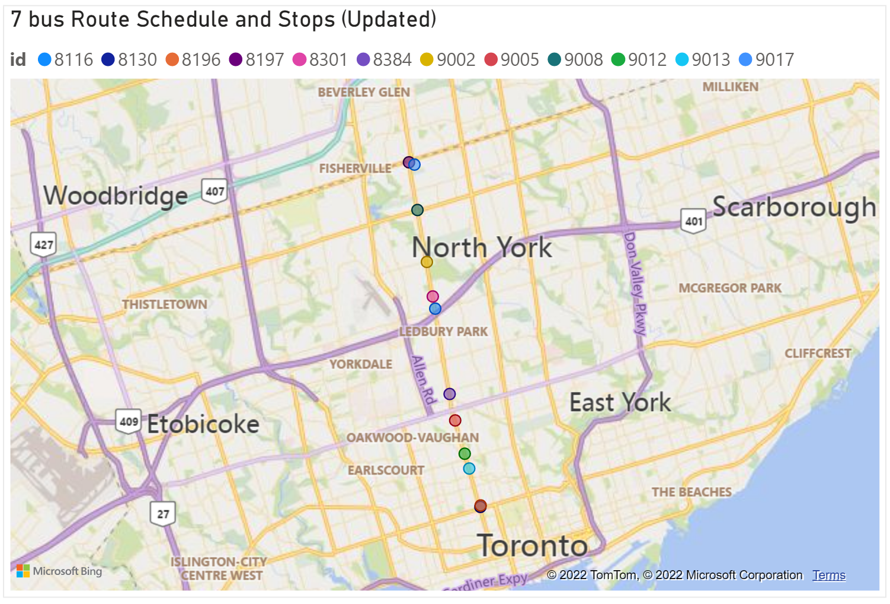
Live Demo

Slide 6
Future Improvements
Productionalize the data pipeline
Currently the NIFI and MYSQL both are both on an EC2 instance, we can use NIFI with EKS and MYSQL with RDS to allow for better scale.
Improve Dashboard Output
The PowerBI dashboard generated here is quite basic for demo purposes. One can greatly improve this dashboard.
Testing
The data pipeline currently does not use any framework to test and validate the data. One can implement a testing framework to improve data quality and pipeline transparency.
PowerBI have other interactive custom visuals that can improve the usefulness of the dashboard

