Slide 1
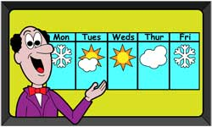
USA City Temperature Analysis
ALY6015 Intermediate Final Project
Northeastern University
March 29,2018
Mohit Abbi, PaoTing Kung

Slide 2

Introduction
Weather is changeable in Boston.
We use USAtemp.csv dataset to forecast five USA cities temperature trend.
Temperature changes depend on season.
Density plots, Time Series decomposition graph, Prediction plot (ARIMA and auto.arima).

Slide 3
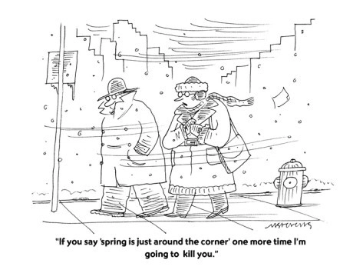
Objective
Generate future weather trend to help company make decisions.
Product quantities, Price, Plant fruits, Build amusement park in which state
Government use weather predictions to take emergency procedures.
School use weather predictions to launch alert.

Slide 4
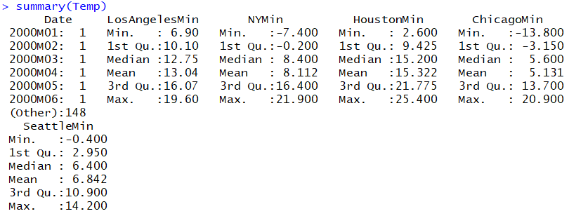
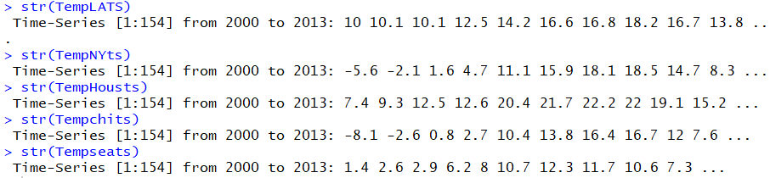
Descriptive Analysis and Summary of Data
Minimum Temperatures of 5 cities of USA from January, 2000 to October, 2012
Notes:
adf.test(TempLATS)

Slide 5
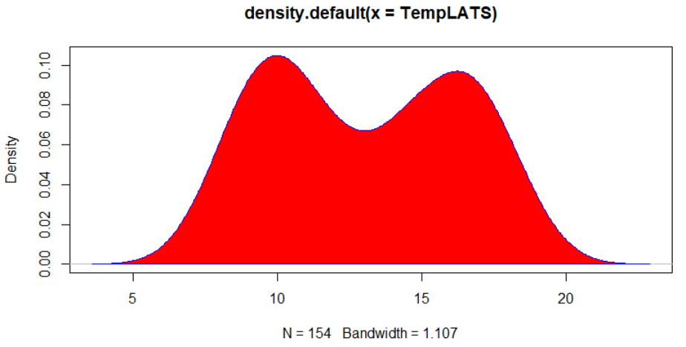
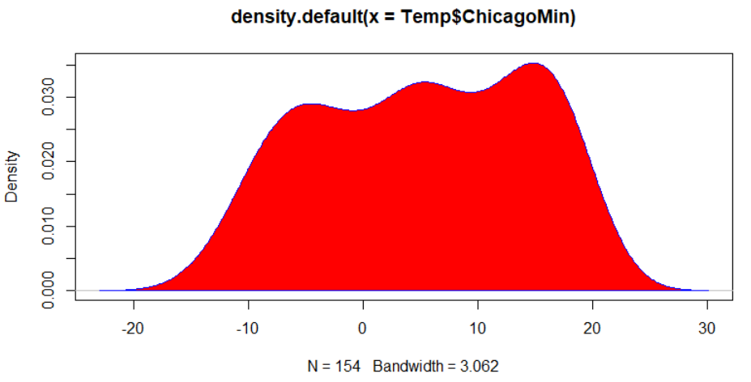
Los Angeles and Chicago Density Plot

Slide 6
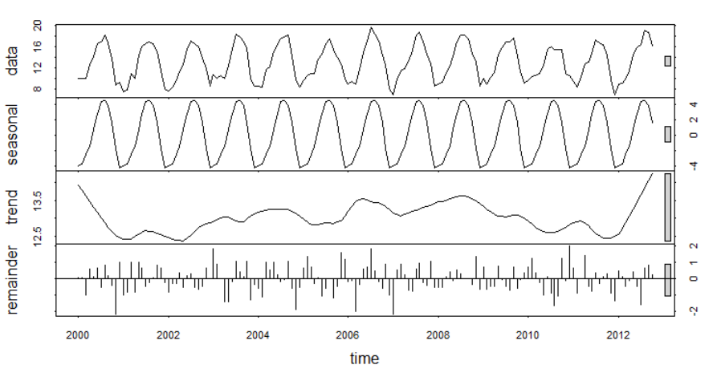
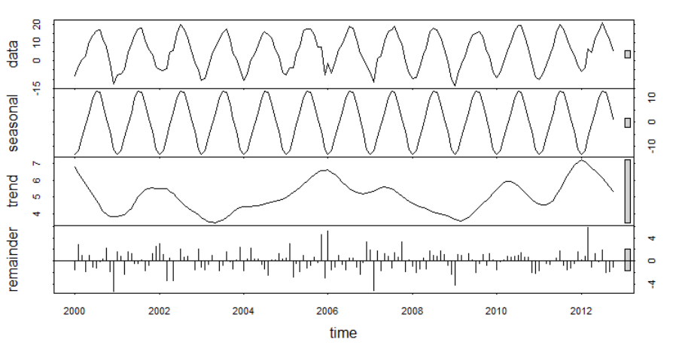
Los Angeles and Chicago Decomposition of Time Series
Los Angeles
Chicago
Notes:
Decomposition provides a useful abstract model for thinking about time series generally and for better understanding problems during time series analysis and forecasting.

Slide 7
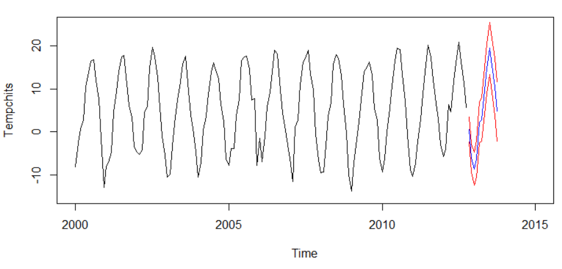
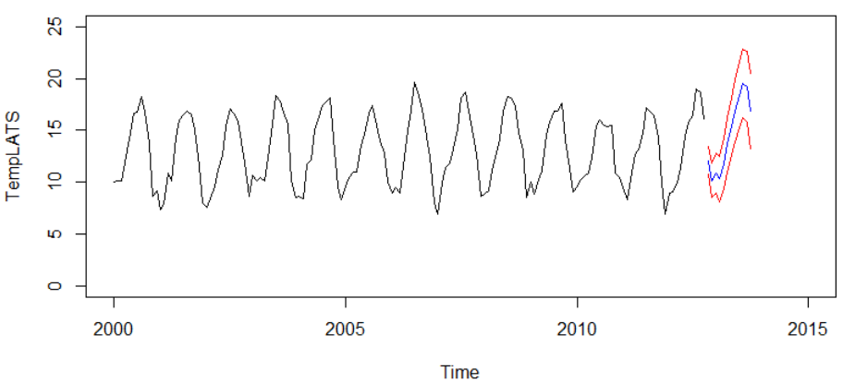
Los Angeles and Chicago Time Series ARIMA Prediction
Los Angeles
Chicago

Slide 8
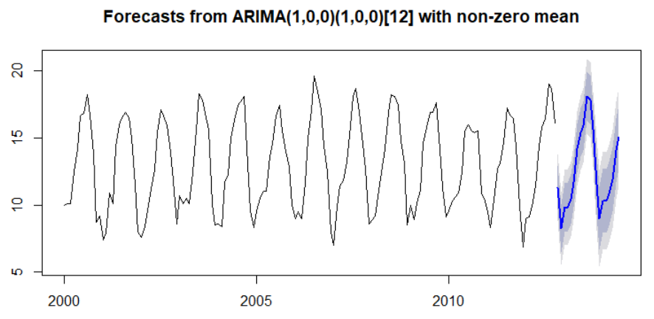
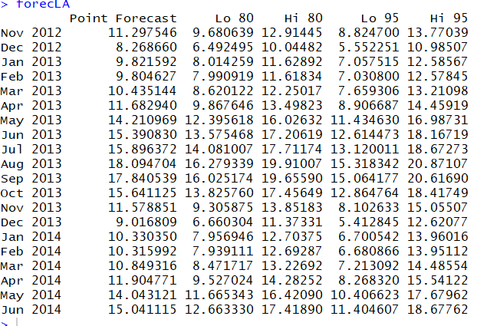
Los Angeles Time Series Auto-ARIMA Prediction
Los Angeles
Notes:
Using auto.arima and forcast function

Slide 9
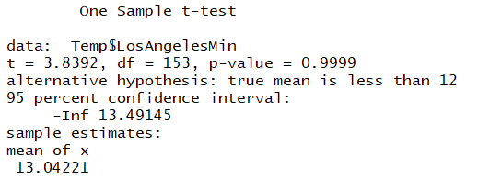
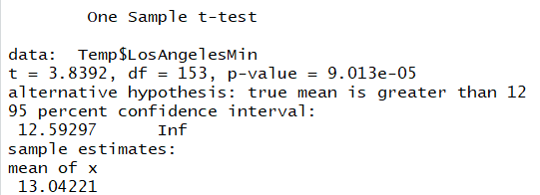
Hypothesis Test (T-test)

Slide 10
Conclusion
Los Angeles & Chicago temperature trend won’t change dramatically in next years .
Temperature range in Los Angeles between 5 to 25.
Temperature range in Chicago between -15 to 25.
People should consider weather condition in Chicago if they want to travel in winter.
Residents should aware extreme weather condition in Chicago.

Slide 11
Limitations/Restrictions
Prediction might change between the range due to uncertainty.
The prediction sample is not random sample from the same population
Unpredictable events like global warming can also affect the temperature trend which can deviate from our original prediction.

Slide 12
Future Extensions
Try different time series methods to get more accurate result
The Box-Jenkins methodology.

Slide 13


Slide 14


