Slide 1
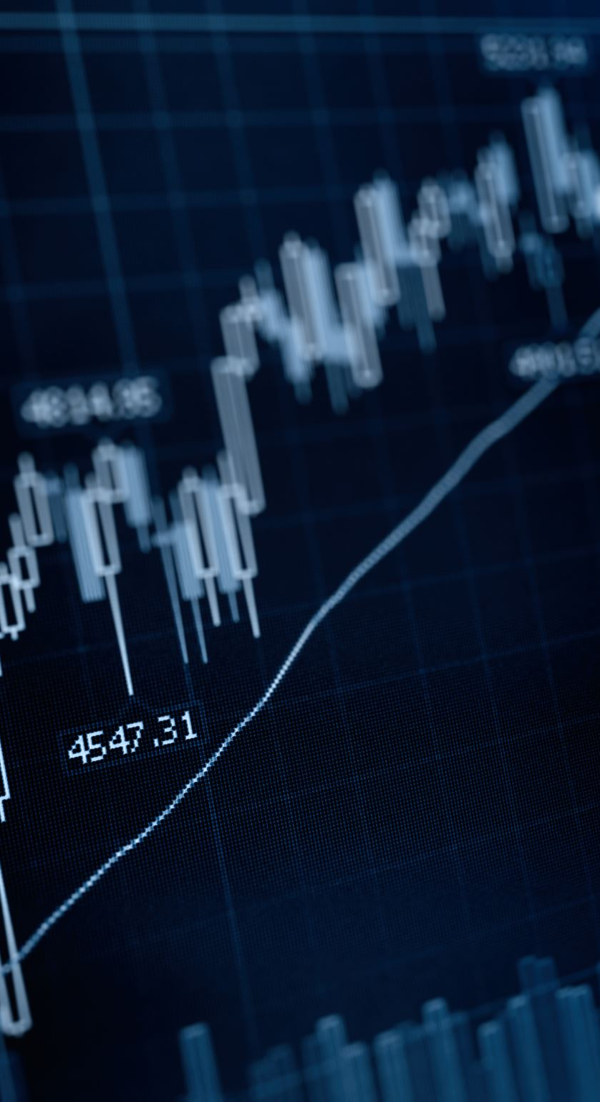
Sales Data Analysis
An overview of key insights and trends from sales data.

Slide 2
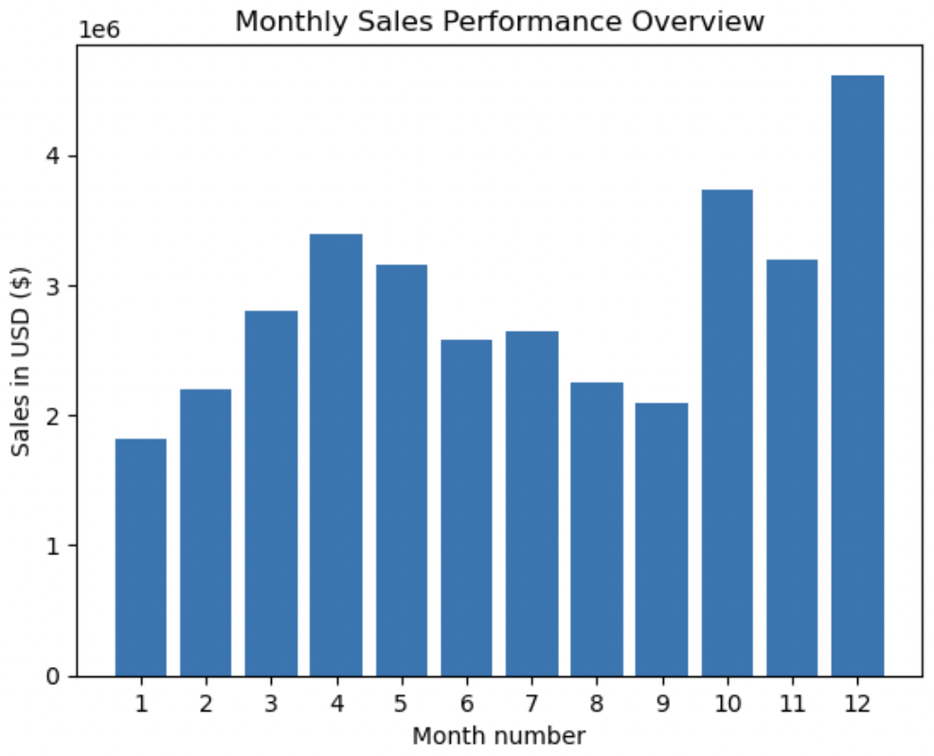
Monthly Sales Trends
Sales peak in December, likely driven by holiday shopping trends.
Recommendations:
Increase inventory and marketing efforts before the holiday season.
Offer holiday promotions and bundle deals to maximize revenue.
Optimize online and in-store visibility for high-demand products.

Slide 3
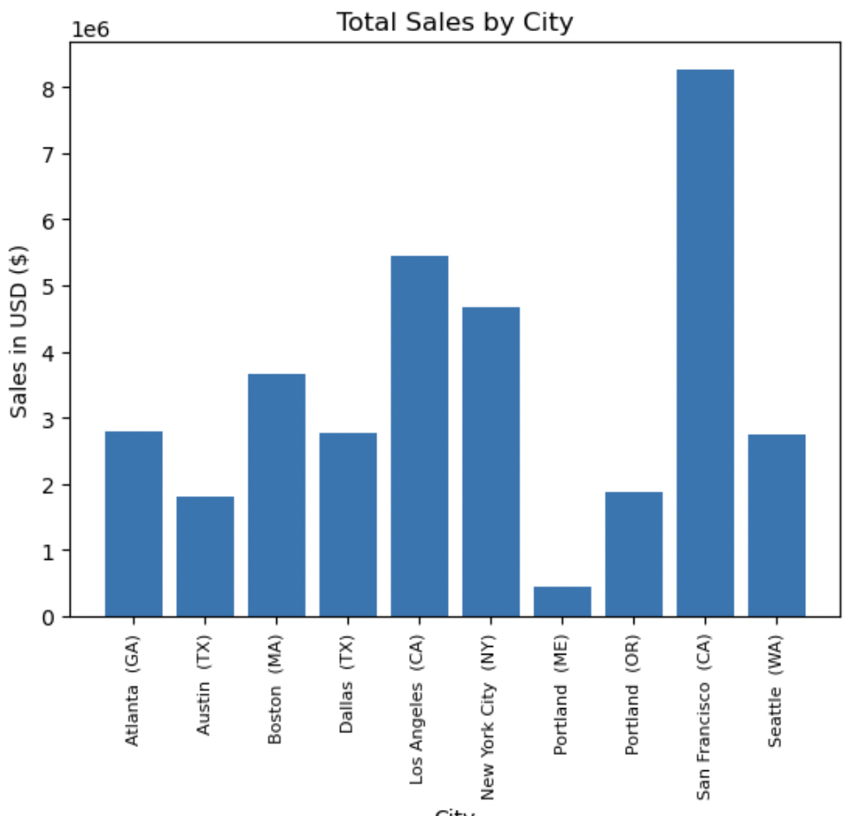
City-Wise Sales
Recommendations:
Focus marketing efforts on top-performing cities (San Francisco, Los Angeles, NYC) to maximize revenue.
Analyze consumer behavior in underperforming cities (e.g., Portland, Austin) to identify growth opportunities.
Targeted promotions in mid-performing cities like Boston and Dallas to boost sales.
Optimize inventory distribution based on demand to prevent stock shortages in high-sales areas.

Slide 4
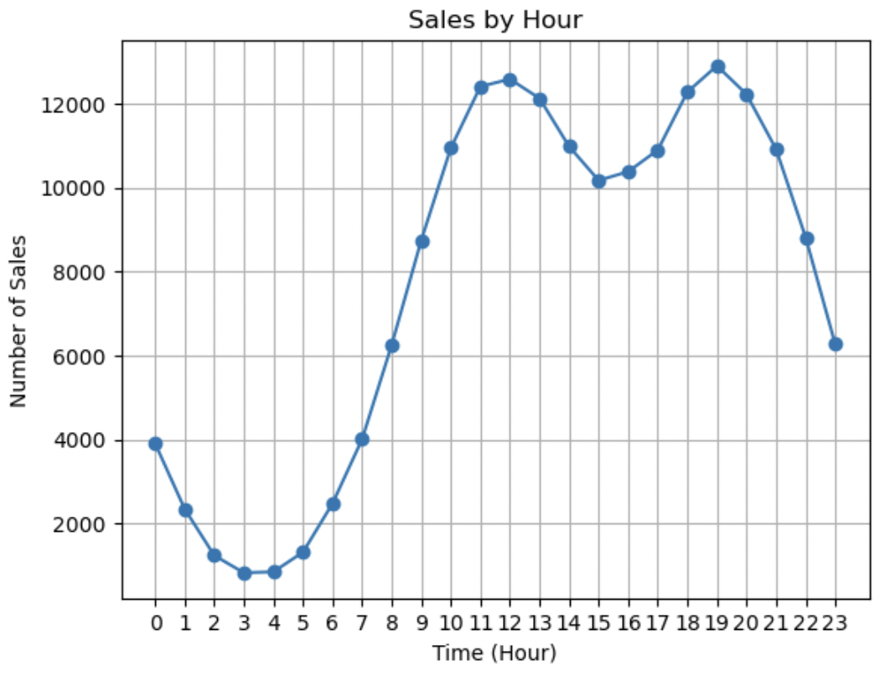
Sales by Hour
Peak purchasing hours:
12 PM
7 PM
Recommendation: The best time to run advertisements are 11 AM and 6 PM as purchasing peak at 12 PM and 7PM.

Slide 5
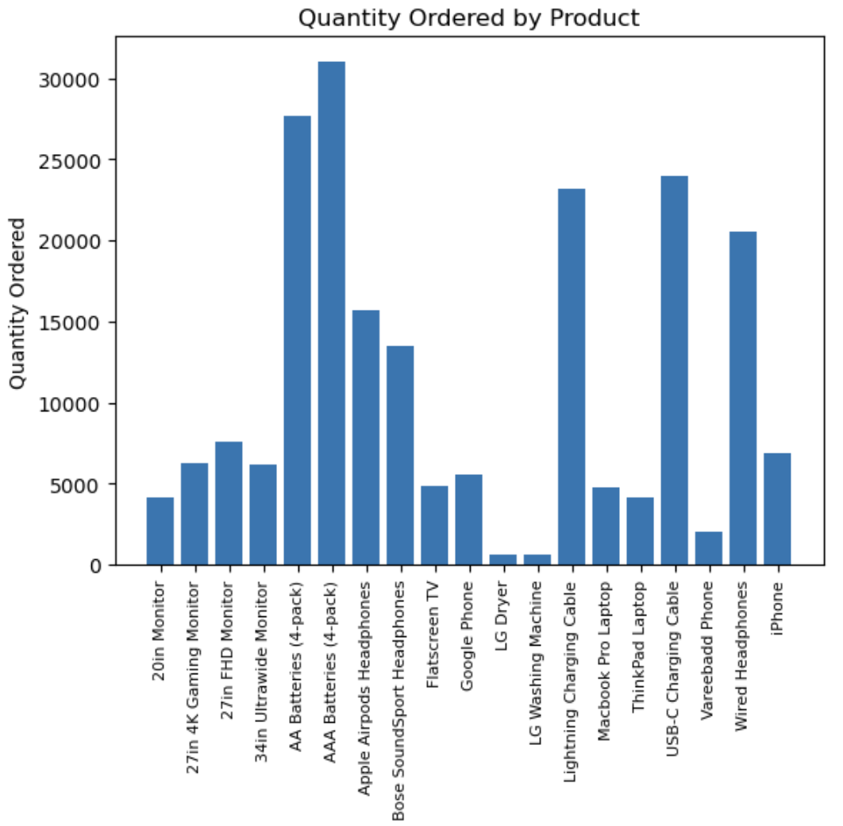
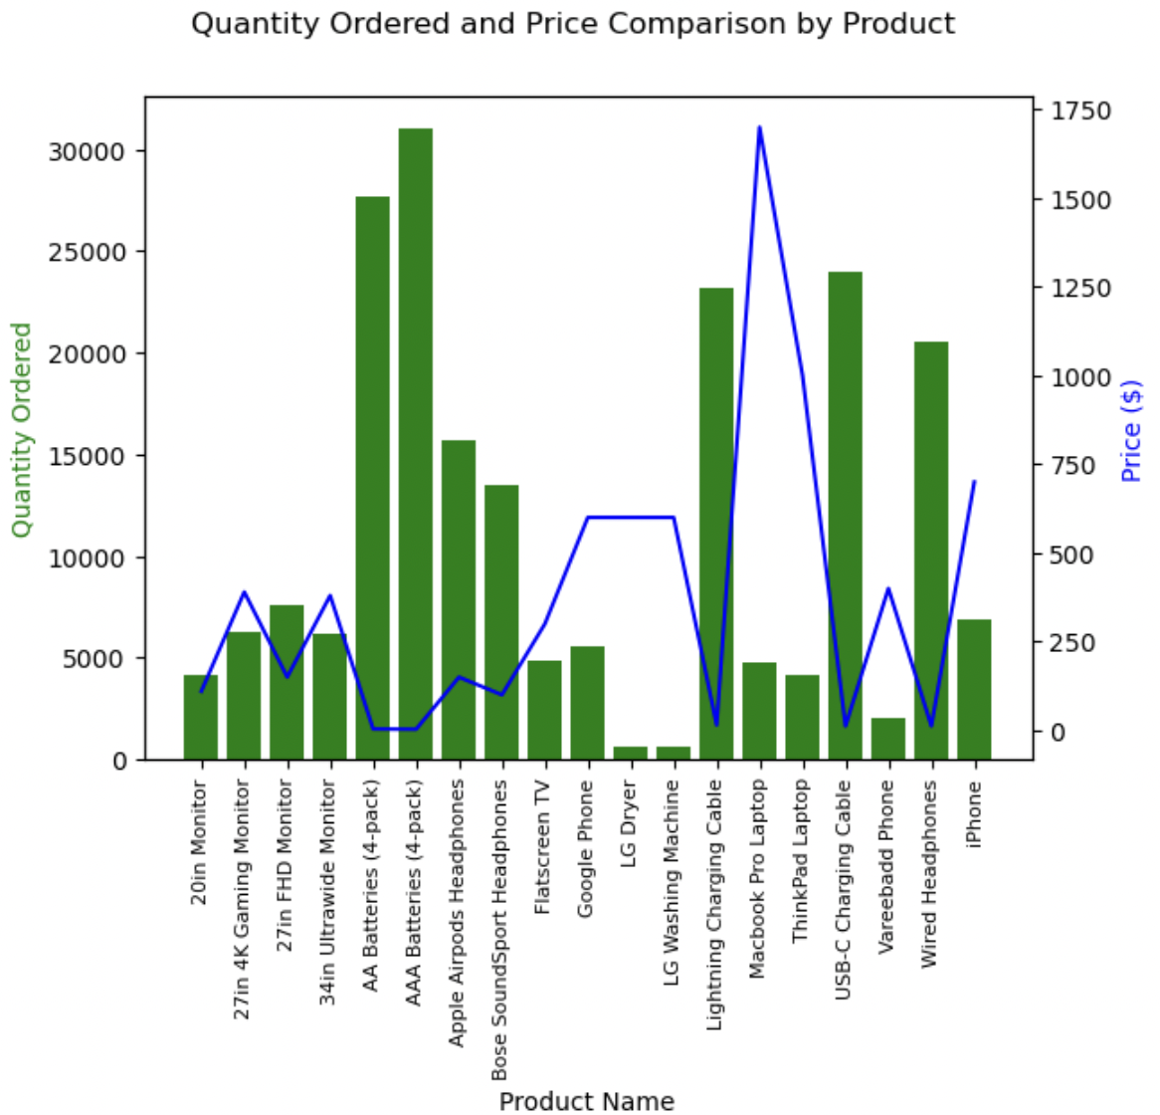
Top-Selling Products
Top-selling products: AAA batteries, AA batteries, and USB-C charging cables.
This suggests that customers frequently purchase small, inexpensive essentials, likely as add-on or impulse buys.
Recommendations:
Bundle Deals: Offer battery packs or phone accessories as combo deals.
Strategic Placement: Position these items near checkout or high-traffic areas.
Targeted Promotions: Run discounts or “buy one, get one” offers.
Cross-Selling: Suggest these items when customers buy related electronics.

Slide 6
Most Common Product Purchased Together
Most Common Product Purchased Together | # of Times
iPhone, Lightning Charging Cable | 1005
Google Phone, USB-C Charging Cable | 987
iPhone, Wired Headphones | 447
Google Phone, Wired Headphones | 414
Vareebadd Phone, USB-C Charging Cable | 361
iPhone, Apple Airpods Headphones | 360
Recommendations:
Bundle these frequently bought-together items to increase sales.
Offer discounts on complementary products to encourage upselling.
Optimize inventory based on these patterns to avoid stock shortages.

Slide 7
THANK YOU!

