Slide 1



Dashboard
View in Power BI
Last data refresh:
12/11/2025 12:56:53 AM UTC
Downloaded at:
12/11/2025 12:58:29 AM UTC

Slide 2
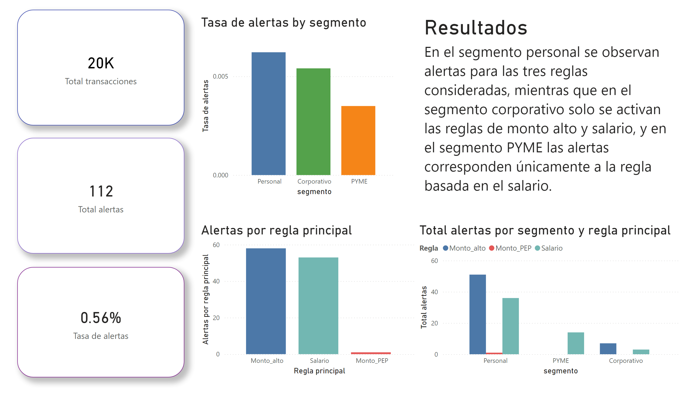
Página 1
Notes:
card
No alt text provided
card
No alt text provided
card
No alt text provided
clusteredColumnChart
No alt text provided
Alertas por regla principal
No alt text provided
Total alertas por segmento y regla principal
No alt text provided
Resultados
No alt text provided

