Slide 1
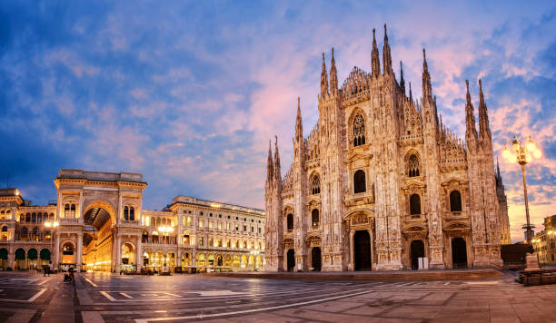
Opening ethnic restaurant in Milan

Slide 2
Business problem
The success of establishing a new restaurant depends on several factors: demand, brand loyalty, quality of food, competition, and so on.
In most cases, a restaurant’s location plays an essential determinant for its success. In this project we will try to find an optimal location for an ethnic restaurant in Milan.
We will analyze the distribution of restaurants and sorrounding businesses, in particular ratings and likes of potential competitors in the areas.

Slide 3
Data
Neighborhood data from Wikipedia: https://en.wikipedia.org/wiki/Category:Districts_of_Milan
Geographical coordinates of neighborhoods from python geocoder library
Venues of given neighborhoods from Foursquare API venues explore
Ranks and likes of restaurants from Foursquare API venues method

Slide 4
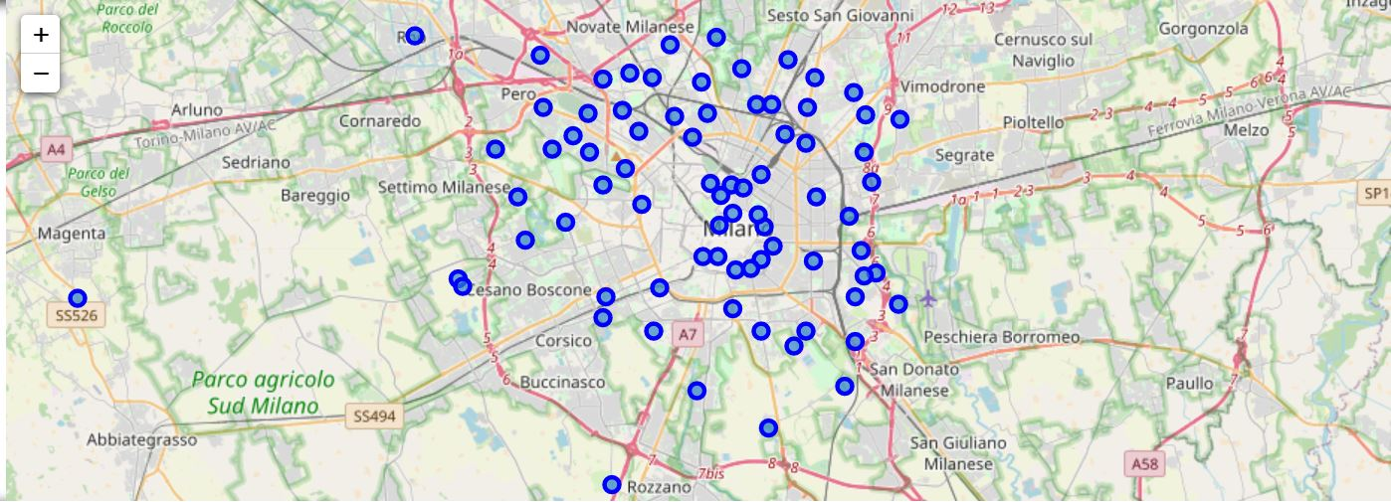
Neighborhoods in Milan

Slide 5
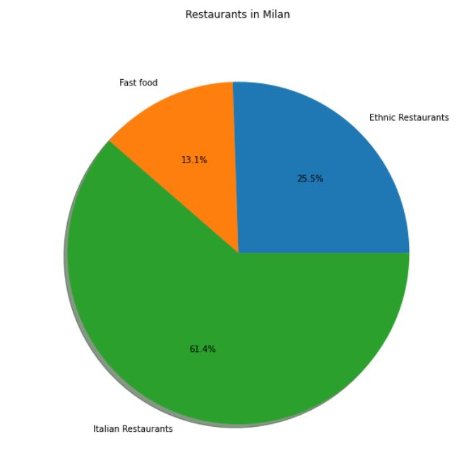
Main categories of restaurants
812 italian restaurants
340 ethnic restaurants
174 fast food

Slide 6
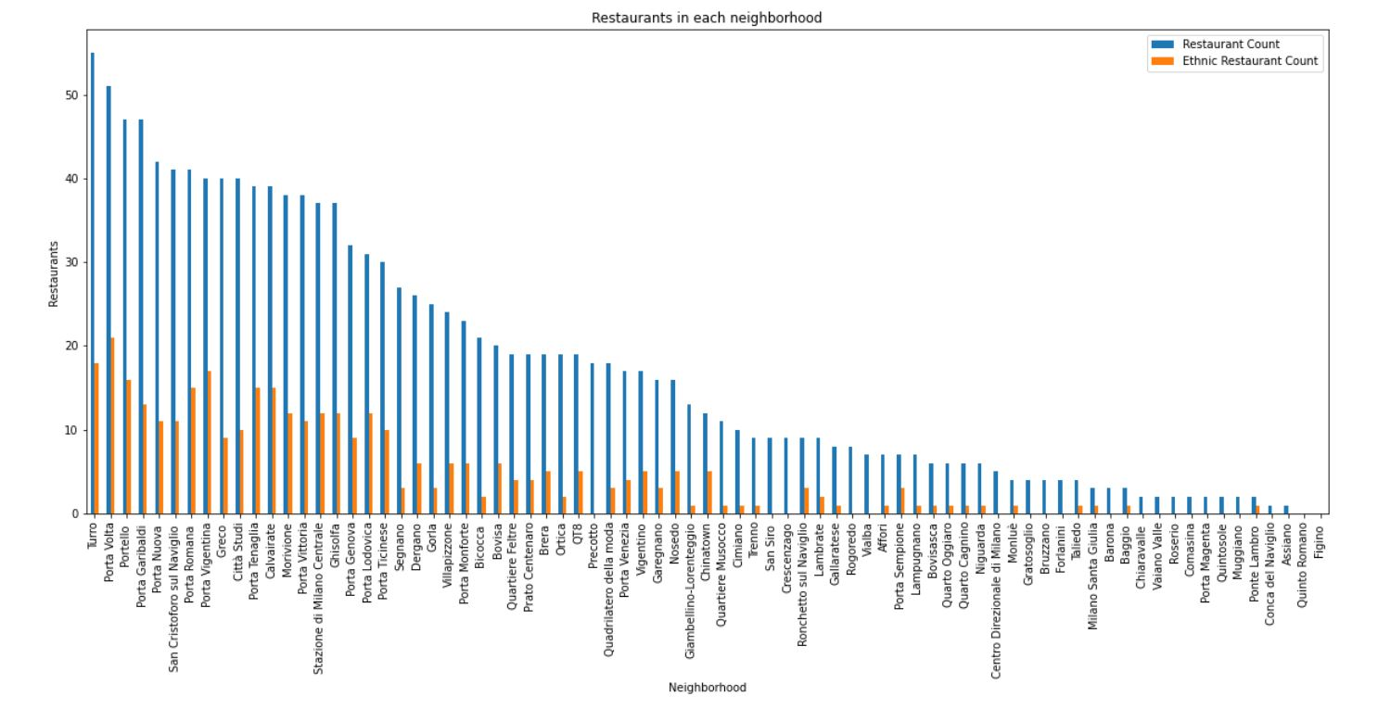
Restaurants in each neighborhood

Slide 7
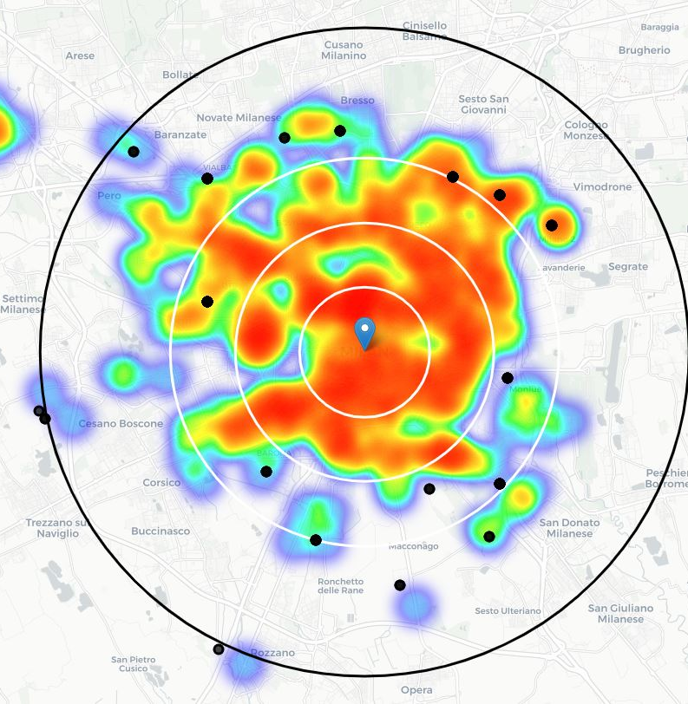
Neighborhoods without ethnic restaurants

Slide 8
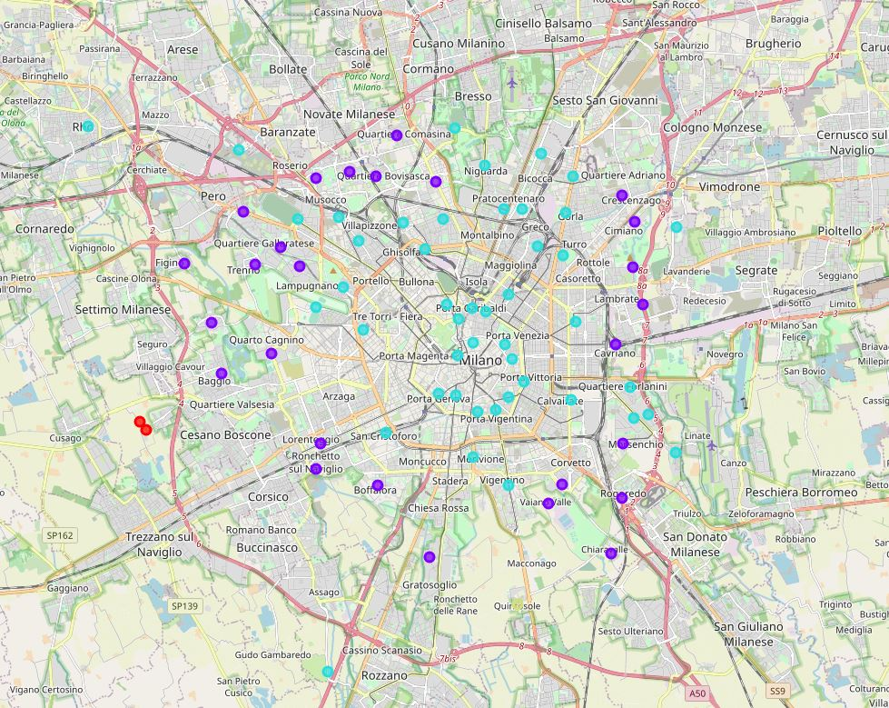
Clustering
Cluster 0: neighborhoods in suburb area without ethnic restaurants
Cluster 1: neighborhoods between 4 and 6 km from the center where there are mainly bar and italian restaurants
Cluster 2: neighborhoods in the heart of the city, full of restaurants of all kinds
Cluster 3: neighborhoods with few ethnic restaurants

Slide 9
Conclusion
The majority of restaurants are situated at the center of the city as expected.
The most promising neighborhoods for opening an ethnic restaurant are in cluster 1. In these neighborhoods the number of competitors is not as high as in the case of cluster 2, moreover these areas are more populated than the neighborhoods of cluster 0 and 3.
There are also interesting location in few neighborhoods of cluster 2 that lack in ethnic restaurants.

Slide 10
Possible locations
Figino
Cluster 1
Has few restaurants
Almost no ethnic restaurant
Bicocca
Cluster 2
Has ethnic restaurants with low rating
University neighborhood
Forlanini
Cluster 2
Has few ethnic restaurant
6 km from the historic center

