Slide 1

Capstone Group 2
Credit Card Churn Analysis
July 2023

Slide 2








Capstone Group-Two Team Members
Quinn Sencenbaugh
Advisory Analyst
Aidan Surowiec
Consulting Analyst
Paniz
Herrera
Advisory Analyst
Paola
Malagon
Consulting Analyst
Max
Schliesman
Consulting Analyst
Juan José
González
Advisory Analyst
Copyright © 2023 Deloitte Development LLC. All rights reserved.
Git-ing it Done Capstone
2
Notes:
Paniz

Slide 3

Contents
Introduction
Project Overview
Business Understanding
Data
Data Understanding
Data Preparation
Solving the Problem
Modeling
Modeling Approach
Model Discussion
Model Evaluation
Solution Model
Conclusion
Recommendations
The Road Ahead
Thank You
Notes:
Paniz

Slide 4
Introduction
Copyright © 2023 Deloitte Development LLC. All rights reserved.
Git-ing it Done Capstone
3

Slide 5
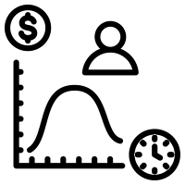




Project Overview
A Business manager at Credit Card Incorporated (CCI) bank hired our team to help formulate a strategy to mitigate their pressing business problem.
High Customer Attrition
The bank has an issue with retaining customers, high numbers of customers are cancelling their credit cards.
Why is this a Problem?
Reduced Customer Lifetime Value
Increased Customer Acquisition Cost
Churn Hurts Company Valuation
Churned Clients can be Vocal
Customers who churn will reduce the overall potential revenue generated.
High churn rates can increase the cost of acquiring new customers – resulting in higher marketing and sales costs.
High churn rates indicate that business has difficulty retaining customers, resulting in a less attractive business opportunity.
Negative reviews for why customers stopped services could impact ability to land new clients.
Notes:
Paniz

Slide 6
Business Understanding
Layout of the business question, what this solution means for CCI, and an overview of our solution approach.
Key Business Question:
Stakeholder Understanding:
Credit Card Churn Prediction aims to predict if a customers will cancel their card. Additionally, what factors are the strongest predictors for a customer to cancel.
A business manager from Credit Card Incorporated (CCI) bank is trying to reduce his attrition rates. Lower attrition means more people are using their credit card for longer, increasing bank profits.
Our Solution
Our team will utilize AI and ML models to analyze credit card data. We will determine which factors are the strongest predictors of attrition and which model will provide the most accurate results. With an understanding of what leads to attrition and which model to use, we can guide our recommendations to CCI.
Notes:
Paniz

Slide 7
Data Understanding
Copyright © 2023 Deloitte Development LLC. All rights reserved.
Git-ing it Done Capstone
3

Slide 8


Data Understanding
The data source we used was from Kaggle. The dataset is from a bank manager trying to reduce attrition, the same problem we are trying to solve.
Credit Dataset
Variable Type
Categorical Variables
Numeric Variables
5 Variables
14 Variables
4 variables are demographic and categorical
Example columns:
Gender
Education Level
Marital Status
2 variables are demographic and numeric:
Customer Age
Dependent Count
Demographic
Rows: 10,127
Columns: 19*
Null Values: 0
6 Variables
1 variable is categorical and a financial / account variable:
Card Category: Credit card tier of customer
Blue, Silver, Gold, Platinum
12 variables are financial and numeric
Example columns:
Credit Limit
Total Transaction Amount
Average Utilization Ratio
Financial
13 Variables
Data Exploration
Class Imbalance
High Correlation
Target Relation
Percentage of Observations by Attrition Flag
Some variables are highly correlated, such as:
Average Utilization Ratio vs. Total Revolving Balance: +0.62
Card Category vs. Credit Limit: +0.49
Our team also examined which variables are closely related with attrition, some examples:
Number of Transactions: -0.37
Total Revolving Balance: -0.26
*The original dataset has 23 columns; the analysis is moving forward with 19 of these
Notes:
Juan Jose

Slide 9
Data Preparation
To properly analyze the data and make recommendation to reduce attrition, our team took several steps to clean the data.
Dropped Irrelevant Columns
Encoded Categorical Variables
Three columns dropped:
Client number (ID) was dropped, ID numbers should have no influence on our predictions.
Two additional columns were dropped due to the author note from the dataset, these were calculated values.
Dummy Variables:
Categorical variables that had no natural order or rank were encoded using dummy variables.
Gender and Marital Status were the two categorical variables that fit this description. The encoding of these variables resulted in six new columns.
Unclean Data
Evaluated “Unknown” Values
Label Encoder
Ready for Modeling
No Null Values, “Unknown” Values Present:
After evaluating value counts, it was clear the three categorical columns had observations with “Unknown” string values.
Income Category, Education Level, and Marital Status had unknowns – only seven observations had “Unknown” as the value for all three, equal to 0.07% of the data.
The small number of instances with multiple unknowns was unlikely to skew results.
Ranked Encoding:
The remaining three categorical columns did have a natural order, these were manually encoded for each value to sequentially represent a rank.
Card Category was ranked as Blue being the lowest and Platinum being the highest.
Education Level and Income Category both had “Unknown” values present, those were encoded as 0.
Notes:
Juan Jose

Slide 10

Solving the Problem
Based on the data, how can we approach the customer attrition issue?
The goal is to predict the attrition flag of any given customer based on the input data.
The attrition flag is an identifier for whether a customer cancelled their credit card or not, since the outcome is either yes (1) or no (0), this is a binary classification problem.
To solve the binary classification task, four models were tested and developed.
A prediction model enables CCI to identify at-risk groups, understand key factors for customers who churn, and make necessary strategic recommendation.
Notes:
Paola

Slide 11
Modeling
Copyright © 2023 Deloitte Development LLC. All rights reserved.
Git-ing it Done Capstone
3

Slide 12


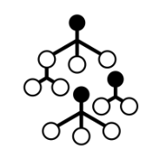

Modeling Approach
The binary classification task can be approached in many ways, multiple models were tested in efforts to offer the optimal solution for this case.
Which models were tested and why?
Logistic Regression: Simple but effective approach.
Decision Tree: Alternative, highly interpretable classification model.
Increasing Model Complexity
Random Forest: Complex model that typically give more accurate results.
XGBoost: Highly complex model that works well with unbalanced data.
The final model will ideally have high recall – we would like to detect as many exiting customers as possible.
It will be better for the model to predict incorrectly that a customer will leave (False Positive), rather than predicting incorrectly they will stay (False Negative).
Notes:
Paola

Slide 13
Logistic Regression
Logistic regression is a statistical model that is often used for classification and predictive analytics.
Modeling Logistic Regression
Feature Importance
Feature Importance is an indicator of what variables are the strongest predictors for customer Attrition.
The feature with the highest correlation is the number of contacts over the past year.
The number of months inactive over the past year, and the total relationship count are also features that are highly correlated.
Performance Metrics
The accuracy of the logistic regression was able to reach 89%.
Recall and F-1 score are going to give a better sense of the performance for our situation. Recall was 74% and the f-1 had a .77. This is significantly lower performance than the accuracy would indicate.
The logistic model performed well with the best model reaching 74% recall and .77 f-1 score.
Because this is such a simple model, we are confident that increasing model complexity will allow us to develop a model better suited for production.
Notes:
Max

Slide 14
Decision Tree
Decision Tree is a supervised machine learning model, are used to classify by partitioning recursively the sample space until we get a discrete class.
Modeling Decision Tree
Feature Importance
The feature with the highest performance is the amount of times that a customer uses their card.
The amount of transactions and the revolving balance a customer has on their card are also very strong predictors.
Performance Metrics
Decision tree reached an accuracy of 94%.
The recall score was an 89% and the f-1 score was .90. This is a significant improvement over the logistic regression model.
The decision tree achieved a better recall than the logistic regression with a 15% increase in score. The problem with this model is a relatively high number of false negatives. Our team wants to reduce the false negative even further.
Notes:
Max

Slide 15
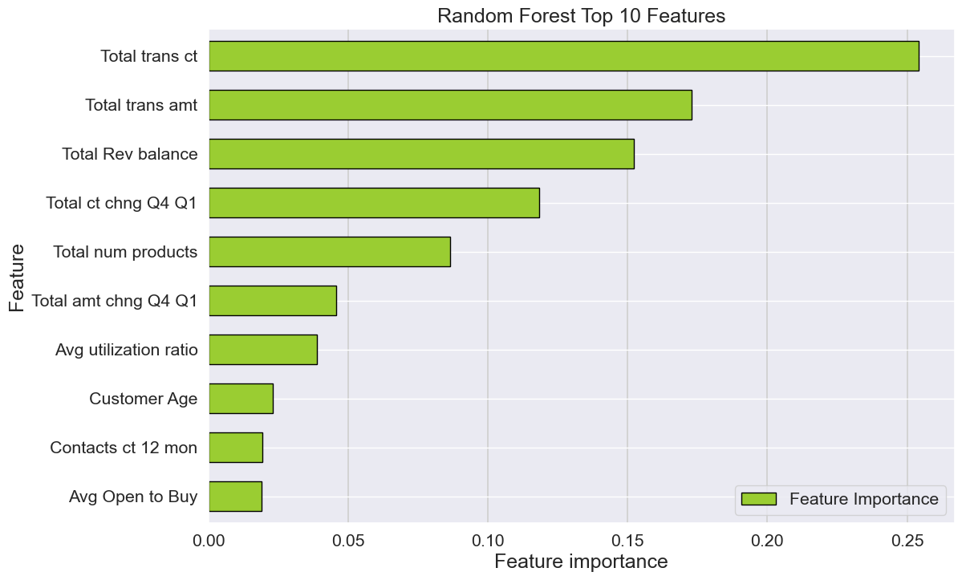
Random Forest
Random Forest is a supervised learning algorithm that makes use of decisions trees and can be used for classification and regression tasks.
Modeling Random Forest
Feature Importance
Feature Importance is an indicator of what variables are the strongest predictors for customer Attrition.
The feature with the highest performance is the amount of times that a customer uses their card.
The total revolving balance and the total amount of transactions are also important predictors of attrition.
Performance Metrics
The default setting for a random forest reached an accuracy of 90.6%, after tuning the hyperparameter an accuracy of 96% was achieved.
Accuracy is a crude metric, so for a better idea of performance we can use an f-1 score and recall. The random forest had a macro f-1 score of .93 and a recall of 91%.
The random forest performed the best so far, however, the recall rate on the test data still has room for improvement. By using a complex model that better handles unbalanced data, we may be able to predict less false negatives.
Notes:
Max

Slide 16
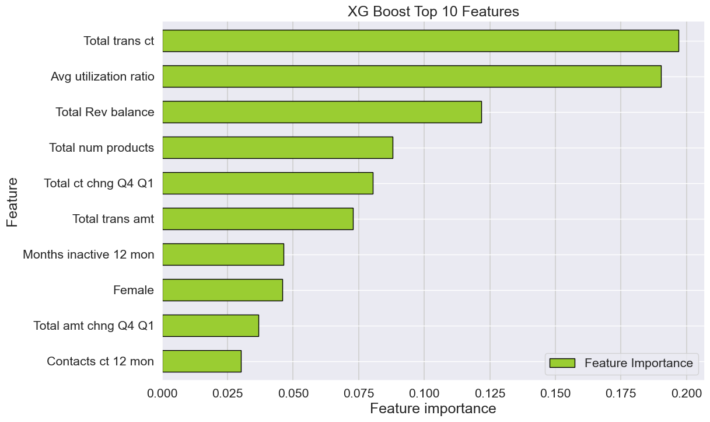
XGBoost
XGBoost is a machine learning algorithm which combines the predictions of multiple other models to create strong predictive models.
Modeling XGBoost
Feature Importance
Feature Importance is an indicator of what predictors are the strongest for customer attrition
The variable with the highest feature importance is Total Transaction Count
9 out of 10 of the most important features are financial variables, demographic variables do not appear to impact customer attrition as much
Performance Metrics
After hyperparameter tuning, the model scored a high accuracy of 94.9%
Class imbalance was addressed in hyperparameters
The recall and F1 scores on the test data were 0.96 and 0.86 respectively
The optimal model predicted 21 false negatives
The XGBoost model resulted in the highest recall score and lowest false negatives out of all the models. The precision and F1 scores suffered but this model was great at achieving optimization in the metrics we deemed most necessary.
Notes:
Quinn

Slide 17
Model Evaluation
Comparison of each model's performance across various metrics on the testing data.
Model Scores
Model | Accuracy | Precision | Recall | F1 | False Positives | False Negatives | True Positives | True Negatives
Logistic Regression | 89% | 81% | 74% | .77 | 81 | 186 | 198 | 2067
Decision Tree | 94% | 90% | 89% | .90 | 81 | 67 | 351 | 2033
Random Forest | 96% | 95% | 91% | .93 | 84 | 24 | 348 | 2076
XGBoost | 95% | 79% | 96% | .87 | 106 | 17 | 402 | 2007
Finding the Optimal Model
High Priority Metrics:
Recall: Best metric for evaluation when there is a high cost of False Negatives
False Negatives: Predicting customers will not cancel and they do - low score is ideal
F1: Metric that combines Precision and Recall
Low Priority Metrics:
Accuracy: The number of correct predictions by the model
Precision: Best metric for evaluating when there is a high cost of False Positives
Notes:
Quinn

Slide 18
The Solution Model
Deep dive for choosing the ideal model for providing a solution to the customer attrition issue.
Chosen Model:
Using the Model:
Random Forest Classification Model
Can be tuned to handle unbalanced data, should be able to adapt to a production environment well.
Highly interpretable model relative to XGBoost.
F1: 0.93 (1st),
Accuracy: 96% (1st),
Recall: 91% (2nd),
False Negatives: 24 (2nd).
Applications
Random Forest will be able to compute churn predictions in real time and can flag new customers as churn risks.
Give insights into which factors influence churn the most and relay how this changes over time.
Able to introduce parameter values that deal with natural data imbalance that.
Our team recommends for CCI to implement a Random Forest model to reduce their attrition rates and increase business performance.
Notes:
Quinn

Slide 19
Conclusion
Copyright © 2023 Deloitte Development LLC. All rights reserved.
Git-ing it Done Capstone
3

Slide 20
Solving the Problem and Recommendations
The identified ideal model for this classification problem is Random Forest – how will this be used to solve the problem?
Strategic Impact
Exiting Factors
By understanding elements associated with exiting customers, CCI could begin testing targeted incentivized solutions to mitigate typical churn risk areas.
Shift Focus
Adjust the marketing strategy to focus primarily on the groups that are not predicted to be at-risk. CCI could confidently change the targeting tactics for new customers.
Support High Risk
Reach out to the high-risk customers and provide support or gauge where there is a gap in needs being met.
Re-evaluate Larger Initiatives
The modeling results can invite conversation for re-evaluating larger retention initiatives such as credit card interest rates, benefits, etc.
Anticipated Implementation Outcomes
Increase Customer Lifetime Value
Decrease Customer Acquisition Costs
Improve Company Valuation
Satisfied Customers
Notes:
Aidan

Slide 21
The Road Ahead
The Random Forest model can provide more than our time-of-analysis suggestions, here is how we think the next six months should look for CCI – if this approach is working, CCI should consider expanding their use of AI solutions.
Deep Dive
Kickoff Standups
Investigation
Discuss findings from the first month, set up reporting schedule to benchmark success.
Begin bi-weekly standups with workstream leads and begin strategy execution.
Investigate the capability for the random forest model to solve other business problems.
October
January
March
September
November
February
Random Forest
Working Sessions
Evaluation
Deploy Random Forest model into production, outline goals of 6-month trial.
Begin series of working sessions to evaluate model success and develop business strategy.
Present statistical reporting of churned customers over the trial period and weigh outcomes against outlined goals.
Notes:
Aidan

Slide 22
Thank You!
Questions?
Copyright © 2023 Deloitte Development LLC. All rights reserved.
Git-ing it Done Capstone
21

Slide 23
Appendix
Copyright © 2023 Deloitte Development LLC. All rights reserved.
Git-ing it Done Capstone
21

Slide 24
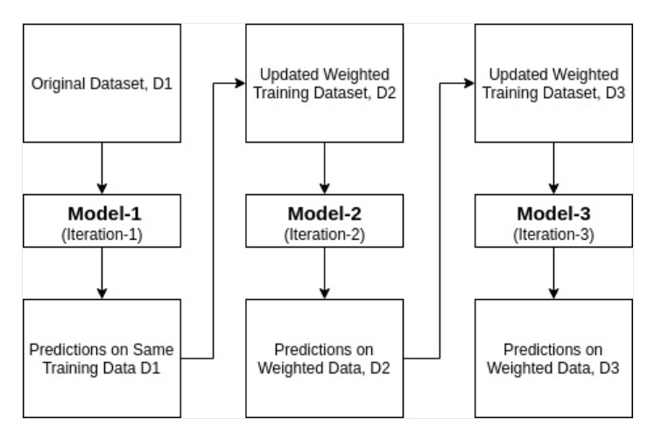
Ada Boost Algorithm
Ada-boost or Adaptive Boosting combines multiple classifiers to increase the accuracy of classifiers. AdaBoost is an iterative ensemble method.
It works in the following steps:
Initially, Ada Boost selects a training subset randomly.
It iteratively trains the AdaBoost machine learning model by selecting the training set based on the accurate prediction of the last training.
It assigns the higher weight to wrong classified observations so that in the next iteration these observations will get the high probability for classification.
Also, It assigns the weight to the trained classifier in each iteration according to the accuracy of the classifier. The more accurate classifier will get high weight.
This process iterate until the complete training data fits without any error or until reached to the specified maximum number of estimators.
To classify, perform a "vote" across all of the learning algorithms you built.

Slide 25
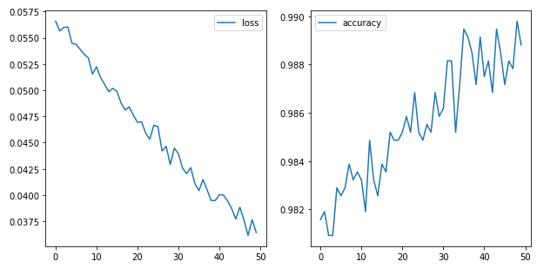
Artificial Neural Network (ANN)
Artificial Neural Networks (ANNs) is a machine learning process that uses interconnected nodes in a layered structure to process data and predicts the probability that a given customer will cancel their credit card.
Modeling Artificial Neural Network (ANN)
Accuracy
The baseline model had the input layer with 12 nodes with 3 input dimensions, one hidden layer with 8 nodes, and an output layer of one node
The issue at hand is binary classification, this is why there is only one output node
After compiling the model and fitting the training data with a batch size of 10 and epochs set at 20, the model produced a 94.23% accuracy, with a continued trend of declining loss
The model was then tuned with a grid search, the optimal model resulted in a training accuracy of 97.3% and a testing accuracy of 98.12%
Still Learning
The loss function has not plateaued yet and still is continuing a general declining trend – this means the model is still learning and can be tuned for further improved performance
Loss of Best Model
Accuracy of Best Model
Uses probabilities associated with our predictions to judge how well prediction fits reality – the aim is to decrease loss as far as possible.
Accuracy judges how well the predictions are after applying the threshold at the output layer – the aim is to increases accuracy as far as possible.

