Slide 2
Motivation & Scope
Can Deep Reinforcement Learning (DRL) be effectively
leveraged for autonomous exploration?
Autonomous exploration is a complex task
Classical analytical methods exist but present some limitations
Learning-based methods can provide more adaptive models
Objective:
Develop a framework to investigate the possibility of integrating learning-based methods with classical ones

Slide 3
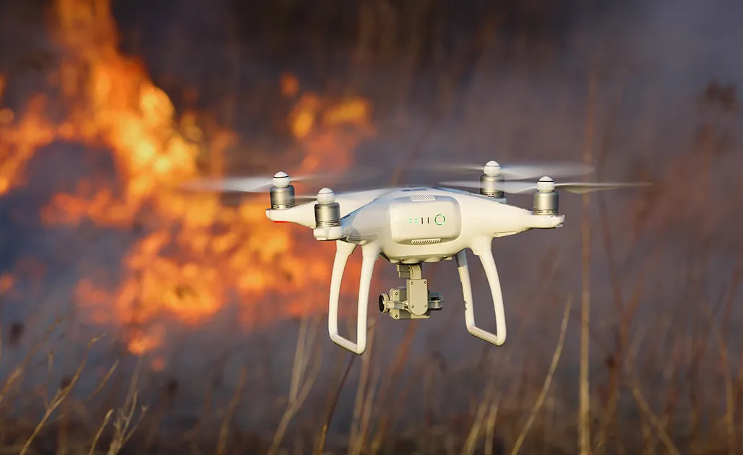
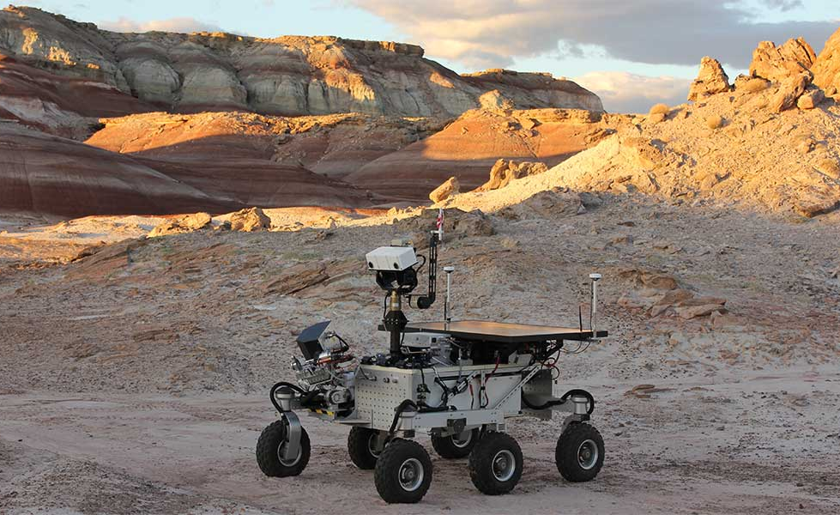
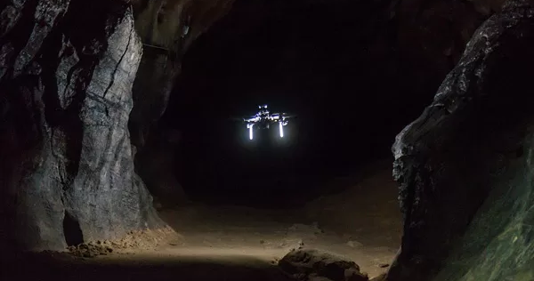
Context: Autonomous Exploration
Exploration: systematically map an unknown environment
Autonomous: the agent can perceive and moves without human guidance
Why autonomous exploration?
Complex task, require simultaneous:
Mapping
Localization
Navigation
Decision making
The agent must decide where to move next
Autonomous exploration application examples

Slide 4
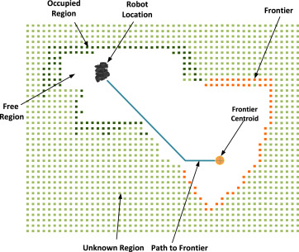
Classical Approaches
Next Best View approach Optimization problem, find the next best position for the sensing apparatus
Frontier-Based Exploration (Yamauchi 1997)
Frontiers: boundary between explored and unknown regions
Often grouped into cluster
The agent moves toward frontier clusters
Fixed heuristics policies to decide which frontier region
Frontier-based exploration illustration

Slide 5
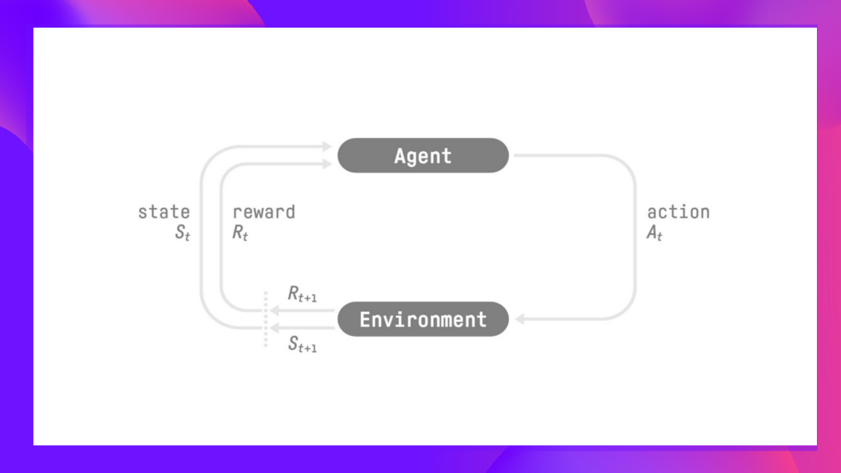
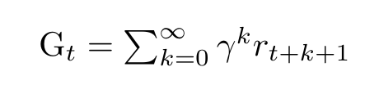
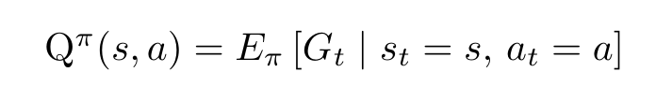
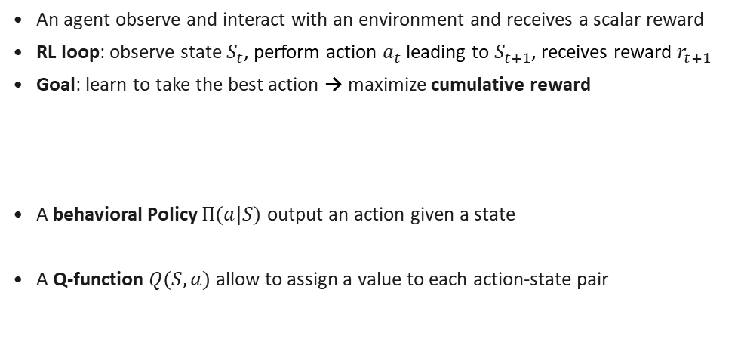
Deep Reinforcement Learning
Reinforcement Learning
An agent observe and interact with an environment and receives a scalar reward
RL loop: observe state $S_{t}$, perform action $a_{t}$ leading to $S_{t+1}$, receives reward $r_{t+1}$
Goal: learn to take the best action → maximize cumulative reward
A behavioral Policy $Π(a|S)$ output an action given a state
A Q-function $Q(S,a)$ allow to assign a value to each action-state pair

Slide 6
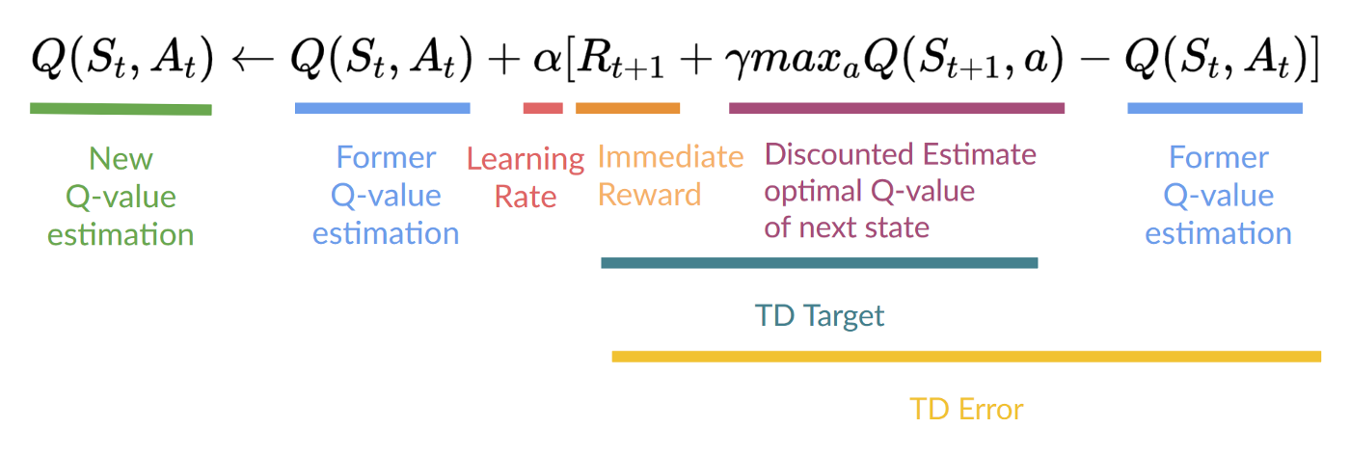
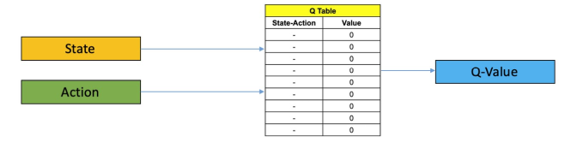
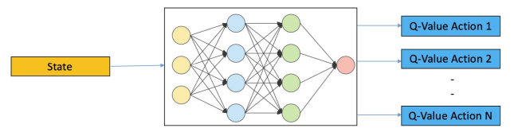
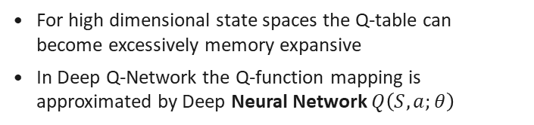
Deep Reinforcement Learning
Q Learning
Q-Algorithm
The Q-function is learned directly, the policy is a greedy heuristic
Q-Algorithm allows to iteratively estimate the Q-function from experience
In Q-learning the Q-function is encoded in a table called Q-table
Q-Table
Deep Q-Network (DQN)
For high dimensional state spaces the Q-table can become excessively memory expansive
In Deep Q-Network the Q-function mapping is approximated by Deep Neural Network $Q\left(S,a;θ\right)$
Q-Network

Slide 7
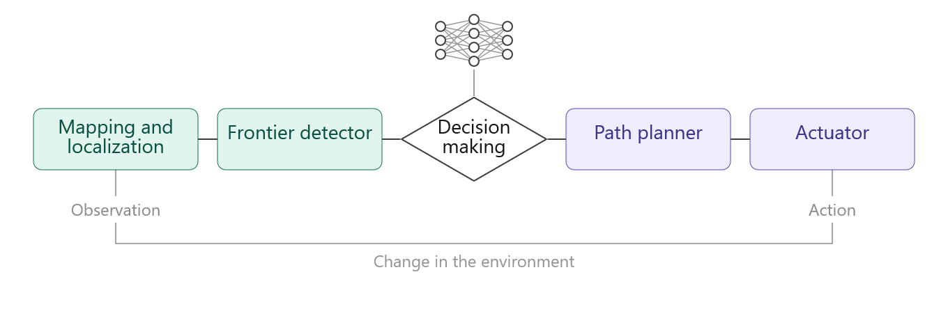
System Architecture
Hybrid modular architecture
Classic analytical components
DRL component
Mapping
Frontier detection
Low level navigation
Decision making module
Selection of the target position

Slide 8
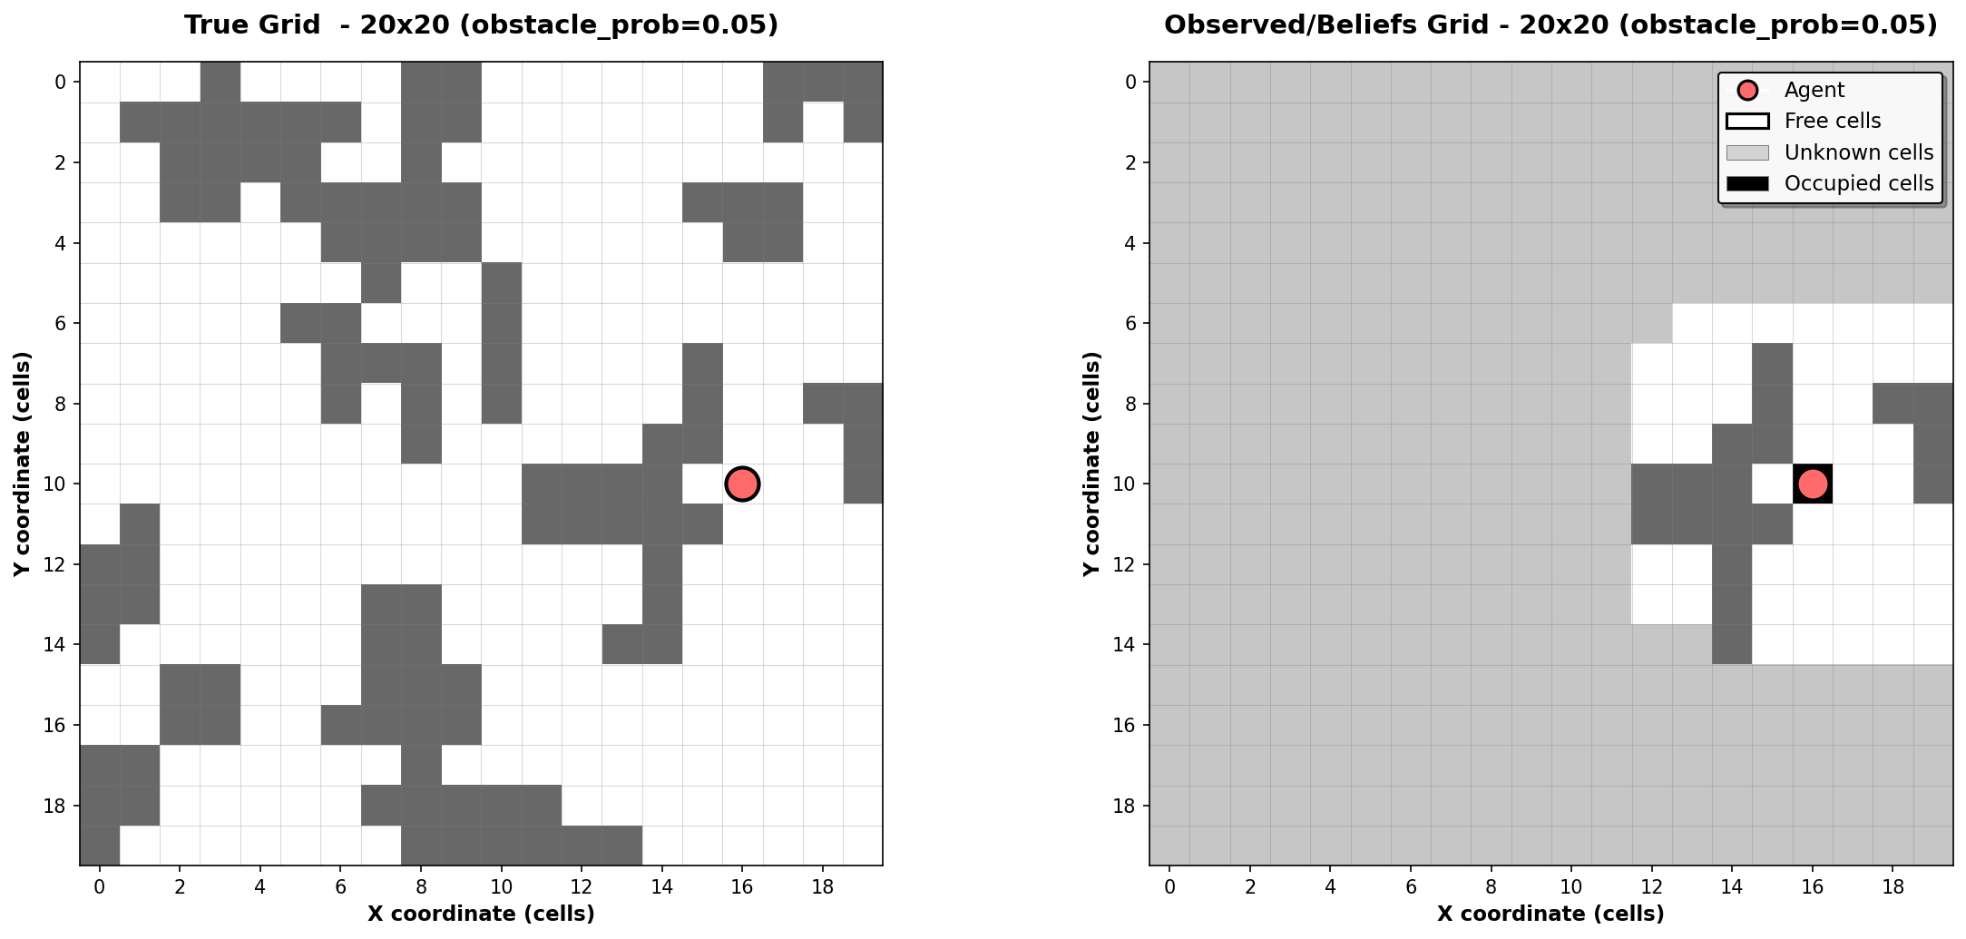
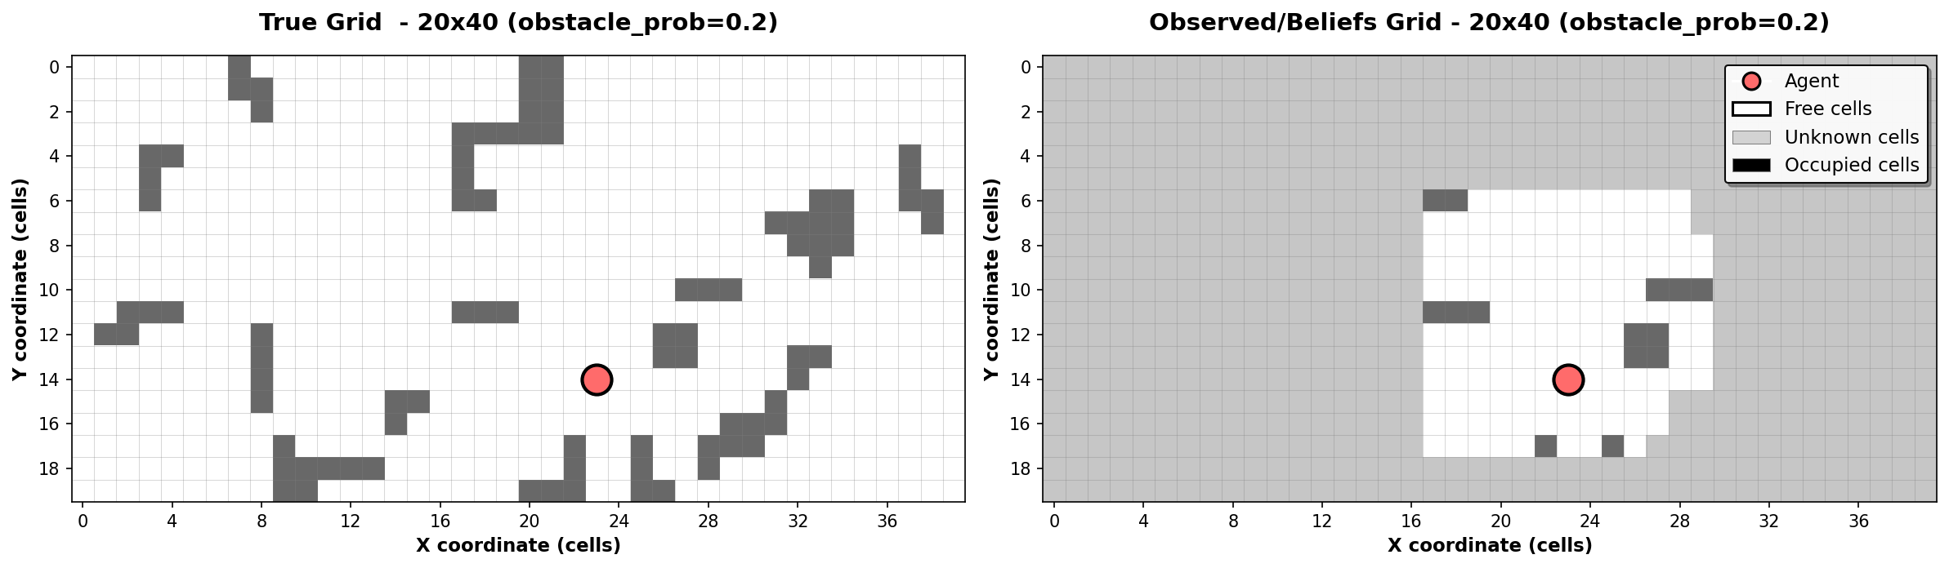
The Simulator
The environment – 2D occupancy grid
Partially observable discrete map
Static maps with random obstacle placement
Agent observes a local window within his perception range
Sequential observations are used to build a believes map

Slide 9
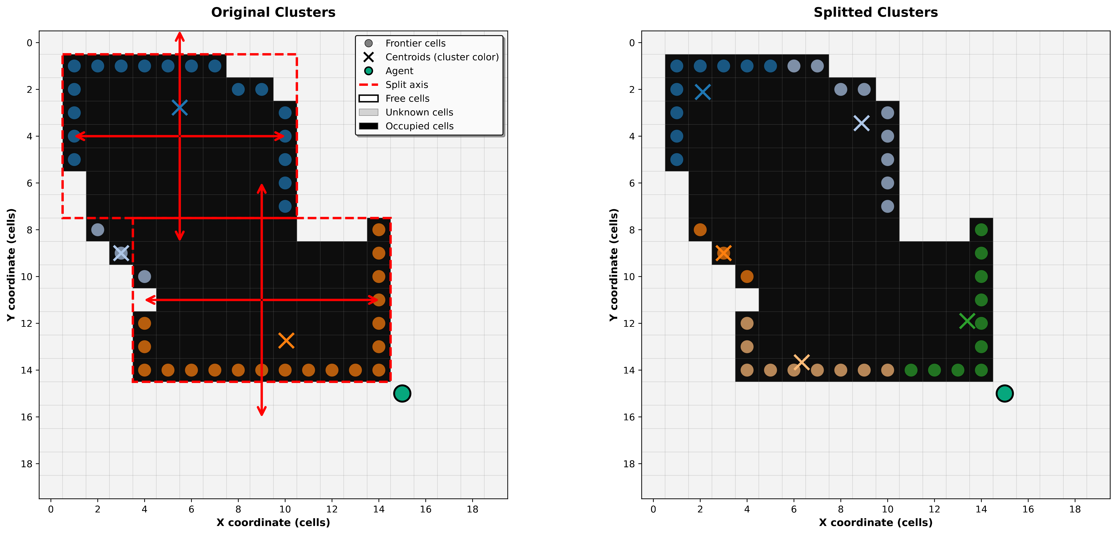
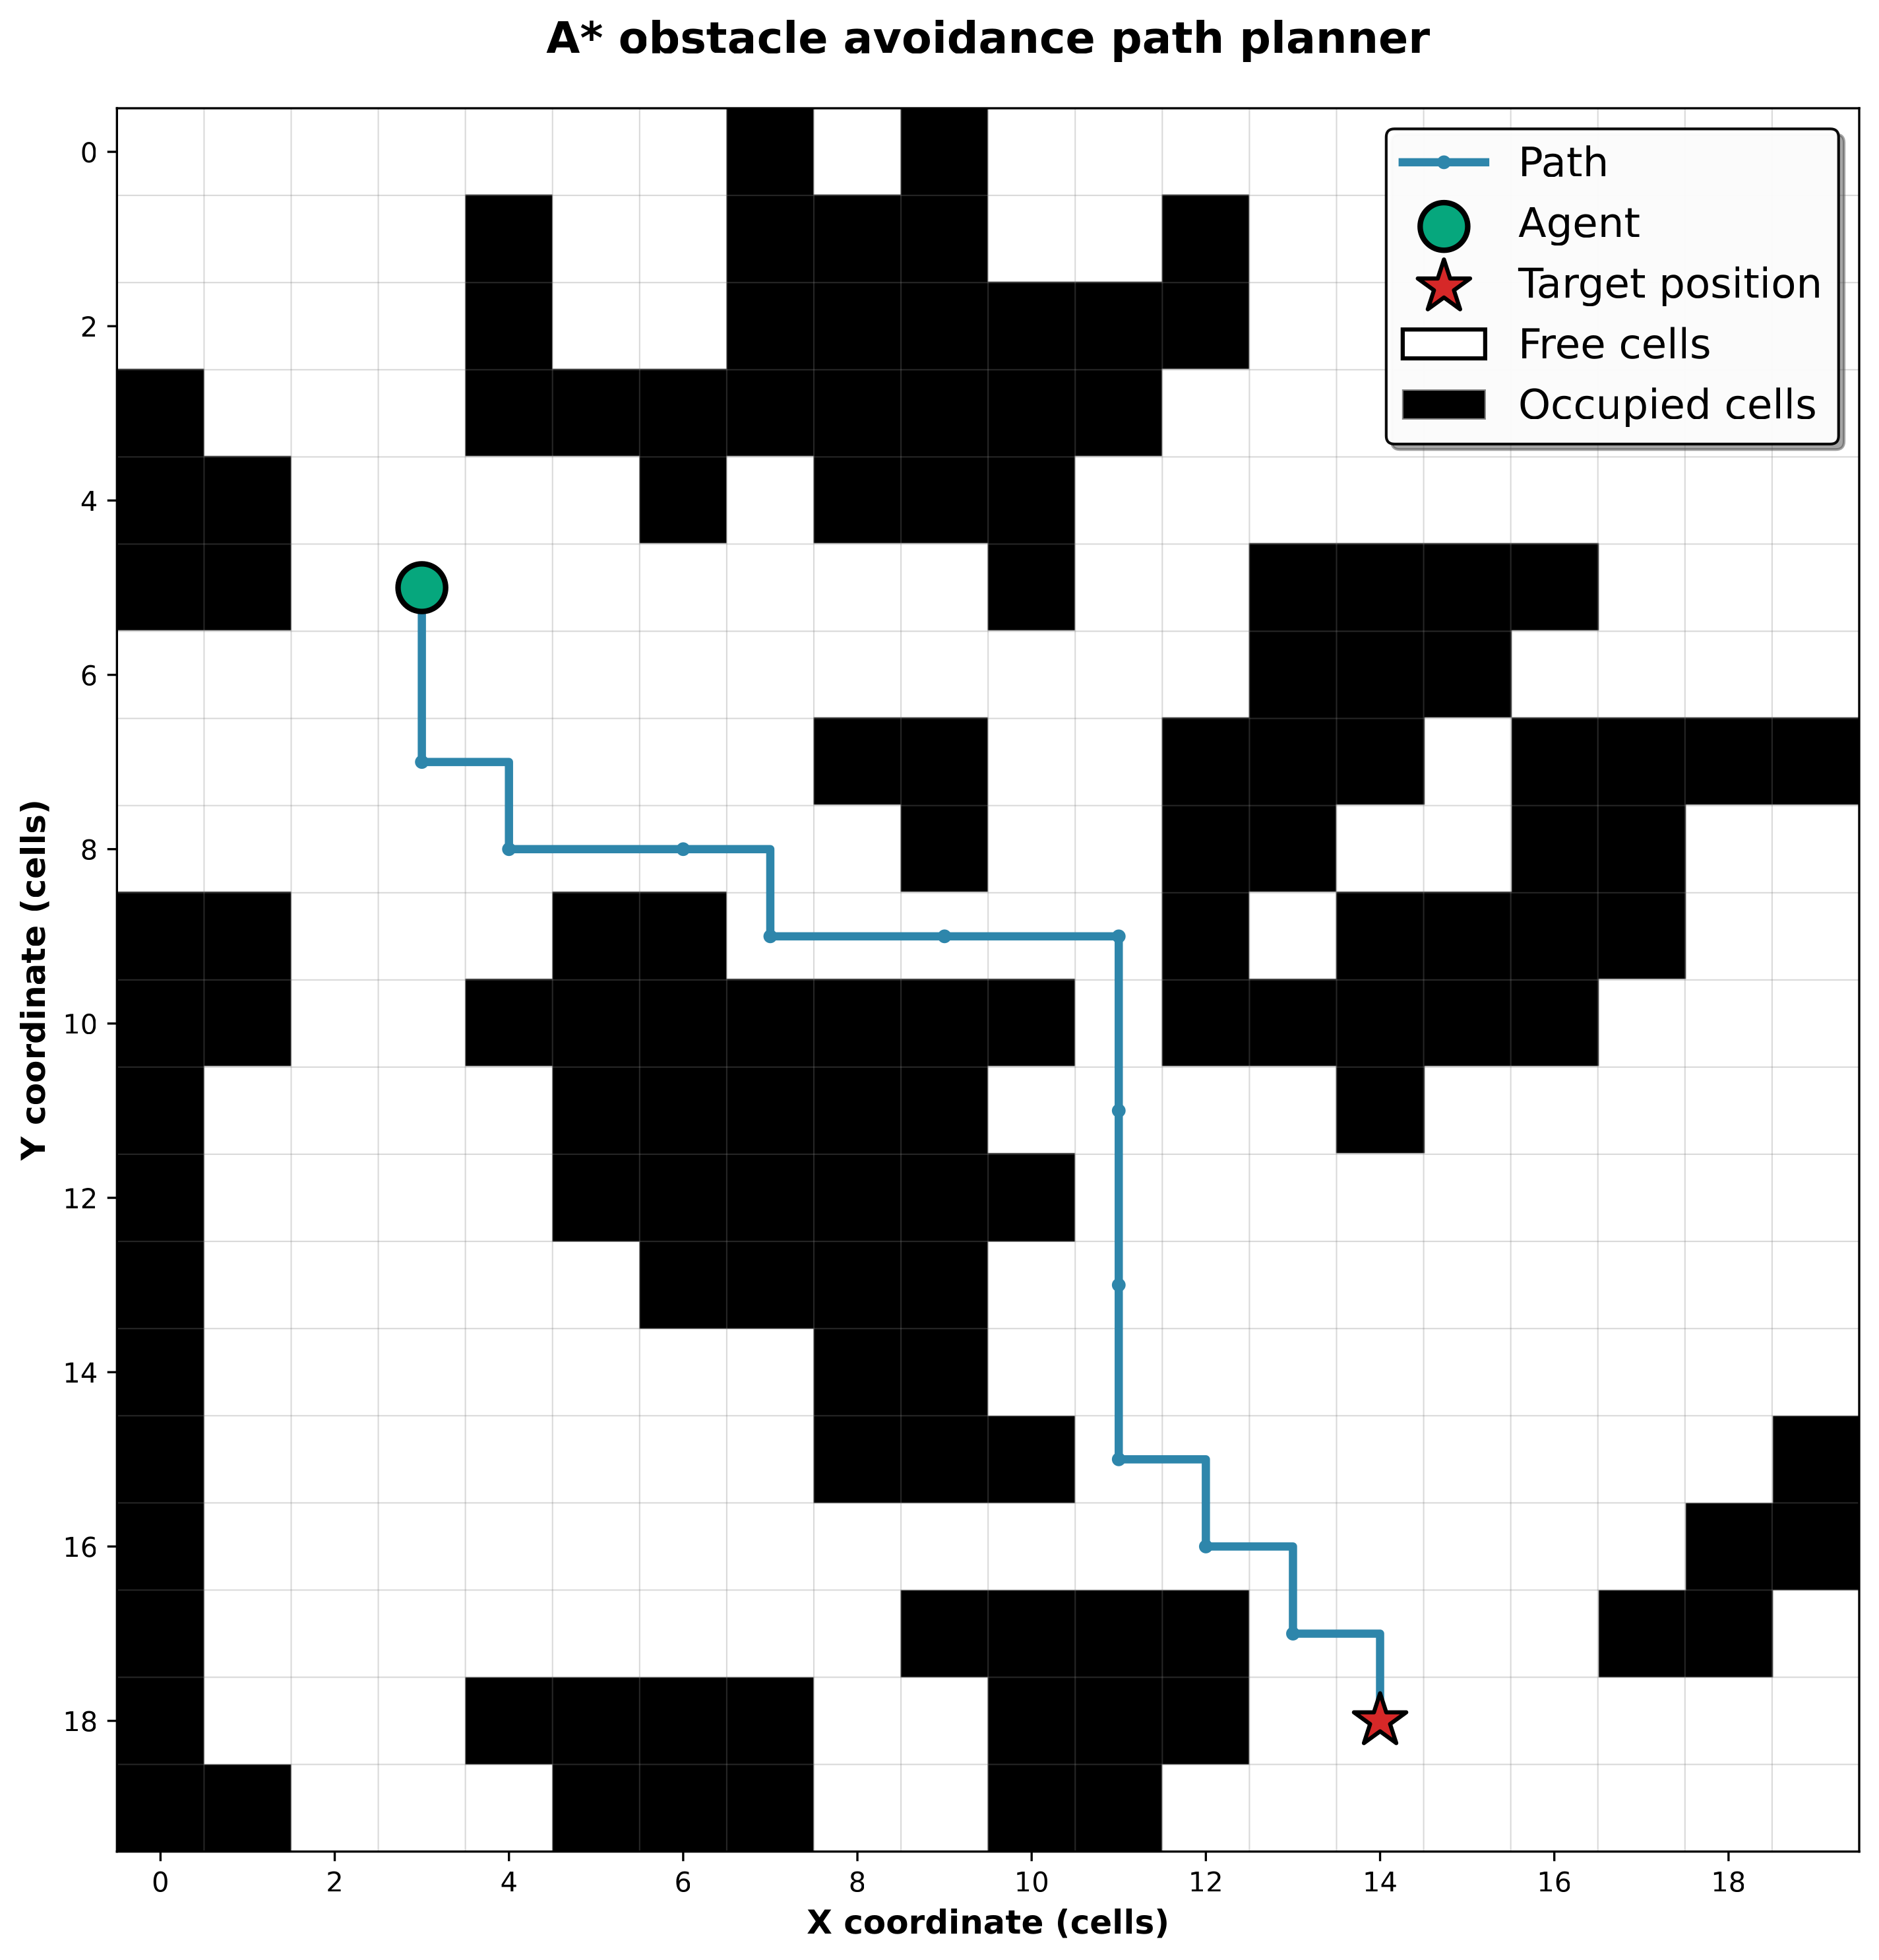
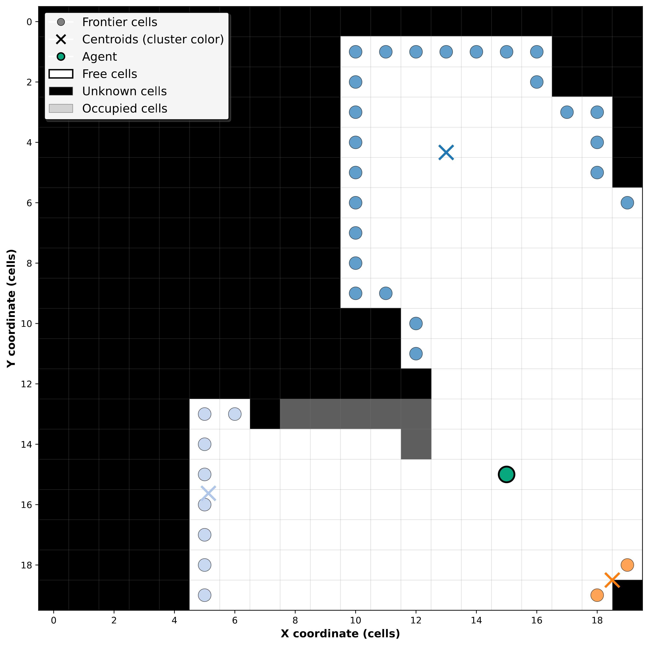
The Simulator
Frontier detection system
Obstacle avoidance path planner
Discriminate frontier cells
Group theme into clusters, splitting them if needed
Compute cluster’s centroids
Compute an obstacle free path to the target position (A* algorithm)

Slide 10
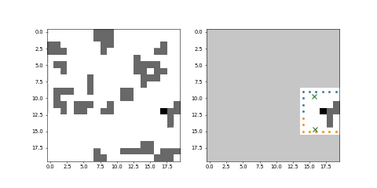
The Simulator
Simulation rendering
Simulation rendering example – Heuristic policy
Configuration setup
Grid size 20x20
Obstacle probability 0.05
Perception range n = 3 cells
Policy: greedy min distance heuristic

Slide 11
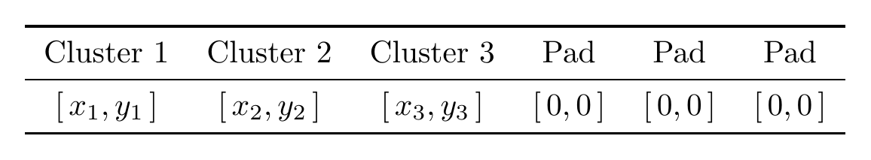
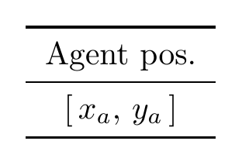
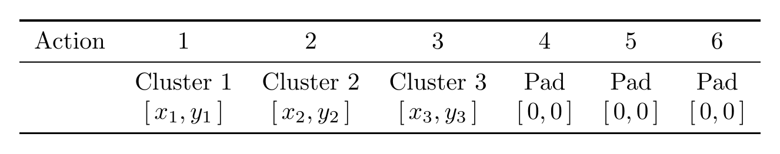
DRL Module: Observations & Actions
Observation Space (What it sees)
Observations:
Configurable setup:
Per-cluster frontiers information vector:
centroids position
information gain
Distance>
Agent position (optional)
Padded to fixed length N for consistent DNN input
Action Space (What it does)
Discrete: select one of N frontier cluster centroids
Chosen centroid passed to Path Planner for navigation
Action (e.g. = 2):

Slide 12
DRL Module: Reward Shaping
Reward Shaping Comparison
Condition | Reward 1 |  |  | Reward 2
Action outcome
Action selects padding slot | large negative | truncated | truncated | small negative | continues
No new cells explored | small negative | — | — | = R1 | —
Some cells explored | proportional positive | — | — | = R1 | —
Episode termination
Exploration ≥ threshold | large positive | terminated |  | = R1 | = R1
Max steps exceeded | large negative | truncated |  | = R1 | = R1
No progress for ≥ 20 steps | intermediate negative | truncated |  | = R1 | = R1
Additional signal — Reward 2 only
Oscillating behavior detected | — |  |  | small negative

Slide 13
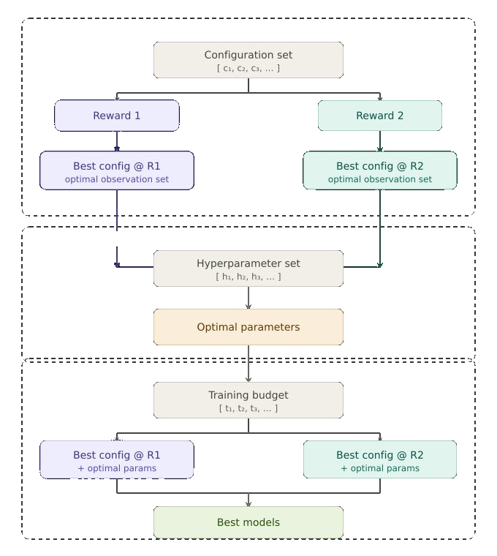
Experimental Campaign
Phase 1 — Configuration search: reward × observation set → best configuration per reward
Phase 2 — Hyperparameter optimization: → converged to a single optimal hyperparameter set
Phase 3 — Training budget: 500k / 750k / 1M time steps → 2 best models selected

Slide 14
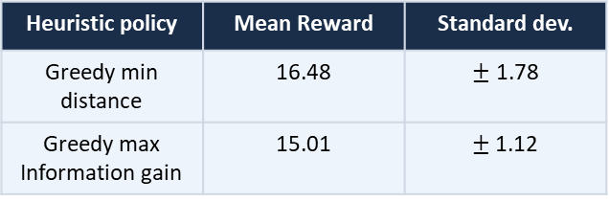
Results Metrics & Baselines
Mean cumulative episode reward
Evaluation reward
Training reward
TD loss (training loss)
Mean reward - heuristics baselines
Heuristic policy | Mean Reward | Standard dev.
Greedy min distance | 16.48 | $±$ 1.78
Greedy max Information gain | 15.01 | $±$1.12

Slide 15
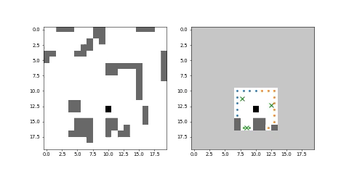
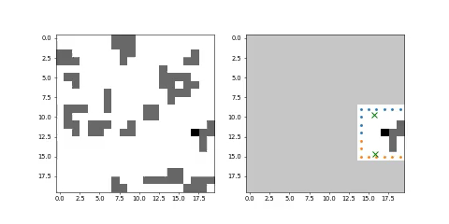
Results – Failed Attempts
Examples of not meaningful policy learning

Slide 16
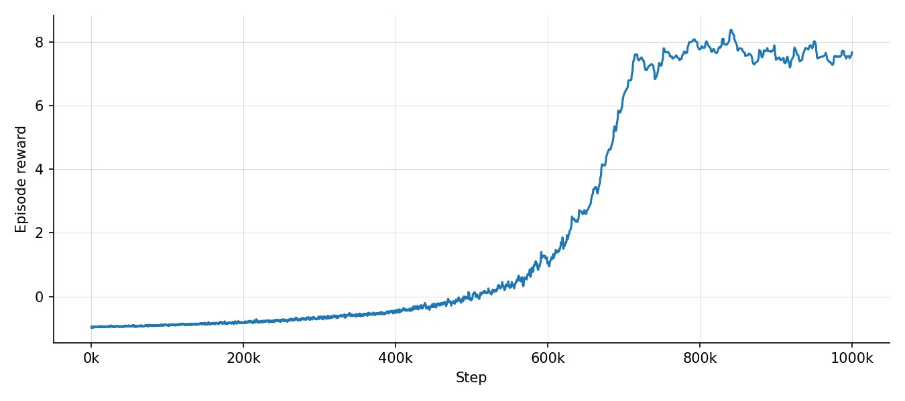
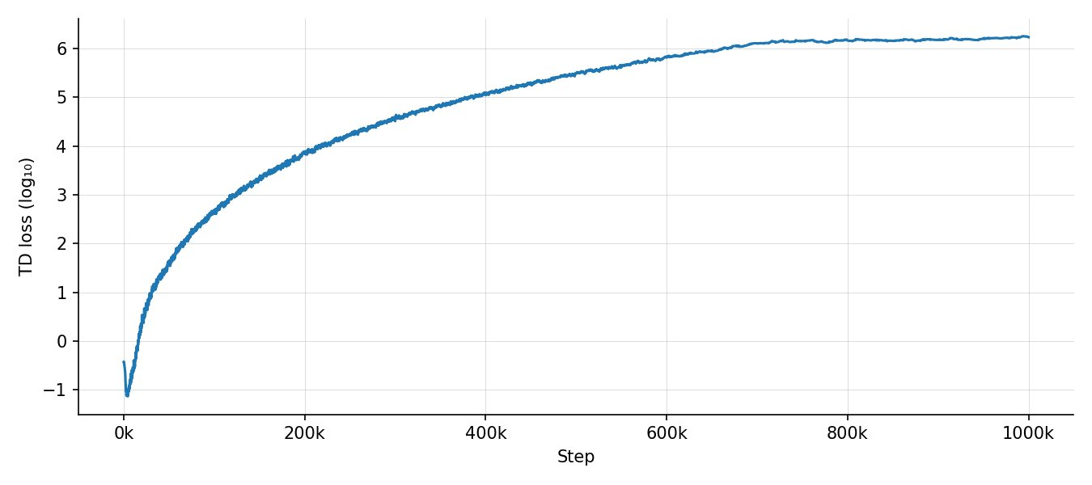
Results — Model 1: Degenerate Policy
Configuration: Centroids relative positions · Sorted by distance · Reward 1 · 1M steps
Episode reward
TD loss
Evaluation reward
Mean | Std. Dev.
16.91 | 0.57
Action distributions
Action | 1 | 2 | 3 | …
Probability | 1.0 | 0.0 | 0.0 | 0.0

Slide 17
Results — Reward Hacking Analysis
Interpretation
The only policy learned always chose action = 0
Diverging huge TD loss
Not meaningfully learning from observations
Root cause
Padding always at end + Large penalty → Strong incentive to chose action = 0
Sorted Centroids → Choosing $action=0$ correspond to the greedy heuristic
Attempted fixes
Remove distance sorting
Soften padding penalty

Slide 18
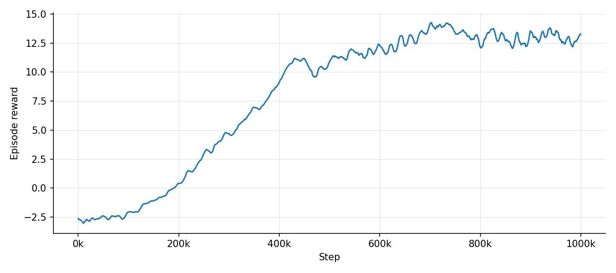
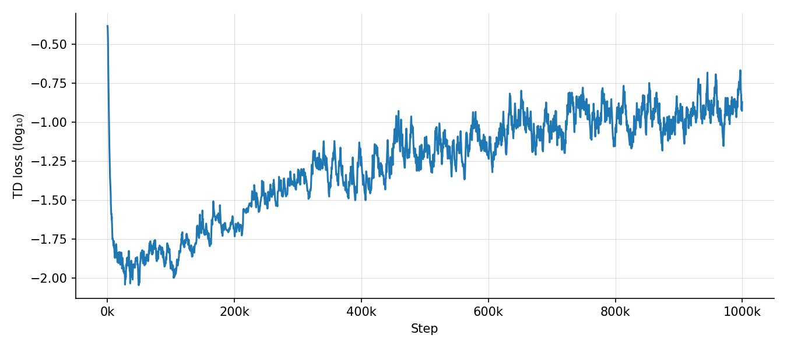
Results — Model 2: Successful Policy
Configuration: Absolute centroids positions · Not-sorted · Agent position · Reward 2 · 1M steps
Episode reward
TD loss
Evaluation reward
Mean | Std. Dev.
15.55 | 2.45
Action distributions
Action | 1 | 2 | 3 | 4 | …
Probability | 0.51 | 0.25 | 0.21 | 0.028 | 0.00

Slide 19
Results — Model 2: Successful Policy
Action distributions - sorted by distance
Action | 1 | 2 | 3 | 4 | 5 | 6 | 7
Probability | 0.62 | 0.19 | 0.085 | 0.063 | 0.016 | 0.021 | 0.003
The policy learned is
different from the heuristic
Interpretation
Good overall performance, comparable with heuristics
Bounded small TD loss
Varied action choice
The model is genuinely learning

Slide 20
Results — Model 2: Successful Policy
Model 2 simulation rendering
Simulation rendering example – Heuristic policy
Configuration setup
Grid size 20x20
Obstacle probability 0.05
Perception range n = 3 cells
Policy: trained Model 2

Slide 21
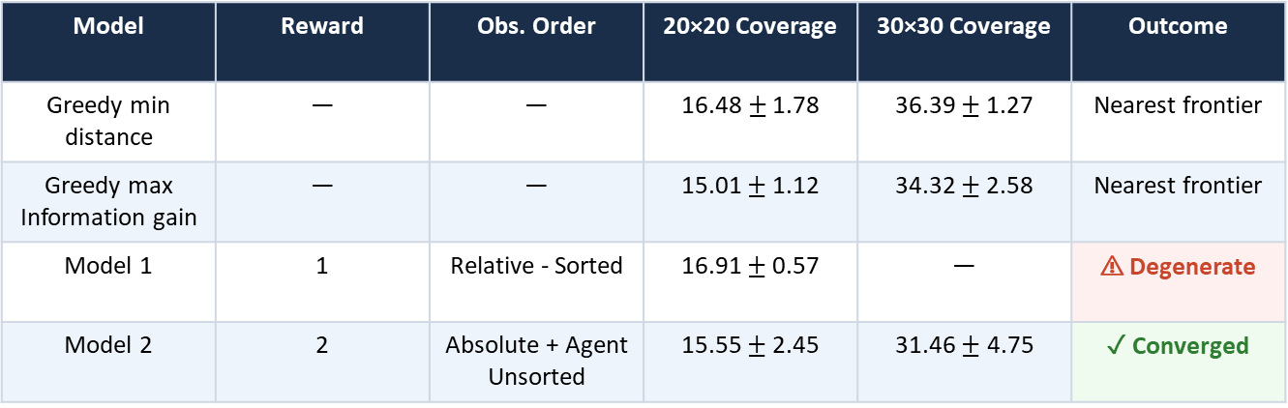
Results — Comparison Summary
Evaluation on 100 test episodes per map size. Metric: mean episode reward at episode end (coverage 90%).
Model | Reward | Obs. Order | 20×20 Coverage | 30×30 Coverage | Outcome
Greedy min distance | — | — | 16.48$±$ 1.78 | 36.39 $±$1.27 | Nearest frontier
Greedy max Information gain | — | — | 15.01 $±$1.12 | 34.32 $±$2.58 | Nearest frontier
Model 1 | 1 | Relative - Sorted | 16.91 $±$ 0.57 | — | ⚠ Degenerate
Model 2 | 2 | Absolute + Agent Unsorted | 15.55 $±$ 2.45 | 31.46 $± \text{4.75}$ | ✓ Converged

Slide 22
Conclusions
A DRL model was successfully integrated in a modular frontier-based exploration pipeline
Reward hacking revealed the critical influence of observation and reward configuration on the learned policy
Model 2 demonstrates convergent training with stable loss — a proof-of-concept for learned frontier selection
The developed framework can be considered validated by the meaningful results obtained
Future work: end-to-end DRL system, multi-agent settings, dynamic and 3D environments, more complex information structures
Paolo Spallanzani · Università degli Studi di Modena e Reggio Emilia · A.A. 2024/2025

