Slide 2
Motivation & Scope
Can Deep Reinforcement Learning (DRL) be effectively
leveraged into autonomous exploration?
Autonomous exploration is complex task
Classical analytical methods exist but present some limitations
Learning-based methods can provide more adaptive models
Objective:
Develop a framework to investigate the possibility of integrating learning-based methods with classical ones

Slide 3
Motivation & Scope
Can Deep Reinforcement Learning (DRL) be effectively
applied to autonomous exploration?
Autonomous exploration is complex task
Classical analytical methods exist but present some limitations
Learning-based methods can provide more adaptive models
Can learning-based method be integrated in classical ones?
Objective:
develop a framework for the investigation of this possibility
3 / 17

Slide 4
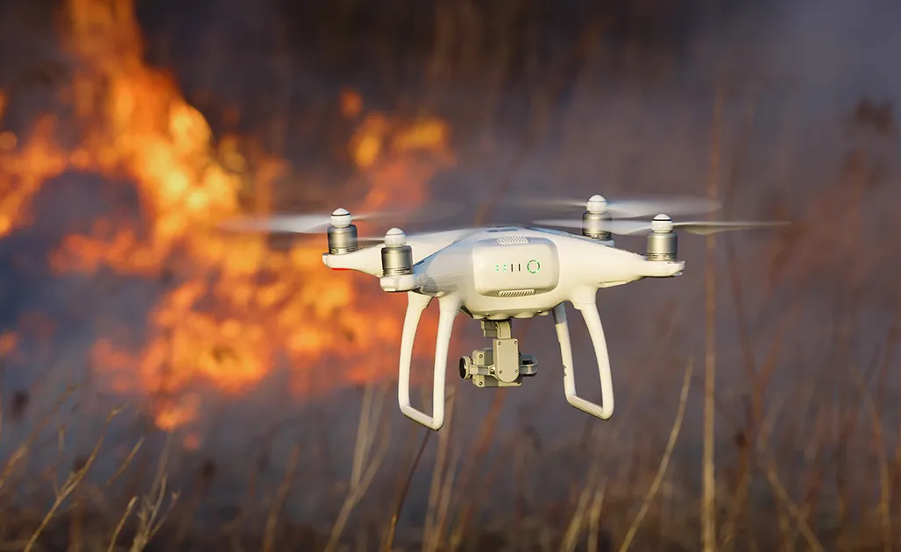
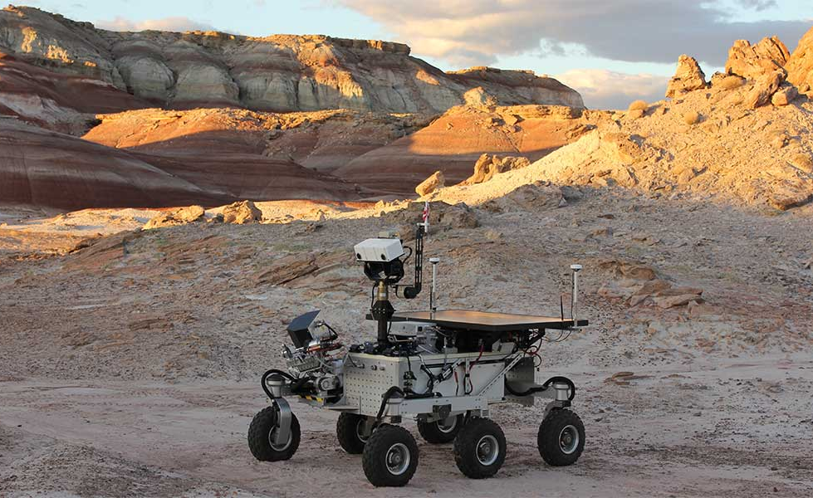
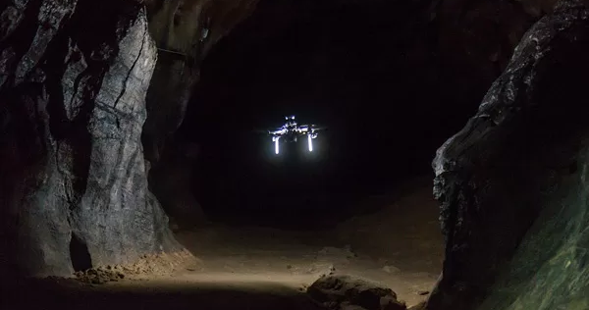
Context: Autonomous Exploration
Exploration: systematically map an unknown environment
Autonomous: the agent can perceive and moves without human guidance
Why autonomous exploration?
Complex task, requires:
Mapping
Localization
Navigation
Decision making
The agent must decide where to move next
Autonomous exploration application examples
4 / 17

Slide 5
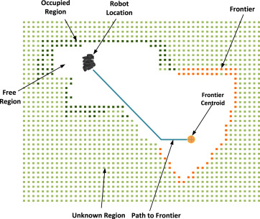
Classical Approaches
Next Best View approach Optimization problem, finding the next best position for the sensing apparatous
Frontier-Based Exploration (Yamauchi 1997)
Frontiers: boundary between explored (free) and unknown cells
Often grouped into cluster
The agent moves toward frontier clusters
Fixed heuristics policies to decide which frontier region
Frontier-based exploration illustration
4 / 17

Slide 6
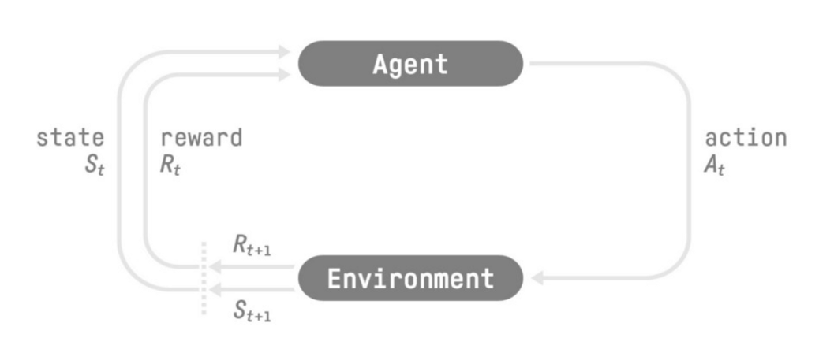
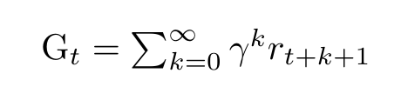
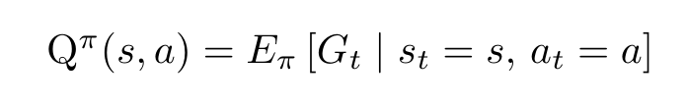
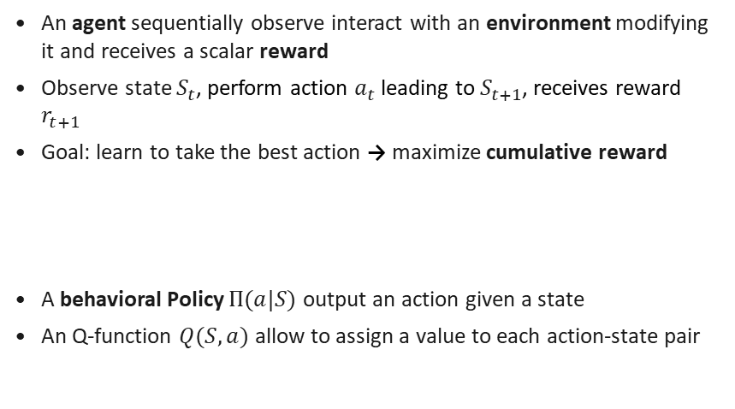
Deep Reinforcement Learning
Reinforcement Learning
An agent sequentially observe interact with an environment modifying it and receives a scalar reward
Observe state $S_{t}$, perform action $a_{t}$ leading to $S_{t+1}$, receives reward $r_{t+1}$
Goal: learn to take the best action → maximize cumulative reward
A behavioral Policy $Π(a|S)$ output an action given a state
An Q-function $Q(S,a)$ allow to assign a value to each action-state pair

Slide 7
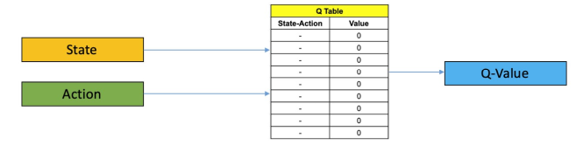
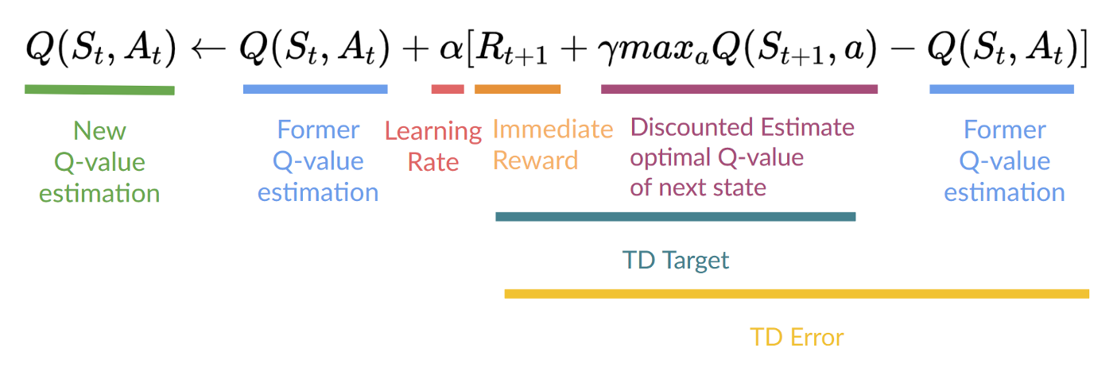
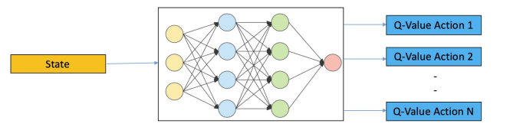
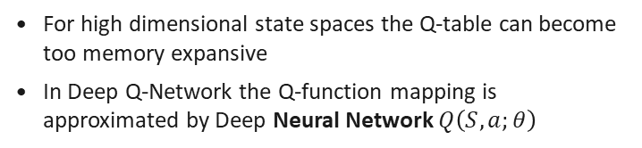
Deep Reinforcement Learning
Q Learning
Q-Algorithm allow to iteratively estimate the Q-function from experience
In Q-learning the Q-function is encoded in a table called Q-table
Deep Q-Network
For high dimensional state spaces the Q-table can become too memory expansive
In Deep Q-Network the Q-function mapping is approximated by Deep Neural Network $Q\left(S,a;θ\right)$

Slide 8
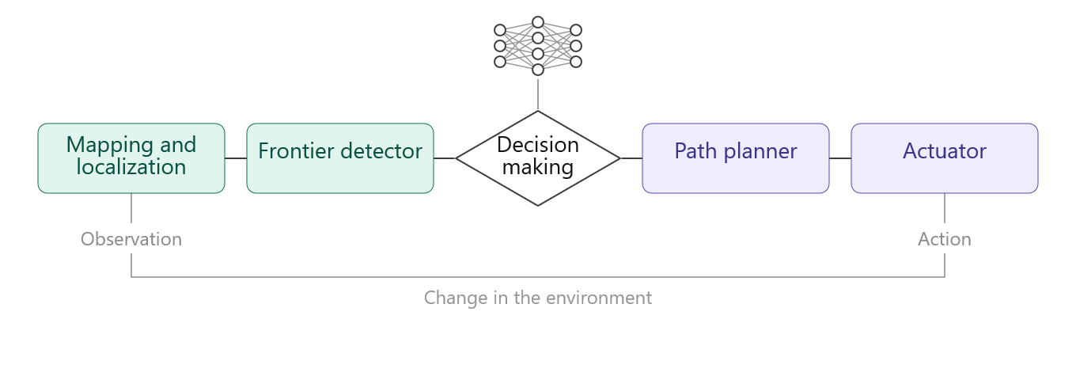
Slide Title
Content goes here

Slide 9
System Architecture
Hybrid modular architecture
Classic analytical components
DRL component
Decision making module
Mapping
Frontier detection
Low level navigation
Selection of the target position
7 / 17

Slide 10
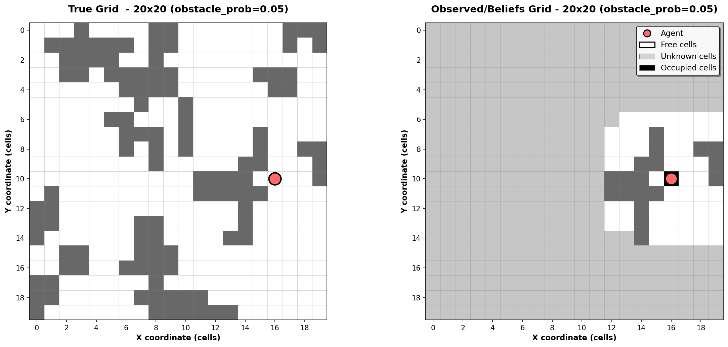
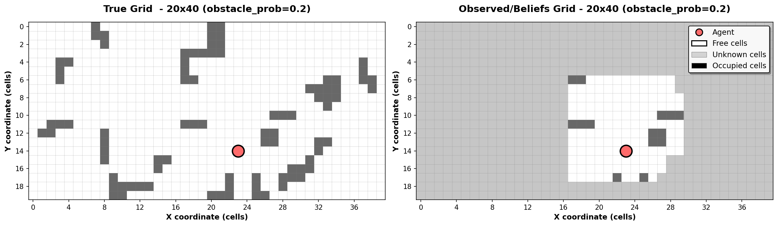
The Simulator
The environment – 2D occupancy grid
Partially observable discrete map
Static maps with random obstacle placement
Agent observes a local window within his perception range
Sequential observations are used to build a believes map

Slide 11
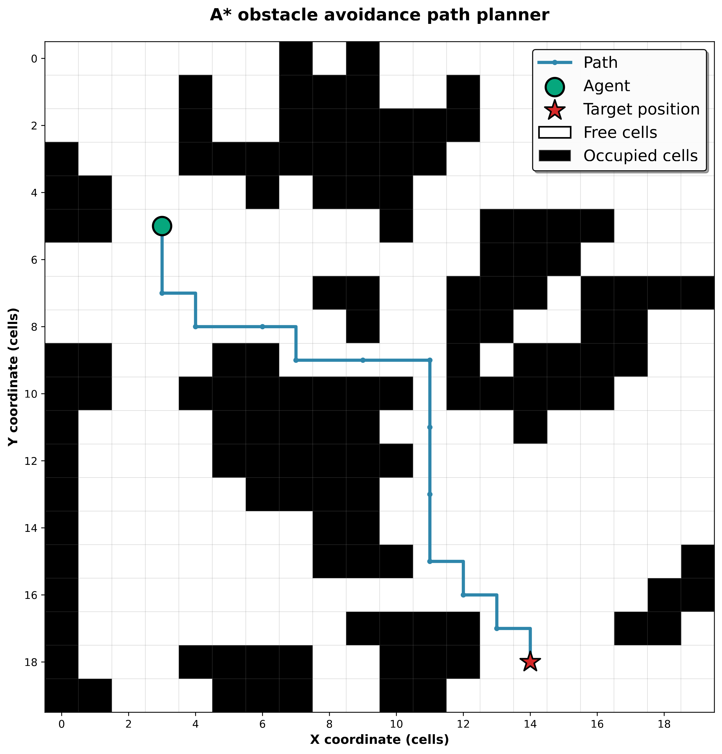
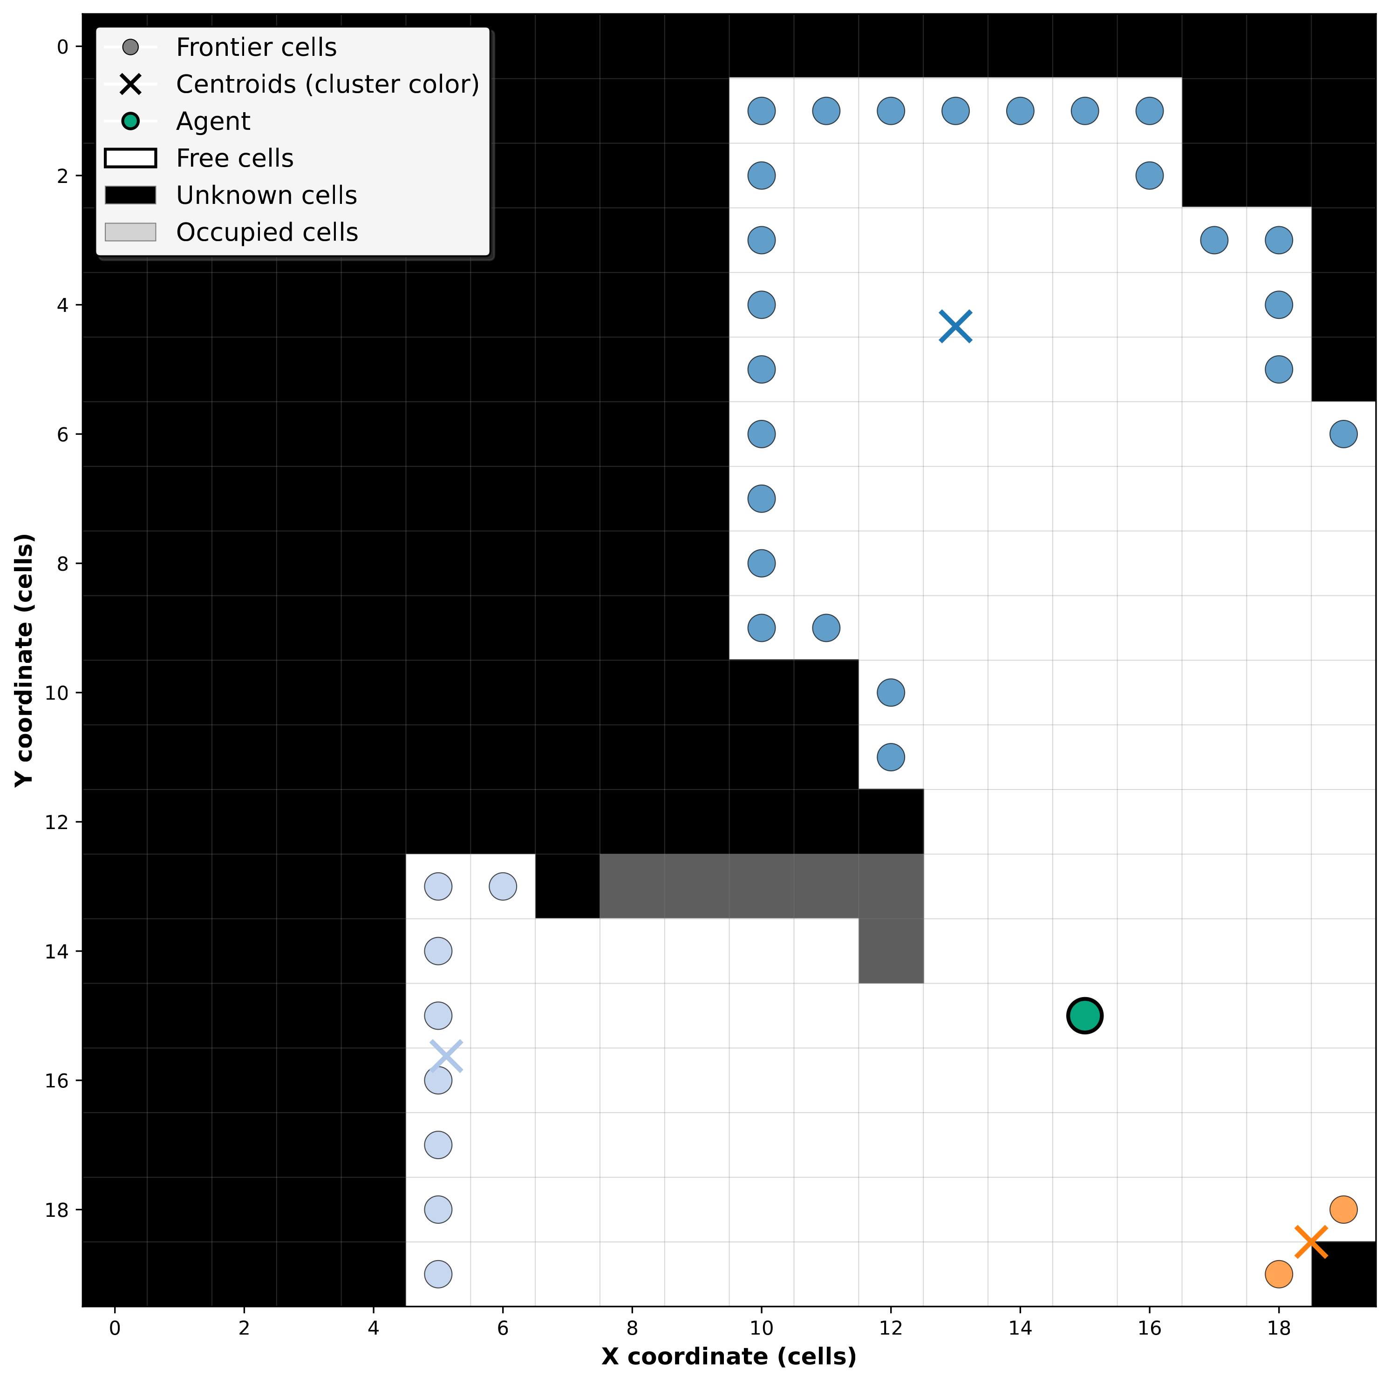
The Simulator
Frontier detection system
Obstacle avoidance path planner
Discriminate frontier cells
Group theme into cluster
Compute cluster’s centroids
Compute an obstacle free path to the target position (A* algorithm)

Slide 12
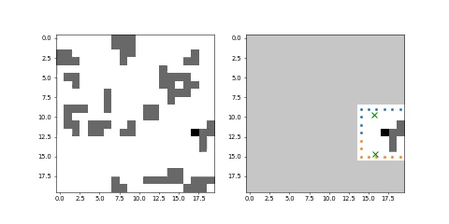
The Simulator
Simulation rendering
Simulation rendering example – Heuristic policy
Configuration setup
Grid size 20x20
Obstacle probability 0.05
Perception range n = 3 cells
Policy: greedy min distance heuristic

Slide 13
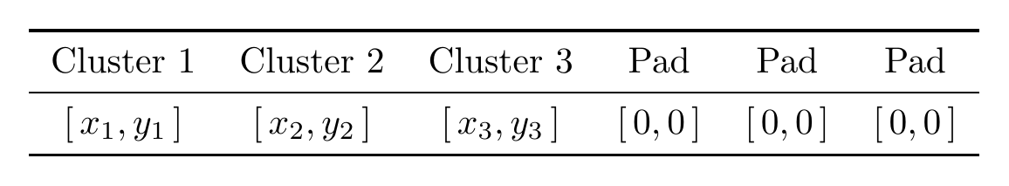
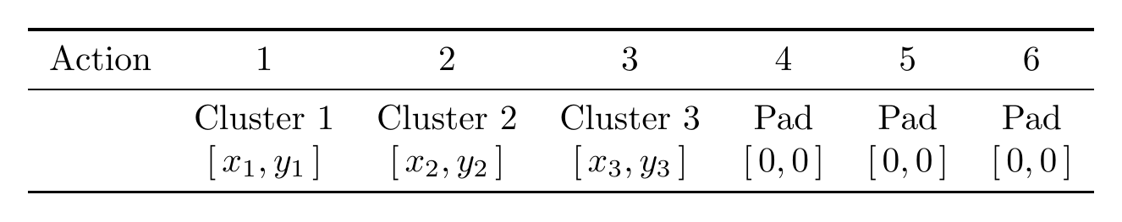
DRL Module: Observations & Actions
Observation Space (What it sees)
Observations:
Configurable setup:
Per-cluster frontiers information vector:
centroids position
information gain
distance
Agent position (optional)
Padded to fixed length N for consistent DNN input
Action Space (What it does)
Discrete: select one of N frontier cluster centroids
Chosen centroid passed to Path Planner for navigation
Action (e.g. = 2):

Slide 14
DRL Module: Observations & Actions
Observation Space – What it sees
Observations:
Configurable setup:
Per-cluster frontiers information vector:
centroids position
information gain
distance
Agent position (optional)
Padded to fixed length N for consistent DNN input
Action Space – What it does
Discrete: select one of N frontier cluster centroids
Chosen centroid passed to Path Planner for navigation
Action (e.g. = 2):

Slide 15
DRL Module: Reward Shaping
Two reward configurations compared across the experimental campaign:
Reward 1 — Relative / Sorted
Reward 2 — Absolute / Unsorted
Reward = newly explored cells at each step (relative gain)
Observations sorted by distance (closest cluster first)
Strong padding penalty for inactive action slots
⚠ Caused degenerate policy — agent always picks action 0
Reward = absolute coverage reached (clearer exploration signal)
Observations in random order — no sorting
Soft padding penalty — avoids degenerate exploitation
✓ First configuration yielding a non-degenerate policy
Paolo Spallanzani · Deep RL in Frontier-Based Autonomous Exploration
10 / 17

Slide 16
DRL Module: Reward Shaping
Reward Shaping Comparison
Condition | Reward 1 |  |  | Reward 2
Action outcome
Action selects padding slot | large negative | truncated | truncated | small negative | continues
No new cells explored | small negative | — | — | = R1 | —
Some cells explored | proportional positive | — | — | = R1 | —
Episode termination
Exploration ≥ threshold | large positive | terminated |  | = R1 | = R1
Max steps exceeded | large negative | truncated |  | = R1 | = R1
No progress for ≥ 20 steps | intermediate negative | truncated |  | = R1 | = R1
Additional signal — Reward 2 only
Oscillating behavior detected | — |  |  | small negative
Entries marked = R1 are identical to Reward 1.

Slide 17
Reward Formulations Comparison
Reward Shaping Comparison
Condition | Reward 1 | Reward 2 | Episode end
 |  |  | R1 | R2
Action outcome
• Action selects padding slot | large negative | small negative | truncated | continues
• No new cells explored | small negative | = R1 | — | —
• Some cells explored | interm. positive | = R1 | — | —
Episode termination
• Exploration ≥ threshold | large positive | = R1 | terminated
• Max steps exceeded | large negative | = R1 | truncated
• No progress for ≥ 20 steps | interm. negative | = R1 | truncated
Additional signal — Reward 2 only
• Oscillating behavior detected | — | small negative | —

Slide 18
Observation Padding
Padded Observation Vector
Example with 3 active clusters and 3 padding slots (N = 6):
Cluster 1 | Cluster 2 | Cluster 3 | Pad | Pad | Pad
[ x₁, y₁ ] | [ x₂, y₂ ] | [ x₃, y₃ ] | [ 0, 0 ] | [ 0, 0 ] | [ 0, 0 ]
Active clusters
Padding (zero-filled)
Active clusters provide real frontier data [ x, y ]
Padding slots are zero-filled [ 0, 0 ] to maintain a fixed-length vector for the DNN input
Ensures consistent observation size regardless of the number of active clusters

Slide 19
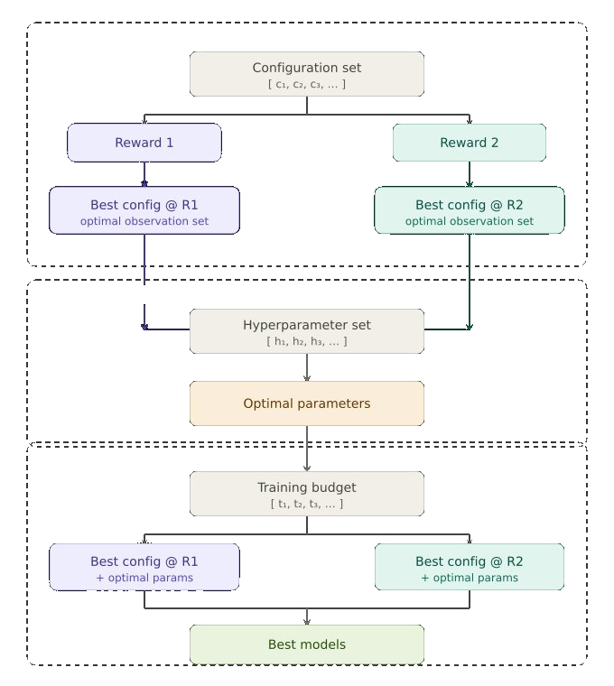
Experimental Campaign
Phase 1 — Configuration search: reward × observation set → best configuration per reward
Phase 2 — Hyperparameter optimization: → converged to a single optimal hyperparameter set
Phase 3 — Training budget: 500k / 750k / 1M time steps → 2 best models selected

Slide 20
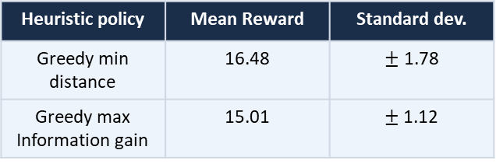
Results metrics and baselines
Mean cumulative episode reward
Evaluation reward
Training reward
TD loss (training loss)
Mean reward - heuristics baselines
Heuristic policy | Mean Reward | Standard dev.
Greedy min distance | 16.48 | $±$ 1.78
Greedy max Information gain | 15.01 | $±$1.12

Slide 21
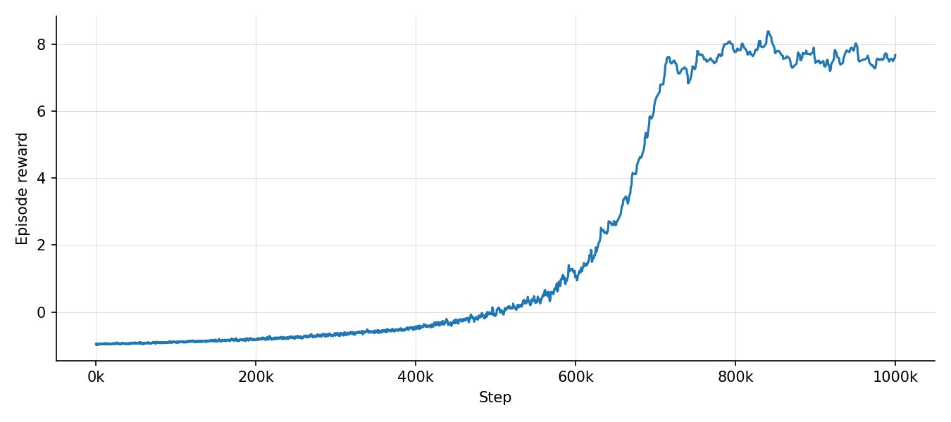
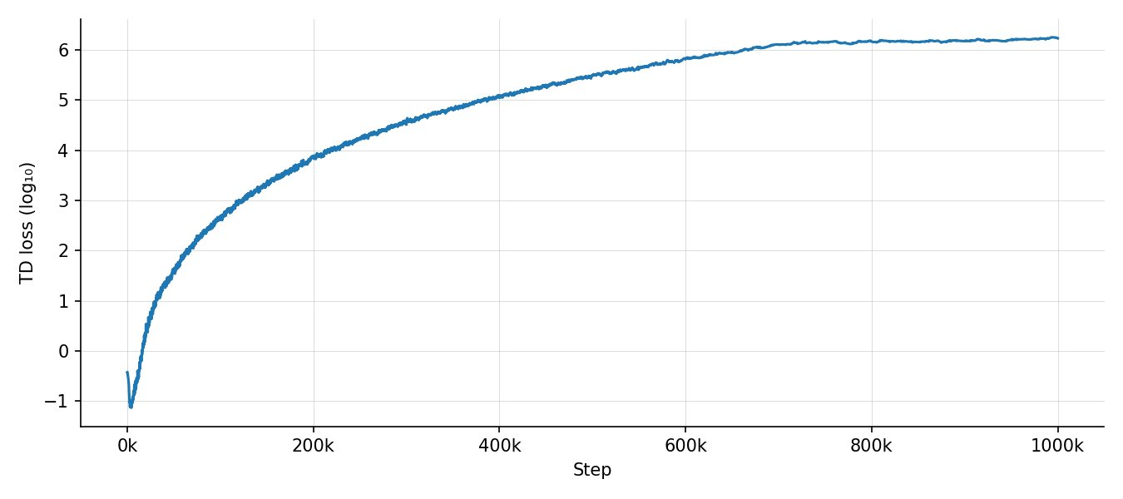
Results — Model 1: Degenerate Policy
Configuration: Centroids relative positions · Sorted by distance · Reward 1 · 1M steps
Episode reward
TD loss
Evaluation reward
Mean | Std. Dev.
16.91 | 0.57
Action distributions
Action | 1 | 2 | 3 | …
Probability | 1.0 | 0.0 | 0.0 | 0.0

Slide 22
Results — Reward Hacking Analysis
Interpretation
Only policy learned always chose action = 0
Diverging huge TD loss
Degenerated Policy
Root cause
Padding always at end + Large penalty → Strong ncentive to chose action = 0
Sorted Centroids → Chosing action = 0 correspond to greedy heuristic
Paolo Spallanzani · Deep RL in Frontier-Based Autonomous Exploration
13 / 17

Slide 23
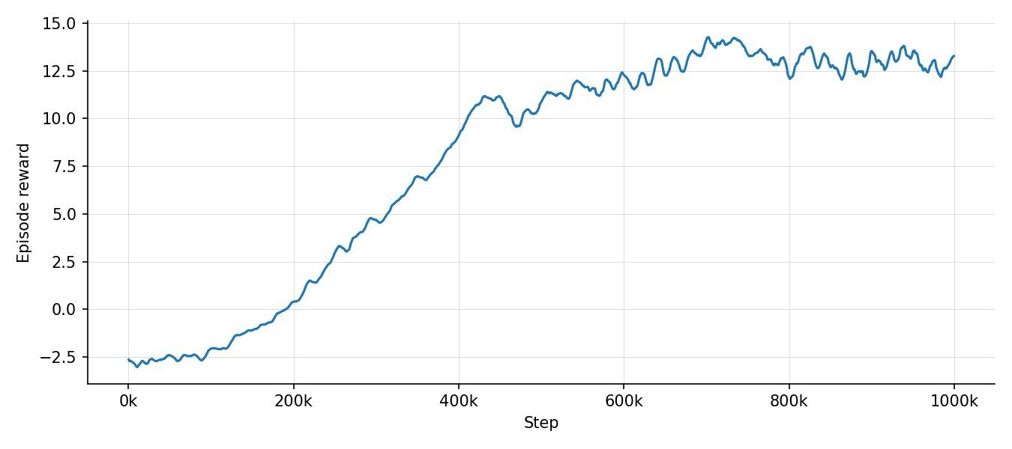
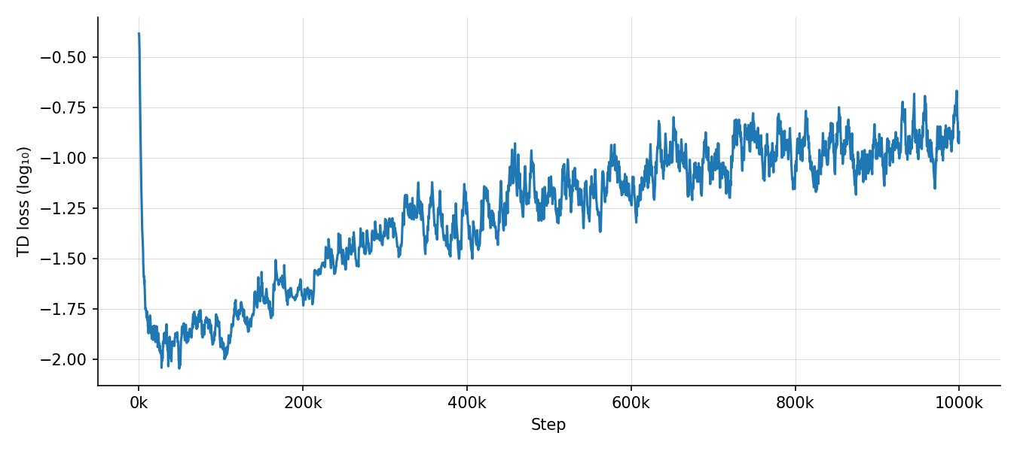
Results — Model 2: Successful Policy
Configuration: Absolute centroids positions · Not-sorted · Agent position · Reward 2 · 1M steps
Episode reward
TD loss
Evaluation reward
Mean | Std. Dev.
15.55 | 2.45
Action distributions
Action | 1 | 2 | 3 | 4 | …
Probability | 0.51 | 0.25 | 0.21 | 0.028 | 0.00

Slide 24
Results — Model 2: Successful Policy
Action distributions - sorted by distance
Action | 1 | 2 | 3 | 4 | 5 | 6 | 7
Probability | 0.62 | 0.19 | 0.085 | 0.063 | 0.016 | 0.021 | 0.003
The policy learned is
different from the heuristic
Interpretation
Good overall performance, comparable with heuristics
Bounded small TD loss
Varied action choice
The model is genuinely learning

Slide 25
Results — Model 2: Successful Policy
Model 2 simulation rendering
Simulation rendering example – Heuristic policy
Configuration setup
Grid size 20x20
Obstacle probability 0.05
Perception range n = 3 cells
Policy: trained Model 2

Slide 26
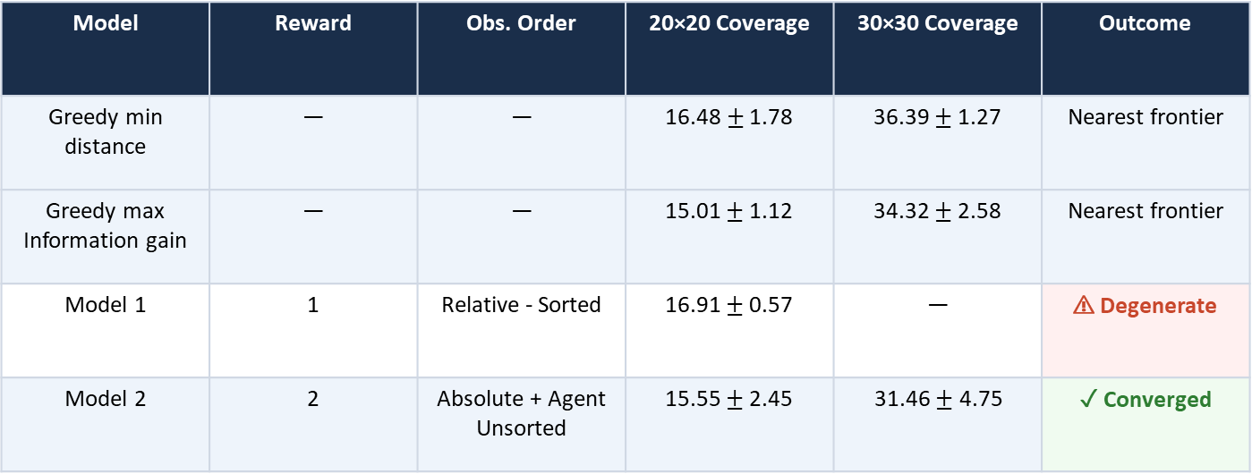
Results — Comparison Summary
Evaluation on 100 test episodes per map size. Metric: mean episode reward at episode end (coverage 90%).
Model | Reward | Obs. Order | 20×20 Coverage | 30×30 Coverage | Outcome
Greedy min distance | — | — | 16.48$±$ 1.78 | 36.39 $±$1.27 | Nearest frontier
Greedy max Information gain | — | — | 15.01 $±$1.12 | 34.32 $±$2.58 | Nearest frontier
Model 1 | 1 | Relative - Sorted | 16.91 $±$ 0.57 | — | ⚠ Degenerate
Model 2 | 2 | Absolute + Agent Unsorted | 15.55 $±$ 2.45 | 31.46 $± \text{4.75}$ | ✓ Converged

Slide 27
Conclusions
A DQN agent was successfully integrated as the decision-making module in a modular frontier-based exploration pipeline
Reward hacking revealed the critical influence of observation and reward configuration on the learned policy
Model 2 demonstrates convergent training with stable loss — a proof-of-concept for learned frontier selection
The developed framework can be considered validated by the meaningful results obtained
Future work: end-to-end DRL system, multi-agent settings, dynamic and 3D environments, more complex information structures
Paolo Spallanzani · Università degli Studi di Modena e Reggio Emilia · A.A. 2024/2025

Slide 29
Section Title
Section subtitle or description

Slide 30
Slide Title
Text content goes here
Image / Chart

