Slide 1
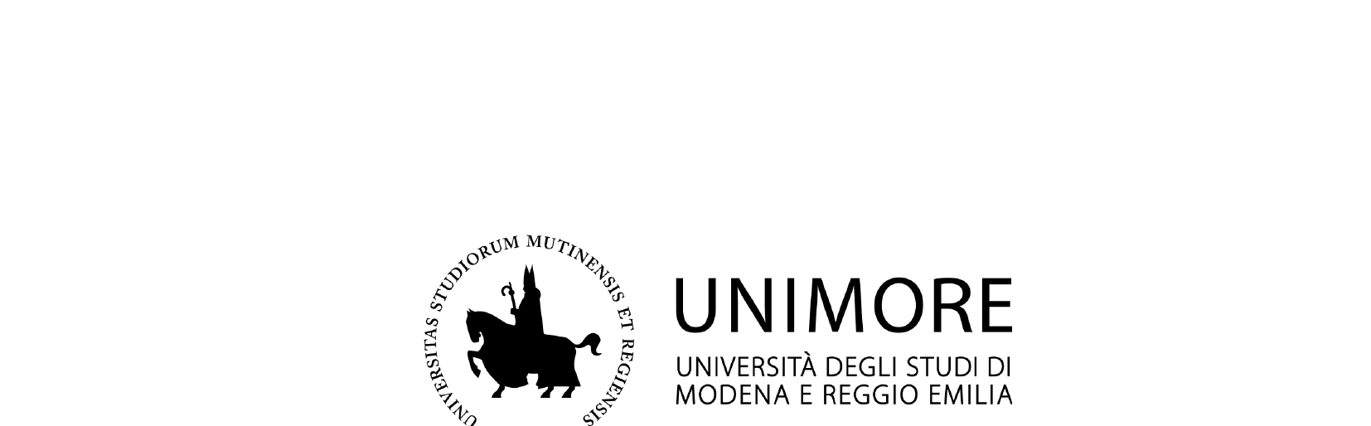
Dipartimento di Scienze e Metodi dell'Ingegneria
Corso di Laurea Magistrale in Digital Automation Engineering
Deep Reinforcement Learning in
Frontier-Based Autonomous Exploration
Tesi di Laurea di: Paolo Spallanzani
Relatore: Prof. Lorenzo Sabattini
Correlatori: Dott. Mattia Catellani · Dott. Mattia Mantovani
Anno Accademico 2024/2025

Slide 2
Outline
1. Motivation & Scope
5. Experiments
2. Autonomous Exploration & Frontier Methods
6. Results & Comparison
3. Deep Reinforcement Learning
7. Conclusions
4. System Design & Simulator
Paolo Spallanzani · Deep RL in Frontier-Based Autonomous Exploration
2 / 17

Slide 3
Motivation & Scope
Can Deep Reinforcement Learning (DRL) be applied to autonomous exploration?
Autonomous exploration is complex task
Classical analytical methods exist but present some limitations
Learning-based methods can provide more adaptive models
Goal: validate DRL as a drop-in decision-maker inside a modular exploration pipeline
Paolo Spallanzani · Deep RL in Frontier-Based Autonomous Exploration
3 / 17

Slide 4
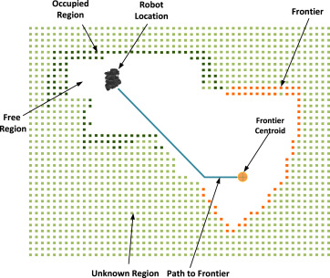
Autonomous Exploration
Exploration: systematically map an unknown environment
Autonomous: no human guidance — the robot decides where to go next
Key trade-off: exploit known areas vs. explore unknown space
Applications: search & rescue, warehouse automation, planetary rovers
Frontier-based exploration illustration
Paolo Spallanzani · Deep RL in Frontier-Based Autonomous Exploration
4 / 17

Slide 5
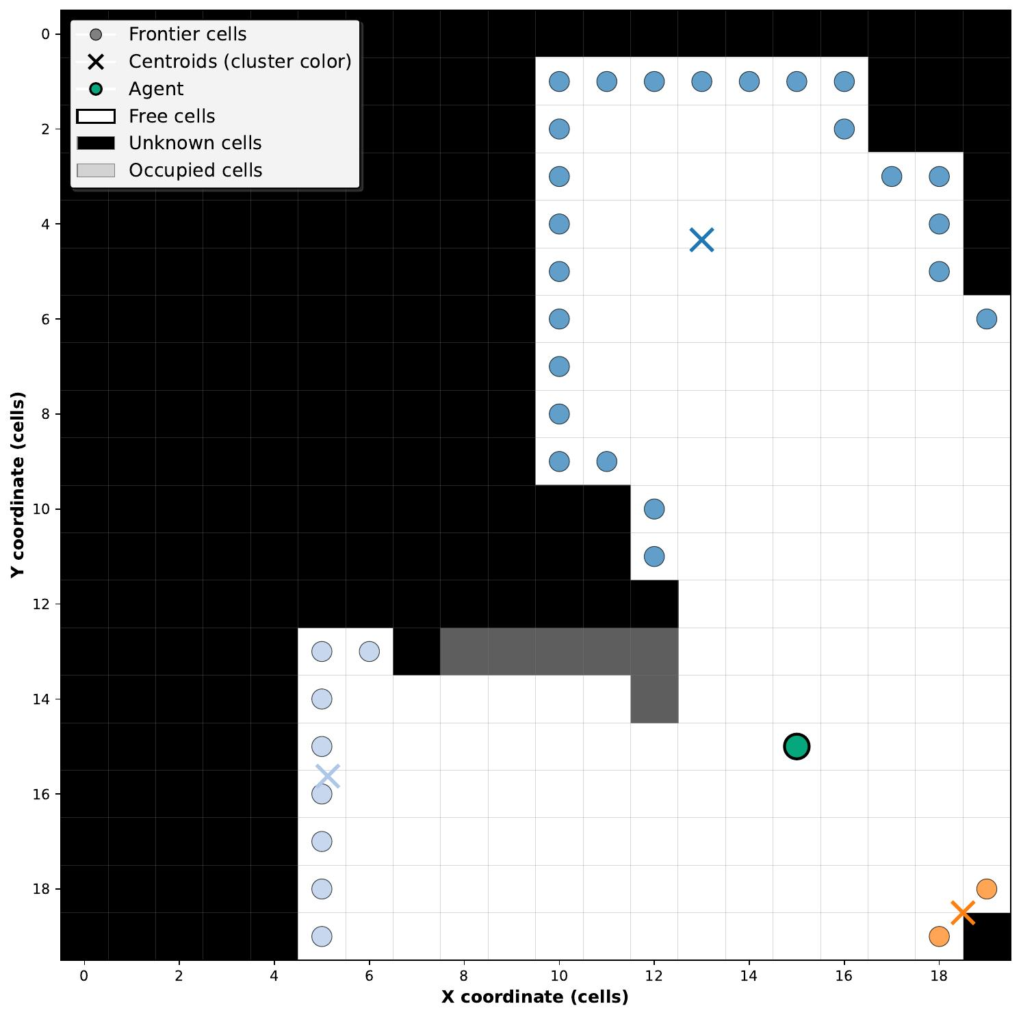
Frontier-Based Exploration
Frontier: boundary between explored (free) and unknown cells
Frontier cells are grouped into clusters; each has a centroid
Agent navigates to chosen centroids to progressively map the environment
Large clusters are split via median-axis strategy for finer resolution
Classical policies (nearest, largest) are deterministic and non-adaptive — the DRL module aims to learn a better selection strategy.
Paolo Spallanzani · Deep RL in Frontier-Based Autonomous Exploration
Frontier clusters detected on a 20×20 grid
5 / 17

Slide 6
Deep Reinforcement Learning
Reinforcement Learning
Deep Q-Network (DQN)
Agent observes state s, takes action a, receives reward r
Goal: maximize cumulative discounted reward G = Σ γ^t r_t
Q-learning estimates Q(s,a) via Bellman updates
Neural network approximates Q(s,a) for large state spaces
Experience Replay: decorrelates training samples
Target Network: stabilizes updates
MDP Formalization for Frontier Selection
State S
Action A
Reward R
Transition T
Frontier cluster features
(position, size, distance)
Select one of N
frontier clusters
Exploration coverage
+ penalty signals
Stochastic under
partial observability
Paolo Spallanzani · Deep RL in Frontier-Based Autonomous Exploration
6 / 17

Slide 7
System Architecture
A modular pipeline: the DRL module plugs in as the frontier-selection decision-maker.
Mapping &
Localization
Frontier
Detector
DRL Decision
Maker
Path
Planner
Actuator
← Updated map feedback loop
Global Hybrid Agent
DRL Decision-Making Module
Classical pipeline handles low-level navigation and mapping
DRL module focuses only on high-level frontier selection
Encapsulates only the frontier-selection policy
Plug-and-play: interchangeable with any other decision strategy
Paolo Spallanzani · Deep RL in Frontier-Based Autonomous Exploration
7 / 17

Slide 8
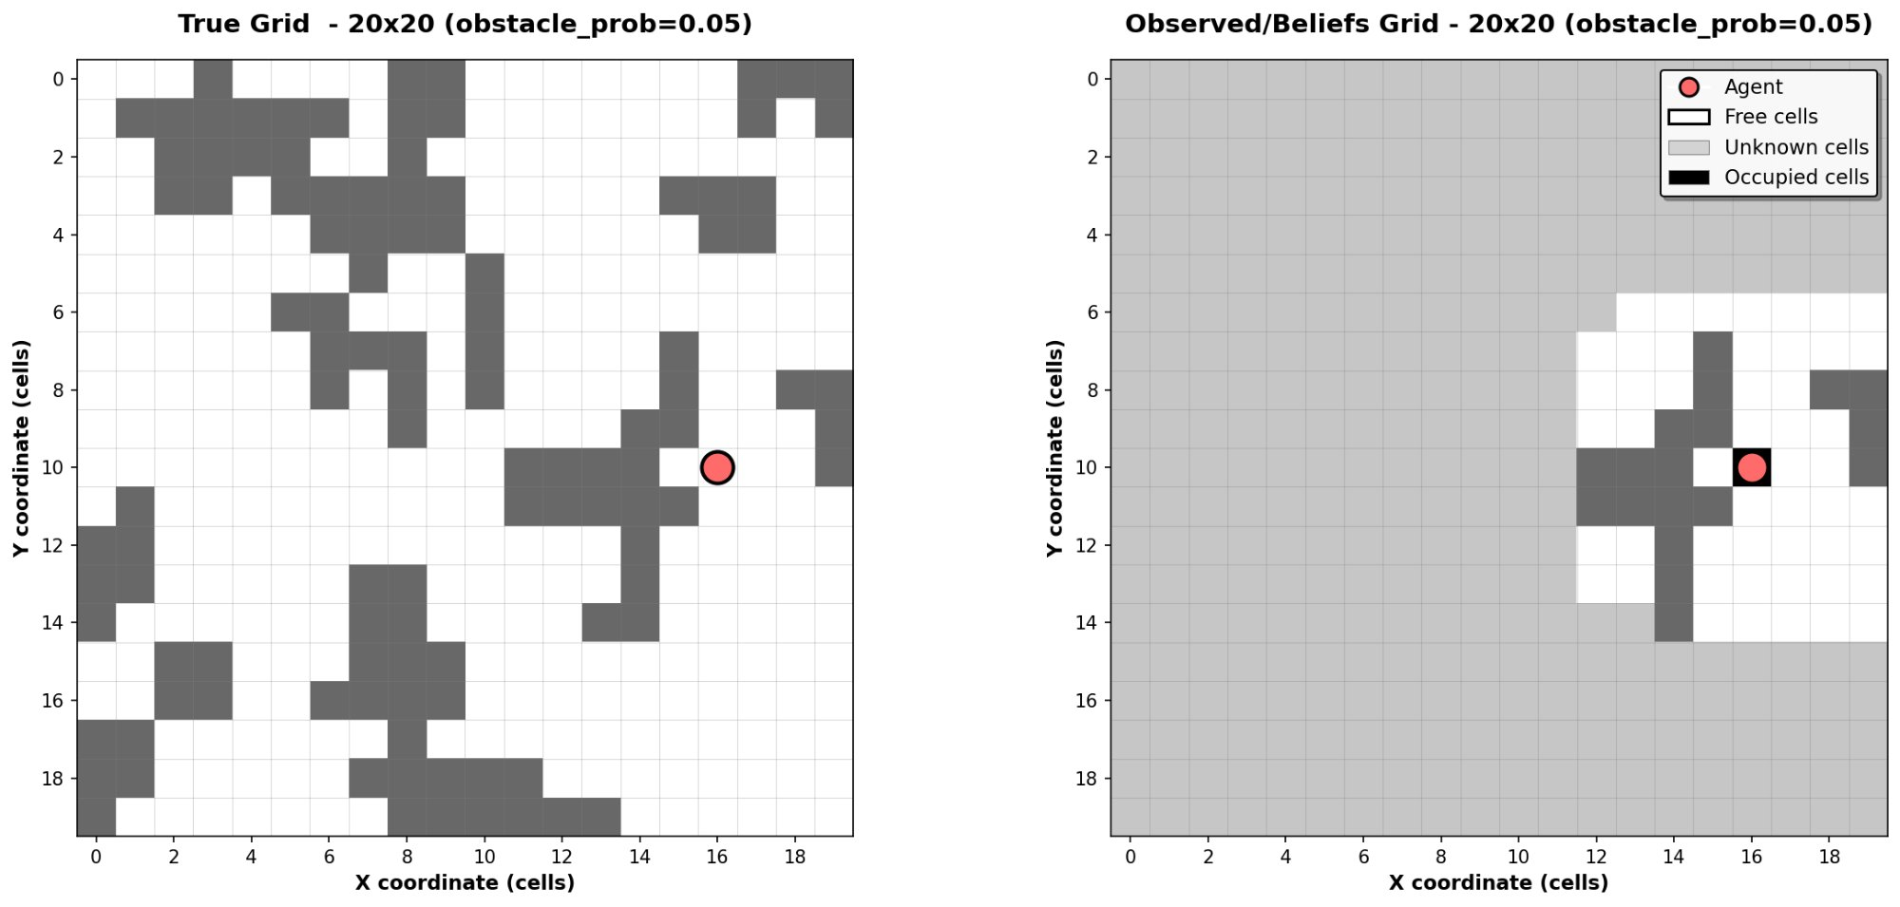
The Agent-Environment Simulator
Custom Gymnasium environment: partially observable grid world
Static maps (20×20 and 30×30 cells) with random obstacle placement
Agent observes a local window of the occupancy grid at each step
Episode ends when coverage exceeds threshold or step budget is spent
Left: true map · Right: agent's belief map (partial observability)
Paolo Spallanzani · Deep RL in Frontier-Based Autonomous Exploration
8 / 17

Slide 9
DRL Module: Observations & Actions
Observation Space
Action Space
Configurable setup:
Per-cluster frontiers information vector:
centroids position
information gain
distance
Agent position (optional)
Padded to fixed length N (max clusters) for consistent DNN input
Discrete: select one of N frontier cluster centroids
Invalid actions (beyond active clusters) handled via masking
Chosen centroid passed to Path Planner for navigation
Episode ends at coverage threshold or step budget exceeded
Paolo Spallanzani · Deep RL in Frontier-Based Autonomous Exploration
9 / 17

Slide 10
DRL Module: Reward Shaping
Two reward configurations compared across the experimental campaign:
Reward 1 — Relative / Sorted
Reward 2 — Absolute / Unsorted
Reward = newly explored cells at each step (relative gain)
Observations sorted by distance (closest cluster first)
Strong padding penalty for inactive action slots
⚠ Caused degenerate policy — agent always picks action 0
Reward = absolute coverage reached (clearer exploration signal)
Observations in random order — no sorting
Soft padding penalty — avoids degenerate exploitation
✓ First configuration yielding a non-degenerate policy
Paolo Spallanzani · Deep RL in Frontier-Based Autonomous Exploration
10 / 17

Slide 11
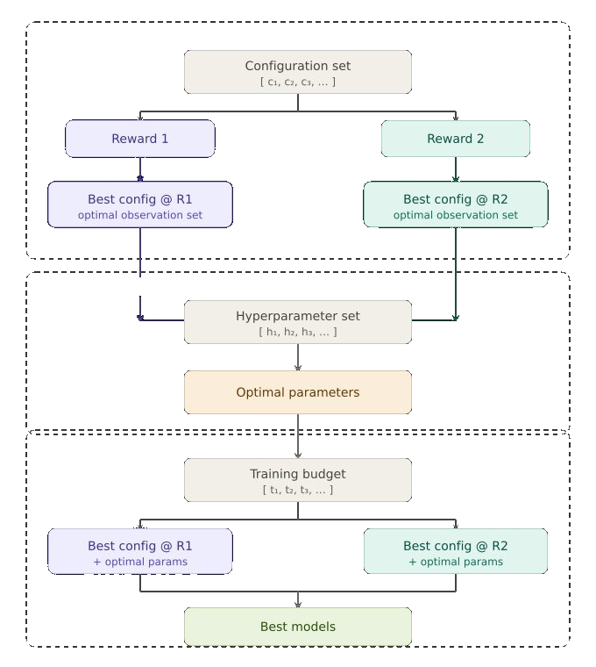
Experimental Campaign
Phase 1 — Configuration search: reward × observation set → best configuration per reward
Phase 2 — Hyperparameter optimization: → converged to a single optimal hyperparameter set
Phase 3 — Training budget: 500k / 750k / 1M time steps → 2 best models selected
Baseline: greedy distance policy (always selects the nearest frontier centroid). Evaluation over 100 independent test episodes per map size.
11 / 17

Slide 12
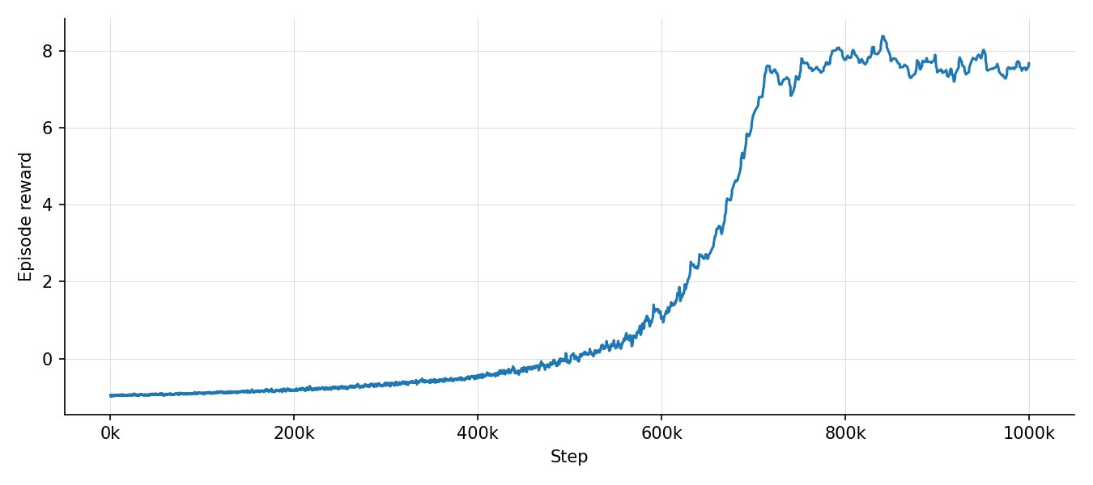
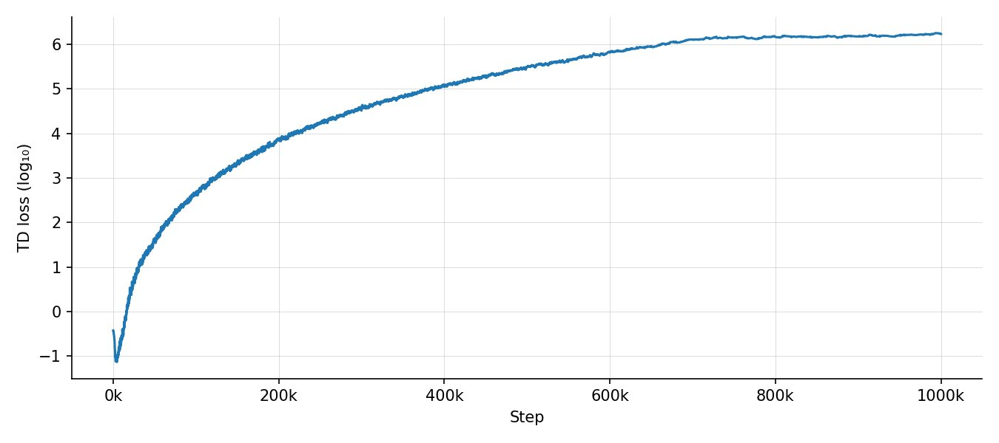
Results — Model 1: Degenerate Policy
Config: Reward 1 (relative) · Sorted observations · Distance penalty · 1M steps
Episode reward — partial convergence via degenerate action-0 policy
Evaluation
Mean Reward | Std. Dev
TD loss — catastrophic explosion (log₁₀ → 6)
Evaluation reward | Mean | Std. Dev.
Paolo Spallanzani · Deep RL in Frontier-Based Autonomous Exploration
12 / 17

Slide 13
Results — Reward Hacking Analysis
Two targeted modifications resolved the degenerate behavior:
Root Cause
Sorted observations → padding always at end → action 0 always maps to the nearest cluster
Large truncation penalty → always-picking-action-0 is the locally optimal (degenerate) strategy
Fix Applied → Model 2
Remove distance sorting → all actions equally accessible at each step
Soften padding penalty → agent no longer exploits padding as a reward shortcut
Switch to absolute reward → clearer and more stable exploration signal
Paolo Spallanzani · Deep RL in Frontier-Based Autonomous Exploration
13 / 17

Slide 14
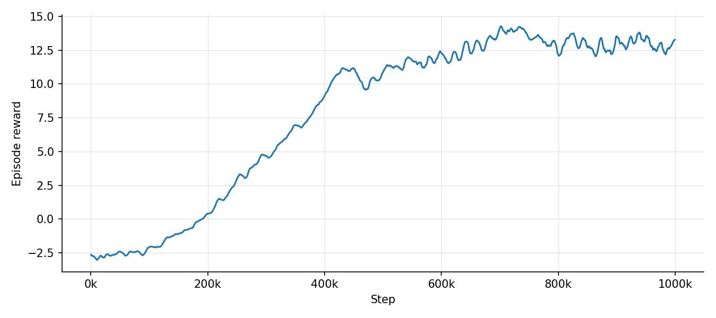
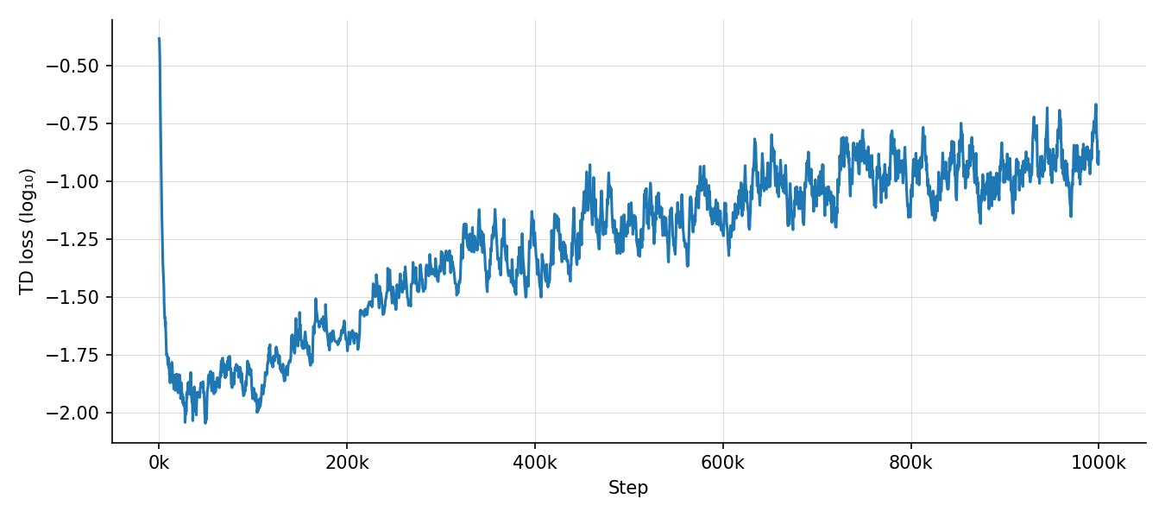
Results — Model 2: Successful Policy
Config: Reward 2 (absolute) · Unsorted observations · Soft padding penalty · 1M steps
Episode reward — monotone convergence to ~13
TD loss — stable, no explosion
✓ First non-degenerate policy. Reward converges steadily; loss remains bounded throughout training.
Paolo Spallanzani · Deep RL in Frontier-Based Autonomous Exploration
14 / 17

Slide 15
Results — Comparison Summary
Evaluation on 100 test episodes per map size. Metric: mean episode reward at episode end (coverage 90%).
Model | Reward | Obs. Order | 20×20 Coverage | 30×30 Coverage | Outcome
Greedy min distance | — | — | — | — | Nearest frontier
Greedy max Information gain | — | — | — | — | Nearest frontier
Model 1 | 1 | Relative - Sorted | — | — | ⚠ Degenerate
Model 2 | 2 | Absolute + Agent Unsorted | See thesis | See thesis | ✓ Converged

Slide 16
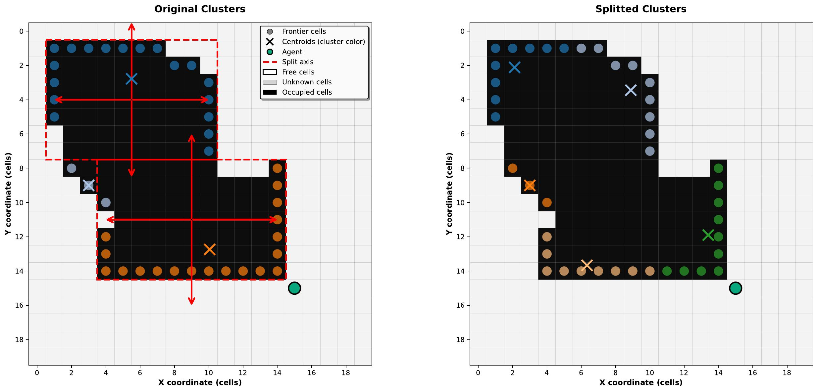
Cluster Splitting — Visual Detail
When a frontier cluster exceeds a size threshold it is split along the median axis
Splitting increases action resolution: agent can select finer-grained targets
Right figure shows two resulting sub-clusters after splitting a large boundary region
Without splitting, oversized clusters with a single centroid reduce the DRL agent's ability to distinguish distinct exploration targets, limiting policy quality.
Paolo Spallanzani · Deep RL in Frontier-Based Autonomous Exploration
16 / 17
Left: original large cluster · Right: after median-axis split

Slide 17
Conclusions
A DQN agent was successfully integrated as the decision-making module in a modular frontier-based exploration pipeline
Reward hacking revealed that observation ordering and penalty magnitude critically shape the learned policy
Removing sorted observations and softening the padding penalty yielded the first non-degenerate policy
Model 2 demonstrates convergent training with stable loss — a proof-of-concept for learned frontier selection
Future work: transfer to real robots, multi-agent settings, dynamic and 3D environments
Paolo Spallanzani · Università degli Studi di Modena e Reggio Emilia · A.A. 2024/2025

Slide 18
Conclusions
A DQN agent was successfully integrated as the decision-making module in a modular frontier-based exploration pipeline
Reward hacking revealed that observation ordering and penalty magnitude critically shape the learned policy
Removing sorted observations and softening the padding penalty yielded the first non-degenerate policy
Model 2 demonstrates convergent training with stable loss — a proof-of-concept for learned frontier selection
Future work: transfer to real robots, multi-agent settings, dynamic and 3D environments
Paolo Spallanzani · Università degli Studi di Modena e Reggio Emilia · A.A. 2024/2025

