Slide 1
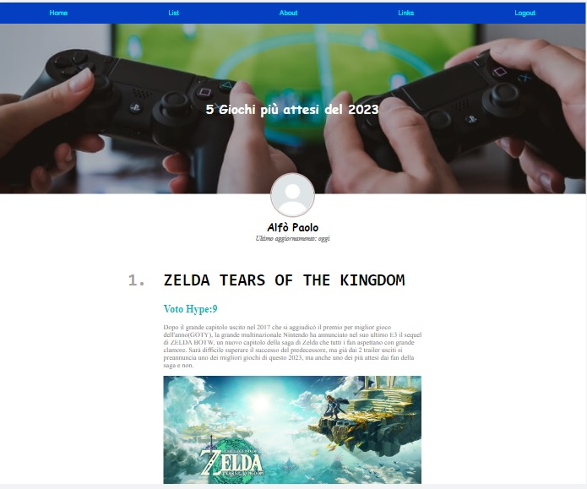
Mini-homework 1
400px
50px
100px
40px
66,7%
20 px
120 px

