Slide 2
camhealth
Hossam Mostafa| Paolo Hadaie
CAMHEALTH – April 2025
EECE 490 | American University of Beirut

Slide 3
Business Aspect
Why CAMHEALTH?
Easy Calorie Tracking
Calorie Underestimation
Educated Eating Choices
No More Guesswork
Scalable for All Diets

Slide 4
CAMHEALTH
Software Tools
Abstract Overview of Software Tools Used
Frontend:
Streamlit
Backend:
Python (Core Logic & API Orchestration)
Roboflow and OpenAI
Machine Learning Models:
Calorie Estimation Model: Multi-label food image classifier based on a fine-tuned Vision Transformer (ViT) architecture trained using Roboflow. Outputs food category for further calorie estimation based on user input.
Chatbot Framework:
OpenAI API
APIs and Integrations
OpenAI GPT
Development Tools
Git
VS Code
Docker

Slide 5
CAMHEALTH
Flow
Upload Image
ViT Classification Model
Detects Food Class
User Input: Quantity & Add-ons
GPT
Nutritional Questions
GPT
Guard
Display Estimated Calories

Slide 6
Business Aspect
Impact on stakeholders
Stakeholders
Users | Easy and fast calorie estimation via image upload; accuracy may vary with image quality and added ingredients.
Nutritionists / Dietitians | Can be used as a pre-consultation tool to help clients track food intake but still needs expert review for medical plans.
Fitness Apps/ Health Platforms | Opportunity for integration to enhance tracking and user engagement, but reliant on consistent performance.
Business | Potential to monetize through premium features or API access; challenges include user trust and nutrition liability.

Slide 7
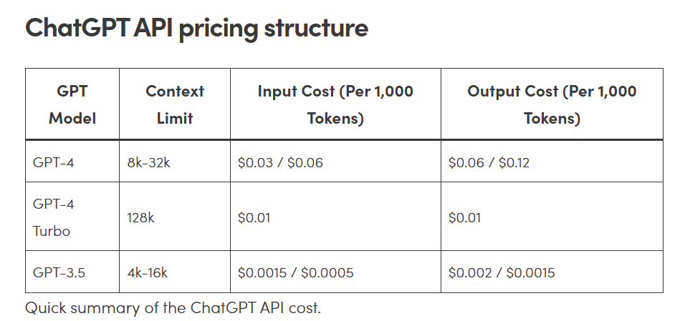
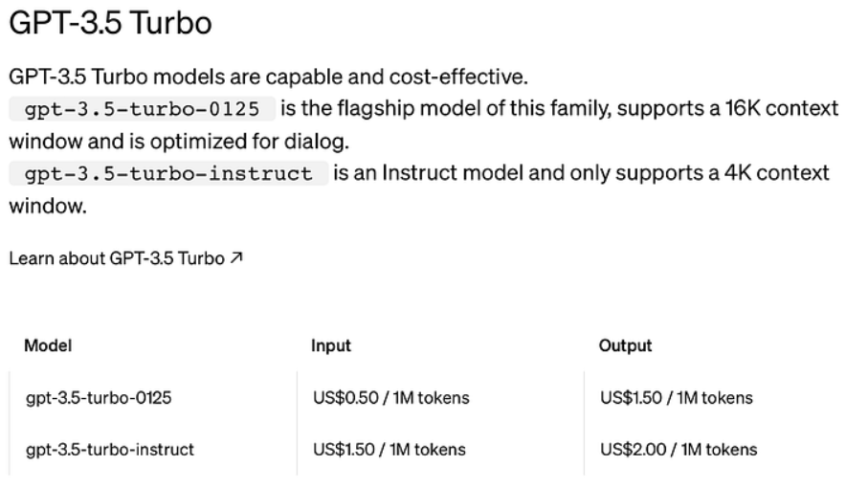
Moneywise:
While GPT-4 with Vision allows direct image input, it comes at a significantly higher token cost. A single image (e.g., 512×512 resolution) can consume around 5,000–8,000 tokens, translating to approximately $0.05–$0.08 per request. In contrast, our current approach leverages a Roboflow ViT model for image classification, and only sends short text prompts to the OpenAI API. Each session typically uses around 70 tokens (including input and output), costing less than $0.003 per user.

Slide 8
Business Aspect
Opportunities for Growth
Feature expansion
Active learning
More data
Personalized bot for each user
Integration with professionals

Slide 9
Now let’s estimate some calories, shall we?

Slide 10
Thank you!

