Slide 1
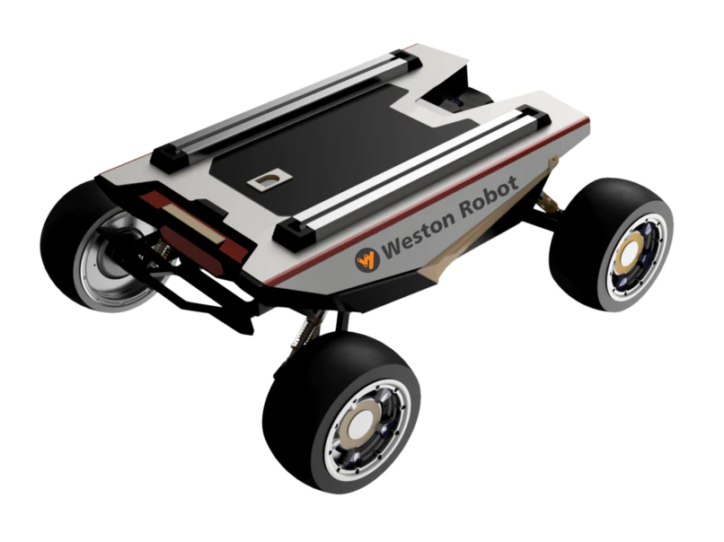
DIPARTIMENTO DI INGEGNERIA ELETTRICA E TECNOLOGIE DELL’INFORMAZIONE
SCUOLA POLITECNICA E DELLE SCIENZE DI BASE
MASTER'S DEGREE IN AUTOMATION ENGINEERING AND ROBOTICS
Field and Service Robotics project
Motion planning and control of car-like robot
Maisto Paolo, Vittozzi Angelo
Weston Robot - Robot SCOUT MINI

Slide 2
Index
Introduction
Car-like robot: kinematic modeling
Motion planning
PRM, BFS and path smoothing
Reeds-Shepp Curves and Dijkstra's algorithm
Input-Output Linearization control
Simulations and results
2/32

Slide 3
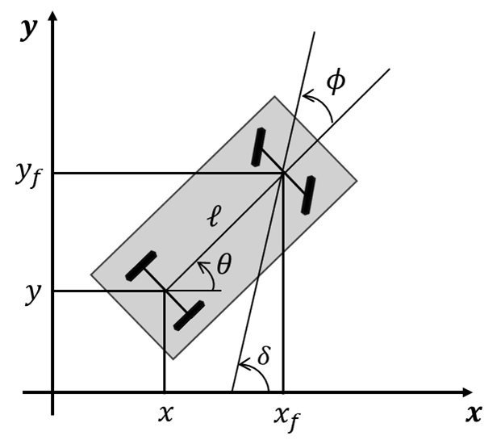
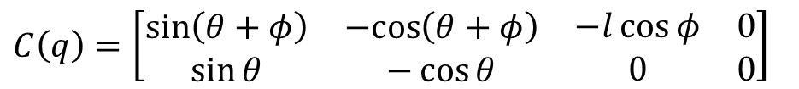
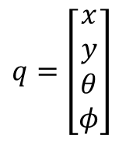




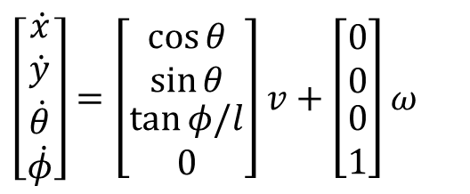
Car-like robot: kinematic modeling
Two nonholonomic constraints, one for each wheel (pure rolling constraints)
Kinematic model (rear-wheel driving)
$$\left[\begin{matrix}\begin{matrix}\dot{x} \\ \dot{y}\end{matrix} \\ \begin{matrix}\dot{θ} \\ \dot{φ}\end{matrix}\end{matrix}\right]=\left[\begin{matrix}\begin{matrix}\cos{θ} \\ \sin{θ}\end{matrix} \\ \begin{matrix}\tan{φ/l} \\ 0\end{matrix}\end{matrix}\right]v+\left[\begin{matrix}\begin{matrix}0 \\ 0\end{matrix} \\ \begin{matrix}0 \\ 1\end{matrix}\end{matrix}\right]ω$$
$${\dot{x}}_{f}\sin\left(θ+φ\right)−{\dot{y}}_{f}\cos\left(θ+φ\right)=0$$
$$\dot{x}\sin{θ−\dot{y}\sin{θ=0}}$$
Using rigid-body constraints
$$x_{f}=x+l\cos{θ}$$
$$y_{f}=y+l\sin{θ}$$
the first kinematic constraint becomes
$$q=\left[\begin{matrix}\begin{matrix}x \\ y\end{matrix} \\ \begin{matrix}θ \\ φ\end{matrix}\end{matrix}\right]$$
$$\dot{x}\sin\left(θ+φ\right)−\dot{y}\cos\left(θ+φ\right)−\dot{θ}l\cos{φ}=0$$
Pfaffian constraint matrix
$$C\left(q\right)=\left[\begin{matrix}\begin{matrix}\sin\left(θ+φ\right) & −cos\left(θ+φ\right) \\ \sin{θ} & −\cos{θ}\end{matrix} & \begin{matrix}−l\cos{φ} & 0 \\ 0 & 0\end{matrix}\end{matrix}\right]$$
3/32

Slide 4
Goals
MOTION PLANNING
A smooth path planning algorithm is implemented for car-like robot and determine trajectory. Two algorithms are implemented:
PRM, BFS and path smoothing method
Reeds-Shepp Curves with Dijkstra’s algorithm
INPUT-OUTPUT LINEARIZATION CONTROL
Given the trajectory in the previous point, an Input/Output Linearization control approach is implemented to control the position of car-like robot.
4/32

Slide 5
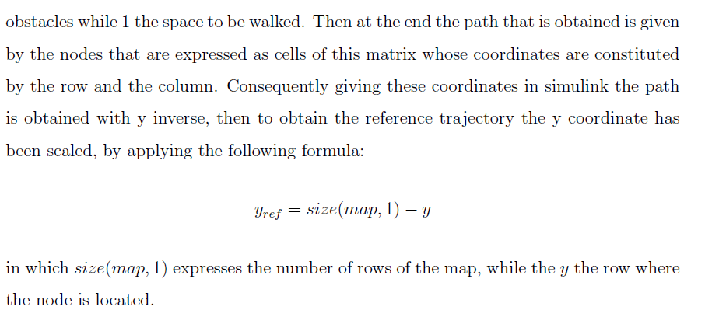
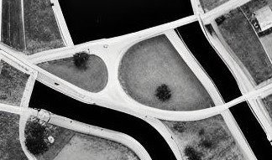


Occupancy map creation
$$y_{ref}=size\left(map,1\right)−y$$
Creation occupancy map with MATLAB
matrix composed of 0 and 1 in which the 0 express
obstacles while 1 the space to be walked.
Then at the end the path that is obtained is given
by the nodes that are expressed as cells of this matrix whose coordinates are constituted
by the row and the column. Consequently giving these coordinates in simulink the path
is obtained with y inverse, then to obtain the reference trajectory the y coordinate has
been scaled, by applying the following formula:
yref = size(map, 1) − y
in which size(map, 1) expresses the number of rows of the map, while the y the row where
the node is located.
5/32

Slide 6
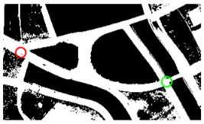
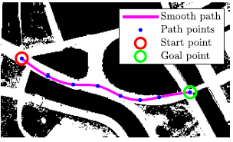
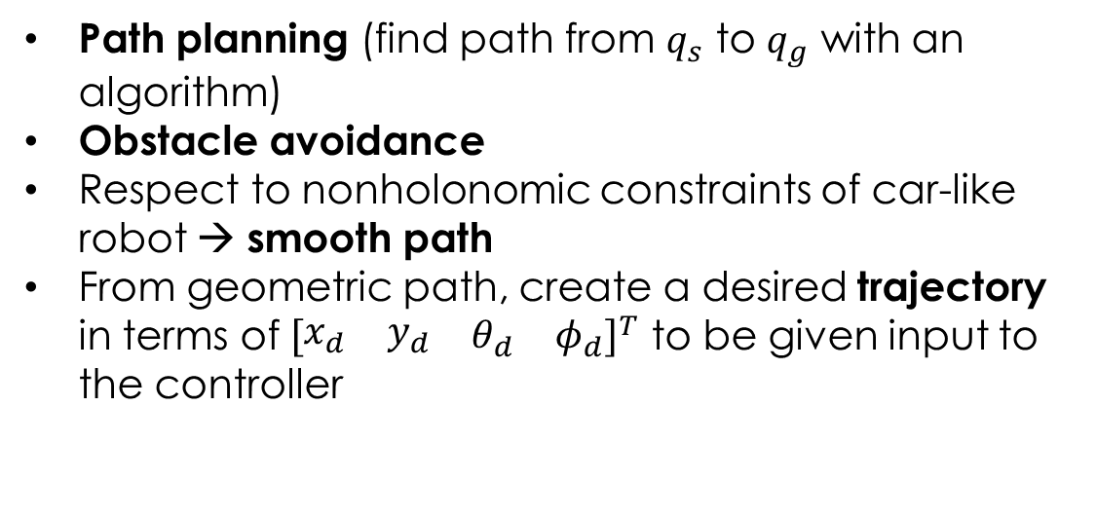
Motion planning: goals
Start point
Goal point
Path planning (find path from $q_{s}$ to $q_{g}$ with an algorithm)
Obstacle avoidance
Respect to nonholonomic constraints of car-like robot → smooth path
From geometric path, create a desired trajectory in terms of ${\left[\begin{matrix}\begin{matrix}x_{d} & y_{d}\end{matrix} & \begin{matrix}θ_{d} & φ_{d}\end{matrix}\end{matrix}\right]}^{T}$ to be given input to the controller
Trajectory
6/32

Slide 7
Motion planning: 2 approaches
1
2
Probabilistic Roadmaps (PRM)
Reeds-Shepp Curves
Smooth path
Breadth-first search (BFS)
Dijkstra's algorithm
Objective:
Path smoothing
7/32

Slide 8
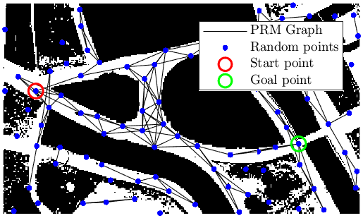
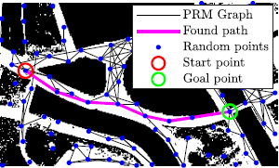
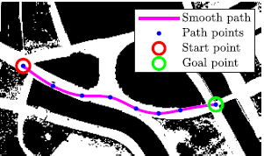
Motion planning: 1° approach
1
Probabilistic Roadmaps (PRM)
Breadth-first search (BFS)
Probabilistic Roadmap Method (PRM)
Breadth-First Search (BFS)
Path smoothing
Path smoothing
8/32

Slide 9
Motion planning: Probabilistic Roadmap Method (PRM)
Roadmap construction
Sampling
Collision Checking
Connecting Nodes
1
Adding Start and Goal
2
Graph creation
3
Termination criteria
4
Next step → find a path with a search algorithm
9/32
Notes:
PRM (Probabilistic Roadmap Method) Implementation
1. Roadmap Construction
Sampling: Randomly generate nodes in the free configuration space (Cfree) using a uniform probabilistic distribution.
Collision Checking: Validate each node to ensure it is collision-free; only valid nodes are added to the roadmap.
Connecting Nodes: Nearby nodes are connected via a local planner (e.g., straight-line paths), ensuring the connections are free of obstacles.
2. Adding Start and Goal
Connection: The start and goal points are added to the roadmap and connected to their nearest nodes using the local planner.
3. Graph Creation
Adjacency Matrix: An adjacency matrix is created based on the collision-free connections between nodes, used to find the optimal path.
4. Termination Criteria
Sampling Thresholds: The process stops once a maximum number of iterations is reached, or a sufficient number of connected components represent Cfree.
5. Path Planning
Optimal Path Search: Once the graph is complete, a search algorithm finds the most efficient path between the start and goal points.

Slide 10
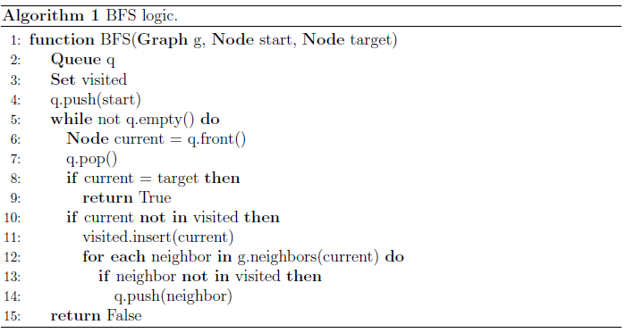
Motion planning: Breadth-First Search (BFS)
From PRM → graph that connects the various nodes including the initial and final point
Now the goal is to find the path that allows to go from the start point to the goal point → Breadth-First Search (BFS)
Next step → make the path smooth
10/32
Notes:
From PRM we obtained the graph that connects the various nodes including the initial and final point remains only to find the optimal path that allows to go from the start point to the goal point and the Breadth-First Search (BFS) was used for this purpose.

Slide 11
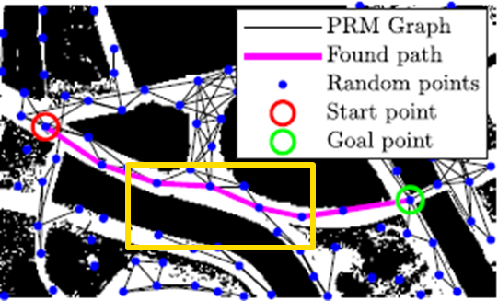

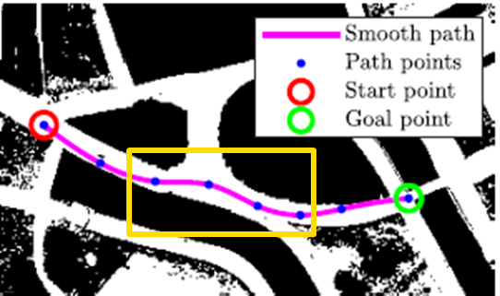

Motion planning: path smoothing
Obtained path, which allows to go from the initial point to the final point, is constituted by broken lines
The aim is to make the path smooth in order to eliminate the cusps within the path (as the car-like robot is not able to rotate on itself) → Spline
Path found with PRM + BFS
Path with spline interpolation
11/32
Notes:
Parlare di spline interpolation con polinomi cubici

Slide 12
Motion planning: path smoothing
Path found with PRM BFS
Path with spline interpolation
12/32

Slide 13
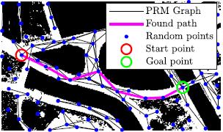
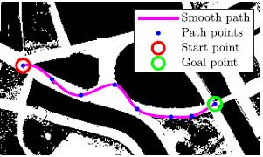
Motion planning: obstacle collision check
A candidate found path
Smooth path intersecting obstacles
Another candidate found path
Obstacle-free smooth path
13/32
Notes:
Parlare del check collisioni anche dopo aver reso il path smooth -> infiniti tentativi

Slide 14
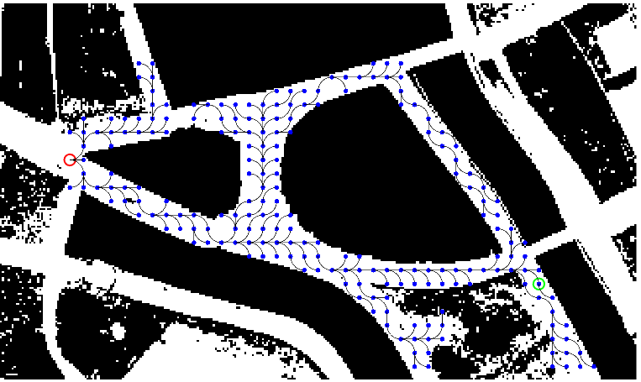
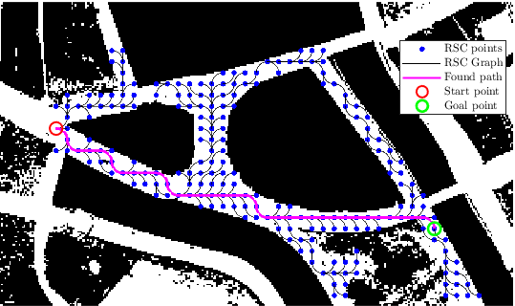
Motion planning: 2° approach
2
Reeds-Shepp Curves
Dijkstra's algorithm
14/32

Slide 15
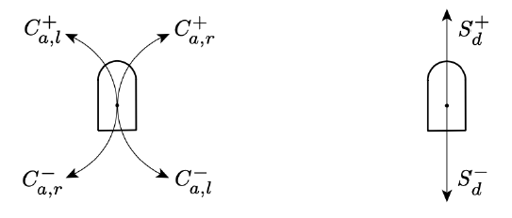

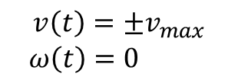

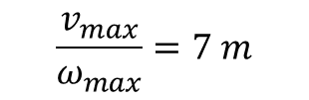
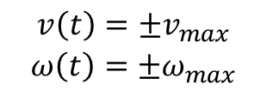
Motion planning: Reeds-Shepp Curves
Dubins Curves
No cusps because the movement is always forward.
Circular arcs of varying lengths traversed with velocities:
$$\begin{matrix}{v\left(t\right)=±v}_{max} \\ {ω\left(t\right)=±ω}_{max}\end{matrix}$$
The radius of these circular arcs is determined by
$$\frac{v_{max}}{ω_{max}}=7 m$$
Linear segments of varying lengths traversed with velocities:
$$\begin{matrix}{v\left(t\right)=±v}_{max} \\ {ω\left(t\right)=0}_{ }\end{matrix}$$
The curves are designed to satisfy the kinematic constraints of the robot, considering only certain motion primitives ($C_{a,l}^{+}$ and $C_{a,r}^{+}$ for circular arcs and $S_{d}^{+}$ for linear segments).
Velocity limits:
Next step → find the optimal path with an optimization algorithm
$$\begin{matrix} v_{max}=3 m/s \\ { ω}_{max}=0.43 rad/s\end{matrix}$$
15/32
Notes:
Implementazione delle Reeds-Shepp Curves (Punti per la Slide)
Definizione delle Curve:
Le Reeds-Shepp curves sono composte da segmenti di movimento elementari: archi circolari e segmenti lineari.
Questi segmenti possono essere percorsi in avanti o indietro e possono coinvolgere rotazioni in senso orario o antiorario.
Kinematic Constraints:
Le curve sono progettate per soddisfare i vincoli cinematici del robot, considerando solo certi primitivi di movimento (C⁺ₐ,ₗ e C⁺ₐ,ᵣ per gli archi circolari e S⁺d per i segmenti lineari).
Le velocità dei movimenti sono definite come:
Arco circolare: v(t)=±vmax, ω(t)=±ωmaxv(t) = ±v_{max}, \, ω(t) = ±ω_{max}v(t)=±vmax​,ω(t)=±ωmax​
Segmento lineare: v(t)=±vmax, ω(t)=0v(t) = ±v_{max}, \, ω(t) = 0v(t)=±vmax​,ω(t)=0
Evitamento dei Cusps:
Una caratteristica fondamentale delle curve è l'evitamento dei cusps (punti in cui il robot dovrebbe invertire il senso di marcia).
Questo rende le Reeds-Shepp curves ideali per manovre in spazi ristretti e ambienti complessi.
Movimento Limitato a Curve Predefinite:
Si assume che il robot possa muoversi solo leggermente in avanti, seguendo le curve C⁺ₐ,ₗ, C⁺ₐ,ᵣ e i segmenti S⁺d.
Ciò implica che le traiettorie generate non consentono movimenti bruschi o inversioni di direzione improvvise.
Integrazione con Algoritmi di Motion Planning:
Le Reeds-Shepp curves vengono integrate con algoritmi di motion planning come RRT o PRM.
Queste curve fungono da primitive di movimento all'interno di tali algoritmi, permettendo la generazione di percorsi fattibili e ottimizzati rispettando i vincoli cinematici.
Ottimizzazione del Percorso:
Dopo aver creato il grafo che connette i vari nodi (inclusi i punti iniziali e finali), si utilizza un algoritmo di ottimizzazione per trovare il percorso ottimale tra il punto di partenza e quello di arrivo.
Applicazioni in Robotica Mobile:
Le Reeds-Shepp curves sono particolarmente utili per i robot non-olonomici, come i robot con guida simile a un'auto, che non possono girare su sé stessi e necessitano di seguire traiettorie senza cusps.

Slide 16

Motion planning: Dijkstra's algorithm
Find neighbors
1
Update distance costs
2
Select next node & repeat
3
Termination criteria
4
16/32
Notes:
The steps of Dijkstra’s algorithm are as follows:
Initialize distances:
Set the distance to the source vertex $s$ to $0$: $d\left(s\right)=0$;
Set the distance to all other vertices to infinity: $d\left(v\right)=∞$ for all $v∈V$, $v≠s$;
Initialize a priority queue $Q$ and insert all vertices $v$ with their corresponding distances $d\left(v\right)$;
While $Q$ is not empty:
Extract the vertex $u$from $Q$ with the smallest distance $d(u)$;
For each neighbor $v$ of $u$ (i.e., for each edge $(u,v)∈E$):
Calculate the potential new path distance: $d_{new}=d\left(u\right)+w(u,v)$, where $w(u,v)$ is the weight of the edge $\left(u,v\right)$;
If $d_{new}<d\left(v\right)$:
Update $d(v)=d_{new}$​;
Decrease the priority of $v$in $Q$;

Slide 17

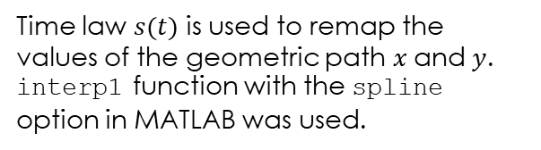


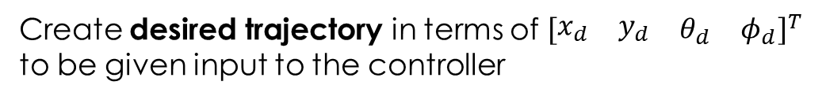
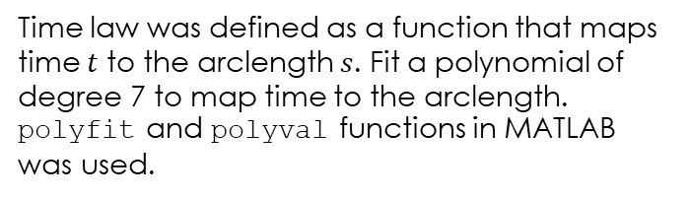
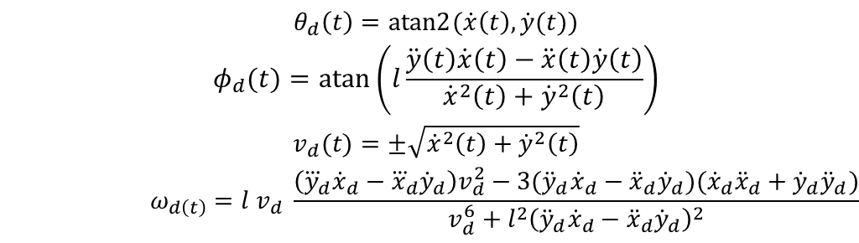
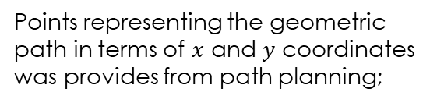
Motion planning: trajectory
TRAJECTORY = PATH + TIME LAW
1
From geometric path $q(s)$
Points representing the geometric path in terms of $x$ and $y$ coordinates was provides from path planning;
Adding time law $s\left(t\right)$
2
Time law was defined as a function that maps time $t$ to the arclength $s$. Fit a polynomial of degree 7 to map time to the arclength. polyfit and polyval functions in MATLAB was used.
3
Trajectory: $x(t)$ and $y(t)$
Time law $s(t)$ is used to remap the values of the geometric path $x$and $y$. interp1 function with the spline option in MATLAB was used.
4
Create desired trajectory in terms of ${\left[\begin{matrix}\begin{matrix}x_{d} & y_{d}\end{matrix} & \begin{matrix}θ_{d} & φ_{d}\end{matrix}\end{matrix}\right]}^{T}$ to be given input to the controller
$$\begin{matrix}\begin{matrix}θ_{d}\left(t\right)=atan2{(\dot{x}\left(t\right),\dot{y}(t)}) \\ φ_{d}(t)=atan\left(l\frac{\ddot{y}\left(t\right)\dot{x}\left(t\right)−\ddot{x}\left(t\right)\dot{y}\left(t\right)}{{\dot{x}}^{2}\left(t\right)+{\dot{y}}^{2}\left(t\right)}\right)\end{matrix} \\ \begin{matrix}v_{d}(t)=±\sqrt{{\dot{x}}^{2}\left(t\right)+{\dot{y}}^{2}\left(t\right)} \\ ω_{d\left(t\right)}=l v_{d} \frac{\left({\overset{⃛}{y}}_{d}{\dot{x}}_{d}−{\overset{⃛}{x}}_{d}{\dot{y}}_{d}\right)v_{d}^{2}−3({\ddot{y}}_{d}{\dot{x}}_{d}−{\ddot{x}}_{d}{\dot{y}}_{d})({\dot{x}}_{d}{\ddot{x}}_{d}+{\dot{y}}_{d}{\ddot{y}}_{d})}{v_{d}^{6}+l^{2}{\left({\ddot{y}}_{d}{\dot{x}}_{d}−{\ddot{x}}_{d}{\dot{y}}_{d}\right)}^{2}}\end{matrix}\end{matrix}$$
17/32
Notes:
Riassumiamo i passaggi principali:
Percorso Geometrico:
Hai già i punti raccolti (collected_points), che rappresentano il percorso geometrico in termini di coordinate xxx e yyy.
Interpoli questi punti utilizzando una spline per ottenere una rappresentazione continua e liscia del percorso in termini di xxx e yyy.
Legge Temporale (Time Law):
Definisci la legge temporale come una funzione che mappa il tempo ttt alla lunghezza dell'arco sss. Questo ti dice quanto il robot si è spostato lungo il percorso in funzione del tempo.
Adatti un polinomio di grado 7 per mappare il tempo alla lunghezza dell'arco: s(t). Questo polinomio fornisce una relazione continua e liscia tra il tempo e la distanza percorsa lungo il percorso.
Interpolazione basata su s(t):
Utilizzi la legge temporale interpolata s_t (che deriva dal polinomio di grado 7) per rimappare i valori del percorso geometrico xxx e yyy.
x_t = interp1(s_sample, x, s_t, 'spline') e y_t = interp1(s_sample, y, s_t, 'spline'): Questi passaggi interpolano il percorso geometrico in base alla legge temporale s_t, cioè ora hai il percorso x(t)x(t)x(t) e y(t)y(t)y(t) che include sia la geometria del percorso sia la variazione temporale.
Derivate e Cinematica:
Una volta che hai x(t)x(t)x(t) e y(t)y(t)y(t) lungo il tempo, calcoli le derivate per ottenere velocità e accelerazioni:
x_dot e y_dot: Derivate rispetto al tempo, che rappresentano le velocità lungo gli assi xxx e yyy.
x_ddot e y_ddot: Derivate seconde rispetto al tempo, che rappresentano le accelerazioni lungo gli assi xxx e yyy.
Calcolo delle variabili cinematiche:
Usando le derivate, calcoli variabili importanti per la cinematica del robot:
theta = atan2(y_dot, x_dot): L'angolo di orientamento del robot rispetto alla direzione di movimento.
v = sqrt(x_dot.^2 + y_dot.^2): La velocità lineare del robot.
phi e omega: L'angolo di sterzata e la velocità angolare, calcolati usando la cinematica del robot in base a velocità e accelerazioni.
Cosa succede dopo?
Traiettoria Finale: Alla fine, ottieni una traiettoria completa che descrive non solo il percorso geometrico del robot (in termini di x(t)x(t)x(t) e y(t)y(t)y(t)), ma anche come il robot deve muoversi lungo questo percorso nel tempo. La legge temporale calcolata con il polinomio di grado 7 garantisce che il robot si muova in modo regolare e controllato lungo la traiettoria, senza brusche variazioni di velocità.
Riassunto Concettuale
Prima definisci il percorso geometrico.
Poi calcoli una legge temporale s(t)s(t)s(t) utilizzando un polinomio di grado 7 per garantire una distribuzione temporale liscia lungo il percorso.
Infine, combini queste informazioni per ottenere la traiettoria finale in termini di posizione, velocità, orientamento e altre variabili cinematiche.
In pratica, stai costruendo un path (percorso geometrico) e una time law (legge temporale) separatamente, e poi li combini per ottenere una traiettoria temporizzata che il robot può seguire in modo fluido e controllato.

Slide 18
Goals
MOTION PLANNING
A smooth path planning algorithm is implemented for car-like robot and determine trajectory. Two algorithms are implemented:
PRM, BFS and path smoothing method
Reeds-Shepp Curves with Dijkstra’s algorithm
INPUT-OUTPUT LINEARIZATION CONTROL
Given the trajectory in the previous point, an Input/Output Linearization control approach is implemented to control the position of car-like robot.
18/32

Slide 19
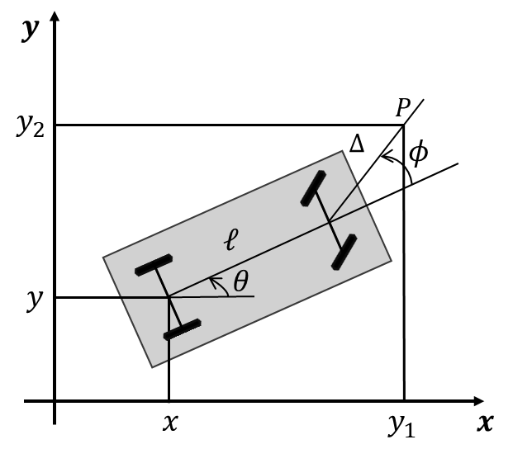


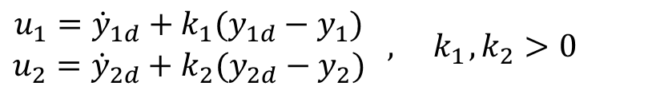

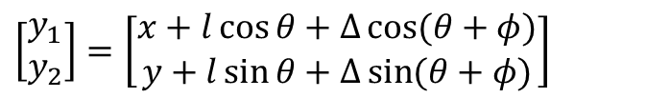
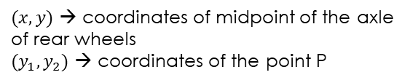
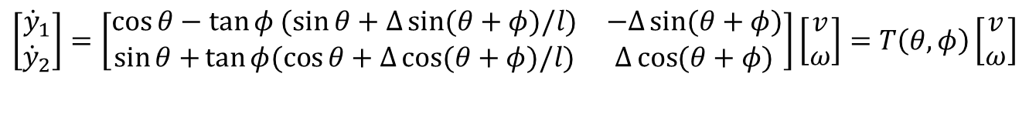

Input-Output Linearization control
The output choice for the trajectory tracking task is:
$$y=\left[\begin{matrix}x \\ y\end{matrix}\right]$$
System output is redefined as:
$$\left[\begin{matrix}y_{1} \\ y_{2}\end{matrix}\right]=\left[\begin{matrix}x+l\cos{θ+Δ\cos{(θ+φ)}} \\ y+l\sin{θ+Δ\sin{(θ+φ)}}\end{matrix}\right]$$
The time derivatives of these outputs:
$$\left[\begin{matrix}{\dot{y}}_{1} \\ {\dot{y}}_{2}\end{matrix}\right]=\left[\begin{matrix}\cos{θ}−\tan{φ (\sin{θ+Δ\sin{(θ+φ)/l)}}} & −Δ\sin{(θ+φ)} \\ \sin{θ+}\tan{φ(\cos{θ+Δ\cos{(θ+φ)/l)}}} & Δ\cos{(θ+φ)}\end{matrix}\right]\left[\begin{matrix}v \\ ω\end{matrix}\right]=T\left(θ,φ\right)\left[\begin{matrix}v \\ ω\end{matrix}\right]$$
$$\left[\begin{matrix}{\dot{y}}_{1} \\ {\dot{y}}_{2}\end{matrix}\right]=\left[\begin{matrix}u_{1} \\ u_{2}\end{matrix}\right]$$
$$\left(\begin{matrix}\text{where} \left[\begin{matrix}u_{1} \\ u_{2}\end{matrix}\right] \text{are} \text{two} \\ \text{virtual} \text{control} \text{inputs}\end{matrix}\right)$$
Since $\det{T\left(θ,φ\right)=Δ/\cos{φ≠0}}$, we can set:
$(x,y)$ → coordinates of midpoint of the axle of rear wheels
$(y_{1},y_{2})$ → coordinates of the point P
Heading velocity and angular velocity:
$$\left[\begin{matrix}v \\ ω\end{matrix}\right]=T^{−1}\left(θ,φ\right)\left[\begin{matrix}u_{1} \\ u_{2}\end{matrix}\right]$$
Controller
$$\begin{matrix}u_{1}={\dot{y}}_{1d}+k_{1}(y_{1d}−y_{1}) \\ u_{2}={\dot{y}}_{2d}+k_{2}(y_{2d}−y_{2})\end{matrix} , { k}_{1}, k_{2}>0$$
19/32
Notes:
System output is redefined as: -> è per cambiare output (prima era x,y -> ora è y1, y2 cioè le coordinate del punto P)

Slide 20
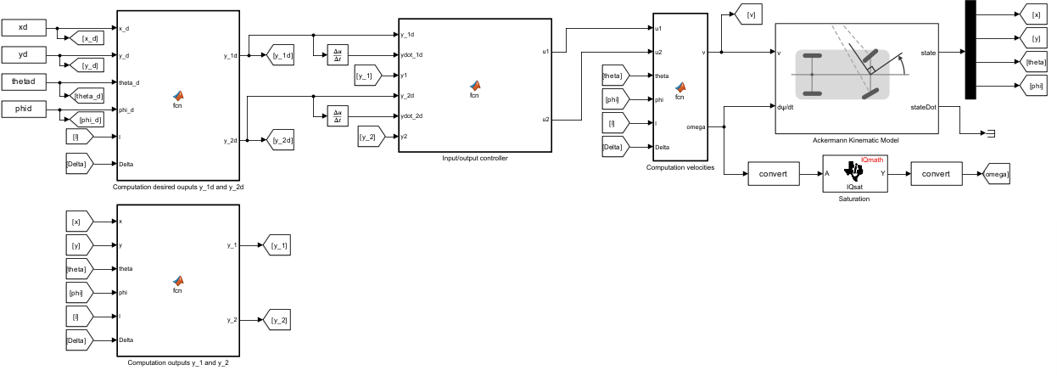
Input-Output Linearization control
Current states
Velocities
Desired outputs
Virtual control inputs
Desired trajectory
Current states
Outputs
20/32

Slide 21
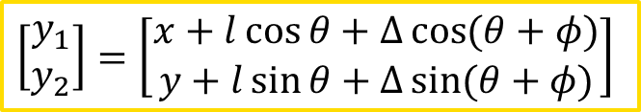
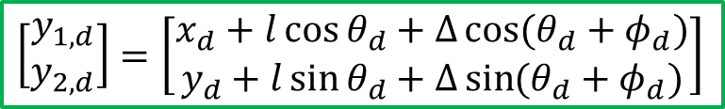
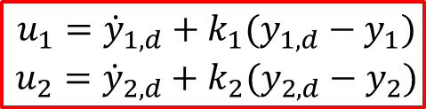
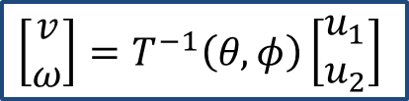


Input-Output Linearization control
$\begin{matrix}k_{1}=5 \\ k_{2}=5\end{matrix}$ PRM + BFS
$\begin{matrix}k_{1}=50 \\ k_{2}=50\end{matrix}$ RSC + Dijkstra
$$\left[\begin{matrix}\begin{matrix}\dot{x} \\ \dot{y}\end{matrix} \\ \begin{matrix}\dot{θ} \\ \dot{φ}\end{matrix}\end{matrix}\right]=\left[\begin{matrix}\begin{matrix}\cos{θ} \\ \sin{θ}\end{matrix} \\ \begin{matrix}\tan{φ/l} \\ 0\end{matrix}\end{matrix}\right]v+\left[\begin{matrix}\begin{matrix}0 \\ 0\end{matrix} \\ \begin{matrix}0 \\ 1\end{matrix}\end{matrix}\right]ω$$
$$\begin{matrix}u_{1}={\dot{y}}_{1,d}+k_{1}(y_{1,d}−y_{1}) \\ u_{2}={\dot{y}}_{2,d}+k_{2}(y_{2,d}−y_{2})\end{matrix}$$
$$\left[\begin{matrix}v \\ ω\end{matrix}\right]=T^{−1}\left(θ,φ\right)\left[\begin{matrix}u_{1} \\ u_{2}\end{matrix}\right]$$
$$\left[\begin{matrix}y_{1,d} \\ y_{2,d}\end{matrix}\right]=\left[\begin{matrix}x_{d}+l\cos{θ_{d}+Δ\cos{(θ_{d}+φ_{d})}} \\ y_{d}+l\sin{θ_{d}+Δ\sin{(θ_{d}+φ_{d})}}\end{matrix}\right]$$
$$\left[\begin{matrix}y_{1} \\ y_{2}\end{matrix}\right]=\left[\begin{matrix}x+l\cos{θ+Δ\cos{(θ+φ)}} \\ y+l\sin{θ+Δ\sin{(θ+φ)}}\end{matrix}\right]$$
21/32

Slide 22
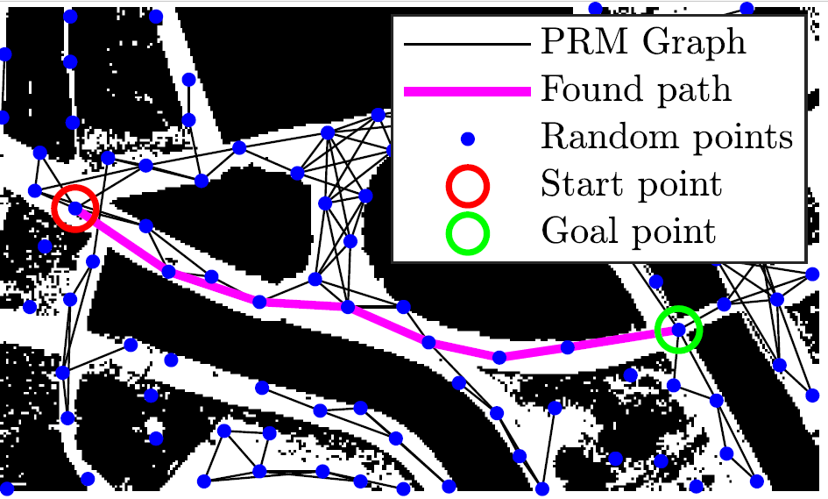
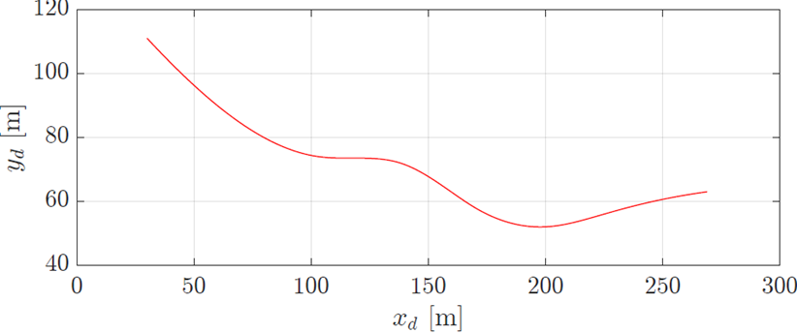
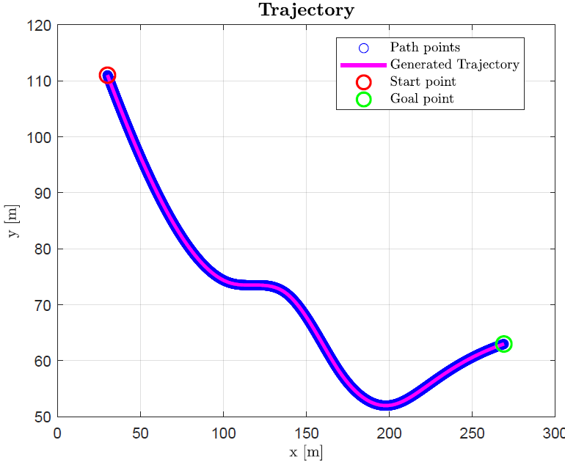
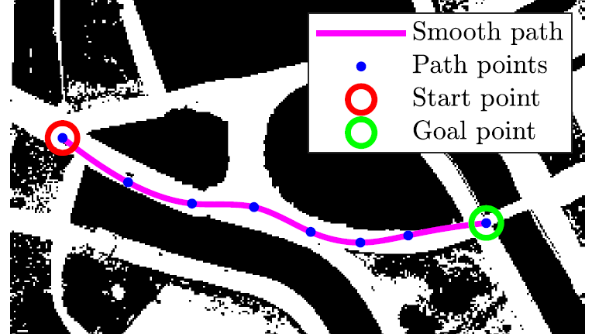
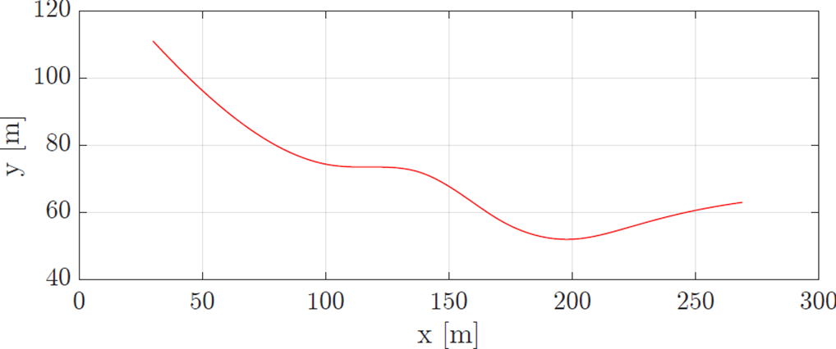
Simulations and Results: 1° approach
Found path with PRM + BFS
Desired trajectory in SIMULINK
Desired trajectory in MATLAB
Smoothed path
Performed trajectory in SIMULINK
22/32

Slide 23
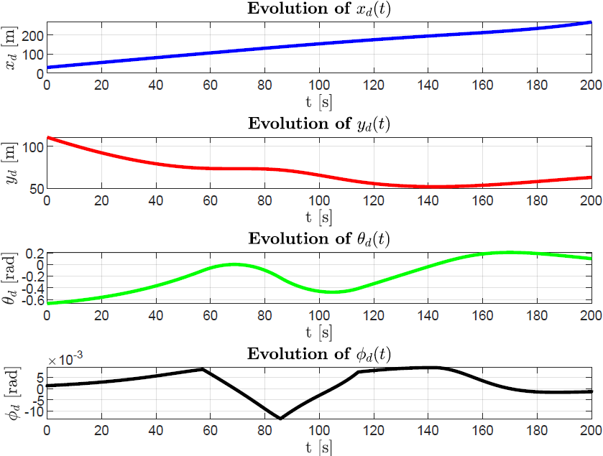
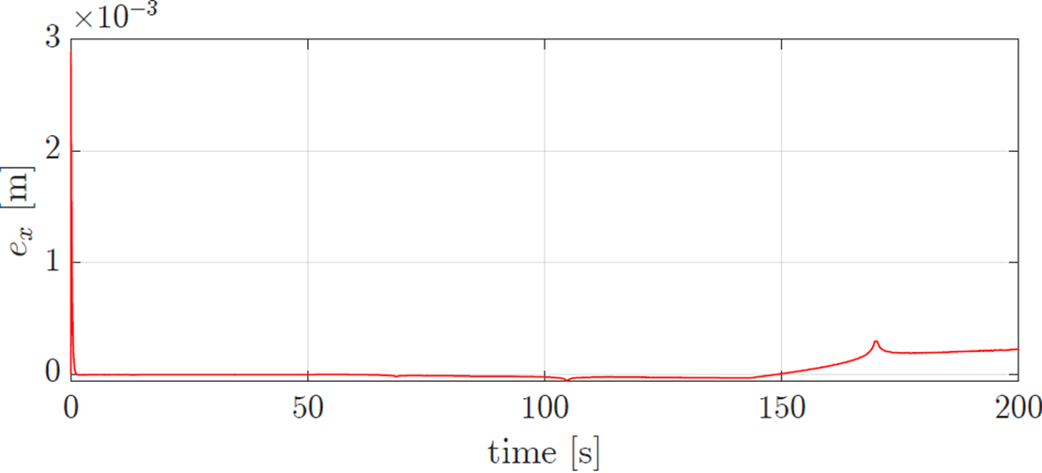
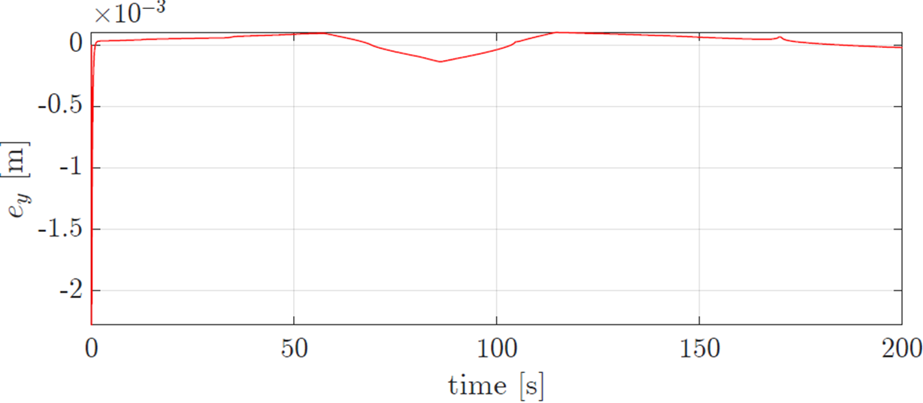






Simulations and Results: 1° approach
Error of $x$
Error of $y$
Error of $θ$
Error of $φ$
23/32

Slide 24


Simulations and Results: 1° approach
Heading velocity and angular velocity in MATLAB
Heading velocity and angular velocity in SIMULINK
24/32

Slide 25




Simulations and Results: 2° approach
Desired trajectory in SIMULINK
Optimal path
Desired trajectory in MATLAB
Performed trajectory in SIMULINK
25/32

Slide 26





Simulations and Results: 2° approach
Error of $x$
Error of $y$
Error of $θ$
Error of $φ$
26/32

Slide 27


Simulations and Results: 2° approach
Heading velocity and angular velocity in MATLAB
Heading velocity and angular velocity in SIMULINK
27/32

Slide 28
Thank you for your attention !!
28/32

