Slide 1
The Sociology of Contemporary Analytic Philosophy
Case study 1

Slide 2
INTRODUCTION
1) Production in analytic philosophy:
1.1) Who are the most productive philosophers?
1.2) Which are the most productive institutions? And in which countries are they based?

Slide 3
INTRODUCTION
2) Informal collaboration in analytic philosophy:
2.1) How many informal collaborators does the average analytic philosopher mention?
2.2) Is informal collaboration common in analytic philosophy?

Slide 4
INTRODUCTION
3) Prestige in the analytic philosophy community:
3.1) Who are the most mentioned philosophers?
3.2) Who are the most mentioned philosophers within the various sub-areas of analytic philosophy?
3.3) How are mentions distributed among the members of the community?
3.4) Are mentions correlated with other indicators of prestige (e.g. number of citations or number of published articles)?
3.5) Does gender affect the chances of accumulating mentions?

Slide 5
METHODOLOGY: 1. Production in Analytic Philosophy
1.1) Who are the most productive philosophers?
Interpretation: productivity as the number of distinct articles a philosopher authored within this database. Computed by joining Authorships_df and Philosophers_df on Phi_ID.
Data quality: No missing identifiers, no duplicate authorship records.
Analysis: Identification of the 10 most productive philosophers (ties included).

Slide 6
METHODOLOGY: 1. Production in Analytic Philosophy
1.2) Which are the most productive institutions? And in which countries are they based?
Interpretation: productivity as the number of distinct articles associated with each institution, computed by joining Authorships_df and Affiliations_df on Inst_ID. This measure is not mutually exclusive across institutions.
Data quality: I checked for missing institutional affiliations in the authorship records (1.4%). Rows with missing Inst_ID were excluded from the analysis.
Analysis: For each institution, I counted the number of distinct articles associated with it, then identified the ten most productive institutions and their geography, accounting also for ties.

Slide 7
METHODOLOGY: 2. Informal Collaboration
2.1) How many informal collaborators does the average analytic philosopher mention?
Interpretation: informal collaborators as distinct acknowledgees per article. Two interpretations proposed: (1) philosopher-level — averaged within each philosopher first, then across philosophers (via Authorships_df), avoiding overweighting prolific authors; (2) article-level — averaged directly over articles.
Data quality: 128 of 2,075 articles have no acknowledgments section (excluded); 103 have a section but name no philosopher (included and coded as 0).
Analysis: for each article with acknowledgments section, I counted its distinct acknowledgees with respect to the two units of analysis discussed above (philosophers and articles). I also report the mean, median, and mode for each version.

Slide 8
METHODOLOGY: 2. Informal Collaboration
2.2) Is informal collaboration common in analytic philosophy?
Interpretation: prevalence as the proportion of articles and philosophers with at least one informal collaborator. Both levels are reported, since they capture different aspects of "commonness.“
Data quality: I reuse the cleaned data from 2.1.
Analysis: I computed the share of articles with at least one acknowledgee, out of those with an observable acknowledgments section, and the share of philosophers with at least one such article among their own work.

Slide 9
METHODOLOGY: 3. Prestige
3.1) Who are the most mentioned philosophers?
Interpretation: "most mentioned" as the number of distinct articles in which a philosopher is named in the acknowledgments section. Acknowledgments_df is used to identify which philosophers are mentioned in which articles and Philosophers_df to retrieve full names.
Data quality: I de-duplicated on Art_ID - Phi_ID before counting, since Acknowledgments_df contains 144 rows where the same philosopher is named more than once within a single article's acknowledgments.
Analysis: For each philosopher, I counted the number of distinct articles mentioning them, and identified the ten most mentioned, while preserving ties.

Slide 10
METHODOLOGY: 3. Prestige
3.2) Who are the most mentioned philosophers within the various sub-areas of analytic philosophy?
Interpretation: I analysed "sub-areas" using the Research_Area field in Articles_df. I attributed each acknowledgment mention to the sub-area of the article it comes from, and ranked philosophers by mentions separately within each sub-area.
Data quality: As in 3.1, I de-duplicated Art_ID - Phi_ID pairs before counting. Moreover, articles lacking a sub-area are excluded from this analysis.
Analysis: I identified the three most mentioned philosophers within each sub-area, using a tie-preserving cutoff.

Slide 11
METHODOLOGY: 3. Prestige
3.3) How are mentions distributed among the members of the community?
Interpretation: "community" as the full population of philosophers recorded in the database (Philosophers_df). Philosophers never mentioned in Acknowledgments_df are coded as zero.
Data quality: as in 3.1 and 3.2 mentions were de-duplicated on Art_ID – Phi_ID before counting.
Analysis: I computed the mean, median, mode, and standard deviation of the number of mentions across the full population of philosophers.

Slide 12
METHODOLOGY: 3. Prestige
3.4) Are mentions correlated with other indicators of prestige (e.g. number of citations or number of published articles)?
Interpretation: I used three variables as plausible prestige indicators: career-wide Citations and Publications (both from Philosophers_df), and N_Articles (the productivity measure from RQ 1). Moreover, correlation is measured as the R2 of linear regression.
Data quality: Citations/Publications are missing for 45% of philosophers (incomplete Scopus matching); models fit on different sample sizes as a result.
Analysis: I computed, for each prestige indicator, three separate linear regressions and R2.

Slide 13
METHODOLOGY: 3. Prestige
3.5) Does gender affect the chances of accumulating mentions?
Interpretation: The analysis is defined over the full population of philosophers with known gender.
Data quality: 92 philosophers (1.5%) with unknown gender are excluded; never-mentioned philosophers are coded as 0, as in 3.3.
Analysis: I segmented the population into four mention tiers (below/at/above median and 10%) based on the median and 90th percentile, and computed the number and percentage of women and men within each tier.

Slide 14
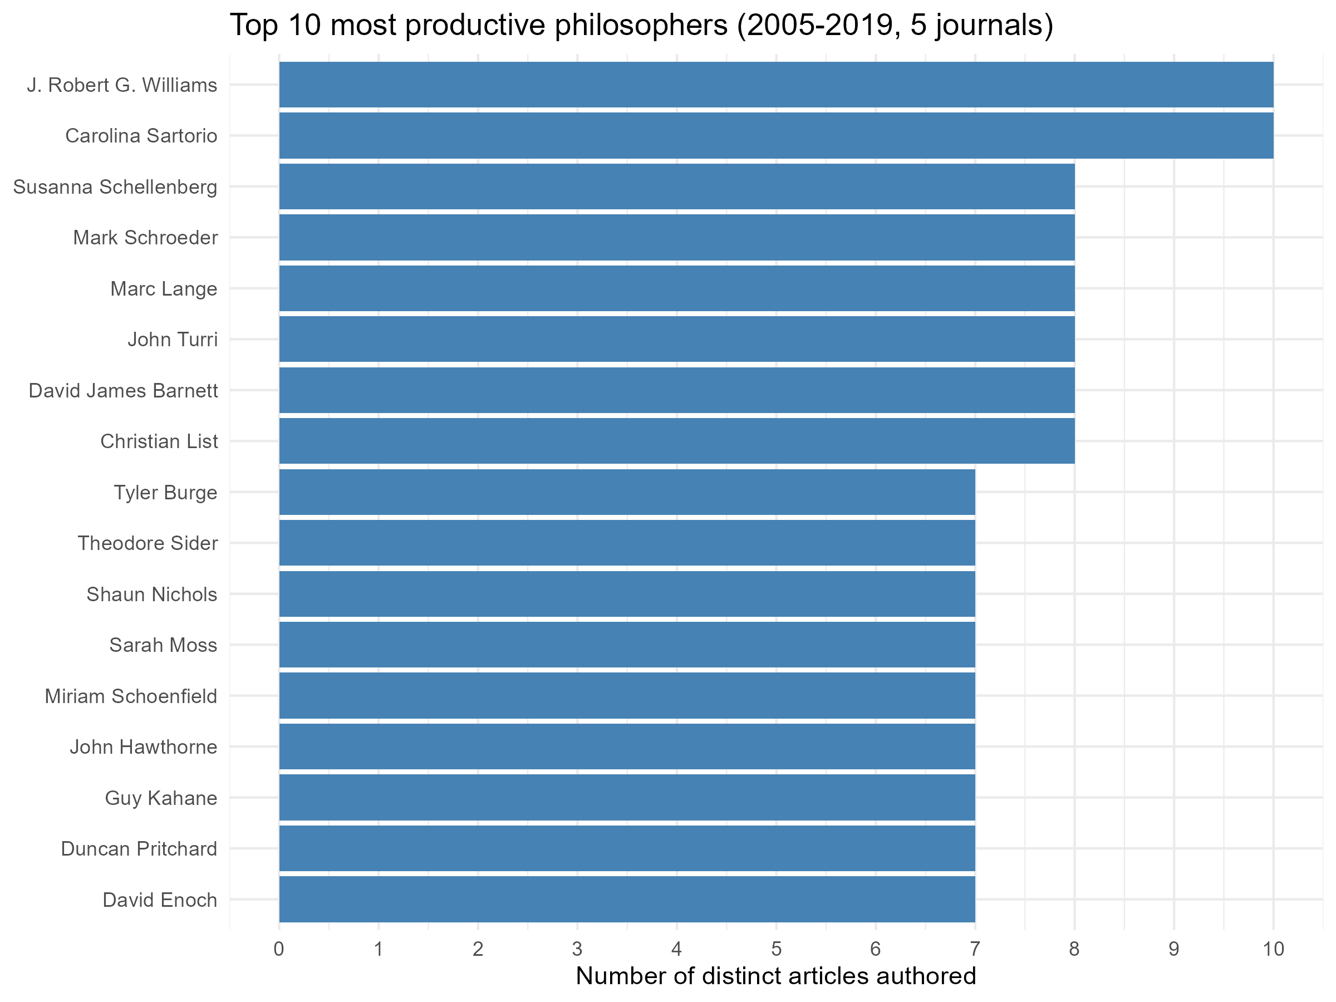
RESULTS: 1.1 Most productive philosophers

Slide 15
RESULTS: 1.1 Most productive philosophers (top_philosophers)
Rank | Philosopher | N Articles
1 | J. Robert G. Williams | 10
2 | Carolina Sartorio | 10
3 | John Turri | 8
4 | Marc Lange | 8
5 | Mark Schroeder | 8
6 | David J. Barnett | 8
7 | Christian List | 8
8 | Susanna Schellenberg | 8
Rank | Philosopher | N Articles
9 | Sarah Moss | 7
10 | Theodore Sider | 7
11 | David Enoch | 7
12 | Duncan Prtichard | 7
13 | John Hawthorne | 7
14 | Tyler Burge | 7
15 | Guy Kahane | 7
16 | Mirian Schoenfield | 7
17 | Shaun Nichols | 7

Slide 16
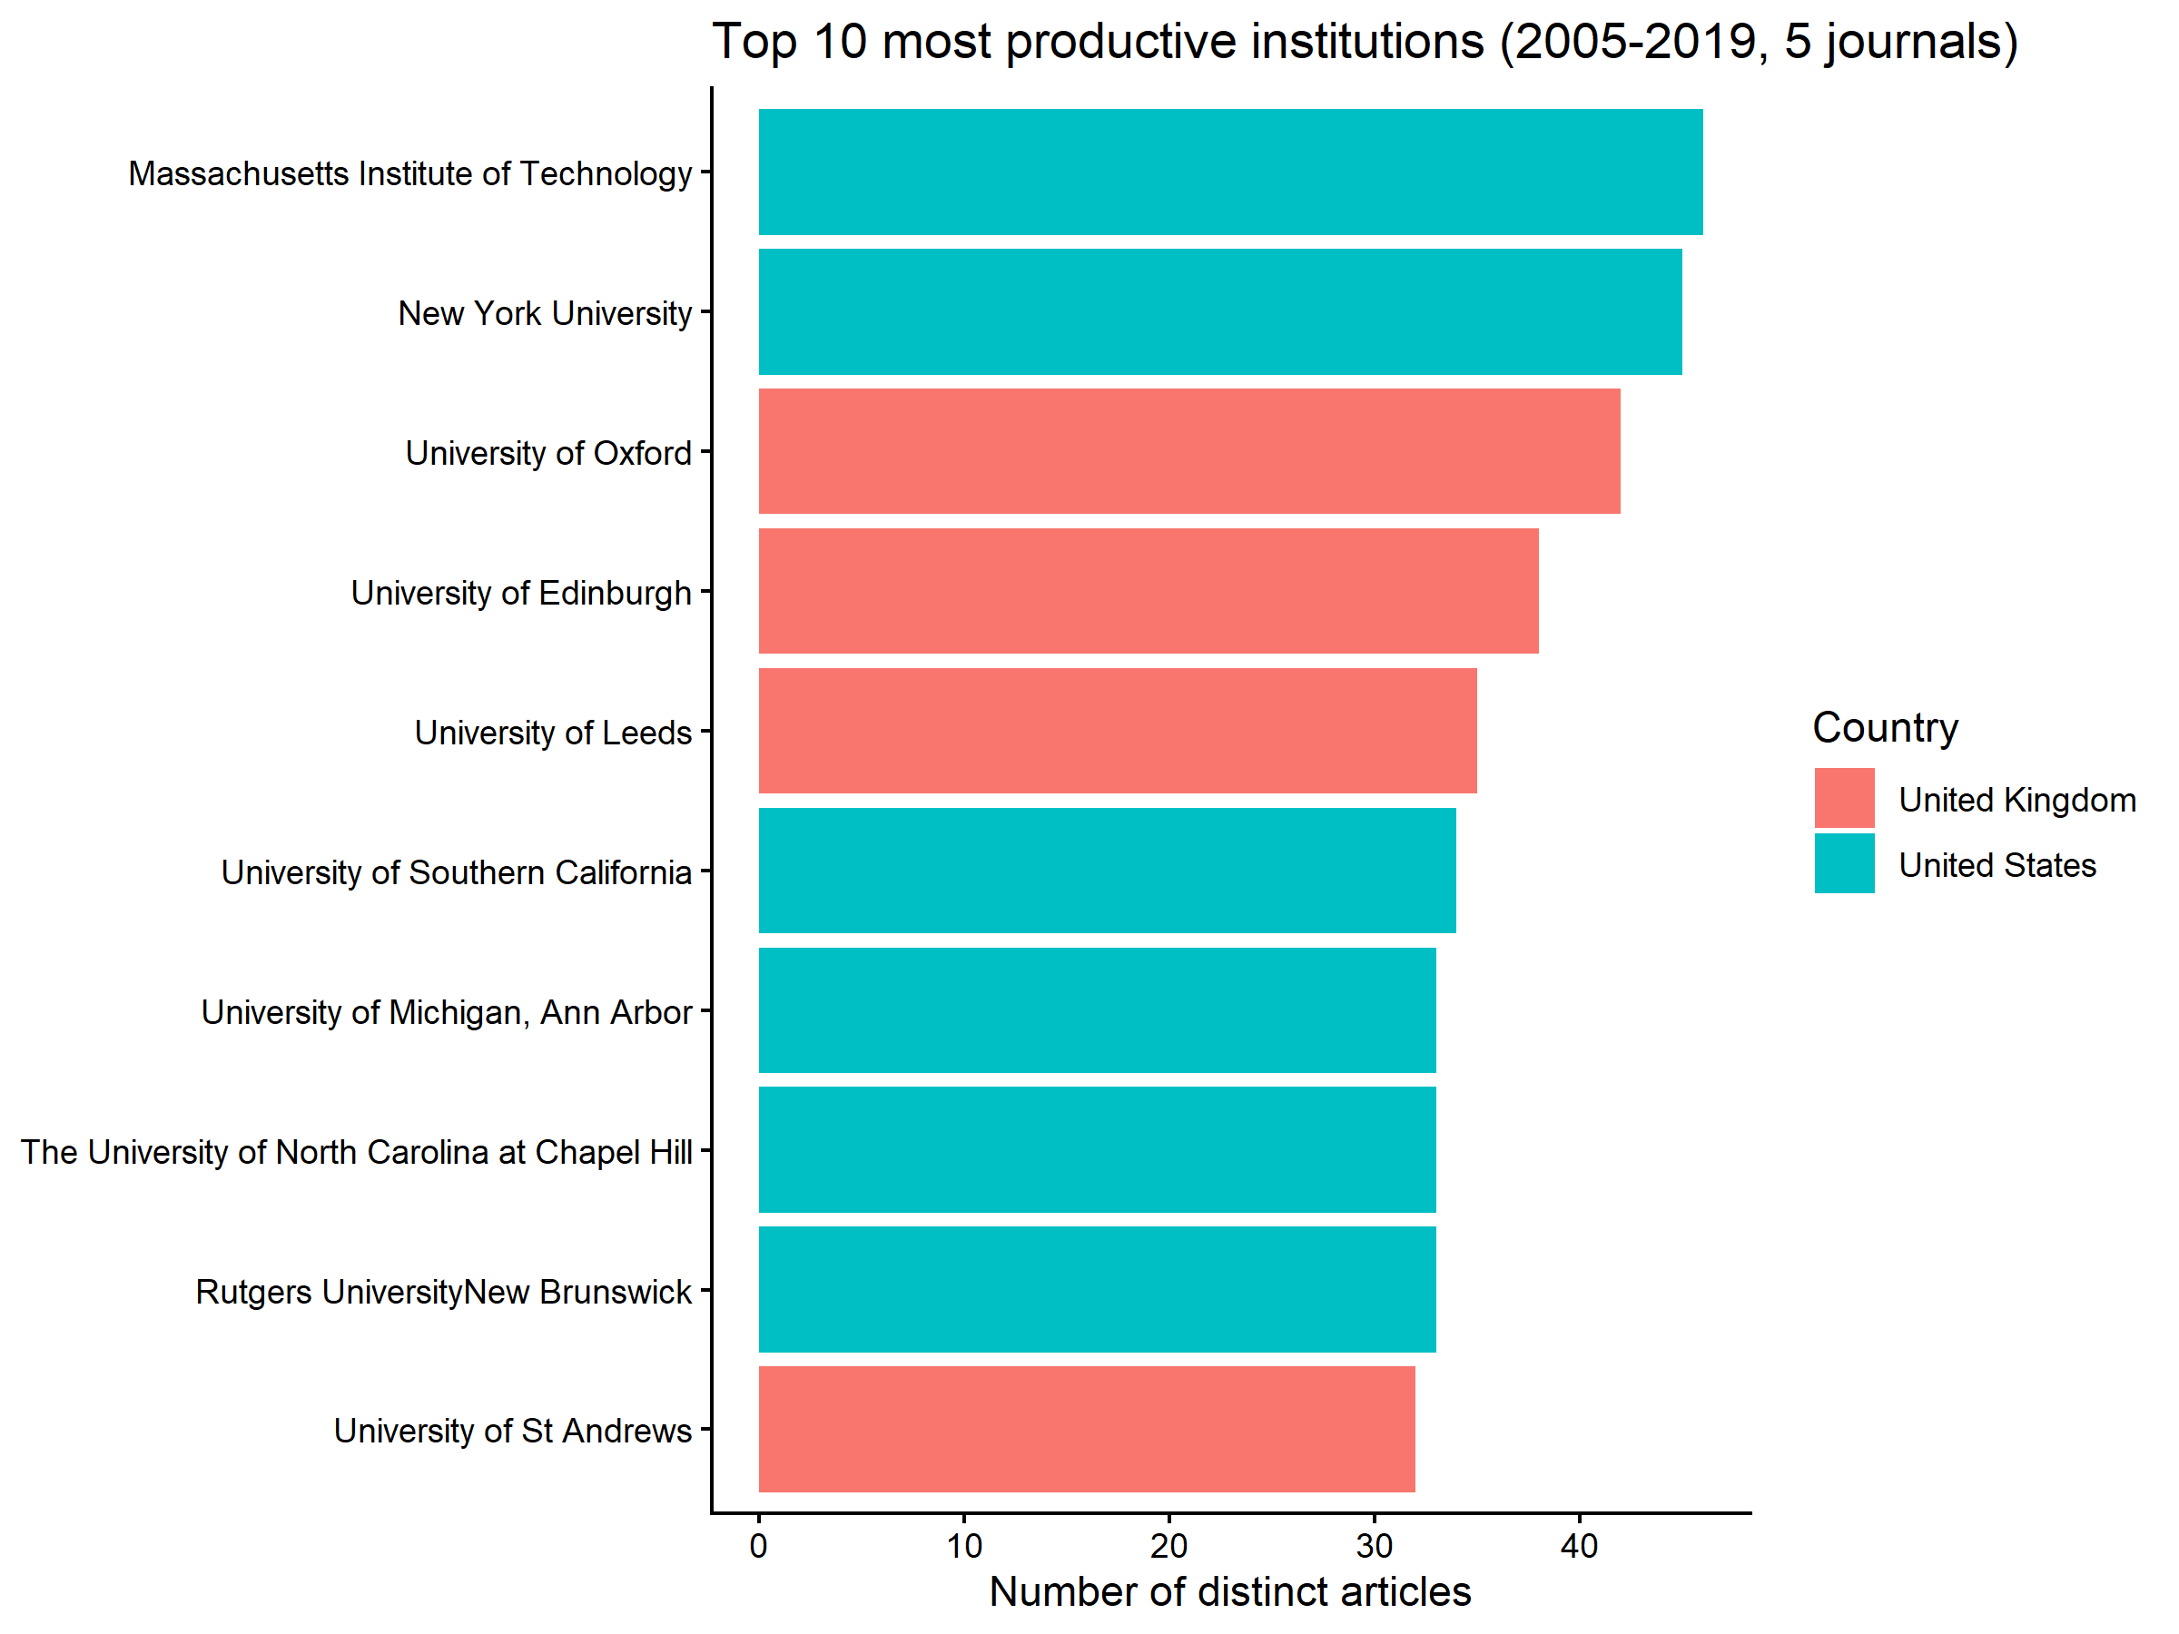
RESULTS: 1.2 Most productive institutions and their geography

Slide 17
RESULTS: 1.2 Most productive institutions and their geography (top_istitutions)
Affiliation name | Affiliation country | N Articles
Massachussets Institute of Technology | United States | 46
New York University | United States | 45
University of Oxford | United Kingdom | 42
University of Edinburgh | United Kingdom | 38
University of Leeds | United Kingdom | 35
University of Southern California | United States | 34
University of Michigan, Ann Arbor | United States | 33
The University of North Carolina at Chapel Hill | United States | 33
Rutgers University-New Brunswick | United States | 33
University of St Andrews | United Kingdom | 32

Slide 18
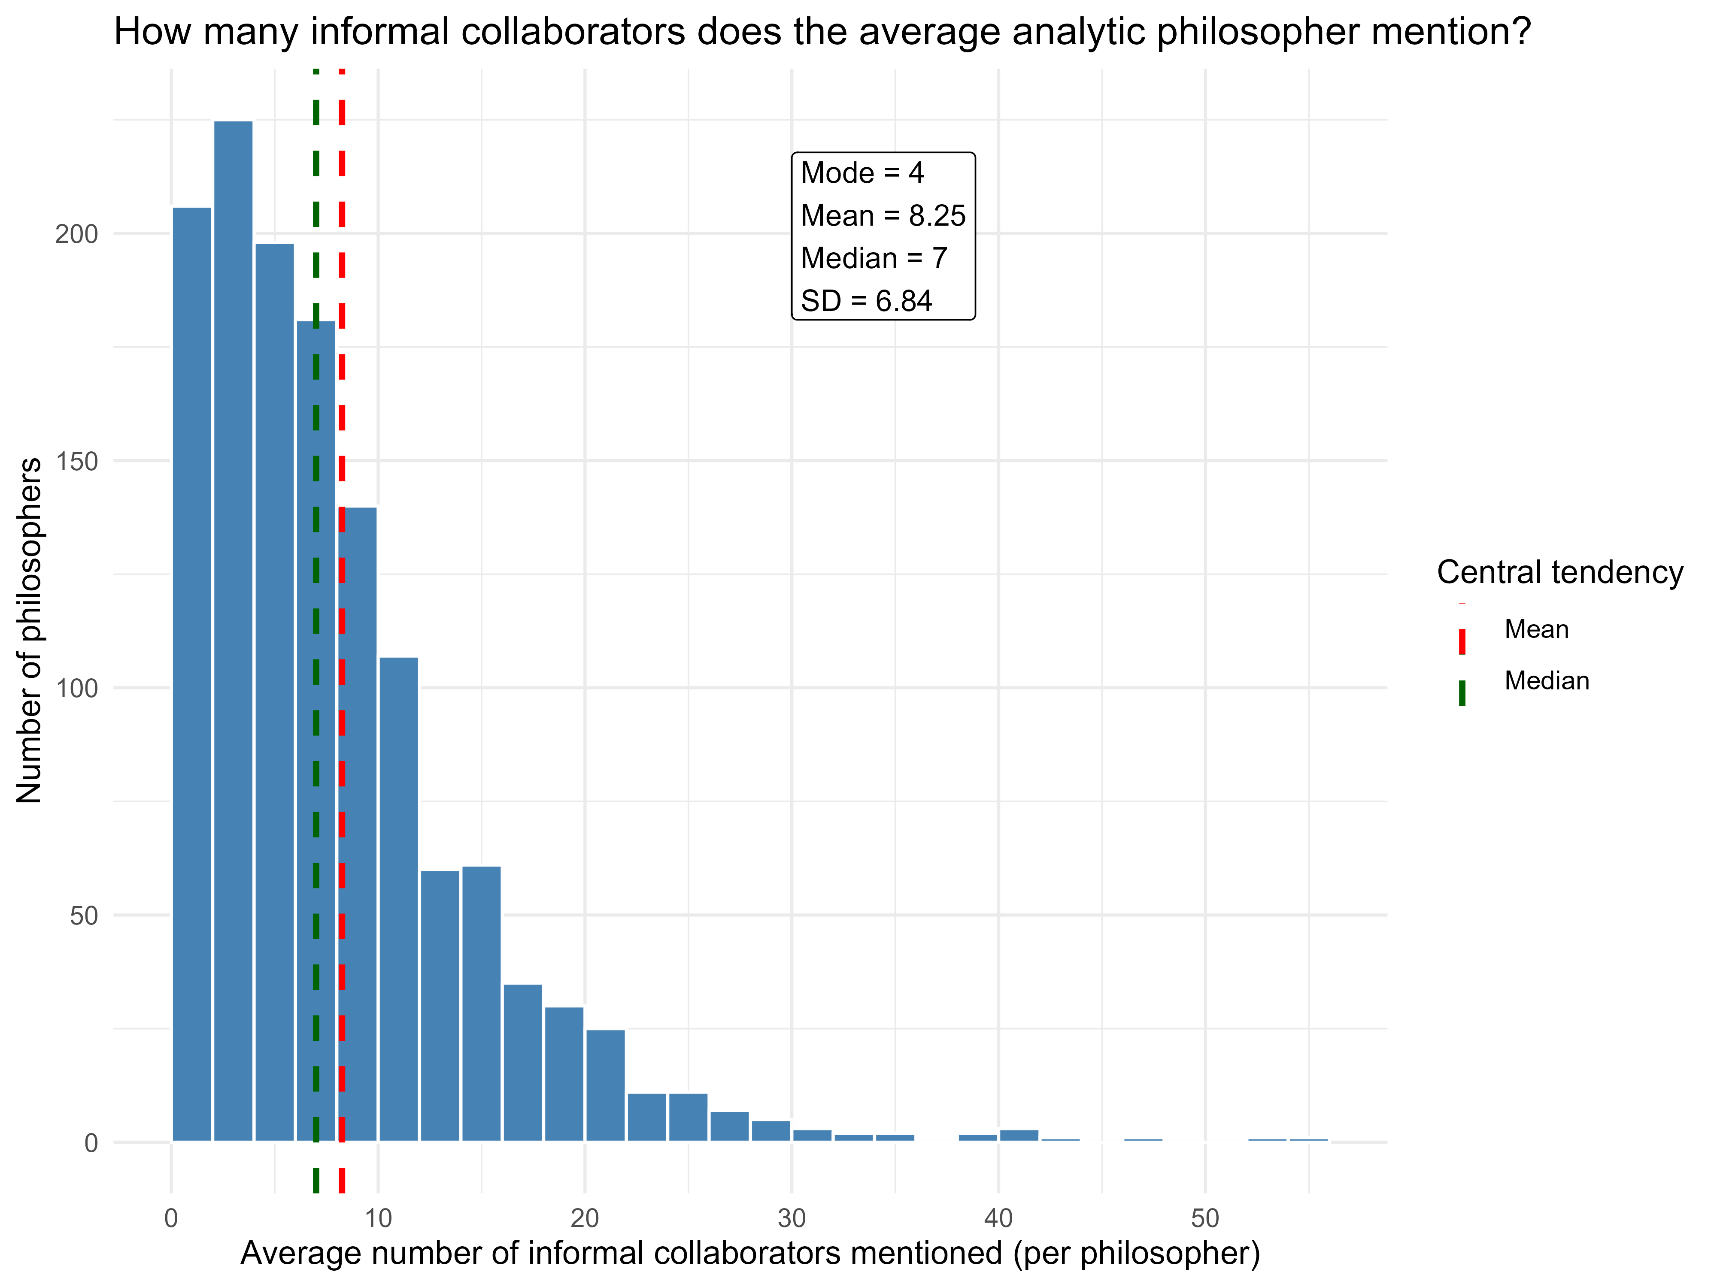
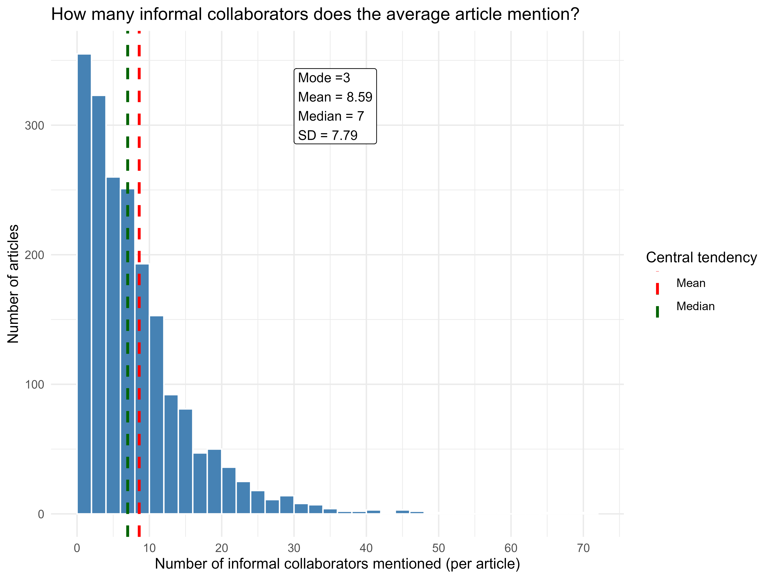
RESULTS: 2.1 How many informal collaborators does the average analytic philosopher mention?

Slide 19
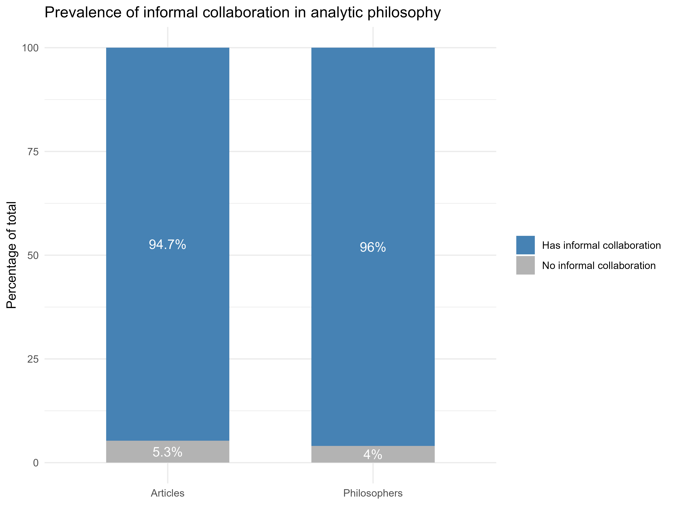
RESULTS: 2.2 Is informal collaboration common in analytic philosophy?

Slide 20
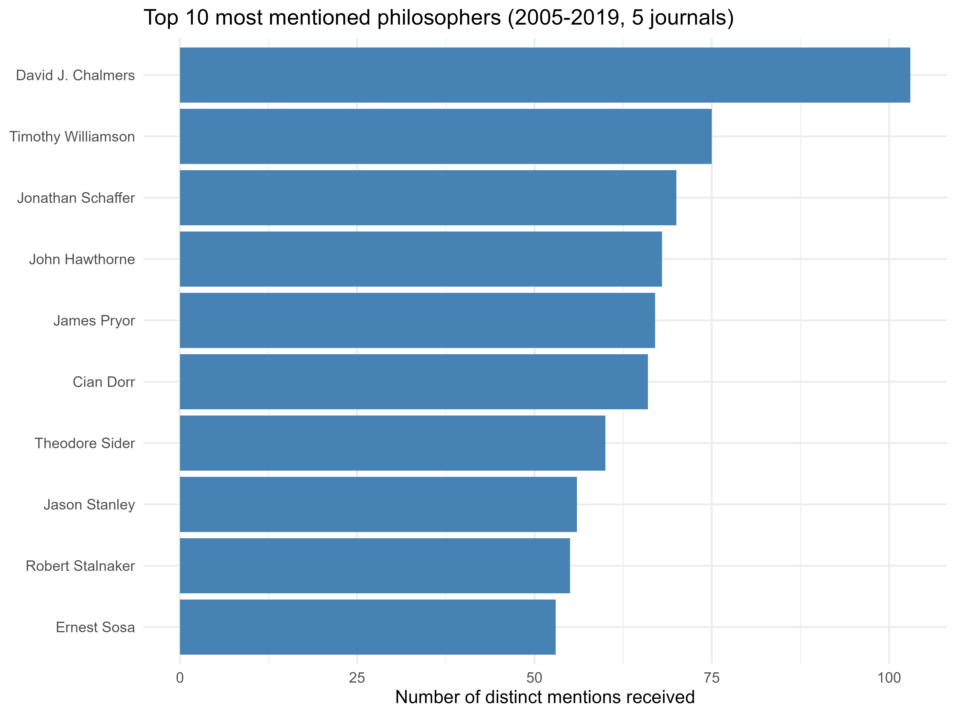
RESULTS: 3.1 Who are the most mentioned philosophers?

Slide 21
RESULTS: 3.1 Who are the most mentioned philosophers? (top_mentioned_phil)
Philosopher | N mentions
David J. Chalmers | 103
Timothy Williamson | 75
Jonthan Schaffer | 70
John Hawthorne | 68
James Pryor | 67
Cian Dorr | 66
Theodore Sider | 60
Jason Stanley | 56
Robert Stalnaker | 55
Ernest Sosa | 53

Slide 22
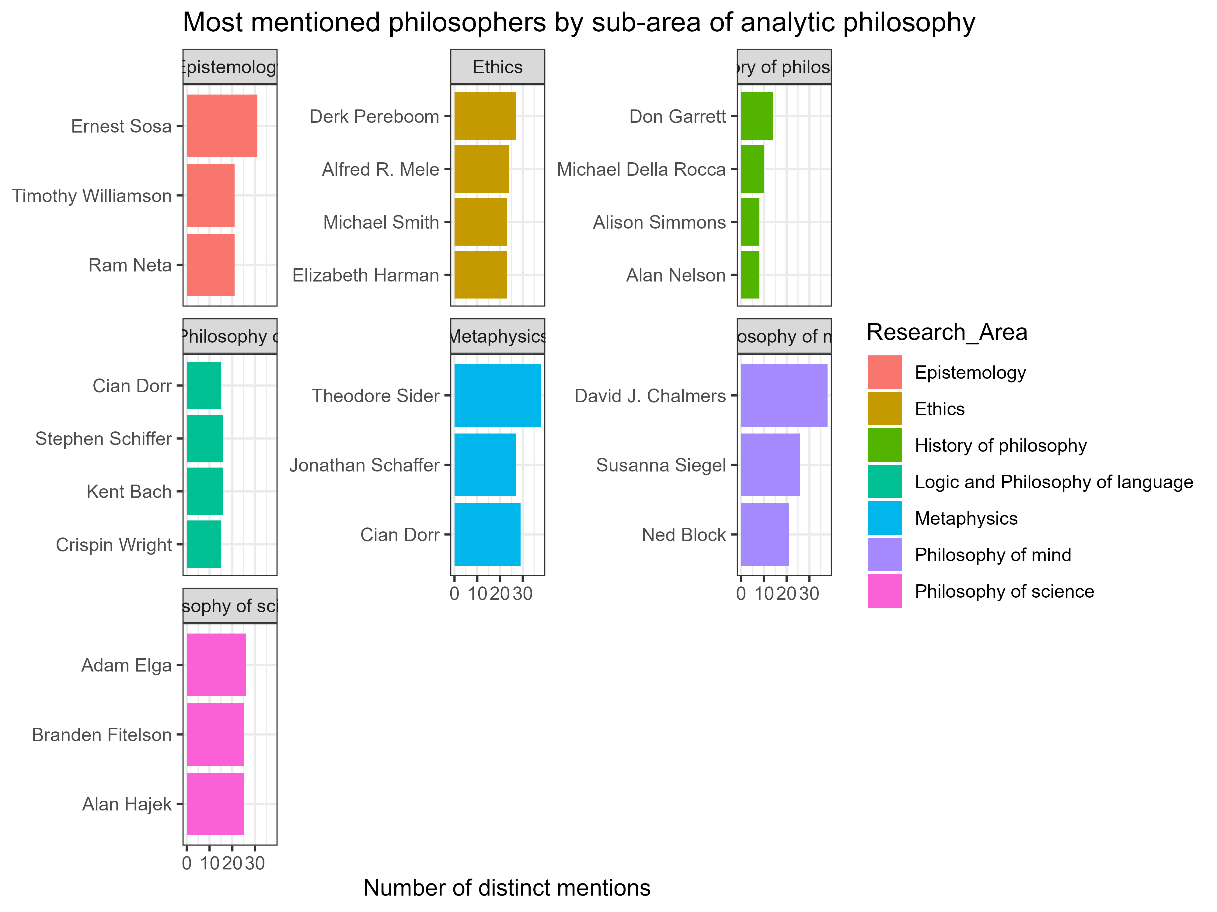
RESULTS: 3.2 Who are the most mentioned within each sub-area?

Slide 23
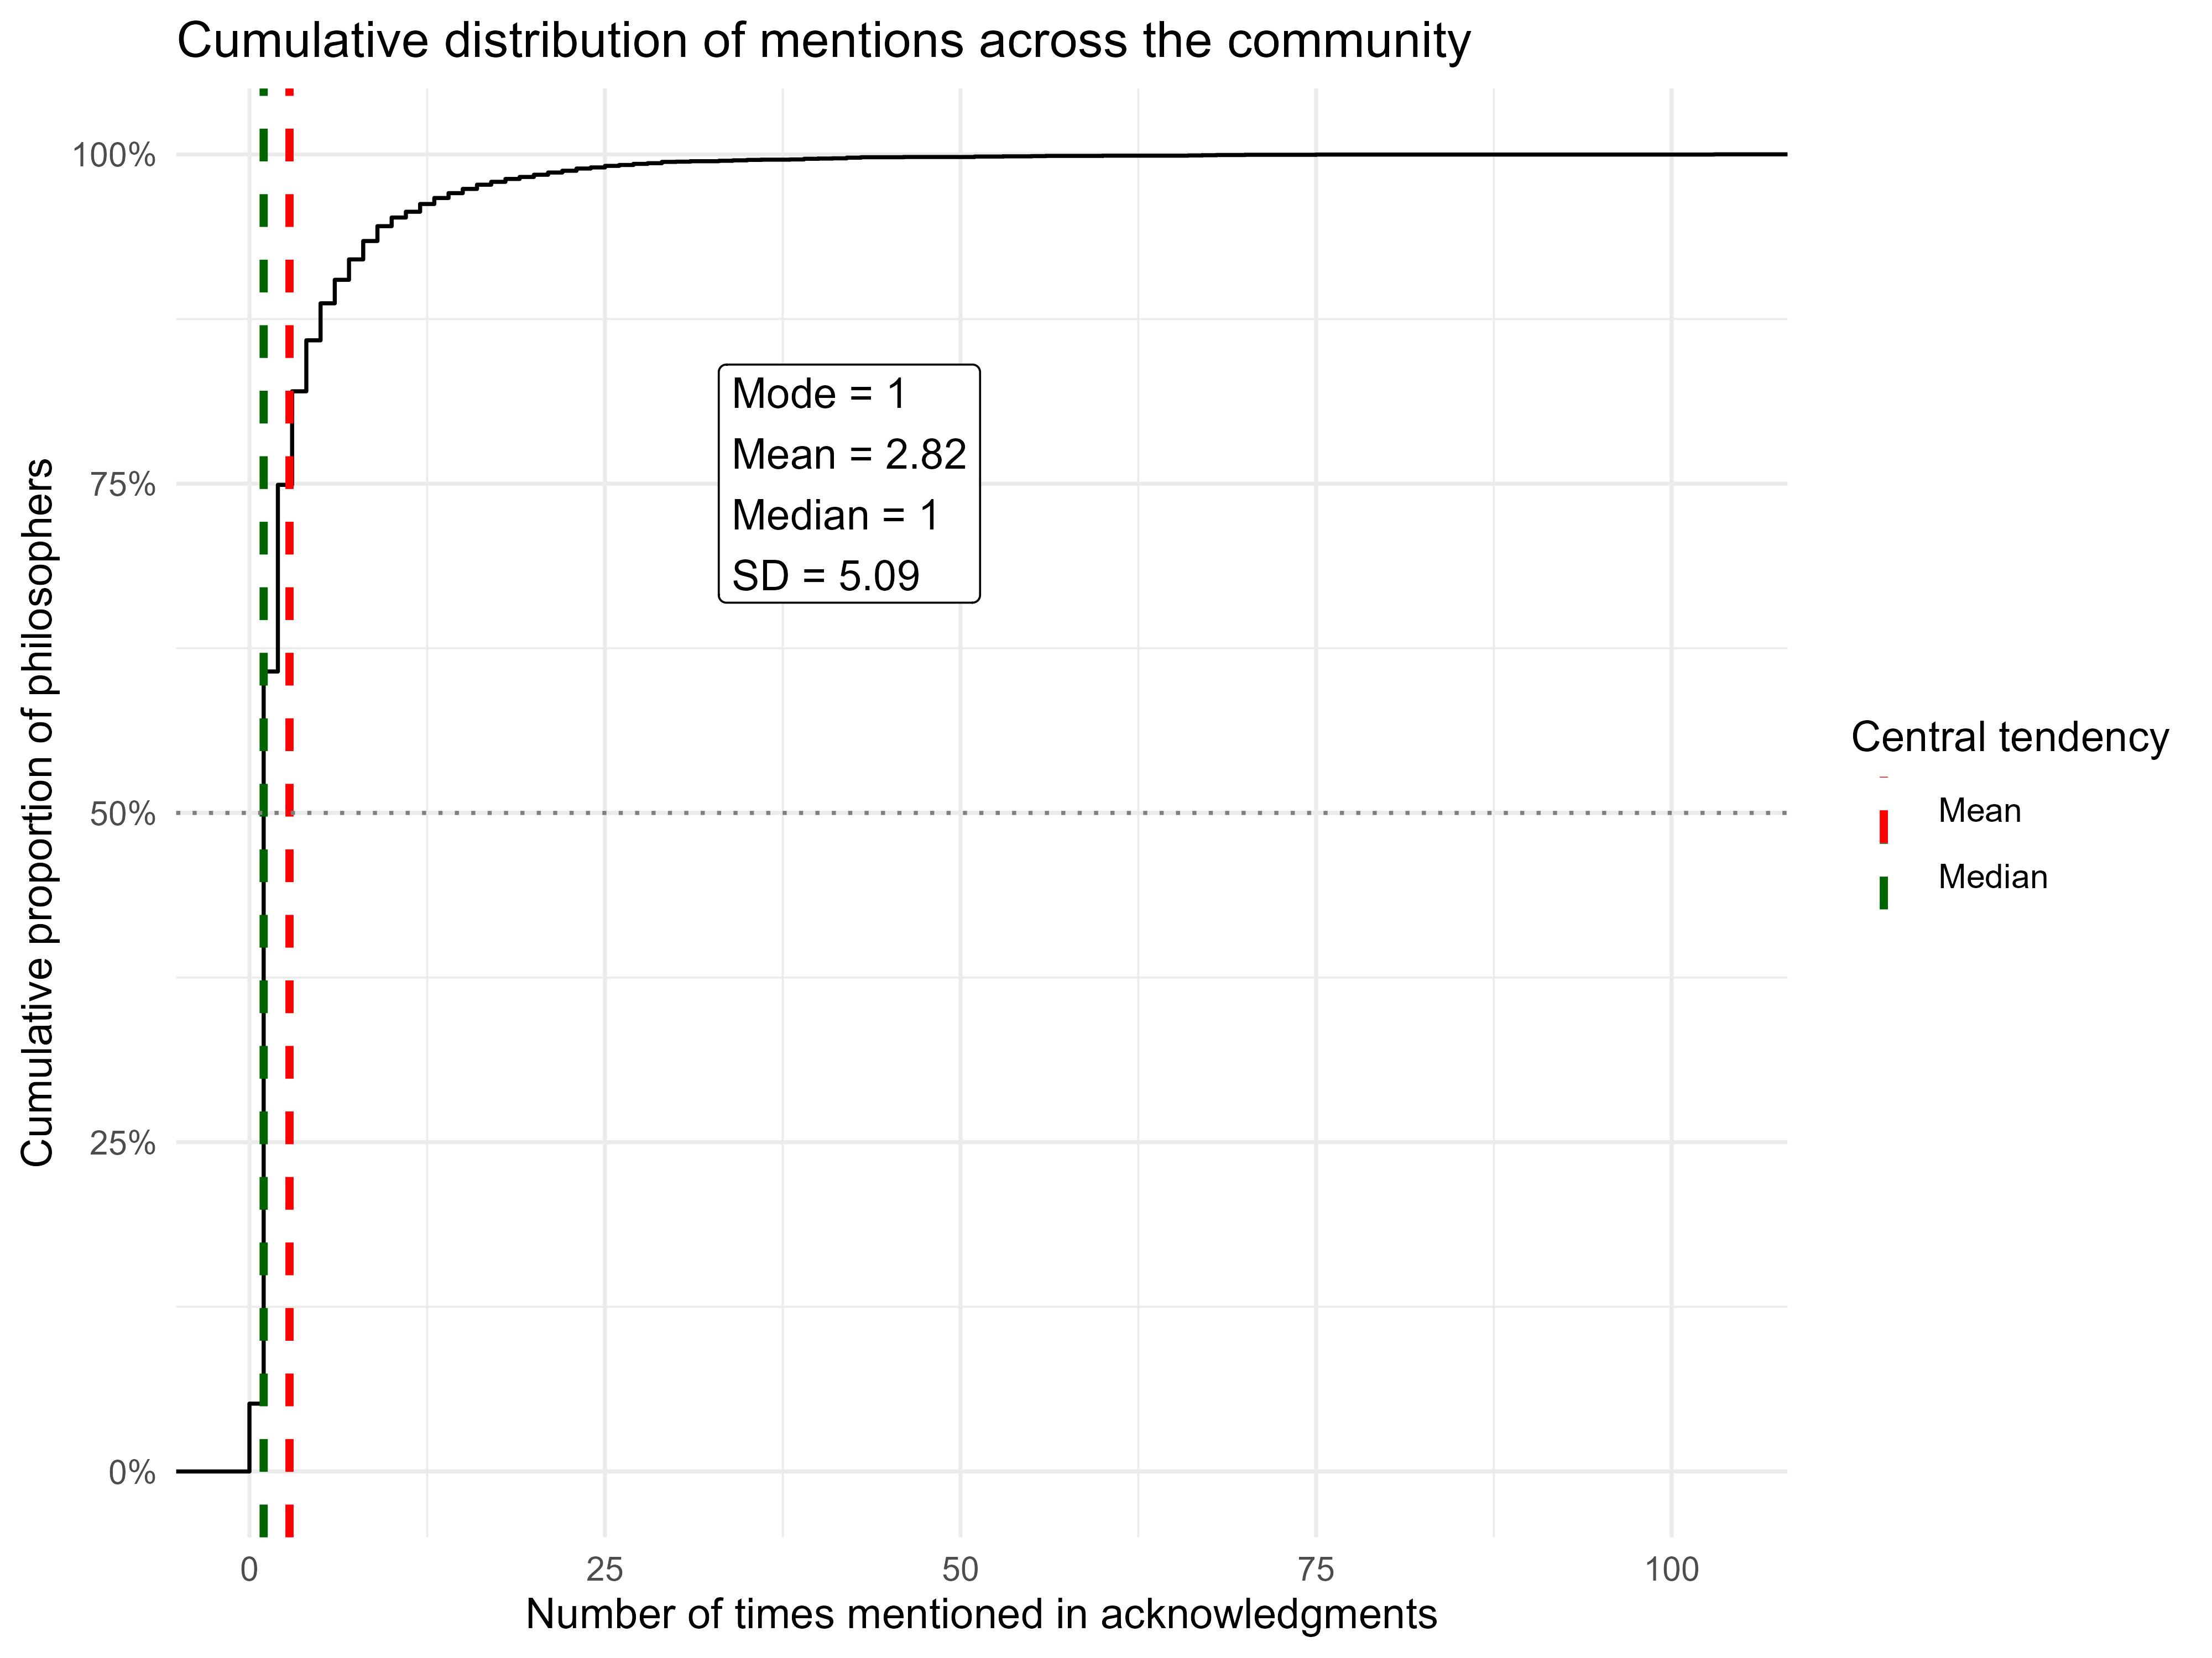
RESULTS: 3.3 How are mentions distributed among the community?

Slide 24
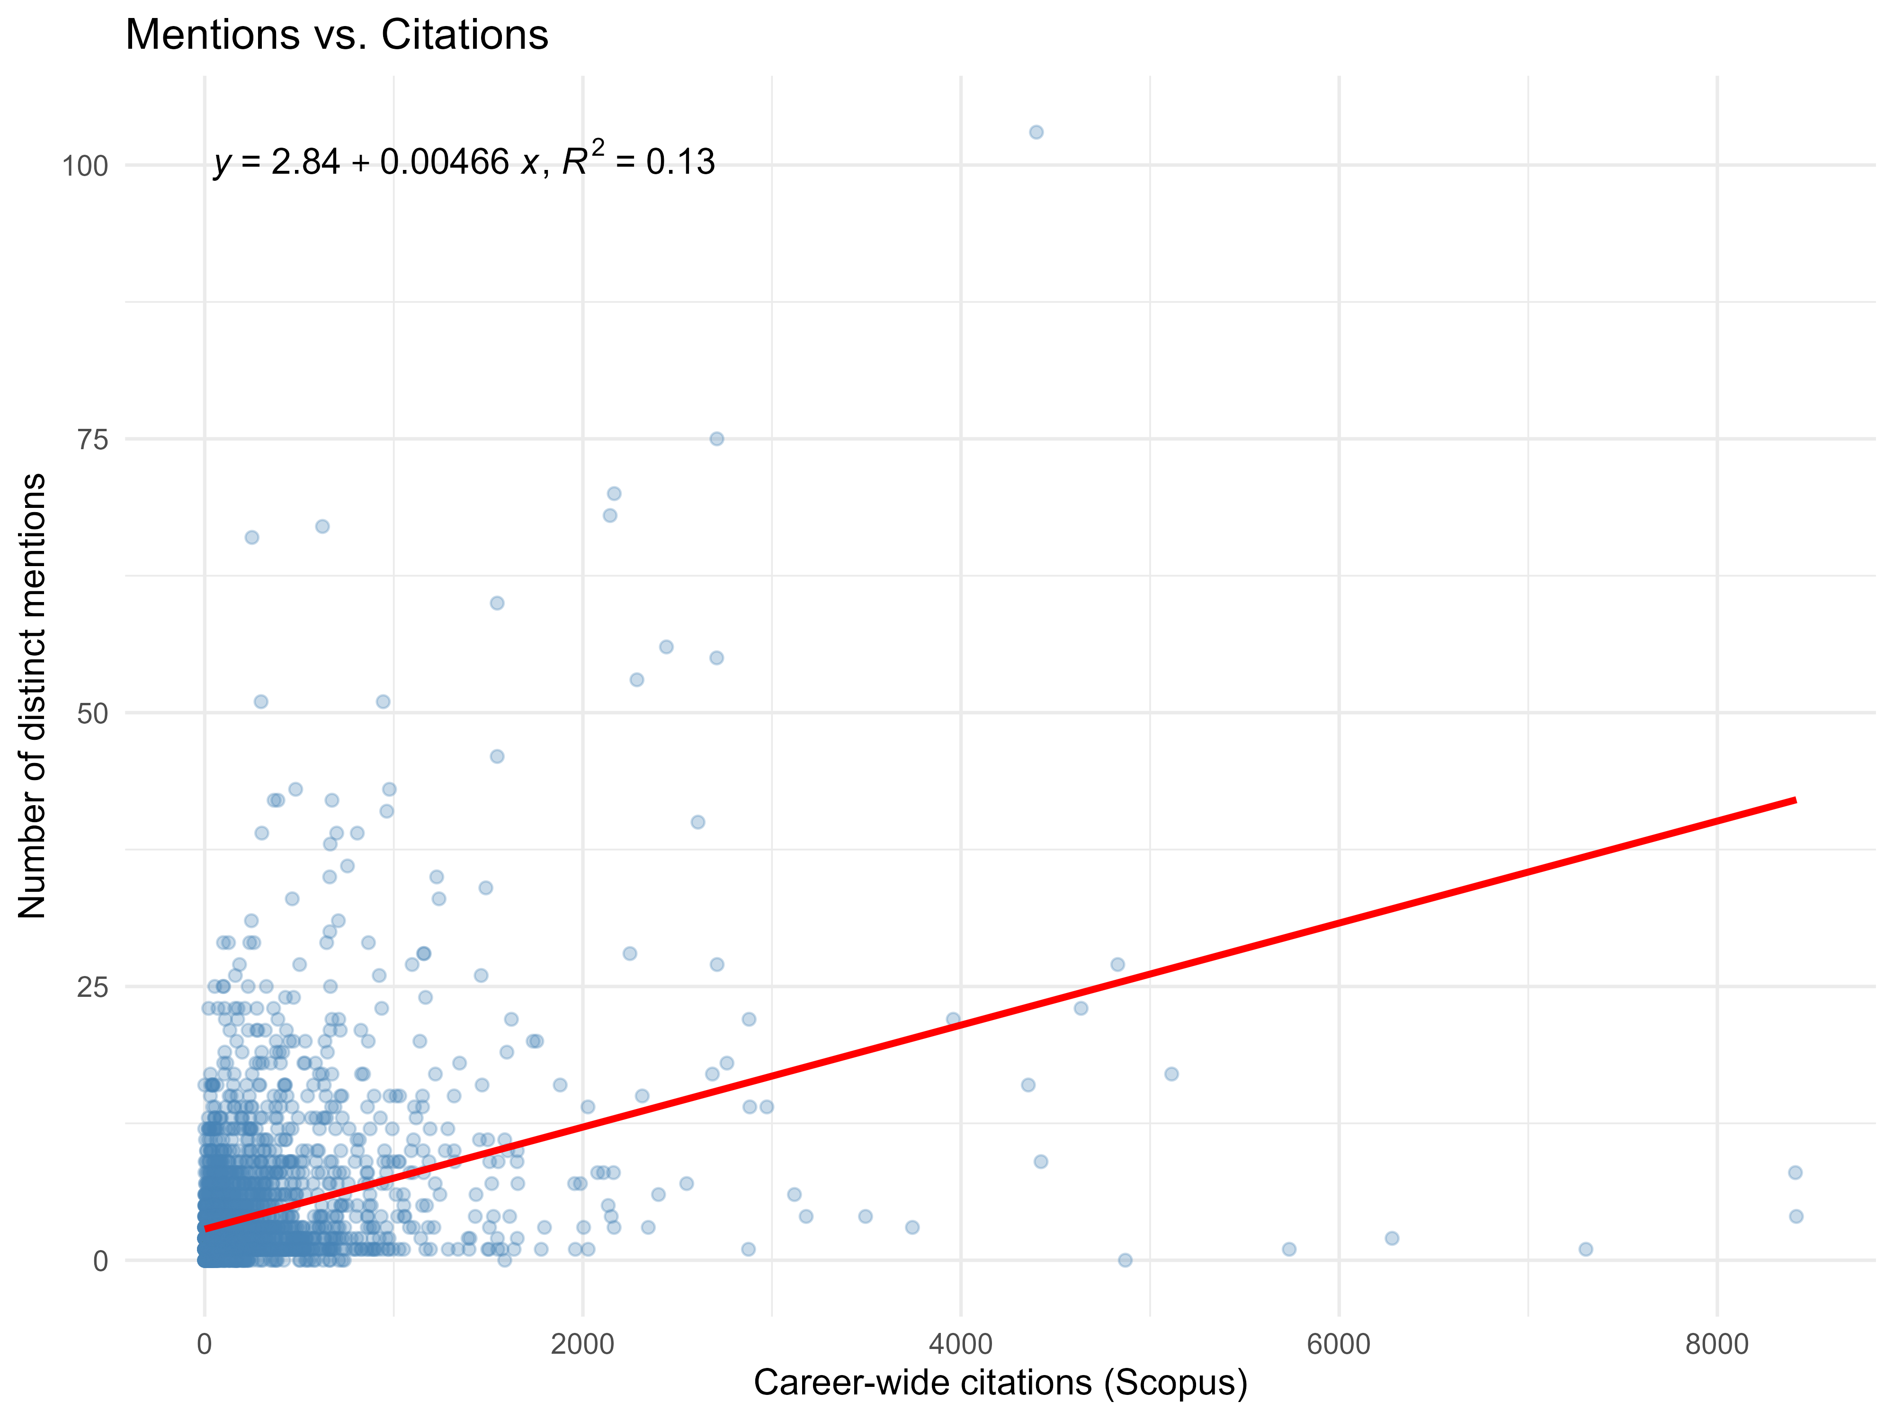
RESULTS: 3.4 Are mentions correlated with other prestige indicators?

Slide 25
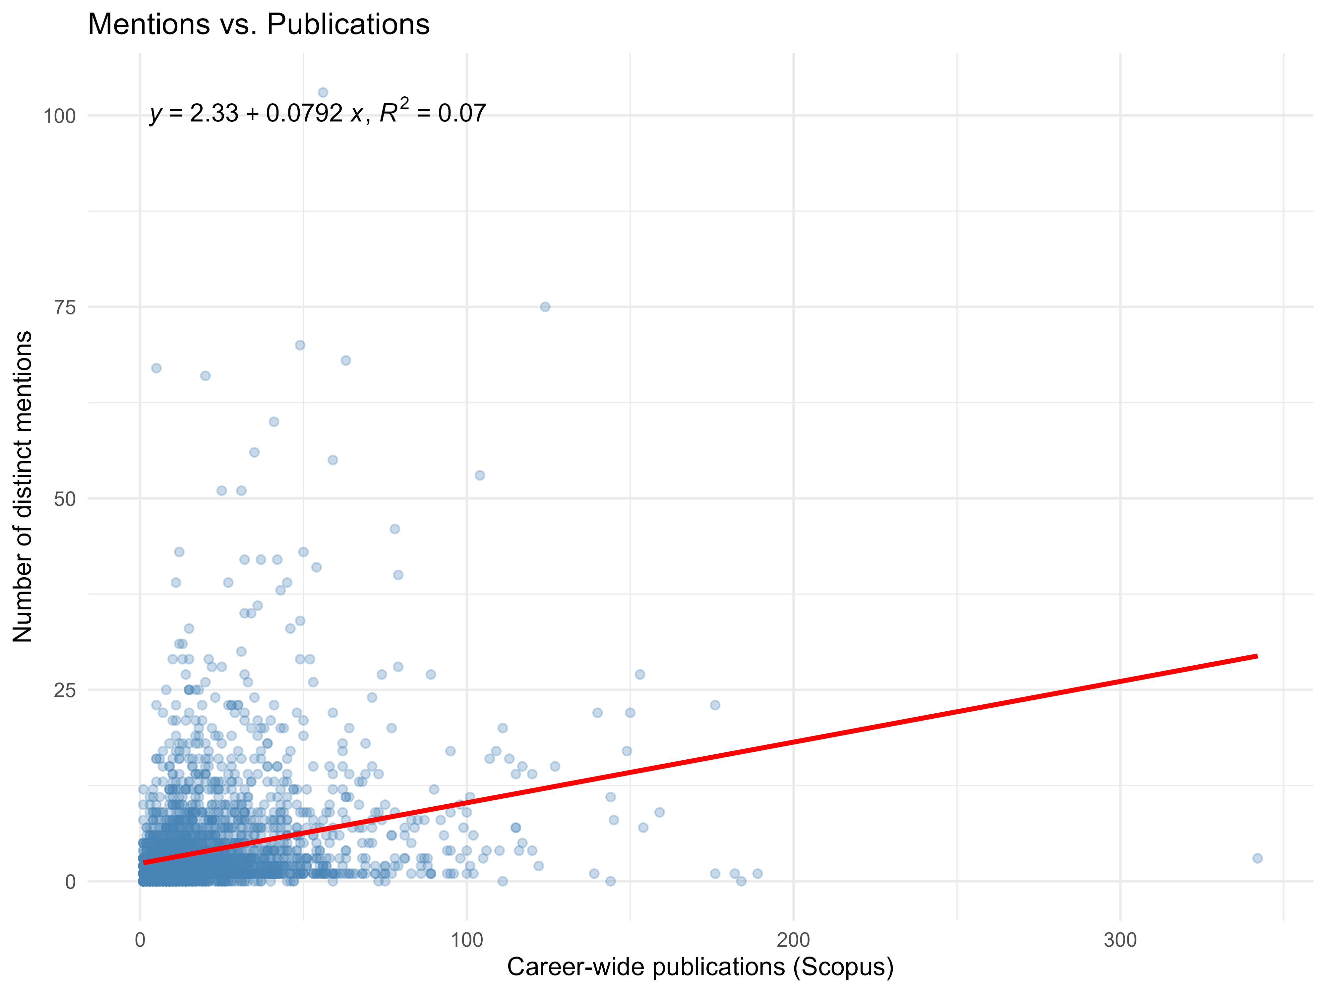
RESULTS: 3.4 Are mentions correlated with other prestige indicators?

Slide 26
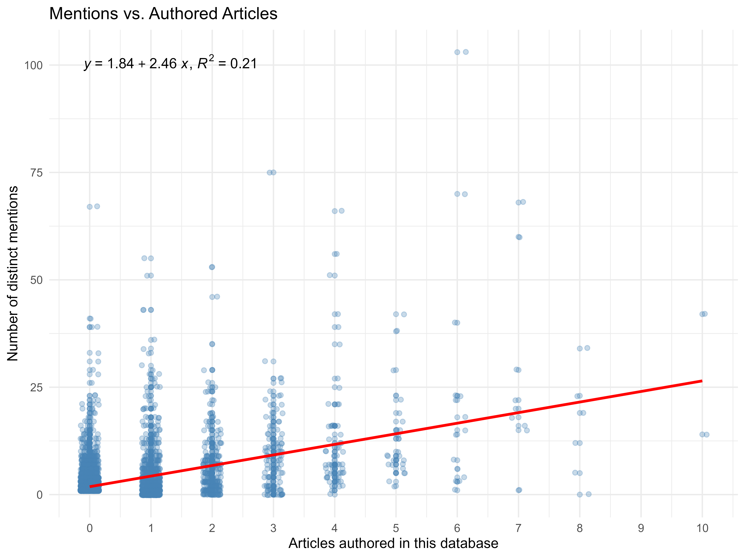
RESULTS: 3.4 Are mentions correlated with other prestige indicators?

Slide 27
RESULTS: 3.5 Does gender affect the chances of accumulating mentions? (gender_tier_table)
Tier | N females | N males | Females (%)
Below median (0) | 61 | 237 | 20.5
At median (1) | 751 | 2472 | 23.3
Above median (2-5) | 352 | 1305 | 21.2
Top 10% (6+) | 113 | 559 | 16.8

Slide 28
CONCLUSIONS: 1) Production
Top philosophers cluster around 7–10 articles, with frequent ties.
Few elite institutions (MIT, NYU, Oxford) dominate the top of the ranking.
Institutional productivity is heavily concentrated in the US and UK, reflecting the geographic connotation of analytic philosophy.

Slide 29
CONCLUSIONS: 2) Informal collaboration
Nearly universal: 94.7% of articles and 96% of philosophers show at least one informal collaborator.
Typical article/philosopher mentions 7–8 collaborators.
Distribution is right-skewed, meaning that a small group of articles/individuals pulls the average up.

Slide 30
CONCLUSIONS: 3) Prestige
Mentions are highly concentrated: one philosopher (Chalmers) dominates, whereas most receive 0–1 mentions.
Only weak-to-moderate correlations between mentions and indicators of prestige, explaining at most about a fifth of the variation in mentions (using authored articles as independent variable).
Gender gap is not uniform; it is concentrated at the top.

