Slide 1




DenseNet-based model for Defect
Classification on Solar Panels
Exam project for
Computer Vision
Tuesday, 28th February 2023
powered by
Simone Pio Caronia
Paolo Ruggirello

Slide 2
Agenda
Look at images
Preprocessing
Model experiments
Transfer learning - DenseNet
Final complete model
How we improved performances
Results

Slide 3
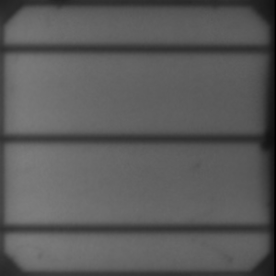
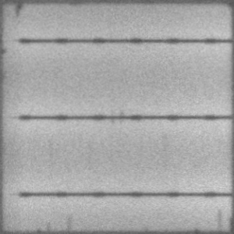
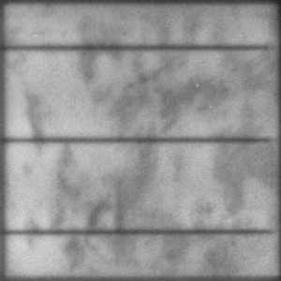
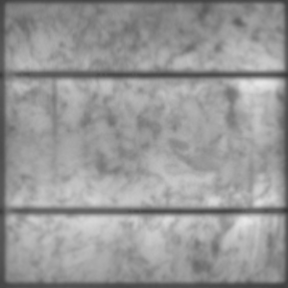
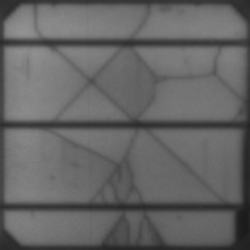
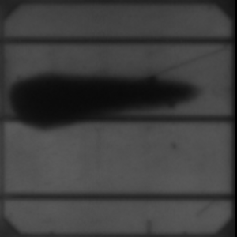
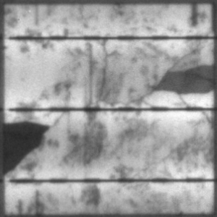
Look at images
In the full dataset of 2624 images, there are:
1803 WORKING cells
821 NOT WORKING cells
Working
+
=
Not Working
Noise
Cracks
No reflection

Slide 4


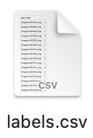
Preprocessing
The preprocessing pipeline implemented gives in output a unique file with both transformed images and related labels.
PREPROCESSING
index | image | label
0 | [[...]] | 1
… | [[...]] | …
2623 | [[...]] | 0
Gaussian filter cv2.GaussianBlur(img, (5,5), 3)
Resizing 300x300 → 224x224
Normalization values in [0, 1]

Slide 5

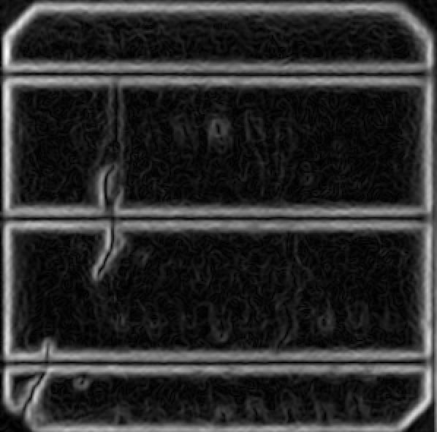
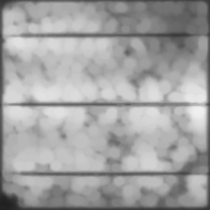
2.1 Failed preprocessing
Different preprocessing pipelines have been tried, but the metrics were lower than the ones got with the final model and preprocessing chosen.
Mask
Applied the mask, calculated as the intersection of link lines of solar cells.
And much more:
LBP;
Reading images in RGB;
Seam carving;
Rescale intensity;
Thresholding: Global, Otsu method, Variable local;
Custom 3-channels image;
Sharpening filters;
and combinations of above.
Gradient
Applied Sobel/Laplacian filters to try working on it.
Morphological operations
Applied opening/closing operations to remove small objects.

Slide 6
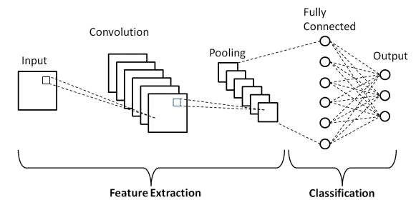
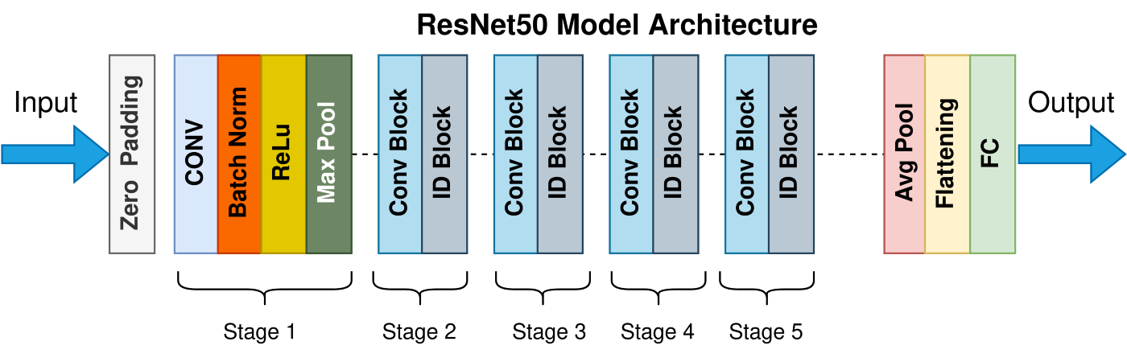
Model experiments
Before getting to the final model, different approaches were tried. The most relevant ones are:
DISCARDED
Too shallow to extract good features, low metrics, time consuming
Homemade
CNN
DISCARDED
Better features, short training time, but low metrics
ResNet-50

Slide 7
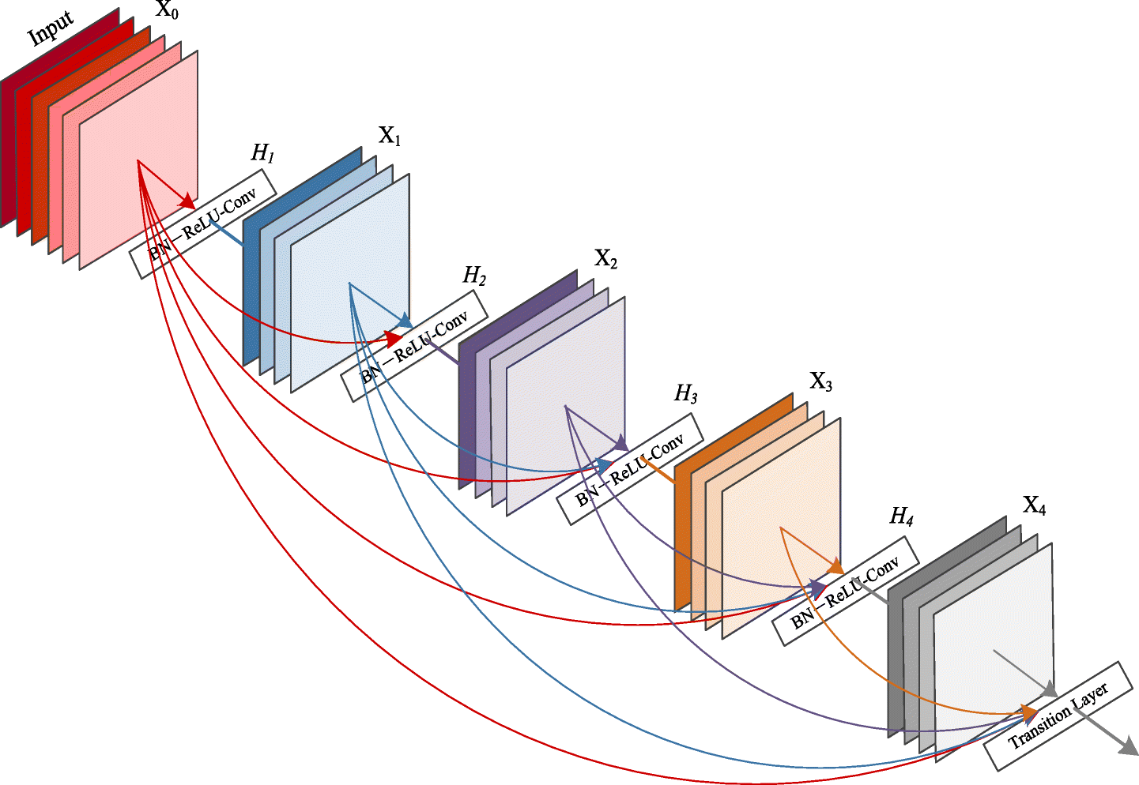
Transfer learning - DenseNet
The approach chosen is based on transfer learning.
The base model selected is DenseNet:
Obtained the best results related to handcrafted version;
Transfer learning using pretrained model on ImageNet;
Exploited its depth to extract better features;
Skip connection as FEATURE MAPS CONCATENATION.
Thanks to that, feature maps extracted in first layers are propagated to all the next ones. Those FM contain information about local characteristics.

Slide 8
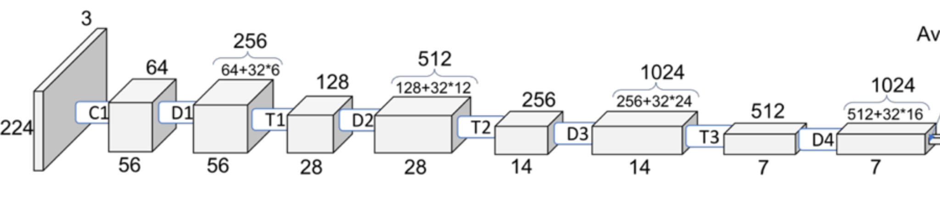
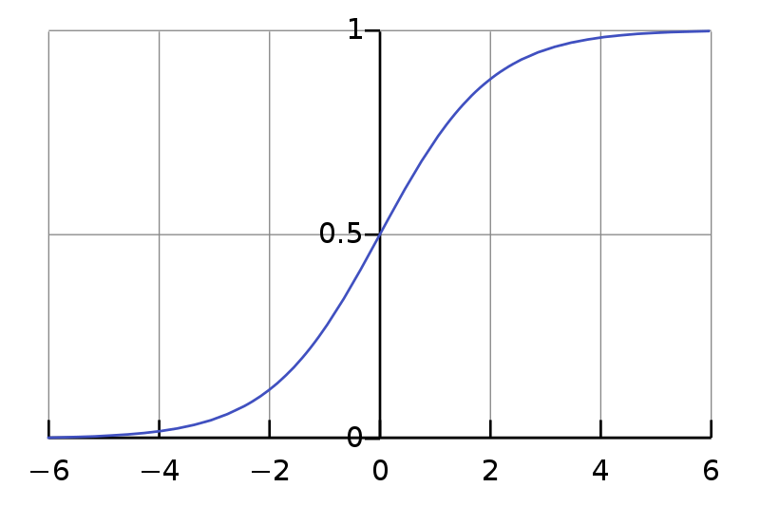
Final complete model
R
R
S
DenseNet-169
Flatten
128
Dropout
64
Output
0.2
.
.
.
.
.
.
net = keras.applications.DenseNet169(
weights='imagenet',
include_top=False,
input_shape=(224, 224, 3)
)
net.trainable = False
NO
y > 0.5
Legend:
R
ReLu
YES
Working
S
Sigmoid
Not Working

Slide 9
How we improved performances
In order to improve performances, the following elements were tuned for the training phase:
Early Stopping: regularization method to avoid overfitting;
Optimizer: Adam optimizer, evolution of stochastic gradient descent which perform well in computer vision tasks;
Class_weight: used to give more weight to class 1 (Not Working) to improve F1 score.
Data augmentation: np.flipud() | np.fliplr()
Other hyperparameters:
Epochs: 20;
Batch size: 32;
Loss function: ‘binary_cross_entropy’.
keras.callbacks.EarlyStopping(
monitor='val_loss',
mode='min',
patience=5,
restore_best_weights=True)
keras.optimizers.Adam()

Slide 10
7 Results per fold
Fold | Accuracy | F1 score
1 | 83% | 69%
2 | 84% | 73%
3 | 84% | 70%
4 | 85% | 72%
5 | 85% | 71%
6 | 85% | 74%
7 | 82% | 70%
8 | 84% | 74%
9 | 85% | 73%
10 | 83% | 72%

Slide 11
7.1 Results
Accuracy
F1
St. Dev. Accuracy
84%
72%
0,01

Slide 12
Thanks for your attention!
Now, Q & A
Simone Pio & Paolo

