Slide 1
SPEECH DENOISING TECHNIQUES & APPROACHES
GROUP 4
DSP Project:
ID | MEMBERS
BI12-075 | Nguyễn Quang Đăng
BI12-064 | Nguyễn Đình Chi
BI12-197 | Phạm Ngọc Huy
BI12-233 | Nhữ Tùng Lâm
BI12-026 | Nguyễn Xuân Cường
BI12-227 | Lê Đức Kiên
BI12-192 | Bạch Ngọc Hưng

Slide 2
01 INTRODUCTION
What is Speech Denoising?

Slide 3
01. INTRODUCTION
Input the data
Pre-processing
Noise Estimation
Frequency Domain Filter
Spectral Subtraction
Output
Noise reduction (Weiner filtering, Spectral gating...)
Post-processing

Slide 4
02 DENOISING TECHNIQUES
Frequency Domain
Spectral Subtraction

Slide 5
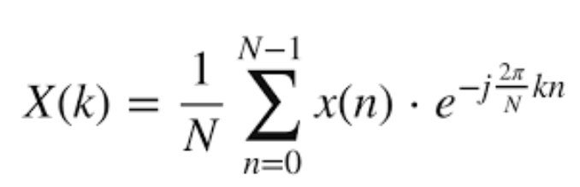
1. Frequency Domain Filter
Fast Fourier Transform (FFT) is used to transform waveform data to frequency spectrum and reduce the amplitudes to zero
Fast fourier transform algorithm:

Slide 6
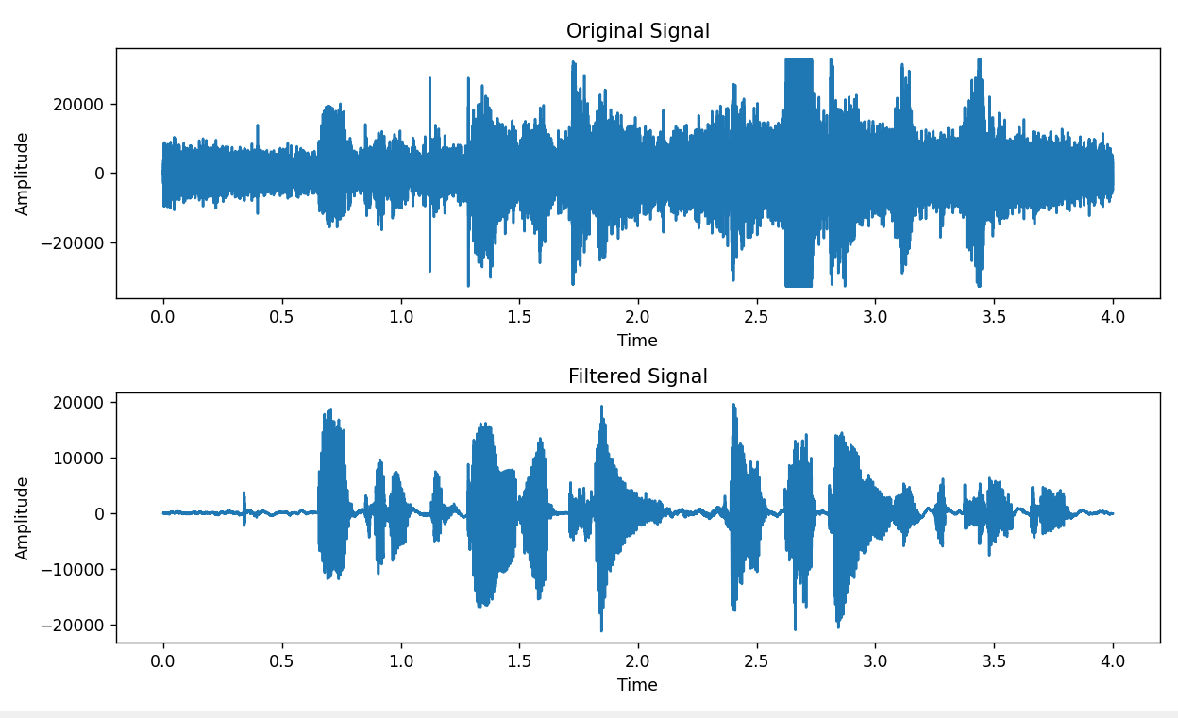
1. Frequency Domain Filter

Slide 7
2. Spectral Subtraction
Input
Frame window
(Hamming)
Fourier transform
Noise estimation
Donec sollicitudin molestie malesuada. Donec rutrum congue leo.
Spectral Subtraction
Output
Post-processing
Inverse FFT
Donec sollicitudin molestie malesuada. Donec rutrum congue leo.
Donec sollicitudin molestie malesuada. Donec rutrum congue leo.
Vestibulum ante ipsum primis in faucibus orci luctus et ultrices posuere cubilia Curae; Donec velit neque, auctor sit amet aliquam vel, ullamcorper sit amet ligula.

Slide 8
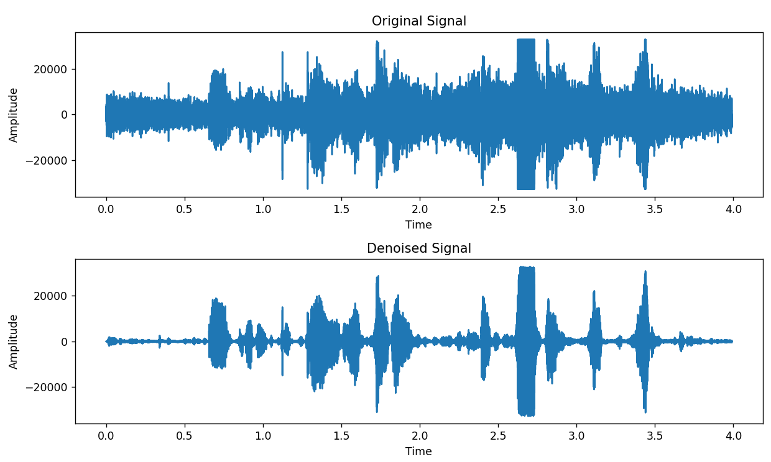
2. Spectral Subtraction

Slide 9
03 CONCLUSION

Slide 10
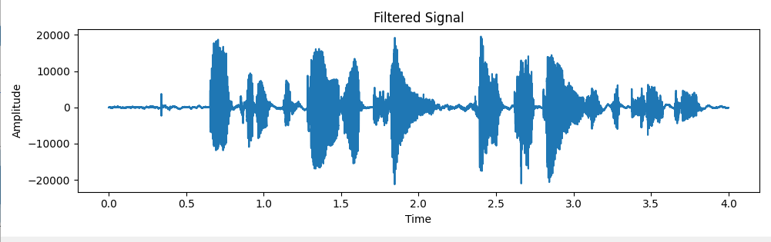
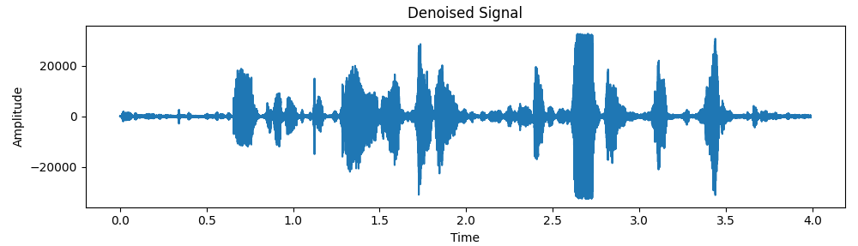
Frequency Domain Filter
Spectral Subtraction

