Slide 1

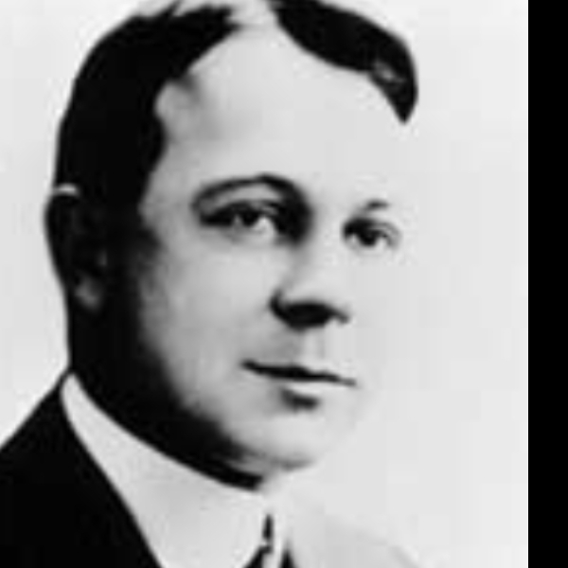
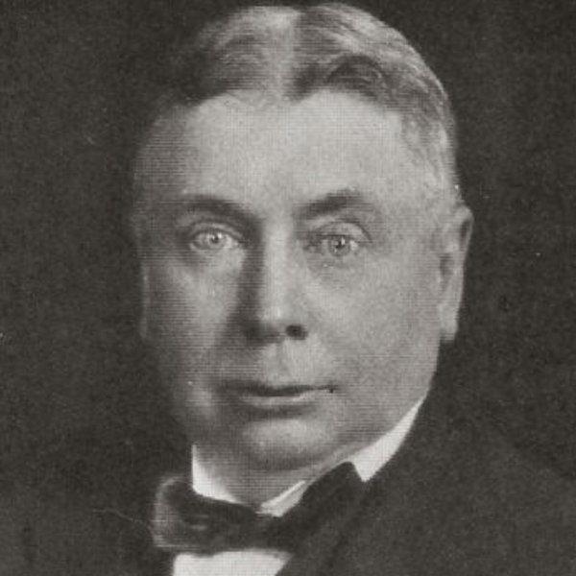
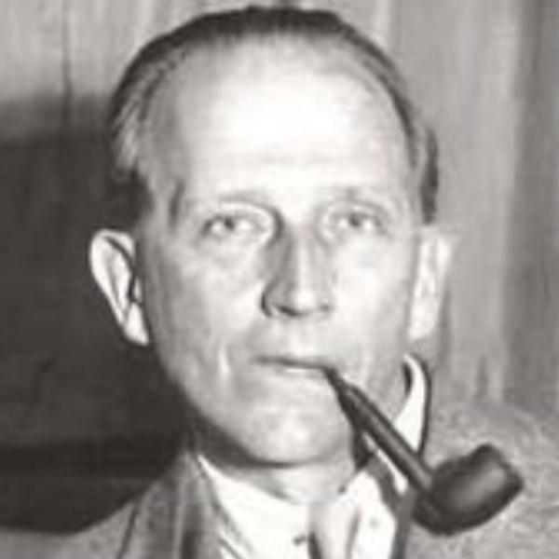


LFW
CONV
5x5,stride=1，
32 kernels
Max POOL
2x2, stride=2
CONV
5x5,stride=1，
64 kernels
Max POOL
2x2, stride=2
CONV
3x3,stride=1，
128 kernels
3
100
5
96
48
32
64
22
64
32
44
5
96
48
44
22
100
Max POOL
2x2, stride=2
CONV
3x3,stride=1，
256 kernels
Max POOL
2x2, stride=2
FC
FC
128
256
256
softmax
20
128
4
20
10
8
4
2048
10
8
Parameter Transfer
Train Set
CONV
5x5,stride=1，
32 kernels
Max POOL
2x2, stride=2
CONV
5x5,stride=1，
64 kernels
CONV
3x3,stride=1，
128 kernels
Max POOL
2x2, stride=2
Train Features
Build
96
32
48
32
44
64
22
64
100
44
22
96
48
Test Set
CONV
3x3,stride=1，
256 kernels
Max POOL
2x2, stride=2
Max POOL
2x2, stride=2
Predict
FC
Test Features
SVM model
128
128
256
256
20
10
8
4
2048
20
10
8
4

