Slide 1
Thesis-Presentation
Multi-label Text Classification
for Greek Legal Documents
Dec. 2021
Apostolos Papatheodorou

Slide 2
1
Multi-label Text Classification
for Greek Legal Documents
Presentation Structure
Definition of the problem
Related work
A Greek legal TC Dataset
DL Methods for XMTC
Experiments
Discussion & Conclusions

Slide 3

What is all this about?
Multi-label Text Classification (MLTC):
Multi-output classification problem
Tagging a text with the most relevant class from a set of concepts
tag1
tag2
tagN
a set of
concepts

Slide 4
What is all this about?
Multi-label Text Classification (MLTC):
Multi-output classification problem
Tagging a text with the most relevant class from a set of concepts
tag1
tag2
tagN
a set of
concepts

Slide 5
What is all this about?
Multi-label Text Classification (MLTC):
Multi-output classification problem
Tagging a text with the most relevant class from a set of concepts
tag1
tag2
tagN
a set of
concepts
Formally speaking:
The difference:
The concepts are not mutually exclusive
No restrictions to the number of concepts
Learn a f(x,y) score function
x for the text input
y for the concept
High scores for relevant (x,y) pairs
Low scores for irrelevant ones

Slide 6
What is all this about?
Extreme Multi-label Text Classification (XMTC):
Multi-output classification problem
Tagging a text with the most relevant class from a set of concepts
tag1
tag2
tagN
a set of
concepts
Formally speaking:
The difference:
The concepts are not mutually exclusive
No restrictions to the number of concepts
Learn a f(x,y) score function
x for the text input
y for the concept
High scores for relevant (x,y) pairs
Low scores for irrelevant ones

Slide 7
What is all this about?
Extreme Multi-label Text Classification (XMTC):
Multi-output classification problem
Tagging a text with the most relevant class from a set of concepts
tag1
tag2
tagN
a set of
concepts
Formally speaking:
The difference:
The concepts are not mutually exclusive
No restrictions to the number of concepts
The N may be extremely large
Learn a f(x,y) score function
x for the text input
y for the concept
High scores for relevant (x,y) pairs
Low scores for irrelevant ones

Slide 8
What is all this about?
Extreme Multi-label Text Classification (XMTC):
Multi-output classification problem
Tagging a text with the most relevant class from a set of concepts
tag1
tag2
tagN
a set of
concepts
Biomedical text annotation
Wikipedia page tagging
Amazon product labeling
Legal documents categorisation
…
why is this important?

Slide 9
What is all this about?
Extreme Multi-label Text Classification (XMTC):
Multi-output classification problem
Tagging a text with the most relevant class from a set of concepts
tag1
tag2
tagN
a set of
concepts
Biomedical text annotation
Wikipedia page tagging
Amazon product labeling
Legal documents categorisation
…
why is this important?

Slide 10
Related work: Early work
Many suggestions to address the problem:
One-vs-All: Transform the problem into another format (e.g. binary or multi-class TC)
Tree-based: Partition the label space in a tree manner and learn a classifier per internal node
Other solutions: Seq2Seq, Adapted methods Embedding based techniques, etc.
Drawbacks
Use simple text representation methods (BoW)
Disregard valuable grammar and semantic context information from the raw text sequences

Slide 11
Related work: Early work
Many suggestions to address the problem:
One-vs-All: Transform the problem into another format (e.g. binary or multi-class TC)
Tree-based: Partition the label space in a tree manner and learn a classifier per internal node
Other solutions: Seq2Seq, Adapted methods Embedding based techniques, etc.
Drawbacks
Use simple text representation methods (BoW)
Disregard valuable grammar and semantic context information from the raw text sequences
Deep learning methods:
Employ modern AI techniques to derive better text representations
Improve the quality of their predictions and have achieved SOTA results in the field

Slide 12
Related work: Early work
Many suggestions to address the problem:
One-vs-All: Transform the problem into another format (e.g. binary or multi-class TC)
Tree-based: Partition the label space in a tree manner and learn a classifier per internal node
Other solutions: Seq2Seq, Adapted methods Embedding based techniques, etc.
Drawbacks
Use simple text representation methods (BoW)
Disregard valuable grammar and semantic context information from the raw text sequences
however
Deep learning methods:
Employ modern AI techniques to derive better text representations
Improve the quality of their predictions and have achieved SOTA results in the field

Slide 13
Related work: Early work
Many suggestions to address the problem:
One-vs-All: Transform the problem into another format (e.g. binary or multi-class TC)
Tree-based: Partition the label space in a tree manner and learn a classifier per internal node
Other solutions: Seq2Seq, Adapted methods Embedding based techniques, etc.
Drawbacks
Use simple text representation methods (BoW)
Disregard valuable grammar and semantic context information from the raw text sequences
however
Deep learning methods:
Employ modern AI techniques to derive better text representations
Improve the quality of their predictions and have achieved SOTA results in the field
The XMTC problem is really challenging
To blindly apply modern DL methods leads to suboptimal solutions
Let’s rely and build on stable scientific work and SOTA publications!

Slide 14

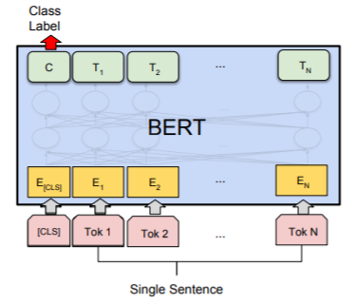
Related work: publications
DL for XMTC : Some interesting ideas…
Layer wise guided training for BERT
Manginas et. al (2020)
Aspect/Feature Based Sentiment Analysis
What is BERT?
Bert is based on Transformer-based architecture
Pretrained on big corpora including Wikipedia
Can be easily fine tuned with one additional layer

Slide 15
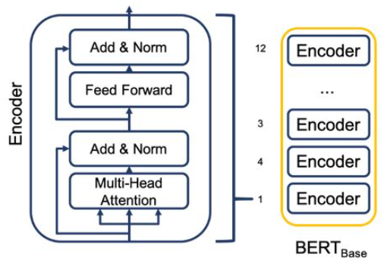
Related work: publications
DL for XMTC : Some interesting ideas…
Layer wise guided training for BERT
Manginas et. al (2020)
Aspect/Feature Based Sentiment Analysis
What is BERT?
Bert is based on Transformer-based architecture
Pretrained on big corpora including Wikipedia
Can be easily fine tuned with one additional layer
The BERT-base version contains 12 layers (transformer blocks)
Greek-BERT and multilingual bert versions are available

Slide 16
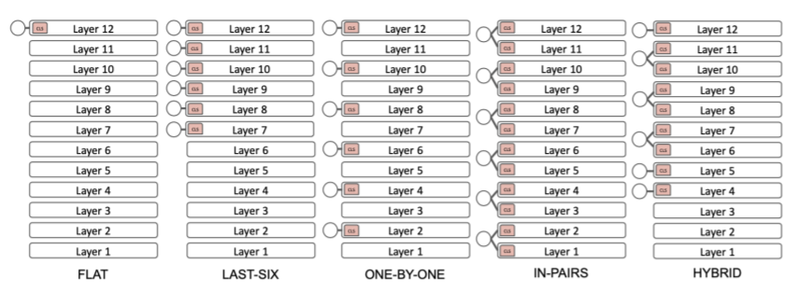
Related work: publications
DL for XMTC : Some interesting ideas…
Layer wise guided training for BERT
Manginas et. al (2020)
Aspect/Feature Based Sentiment Analysis
Use BERT-based models and exploit the label hierarchy
Main objective is to interconnect predictions of different levels of hierarchy with specific BERT layers
Target: To achieve better fine-tuning & parameter utilisation
Suggest 5 variants (Flat, Last6, OnebyOne, In-Pairs, hybrid)
Compare the [CLS] representation to evaluate their results

Slide 17
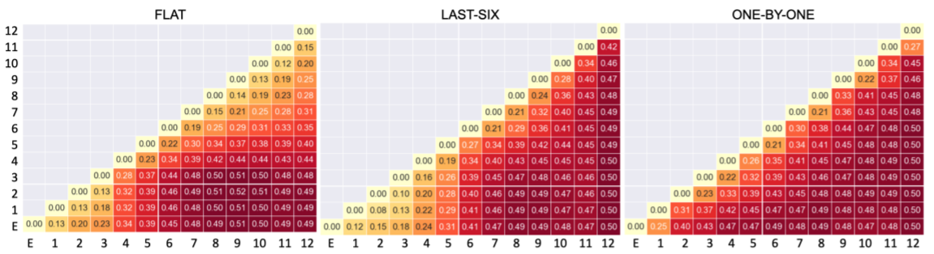
Related work: publications
DL for XMTC : Some interesting ideas…
Layer wise guided training for BERT
Manginas et. al (2020)
Aspect/Feature Based Sentiment Analysis
Use BERT-based models and exploit the label hierarchy
Main objective is to interconnect predictions of different levels of hierarchy with specific BERT layers
Target: To achieve better fine-tuning & parameter utilisation
Suggest 5 variants (Flat, Last6, OnebyOne, In-Pairs, hybrid)
Compare the [CLS] representation to evaluate their results

Slide 18
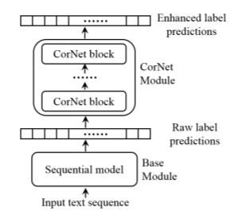
Related work: publications
DL for XMTC : Some interesting ideas…
Layer wise guided training for BERT
Manginas et. al (2020)
Aspect/Feature Based Sentiment Analysis
Correlation Networks (CorNet)
Xu et. al (2020)
Aspect/Feature Based Sentiment Analysis
Propose the CorNert Unit, a module for extracting correlations across the label set
Can be integrated into different structures (CNN, LSTM, BERt, etc.)
Uses many [CLS] representations as feature vectors

Slide 19
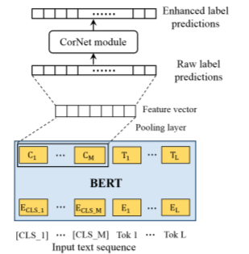
Related work: publications
DL for XMTC : Some interesting ideas…
Layer wise guided training for BERT
Manginas et. al (2020)
Aspect/Feature Based Sentiment Analysis
Correlation Networks (CorNet)
Xu et. al (2020)
Aspect/Feature Based Sentiment Analysis
Propose the CorNert Unit, a module for extracting correlations across the label set
Can be integrated into different structures (CNN, LSTM, BERt, etc.)
Uses many [CLS] representations as feature vectors

Slide 20
Related work: publications
DL for XMTC : Some interesting ideas…
Layer wise guided training for BERT
Manginas et. al (2020)
Aspect/Feature Based Sentiment Analysis
Correlation Networks (CorNet)
Xu et. al (2020)
Aspect/Feature Based Sentiment Analysis
Aspect/Feature Based Sentiment Analysis
Metadata­ TC in Large Hierarchy(MATCH)
Zhang et. al (2020)
Harness parent-child relations
Incorporate metadata into the training process
Uses many [CLS] representations as feature vectors

Slide 21
Related work: publications
DL for XMTC : Some interesting ideas…
Layer wise guided training for BERT
Manginas et. al (2020)
Aspect/Feature Based Sentiment Analysis
Build upon the ideas of:
Layer wise training
Multiple [CLS] tokens
Label hierarchy and correlations
Correlation Networks (CorNet)
Xu et. al (2020)
Aspect/Feature Based Sentiment Analysis
Aspect/Feature Based Sentiment Analysis
Metadata­ TC in Large Hierarchy(MATCH)
Zhang et. al (2020)

Slide 22
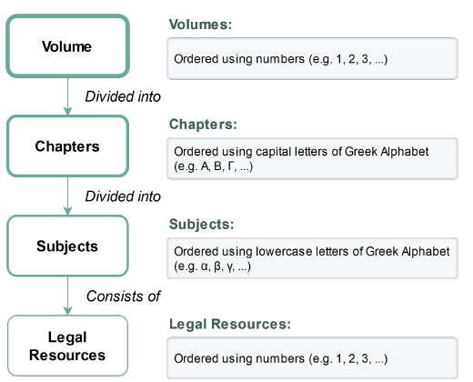
A Greek legal TC dataset
Raptatrchis47k dataset
Recently released (Dec 2020)
Suitable for classification problems
Greek legal texts from 1825 - 2015
The Structure:
Each article belongs to a unique Volume, Chapter, Subject category
There is a standard 3-level hierarchy Volumes>Chapters>Subjects
There are 47 Volume, 289 Chapter, and 2285 Subject distinct classes
It is assumed that the label graph has a tree thematic structure

Slide 23
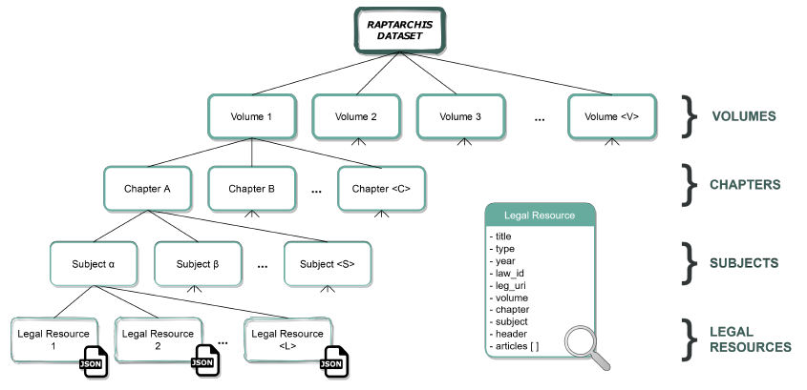
A Greek legal TC dataset
Raptatrchis47k dataset
Recently released (Papl. Dec 2020)
Suitable for classification problems
Greek legal texts from 1825 - 2015
The Structure:
Each article belongs to a unique Volume, Chapter, Subject category
There is a standard 3-level hierarchy Volumes>Chapters>Subjects
There are 47 Volume, 289 Chapter, and 2285 Subject distinct classes
It is assumed that the label graph has a tree thematic structure
Questions?
Is Raptarchis47k a tree graph?
How can we exploit it so as to solve the XMTC task?
Experiments!
And that’s all that we know!

Slide 24
A Greek legal TC dataset
Raptatrchis47k dataset
Recently released (Papl. Dec 2020)
Suitable for classification problems
Greek legal texts from 1825 - 2015
The Structure:
Each article belongs to a unique Volume, Chapter, Subject category
There is a standard 3-level hierarchy Volumes>Chapters>Subjects
There are 47 Volume, 289 Chapter, and 2285 Subject distinct classes
It is assumed that the label graph has a tree thematic structure
Question-1: Is Raptarchis47k a tree graph?
And that’s all that we know!

Slide 25
A Greek legal TC dataset
Raptatrchis47k dataset
Recently released (Papl. Dec 2020)
Suitable for classification problems
Greek legal texts from 1825 - 2015
The Structure:
Each article belongs to a unique Volume, Chapter, Subject category
There is a standard 3-level hierarchy Volumes>Chapters>Subjects
There are 47 Volume, 289 Chapter, and 2285 Subject distinct classes
It is assumed that the label graph has a tree thematic structure
Question-1: Is Raptarchis47k a tree graph?
Short answer: No!
And that’s all that we know!

Slide 26
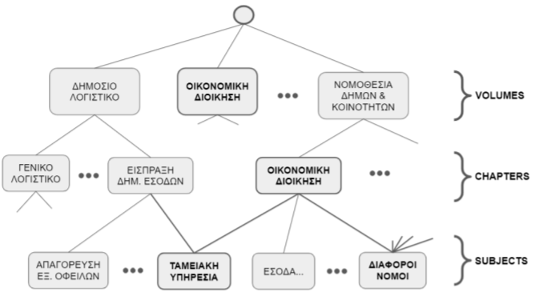
A Greek legal TC dataset
Raptatrchis47k dataset
Recently released (Papl. Dec 2020)
Suitable for classification problems
Greek legal texts from 1825 - 2015
The Structure:
Each article belongs to a unique Volume, Chapter, Subject category
There is a standard 3-level hierarchy Volumes>Chapters>Subjects
There are 47 Volume, 289 Chapter, and 2285 Subject distinct classes
It is assumed that the label graph has a tree thematic structure
Question-1: Is Raptarchis47k a tree graph?
Short answer: No!

Slide 27
A Greek legal TC dataset
Raptatrchis47k dataset
Recently released (Papl. Dec 2020)
Suitable for classification problems
Greek legal texts from 1825 - 2015
The Structure:
Each article belongs to a unique Volume, Chapter, Subject category
There is a standard 3-level hierarchy Volumes>Chapters>Subjects
There are 47 Volume, 289 Chapter, and 2285 Subject distinct classes
It is assumed that the label graph has a tree thematic structure
Question-1: Is Raptarchis47k a tree graph?
Short answer: No!
From our experiments we discovered that:
Many nodes have multiple parents (indegree>2)
Nodes with the same name on different levels of the hierarchy (parent-child relationship)
Nodes with the same name on different levels of the hierarchy (No parent-child relationship)

Slide 28
A Greek legal TC dataset
Raptatrchis47k dataset
Recently released (Papl. Dec 2020)
Suitable for classification problems
Greek legal texts from 1825 - 2015
The Structure:
Each article belongs to a unique Volume, Chapter, Subject category
There is a standard 3-level hierarchy Volumes>Chapters>Subjects
There are 47 Volume, 289 Chapter, and 2285 Subject distinct classes
It is assumed that the label graph has a tree thematic structure
Question-1: Is Raptarchis47k a tree graph?
Short answer: No!
Answer: Raptarchis47k is just a simple directed graph.

Slide 29
A Greek legal TC dataset
Raptatrchis47k dataset
Recently released (Papl. Dec 2020)
Suitable for classification problems
Greek legal texts from 1825 - 2015
The Structure:
Each article belongs to a unique Volume, Chapter, Subject category
There is a standard 3-level hierarchy Volumes>Chapters>Subjects
There are 47 Volume, 289 Chapter, and 2285 Subject distinct classes
It is assumed that the label graph has a tree thematic structure
Question-2: How can we exploit it so as to solve the XMTC task?.

Slide 30
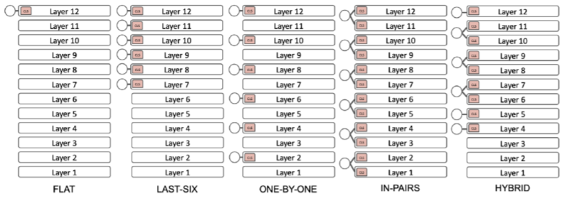
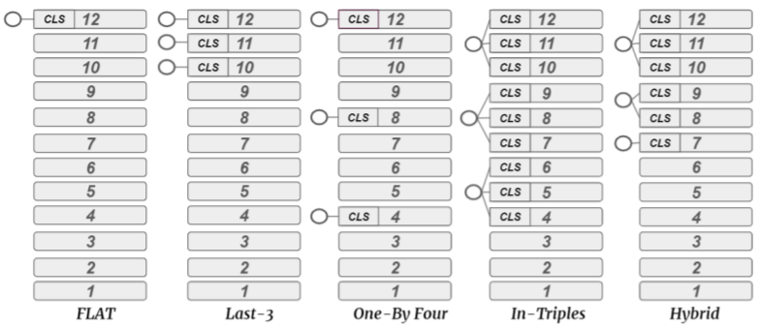
Experiments: methods
To achieve our goals we split our approaches to the 3 following categories: (⅓)
Layer-wise guided training methods
We adjust the (Magninas et. al 2020) methods to the requirements of Raptarchis dataset
We go from the 6-level to 3-level output models
Original models
Our adjusted models

Slide 31
Experiments: methods
To achieve our goals we split our approaches to the 3 following categories: (⅓)
Layer-wise guided training methods
We adjust the (Magninas et. al 2020) methods to the requirements of Raptarchis dataset
We go from the 6-level to 3-level output models
We repeat the same (almost) [CLS] comparison in order to verify the preceding findings
Original models
Our adjusted models

Slide 32
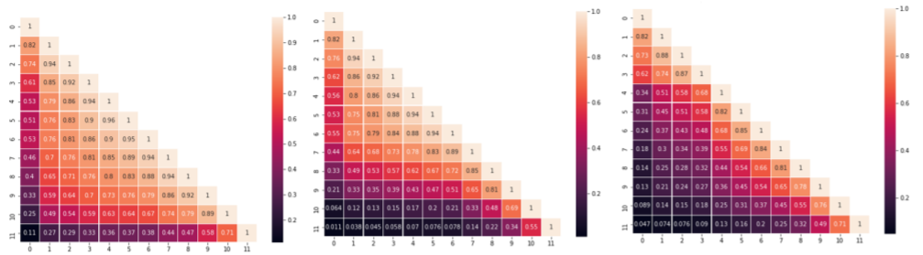
Experiments: methods
To achieve our goals we split our approaches to the 3 following categories: (⅓)
Layer-wise guided training methods
We adjust the (Magninas et. al 2020) methods to the requirements of Raptarchis dataset
We go from the 6-level to 3-level output models
We repeat the same (almost) [CLS] comparison in order to verify the preceding findings
Authors results
GreekBert results

Slide 33
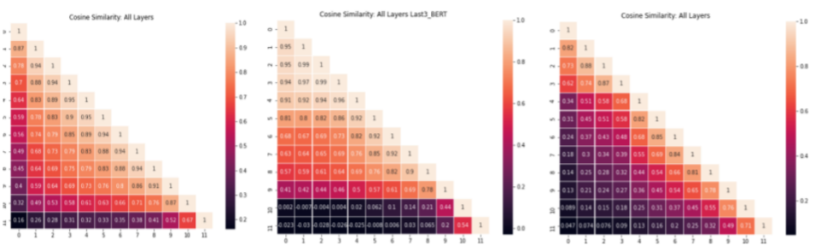
Experiments: methods
To achieve our goals we split our approaches to the 3 following categories: (⅓)
Layer-wise guided training methods
We adjust the (Magninas et. al 2020) methods to the requirements of Raptarchis dataset
We go from the 6-level to 3-level output models
We repeat the same (almost) [CLS] comparison in order to verify the preceding findings
Authors results
Multilingual results

Slide 34
Experiments: methods
To achieve our goals we split our approaches to the 3 following categories: (⅔)
Layer-wise guided training methods
Masking techniques (our proposal)
Guided training sequentially predicts the categories for certain hierarchical levels.
The predictions are produced independently and do not influence each other to the final output.
We expand the former methods to exploit the outcomes that are higher in label hierarchy
SubOut-1
ChOut-1
VolOut-1
BERT

Slide 35
Experiments: methods
To achieve our goals we split our approaches to the 3 following categories: (⅔)
Layer-wise guided training methods
Masking techniques (our proposal)
Affinity matrices
Guided training sequentially predicts the categories for certain hierarchical levels.
The predictions are produced independently and do not influence each other to the final output.
We expand the former methods to exploit the outcomes that are higher in label hierarchy
Vol-2-Ch
|Vol|x|Ch|
Algorithm
Step-1: We construct 2 affinity matrices
Vol2Ch: |VolNum| ∗ |ChNum| that describes the Volume-­Chapter relations

Slide 36
Experiments: methods
To achieve our goals we split our approaches to the 3 following categories: (⅔)
Layer-wise guided training methods
Masking techniques (our proposal)
Affinity matrices
Guided training sequentially predicts the categories for certain hierarchical levels.
The predictions are produced independently and do not influence each other to the final output.
We expand the former methods to exploit the outcomes that are higher in label hierarchy
Vol-2-Ch
|Vol|x|Ch|
Ch-2-Sub
|Ch|x|Sub|
Algorithm
They Carry the concept correlations in the dataset
Step-1: We construct 2 affinity matrices
Vol2Ch: |VolNum| ∗ |ChNum| that describes the Volume-­Chapter relations
Ch2Sub: |ChNum| ∗ |SubNum| that represents the Chapter-­Subject relations

Slide 37
Experiments: methods
To achieve our goals we split our approaches to the 3 following categories: (⅔)
ChOut-2
Layer-wise guided training methods
Masking techniques (our proposal)
*
Hadamard Product
Guided training sequentially predicts the categories for certain hierarchical levels.
The predictions are produced independently and do not influence each other to the final output.
We expand the former methods to exploit the outcomes that are higher in label hierarchy
MaskVector
ChOut-1
Dot Product
Algorithm
Step-1: We construct 2 affinity matrices
Step-2: Multiply the previous output with the affinity matrix in order to produce the new output (MaskVector)
Vol-2-Ch
|Vol|x|Ch|
VolOut-1

Slide 38
Experiments: methods
To achieve our goals we split our approaches to the 3 following categories: (⅔)
The whole masking process
Layer-wise guided training methods
Subjects
Chapters
Volumes
Masking techniques (our proposal)
Guided training sequentially predicts the categories for certain hierarchical levels.
The predictions are produced independently and do not influence each other to the final output.
We expand the former methods to exploit the outcomes that are higher in label hierarchy
SubOut-2
Time
ChOut-2
VolOut-2
Masking Component
Algorithm
Masking Component
Step-1: We construct 2 affinity matrices
Step-2: Multiply the previous output with the affinity matrix in order to produce the new output (MaskVector)
Step-3: Yield a new enhanced output by multiplying elementwise (Hadamard product) the old predictions with the MaskVector
SubOut-1
ChOut-1
VolOut-1

Slide 39
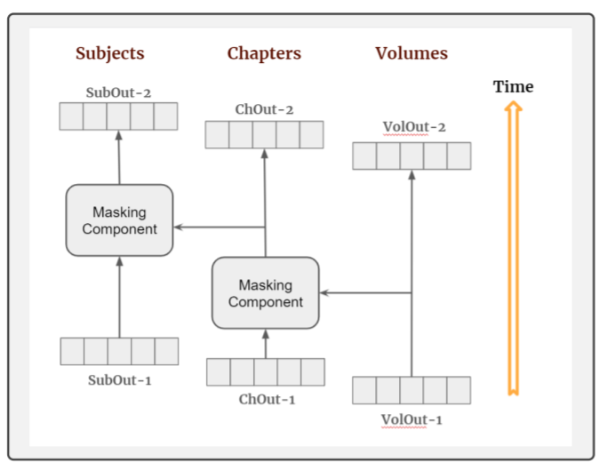
Experiments: methods
To achieve our goals we split our approaches to the 3 following categories: (⅔)
The whole masking process
Layer-wise guided training methods
Masking techniques (our proposal)
Guided training sequentially predicts the categories for certain hierarchical levels.
The predictions are produced independently and do not influence each other to the final output.
We expand the former methods to exploit the outcomes that are higher in label hierarchy
Algorithm
Step-1: We construct 2 affinity matrices
Step-2: Multiply the previous output with the affinity matrix in order to produce the new output (MaskVector)
Step-2: Yield a new enhanced output by multiplying elementwise (Hadamard product) the old predictions with the MaskVector

Slide 40
Experiments: methods
To achieve our goals we split our approaches to the 3 following categories: (3/3)
Layer-wise guided training methods
Masking techniques (our proposal)
ManyCLS, SumLastBERT and SumLast4BERT

Slide 41
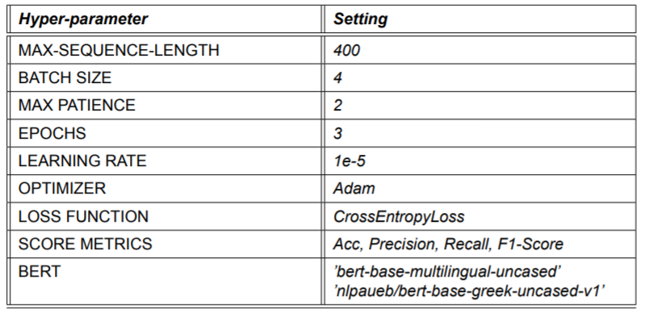
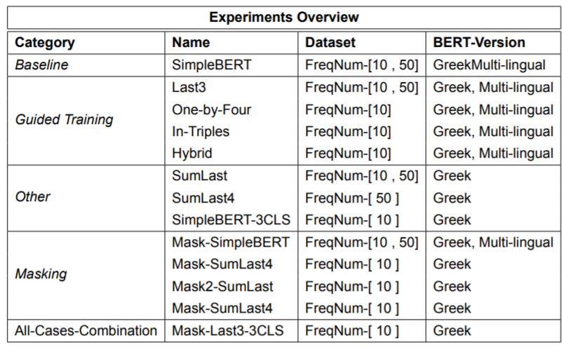
Experiments: Configuration

Slide 42
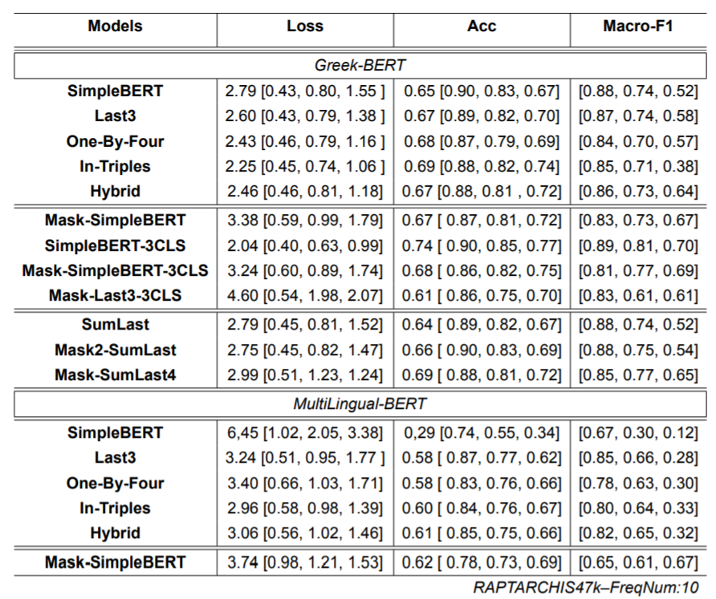
Experiments: Results
General conclusions & synopsis:
Monolingual models are more robust than the cross lingual versions
Masking techniques can further improve and corroborate the overall training ability of the algorithms
Utilization of extra [CLS] tokens (e.g. SimpleBert­3CLS) may enhance the learning capabilities of the models

Slide 43
Summary & Discussion
Contribution
Limitations
We engaged with the problem of XMTC for Greek legal documents
We explored, analyse and unravel hidden aspects of the RAPTARCHIS47k
We expand the current bibliography on XMTC by proposing our techniques and testing other innovative ideas
Our masking techniques require specific structure (it may not be true in some cases)
The small number of epochs does not allow us to draw safe conclusions for the capabilities of our techniques
Raptarchis47k has a very simple hierarchy (e.g. does not include omnibus bills)
Experiments on more challenging datasets!

Slide 44
Questions?
Thank you for your time!

