Slide 1
Business Intelligence · IIB423T-1 · Certamen 1
Respiratory Emergency Visits in Chile (2020–2024)
Full Exploratory Data Analysis, Five Cs Quality Audit, and Capacity Planning for the Winter Campaign
Team: Benjamín Pinto & Sebastián Herrera | Group: 02
Instructor: Tomás Fontecilla Correa | Date: September 29, 2026

Slide 2
BUSINESS INTELLIGENCE IIB423T-1 · CERTAMEN 1
Operational Context & The Winter Campaign Decision
• The Public Health Concern: Recurrent, severe seasonal surges in acute respiratory infections (RSV, Influenza A/B, Adenovirus, COVID-19) place intense pressure on the Chilean emergency network.
• Target Users: Directorate for Health Care Network Management (DIGERA), Health Service directors, and emergency leaders (SAPU, SAR, SUR, and Hospitals).
• The Decision to Inform: Timing the activation of Winter Campaign measures: scheduling clinical shifts (physicians, nurses, kinesitherapy), phased critical bed conversions, and primary care triage diversion before hospital emergency departments reach saturation.
• Core KPI & Analytical Formula: Respiratory Share (%) = 100 × Total Respiratory Visits (IdCausa = 2) / Total Emergency Visits (IdCausa = 1).
• Critical Boundary: This measures recorded public-network consultation activity. It does NOT measure individual disease risk, clinical severity, bed occupancy, or population incidence.

Slide 3
BUSINESS INTELLIGENCE IIB423T-1 · CERTAMEN 1
Selection from W1 and the C1 Correction
• Why Candidate A (Respiratory) was Selected: Offers a continuous, high-frequency time series (262 dated weeks across 2020–2024) with complete reporting, directly supporting seasonal monitoring.
• Why Candidate B (REM-P2 Child Nutrition) was Deselected: Audit uncovered severe reporting collapse in June 2020 (only 83 facilities reported due to pandemic lockdowns vs >1,950 normally); only 10 reporting points in 5 years; >59% of age/sex breakdown cells missing; code changes in 2023.
• The W1-to-C1 Reproducibility Correction: While W1 reported 5-year aggregates, its submitted reduced extract included only sample peak weeks in 2023–2024. For C1, our teammate's internal review corrected this by expanding the packaged extract to EVERY date across all 5 years (2020–2024).
• Audit Scope: The uncleaned extract contains 2,169,824 rows (~85x larger than W1's extract) while maintaining an efficient 19 MB compressed archive size.

Slide 4
BUSINESS INTELLIGENCE IIB423T-1 · CERTAMEN 1
Application of the Seven Steps (Class 03 Framework)
• 1. Decision: Proposed winter planners review weekly demand trajectory to determine when to activate phased staffing and bed contingency plans.
• 2. Success Criteria: Construct a reproducible 2020–2024 weekly baseline with audited coverage, stable codes, and verified care-setting coupling.
• 3. Business Question: How did the weekly volume and share of respiratory emergency visits vary in 2020–2024 across care settings and age bands?
• 4. Care Process: Daily emergency consultation records (DAU/SADU) logged at health facilities and transmitted to DEIS.
• 5. Entities & Events: Entity: Health facility. Event: Recorded emergency visit. Observation unit: Aggregate facility × date × cause count (NOT unique patients).
• 6. Representation: Candidate key: (source_year, IdEstablecimiento, fecha, IdCausa). Clean case derives Sunday week starts from parsed dates.
• 7. Measurement: Respiratory Visits = Total(IdCausa=2); Respiratory Share (%) = Total(IdCausa=2) / Total(IdCausa=1) × 100 within identical periods/units.

Slide 5
BUSINESS INTELLIGENCE IIB423T-1 · CERTAMEN 1
Data Profiling & The Five Cs Quality Audit
• Clean: Checked 2,169,824 rows: zero missing key/measure cells; zero negative values; age sums match Total 100%. Two identical duplicate rows in 2023 removed only from derived tables (-13 all visits, -0 respiratory). Valid zero-count rows retained.
• Consistent: IdCausa 1 and 2 maintain stable definitions across 2020–2024. Parsing dates into Sunday week starts resolves calendar boundary collisions where the same (year, semana) label mapped to two disjoint weeks.
• Conformed: Harmonized schemas across annual DEIS archives. No external geographic join is claimed: 2020–2022 lack direct comuna/region fields, and unvalidated joins risk creating duplicate or unmatched rows.
• Current: The 2020–2024 series is appropriate for historical baseline analysis. It cannot directly guide live 2026 shift decisions without an automated operational feed.
• Comprehensive: Covers the entire reporting public emergency network (>600 facilities annually). Does not cover private clinic care or self-treated community cases.

Slide 6
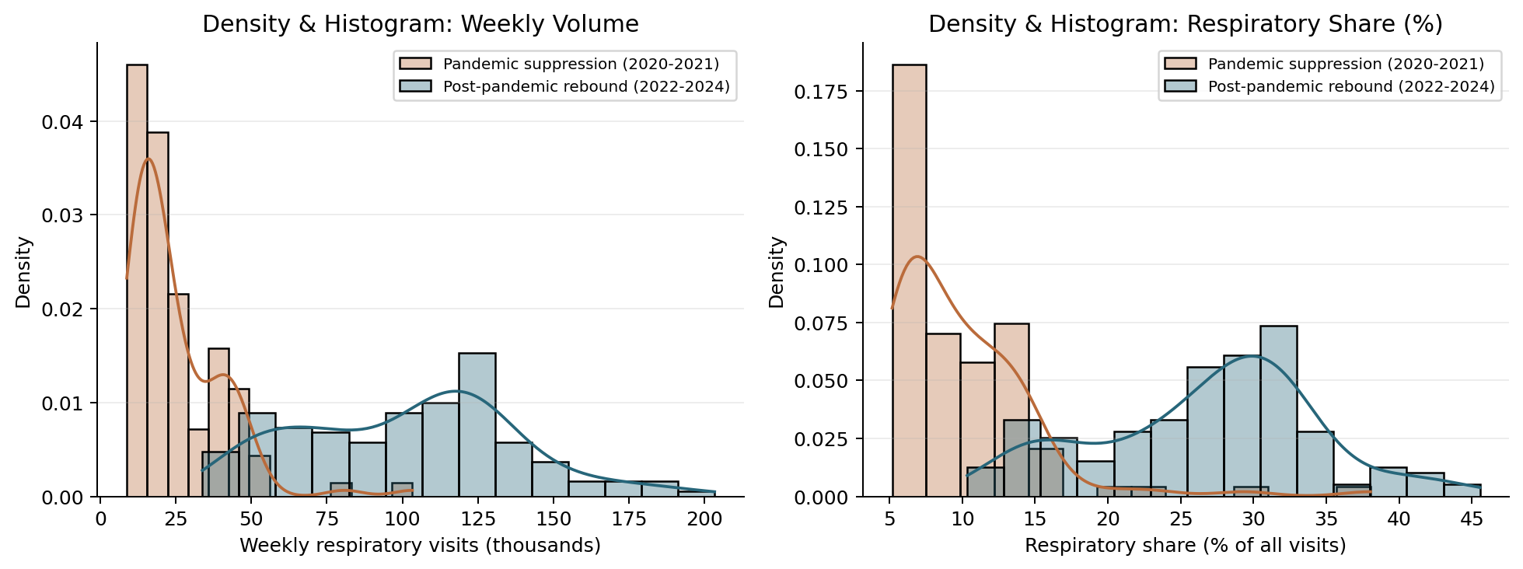
BUSINESS INTELLIGENCE IIB423T-1 · CERTAMEN 1
Full EDA: Histograms & Kernel Density Estimation (KDE)
Key Statistical Findings:
• Parametric Non-Normality: Weekly volume and share distributions exhibit high positive skewness and heavy right tails during epidemic surges; normality assumptions fail.
• Pandemic Suppression (2020–2021): Unimodal, tightly bounded distribution centered at ~10% share and <50k weekly visits due to school closures and mask mandates.
• Post-Pandemic Rebound (2022–2024): Multimodal distribution with broad dispersion reaching 45.56% share and 203,353 visits/week.
• Operational Implication: Planning models must account for regime shifts; assuming a single Gaussian distribution severely underestimates peak surge risk.

Slide 7
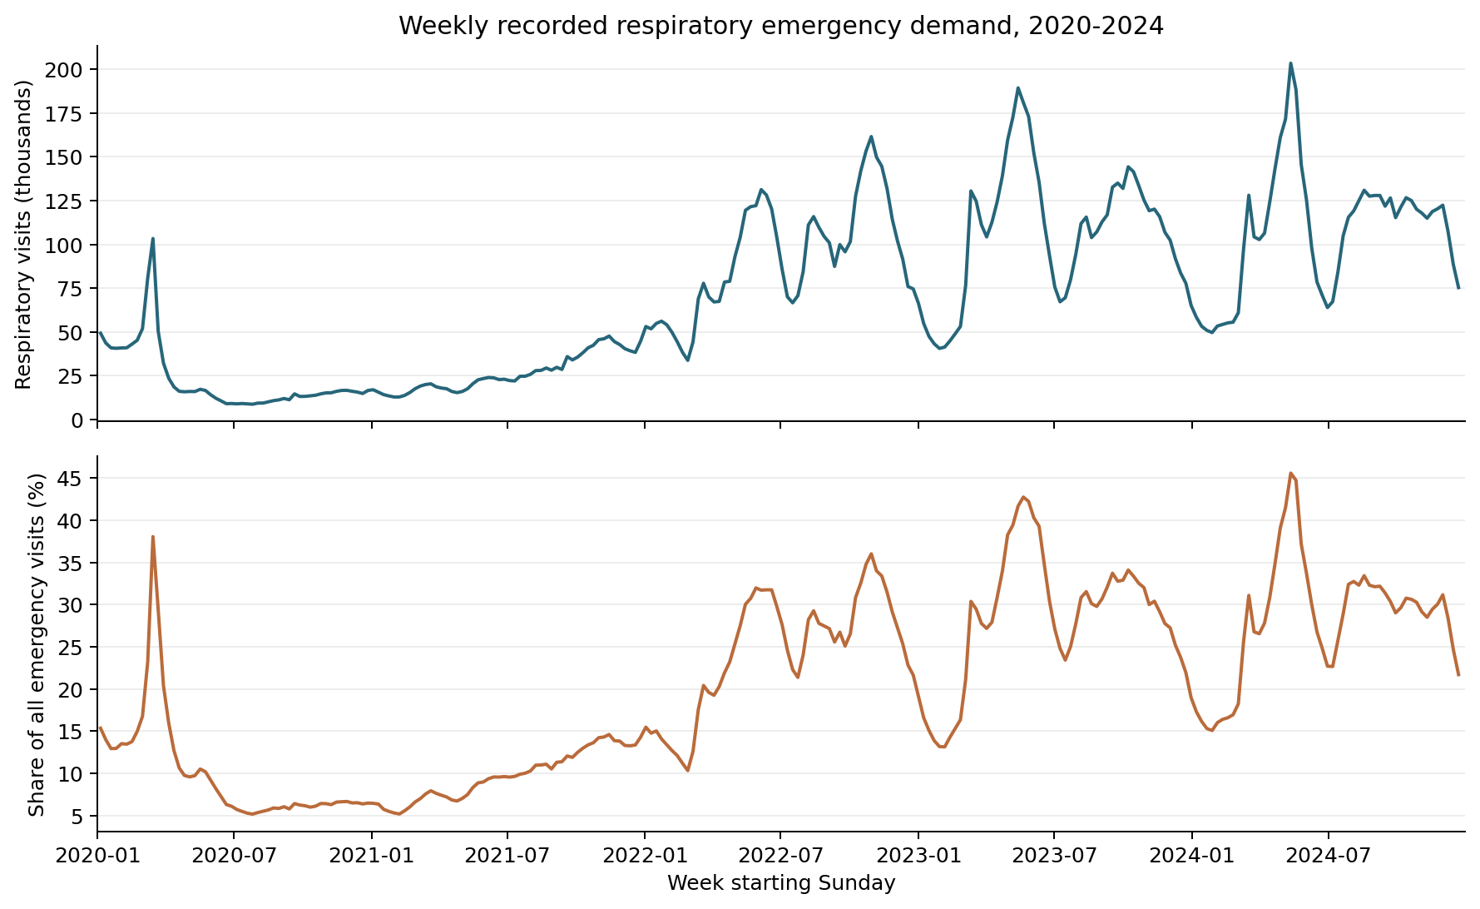
BUSINESS INTELLIGENCE IIB423T-1 · CERTAMEN 1
Full EDA: Seasonal Dynamics & Autumn Peaks
Historical Peak Evidence:
• 260 Complete Weeks Analyzed: Edge weeks (4 and 3 days) excluded for strict cross-year peak comparability.
• 2023 Peak: Week of 14–20 May: 189,297 respiratory visits (41.66% share).
• 2024 Peak: Week of 12–18 May: 203,353 respiratory visits (45.56% share).
• Timing Corroboration: MINSAL's 24 May 2024 official campaign report recorded 45.4% week-20 share, broadly corroborating this archive's 45.56% timing.
• Key Takeaway for Planners: Peaks in recent years occurred in mid-May (late autumn), NOT in July/August (mid-winter). Preparedness reviews must begin early in April.

Slide 8
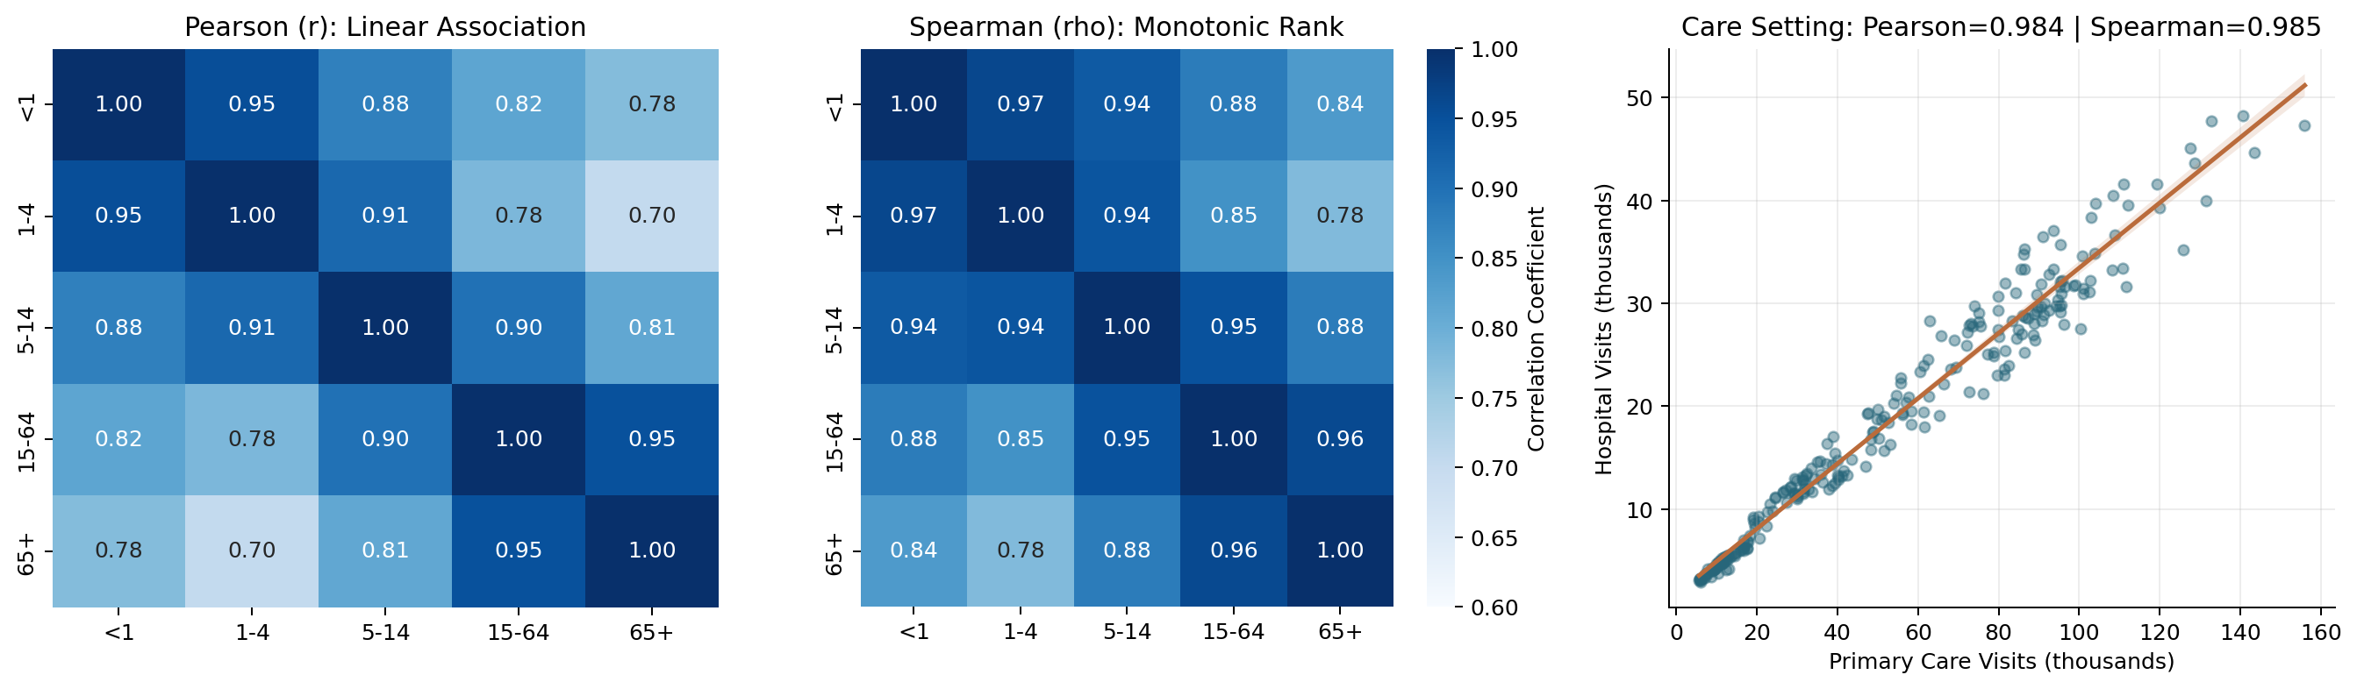
BUSINESS INTELLIGENCE IIB423T-1 · CERTAMEN 1
Statistical Correlation: Pearson (Linear) vs. Spearman (Rank)
The Statistician's View:
• Linear vs Monotonic: Pearson evaluates linear bivariate normality; Spearman evaluates monotonic rank ordering, immune to non-linear surges.
• Age Co-Movement: Spearman is systematically higher than Pearson across all age groups (+0.012 to +0.074). Between <1 and 65+, correlation rises from r = 0.775 (Pearson) to rho = 0.835 (Spearman).
• Why? Epidemic Dynamics: Different virus onset slopes (steep early RSV surge vs delayed influenza wave) depress linear Pearson, but rank severity across weeks is strongly preserved.
• Network Coupling: Primary Care (SAPU/SAR) vs Hospital demand has Pearson r = 0.9835 and Spearman rho = 0.9848. Triage and hospital pressure move in lockstep.

Slide 9
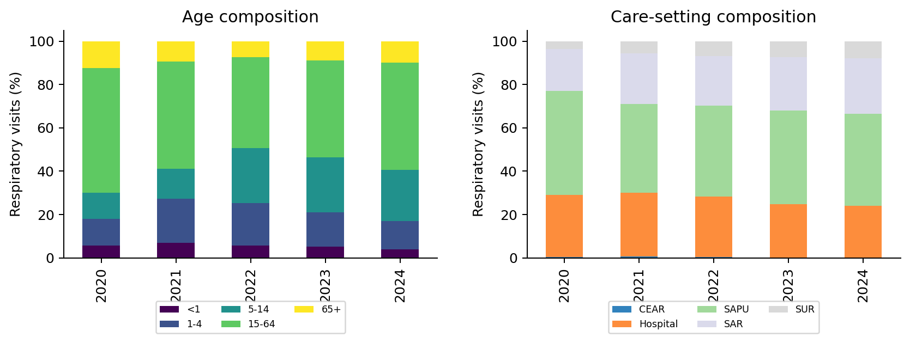
BUSINESS INTELLIGENCE IIB423T-1 · CERTAMEN 1
Demand Breakdown: Care Settings & Vulnerable Age Groups
Compositional Findings:
• Primary Care Shock Absorber: SAPU, SAR, and SUR facilities handle between 71.08% (2020) and 75.87% (2024) of all recorded respiratory emergencies.
• Pediatric Share: Under-15 visits represented 30.05% of respiratory consultations in 2020, spiking to 50.71% in 2022 with school reopening, and settling at 40.72% in 2024.
• Older Adult Demand: Adults aged 65+ account for ~15-18% of visits, but represent the highest risk of hospitalization and ICU admission.
• Design Consequence: Monitoring cannot look only at hospitals. Primary care triage volume is the earliest and largest indicator of winter network strain.

Slide 10
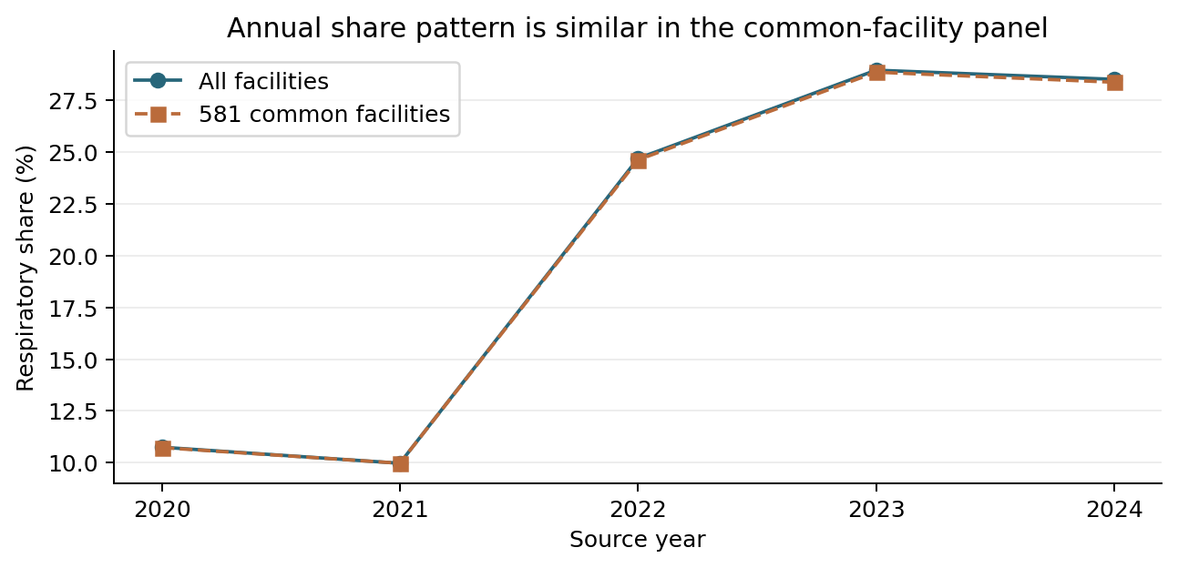
BUSINESS INTELLIGENCE IIB423T-1 · CERTAMEN 1
Sensitivity Check: Stable 581-Facility Panel
Controlling for Entry/Exit:
• Compositional Bias Risk: Total reporting facilities varied from 607 (2020) to 642 (2023). Did facility entry/exit create the observed respiratory surge?
• The Stable Panel: 581 facility IDs reported across ALL five years, covering 98.05% of all emergency visits in 2020 and 95.89% in 2024.
• Empirical Result: Respiratory share in the common-facility panel: 10.73%, 9.97%, 24.62%, 28.86%, 28.37% (virtually identical to full sample).
• Conclusion: The dramatic post-pandemic rebound is a genuine epidemiological and care-seeking reality, not an artifact of reporting panel turnover.

Slide 11
BUSINESS INTELLIGENCE IIB423T-1 · CERTAMEN 1
Project Continuity: Beyond C1 (ML & Dashboard)
• Future Supervised ML Task: Predict weekly respiratory emergency volume 2 completed weeks ahead (t+2) by care setting (SAPU/SAR vs Hospitals).
• Information Boundary & Data Leakage: Predictors restricted strictly to information available prior to the forecast week: lagged volume counts, calendar week indicators, and historical seasonal moving averages. No target week counts or post-outcome fields used.
• Honest ML Feasibility Challenges: With only 5 annual cycles and a strong regime shift in 2020–2021, standard time-series splits face high variance. Operational deployment requires an automated live feed. (No model trained in C1).
• Future BI Dashboard Prototype: Targeted at DIGERA and Health Service emergency coordinators.
• Core Dashboard Views: 1) Real-time weekly demand curve against 5-year historical confidence bands; 2) Pediatric (<1, 1-4) vs Geriatric (65+) composition; 3) SAPU/SAR absorption ratio; 4) Reporting facility freshness and completeness flags.

Slide 12
BUSINESS INTELLIGENCE IIB423T-1 · CERTAMEN 1
Summary & Individual Defense Anchors (Q&A)
• What This Analysis Demonstrates (F): Defensible, auditable 5-year retrospective characterization of respiratory emergency demand, peak timing (May), age co-movement, and care-setting coupling in Chile.
• What This Analysis Cannot Claim (H): Does not estimate individual patient risk, true disease incidence, bed occupancy rates, triage wait times, or causal impacts of health campaigns.
• Benjamín Pinto — Methodological Lead (G): Processing 2.17M rows; 5 Cs quality audit; duplicate key resolution; date-derived Sunday week starts; statistical correlation analysis (Pearson vs Spearman); parametric vs nonparametric density.
• Sebastián Herrera — Selection & Sensitivity Lead (G): Candidate B deselection audit (REM-P2 coverage collapse in June 2020); 581 common-facility panel sensitivity; care-setting breakdown (SAPU vs Hospital); dashboard design & operational framing.

