Slide 1

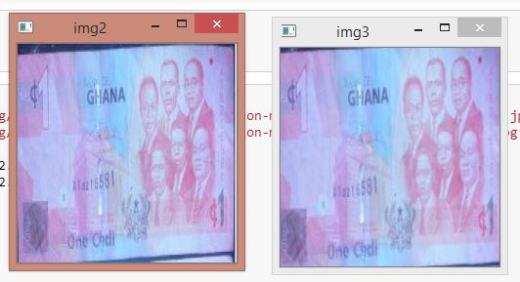
FAKE CURRENCY DETECTION USING DEEP CONVOLUTIONAL NETWORK (DCNN)
Introduction
Model
Conclusion and future works
Object recognition is an important and highly demanded area of pattern recognition. Similarly, paper currency recognition is as important as any other object recognition. This work used DCNN to recognize fake paper currency from real currency in the Republic of Ghana. The proposed scheme is different from various existing methods because of its ability to use the water mark feature in the recognition phases on the Deep Convolutional Neural Network methods.
The DCNN is a network with a certain level of complexity, a neural network with more than two layer. DCNN uses sophistication mathematics to process data in a complex way.
At a convolution layer, the previous layer’s feature maps are convolved with learnable kernels and put through the activation function to form the output feature map. Each output map may combine convolutions with multiple input maps. In general, we have that
Future avenues of research include examining various deep neural network architectures which are more efficient in terms of time and space complexity. Applying image pre-processing techniques like noise removal and edge-detection to crop the currency note out of an image will present a better input to the deep neural network.
References
Sargano AB, Sarfraz M, Haq N. An Intelligent System for Paper Currency Recognition with Robust Features, Journal of Intelligent and Fuzzy Systems 2014; 27(4): 1905 –1913.
Althafiri E, Sarfraz M, Alfarras M. Bahraini Paper Currency Recognition, Journal of Advanced Computer Science and Technology Research 2012;2(2):104 –115.
Mohammad H Alshayeji, Mohammad Al-Rousan and Dunya T. Hassoun, (2015). Detection Method for Counterfeit Currency Based on Bit-Plane Slicing Technique ,International Journal of Multimedia and Ubiquitous Engineering Vol.10, No.11. .
Dataset
Two key notes from the Ghana cedis was taken for this work that is 5 cedis note and 1 cedi note
There were images of 4 real 1 and 5 Cedi note. To simulate a fake 1 and 5 Cedis note images, we manually erased the exposed watermark through a basic photo editing software.
Method and Result
We required at least 1000 images in each data-set even for the purpose of fine-tuning a pre-trained DCNN. The simplest way to get around a lack of data is to augment the data-set.

