Slide 1
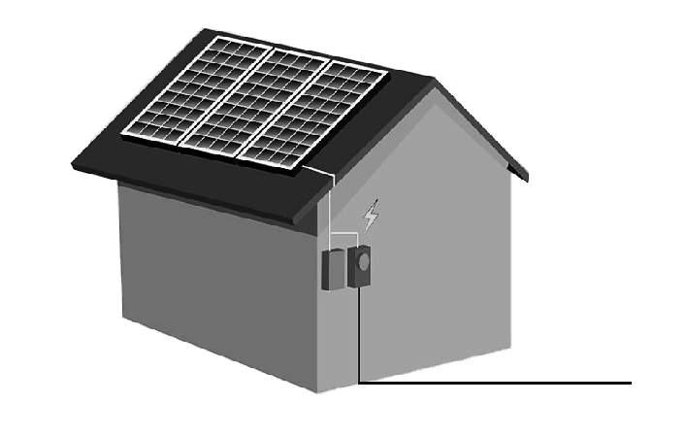
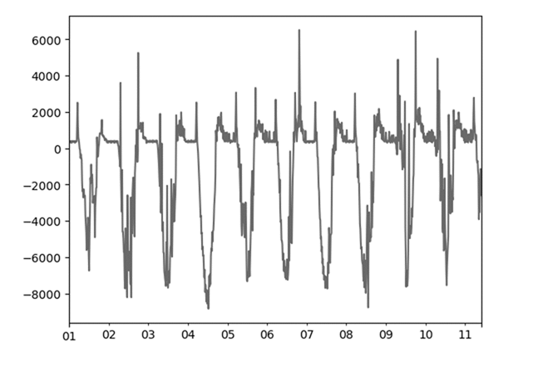

Inputs
Time series
Modelling
Feature Engineering
Model Selection
Net Load Data
Target
HPO
Weather &
ML-derived Information
Sliding Window
Evaluation
Weather Data
Features

