Slide 1
Getting Start to Build ML Model

Slide 2
Numpy Library
This library provides:
A high-performance multidimensional array object
Tools for working with these arrays
3 | 5 | 7
0 | 1 | 2
0 | 1.5 | 2 | 3
1 | 4 | 5 | 6
 | 0 | 1 | 2
Usage
import numpy as np
#Creating Arrays
a = np.array([3,5,7])
b = np.array([[1.5,2,3],[4,5,6]])
print(a[1:])
print(b[0,1])
print(b[:,1])
print(b[1,:])
print(b.shape)
Output
[5 7]
2.0
[2. 5.]
[4. 5. 6.]
(2,3)

Slide 3
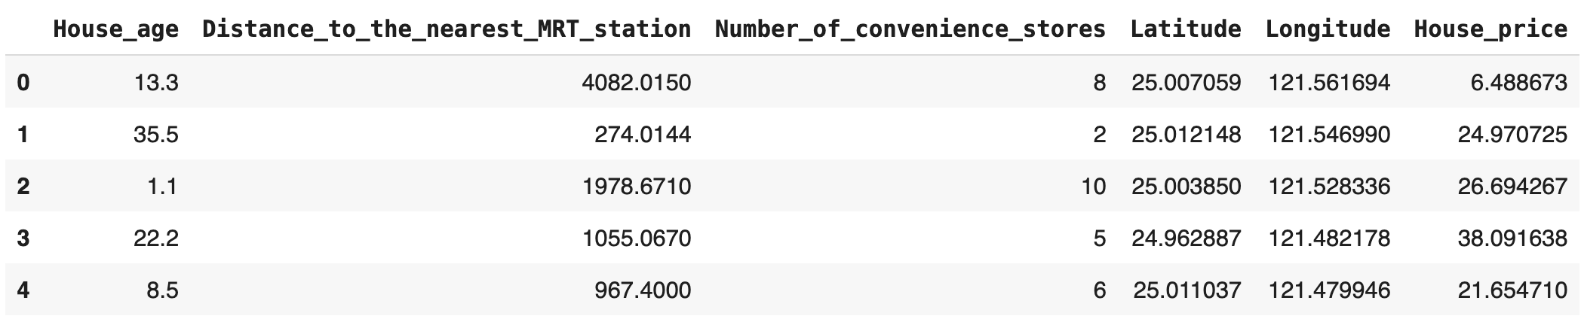
Pandas Library
This library is built on NumPy and provides easy-to-use data structures and data analysis tools.
Usage
import numpy as np
import pandas as pd
data = pd.read_csv(r‘Real_Estate.csv’)
data.head()
https://github.com/Papangkorn-ink/train-prc-ds.git
Columns
Index

Slide 4
Pandas Library
Usage
# Get a subset
data[2:5]
# Slice data
data.loc[:,['House_age','House_price']]
# Select row by conditions
data[(data['House_age']>=10) & (data['House_age’]<20)]

Slide 5
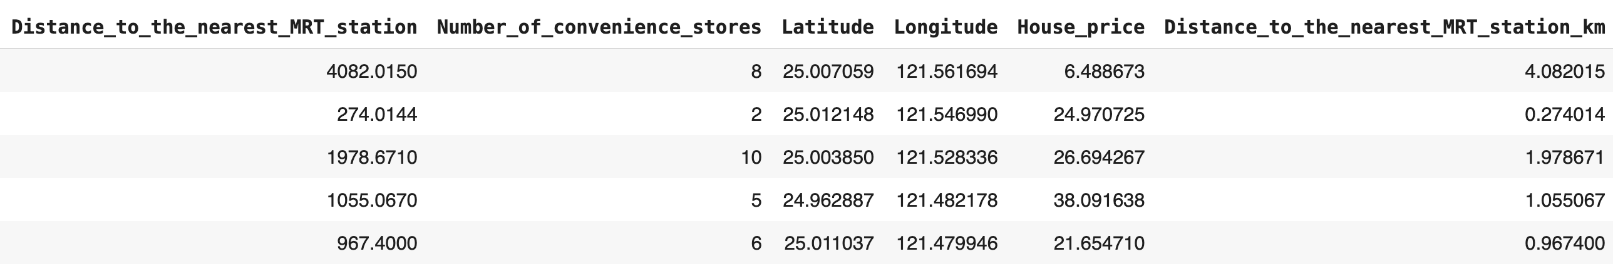
Pandas Library
Usage
data['Distance_to_the_nearest_MRT_station_km'] = data['Distance_to_the_nearest_MRT_station']/1000
data.head()
New columns

Slide 6
Pandas Library
Usage
data.sum()
data.min()
data.max()
data.idxmin()
data.idxmax()
data.mean()
data.median()
data.describe()

Slide 7
Pandas Library
Usage
for index, row in data.iterrows():
print(row["House_age"])
print(row["Distance_to_the_nearest_MRT_station"])
print(row["Number_of_convenience_stores"])

Slide 8
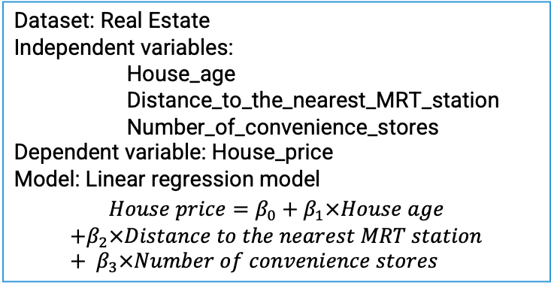
Build ML Model for Regression
Dataset: Real Estate
Independent variables:
House_age Distance_to_the_nearest_MRT_station Number_of_convenience_stores
Dependent variable: House_price
Model: Linear regression model
$$House price=β_{0}+β_{1}×House age$$
$$+β_{2}×Distance to the nearest MRT station+ β_{3}×Number of convenience stores$$
Real_Estate.csv
Load data
Prepare data
Training Set
Test Set
Standardize data
Parameters
Feature Engineering
Feature Engineering
Use Linear Regression
Model Training
Model
Inference
Evaluation

Slide 9
Load data
Real_Estate.csv
Prepare variables
Load data
Split train and test dataset
Prepare data
Standardize features on training dataset
Training Set
Test Set
Train linear regression model
Standardize data
Parameters
Feature Engineering
Feature Engineering
Standardize features on test dataset
Use Linear Regression
Model Training
Model
Inference
Predict test samples
Evaluation
Calculate evaluation matrices

Slide 10
Load data
data = pd.read_csv(r‘Real_Estate.csv’)
X = data.loc[:,[‘House_age’, ‘Distance_to_the_nearest_MRT_station’, ‘Number_of_convenience_stores’]]
y = data.loc[:,[‘House_price’]]
Prepare variables
Split train and test dataset
X_train, X_test, y_train, y_test = train_test_split(X, y, test_size=0.3)
scaler = StandardScaler()
scaler.fit(X_train)
X_train = scaler.transform(X_train)
Standardize features on training dataset
regressor = LinearRegression()
regressor.fit(X_train, y_train)
Train linear regression model
Standardize features on test dataset
X_test = scaler.transform(X_test)
Predict test samples
y_pred = regressor.predict(X_test)
mae = mean_absolute_error(y_true=y_test,y_pred=y_pred)
rmse = mean_squared_error(y_true=y_test,y_pred=y_pred,squared=False)
Calculate evaluation matrices

Slide 11
Build ML Model using Scikit-learn Library
Workshop
import numpy as np
import pandas as pd
from sklearn.model_selection import train_test_split
from sklearn.preprocessing import StandardScaler
from sklearn.linear_model import LinearRegression
from sklearn.metrics import mean_absolute_error, root_mean_squared_error
# Load data
data = pd.read_csv(r‘cardio.csv’)
data.head()
# Data preparing
X = data.loc[:,[‘House_age’, ‘Distance_to_the_nearest_MRT_station’, ‘Number_of_convenience_stores’]]
y = data.loc[:,[‘House_price’]]
X_train, X_test, y_train, y_test = train_test_split(X, y, test_size=0.3, random_state=42)

Slide 12
Build ML Model using Scikit-learn Library
Workshop
# Training phase
# Feature engineering
scaler = StandardScaler()
scaler.fit(X_train)
X_train = scaler.transform(X_train)
# Test phase
# Feature engineering
X_test = scaler.transform(X_test)

Slide 13
Build ML Model using Scikit-learn Library
Workshop
# Training phase
# Model training
regressor = LinearRegression()
regressor.fit(X_train, y_train)
# Test phase
# Inference
print(regressor.score(X_test, y_test))
y_pred = regressor.predict(X_test)
# Evaluating the performance
mae = mean_absolute_error(y_true=y_test,y_pred=y_pred)
rmse = root_mean_squared_error(y_true=y_test,y_pred=y_pred)
print("MAE:",mae)
print(”RMSE:",rmse)

Slide 14
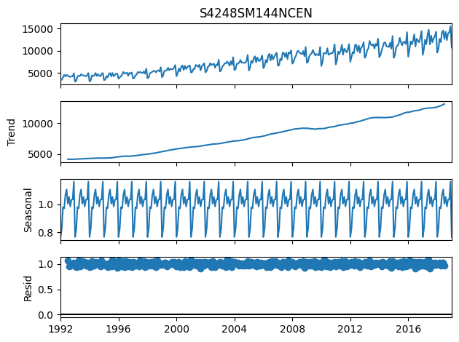
Build ML Model for Time Series Data
Dataset: Alcohol Sales
Alcohol_Sales.csv
Load data
Prepare data
Training Set
Test Set
Explore Data
Use ARIMA
Model Training
Model
Inference
Evaluation

Slide 15
Alcohol_Sales.csv
Load data
Load data
Split train and test dataset
Prepare data
Training Set
Test Set
Explore training dataset
Explore Data
Train ARIMA model
Use ARIMA
Model
Predict test samples
Model Training
Inference
Calculate evaluation matrices
Evaluation

Slide 16
Load data
data = pd.read_csv(r‘Alcohol_Sales.csv’)
train_data = data['1992-01-01':'2016-12-01']
test_data = data['2017-01-01':]
Split train and test dataset
result = seasonal_decompose(train_data['S4248SM144NCEN'],model ='multiplicative')
result.plot()
Explore training dataset
stepwise_fit = auto_arima(train_data['S4248SM144NCEN’],
start_p = 1, start_q = 1,
max_p = 3, max_q = 3, m = 12,
start_P = 0, seasonal = True,
d = None, D = 1, trace = True,
error_action ='ignore', suppress_warnings = True, stepwise = True)
Train ARIMA model
Predict test samples
pred = stepwise_fit.predict(n_periods=test_data.shape[0]).rename("Predictions")
mae = mean_absolute_error(y_true=y_test,y_pred=y_pred)
rmse = root_mean_squared_error(y_true=y_test,y_pred=y_pred)
Calculate evaluation matrices

Slide 17
Build ML Model for Time Series Data
Workshop
import numpy as np
import pandas as pd
import matplotlib.pyplot as plt
from statsmodels.tsa.seasonal import seasonal_decompose
from sklearn.metrics import mean_absolute_error, root_mean_squared_error
from pmdarima import auto_arima
import warnings
warnings.filterwarnings("ignore")
data = pd.read_csv('Alcohol_Sales.csv',
index_col ='DATE',
parse_dates = True)
data.head()
train_data = data['1992-01-01':'2016-12-01']
test_data = data['2017-01-01':]

Slide 18
Build ML Model for Time Series Data
Workshop
# ETS Decomposition
result = seasonal_decompose(train_data['S4248SM144NCEN'],model='multiplicative')
result.plot()
#Fine-tune ARIMA
stepwise_fit = auto_arima(train_data['S4248SM144NCEN'], start_p = 1, start_q = 1,
max_p = 3, max_q = 3, m = 12,
start_P = 0, seasonal = True,
d = None, D = 1, trace = True,
error_action ='ignore', suppress_warnings = True,
stepwise = True)
#Predict next times
pred = stepwise_fit.predict(n_periods=test_data.shape[0]).rename("Predictions")

Slide 19
Build ML Model for Time Series Data
Workshop
# Plot results
pred.plot(legend = True)
test_data['S4248SM144NCEN'].plot(legend = True)
data['S4248SM144NCEN'].plot(figsize = (12, 5), legend = True)
pred.plot(legend = True)
# Evaluating the performance
mae = mean_absolute_error(test_data['S4248SM144NCEN'], pred)
rmse = root_mean_squared_error(test_data['S4248SM144NCEN'], pred)
print("MAE:",mae)
print(”RMSE:",rmse)

