Slide 1
Here I present the main results of my analysis. For a more detailed view of my work, please visit the Tableau dashboards. Thank you.

Slide 2
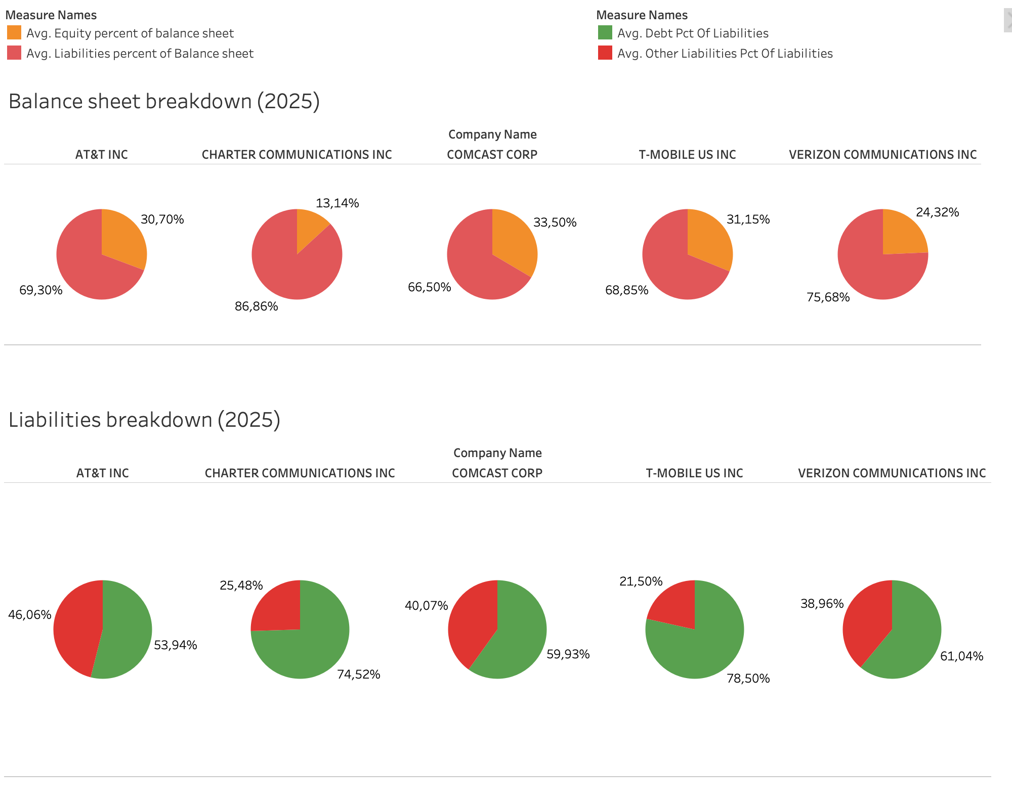

Slide 3
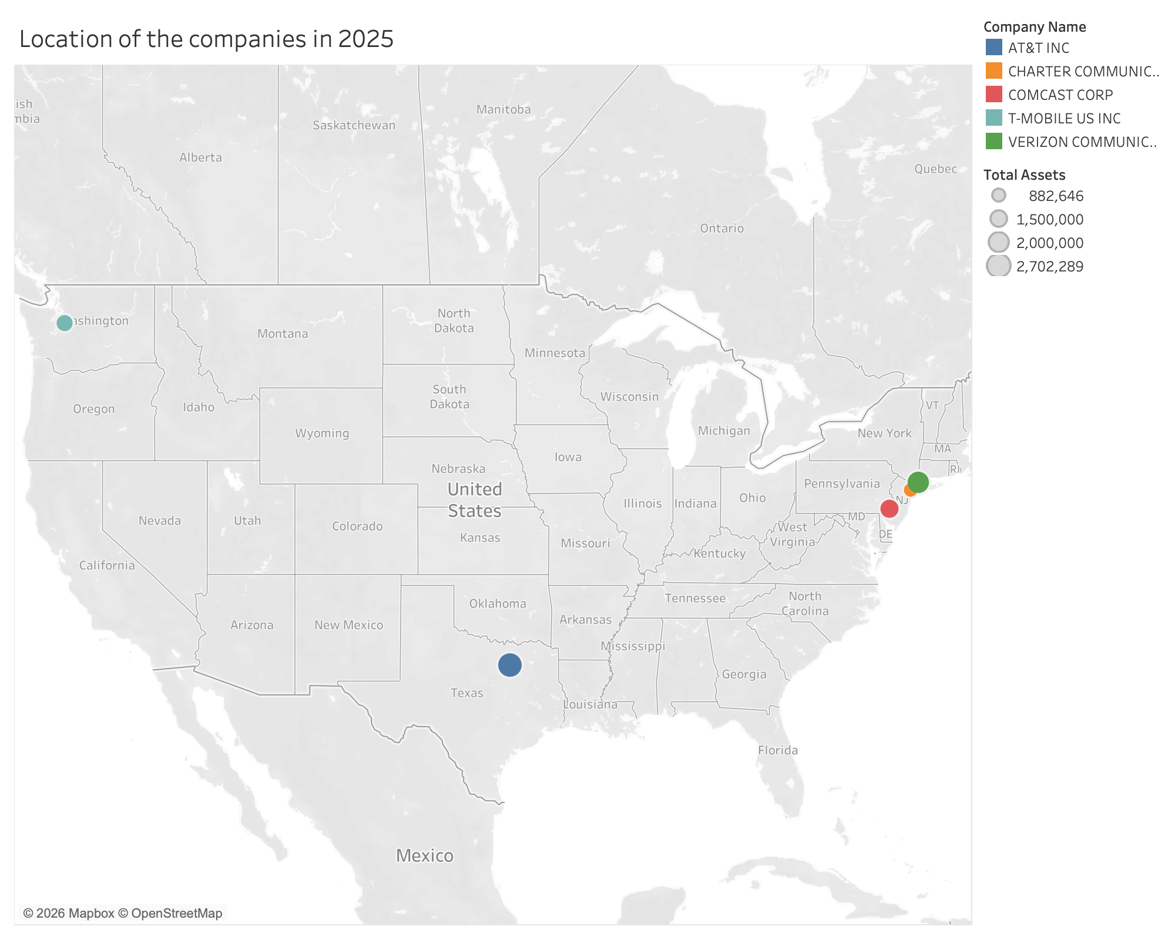

Slide 4
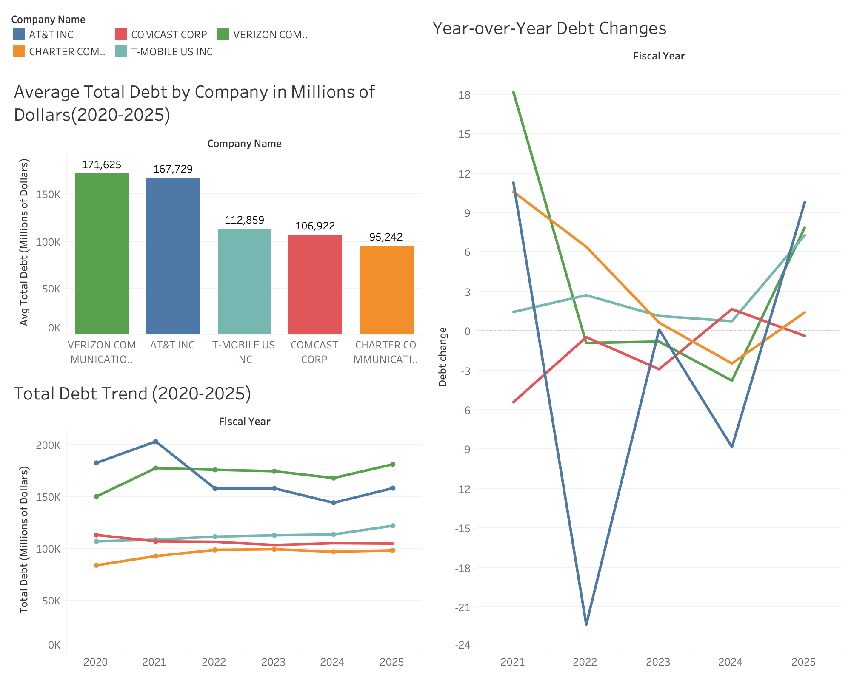

Slide 5
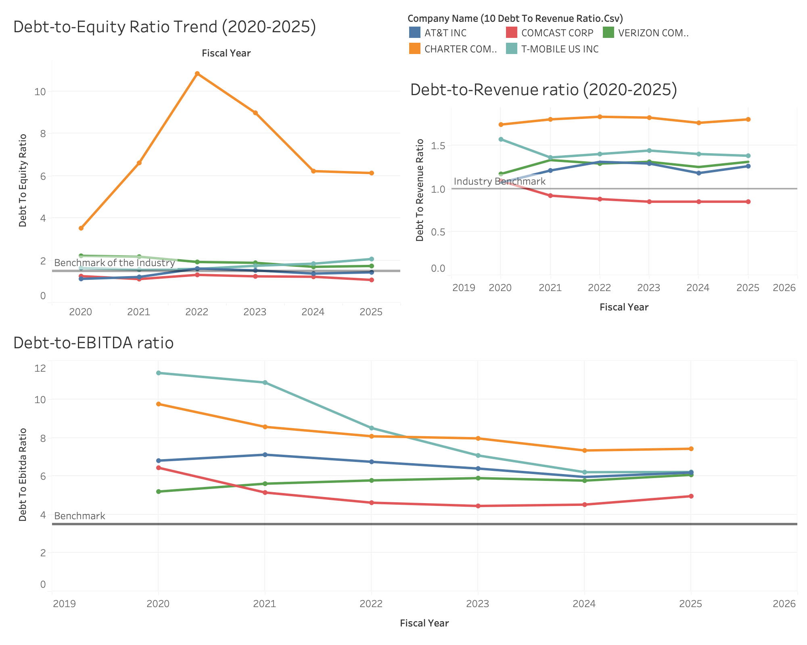

Slide 6
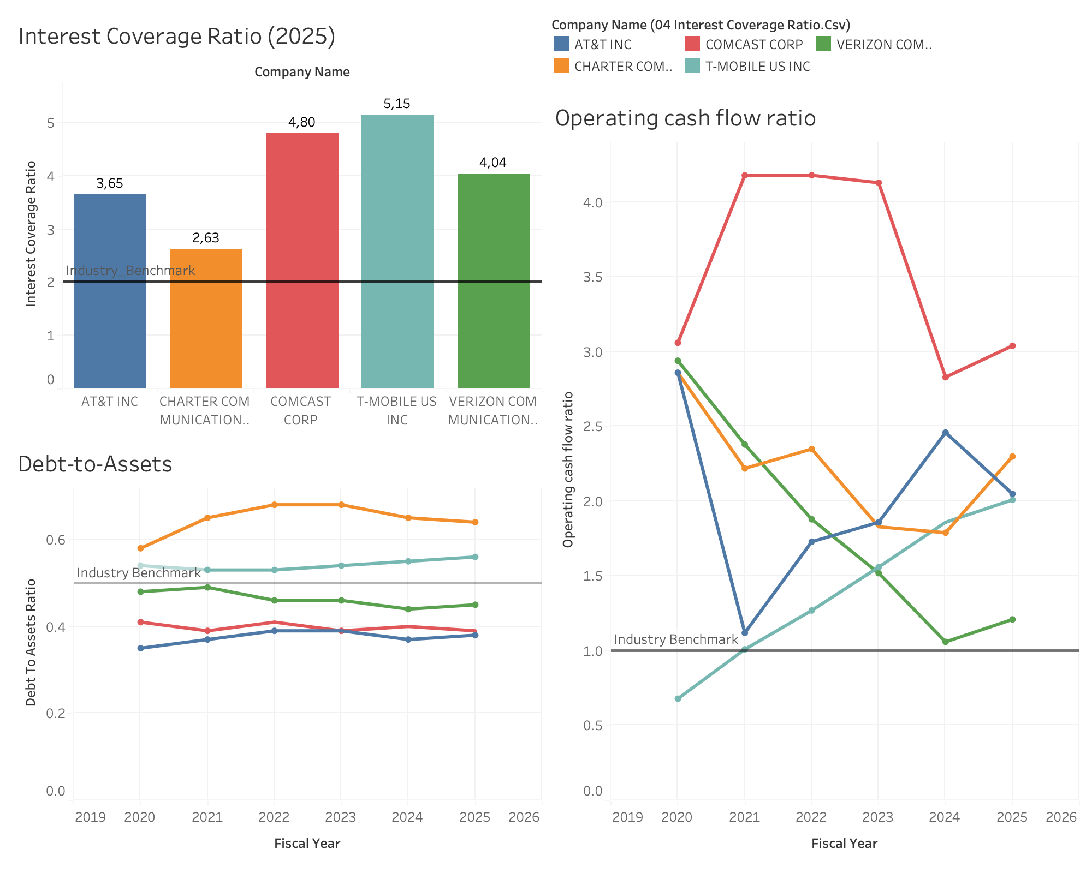

Slide 7
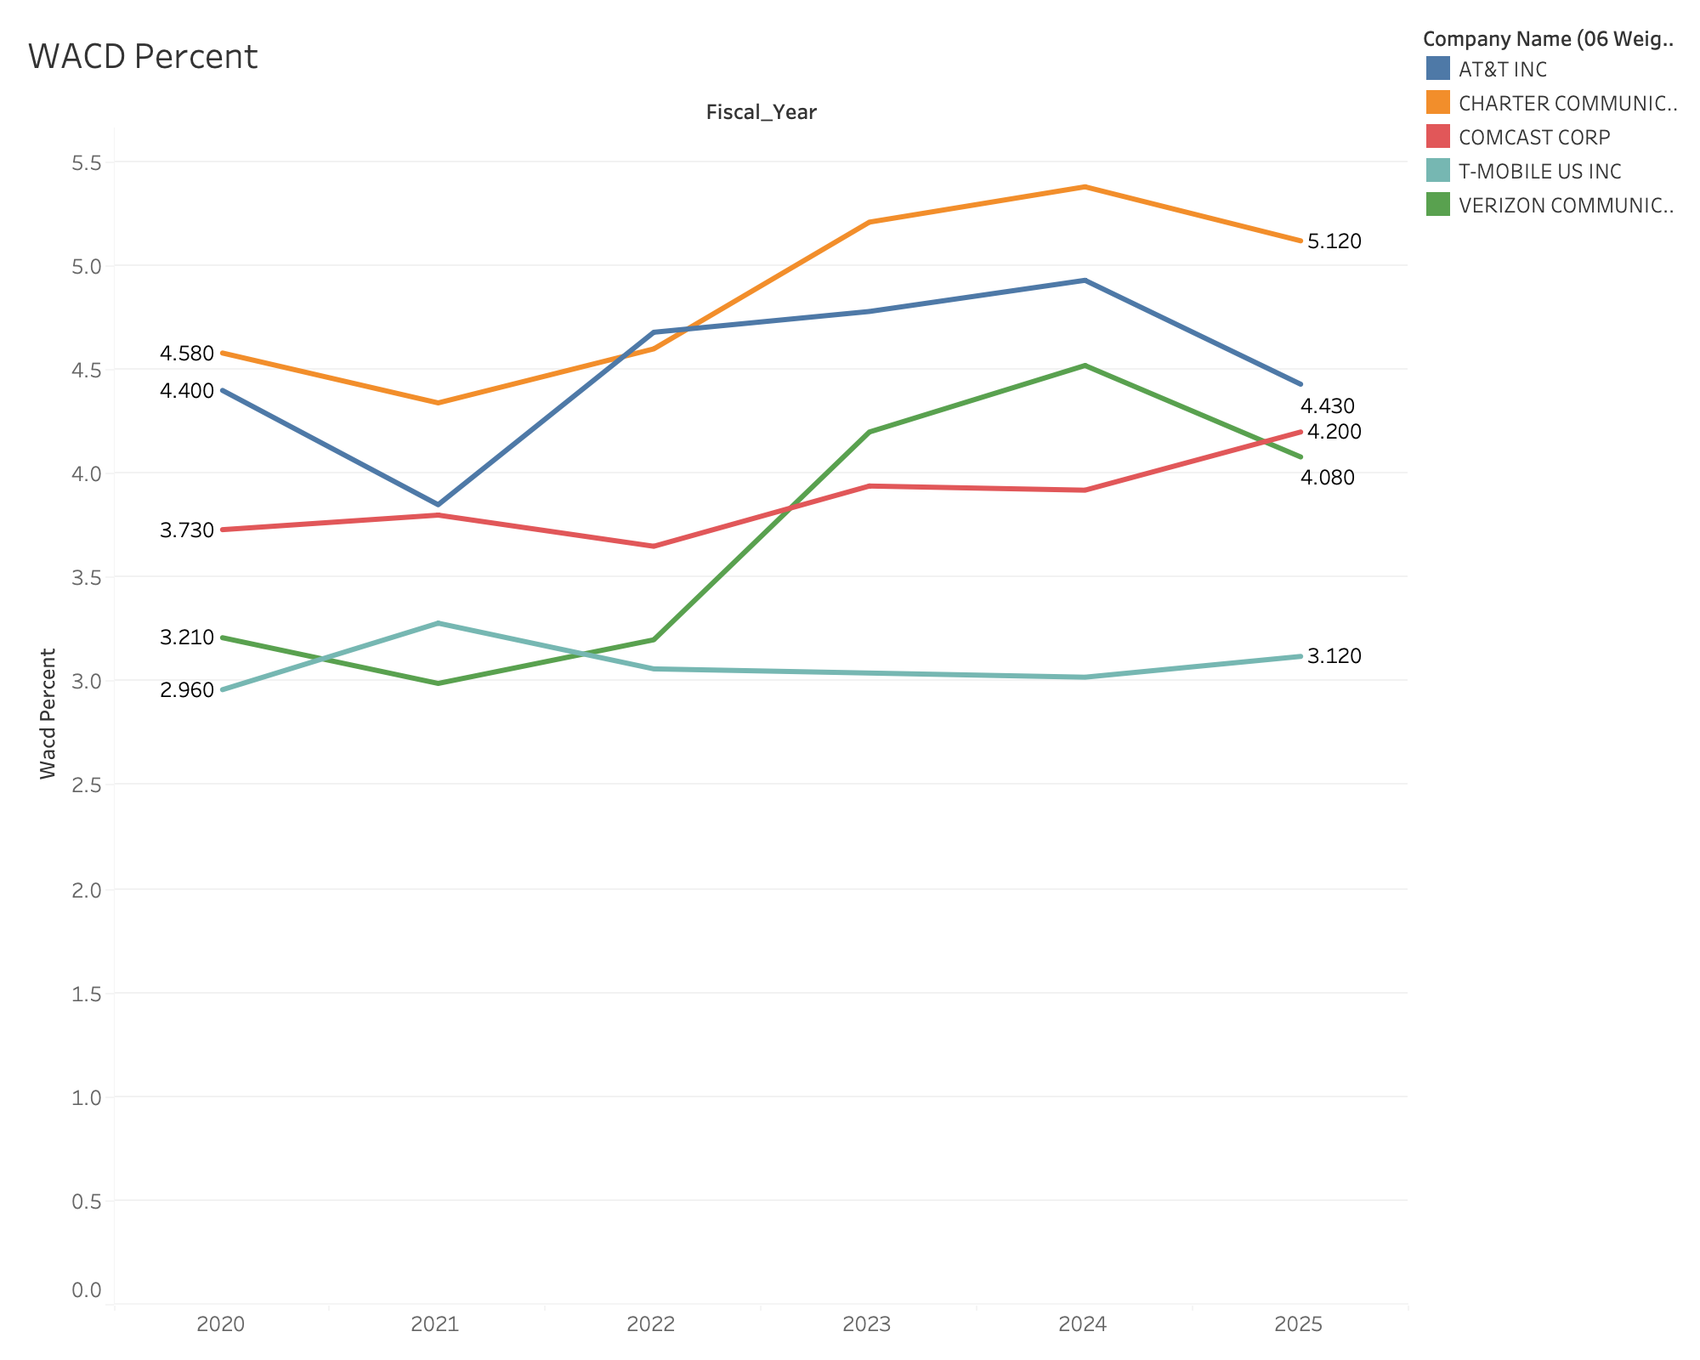

Slide 8
