Slide 1
Virtual Network Embedding in Multi-Domain Networks
A Study of PSO, Reinforcement Learning, and Swarm Intelligence Approaches

Slide 2
0. OUTLINE
I
Abstract
II
Introduction & Motivation
III
Problem Formulation
IV
Related Work
V
Proposed Methods
VI
Experiment
VII
Results & Discussion
VIII
Conclusion & Future Work
IX
References

Slide 3
I. ABSTRACT
Network virtualization enables multiple virtual networks to coexist on shared physical infrastructure, but efficiently embedding virtual network requests onto substrate networks — the Virtual Network Embedding (VNE) problem — remains NP-hard, especially in multi-domain environments.
This work investigates and compares six VNE algorithms spanning three paradigms: heuristic (greedy), metaheuristic (Particle Swarm Optimization), and learning-based (Q-Learning, Deep Q-Networks, Swarm Reinforcement Learning). All algorithms operate within a unified centralized hierarchical multi-domain architecture.
Experiments on a multi-domain substrate network with 4 domains (120 nodes) show that hybrid approaches combining PSO with DQN-guided fitness and multi-path routing achieve the best trade-off between cost, delay, acceptance rate, and revenue-to-cost ratio. We contextualize our work against the Virne benchmark (ICLR 2026), which identifies generalization and scalability as key open challenges.
Keywords:
Virtual Network Embedding, Particle Swarm Optimization, Deep Q-Network, Swarm Intelligence, Multi-Domain, Multi-Path

Slide 4
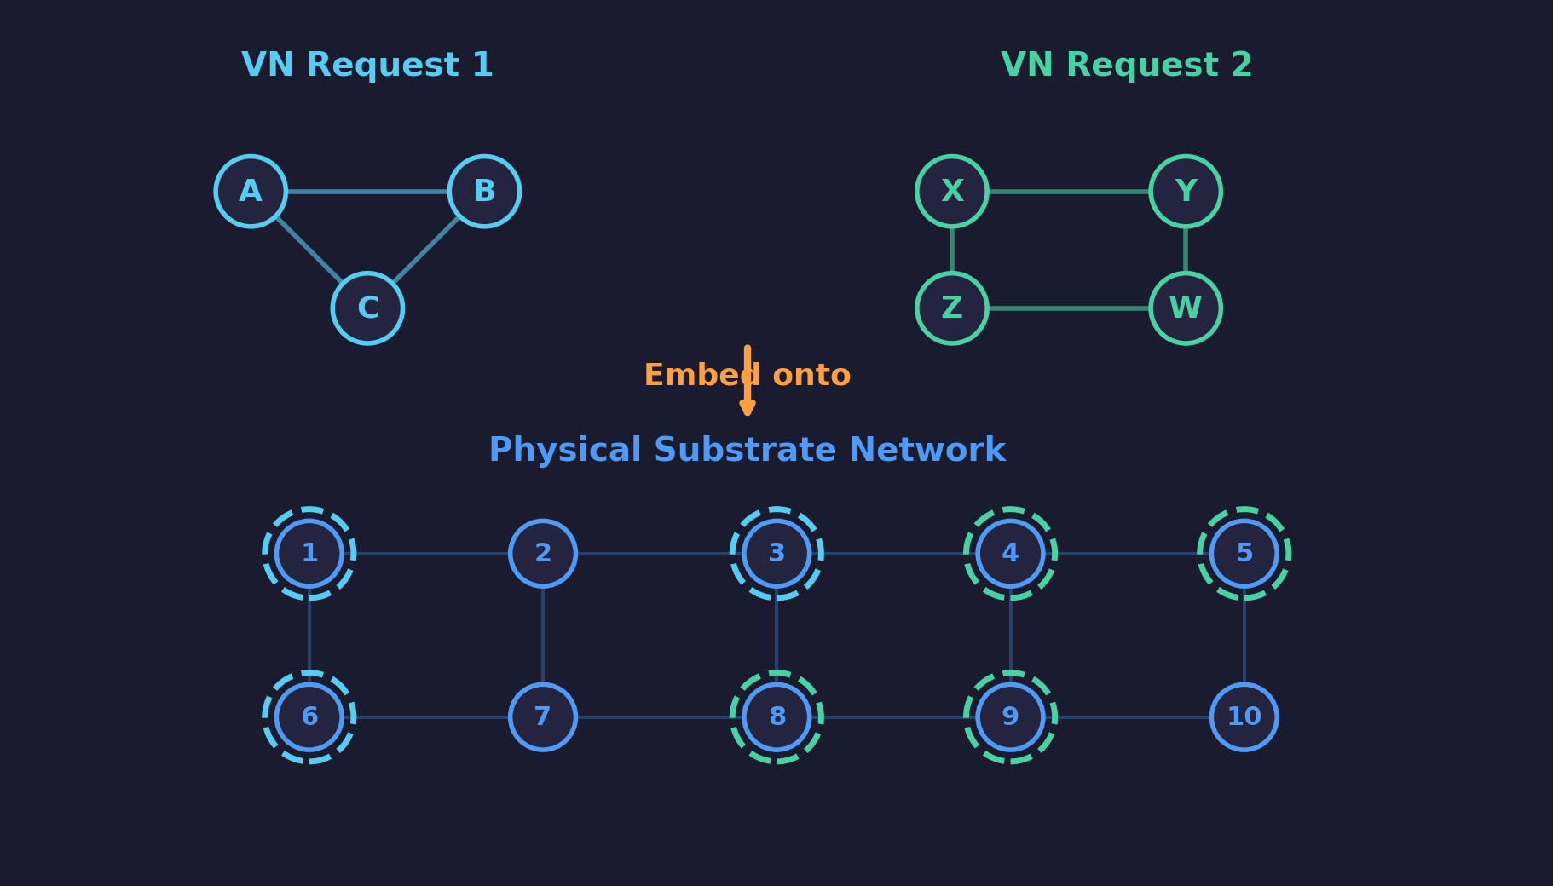
II. INTRODUCTION & MOTIVATION
What is Network Virtualization?
Applications
• Cloud computing: multi-tenant resource sharing
• 5G network slicing: dedicated VN per service
• Internet of Drones (IoD) in Industry 4.0
• Edge computing for latency-sensitive services
Network virtualization decouples virtual networks from physical infrastructure, allowing multiple isolated virtual networks to share the same substrate.
VNE Problem (NP-hard)
• Node mapping: assign virtual nodes → physical nodes
• Link mapping: route virtual links → physical paths
• Constraints: CPU capacity, bandwidth, domain
Key Challenges in Multi-Domain
• Combinatorial explosion: O(|Np|^|Nv|) possible mappings
• Coupled decisions: node placement affects link routing
• Cross-domain routing via boundary nodes
• Dynamic arrivals: online problem with resource fragmentation

Slide 5
II. INTRODUCTION & MOTIVATION
Motivation: Why Compare Multiple Approaches?
No single paradigm dominates VNE. We systematically compare three paradigms to understand their trade-offs:
Heuristic
• Greedy node ranking
• Kruskal MST for links
• Fast, simple, deterministic
• No global optimization
Metaheuristic
• Particle Swarm Optimization
• Global search over solution space
• Genetic mutation avoids local optima
• No learning between requests
Learning-based
• Q-Learning / Deep Q-Networks
• Swarm RL (multiple DQN agents)
• Adapts and improves over time
• Training cost, generalization issues
Our Approach: Combine all three → PSO + DQN Swarm + Multi-Path allocation
6 algorithms from simple greedy to advanced Swarm RL + PSO hybrids, all in a unified multi-domain framework

Slide 6
III. PROBLEM FORMULATION
Substrate Network Model
Based on MP-VNE [Zhang et al., 2022]
Gˢ = ({Gᵢˢ}ᵢ₌₁ᴰ, Lˢ_inter) | Each domain: Gᵢˢ = (Nᵢˢ, Lᵢˢ) with boundary nodes Bᵢˢ ⊂ Nᵢˢ
Component | Symbol | Description | Range
Node CPU | Cₙˢ | Processing capacity | [50, 100]
Node Price | Pₙˢ | Unit price of CPU | [1, 5]
Node Delay | Dₙˢ | Processing delay | [0.1, 2.0]
Link BW | Bₗˢ | Bandwidth capacity | [500, 1000]
Inter-Domain | Symbol | Description | Range
Link BW | Bₗˢ | Bandwidth capacity | [1000, 5000]
Link Price | Pₗˢ | Unit price of BW | [0.5, 2.0]
Link Delay | Dₗˢ | Transmission delay | [5.0, 20.0]
Topology: Random graph, edge probability = 0.5 per domain, 4 domains × 30 nodes = 120 total nodes

Slide 7
III. PROBLEM FORMULATION
Virtual Network Request Model
Gᵛ = (Nᵛ, Lᵛ)
Request Arrival Model
• Nodes per VNR: Uniform U(3, 10)
• Edge probability: 0.5
• Arrival process: Poisson, λ = 0.04
• Lifetime: Exponential, mean = 500 time units
• Dynamic online problem — requests arrive
• and depart continuously over simulation time
Component | Symbol | Description | Range
Node CPU | Cᵢᵛ | CPU demand | [1, 20]
Link BW | Bᵢⱼᵛ | Bandwidth demand | [1, 50]
Domain | Dᵢᵛ | Allowed domains | Subset of {1..D}

Slide 8
III. PROBLEM FORMULATION
VNE Mapping Definition & Constraints
Node Mapping: Mₙ : Nᵛ → Nˢ
• Resource: Cᵢᵛ ≤ C_avail(Mₙ(nᵢᵛ))
• Domain: Mₙ(nᵢᵛ) ∈ Domain(Dᵢᵛ)
• One-to-one: Mₙ(nᵢᵛ) ≠ Mₙ(nⱼᵛ) ∀ i ≠ j
• Each virtual node maps to exactly one
• physical node with sufficient CPU
Link Mapping: Mₗ : Lᵛ → P(Lˢ)
• Single-path: one physical path per virtual link
• Multi-path: split BW across ≤ 5 paths
• Bᵢⱼᵛ ≤ Σ B_avail(p) for all paths p
• Multi-path improves acceptance rate by
• utilizing residual bandwidth across paths
Optimization Objective
min Cost(Gᵛ) = Σ Cᵛₙ × Pˢ_M(nᵛ) + Σ Bᵛₗ × Pˢₗ × hops
Node cost Link cost

Slide 9
III. PROBLEM FORMULATION
Evaluation Metrics
Metric | Formula | Description
RAC | # Accepted VNRs / # Total VNRs | Request Acceptance Rate
LAR | Σ REV(v) × lifetime(v) / T | Long-term Average Revenue
R2C | Σ REV × lifetime / Σ COST × lifetime | Revenue-to-Cost Ratio
Avg Cost | Σ COST(v) / # Successes | Average per-embedding cost
Avg Delay | Σ PathDelay(v) / # Successes | Average physical path latency
Revenue proxy: REV(v) = Σ Cᵛₙ + Σ Bᵛₗ (total resource demand)

Slide 10
IV. RELATED WORK
Three Paradigms for Solving VNE
Paradigm | Approach | Strengths | Weaknesses
Heuristic | Greedy ranking, MST | Fast, simple, deterministic | No global optimization, myopic
Metaheuristic | PSO, GA, ACO | Global search, avoids local optima | Slow, no learning between requests
Learning-based | Q-Learning, DQN, GNN+RL | Adapts over time, learns patterns | Training cost, generalization
Our work spans all three paradigms with 6 algorithms, exploring how combining them yields better results.

Slide 11
IV. RELATED WORK
MP-VNE [Zhang et al., 2022]
Multi-Domain VNE Based on Multi-Objective Optimization for IoD
Key Contributions
• Centralized hierarchical multi-domain architecture
• with Global-Local controllers
• PSO with genetic mutation (10% random reset)
• to avoid local optima
• Estimated mapping cost for candidate
• node pre-selection
• Weighted summation converting multi-objective
• (cost + delay) into single objective
Results
• Outperforms MC-VNM, VNE-PSO, LID-VNE
• Acceptance rate: ~60% (steady)
• Mapping cost: 650-750 (best)
• Mapping delay: ~460 (minimum)
Our Adoption
• Problem formulation and multi-domain architecture
• PSO framework as foundation for all 6 algorithms
• Multi-path link allocation mechanism

Slide 12
IV. RELATED WORK
FlagVNE [Wang et al., IJCAI 2024]
Flexible and Generalizable RL Framework for Network Resource Allocation
Bidirectional Action
• Joint selection of virtual AND
• physical node simultaneously
• aₜ = (nᵛ, nᵖ)
• Expands action space from
• |Nᵖ|×1 to |Nᵖ|×|Nᵛ|
• Provably better than
• unidirectional (Theorem 1)
Hierarchical Decoder
• Bilevel policy decomposition:
• π(aₜ|sₜ) = πᴴ(nᵛ|sₜ) · πᴸ(nᵖ|sₜ,nᵛ)
• High-level: which virtual node
• Low-level: where to place it
• Reduces distribution size:
• |Nᵛ|×|Nᵖ| → |Nᵛ|+|Nᵖ|
Meta-RL + Curriculum
• MAML for varying VNR sizes
• as distinct tasks
• Curriculum scheduling:
• 1. Start with smallest VNRs
• 2. Monitor policy entropy
• 3. Add larger sizes when
• entropy < threshold δ
• Result: +10.4% RAC over A3C-GCN
Our Reference
• FlagVNE represents state-of-the-art RL-VNE. Bidirectional actions and meta-RL are future work directions for our system.

Slide 13
IV. RELATED WORK
Swarm RL Using PSO [Srini-Rohan, GitHub]
Core Idea
• Multiple DQN agents act as PSO particles
• Each agent explores independently, shares discoveries
• PSO equations influence Q-value updates:
• Q_target += β(Q_pBest - Q_curr) + δ(Q_gBest - Q_curr)
• Personal best (pBest) + Global best (gBest) tracking
Results (CartPole Benchmark)
• Single DQN agent: 130 episodes to converge
• 4-agent PSO swarm: 117 episodes (best agent)
• ~10% faster convergence through collaboration
•
• Demonstrates: multi-agent knowledge sharing
• accelerates RL convergence
Our Adoption: Adapted Swarm RL for VNE
• SRL-VNE: DQN swarm for node selection + single-path Dijkstra
• MP-DQN-VNE: DQN-guided PSO fitness + multi-path allocation
• SRL-MP-VNE: Full swarm RL + PSO + multi-path (most advanced hybrid)

Slide 14
IV. RELATED WORK
Virne Benchmark [Wang et al., ICLR 2026]
Comprehensive Benchmark for Deep RL-based NFV Resource Allocation
Feature | Previous Benchmarks | Virne
Scenarios | Cloud only | Cloud + Edge + 5G
Algorithms | 1-5 | 30+
RL support | None | Gym-style environments
Evaluation | Effectiveness only | Multi-perspective
GNN support | None | MLP/CNN/GCN/GAT/DualGCN
Key Findings from Virne
• PPO-DualGAT best: 78.1% RAC, 0.74 R2C
• Fixed intermediate reward (0.1) is optimal
• Action masking: +5.3% acceptance
• Generalization is biggest open problem
• → policies degrade on unseen traffic
• We use Virne's metrics & methodology

Slide 15
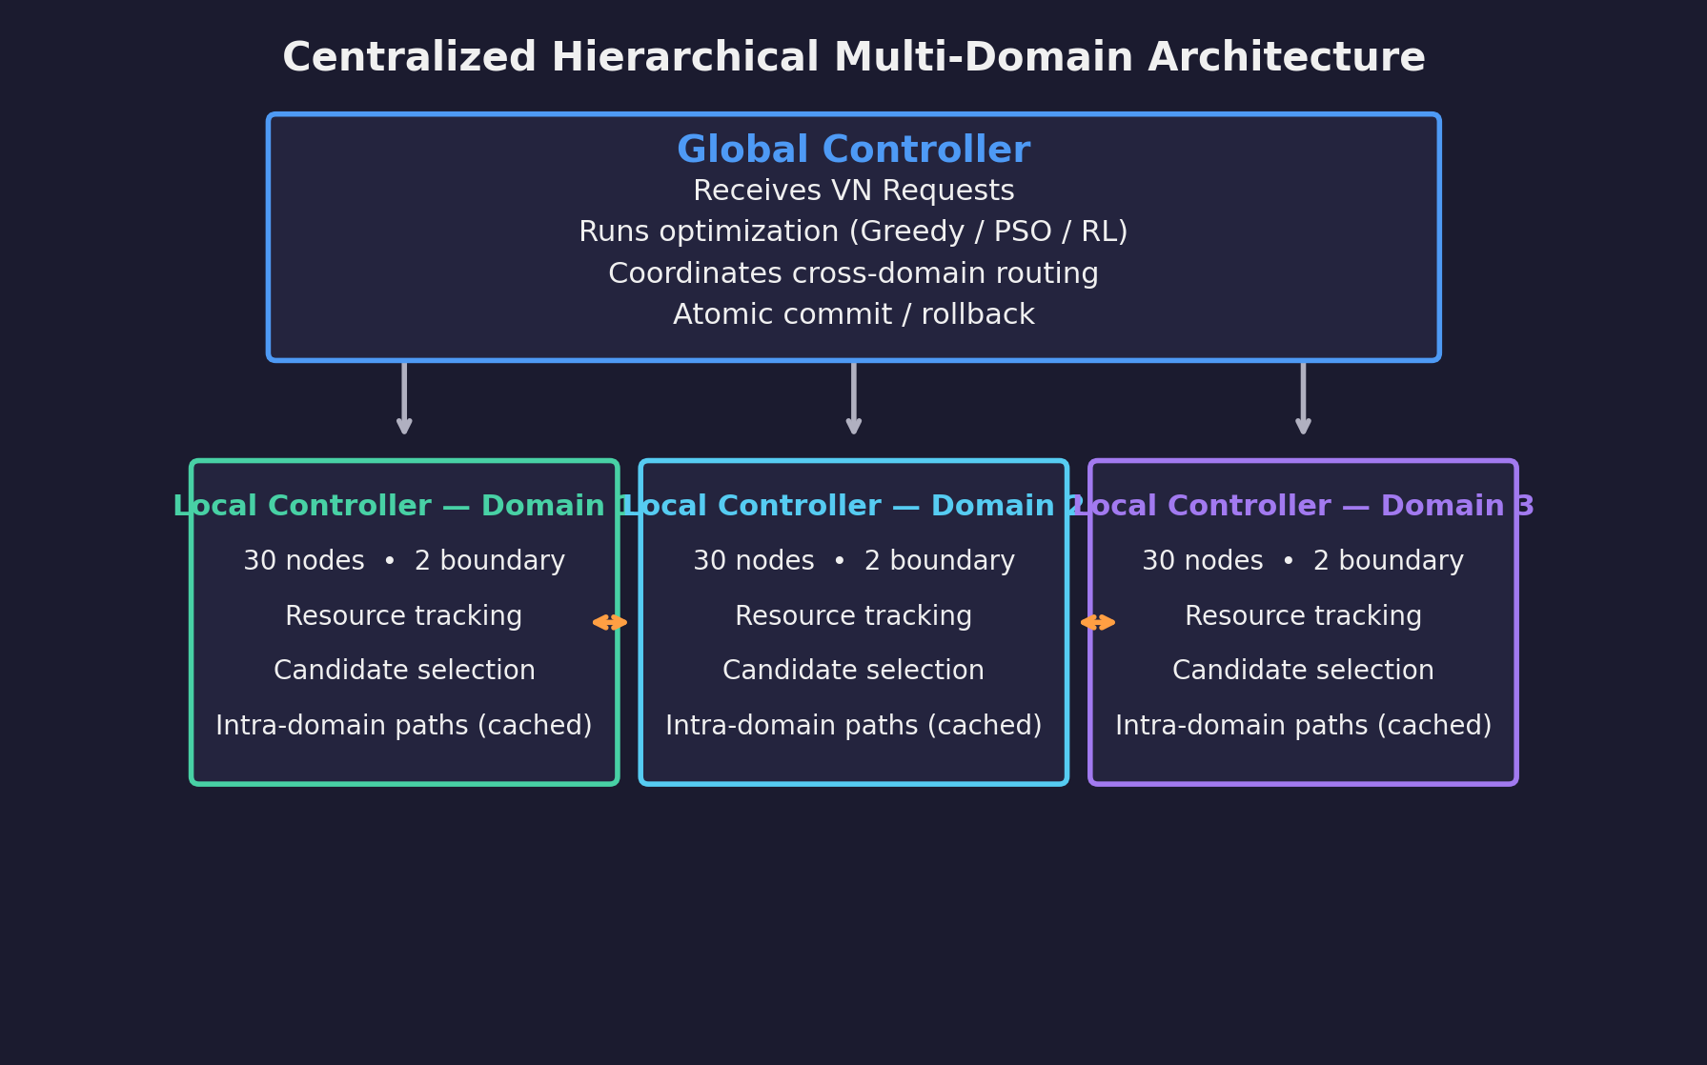
V. PROPOSED METHODS
System Architecture: Centralized Hierarchical Multi-Domain
Global Controller
• Orchestrates optimization algorithm
• Inter-domain path routing
• Commit/rollback allocations
Local Controllers
• Per-domain resource management
• Candidate node selection
• Intra-domain path caching

Slide 16
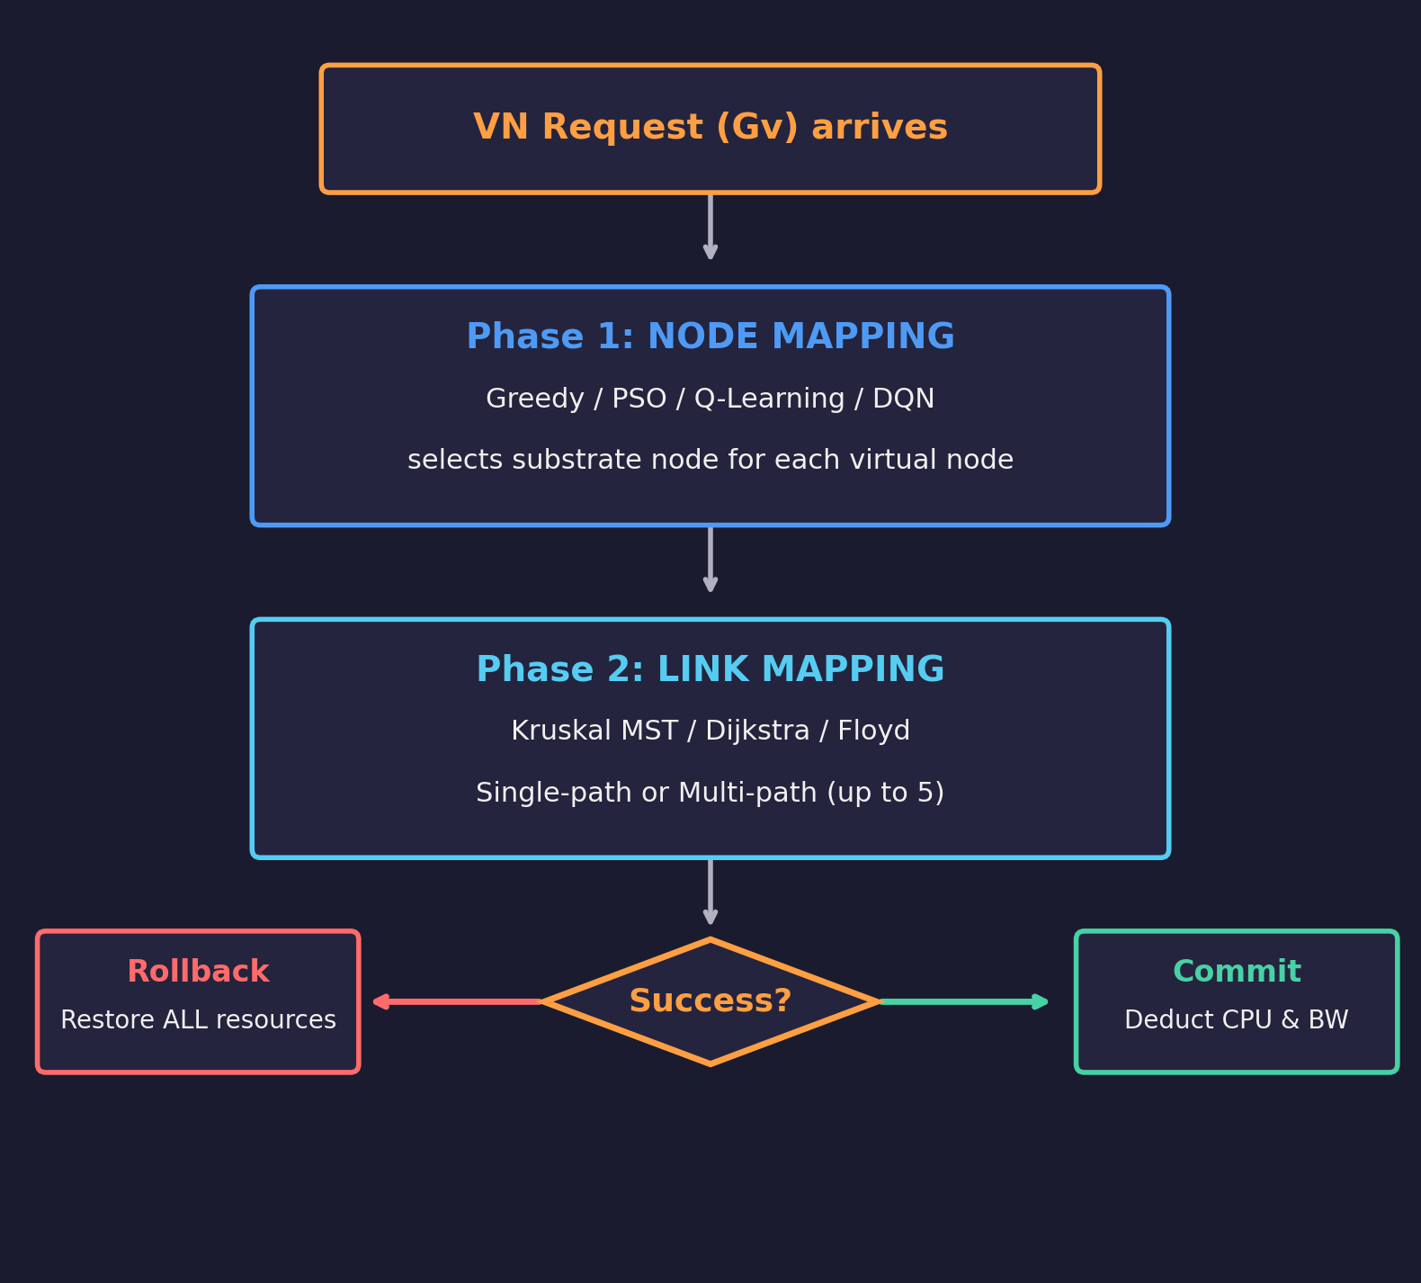
V. PROPOSED METHODS
Two-Phase Mapping Pipeline
Single-Path Link Mapping
• One physical path per virtual link
• Dijkstra or Kruskal MST
• Simple but may fail if path lacks BW
• Used by: MC-VNM, MPQ-VNE, SRL-VNE
Multi-Path Link Mapping (≤ 5 paths)
• Split bandwidth across multiple paths
• 1. Find shortest path → allocate min(demand, avail)
• 2. Update remaining demand
• 3. Repeat until satisfied or 5 paths
• 4. Rollback if insufficient
• Used by: MP-VNE, MP-DQN-VNE, SRL-MP-VNE

Slide 17
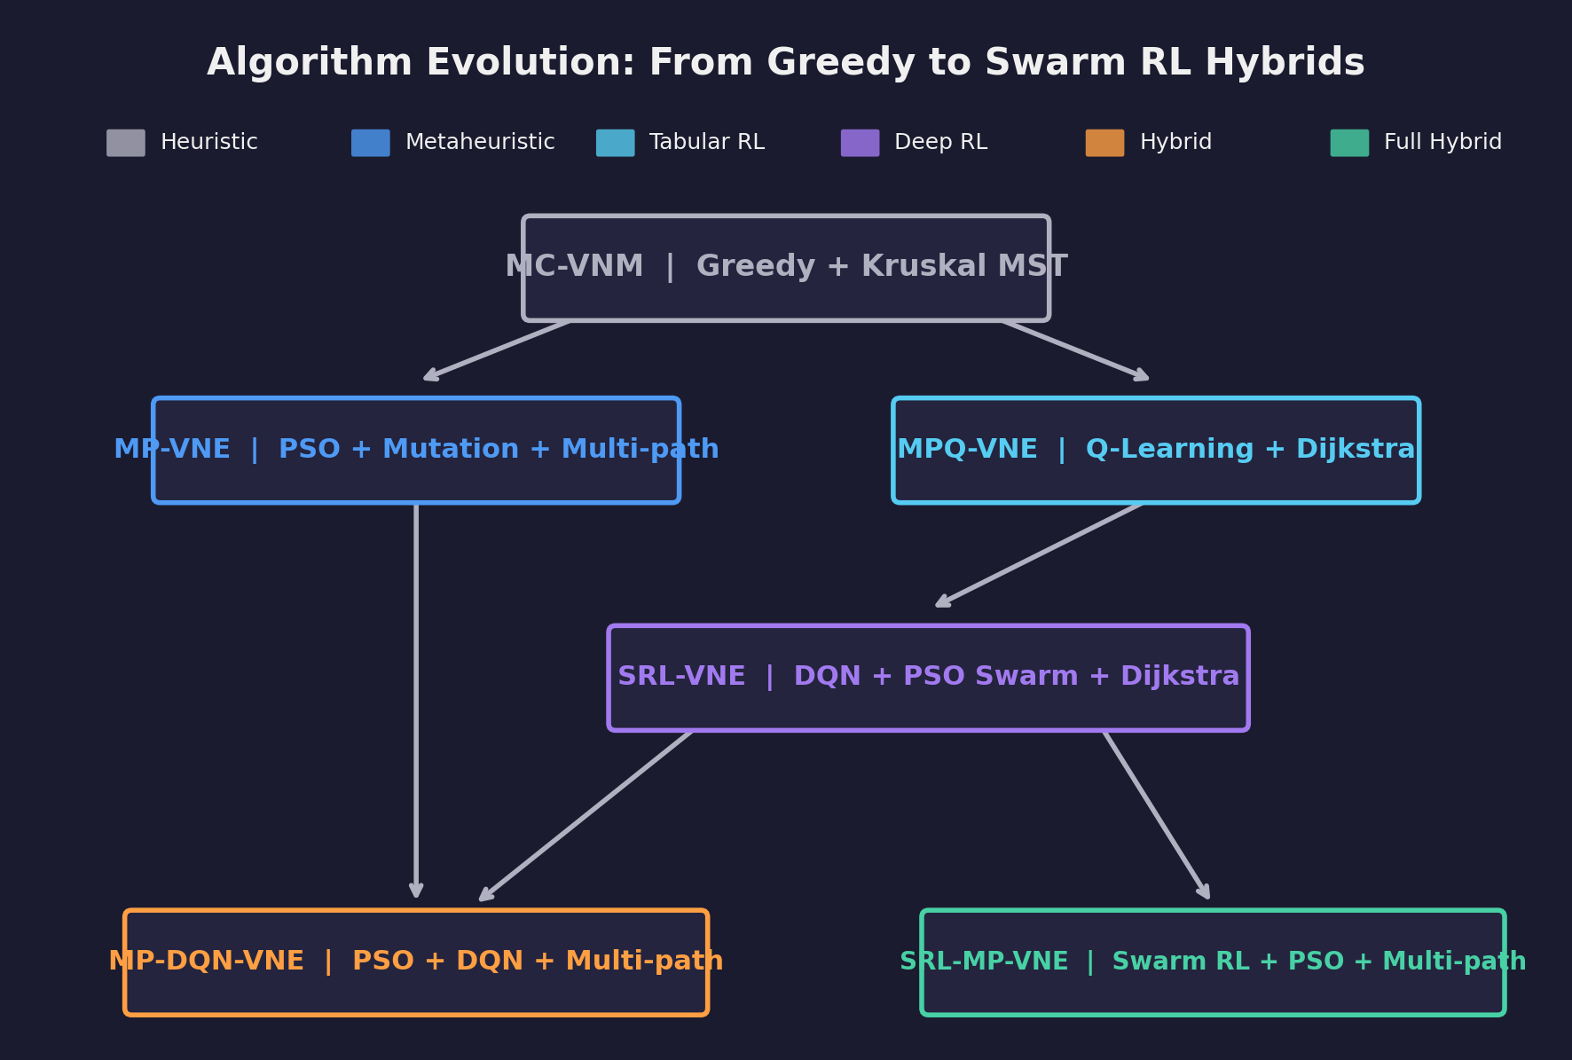
V. PROPOSED METHODS
Algorithm Summary
Algorithm | Node Mapping | Link Mapping | Learning | Paths
MC-VNM | Greedy ranking | Kruskal MST | None | Single
MP-VNE | PSO (20p, 15i) | Floyd shortest path | None | Multi (≤5)
MPQ-VNE | Q-Learning (ε-greedy) | Dijkstra | Q-table | Single
SRL-VNE | DQN + PSO Swarm | Dijkstra | DQN (4 agents) | Single
MP-DQN-VNE | PSO + DQN fitness | Floyd shortest path | DQN (4 agents) | Multi (≤5)
SRL-MP-VNE | PSO + Swarm RL | Floyd shortest path | DQN (4 agents) | Multi (≤5)

Slide 18
V. PROPOSED METHODS
Method 1: MC-VNM — Baseline Greedy
Node Mapping — Greedy Cost-Efficient Selection
• 1. Sort virtual nodes by CPU demand (descending)
• → hardest-to-place first
• 2. Score each candidate substrate node:
• Score(nˢ) = P_cpu(nˢ) / (C_avail(nˢ) + ε)
• 3. Select node with LOWEST score
• → cheapest per available CPU unit
Link Mapping — Kruskal's MST
• 1. Sort substrate links by cost:
• D_trans(l) + P_bw(l) × B_demand
• 2. Build MST using Union-Find
• 3. Find path in MST via BFS
• 4. Single path per virtual link
Pros
• Fastest algorithm — no iterations, no learning
• Deterministic — reproducible results
• Simple to implement and debug
Cons
• Myopic — each node placed independently
• No global optimization of mapping cost
• Single-path limits bandwidth flexibility

Slide 19
V. PROPOSED METHODS
Method 2: MP-VNE — PSO + Multi-Path
Particle Swarm Optimization for Node Mapping
• Each particle = a complete node mapping scheme
• Swarm of particles searches solution space collectively
• Velocity: vᵢ = w·vᵢ + c₁·r₁·(pbestᵢ - xᵢ) + c₂·r₂·(gbest - xᵢ)
• Position: xᵢ = xᵢ + vᵢ
Parameter | Value | Role
Particles | 20 | Population size
Iterations | 15 | Search depth
w (inertia) | 0.7 | Momentum of direction
c₁ (cognitive) | 1.5 | Pull toward personal best
c₂ (social) | 1.5 | Pull toward global best
Mutation rate | 0.1 | 10% random reset
Fitness Function
• f(x) = Σ NodeCost + Σ LinkCost
• LinkCost = D_trans + P_bw × B_demand per hop
Genetic Mutation (Key Innovation)
• 10% probability of random position reset
• Prevents PSO from converging to local optima
• Inspired by genetic algorithm crossover

Slide 20
V. PROPOSED METHODS
Method 3: MPQ-VNE — Q-Learning
Q-Learning Node Selection
• Q-table maps (domain_id, snode_id) → Q-value
• Initialization:
• Q(s) = C_cpu(nˢ) / (P_cpu(nˢ) + ε)
• Action selection (ε-greedy):
• 90%: select argmax Q(s) (exploit)
• 10%: select random (explore)
• Q-update after each VNR:
• Q(s) ← Q(s) + α·(reward - Q(s))
Parameter | Value
Learning rate (α) | 0.1
Discount factor (γ) | 0.9
Exploration (ε) | 0.1
Reward (success/fail) | +1.0 / -1.0
Link Mapping
• Dijkstra's single shortest path
• Cost: D_trans + P_bw × B_demand
Limitation
• Tabular Q-learning doesn't scale to large
• or continuous state spaces → need DQN

Slide 21
V. PROPOSED METHODS
Method 4: SRL-VNE — DQN + PSO Swarm
DQN Architecture
• Input: 6-dim state vector
• → FC 64 → ReLU
• → FC 64 → ReLU
• → Output: 20 Q-values
Feature | Description | Norm
v_cpu | Virtual node CPU demand | ÷ 20
s_cpu | Substrate node avail CPU | ÷ 100
s_bw | Avg available bandwidth | ÷ 500
s_degree | Node degree in network | ÷ 1000
progress | Mapping completion ratio | [0,1]
bias | Constant term | 0.5
Swarm (4 Agents)
• Each agent = DQN
• Track pBest, gBest
•
• PSO Q-update:
• Q += β(Q_pBest-Q)
• + δ(Q_gBest-Q)
•
• β = δ = 0.1
Training Details
• Memory buffer: 2000 transitions, batch: 64
• ε: 1.0 → 0.05 (decay 0.995 per episode)
• γ (discount): 0.95
Reward Function
• R = 100 × Revenue / (Cost + ε)
• Revenue = Σ CPU_demand + Σ BW_demand
• Link mapping: Dijkstra (single path)

Slide 22
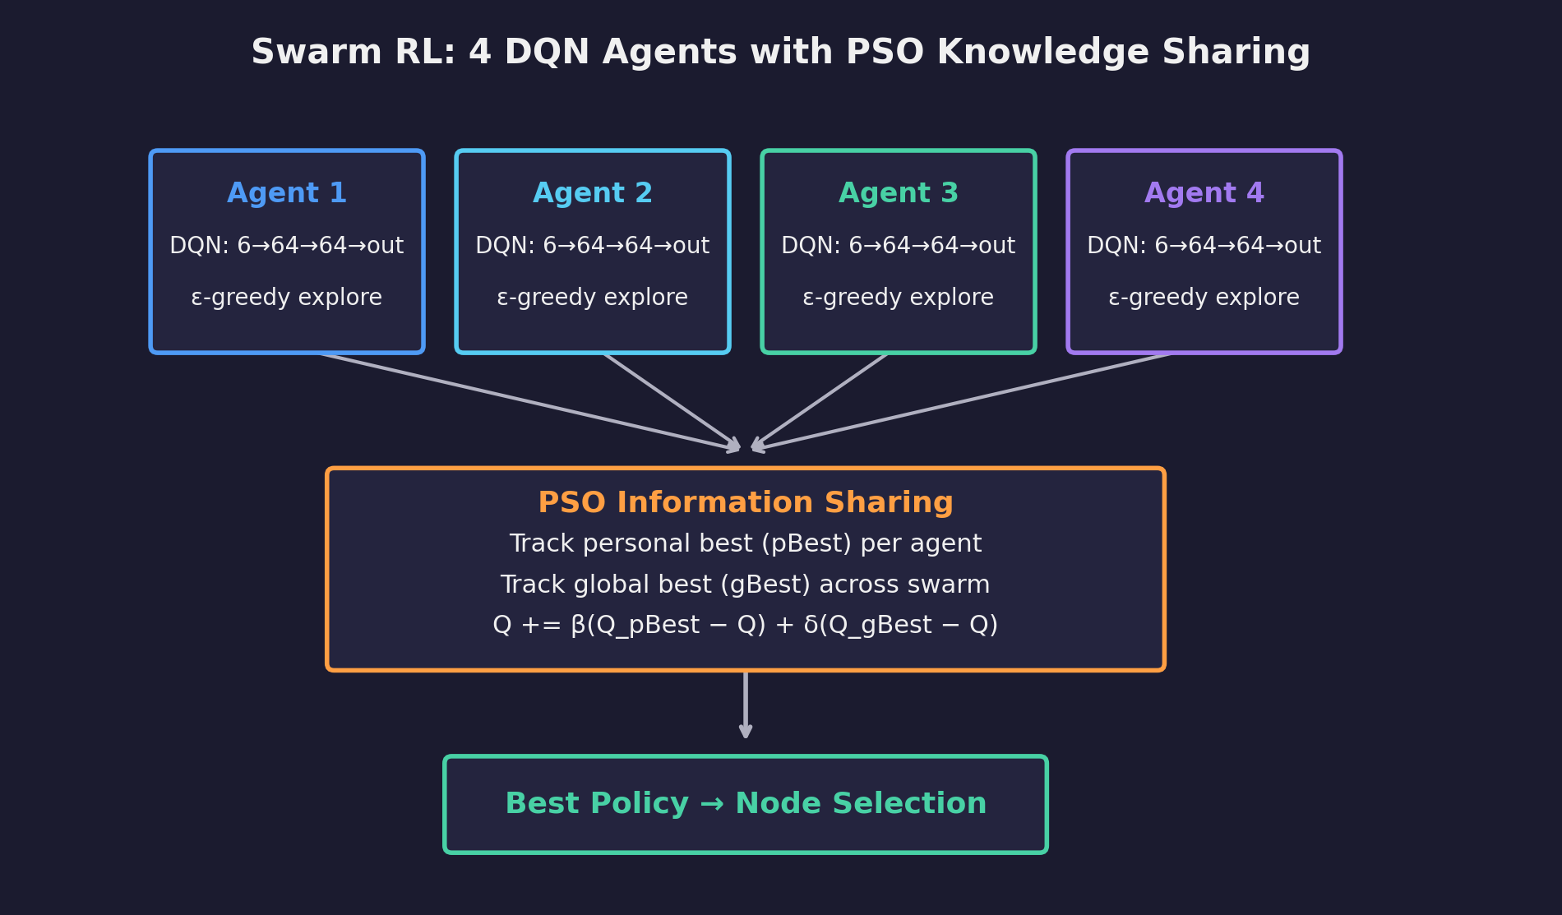
V. PROPOSED METHODS
Method 4: SRL-VNE — PSO Swarm Knowledge Sharing

Slide 23
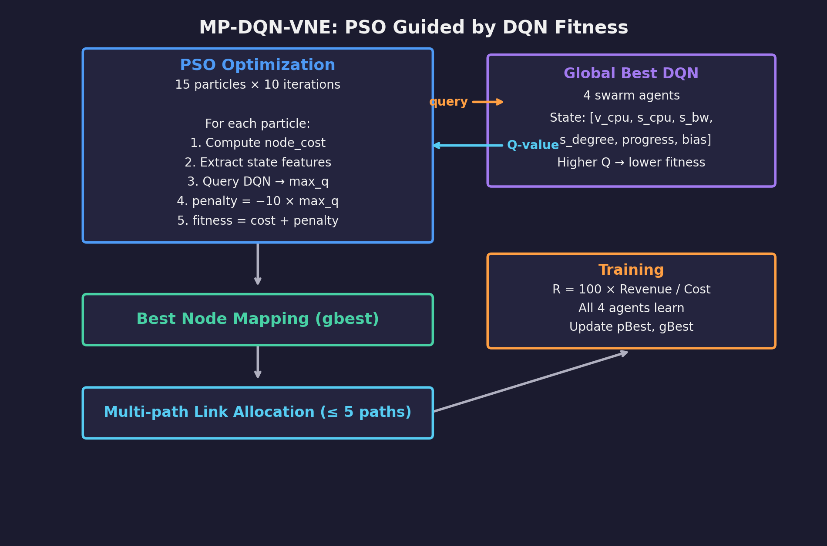
V. PROPOSED METHODS
Method 5: MP-DQN-VNE — PSO Guided by DQN
Key Innovation: DQN acts as an intelligent fitness function for PSO
• PSO handles combinatorial search; DQN provides learned heuristics about node quality. DQN improves over time → PSO fitness becomes more accurate.
Link Mapping
• Multi-path allocation (up to 5 paths)
• Same as MP-VNE mechanism
• Floyd shortest path routing
Training
• All 4 swarm agents receive same reward
• Cooperative learning
• R = 100 × Revenue / (Cost + ε)

Slide 24
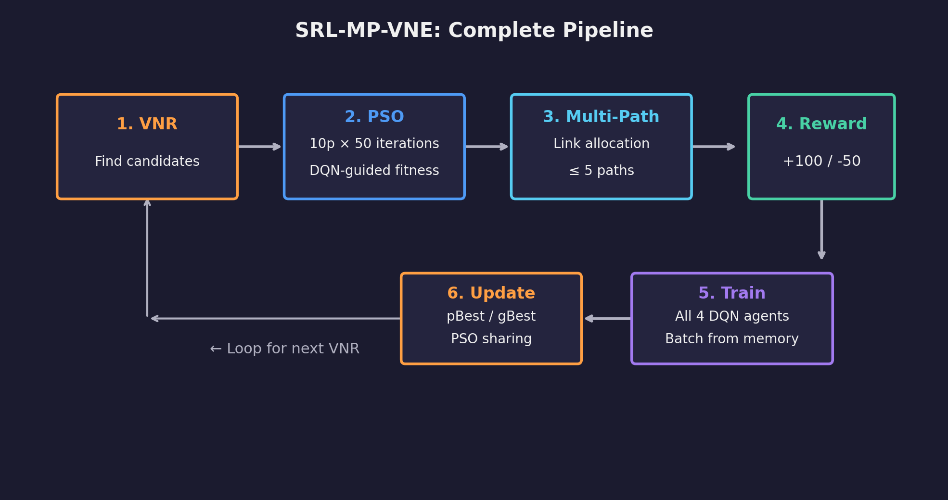
V. PROPOSED METHODS
Method 6: SRL-MP-VNE — Full Swarm RL + Multi-Path
Most complete hybrid — combines all techniques
Component | Configuration
PSO particles | 10
PSO iterations | 50 (deepest search)
Swarm agents | 4 DQN agents
Max paths/link | 5
Reward | +100 (success) / -50 (fail)
 | MP-DQN-VNE | SRL-MP-VNE
PSO iterations | 10 | 50 (deeper search)
Reward signal | Continuous R2C | Binary (+100/-50)
Degree normalization | ÷ 1000 | ÷ 10

Slide 25
VI. EXPERIMENT
Experimental Setup — Substrate Network
Parameter | Value
Number of domains | 4
Nodes per domain | 30
Boundary nodes/domain | 2
Total physical nodes | 120
Intra-domain edge prob | 0.5
Inter-domain edge prob | 0.1
Resource | Intra-domain | Inter-domain
CPU capacity | U(50, 100) | —
CPU price | U(1, 5) | —
Processing delay | U(0.1, 2.0) | —
BW capacity | U(500, 1000) | U(1000, 5000)
BW price | U(0.1, 1.0) | U(0.5, 2.0)
Trans. delay | U(1.0, 10.0) | U(5.0, 20.0)

Slide 26
VI. EXPERIMENT
Experimental Setup — Virtual Requests & Evaluation Protocol
VNR Parameter | Value
Nodes per VNR | U(3, 10)
Edge probability | 0.5
CPU demand | U(1, 20)
Bandwidth demand | U(1, 50)
Arrival process | Poisson, λ=0.04
Lifetime | Exp, mean=500
Evaluation Protocol
• 3 independent runs per algorithm, same dataset
• Results averaged with ± std deviation bands
• 6 metrics plotted over simulation time
• Binned every 1000 time units
Metric | What it Measures
RAC | Request acceptance rate over time
LAR | Long-term average revenue
R2C | Revenue-to-cost efficiency
Avg Cost | Average per-embedding cost
Avg Delay | Average physical path latency
Success # | Cumulative successful embeddings

Slide 27
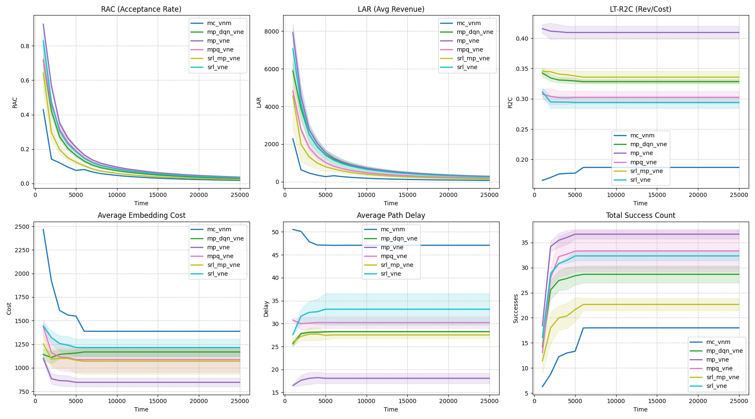
VII. RESULTS & DISCUSSION
Performance Comparison — 6 Metrics Over Time

Slide 28
VII. RESULTS & DISCUSSION
Analysis
Aspect | Finding
Acceptance Rate | Multi-path methods (MP-VNE, MP-DQN-VNE, SRL-MP-VNE) achieve higher RAC — flexible BW splitting
Embedding Cost | PSO-based methods find lower-cost mappings than greedy MC-VNM
Learning Effect | RL methods show improving performance over time as DQN agents learn
Delay | PSO fitness explicitly includes delay → lower average latency than greedy
Revenue | Higher acceptance + lower cost → higher long-term revenue for hybrid methods
Algorithm | Speed | Quality | Scalability | Learning
MC-VNM | ★★★★★ Fastest | ★☆ Lowest | ★★★★ Good | None
MP-VNE | ★★★ Medium | ★★★ Good | ★★★ Medium | None
MPQ-VNE | ★★★★ Fast | ★★ Medium | ★★★★ Good | Q-table
SRL-VNE | ★★ Slower | ★★★ Good | ★★★ Medium | DQN
MP-DQN-VNE | ★ Slowest | ★★★★ High | ★★★ Medium | DQN+PSO
SRL-MP-VNE | ★ Slowest | ★★★★★ Highest | ★★★ Medium | Swarm

Slide 29
VII. RESULTS & DISCUSSION
Comparison with Literature
Source | Best Method | RAC | Key Insight
MP-VNE [Zhang 2022] | MP-VNE | ~60% | PSO + mutation for multi-domain
FlagVNE [IJCAI 2024] | FlagVNE | +10.4% vs A3C-GCN | Bidirectional + meta-RL
Virne [ICLR 2026] | PPO-DualGAT | 78.1% | GNN encoder + action masking
Our work | SRL-MP-VNE | (see plots) | PSO + Swarm DQN + multi-path
Our Unique Contributions
• Multi-domain focus (vs single-domain in Virne/FlagVNE)
• Systematic comparison of 3 paradigms in unified framework
• Novel PSO + DQN hybrid combinations
• Multi-path link allocation across all PSO methods
Gaps to Address
• No GNN encoder yet (Virne: DualGAT is best)
• No bidirectional actions (FlagVNE advantage)
• No meta-RL for generalization
• Limited to synthetic topology (120 nodes)

Slide 30
VIII. CONCLUSION & FUTURE WORK
Conclusion
What We Built
• Unified multi-domain VNE framework with
• Global-Local controller architecture
• 6 algorithms: greedy → PSO → Q-Learning
• → DQN Swarm → PSO+DQN → Full hybrid
• Multi-path link allocation (≤ 5 paths)
• Automated evaluation (6 metrics, 3 runs)
Key Findings
• PSO >> Greedy (global search matters)
• DQN-guided PSO combines learned heuristics
• with metaheuristic search effectively
• Swarm intelligence (4 agents + PSO sharing)
• accelerates RL convergence
• Multi-path ↑ acceptance, ↑ complexity
• Clear speed–quality trade-off exists

Slide 31
VIII. CONCLUSION & FUTURE WORK
Future Work
Direction | Description | Reference
GNN-based encoders | GCN, GAT, DualGAT to capture graph topology in state representation | Virne [ICLR 2026]
Bidirectional actions | Joint virtual-physical node selection — provably better search space | FlagVNE [IJCAI 2024]
Meta-RL + curriculum | Generalize across VNR sizes without retraining from scratch | FlagVNE [IJCAI 2024]
Latency / energy aware | Multi-objective optimization for edge and 5G scenarios | Virne [ICLR 2026]
Larger-scale evaluation | Real topologies: GEANT (40), BRAIN, WX500 (500 nodes) | Virne [ICLR 2026]
Virne integration | Standardized comparison against 30+ algorithms in unified benchmark | Virne [ICLR 2026]

Slide 32
IX. REFERENCES
[1] P. Zhang, C. Wang, Z. Qin, H. Cao, "A Multi-Domain VNE Algorithm Based on Multi-Objective Optimization for IoD Architecture in Industry 4.0," arXiv:2202.12830, 2022.
[2] T. Wang, Q. Fan, C. Wang, L. Yang, L. Ding, N. J. Yuan, H. Xiong, "FlagVNE: A Flexible and Generalizable Reinforcement Learning Framework for Network Resource Allocation," IJCAI, 2024.
[3] Srini-Rohan, "Swarm Reinforcement Learning Using PSO," GitHub.
[4] T. Wang, L. Deng, X. Chen, J. Wang, H. He, L. Ding, W. Wu, Q. Fan, H. Xiong, "Virne: A Comprehensive Benchmark for Deep RL-based Network Resource Allocation in NFV," ICLR, 2026.

Slide 33
A. APPENDIX
Path Finding Algorithms Used
Algorithm | Used By | Type | Complexity
Floyd-Warshall | MP-VNE, MP-DQN-VNE, SRL-MP-VNE | All-pairs (cached) | O(V³)
Dijkstra | MPQ-VNE, SRL-VNE | Single-source | O(E log V)
Kruskal MST+BFS | MC-VNM | Min spanning tree | O(E log E)
Link cost function: Cost(lˢ) = D_transmission(lˢ) + P_bandwidth(lˢ) × B_demand(lᵛ)

Slide 34
A. APPENDIX
DQN Hyperparameter Comparison
Parameter | SRL-VNE | MP-DQN-VNE | SRL-MP-VNE
Swarm agents | 4 | 4 | 4
Network architecture | 6→64→64→20 | 6→64→64→20 | 6→64→64→1
Memory buffer | 2000 | 2000 | 2000
Batch size | 64 | 64 | 64
γ (discount) | 0.95 | 0.95 | 0.95
ε start → end | 1.0 → 0.05 | 1.0 → 0.05 | 1.0 → 0.05
ε decay rate | 0.995 | 0.995 | 0.995
β (pBest influence) | 0.1 | 0.1 | 0.1
δ (gBest influence) | 0.1 | 0.1 | 0.1

Slide 35
Thank You
Questions?

