Slide 1
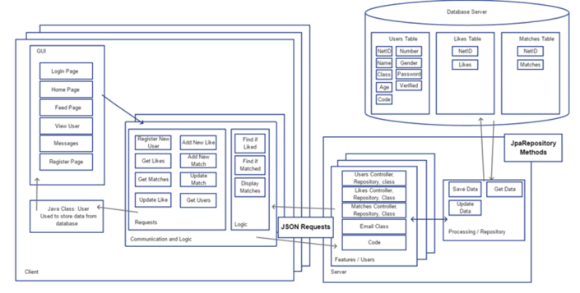
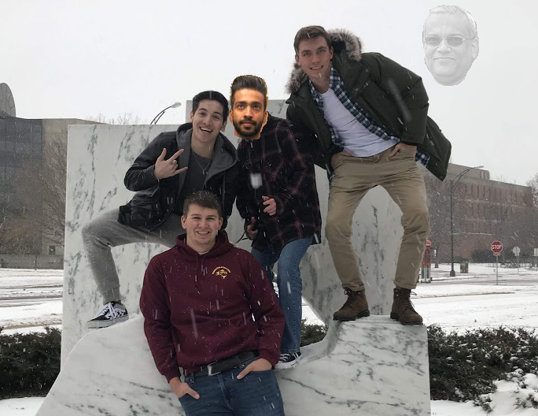
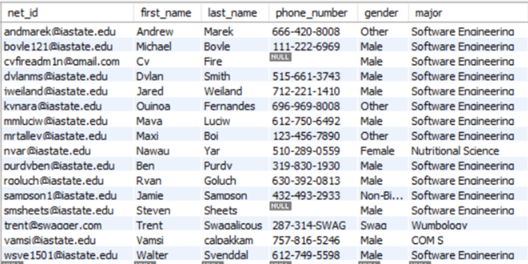
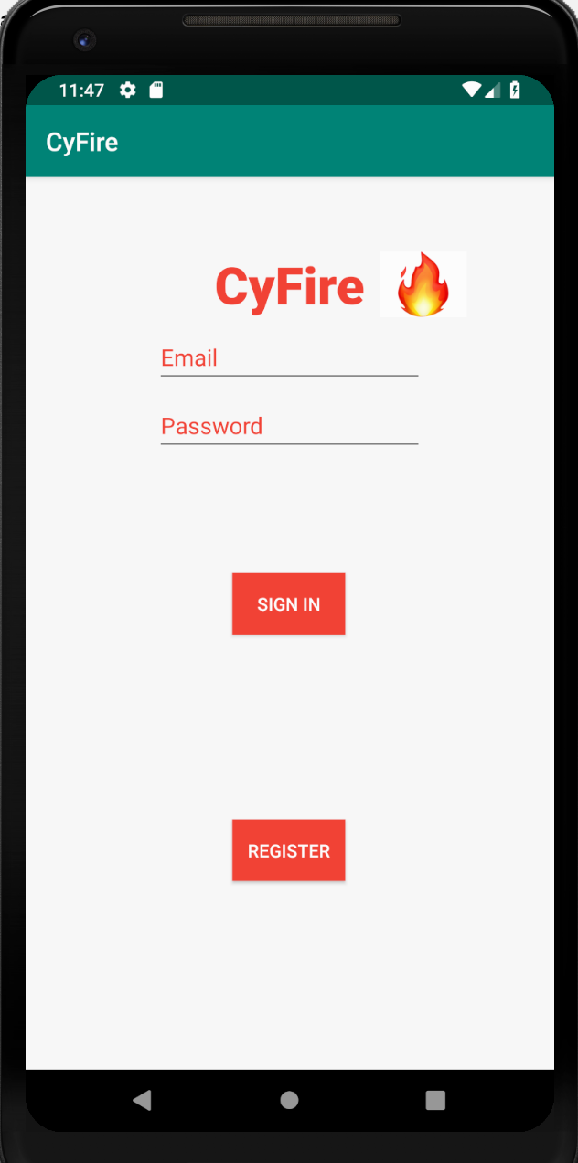
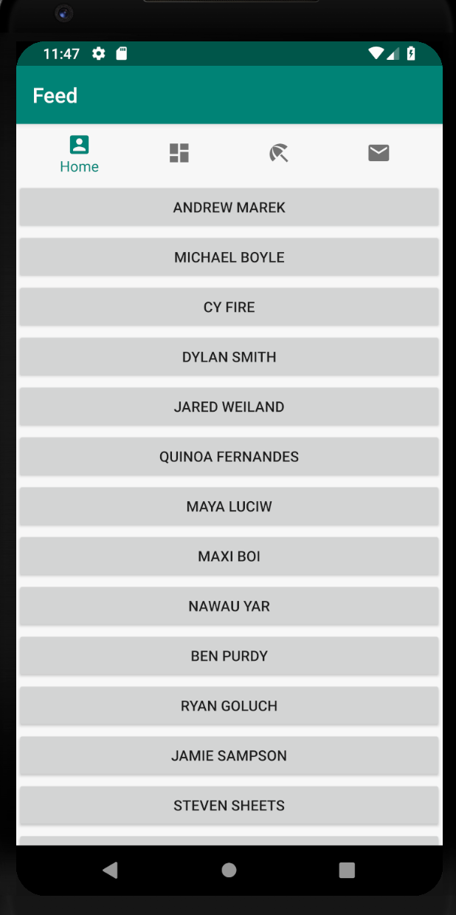
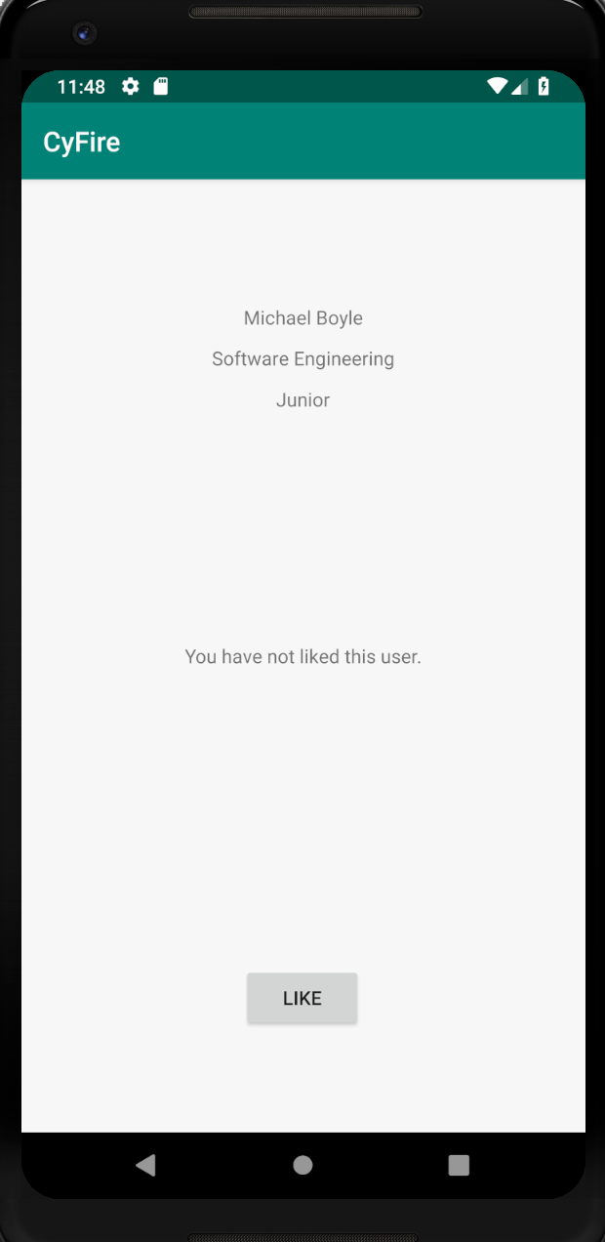
Andrew Marek
Steven Sheets
Jared Weiland
COM S 309: Spring 2019 TA: Vamsi Calpakkam
Project Description
CyFire is a dating app specific to Iowa State students to help them find the love of their life to walk around Lake Laverne with. Some core features include.
❖ Creating accounts with NetID.
❖ Being able to sort by age, major, classification.
❖ You’re able to talk with anyone, but matching with another Cyclone gives you extra privileges with them.
Users: ❖ Administrators ❖ Iowa State Students
User Interfaces (Frontend)
❖ User registers using Iowa State email (needs to be Iowa State affiliated).
❖ User can login using pre-existing account.
❖ Profile opens up with pictures of user and information entered from registration.
❖ Bottom navigation bar allows user to switch between fragments such as: profile, feed, messages, settings.
❖ User can scroll through feed and like users, which will then be displayed on their profile.
❖ User can message any other user.
Module Interfaces (Backend)
Users, Likes, and Matches Interfaces
❖ Held all the information about a user such as name, email, age, major.
❖ Likes and Matches were linked to user table by net id.
Code Interface
❖ Generates a verification code for a new user when they register. They must use that code to verify their account before they can sign in and use the app.
Email Interface
❖ Sends the user’s verification code to the email they entered when registering.
WebSockets
❖ Handles the chat, allowing users to communicate with each other.
Team Information
Team VC_3
Andrew Marek – Software Engineering (SOPH)
Steven Sheets – Software Engineering (SOPH)
Jared Weiland – Software Engineering (SOPH)
What went wrong? ❖ Team member dropped out. ☹ ❖ Didn’t completely finish app implementation.
❖ Did not implement image save/retrieval/display.
What went right? ❖ Most core features of the app were implemented, such as adding/removing/editing users, emailing, messaging (almost), etc..
❖ We definitely learned a lot, and the app conceptually has a lot of potential for usability and growth. Could continue working on it in the future.
Lessons Learned:
❖ Ask for help early. Don’t be afraid to reach out to the professor or TAs.
❖ Learned the structure of how a mobile Spring Boot application should be developed.

