Slide 1
Mixture-of-Experts with Expert Choice Routing
a NeurIPS 2022 Paper
Authors: Yanqi Zhou, Tao Lei, Hanxiao Liu, et al. (Google)
Zinan Wang
Notes:
Good morning/afternoon, everyone. My name is Zinan Wang, and today I'll be presenting on a cutting-edge topic in large AI models: Mixture-of-Experts, focusing on a novel routing strategy. authored by Yanqi Zhou and colleagues from Google.

Slide 2
Background: Scaling Challenges & MoE
Key Points:
Large AI models: High computation costs.
MoE Idea: Large parameters, but sparse activation (few "experts" per input).
Benefit: Increased model capacity at similar computation cost.
Need for Routing: How to decide which input (Token) goes to which expert(s)?
Notes:
Let's begin with the motivation. Building and training large AI models is just very expensive. As models grow in complexity and size, the computational cost increases significantly.
Mixture-of-Experts models provide an elegant solution to this.
The core idea is to increase the total number of model parameters – the 'experts' – but crucially, for any given input, only activate and use a small, sparse subset of these experts.
With this architecture, a critical component is the 'routing' part: how do we efficiently and effectively decide which input token should be processed by which expert?"

Slide 3
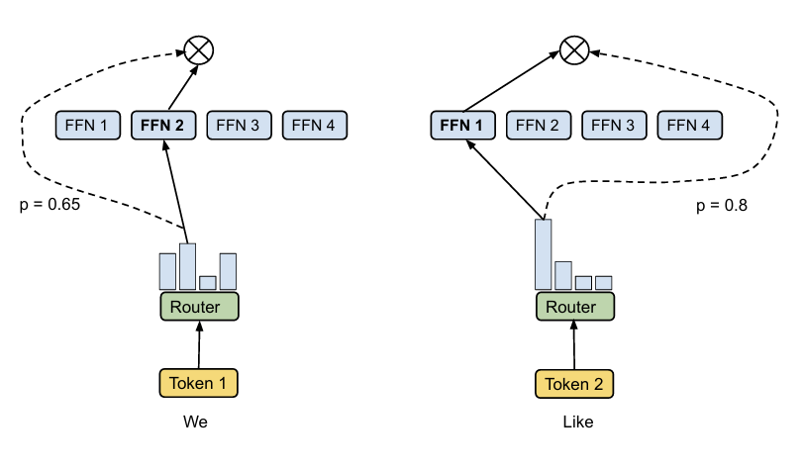
The Problem with Traditional Routing: Token Choice
Strategy: Each Token independently selects its Top-K "best" experts.
Problems:
Load Imbalance (Experts Overloaded/Idle)
Under-trained/Under-specialized Experts
Fixed computation per Token
Notes:
Historically, MoE models have primarily used 'Token-Choice Routing'. As illustrated on the left side, the strategy is straightforward: each input token independently evaluates all the available experts and selects the Top-K experts with the highest scores to handle it.
However, this approach suffers from significant problems. The most prominent issue is Load Imbalance. Tokens tend to flock to the same few experts, leading to some experts being heavily overloaded while others remain largely idle
Overloaded experts can become bottlenecks and may even have to drop tokens, wasting computation. Idle experts don't receive enough training data, resulting in them being under-trained or failing to specialize.
Additionally, this method assigns a fixed amount of computation (K experts) to every token, regardless of its complexity."

Slide 4
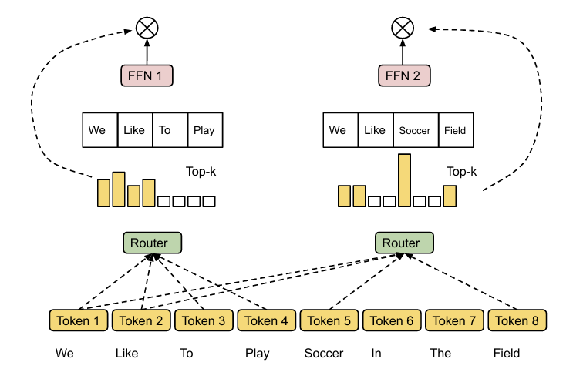
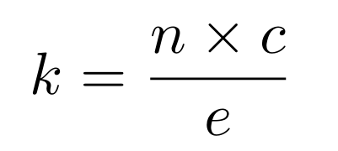
New Method: Expert Choice Routing
Core Idea: Experts select Tokens (instead of Tokens selecting Experts).
Key Design: Fixed Expert Capacity (k)
Each expert processes k Tokens.:
n: Total Tokens in batch
c: Capacity Factor (Avg. experts per Token)
ϵ: Total number of experts
Result: Natural Load Balancing (No Auxiliary Loss Needed)
Tokens can be processed by varying numbers of experts (Flexibility).
Notes:
This paper introduces a novel approach called 'Expert Choice Routing' that tackles these issues head-on. The core idea is to reverse the perspective: instead of tokens choosing experts, the experts choose the tokens they will process.
A key design element here is the Fixed Expert Capacity, denoted by k. Each expert is assigned a predetermined capacity , which means a fixed number of tokens it is responsible for processing in each forward pass
this method inherently achieves perfect load balancing across all experts, eliminating the need for complex auxiliary loss functions. Furthermore, this approach naturally allows different tokens to be processed by a variable number of experts, providing flexibility based on the learned routing

Slide 5
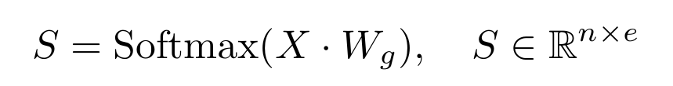
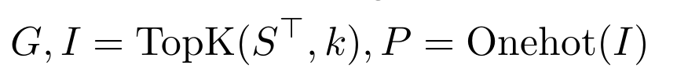
Routing Mechanism Simplified
Calculate Token-to-Expert Affinity Scores (Token×Expert)
Experts Pick Tokens: Apply TopK to the transpose of S (), each expert (row) selects Top-k Tokens.
Outcome: Efficient and balanced routing.
Notes:
Let's briefly touch upon the simplified routing part. First, the model computes an affinity score matrix S between the input tokens and the experts, typically using a linear layer and a Softmax function
The critical step for Expert Choice is applying the TopK operation to the transpose of S
This process yields the gating weights (G) and indices (I) of the selected tokens. The matrix P is then constructed from these indices.

Slide 6
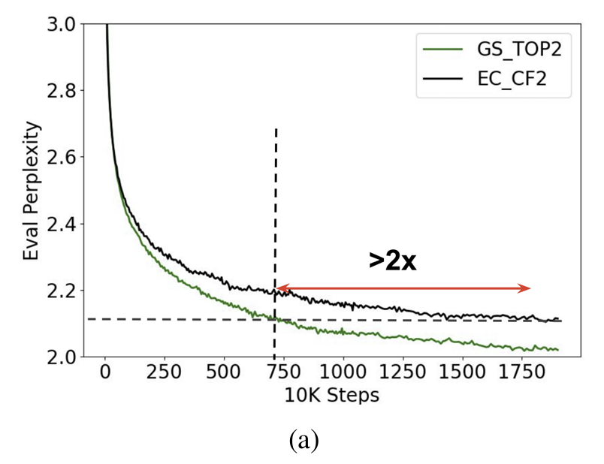
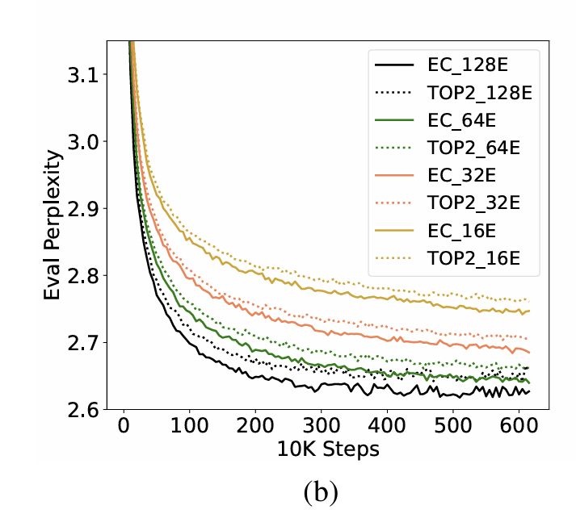
Experimental Validation: Key Findings
Faster Training:
>2x convergence speed (vs. GShard Top-2)
Good Scaling: Performance improves with more experts
Notes:
The paper presents strong experimental evidence supporting the effectiveness of Expert Choice routing.
First, in terms of training efficiency, the method shows significantly faster convergence. As you can see in this graph, Expert Choice (EC_CF2) reaches the same perplexity level more than twice as fast compared to the traditional method.
The method also demonstrates good scaling properties. This graph shows that increasing the number of experts, while keeping the expert size fixed, consistently improves training perplexity.

Slide 7
Challenges & Future Directions
Application Limitations: Auto-regressive generation / Small batch inference adaptation needed.
Hardware: High total parameter memory remains a challenge.
Future: Improve inference efficiency, more dynamic routing, etc.
Notes:
Despite advantages, challenges remain. Adapting for auto-regressive generation and small batches needs work. High total memory is still a constraint.
Future work might focuses on deployment and more dynamic routing.

Slide 8

Summary: Efficient & Flexible Expert Choice MoE
Novel "Experts Select Tokens" routing strategy.
Intrinsic load balancing.
Improved training efficiency and performance.
Provides a new approach for large, efficient AI models.
Application e.g.:
Notes:
In summary, Expert Choice Routing uses 'experts select tokens' for natural load balancing. It significantly boosts training efficiency and performance. There are already influencing models use this arch like DeepSeek.

Slide 9
Questions & Answers
Thanks!
Notes:
I'm now ready to take any questions you may have
你提到了内存占用大的局限性，如果总参数量很大，部署起来会不会很困难？
Question: You mentioned the limitation of high memory usage. If the total parameter count is very large, will deployment be very difficult?
答： 这是 MoE 模型普遍面临的挑战。虽然专家选择提高了计算效率，但所有专家的参数都需要加载到内存中。所以相比同等计算成本的密集模型，总参数量更大的 MoE 需要更多的内存。部署时可能需要专门的硬件或优化技术来解决这个问题。
除了负载均衡，这个新方法还有其他什么主要优点吗？
Question: Besides load balancing, what other main advantages does this new method have?Question: Why can the computational cost of MoE models be similar to that of dense models, even when the total parameter count is much larger?
答： 最大的优点是显著提高了训练效率，收敛速度比以前的方法快两倍多。同时，在 GLUE 和 SuperGLUE 等任务上的下游性能也更好。另外，它允许 Token 被数量不等的专家处理，增加了灵活性。
为什么 MoE 模型在总参数量大很多的情况下，计算成本可以和密集模型相似？
Question: Why can the computational cost of MoE models be similar to that of dense models, even when the total parameter count is much larger?
答： 这是因为 MoE 采用了稀疏激活。虽然总参数量大，但在处理每个 Token 时，只有少数（比如 k 个）专家是被实际激活和计算的。密集模型处理每个 Token 时会使用到几乎所有参数。所以 MoE 用“以空间换时间”的方式，在相似的计算时间下实现了更大的模型容量。
专家选择路由方法是不是特别适合某些类型的任务？比如文本生成还是理解？
Question: Is the Expert Choice routing method particularly suitable for certain types of tasks?
答： 论文主要在自然语言理解任务（GLUE/SuperGLUE）上验证了效果，表现很好。它提高了 MoE 的通用效率和性能。虽然论文提到了自回归生成是局限性，但其核心思想对多种需要 MoE 的任务都有潜力。
有没有发现哪些类型的 Token 更容易被多个专家选中？是像关键词或者难理解的词吗？
Question: Have you found which types of Tokens are more likely to be selected by multiple experts? Are they like keywords or difficult-to-understand words?
答： 论文中没有具体分析是哪些“类型”的 Token（比如词性）被更多专家选中。这个也许需要其他后续的研究

