Slide 1
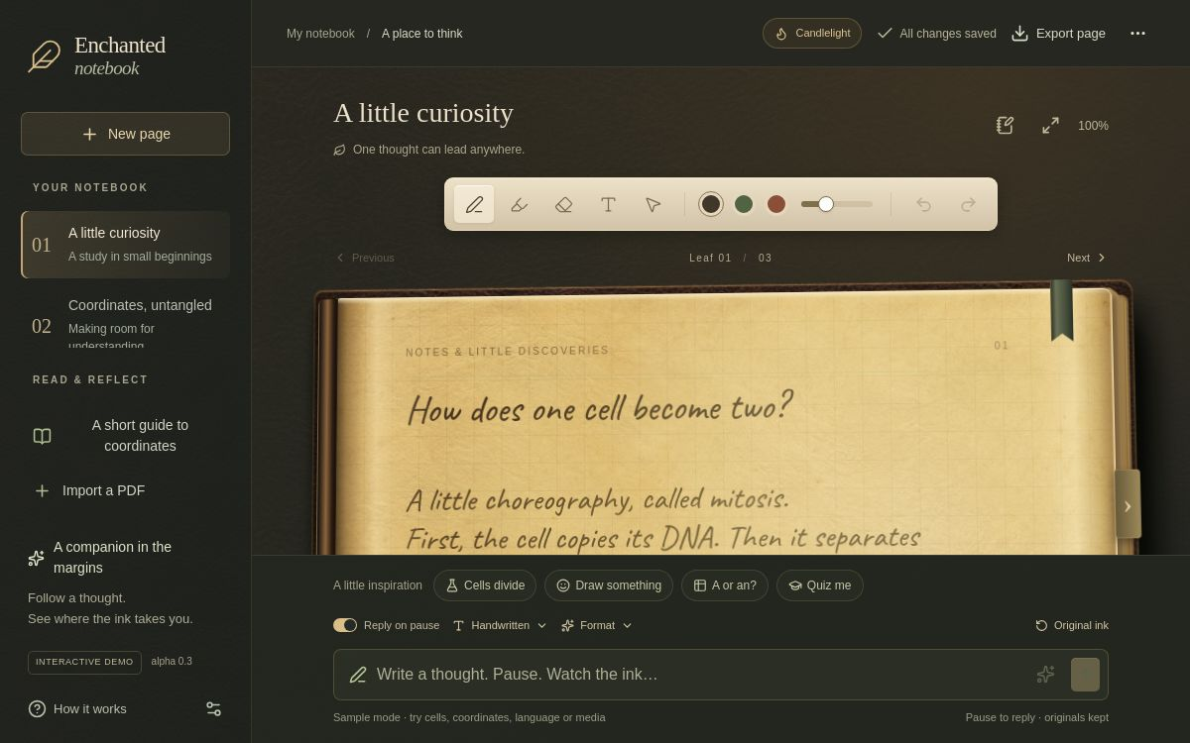
BUSINESS PLAN / INVESTOR BRIEF
Enchanted
Notebook
An AI-native handwritten workspace for learning, reflection, and creative planning.
The product wedge is simple: make the page more useful without taking the page away.
OPEN THE PRODUCT TOUR
PRODUCT WEDGE
https://enchanted-notebook-sakura.sakuraasuna.chatgpt.site/demo
ink + companion + memory
Notes:
Product source: Build Interactive Demo alpha 0.3 screenshot at /workspace/scratch/8f4a6e16de47/recovered/public/demo/alpha-0.3.jpg
Live product tour: https://enchanted-notebook-sakura.sakuraasuna.chatgpt.site/demo

Slide 2
OPPORTUNITY
The note is captured. The next move is still scattered.
Handwriting apps, AI note assistants, and journaling products each solve part of the job. Users still move between surfaces when a thought needs context, a source needs checking, or a plan needs a response.
CAPTURE
UNDERSTAND
CONTINUE
Write by hand, type, clip, or annotate.
Ask for structure, explanation, or a source.
Return to the thought with memory and a next step.
existing strength
new expectation
unmet continuity
Business thesis
Own the transition from a handwritten thought to an inspectable, useful continuation.
ENCHANTED NOTEBOOK / 02
BUSINESS PLAN / ALPHA 0.3
Notes:
Analytical framing based on the product architecture and companion integration contract in ARCHITECTURE.MD, COMPANION_INTEGRATION.md, and COMPANION_PROFILES.md.

Slide 3
PRODUCT TRUTH
The working loop is the product advantage
The alpha already demonstrates a coherent interaction contract. A user can write immediately, wait for a response, and continue with the original source intact.
WRITE
PAUSE
ink appears now
work can wait
REPLY
KEEP
meaning arrives in context
source stays reversible
Watch the product clip
ENCHANTED NOTEBOOK / 03
BUSINESS PLAN / ALPHA 0.3
Notes:
Source: alpha 0.3 product implementation and MEMORY&LEARNED.MD. The product loop is write, pause, respond, keep.

Slide 4



CREATIVE DIFFERENTIATION
Companionship belongs in the margin
The companion is a persistent identity inside the notebook, not a chat tab. It can teach, challenge, map, or spark a new branch while the user remains the protagonist.
Mara
Cassian
Mira
ground the next step
map the trade-offs
open a creative door
voice + placement + boundary
voice + placement + boundary
voice + placement + boundary
Defensible design choice
The renderer owns the page. Providers return intent and semantic placement, not a foreign visual layer.
ENCHANTED NOTEBOOK / 04
BUSINESS PLAN / ALPHA 0.3
Notes:
Sources: COMPANION_PROFILES.md, COMPANION_INTEGRATION.md, and companion_profiles.json. Portraits are supplied project assets.

Slide 5
MARKET SIGNAL
Adjacent products already monetize the job
Selected annual price points show willingness to pay for handwriting, AI assistance, secure memory, and media-rich reflection. These are category signals, not a market-size estimate.
Goodnotes Pro
$35.99
What the signal says
Notability Pro
$79.99
The category supports a freemium path with paid AI or memory depth.
Our opening wedge can price for continuity and trust, then expand into education and teams after the core loop retains users.
Reflect annualized
$120.00
Day One Gold
$74.99
Observed plans / USD per year
ENCHANTED NOTEBOOK / 05
BUSINESS PLAN / ALPHA 0.3
Notes:
Sources accessed 2026-09-11:
Goodnotes, “Plans, Pricing & Free Trial,” https://www.goodnotes.com/pricing (Pro $35.99/year; Teams $120/seat/year; AI Pass listed separately).
Notability, “Plans tailored to you,” https://notability.com/pricing (Plus $15.99/year; Pro $79.99/year; Business $60/user/year).
Reflect, product page, https://reflect.app/ ($10/month billed annually, equivalent to $120/year).
Day One, “Choose a Day One Plan,” https://dayoneapp.com/plans/ (Gold $74.99/year).

Slide 6
POSITIONING
A focused wedge between four familiar categories
We are not competing on every note feature. We are combining the strongest expectations of adjacent products around one distinctive surface.
Handwriting tools
natural capture + PDF markup
Goodnotes / Notability
AI knowledge tools
search + assistant + connections
Reflect
Journaling tools
secure memory + media + prompts
Day One
Enchanted Notebook
source-preserving companion on the page
our wedge
ENCHANTED NOTEBOOK / 06
BUSINESS PLAN / ALPHA 0.3
Notes:
Category descriptions grounded in official product pages:
Goodnotes: https://www.goodnotes.com/pricing
Notability: https://notability.com/pricing
Reflect: https://reflect.app/
Day One: https://dayoneapp.com/plans/
Enchanted Notebook positioning is an analytical product hypothesis based on the project architecture and interaction contract.

Slide 7
COMMERCIAL WEDGE
Start where the page already has a job
The first buyer does not need an entire world simulation. They need a trusted writing surface that makes a recurring kind of work feel lighter.
Beachhead
Expansion
Later
Reflective learning
Creative planning
Education and teams
Students, independent learners, and people who already annotate by hand. Paid value: continuity, guided review, and source-linked memory.
Writers, designers, worldbuilders, and project leads. Paid value: companion modes, visual branching, and reusable notebooks.
Shared libraries, facilitator views, policy controls, and exportable evidence. Paid value: cohort workflows and governance.
Commercial assumption
Win one repeatable use case before adding breadth.
ENCHANTED NOTEBOOK / 07
BUSINESS PLAN / ALPHA 0.3
Notes:
Segment sequence is a product hypothesis for investor discussion, not a reported market fact. It follows the current alpha 0.3 surface and the companion profile best-for matrix.

Slide 8
BUSINESS MODEL
Charge for continuity, depth, and control
The pricing shape should mirror the product's trust model: the free tier proves the surface, paid tiers unlock durable value, and institutions pay for governance.
Free
Plus
Pro
Teams / Education
one notebook
personal companion
creative system
shared practice
capture + sample mode
memory depth + richer media
multiple companions + export
admin, cohorts, evidence
Pricing hypothesis, to validate with activation and retention evidence before committing.
ENCHANTED NOTEBOOK / 08
BUSINESS PLAN / ALPHA 0.3
Notes:
Pricing architecture is a product hypothesis informed by observed adjacent annual tiers on Goodnotes, Notability, Reflect, and Day One. It is not a proposed final price list.

Slide 9
DEFENSIBILITY AND ROADMAP
The moat is a trustworthy system, not a magic trick
The product can improve models without surrendering ownership of the page. That separation creates a durable path for providers, companions, and future devices.
Source-preserving data model
raw ink, derived text, response, and memory proposals stay separate
Roadmap
NOW alpha 0.3
working folio, sample companion, PDF reader, quizzes
NEXT alpha 0.4
recognition review, provider registry, notebook-scoped memory
THEN beta
cohorts, shared libraries, companion packs, device polish
Renderer-owned experience
providers return meaning and placement; the app owns page consistency
Inspectability
memory is notebook-scoped, source-linked, editable, and reversible
ENCHANTED NOTEBOOK / 09
BUSINESS PLAN / ALPHA 0.3
Notes:
Sources: ARCHITECTURE.MD, WORKFLOW.MD, MEMORY&LEARNED.MD, and COMPANION_INTEGRATION.md. Roadmap items labeled NEXT and THEN are proposed seams, not completed functionality.

Slide 10
THE NEXT PROOF
Prove repeat value before adding more magic
The next milestone is commercial evidence: can the writing loop bring people back, and will they pay for a deeper companion relationship?
01
Activation
02
Retention
Can a first-time user write, pause, and keep a useful response in under five minutes?
Do people return to the same notebook because the companion remembers the right things?
03
Conversion
04
Distribution
Which depth unlock earns payment: memory, creative modes, or shared practice?
Can a learning or creator partner bring a cohort to the same surface?
https://enchanted-notebook-sakura.sakuraasuna.chatgpt.site/demo
live product tour
ENCHANTED NOTEBOOK / 10
BUSINESS PLAN / ALPHA 0.3
Notes:
Live proof surface: https://enchanted-notebook-sakura.sakuraasuna.chatgpt.site/demo
Validation questions are proposed for the next product milestone.

Slide 11
SOURCES AND SCOPE
Evidence used in this brief
Market claims are limited to public product pages accessed on 2026-09-11. Product claims come from the Build Interactive Demo artifacts and the deployed alpha surface.
Goodnotes
Plans, Pricing & Free Trial
https://www.goodnotes.com/pricing
Notability
Plans tailored to you
https://notability.com/pricing
Reflect
Product and pricing page
https://reflect.app/
Day One
Choose a Day One Plan
https://dayoneapp.com/plans/
Project artifacts
ARCHITECTURE.MD, WORKFLOW.MD, MEMORY&LEARNED.MD, COMPANION_INTEGRATION.md, COMPANION_PROFILES.md
Local project sources
Commercial values are hypotheses to validate, not guarantees.
ENCHANTED NOTEBOOK / 11
BUSINESS PLAN / ALPHA 0.3
Notes:
Full market URLs:
https://www.goodnotes.com/pricing
https://notability.com/pricing
https://reflect.app/
https://dayoneapp.com/plans/
Project artifacts: /workspace/scratch/8f4a6e16de47/project_sources/04-ARCHITECTURE.MD, 05-WORKFLOW.MD, 03-MEMORY-LEARNED.MD, 09-COMPANION_INTEGRATION.md, 10-COMPANION_PROFILES.md

