Slide 2
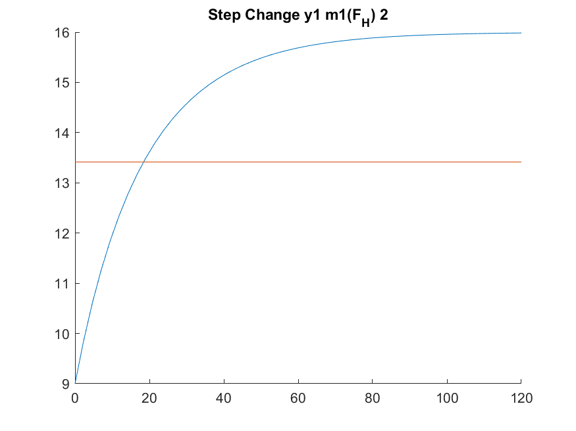
Dead time = 0(sec)
Time constant = 25(sec)
K_p = (16-9)/ (2-0) = 3.5

Slide 3
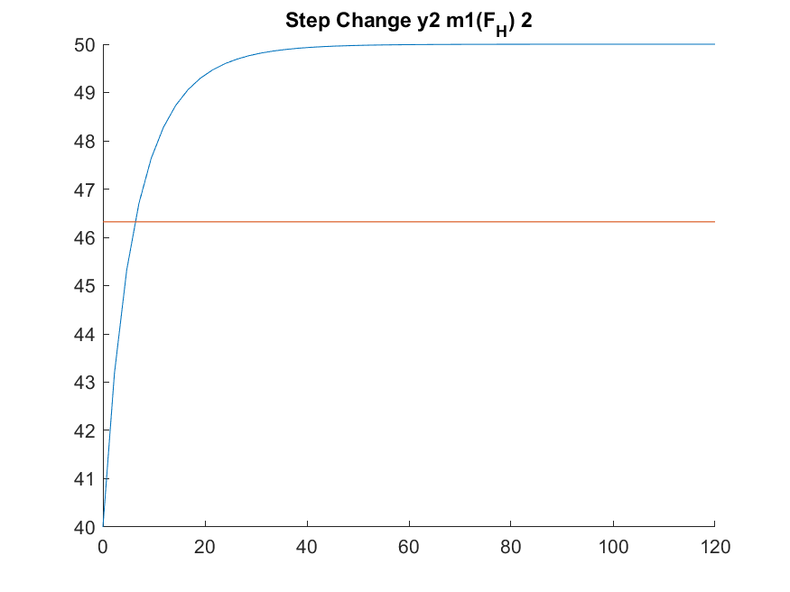
Dead time = 0(sec)
Time constant = 7(sec)
K_p = (50-40)/ (2-0) = 5

Slide 4
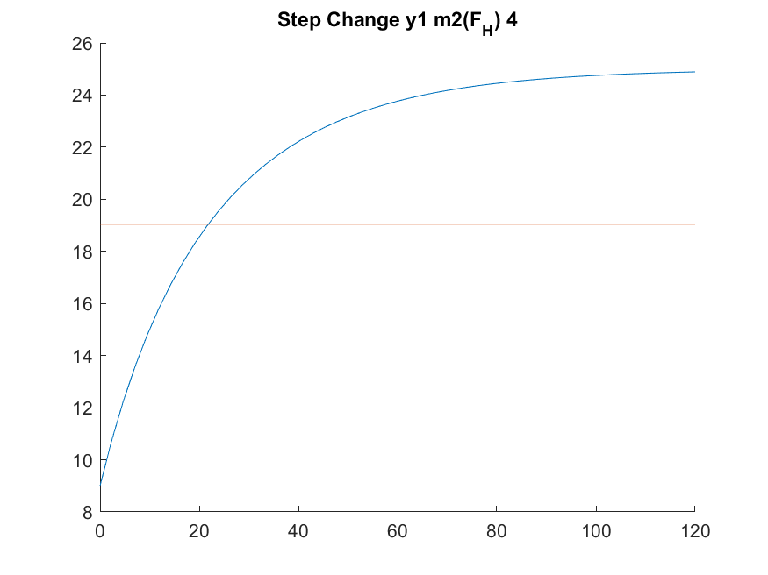
Dead time = 0(sec)
Time constant = 25(sec)
K_p = (25-9)/ (4-0) = 4

Slide 5
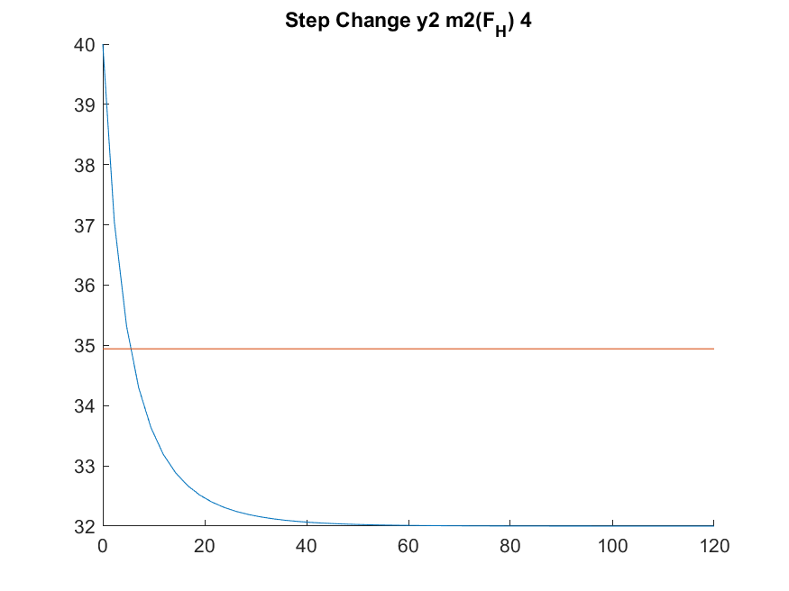
Dead time = 0(sec)
Time constant = 8(sec)
K_p = (32-40)/ (4-0) = -2

