Slide 2
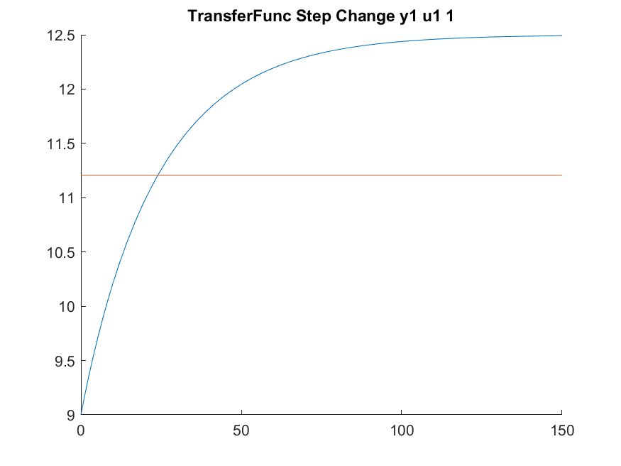
K_p = (12.5-9(y1))/ (25-0(sec))
Delta_u1 = (1-0)
Dead time = 1

Slide 3
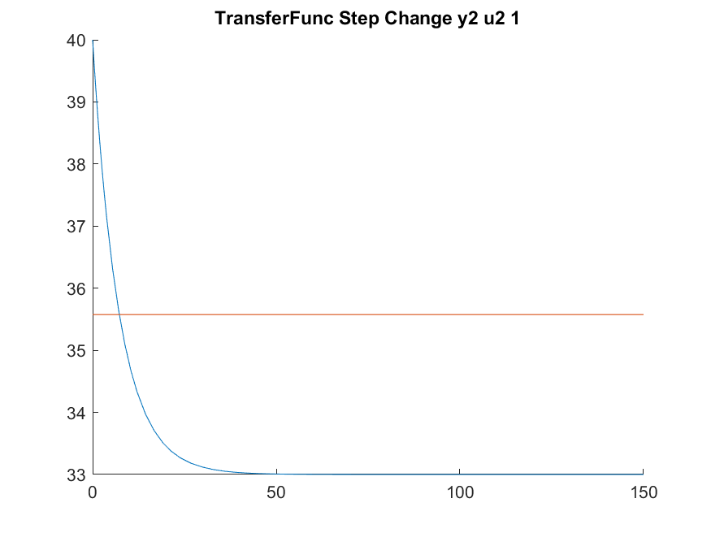
K_p = (40-33)/ (10-0)
Delta_u2 = (1-0)
Dead time = 1

