Slide 1
Homework #5
CH#507 Advanced Process Control
Prof. S.S. Jang

Slide 2
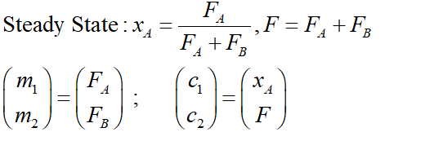
Problem 1: Blending Problem –
Determine the Relative Gain Array
Of the following problem
X_{A}
F
Such that :
CT
FT
F_{A}
X_{A}
F_{B}
F

Slide 3

Problem 2: Consider the following two input- two output System, determine the relative gain array
$y_{1}\left(s\right)=\frac{2}{3s+1}m_{1}\left(s\right)+\frac{5}{s+1}m_{2}\left(s\right)$
$y_{2}\left(s\right)=\frac{4}{s+1}m_{1}\left(s\right)+\frac{1}{2s+1}m_{2}\left(s\right)$

Slide 4
Problem 3
Determine the interactive transfer functions of the hot-cold water system in the notes.
What is the decoupling system of this system?
Implement the decoupling system by SIMULINK.
Compare the decoupling and original control system using SIMULINK.

