Slide 2
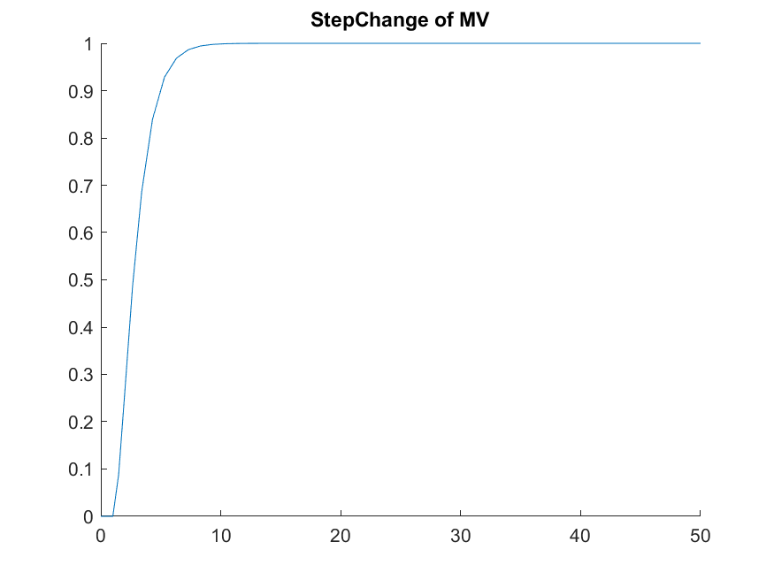
Gain = (1-0) / (1-0)
Time constant = 2
Time delay = 1

Slide 3
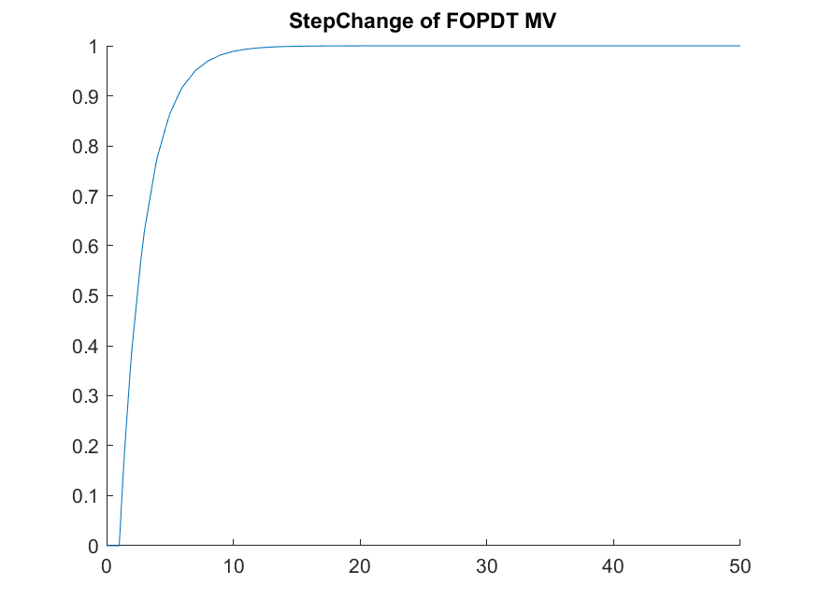
Slope = (1-0)/ (3-1)
Delta_mv = 1
Time delay = 1

