Slide 2
Q02: Layout

Slide 3
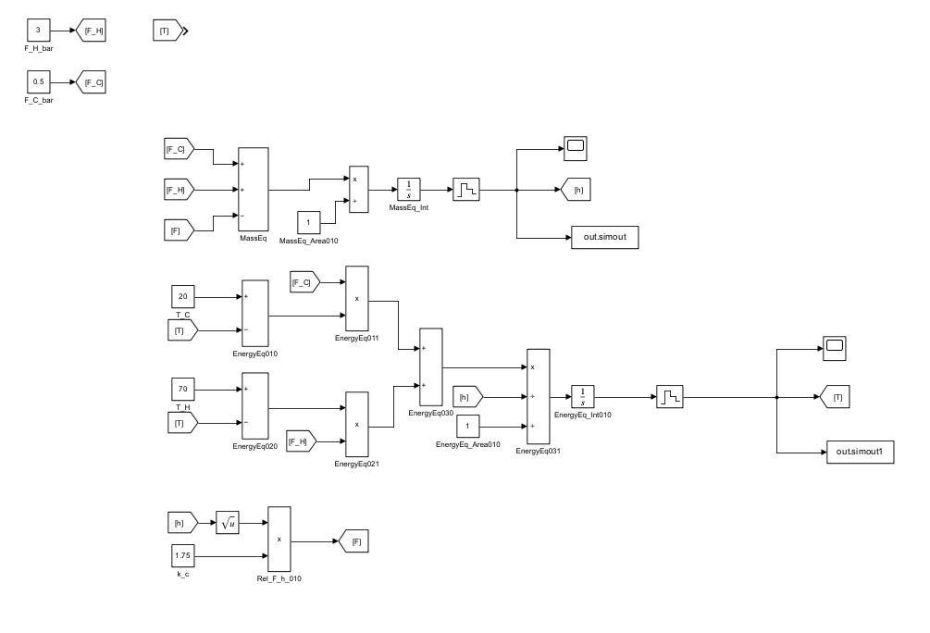
sampling period
= 1

Slide 4
Step Change: F_C

Slide 5
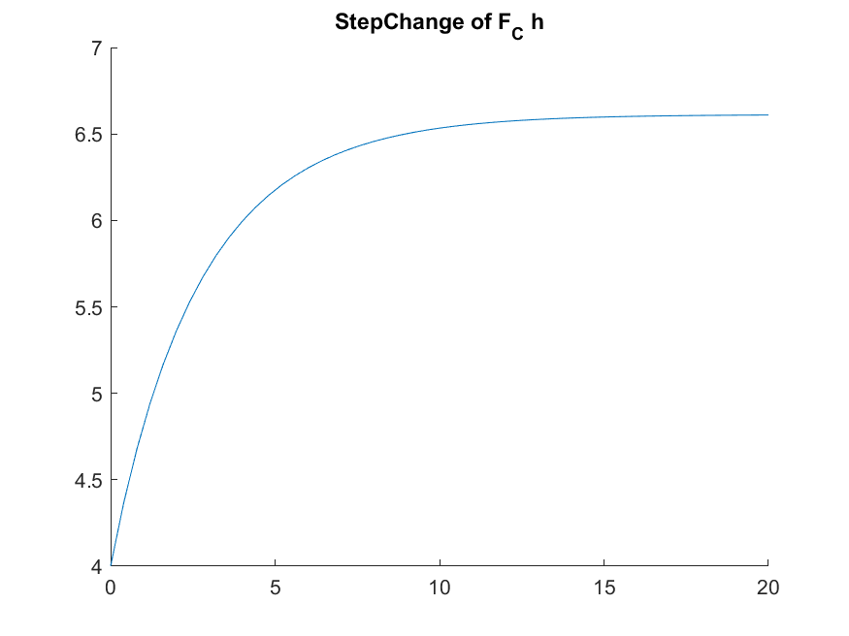

$F_{c} →h$
Gain, $K_{c}$ = (6.6-4)/ (1.5-0.5)
Time constant, $τ$ = 3.5
Delay time, $θ$ = 0

Slide 6
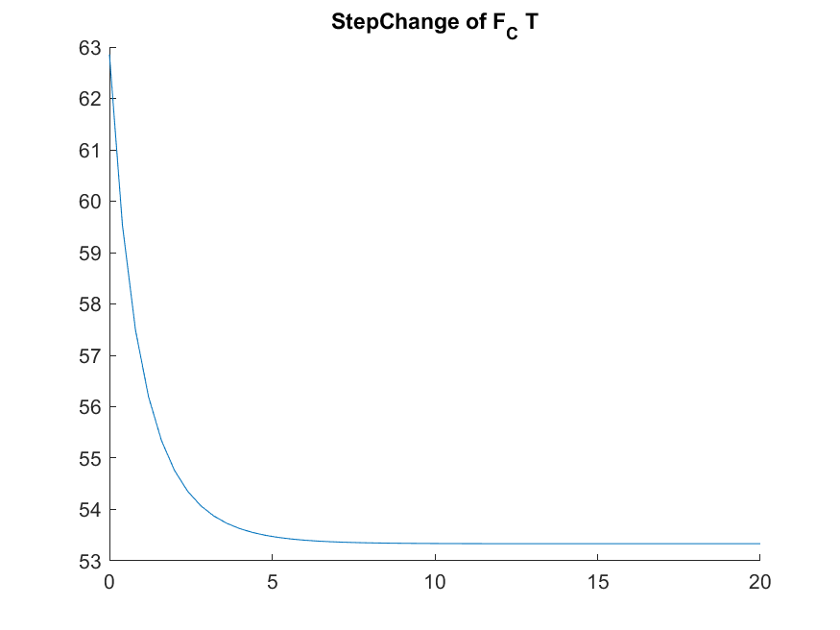

$F_{c} →T$
Gain, $K_{c}$ = (53.5-63)/ (1.5-0.5)
Time constant, $τ$ = 1.5
Delay time, $θ$ = 0

Slide 7
Step Change: F_H

Slide 8


d
$F_{H} →h$
Gain, $K_{c}$ = (6.6-4)/ (4-3)
Time constant, $τ$ = 3.5
Delay time, $θ$ = 0

Slide 9
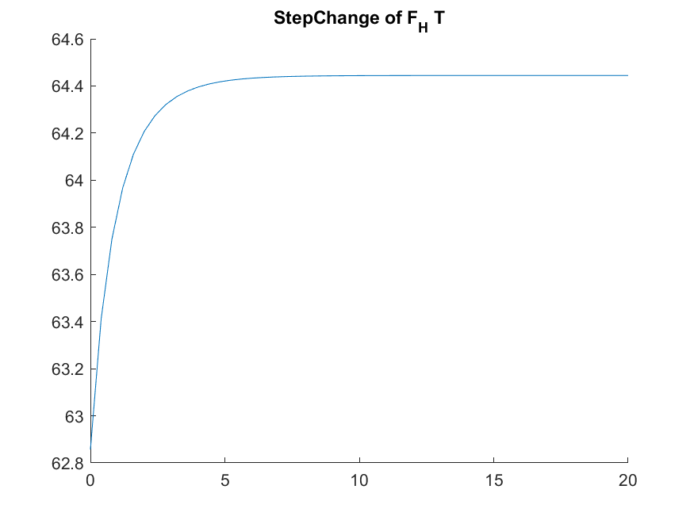

$F_{H} →T$
Gain, $K_{c}$ = (64.4-62.8)/ (4-3)
Time constant, $τ$ = 1
Delay time, $θ$ = 0

Slide 10
Relative Gain Array

Slide 11
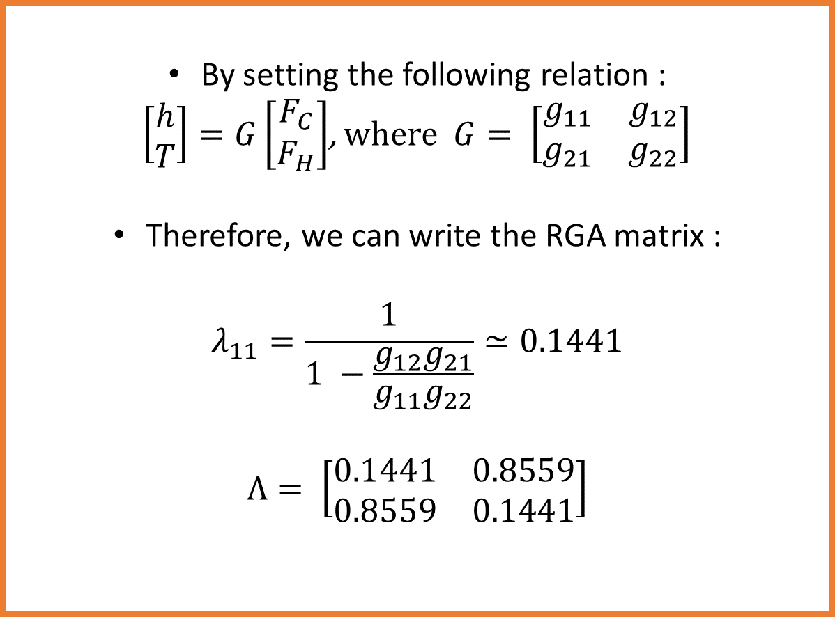
By setting the following relation :
$\left[\begin{matrix}h \\ T\end{matrix}\right]=G\left[\begin{matrix}F_{C} \\ F_{H}\end{matrix}\right]$, where $G= \left[\begin{matrix}g_{11} & g_{12} \\ g_{21} & g_{22}\end{matrix}\right]$
Therefore, we can write the RGA matrix :
$$λ_{11}=\frac{1}{1 −\frac{g_{12}g_{21}}{g_{11}g_{22}}}≃0.1441$$
$$Λ= \left[\begin{matrix}0.1441 & 0.8559 \\ 0.8559 & 0.1441\end{matrix}\right]$$

Slide 12
FOPDT

Slide 13

Transfer function from FOPDT method
$\left[\begin{matrix}h \\ T\end{matrix}\right]=G\left[\begin{matrix}F_{C} \\ F_{H}\end{matrix}\right]$, where $G= \left[\begin{matrix}g_{11} & g_{12} \\ g_{21} & g_{22}\end{matrix}\right]$
where
$g_{11}=\frac{2.6}{3.5s+1}$
$g_{12}=\frac{2.6}{3.5s+1}$
$g_{21}=\frac{−9.5}{1.5s+1}$
$g_{22}=\frac{1.6}{1s+1}$

Slide 14
Decouple

Slide 15

Derive decoupling system
According to assumption:
$$d= \left[\begin{matrix}1 & d_{12} \\ d_{21} & 1\end{matrix}\right]$$
$d_{12}=−\frac{g_{12}}{g_{11}}$
$d_{21}=−\frac{g_{21}}{g_{22}}$

