Slide 2
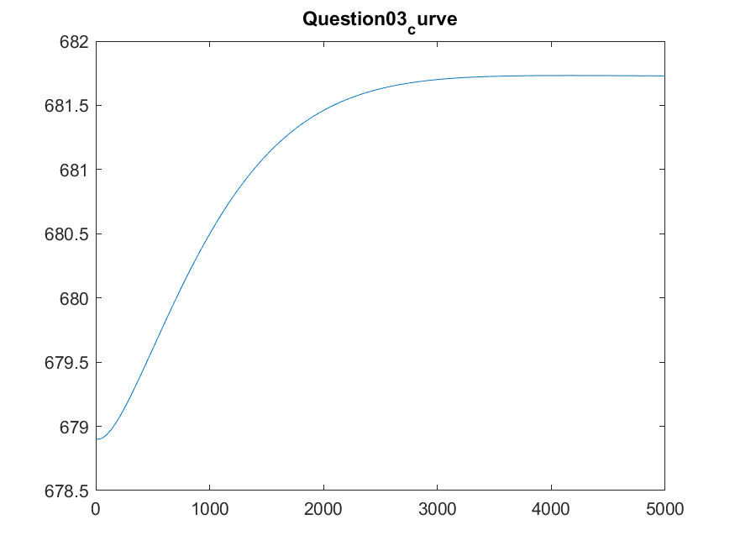
MV change =
-0.0771
Dead time = 1sec
Slope =
(678.9 – 681.726) / 17sec
= -0.1662

